Slide 1
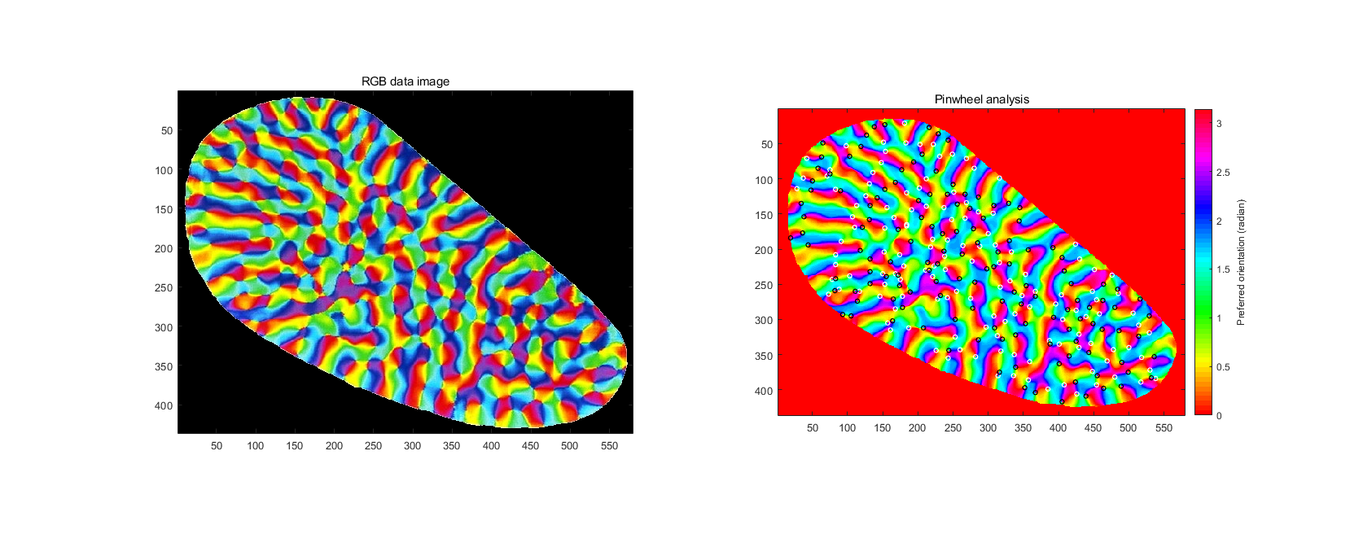
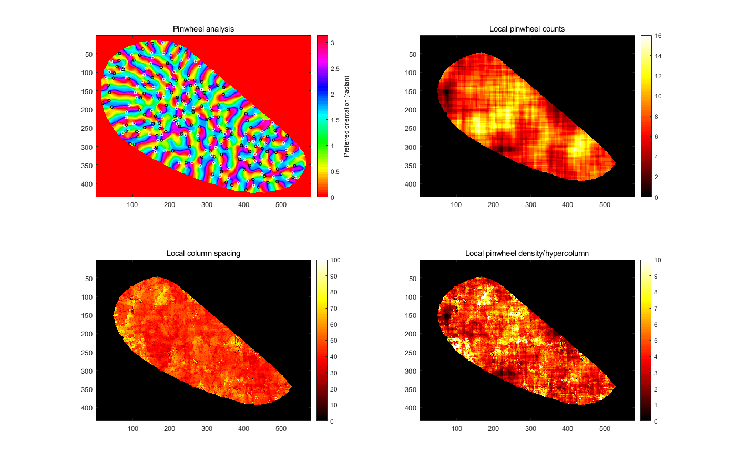
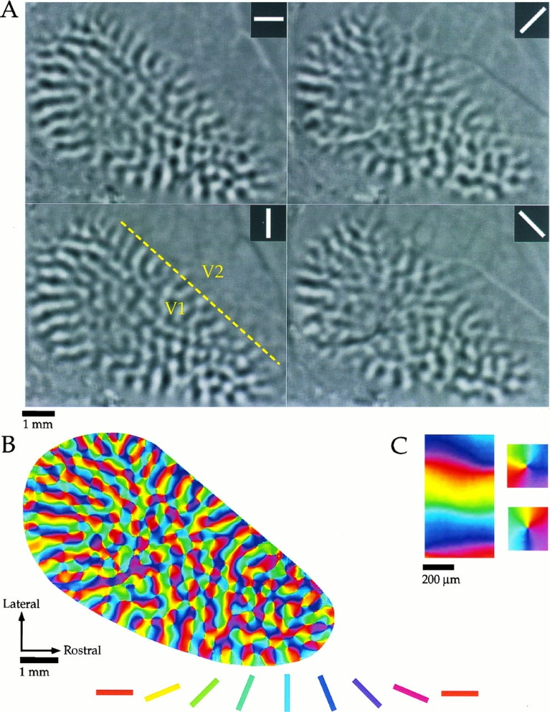


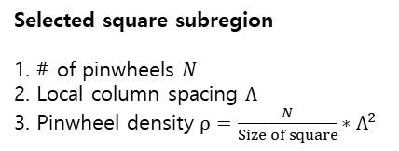
1. Data preprocessing
$$Λ$$
RGB-orientation conversion
Noise filtering
(Gaussian, std 2.5 pixel)
Selected square subregion
1. # of pinwheels $N$
2. Local column spacing $Λ$
3. Pinwheel density $ρ=\frac{N}{Size of square}∗Λ^{2}$
2. Measurement
Check every valid subregions
$$N(x,y), Λ\left(x,y\right), ρ\left(x,y\right)$$
......
......
Collect
(Considered invalid)

Slide 2
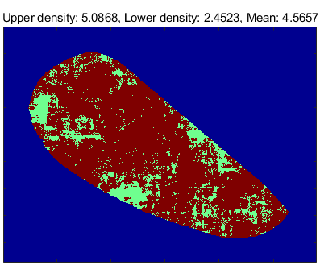
60X60
Subregion size: 60X60
Mean pinwheel density: 4.56
Brown : Green Ratio
0.81 : 0.19
Brown region: Pinwheel density > 3.14
Green region: Pinwheel density < 3.14

Slide 3
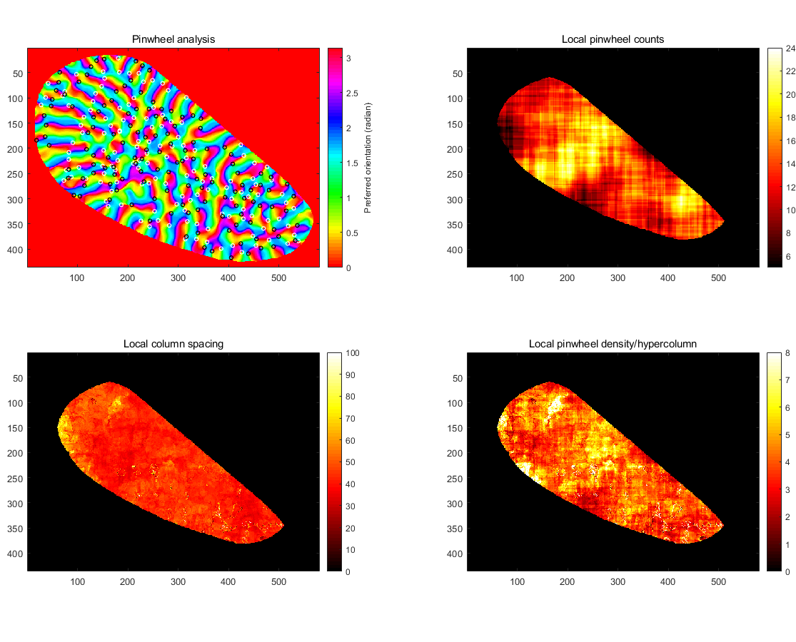
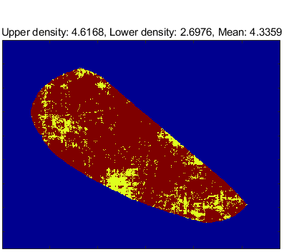
80X80
Subregion size: 80X80
Mean pinwheel density: 4.34
0.86 : 0.14
Brown region: Pinwheel density > 3.14
Yellow region: Pinwheel density < 3.14

Slide 4
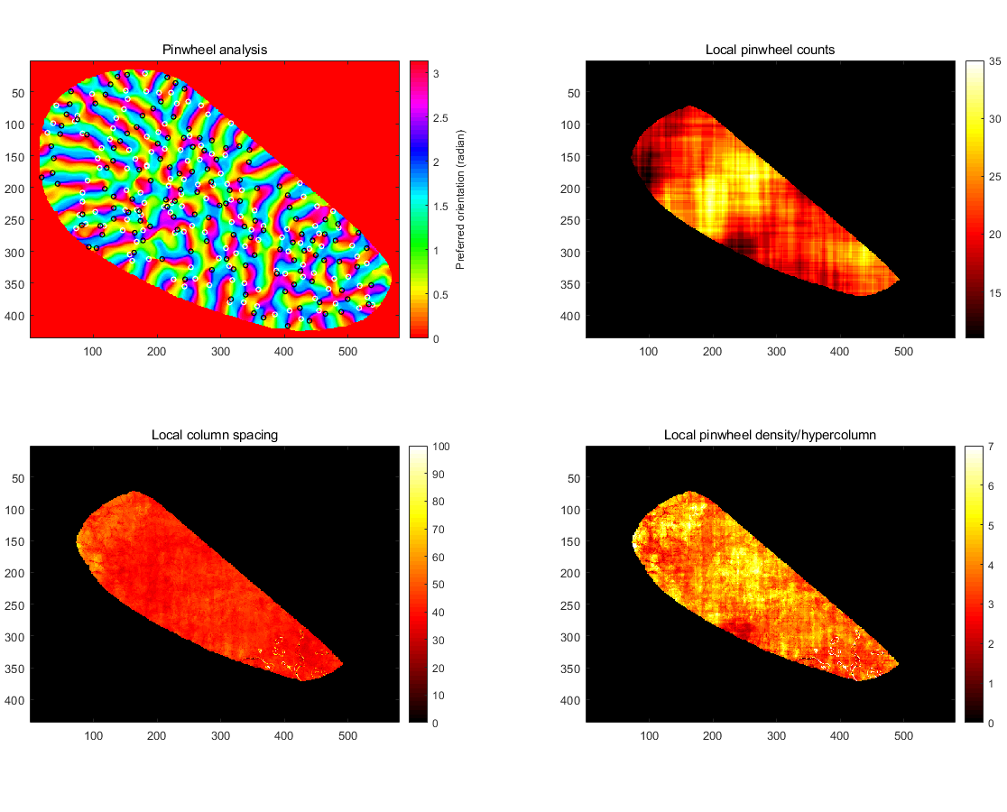
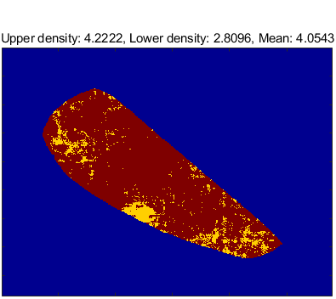
100X100
Subregion size: 100X100
Mean pinwheel density: 4.05
0.89 : 0.11
Brown region: Pinwheel density > 3.14
Yellow region: Pinwheel density < 3.14

Slide 5
Analysis purpose:
To show that center regions have higher pinwheel density than boundary (stripe) regions.

