Slide 1
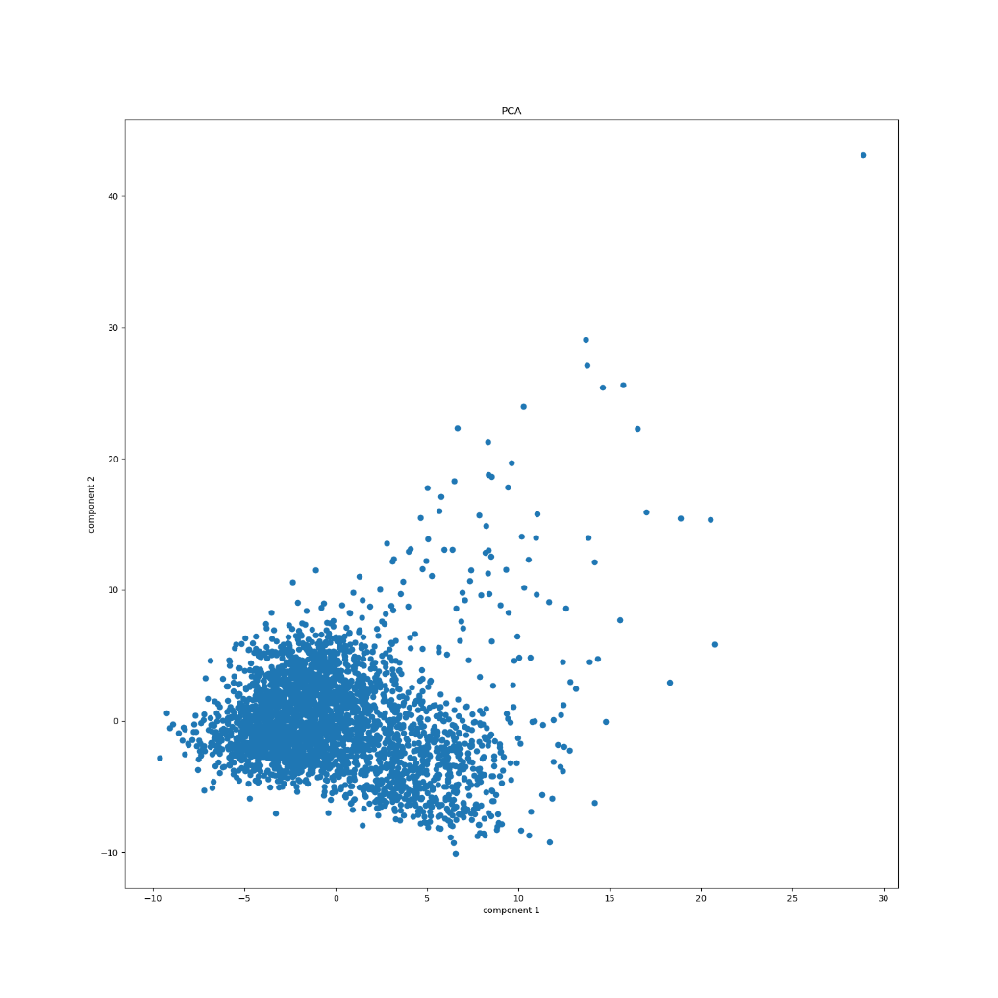
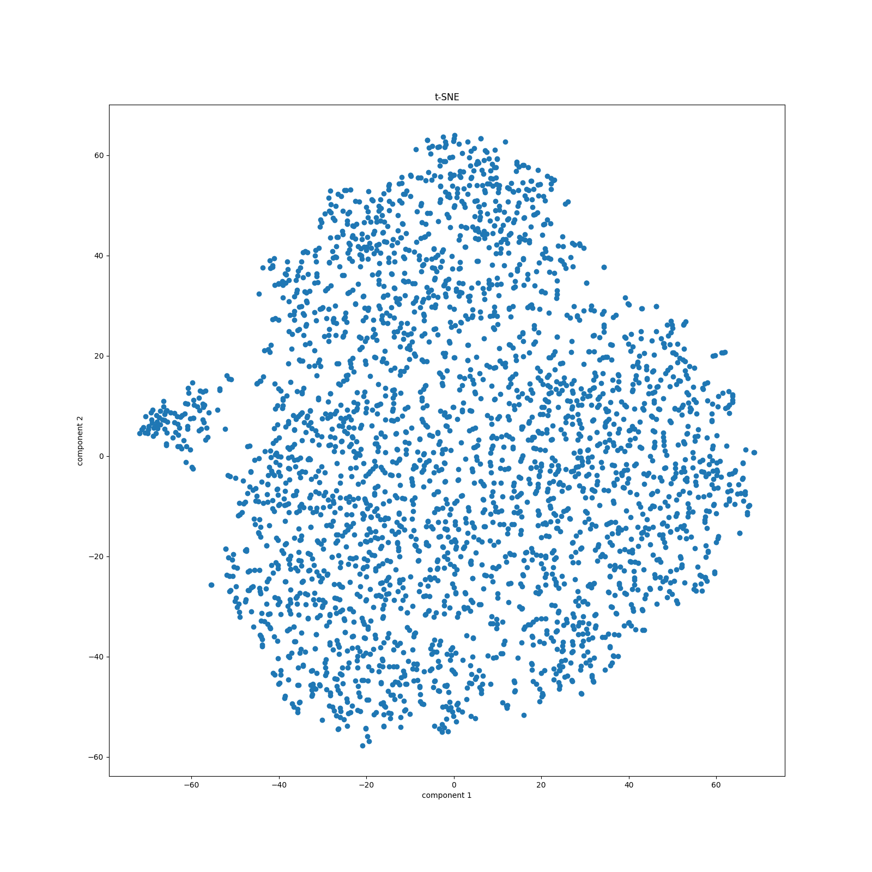
PCA
t-SNE
0.6
20
0.4
10
0.2
0
Component 2
Component 2
0.0
-10
-0.2
-20
-0.4
-0.3
-0.2
-0.1
0.0
0.1
0.2
0.3
0.4
-40
-30
-20
-10
0
10
20
30
40
Component 1
Component 1

Slide 2
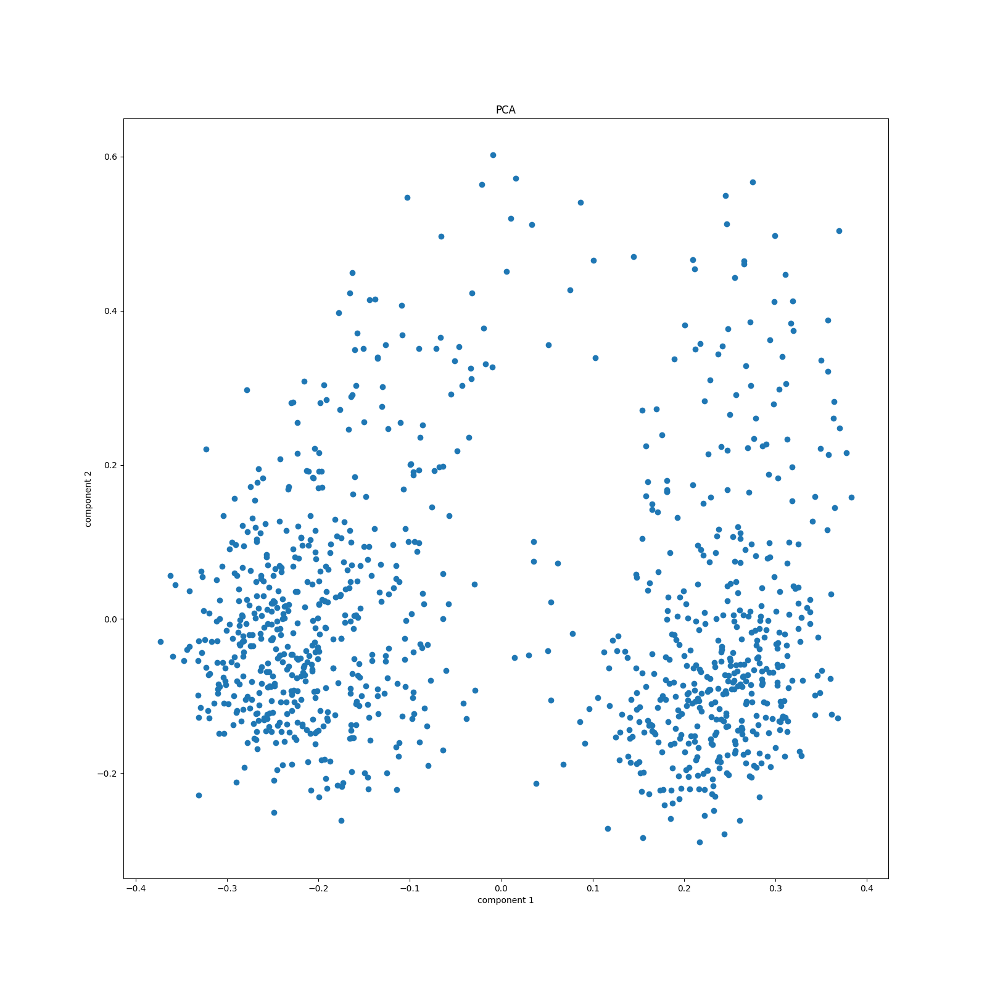
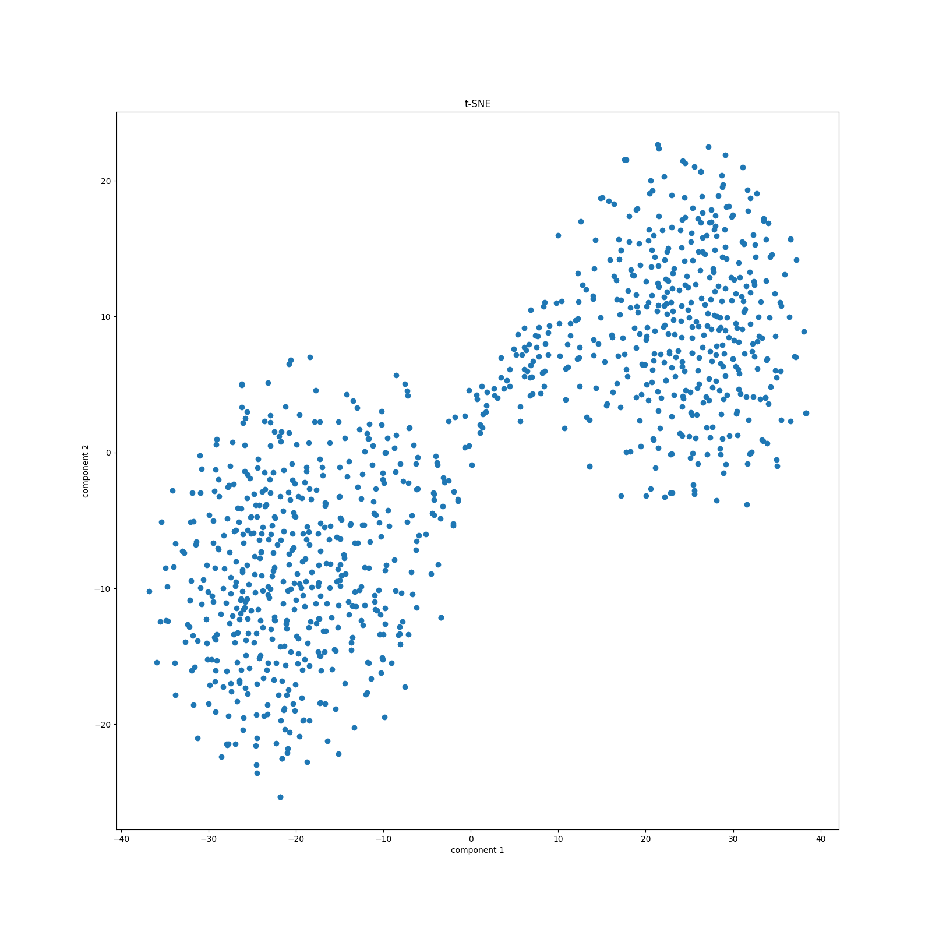
PCA
t-SNE
0.6
20
0.4
10
0.2
0
Component 2
Component 2
0.0
-10
-0.2
-20
-0.4
-0.3
-0.2
-0.1
0.0
0.1
0.2
0.3
0.4
-40
-30
-20
-10
0
10
20
30
40
Component 1
Component 1

Slide 3
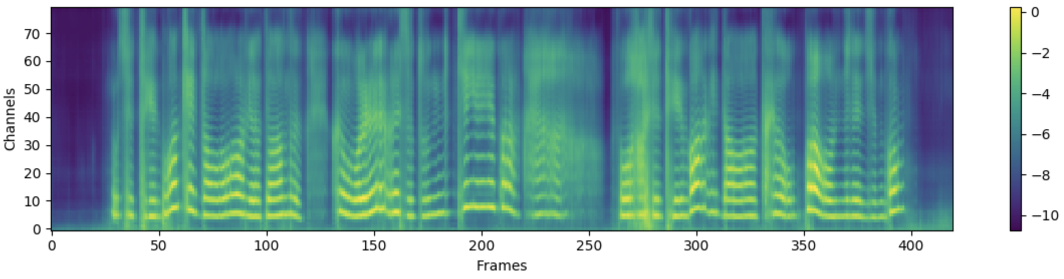
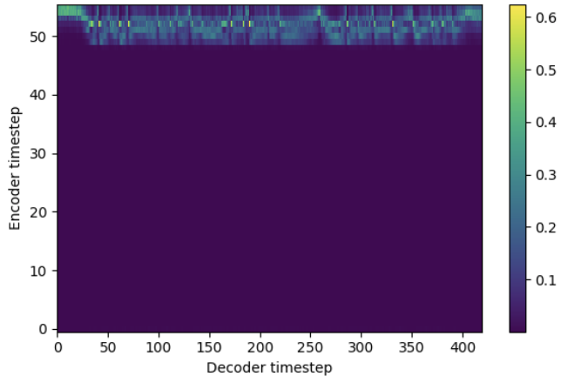
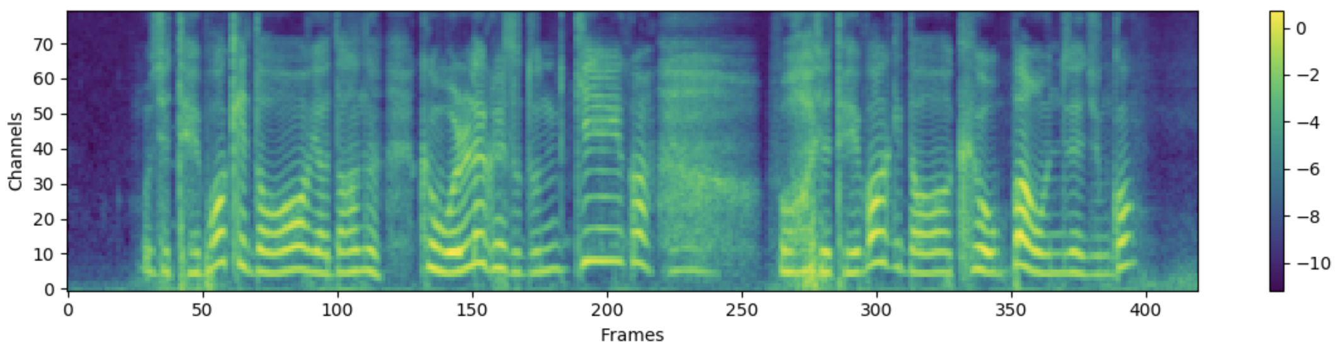
Predicted spectrogram
Attention alignment
Target spectrogram

Slide 4
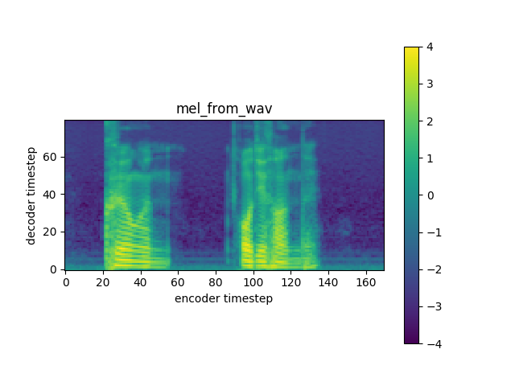
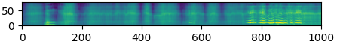
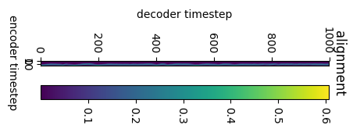
Predicted spectrogram
50
Channels
0
0
200
600
600
800
1000
Frames
Target spectrogram
Attention alignment
Channels
Frames

