Slide 1
Data Analytics Customer Care Analytics Project ID: PTID-CDA-JAN-23-098
Submitted By:
Arun Ashok Kumar – arunk9625@gmail.com
Saurabh Joshi - saurabhjoshi07081@gmail.com
Vishal Rathod - vishalrathod26316@gmail.com

Slide 2
Table of contents
01
02
03
04
05
Data Retrieving
Observation
Data Cleaning
From where the data was collected/retrieved
First Observation of the dataset
How the data was made consistent for analysis
Analysis
Power BI
Insights taken from the data
Dashboard created for the insights

Slide 3
Whoa!
You may have heard the world is made up of atoms and molecules, but it's really made up of stories. When you sit with an individual that's been here, you can give quantitative data a qualitative overlay.
- William Turner

Slide 4
01
Data Retreviving

Slide 5
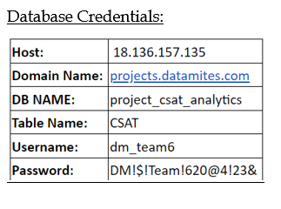
Data Retreving
Connected to the datamites database using the given database credentials.
The primary connection was made using Microsoft excel.
Get Data > From Database > From MySql Database

Slide 6
02
Observation

Slide 7
Observation
id | customer_name | sentiment | csat_score | call_timestamp | Call_Day | reason | city | state | channel | response_time | call_duration_in_minutes | call_center
AAA-03321706-1-866834-I1 | Andrea Bailiss | Negative | 3 | 10/15/2020 | 15 | Payments | Charlotte | North Carolina | Call-Center | Within SLA | 12 | Baltimore/MD
AAB-04923282-m-405308-yW | Othilie Strand | Negative | 0 | 10/22/2020 | 22 | Service Outage | Nashville | Tennessee | Web | Below SLA | 5 | Baltimore/MD
AAB-23102945-b-065985-xp | Sondra Bearman | Very Positive | 0 | 10-06-2020 | 6 | Billing Question | Salem | Oregon | Call-Center | Above SLA | 9 | Chicago/IL
AAB-64454903-y-396859-bx | Gibb Augustine | Positive | 0 | 10/15/2020 | 15 | Service Outage | Littleton | Colorado | Web | Within SLA | 20 | Los Angeles/CA
AAB-68191584-X-296651-JM | Hope Verissimo | Positive | 0 | 10-02-2020 | 2 | Billing Question | Fresno | California | Web | Within SLA | 43 | Chicago/IL
AAD-09890763-W-615200-jL | Eydie Firebrace | Neutral | 0 | 10/16/2020 | 16 | Billing Question | Las Vegas | Nevada | Web | Within SLA | 28 | Baltimore/MD
This is the first glimpse of the data where it consist 32941 records.
Further looking the data it gave a picture that sentiment is divided into 5 categories i.e Very Positive, Positive, Neutral, Negative, Very Negative
The reason column has 3 categories i.e Payments, Billing Question, and Service Outage
Channel has 4 categories i.e Call-center, Web, Email, and chatbot
Response time has 3 categories i.e Within SLA, Below SLA, and Above SLA

Slide 8
03
Data Cleaning

Slide 9
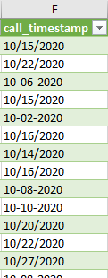
Data Cleaning
Call_timestamp
This column was not in proper single date format. So our first task in cleaning was to make sure that it is of proper date format.
We came to know that the whole data was of single month that is of October.

Slide 10
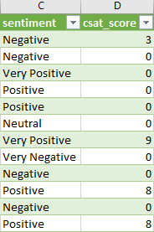
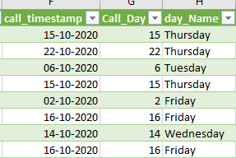
Data Cleaning
Sentiment and csat_score
Day_name
Further looking at both the columns we got that there are many zero values in csat_score and is irrelevant
So one solution will be that the asking the client that whether the recorded values are correct.
And other solution we did is to adjust the csat score use vlookup fuction and each sentiment has 1 unique value
Made a new column as day_Name where we converted the call_timestamp to the actual day name.

Slide 11
04
Data Analysis

Slide 12
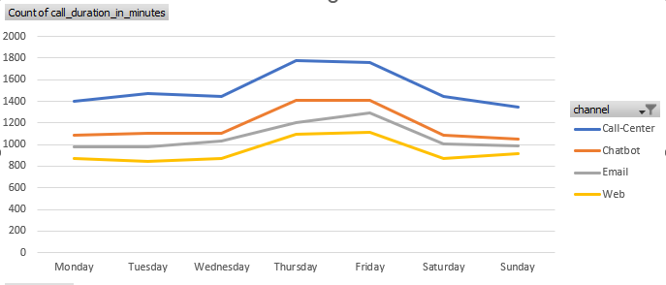
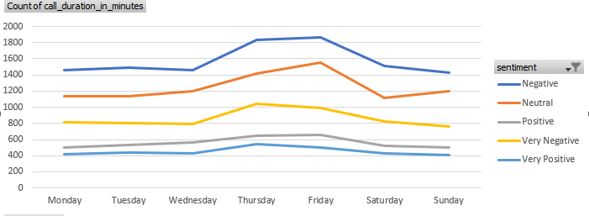
Insights
Call trend wrt channel
How sentiment looked in a week
During the week it is observed that Thursdays and Fridays had highest number of calls from customers
This also shows that Thursdays and Fridays got more number of Negative and Neutral calls.

Slide 13
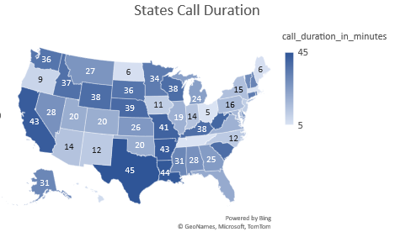
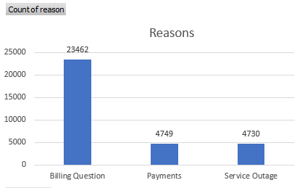
Insights
States call Duration
Reason for calling
Monthly call duration and Texas clocked the highest as 45 min in a month.
It shows that a maximum number of people called regarding billing questions.

Slide 14
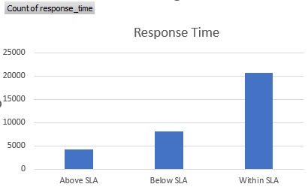
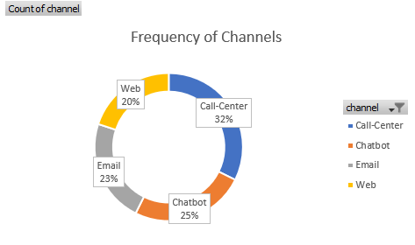
Insights
Response Time
Calls at each channel
Most of the calls response time was withing SLA
It is observed that most of the calls came to the call-center and it constituted 32% of the total calls.

Slide 15
04
Power BI Dashboard

Slide 16
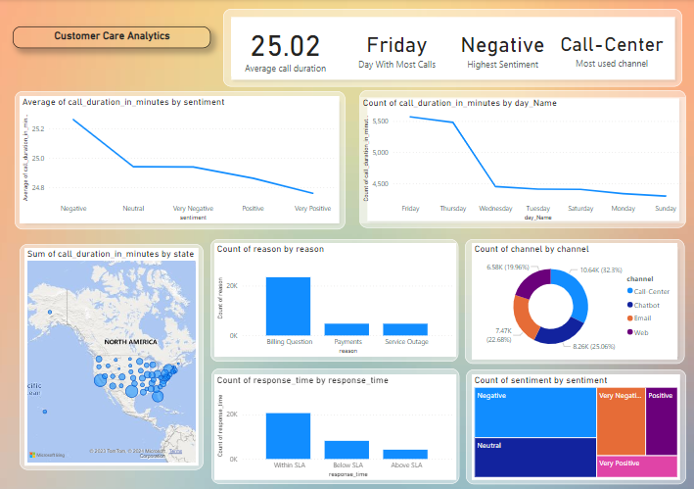
Power BI Dashboard

Slide 17
Thank You

