Slide 1

16 X16 PIPELINED
BRAUN MULTIPLIER
Date:- 14th May, 2022
PRESENTED BY:-
ASHISH KUMAR TIWARI
ROLL NO 214102417

Slide 2
MULTIPLIER
Multiplication can be considered as a series of repeated additions. The number to be added is the multiplicand, the number of times that it is added is the multiplier, and the result is the product.
Each step of the addition generates a partial product. In most computers, the operands usually contain the same number of bits.
When the operands are interpreted as integers, the product is generally twice the length of the operands in order to preserve the information content.
Types of multiplier and its algorithms are as follows
Serial-Parallel Multiplier
Braun Parallel Multiplier
Booth Algorithm
Wallace Trees

Slide 3
BRAUN MULTIPLIER:-
The simplest parallel multiplier is the Braun array. All the partial products A.bk are computed in parallel, and then collected through a cascade of Carry Save Adders.
At the bottom of the array, the output of the array is noted in Carry Save, so an additional adder converts it (by the mean of carry propagation) .
The completion time is limited by the depth of the carry save array, and by the carry propagation in the adder. Note that this multiplier is only suited for positive operands.

Slide 4
WORKING
Braun multipliers are regularly arranged arrays that have n *(n-1) adders and n^2 AND gates, where n is the number of inputs.
Each of the inputs A and B of the multiplier cell’s product bits is generated in parallel with the AND gates.
The partial products can be added to the previous sum of the partial product by using one row of an adder.
The carry signals are shifted one bit to the left and then added to the sums of the first adder and the new partial product.
They are then passed diagonally downward to the next adder stage. There is no horizontal carry propagation for the first rows.
Instead, the carry bit is saved for the subsequent adder stage.

Slide 5
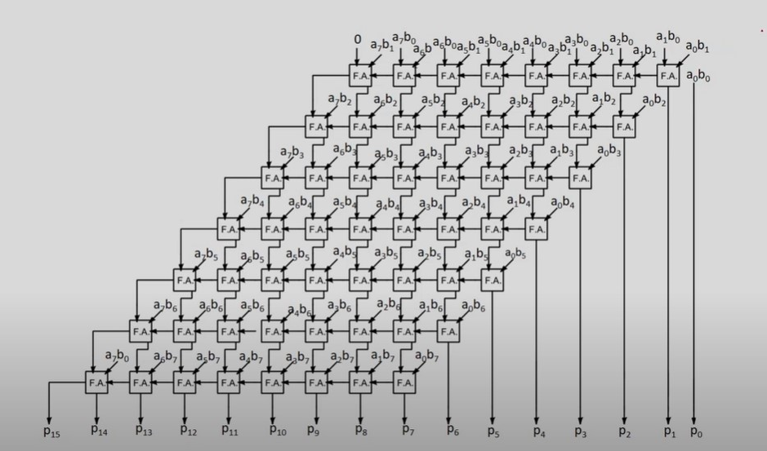
Example of 8 X 8 braun multiplier

Slide 6
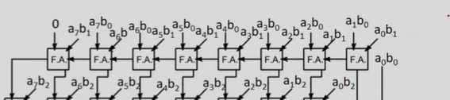
CODE
For the 1st bit and 2nd bit :-
assign prod[0]=a[0]&b[0];
assign c0[0]=1'b0;
for(k=0;k<=15;k=k+1)
begin
if(k<15)
fa f1(c0[k+1],sum0[k],a[k]&b[1],a[k+1]&b[0],c0[k]);
else if(k==15)
fa f2(c0[k+1],sum0[k],a[k]&b[1],0,c0[k]);
end
assign sum0[16]=c0[16];
assign prod[1]=sum0[0];

Slide 7
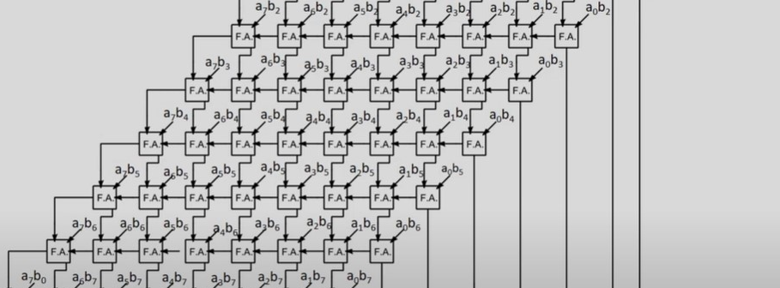
For the 2nd bit onwards till 15th bit
assign c1[0]=c0[0];
for(k=0;k<=15;k=k+1)
begin
fa f3(c1[k+1],sum1[k],a[k]&b[2],sum0[k+1],c1[k]);
end
assign sum1[16]=c1[16];
assign prod[2]=sum1[0];
assign c2[0]=0;

Slide 8

From 16th bit to 31st bit
assign prod[16]=sum14[1];
assign prod[17]=sum14[2];
assign prod[18]=sum14[3];
assign prod[19]=sum14[4];
assign prod[20]=sum14[5];
assign prod[21]=sum14[6];
assign prod[22]=sum14[7];
assign prod[23]=sum14[8];
assign prod[24]=sum14[9];
assign prod[25]=sum14[10];
assign prod[26]=sum14[11];
assign prod[27]=sum14[12];
assign prod[28]=sum14[13];
assign prod[29]=sum14[14];
assign prod[30]=sum14[15];
assign prod[31]=sum14[16];

Slide 9
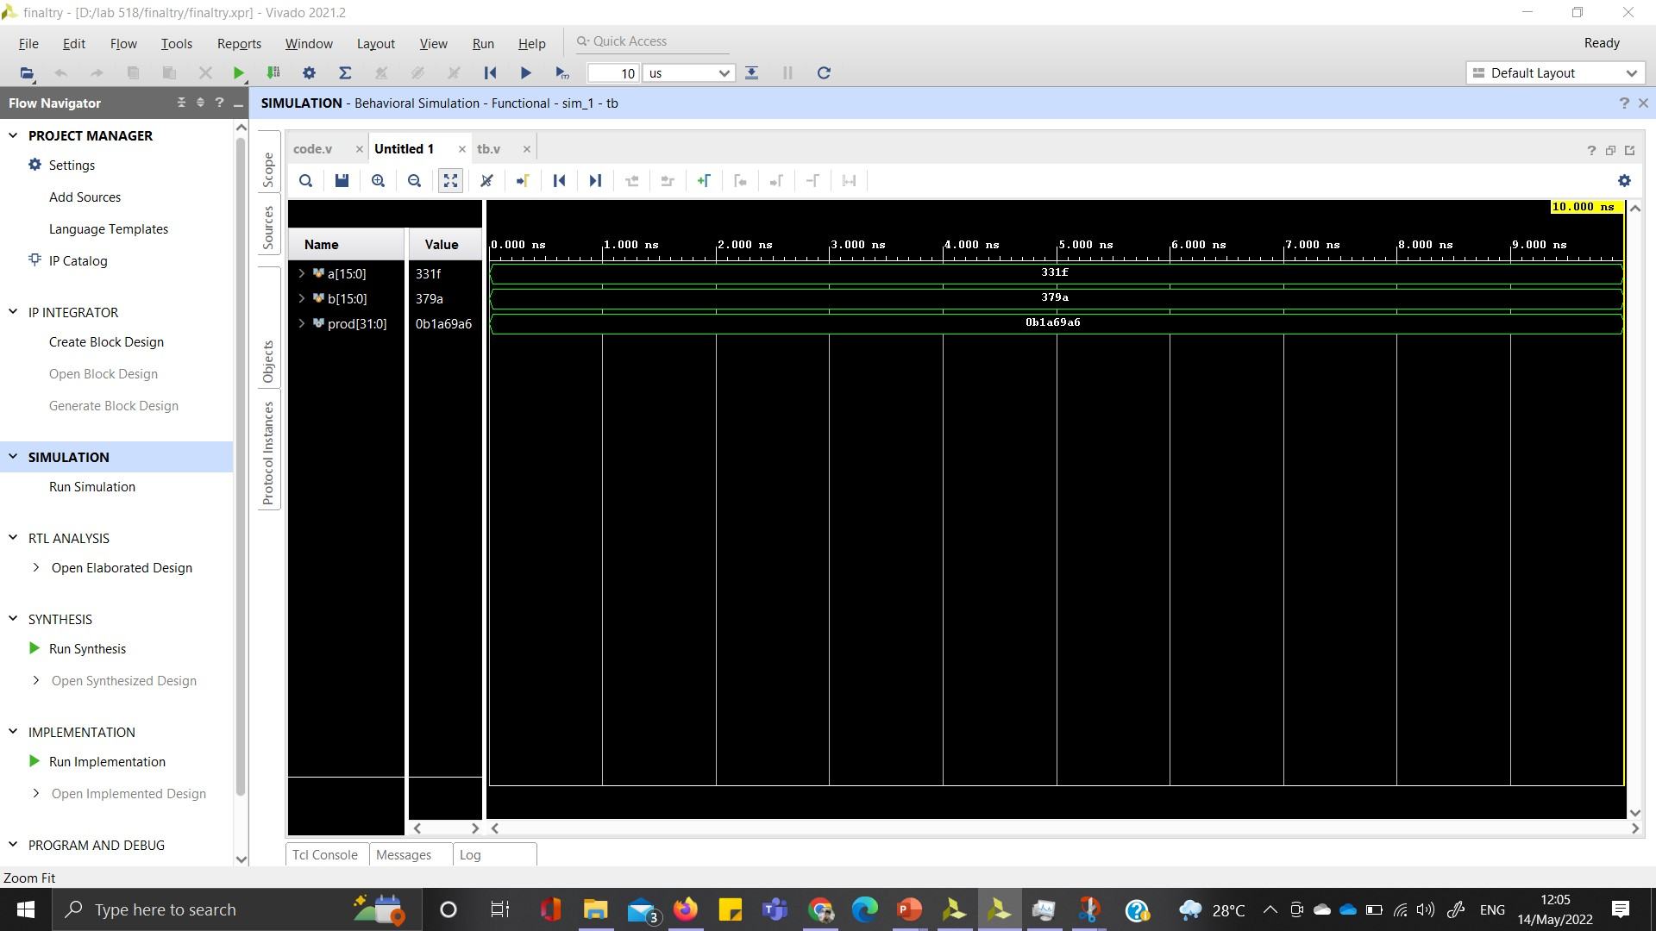

Slide 10
THANKS

