Slide 1
NAMED ENTITY RECOGNITION SYSTEM FOR TURKISH TWEETS BUĞSE ERDOĞAN & FAHRİYE GÜN & KÜBRA ÖZGÖÇ

Slide 2
Our Project;
- develop a machine learning based system (supervised learning)
- extract features for machine learning algorithm to identify NE
- focus on Twitter data and Twitter specific features

Slide 3
Based on the problem description and the objectives, the following assumptions are taken:
- Search, download, install and test the existing NER systems
- A program need to be developed to test the tweets’ data sets.

Slide 4






Scope of the Project
Constraints:
Fahriye Marmara Üniversitesi’ne başladı.

Slide 5
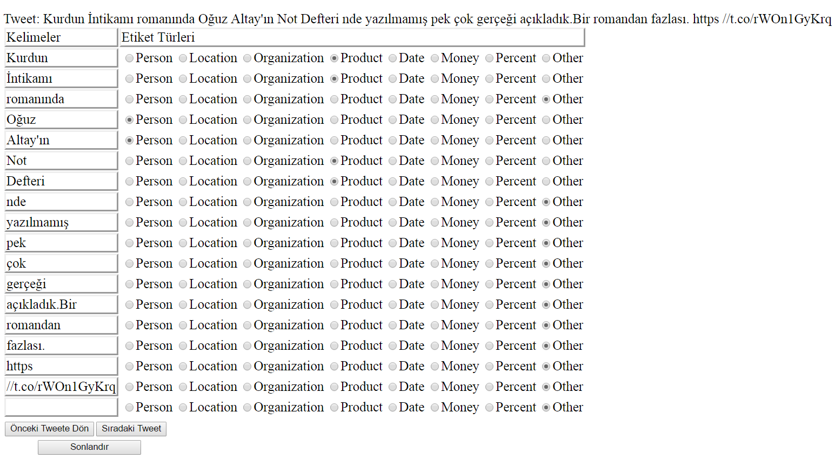
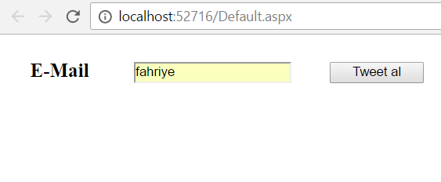
Tagging System

Slide 6
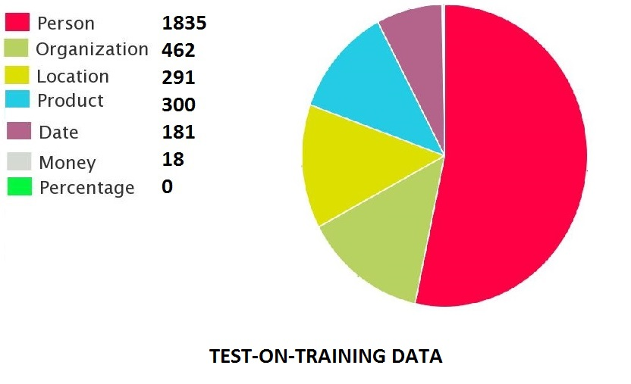
Class Distribution

Slide 7
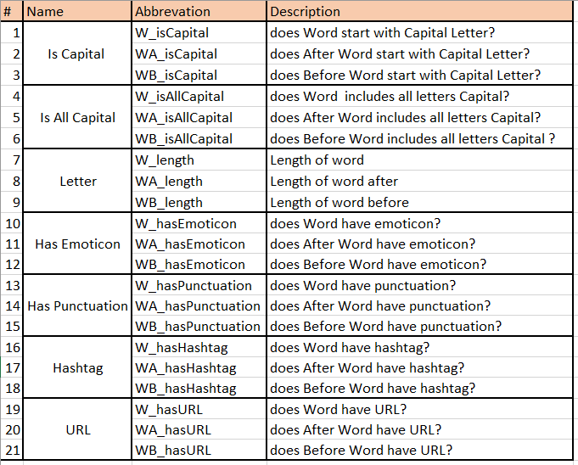
Attributes List of Word

Slide 8
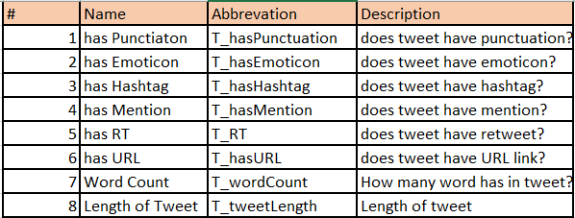
Attributes List of Tweet

Slide 9
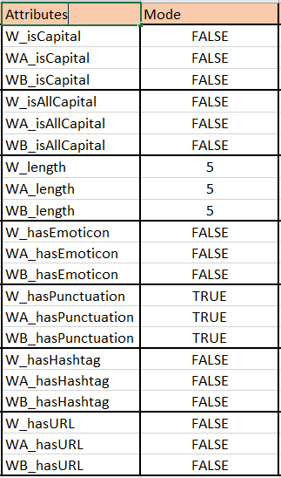
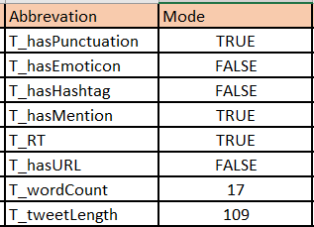
Attribute Stats

Slide 10
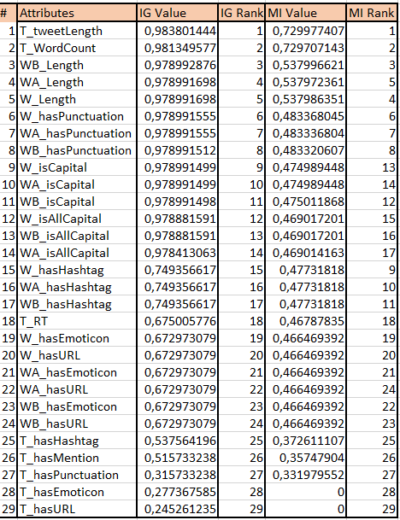
Feature Selection

Slide 11
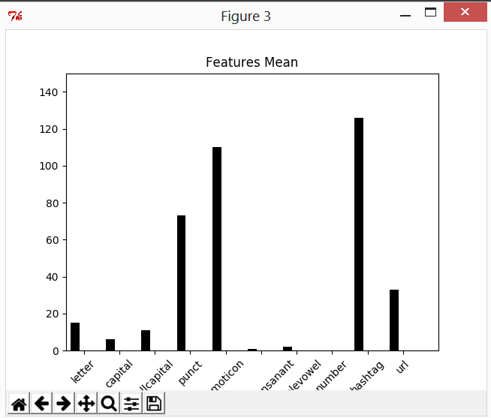

Slide 12
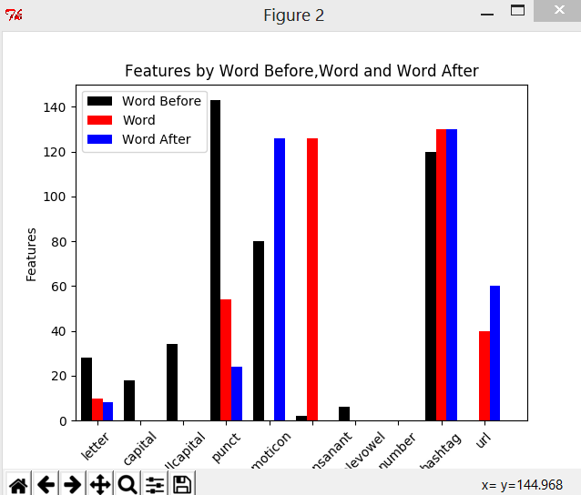

Slide 13
Used Algorithms
Logistic Regression (LR)
Multinomial Naive Bayes (MNB)
k-Nearest Neighbors (k-NN)
Support Vector Machine (SVM)
Gauissian NB
Bernoulli NB
Extra Tree Classifier
DecisionTree Classifier
SVC(kernel=‘linear’)

Slide 14
Experiments and Result of Turkish Tweets on ML

Slide 15
Experiment and Result of English Tweets on ML

Slide 16
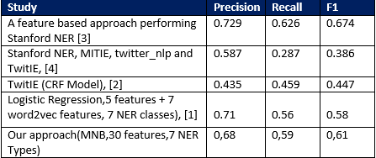
Comparison of the performance with respect to the studies presented in NEEL 2016 workshop [5].

Slide 17
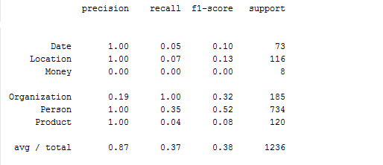
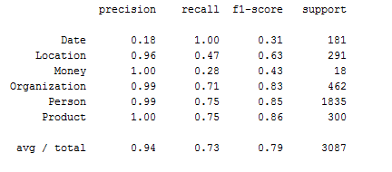
K-NN Results
Test on traning
Training 60% Test 40%

Slide 18
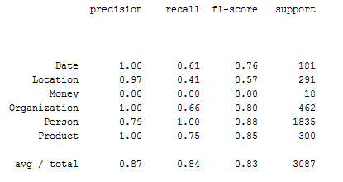
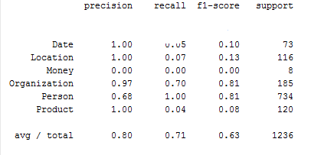
LR Results
Test on traning
Training 60% Test 40%

Slide 19
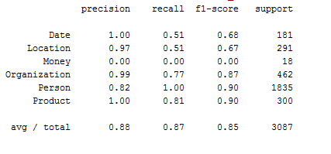
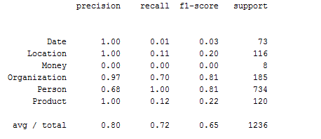
MVB Results
Test on traning
Training 60% Test 40%

Slide 20
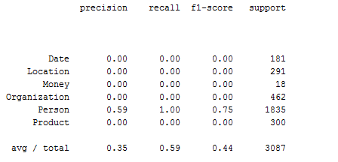
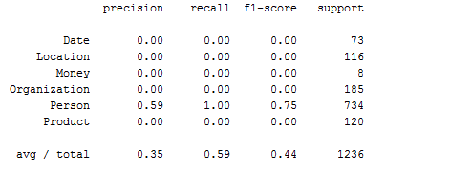
SVM Results
Test on traning
Training 60% Test 40%

