Slide 1
NAMED ENTITY RECOGNITION SYSTEM FOR NOISY TURKISH TWEETS BUĞSE ERDOĞAN & FAHRİYE GÜN & KÜBRA ÖZGÖÇ

Slide 2
Our Project;
- develop a machine learning based system (supervised learning)
- extract features for machine learning algorithm to identify NE
- focus on Twitter data and Twitter specific features

Slide 3
Based on the problem description and the objectives, the following assumptions are taken:
- Search, download, install and test the existing NER systems
- A program need to be developed to test the tweets’ data sets.

Slide 4






Scope of the Project
Constraints:
Fahriye Marmara Üniversitesi’ne başladı.

Slide 5
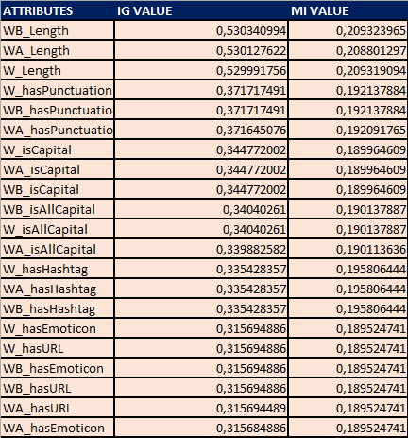
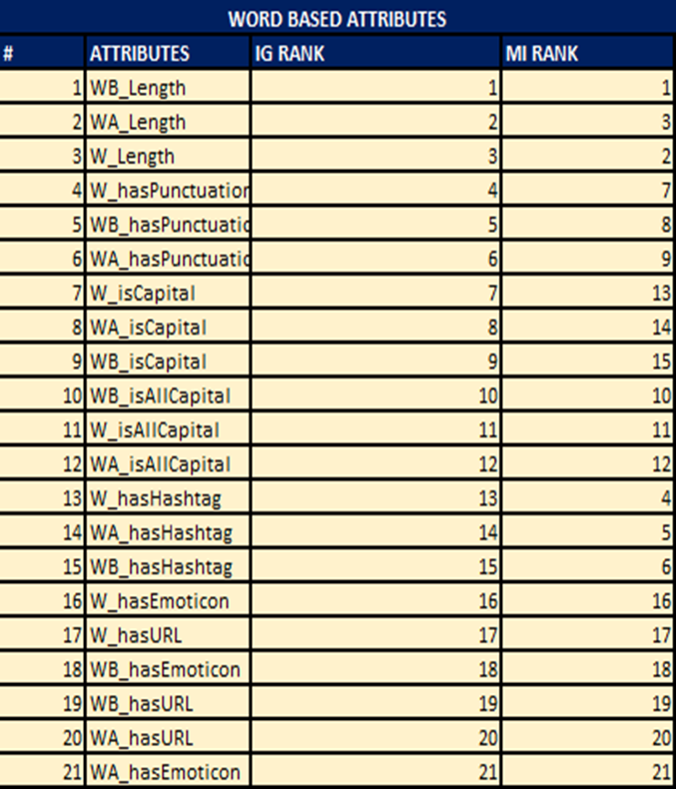
Feature Selection

Slide 6
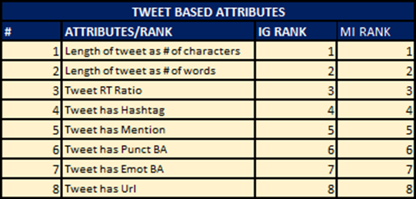
Feature Selection(cont’d)

Slide 7
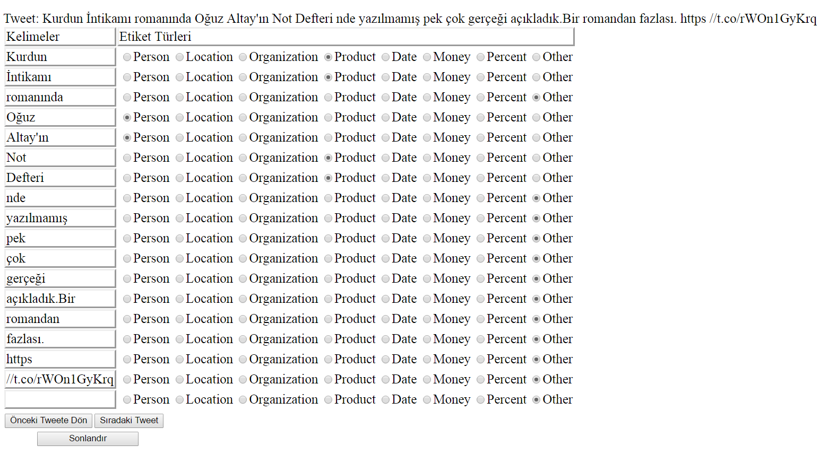
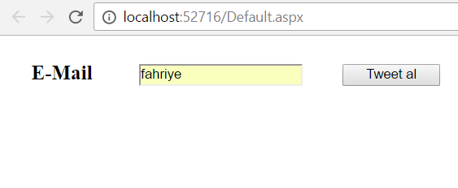
Tagging System

Slide 8
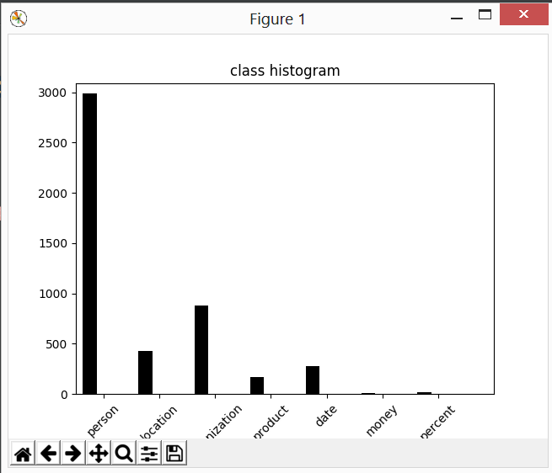

Slide 9
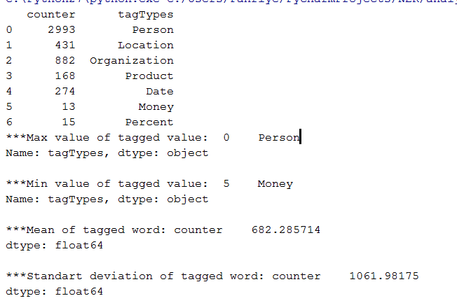

Slide 10
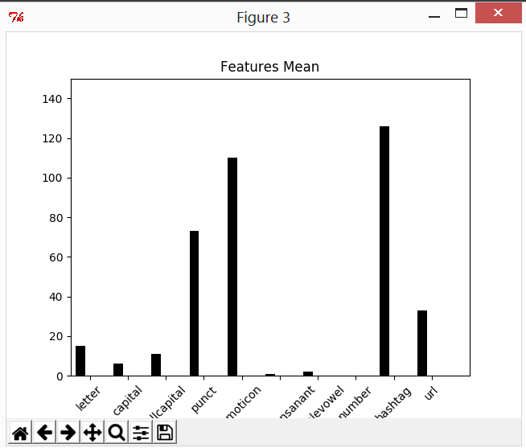

Slide 11
