Slide 1

Department of CSE(AI and ML)
AlgoViz
Flask-Based web-app for Teaching Algorithms
Batch 9
1. S. Soniya Yadav (5221412045)
2. B. Siva Krishna (5221412005)
3. A. Kushal Pavan (5221412056)
4. P. Vijaya Bhaskar (5221412038)
Guide Name : Mrs. K. Kausalya , Assistant Professor

Slide 2
Department of CSE(AI and ML)
Outline
📘 Title & Introduction
🎯 Abstract & Objectives
📑 Literature Survey
⚠ Existing System
💡Proposed System/Design
⚙ Methodology

Slide 3
Department of CSE(AI and ML)
Title & Introduction
Project Title: AlgoViz
Background: Algorithms are the foundation of computer science, yet students often struggle to understand their working through theory alone. Traditional methods fail to show the step-by-step execution, making problem-solving in graphs, puzzles, and optimization difficult to grasp.
Introduction: This project is a Flask-based web application designed to visualize and simulate algorithms interactively. It helps learners understand the step-by-step working of different problem-solving methods through dynamic visualization. The tool makes abstract concepts more intuitive, engaging, and easy to learn.

Slide 4
Department of CSE(AI and ML)
Abstract & Objectives
Abstract: This project presents a web-based visualization platform for demonstrating the working of various algorithms in Data Structures, Design and Analysis of Algorithms (DAA), and Artificial Intelligence. Built using the Flask framework, it allows users to construct inputs, define parameters, and observe step-by-step execution of algorithms. The system records operations such as data structure updates, node or element visits, decision-making processes, and where applicable, solution costs. These are presented visually to simplify understanding. By transforming abstract concepts into interactive and engaging experiences, the platform enhances comprehension, making it a valuable tool for both students and educators.
Objectives of the project:
To develop a web-based platform for visualizing algorithms in Data Structures, DAA, and Artificial Intelligence.
To provide an interactive environment where users can define inputs, parameters, and observe algorithm behavior.
To capture and display step-by-step execution, including operations, decisions, and data structure updates.
To make abstract algorithmic concepts intuitive and engaging through visual demonstrations.
To serve as an educational tool that enhances learning for students and supports teaching for educators.

Slide 5
Department of CSE(AI and ML)
Existing System
1. Algorithm Visualizer (https://algorithm-visualizer.org/)
This open-source platform offers interactive visualizations for core algorithms such as sorting, searching, and graph traversal, categorized by difficulty levels (easy, medium, hard) to help learners choose based on skill.
Limitations:
Offers only a limited set of basic algorithms.
Interactivity is minimal—users can't customize inputs or see detailed internal steps.
2. VisuAlgo (https://visualgo.net/en)
A comprehensive educational platform developed at NUS. It supports around 24 visualization modules, including advanced topics like NP-hard problems, and offers features like online quizzes, multiple language support, e-Lecture mode, and custom input functionality
Limitations:
Interactivity is limited—users can’t define weights, heuristics, or tweak execution logic.
Algorithm analysis and computational complexities are not provided.
3. Algorithm-Visualizer (https://algorithm-visualizer.seancoughlin.me/)
While less documented in our search results, similar tools offer code-based visualizations—allowing users to input or view algorithm code execution visually. However, these tend to prioritize coding rather than educational clarity .
Limitations:
Does not allows user to modify the Data Structures.

Slide 6
Department of CSE(AI and ML)
Proposed System/Design
The proposed system is a Flask-based interactive web application designed to visualize the execution of algorithms in a step-by-step manner. Unlike traditional approaches, this platform allows users to directly construct problem scenarios, define parameters such as graph edges, weights, or heuristic values, and then observe how the algorithm proceeds towards a solution.
The system dynamically captures each stage of execution, including node visits, data structure updates, and decision-making steps, and presents them visually in an easy-to-understand format. For optimization or cost-based problems, the solution path and associated cost are also displayed.
This design emphasizes interactivity, accessibility, and clarity, enabling students to experiment with different inputs and immediately observe the effects. Educators can also use the tool as a demonstration platform in classrooms. By integrating multiple problem domains-such as search strategies, optimization problems, and puzzles—the system provides a comprehensive, unified learning environment that bridges the gap between theory and practice.

Slide 7
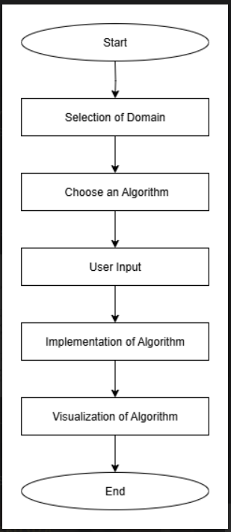
Department of CSE(AI and ML)
Methodology
Tools
Frontend: HTML, CSS, is, D3.js
Backend: Python+Flask
Problem Identification
1. Difficulty in understanding algorithms via theory/pseudocode.
2. Need for interactive visualization.
System Design
1. Flask chosen as framework.
2. UI for graph input, costs, heuristics.
Graph Construction & Input Handling
1.Build weighted/unweighted graphs.
2.Accept start/target nodes, costs, heuristics.
Algorithm Implementation
1. Code algorithms in Python.
2. Track steps: node visits, data structure updates, cost.
Visualization & Output
1. Display step-by-step execution.
2. Show traversal order, explored nodes, final path, cost.
Testing & Validation
1. Test with different graphs/problems.
2. Ensure accuracy of paths and results.
Deployment
1. Host Flask web app.
2. Provide user-friendly interface for students/educators.

Slide 8
Department of CSE(AI and ML)
Unified Modeling Language(UML)
UML diagrams are standardized visual representations used to model the structure and behavior of a system.
They help in planning, designing, and understanding software systems clearly before implementation.
Use Case Diagram shows how users (actors) interact with a system.
It represents the system’s functionalities and the relationships between users and those functions.
Class Diagram represents the structure of a system by showing classes, their attributes, methods, and relationships.
It is used to model the static design of an object-oriented system.
Sequence Diagram shows the interaction between objects in a system in a time-ordered sequence.
It illustrates how messages are passed between objects to complete a specific functionality.
Activity Diagram represents the flow of activities or actions in a system.
It is used to model workflows, decisions, and parallel processes from start to end.

Slide 9
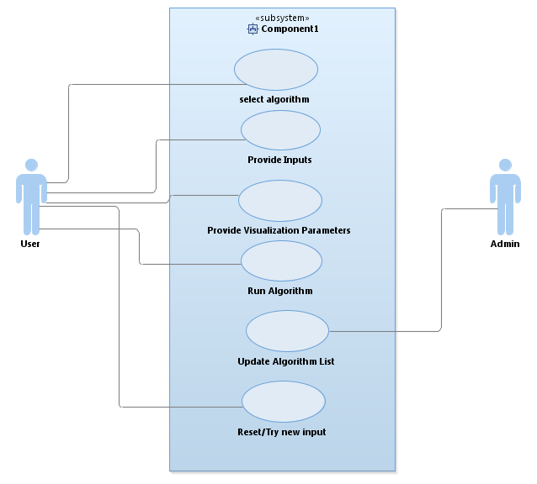
Department of CSE(AI and ML)
Use Case Diagram
👤 Actors :
User (Student / Learner)
The user interacts with the system to select algorithms, provide inputs, and observe step-by-step visualizations.
Admin
The admin manages the algorithm content available in the system.
This includes adding, updating, or maintaining algorithms.
Select Algorithm
Allows the user to choose an algorithm to be visualized from the available list.
The selected algorithm determines the required inputs and execution logic.
Provide Inputs
The user enters problem-specific inputs such as graphs, arrays, weights, or heuristics.
These inputs are used by the system to execute the algorithm correctly.
Provide Visualization Parameters
Allows the user to customize visualization settings like speed and highlighting.
This improves clarity and understanding of algorithm execution.
Run Algorithm
Executes the selected algorithm using the provided inputs and parameters.
The system processes and generates step-by-step execution data.
Update Algorithm List
Enables the admin to add or update algorithms in the system.
This ensures the platform remains updated and extensible.
Reset / Try New Input
Allows the user to reset the current execution and enter new inputs.

Slide 10
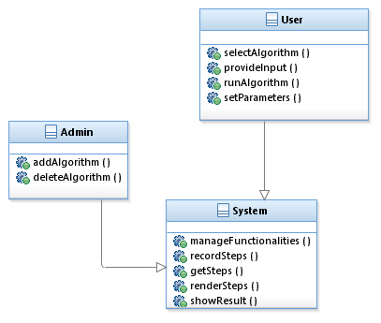
Department of CSE(AI and ML)
Class Diagram
Class: User
The User class represents students or educators who interact with the system to visualize algorithms.
It allows users to select algorithms, provide inputs, configure parameters, and run algorithms.
Operations:
selectAlgorithm() – Chooses the algorithm to be visualized.
provideInput() – Supplies inputs such as graphs or arrays.
runAlgorithm() – Initiates algorithm execution.
setParameters() – Sets visualization parameters like speed or highlighting.
Class: Admin
The Admin class manages the algorithms available in the system.
It ensures the algorithm list remains updated and relevant.
Operations:
addAlgorithm() – Adds new algorithms to the system.
deleteAlgorithm() – Removes outdated or incorrect algorithms.
Class: System
The System class handles the core functionality of AlgoViz.
It manages execution, tracks steps, and produces visual output.
Operations:
manageFunctionalities() – Coordinates overall system operations.
recordSteps() – Stores step-by-step execution details.
getSteps() – Retrieves recorded execution steps.
renderSteps() – Converts steps into visual animations.
showResult() – Displays the final output and cost/path.

Slide 11
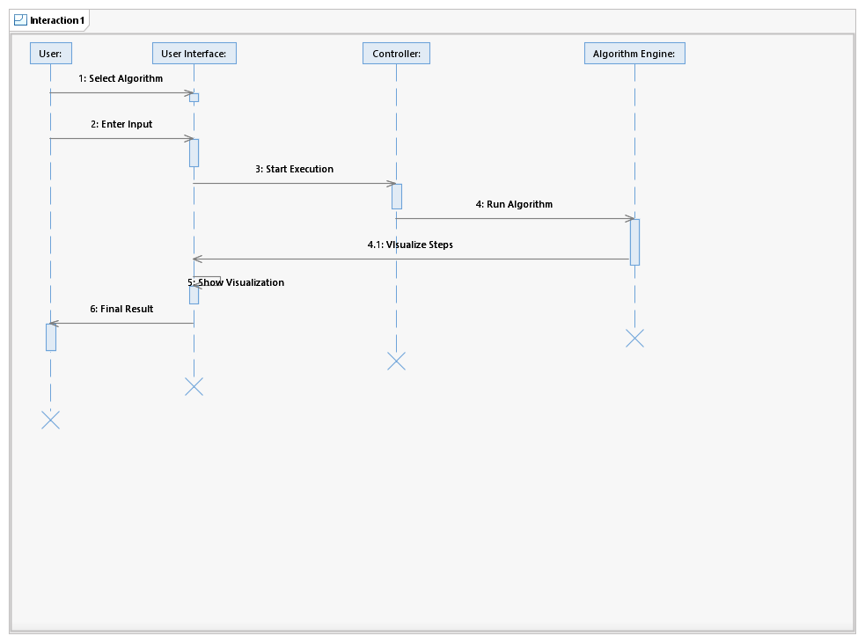
Department of CSE(AI and ML)
Sequence Diagram
Participants:
User – Initiates actions such as selecting algorithms and providing inputs.
User Interface – Acts as the interaction layer between the user and backend.
Controller – Handles execution requests and controls algorithm flow.
Algorithm Engine – Executes the selected algorithm and generates steps.
Explanation:
The User selects an algorithm via the User Interface.
The User Interface provides the algorithm options as Result to the user.
The user enters the required inputs through the User Interface.
The Controller receives the execution request and instructs the Algorithm Engine to run the algorithm.
The Algorithm Engine executes the algorithm and sends the steps back to the Controller for visualization.
The Controller forwards the visualization steps to the User Interface, which displays the visualized output to the user.

Slide 12
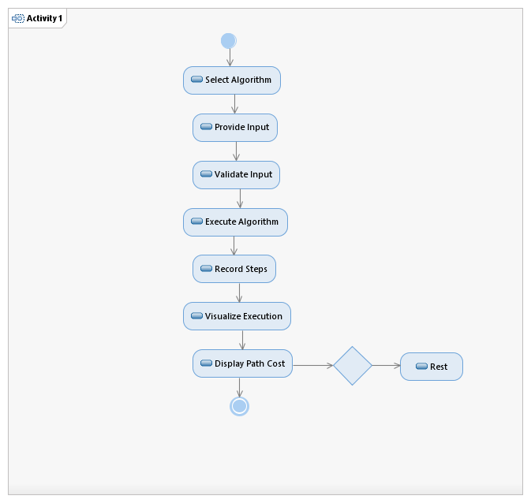
Department of CSE(AI and ML)
Activity Diagram
Activity Flow Explanation:
The activity starts with the user selecting an algorithm.
The user then provides the required input, which is validated before execution.
After successful validation, the system executes the algorithm.
The algorithm’s intermediate steps are recorded for visualization purposes.
The system visualizes the execution and displays the path cost as output.
The flow ends, with an optional reset action allowing the process to restart.

Slide 13
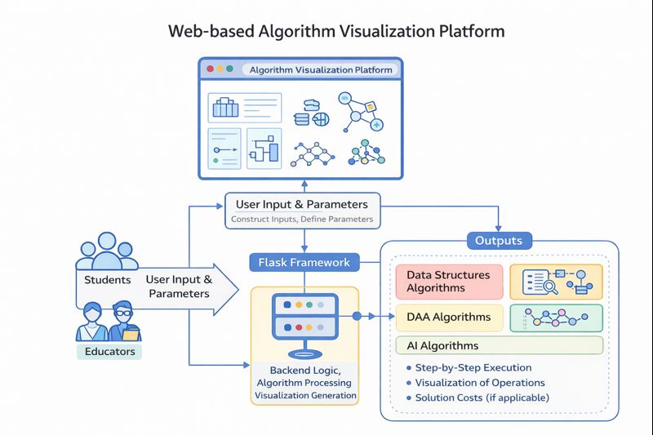
Department of CSE(AI and ML)
Block Diagram

Slide 14
Department of CSE(AI and ML)
ALGORITHM: AlgoViz ( Flask-Based web-app for Teaching Algorithms )
Step 1 : Application Initialization
The system starts the ALGOVIZ application and prepares the user interface for interaction.
Step 2 : Algorithm Selection
The list of available algorithms is displayed, and the user selects the required algorithm.
Step 3 : Input Collection
The system prompts the user to enter the necessary input values related to the selected algorithm.
Step 4 : Input Validation
The entered input is checked for correctness and completeness. If the input is invalid, an error message is displayed and the user is asked to re-enter the input.
Step 5 : Controller Invocation
Once the input is valid, the data is forwarded to the controller, which invokes the selected algorithm in the algorithm engine.

Slide 15
Department of CSE(AI and ML)
ALGORITHM: AlgoViz ( Flask-Based web-app for Teaching Algorithms )
Step 6 : Algorithm Execution
The algorithm is executed step-by-step, ensuring each logical operation is performed in sequence.
Step 7 : Step Recording
All intermediate steps generated during execution are recorded for visualization purposes.
Step 8 : Visualization Process
The recorded steps are sent to the visualization module, which dynamically displays the execution flow on the user interface.
Step 9 : Result Display
The final output, such as the result, path cost, or sorted data, is displayed to the user.
Step 10 : Reset or Termination
The system provides an option to reset and select another algorithm or to end the process.

