Slide 1
Procedural landscape generation

Slide 2
Flat algorithm
fn flat(_x: f64,
_y: f64,
surface_level: f64
) -> f64 {
surface_level
}

Slide 3
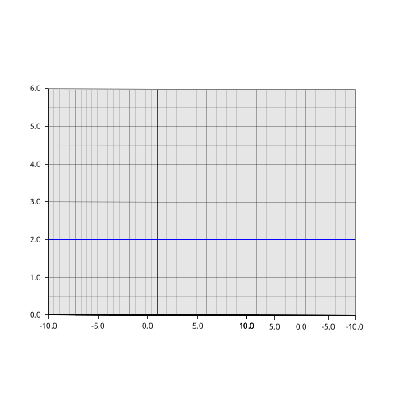

Slide 4
True random algorithm
fn true_random(_x: f64,
_y: f64,
surface_level: f64
) -> f64 {
let mut rng = rand::thread_rng();
let randomness: f64 = rng.gen();
surface_level + randomness
}

Slide 5
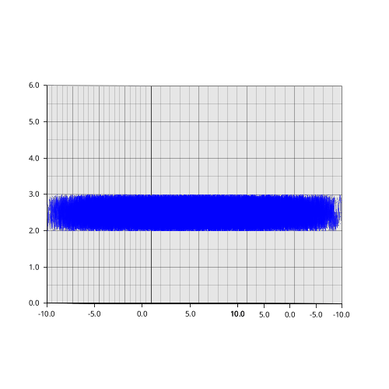

Slide 6
Sine curve algorithm
fn curve(x: f64,
y: f64,
surface_level: f64,
wave_l_incr: f64,
ampl_red: f64
) -> f64 {
surface_level
+ ((x / wave_l_incr).sin()
+ (y / wave_l_incr).sin()) / ampl_red
}

Slide 7
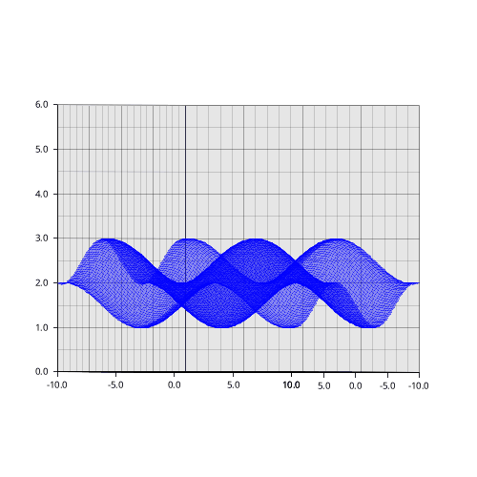
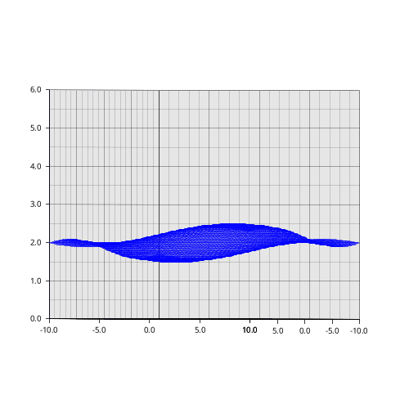

Slide 8
Perlin noise algorithm
fn perlin(
x: f64,
y: f64,
surface_level: f64,
wave_l_incr: f64,
ampl_red: f64,
perlin_seed: u32,
) -> f64 {
let perlin = Perlin::new(perlin_seed);
surface_level
+ perlin.get([x / wave_l_incr,
y / wave_l_incr]) / ampl_red
}

Slide 9
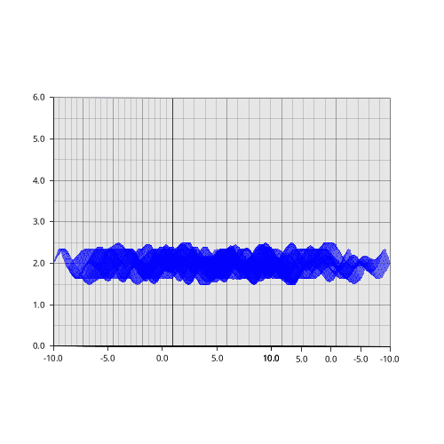
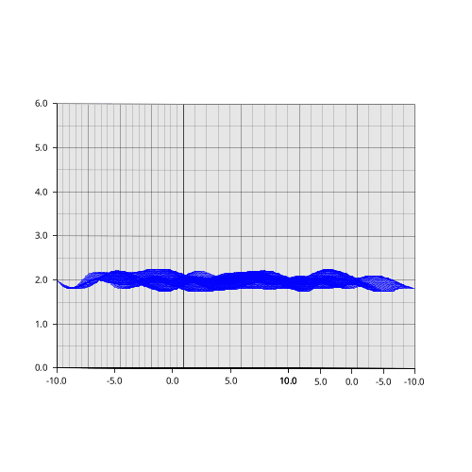

Slide 10
The idea behind

Slide 11
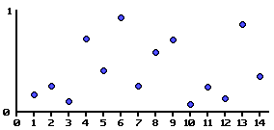
The idea behind

Slide 12
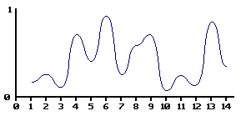
The idea behind

