Slide 1
Milestone II- Digital VLSI
Dual Rail Dynamic Footless
64 bit Adder/ Subtractor
Rajesh Satyavada
Sravan Kumar Buggaveeti
11/21/2008

Slide 2
Specifications:
Process: 0.18u TSMC process.
Supply: V_{DD} (1.8 V).
Temperature: 25 ⁰C.
Frequency: 500MHz and above.
Hierarchy :5 ((log₂64)-1)
Load: 10 fF.
Logic Style: Dynamic Dual-rail footless.
Internal clocks: Duty-cycle clock.
Outputs on the falling edge.

Slide 3
Specifications (contd..)
Inputs: 64 bit data word A input.
64 bit data word B input.
A signal for Add or Subtract
Carry internally generated
Outputs: Cout and its compliment
64 bit sum.
Internally we have 64 bit generate, kill, propagate and inverted input signals.
All the signals have been inputted using DFF

Slide 4
Overview
Project Block diagram
Block diagram of carry chain
Schematics of major sub-blocks
Test benches of each sub-block
Transient response of each sub-block
Schematic of 64-bit Manchester carry chain with 5 level carry skip
Test bench of 16 bit adder/ Subtractor and also for 64 bit.
Conclusions

Slide 5
Block Diagram for 64 bit adder
Inputs signals and clock
Propagate block
Sum block
S<63:0>
Buffers and Flip flop block and adder subtractor’s XOR block
P<63:0>
Generate
block
C<63:0>
G<63:0>
A<63:0> B<63:0>
Manchester Carry chain with bypass block
Kill block
C64
K<63:0>
Carry input
Note: The Inverted signals are generated along with the logic high signals simultaneously from the buffers and flip flop block
Notes:
Note: The Inverted signals are generated along with the logic high signals simultaneously from the buffers and flip flop block

Slide 6
Block Diagram of Carry Chain 16 bit
C0 C2
C2 C4
C4 C6
C6 C8
Level 1
PG logic
PG logic
PG logic
PG logic
Level 2
PG logic
PG logic
Level 3
PG logic
C8 C10
C10 C12
C12 C14
C14 C16
Level 1
PG logic
PG logic
PG logic
PG logic
Level 2
Level 3
PG logic
PG logic
PG logic
Notes:
For a 16 bit carry chain , we have 3 levels of Hierarchy for by pass.

Slide 7
Block diagram for 64 bit Manchester Carry chain
C0 C16
C16 C32
C32 C48
C48 C64
Level 4
PG logic
PG logic
PG logic
PG logic
Level 5
PG logic
PG logic

Slide 8
Manchester carry chain hierarchy logic
Logic used for bypassing at level 5
Cbar<64>
In this NAND gate we changed the sizing of the N-mos transistors to speed up the circuit. The sizing has been done so as to reduce the effective capacitance in the 5 input NAND gate.
Cbar<60>
NAND 5x1
Cbar<56>
C<64>
Cbar<48>
Cbar<32>
These inverted carry are bypassed with a pass gate which is activated by the propagate signal and a pre-charge, which is switching with the clock
C2bar
2 Bit MCC
C2
Logic used for bypassing at level 2
C0in
C0bar
We simply used “Wired OR” at lowest hierarchy and have to an extent the size of the NAND gate at level 5
Notes:
In this NAND gate we changed the sizing of the Nmos transistors to speed up the circuit

Slide 9
Major Sub-blocks
For milestone 1, the major sub-blocks are:
1. Propagate,(Dual rail) A^B
2. Generate A.B
3. Kill ~A.~B
4. Sum P^C
5. Manchester Carry chain with carry skip
6. Clock Generator
7. Add/sub block

Slide 10
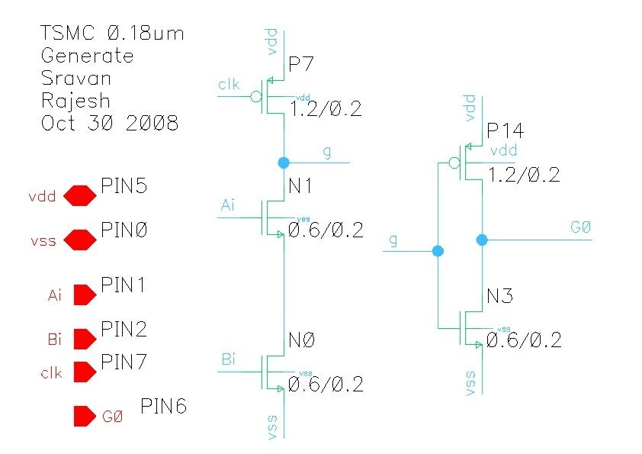
Schematic for Generate

Slide 11
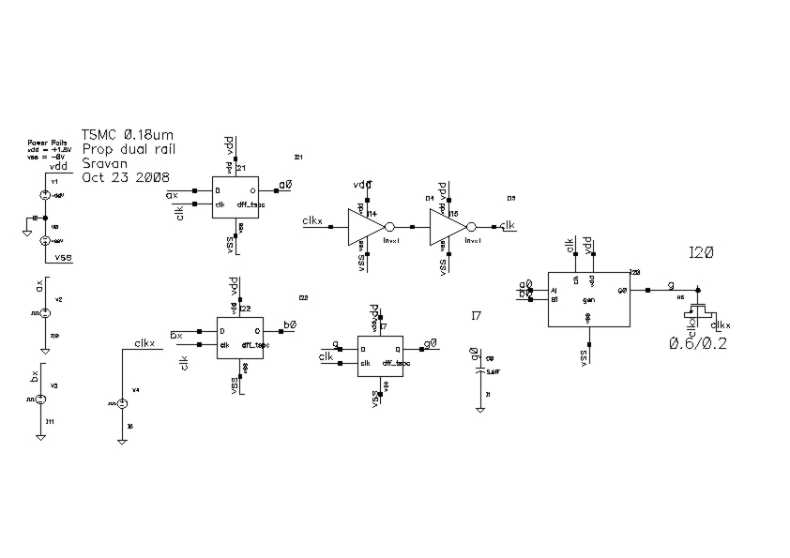
Generate test bench

Slide 12
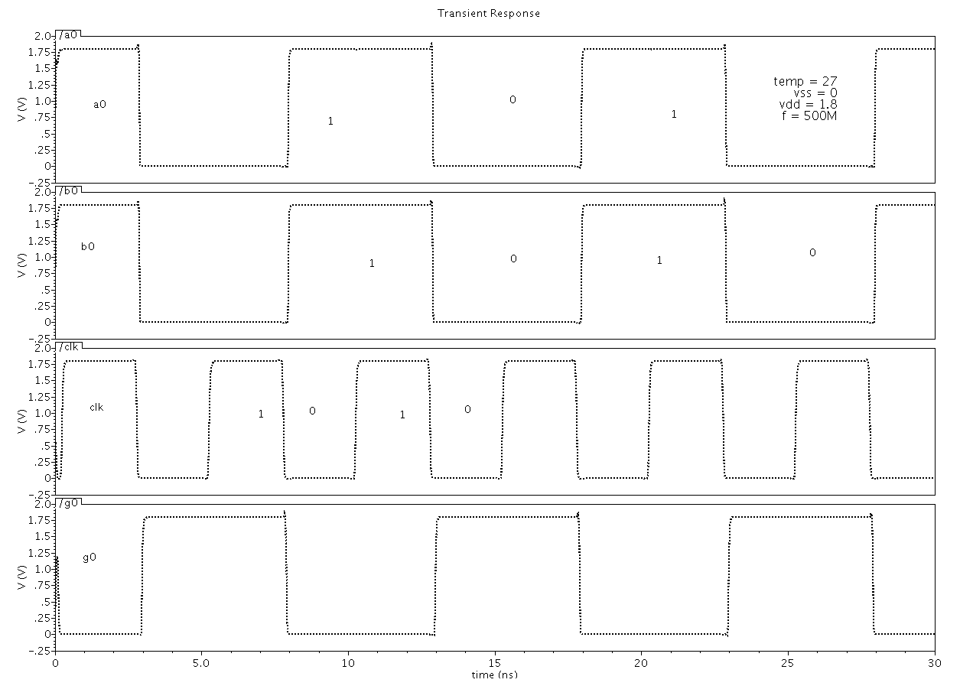
Waveforms for Generate

Slide 13
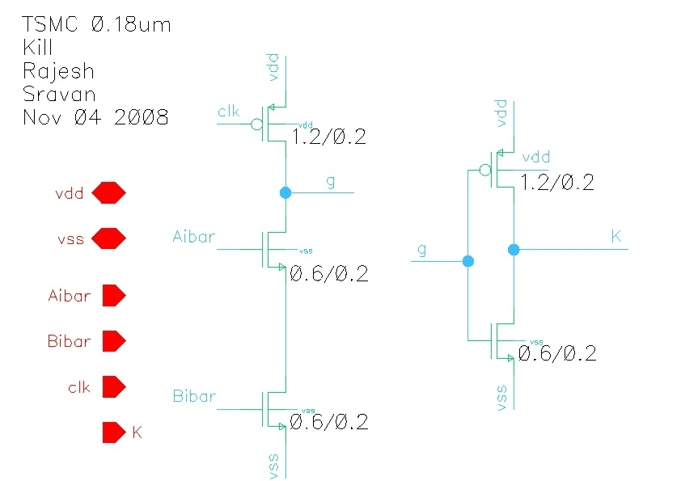
Schematic for Kill Circuit

Slide 14
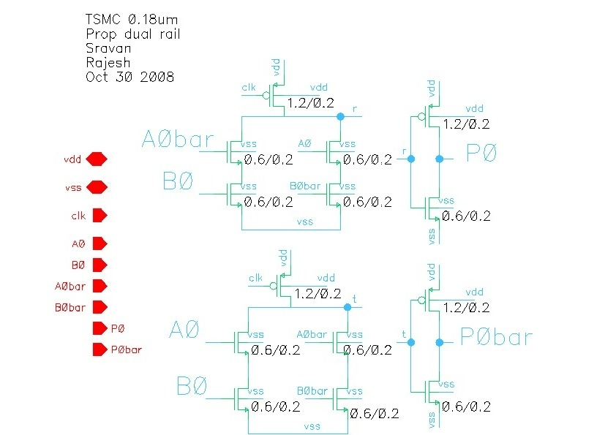
Schematic for Propagate Dual Rail

Slide 15
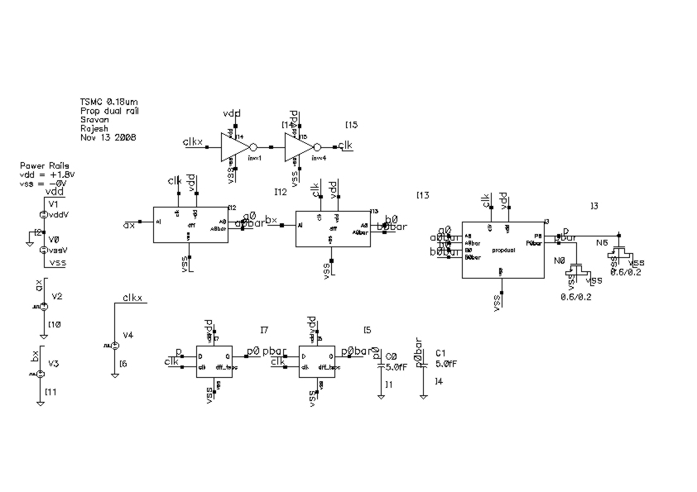
Propagate test bench

Slide 16
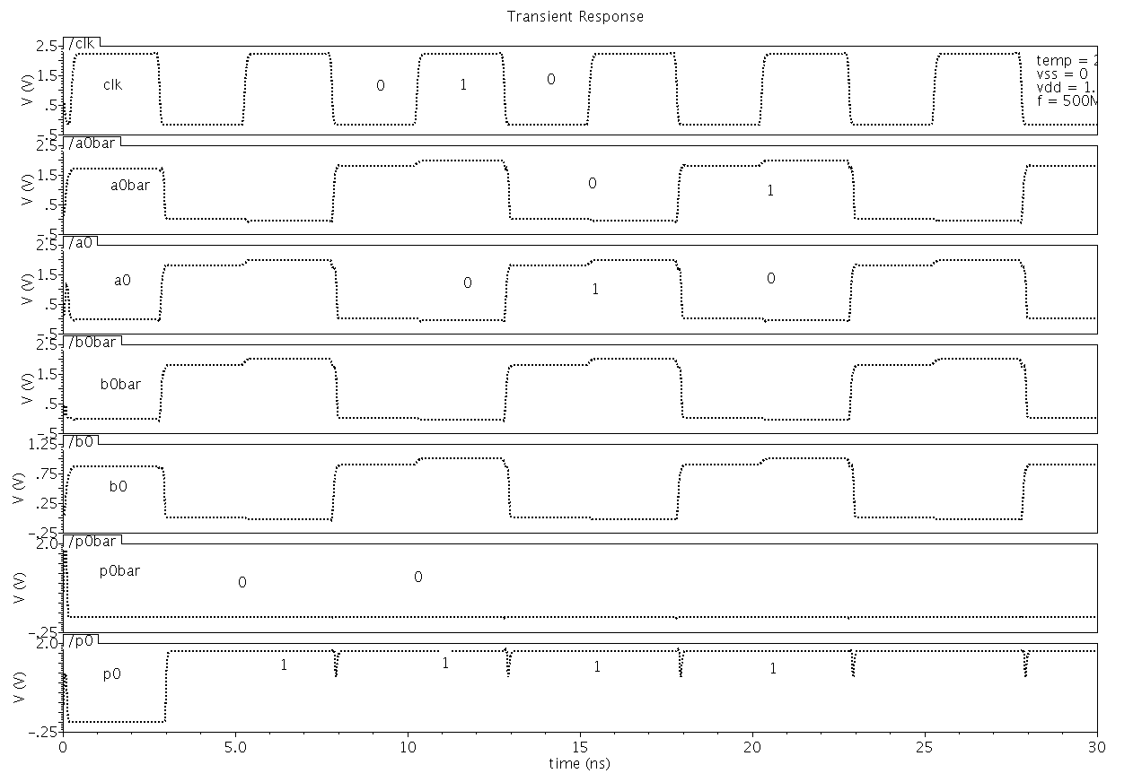
Waveforms for propagate

Slide 17
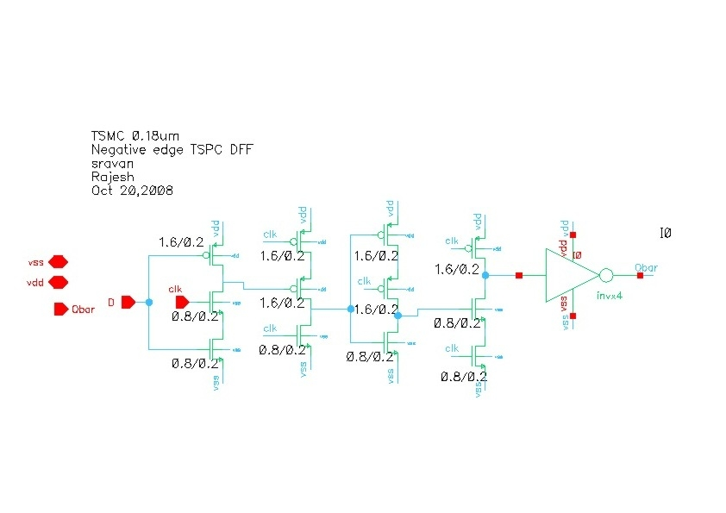
DFF Schematic

Slide 18
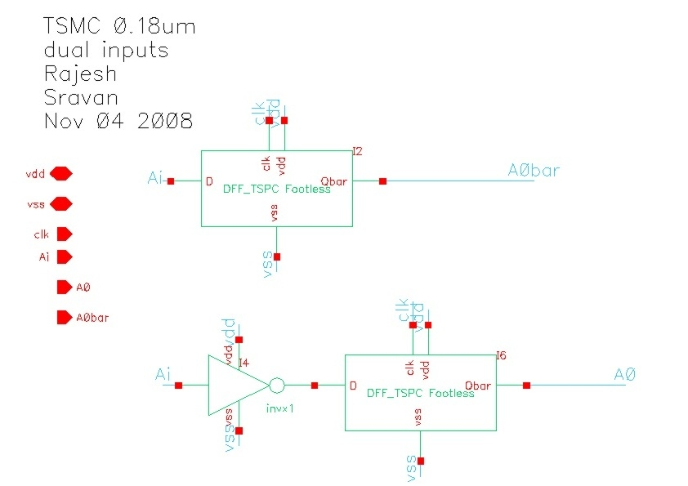

Slide 19
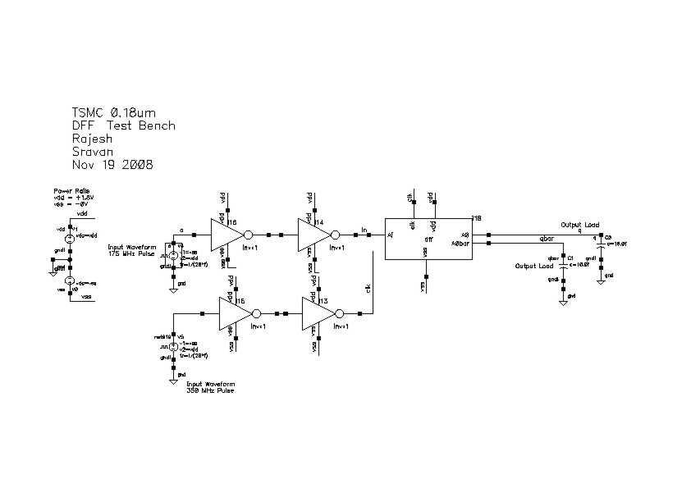
DFF Test Bench

Slide 20
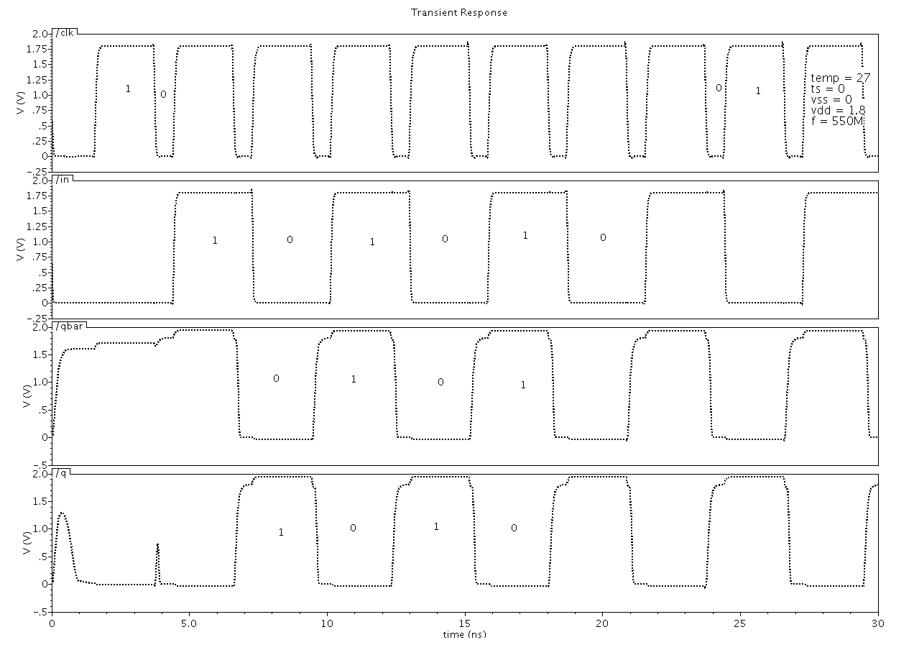
DFF Waveforms

Slide 21
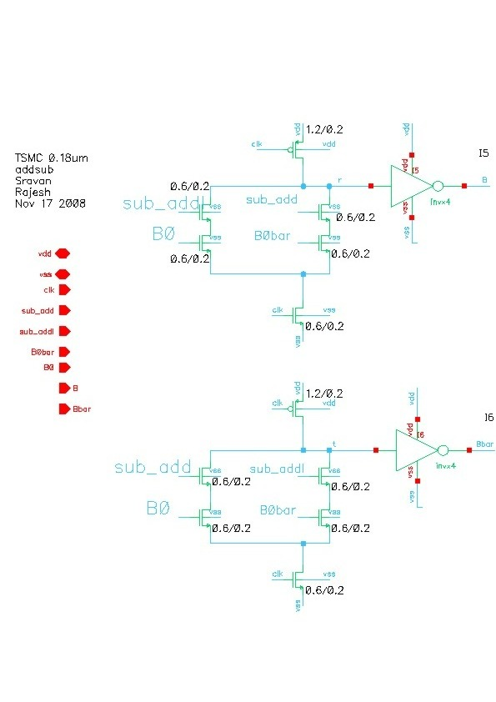
Add Sub schematic

Slide 22
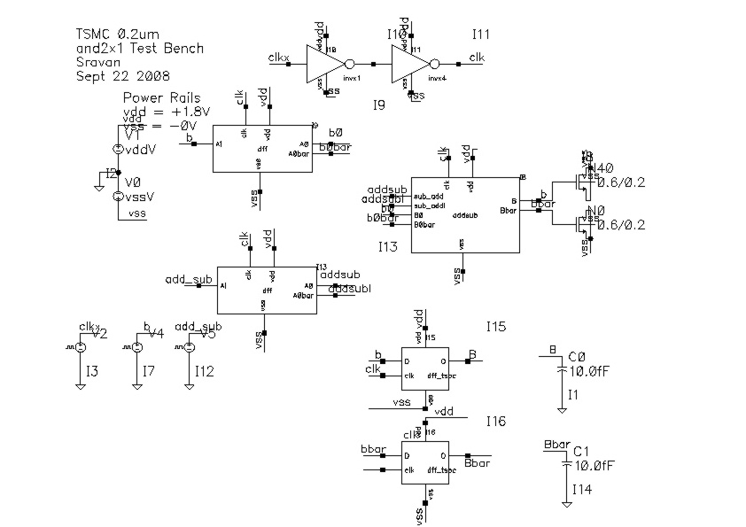
Add Sub Test Bench

Slide 23
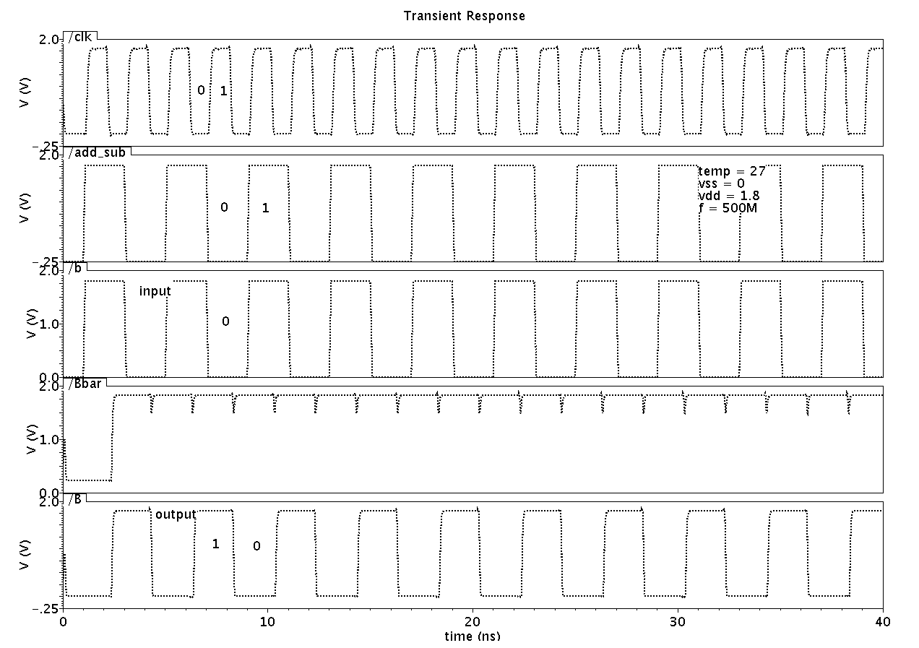
Waveforms for Add Sub

Slide 24
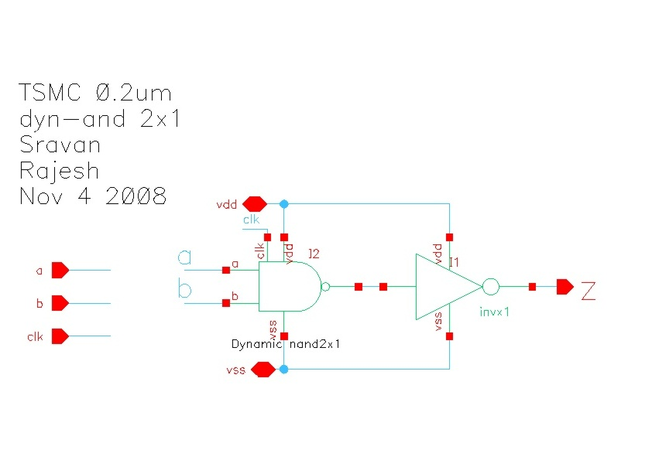

Slide 25
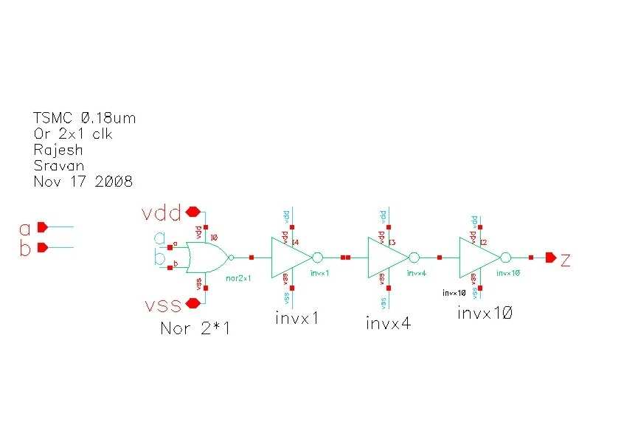

Slide 26
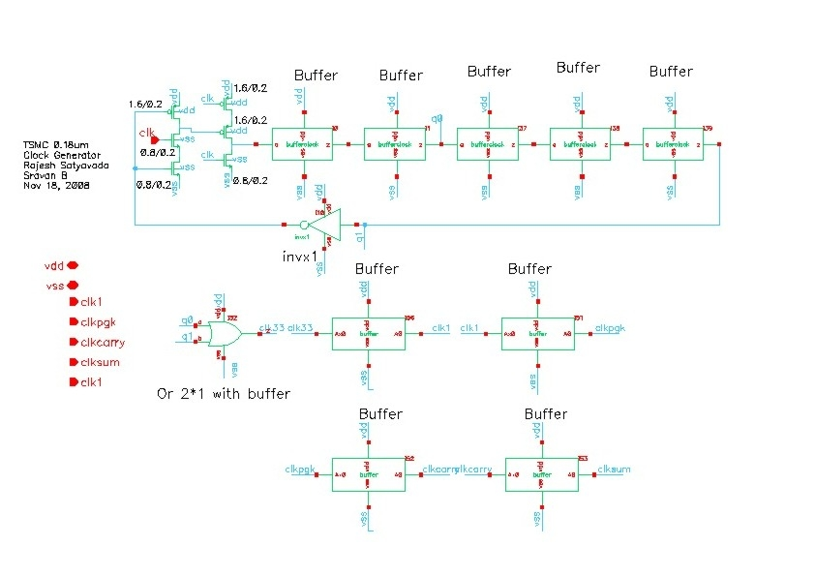
Clock Generator

Slide 27
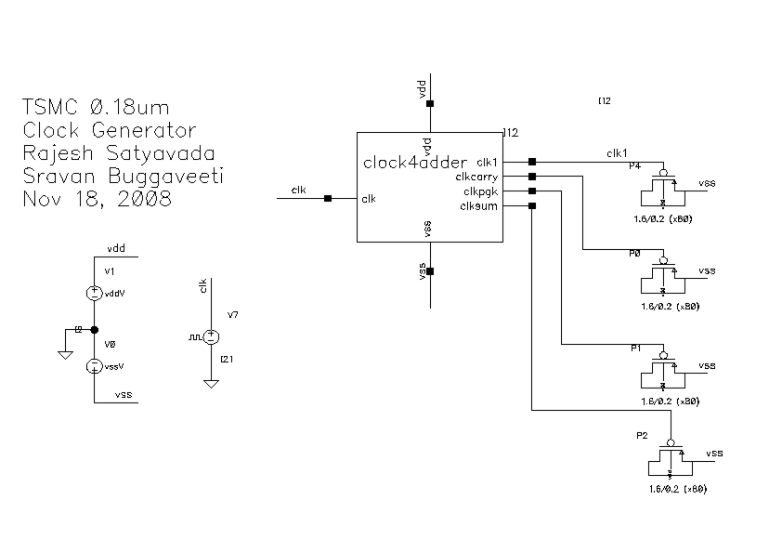
Clock Generator Test Bench

Slide 28
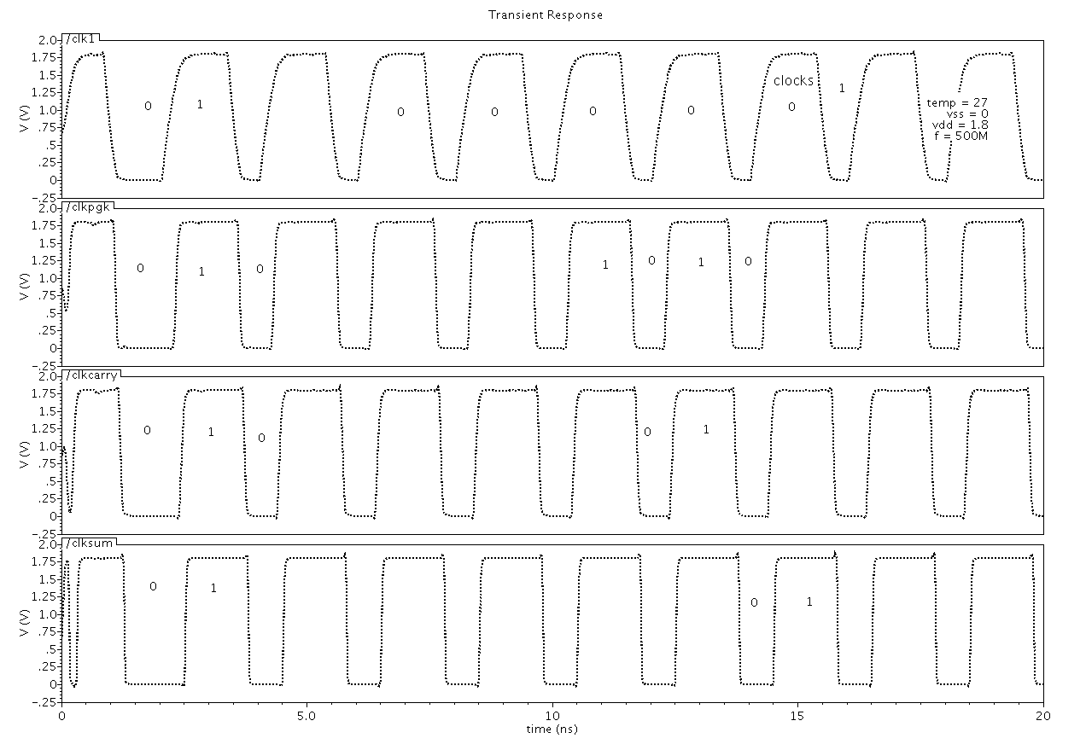
Clock Generator waveforms

Slide 29
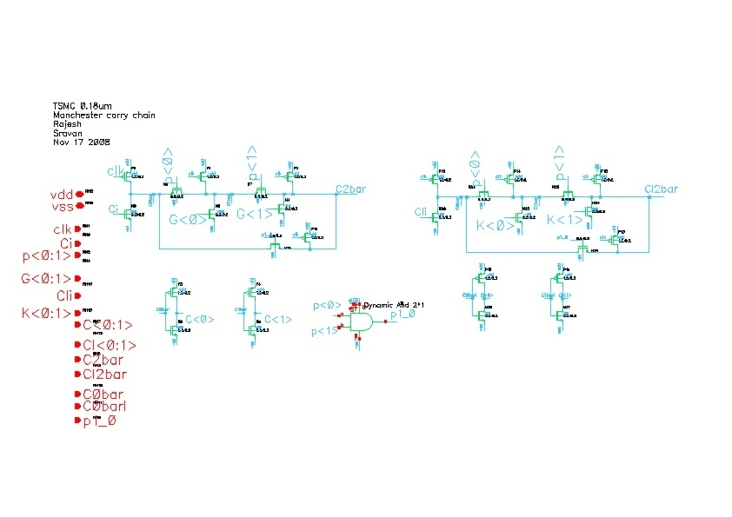
Manchester carry chain 2 bit

Slide 30
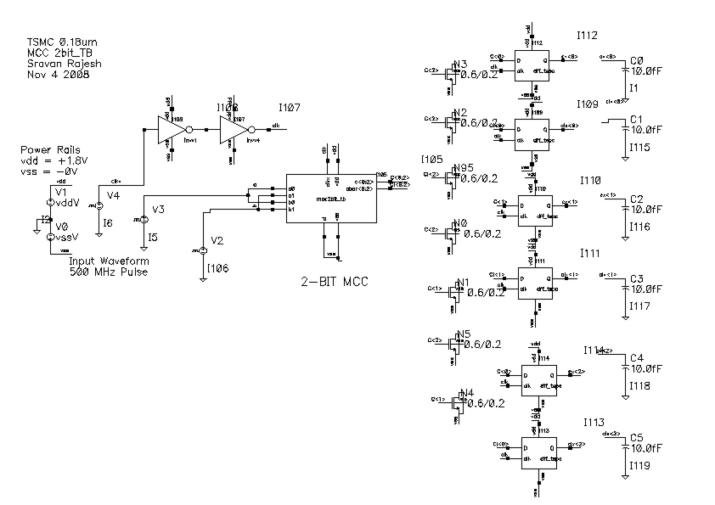
MCC 2bit Test bench

Slide 31
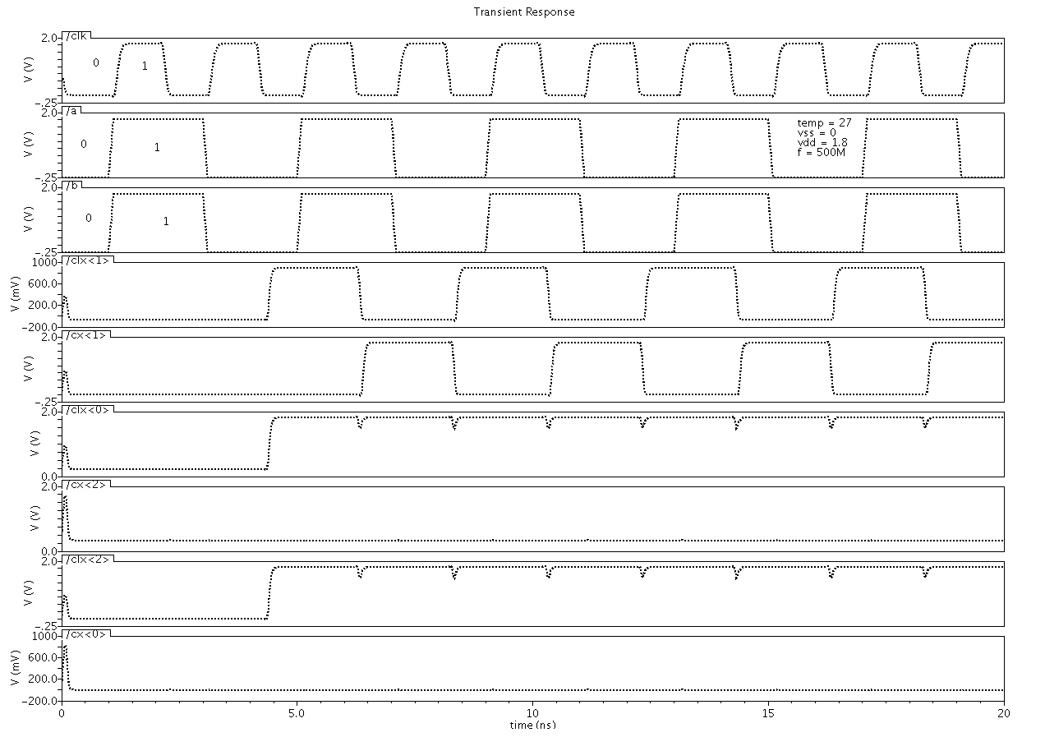
Waveforms of 2bit MCC

Slide 32
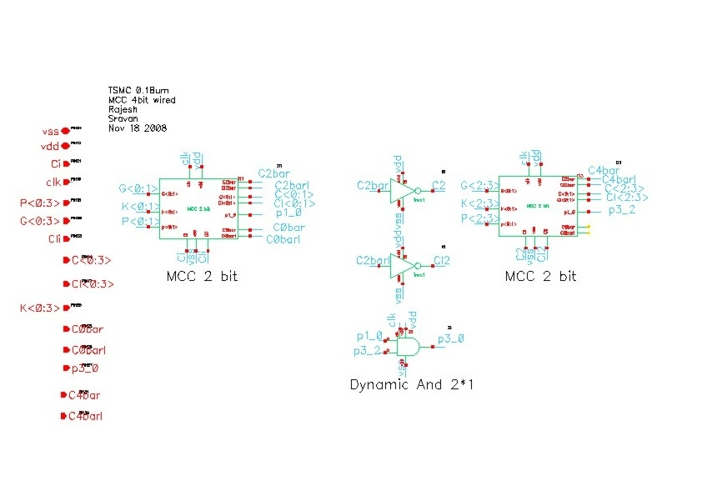
The design was made modular in order to simplify the design at higher levels and also this would help at the time of laying out the design
Notes:
The design was made modular in order to simplify the design at higher levels and also this would help at the time of laying out the design

Slide 33
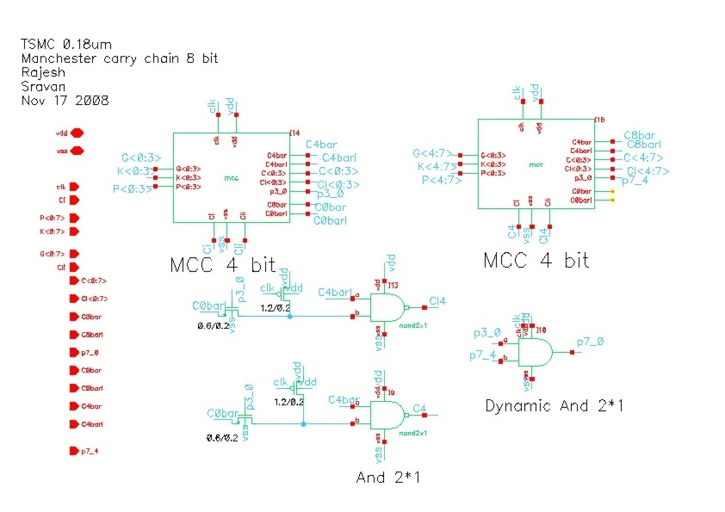

Slide 34
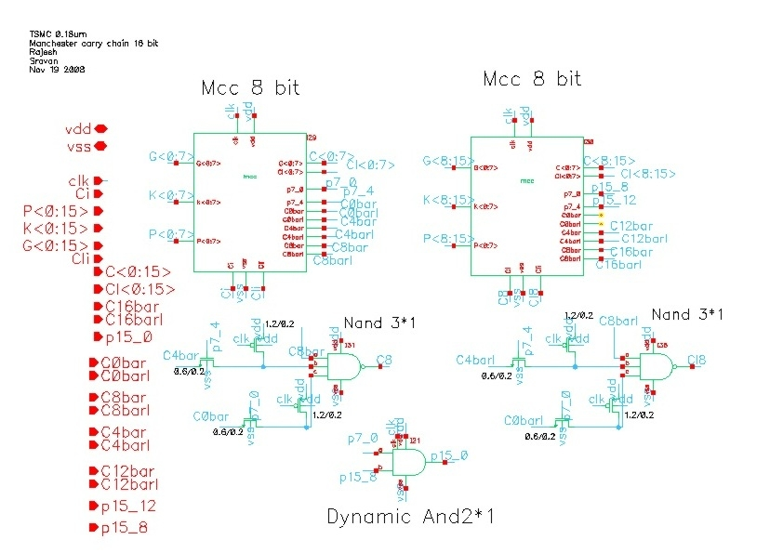

Slide 35
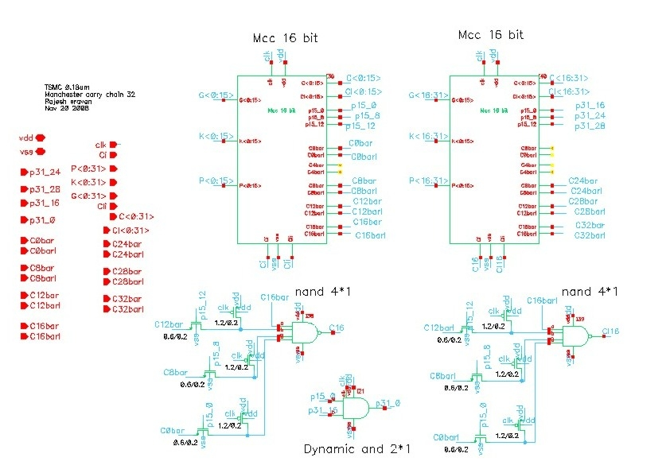

Slide 36
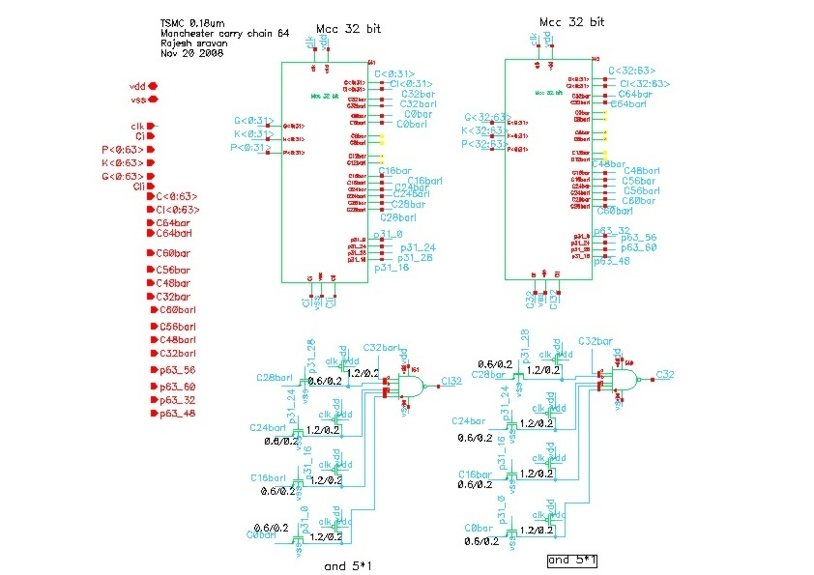

Slide 37
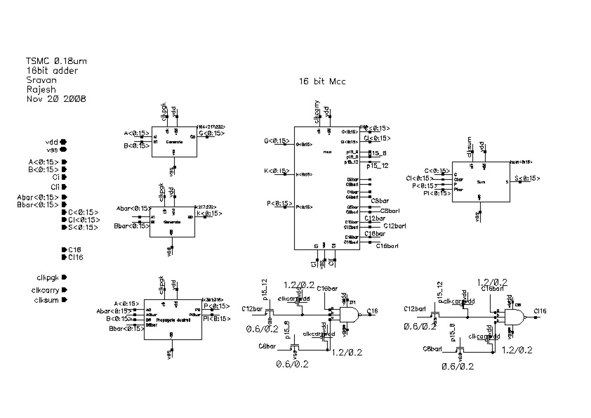
16 bit adder cicuit

Slide 38
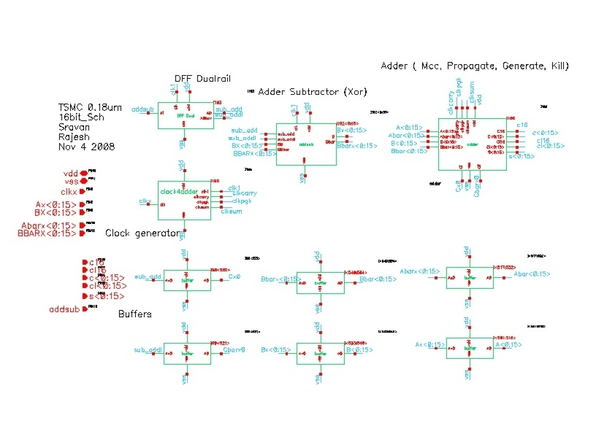
16 bit complete design

Slide 39
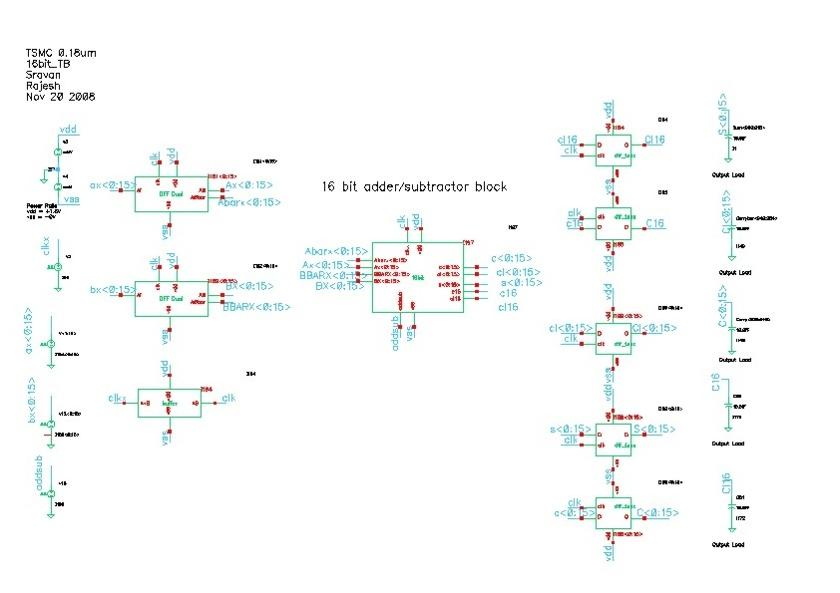
16 bit complete design test bench

Slide 40
Clock Generator waveforms

Slide 41
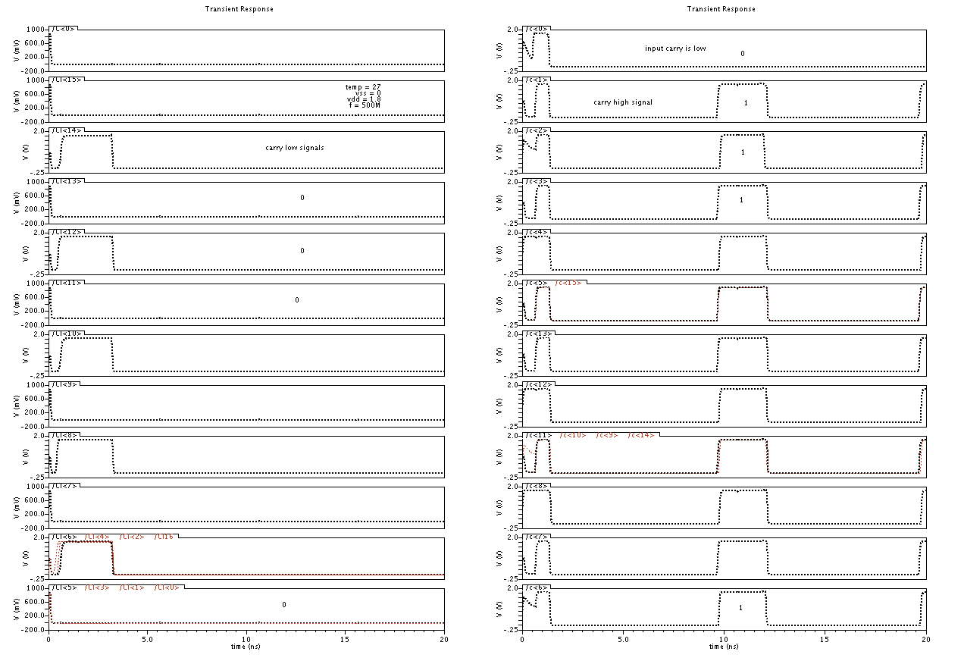
9c
Ii

Slide 42
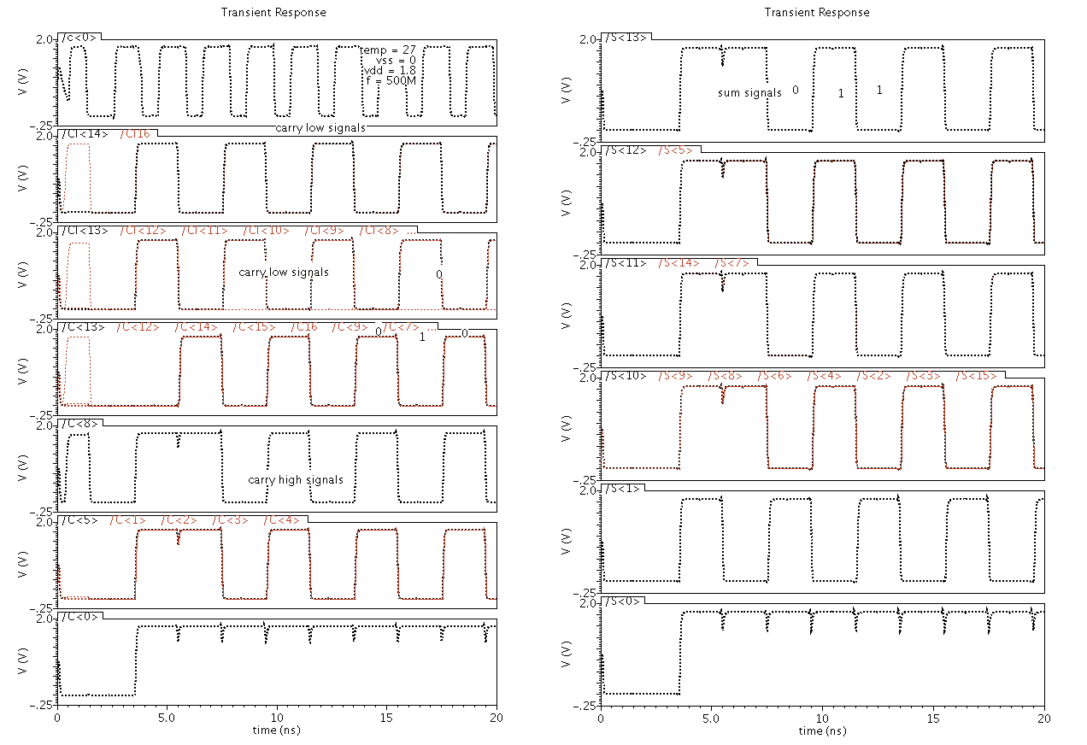
Here we can see that all the sums go high…for 9c,

Slide 43
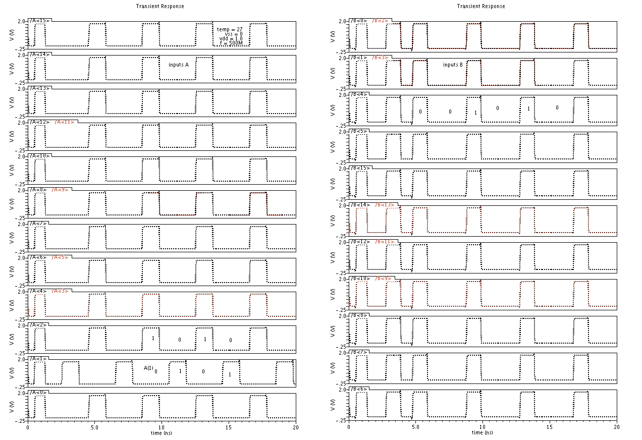
9B, inputs

Slide 44
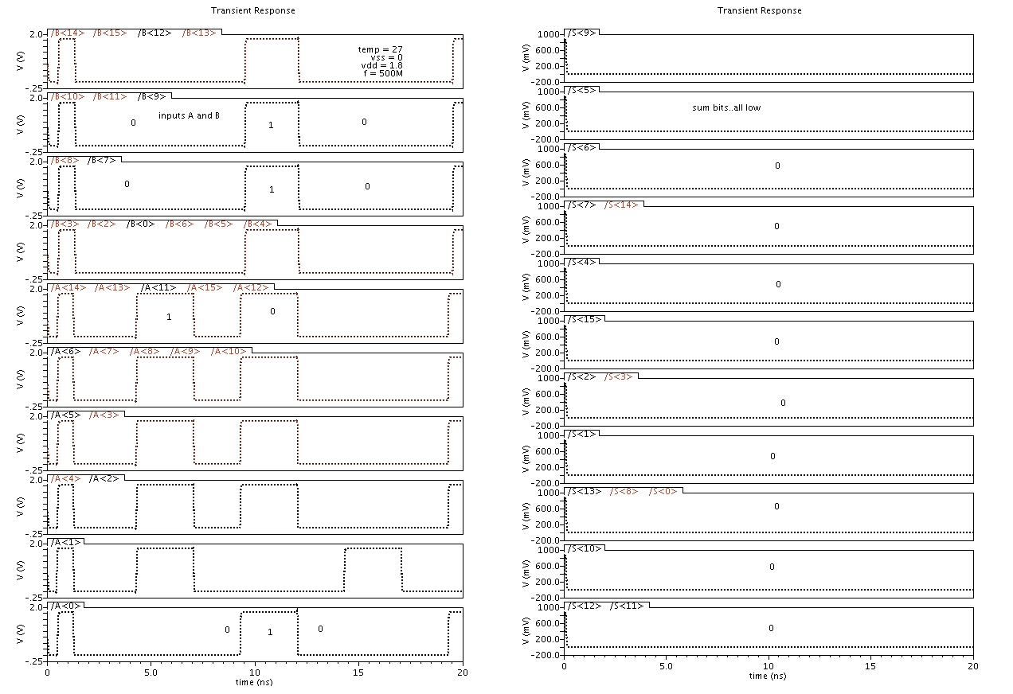
9B Sum and inputs

Slide 45
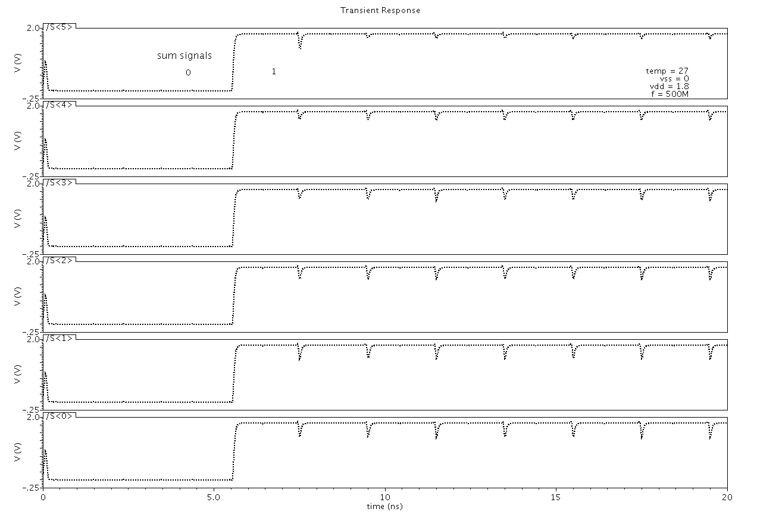
Sum signals going high for subtraction

Slide 46
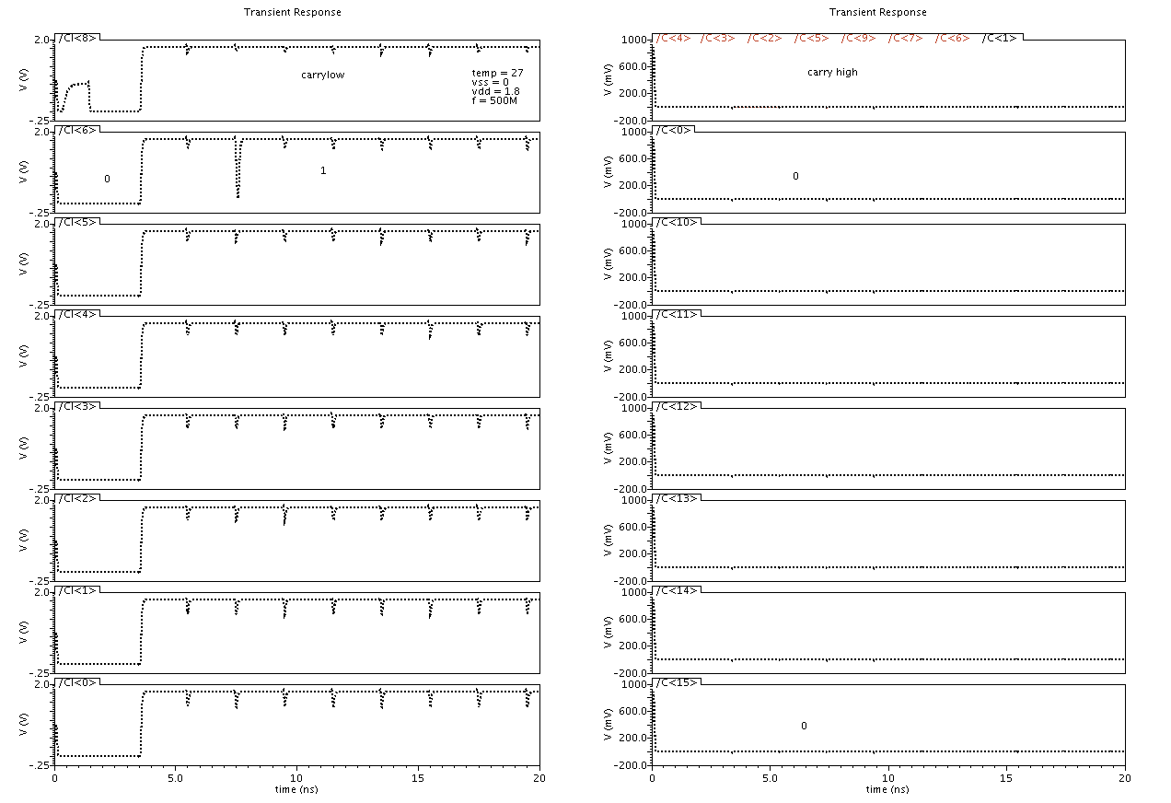
Addition operation,

Slide 47
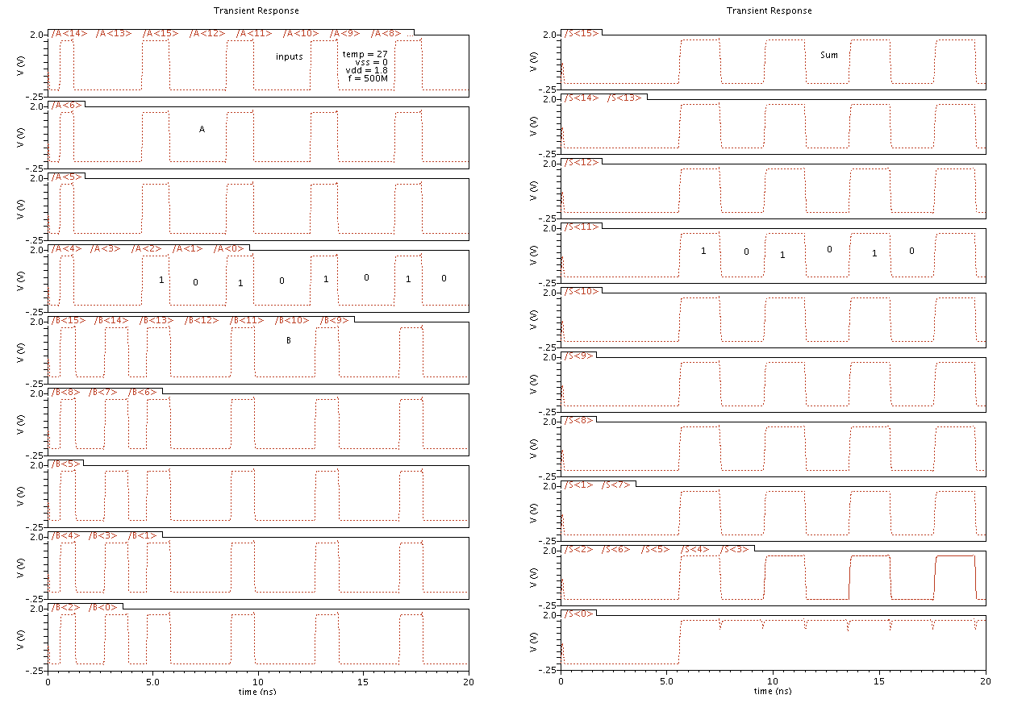

Slide 48
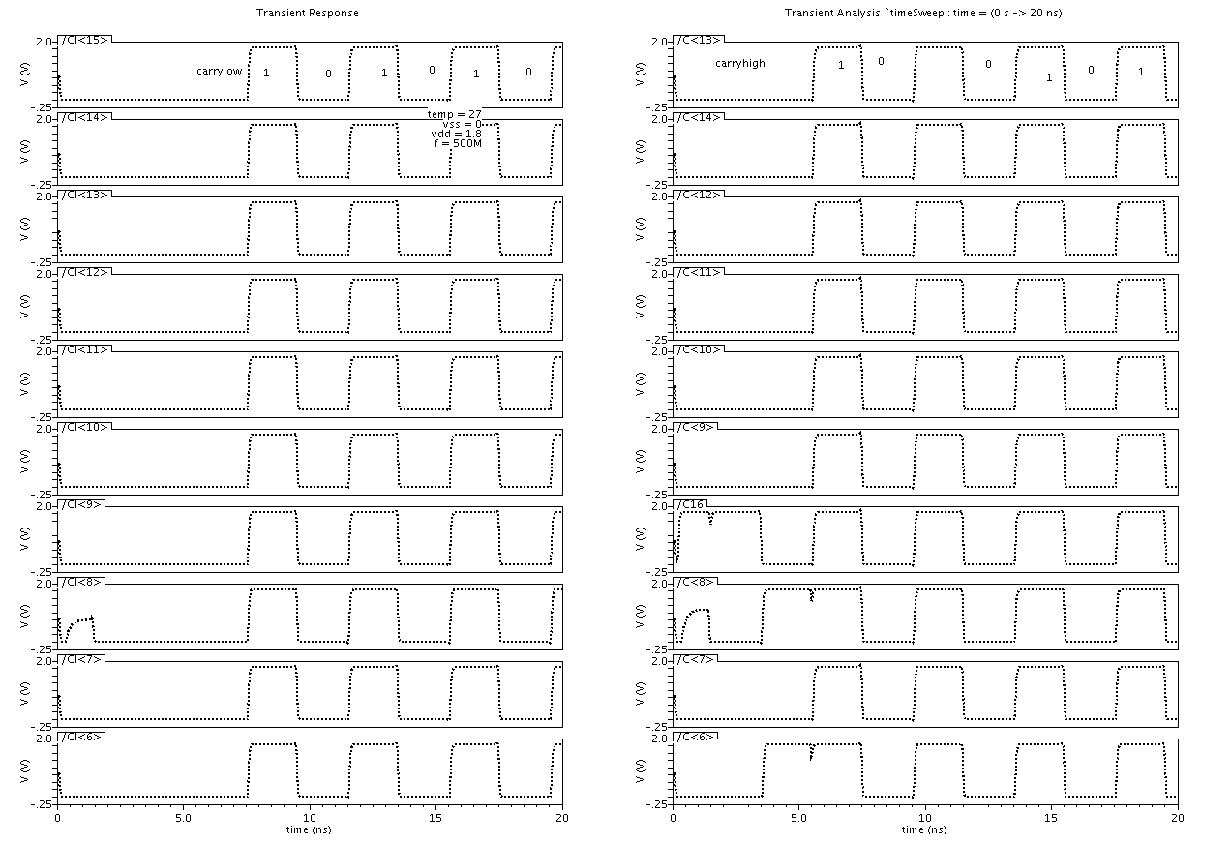

Slide 49
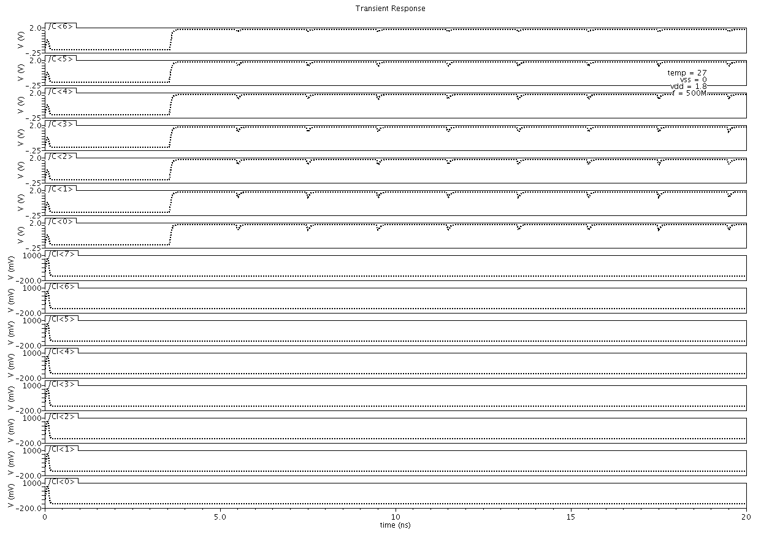
Subtraction operation , carry outputs go high..

Slide 50
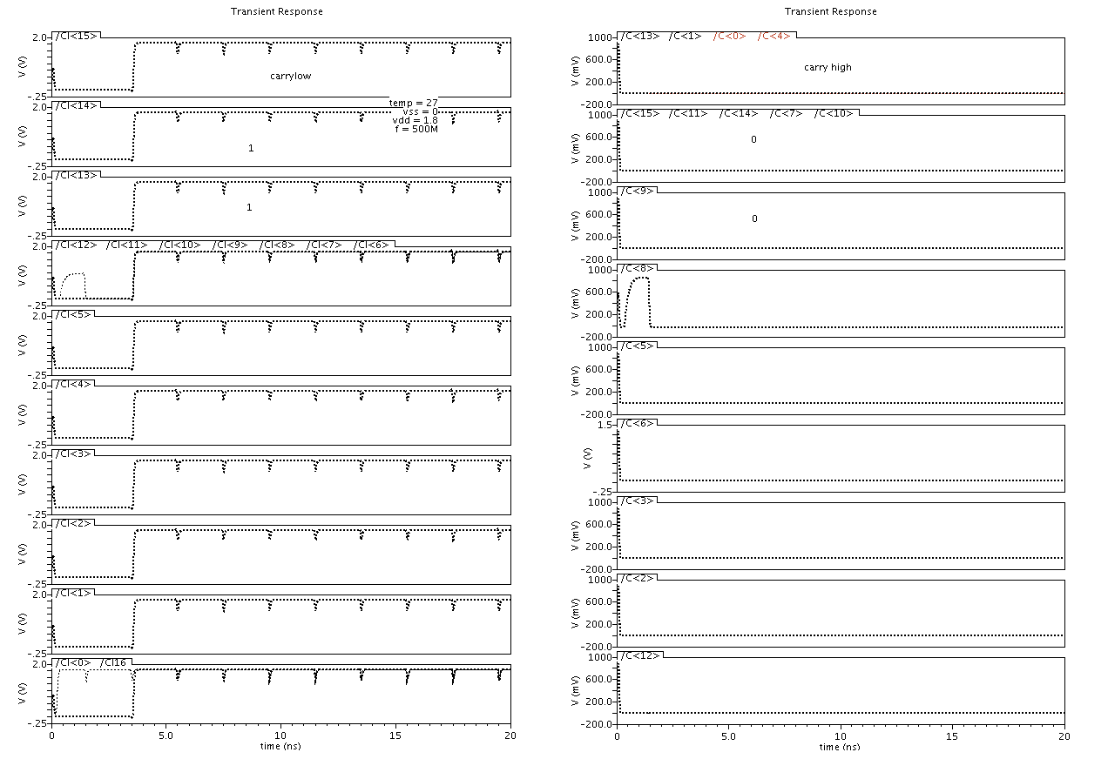
All the carry signals go low while carry bar are high when inputs go low

Slide 51
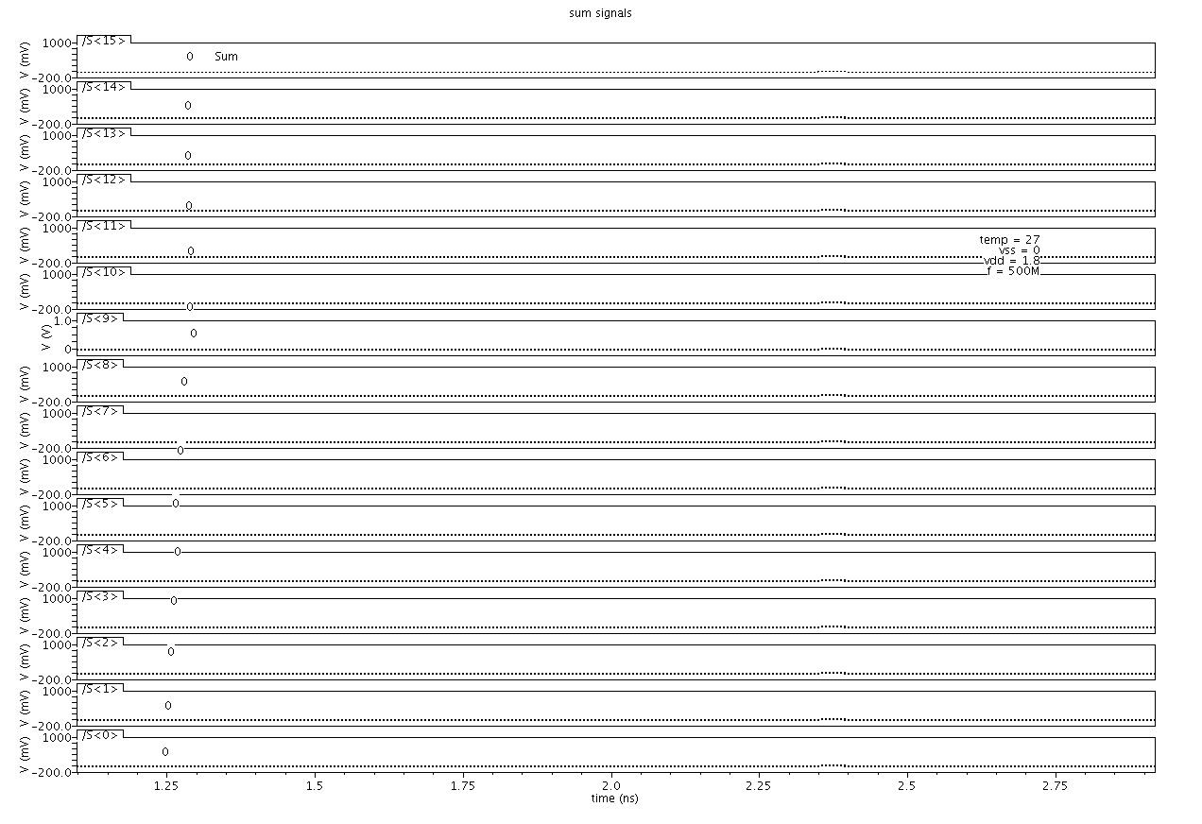
All the sums are low when inputs are low

Slide 52
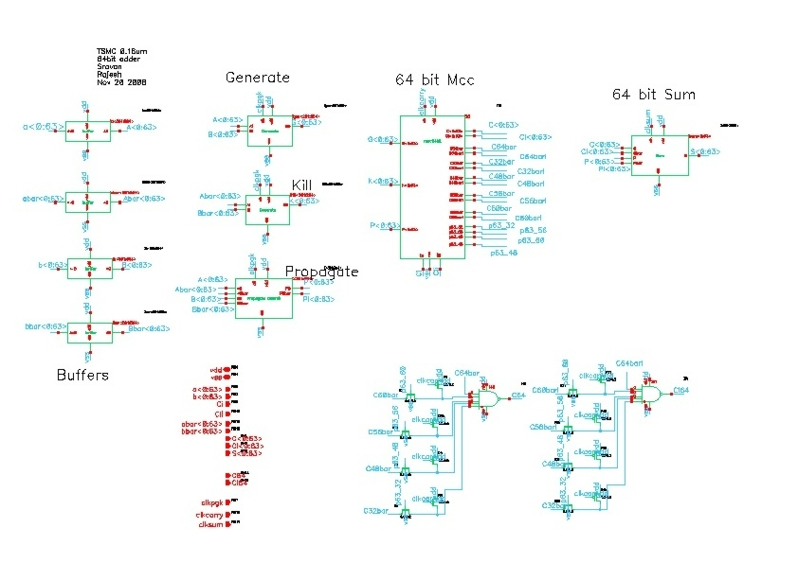

Slide 53
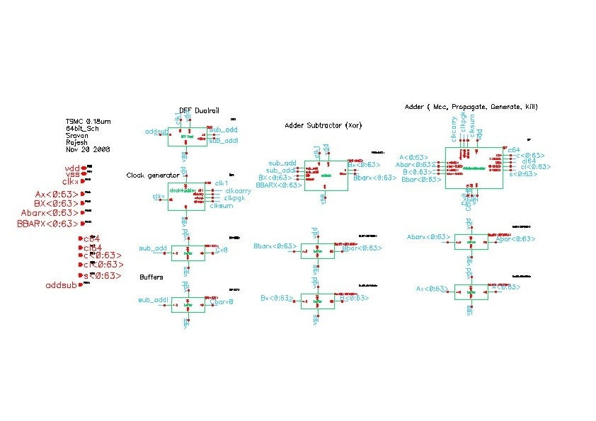

Slide 54
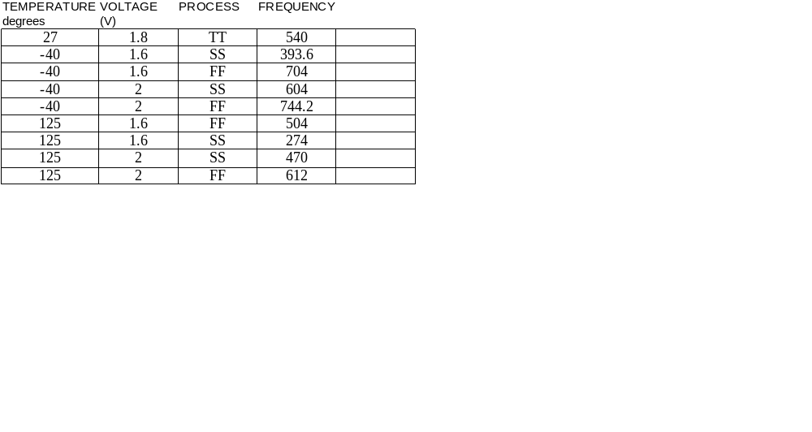
Performance at different Process corners

Slide 55
Changes made in the design
The duty cycle was varied. Instead of 50%, we used duty cycle up to 80-
85%
More clocks are used in milestone II.
Changed the design of Manchester carry chain. We made it modular. This
will make our work easier when drawing the layouts.
Bigger buffers (invx10 and invx 20) are introduced to compensate the
weakening of the clock.
At the lowest hierarchy for carry chain bypass, we used “wired Or” instead
of a NAND
The sizing of the NAND gate at the highest carry chain bypass was modified
in order to speed up the circuit

Slide 56
Work load Share
Rajesh
Manchester carry chain (MCC)16 bit schematic
MCC 32 bit test bench
Generate and Propagate
Schematics and test benches
Dynamic AND gate
DFF footless compatible
Block diagrams
Clock generation circuit
Sravan
Manchester carry chain(MCC) 32 bit schematic
MCC 16 bit test bench
Sum dual schematic and test benches
64 bit Dynamic Adder schematic
Slides for the presentation
Simulation of the sub blocks
Schematics, few simulations of the added blocks
We shared the work load as equally as possible.
Notes:
Schematics, Power point presentation

Slide 57
Work needed to be done for next milestone
We still need to speed up the circuit by designing the clock circuit for higher frequencies
Modify the sizing of the transistors so as to improve the speed.
We still need to layout the circuit .

Slide 58
Conclusion
In this milestone could implement the 64 bit adder/subtractor circuit
We could perform addition of two 64-bit inputs with carry equal to 0 and subtraction when carry in is 1.
The design works well up to 540MHz(Typical conditions)
Individual blocks work well at frequencies of 1GHz.

