Slide 1
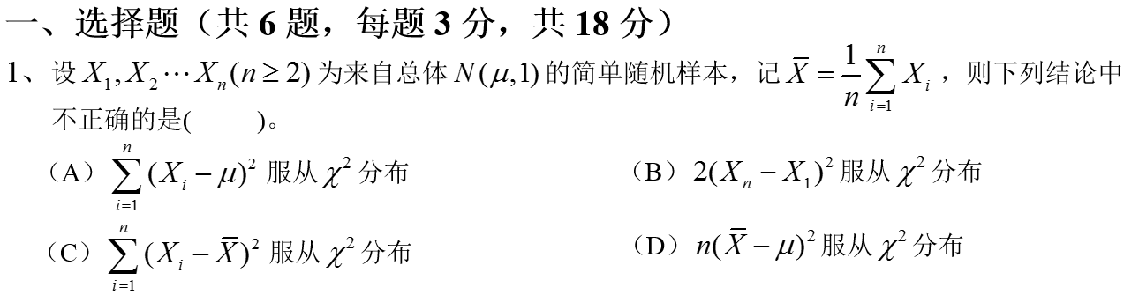
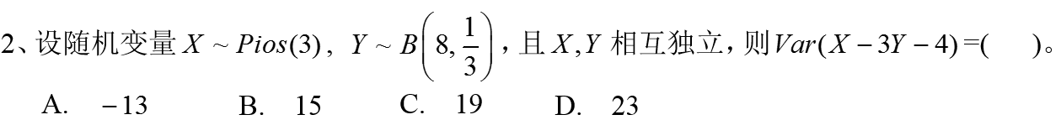


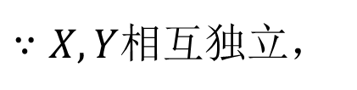
$$B$$
$$C$$
$$∴Var\left(X−3Y−4\right)=VarX+9VarY=3+9∙8∙\frac{1}{3}∙\frac{2}{3}=19$$
解：
$∵X,Y$相互独立，

Slide 2
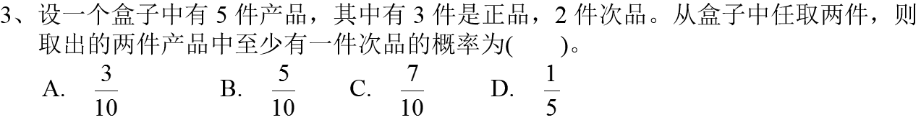
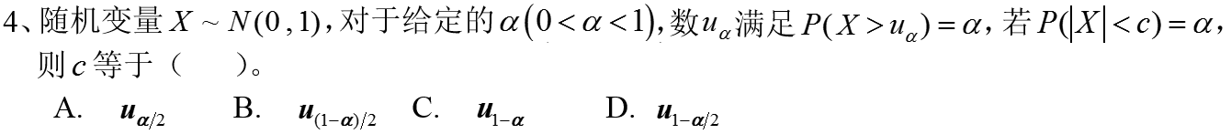

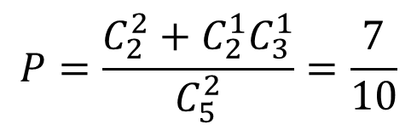

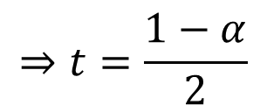
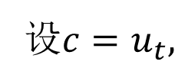


$$C$$
$$P=\frac{C_{2}^{2}+C_{2}^{1}C_{3}^{1}}{C_{5}^{2}}=\frac{7}{10}$$
解：
$$B$$
解：
$$P\left(X>u_{α}\right)=α⇒P\left(X≤u_{α}\right)=1−α,$$
设$c=u_{t},$
$$P\left(\left|X\right|<u_{t}\right)=P({−u}_{t}<X<u_{t})$$
$$=Φ\left(u_{t}\right)−Φ\left(−u_{t}\right)=2Φ\left(u_{t}\right)−1=2P\left(X<u_{t}\right)−1$$
$$⇒t=\frac{1−α}{2}$$
$$=2\left(1−t\right)−1=α$$

Slide 3
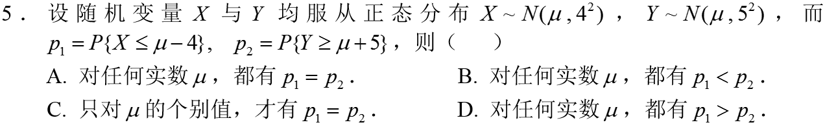




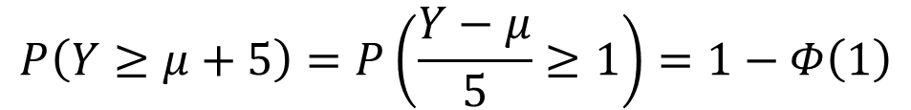

$$A$$
$$P\left(X≤μ−4\right)=P\left(\frac{X−μ}{4}≤−1\right)=Φ\left(−1\right)=1−Φ\left(1\right),$$
解：
$$P\left(Y≥μ+5\right)=P\left(\frac{Y−μ}{5}≥1\right)=1−Φ\left(1\right)$$
$$A$$
解：
$$E\left[\left(X−1\right)\left(X−2\right)\right]=E\left[X^{2}−3X+2\right]=E\left[X^{2}\right]−3E\left[X\right]+2$$
$$=Var\left[X\right]+{(E[X])}^{2}−3\left[X\right]+2=λ^{2}−2λ+2=1$$
$$⇒λ^{2}−2λ+1=0$$
$$⇒λ=1$$

Slide 4
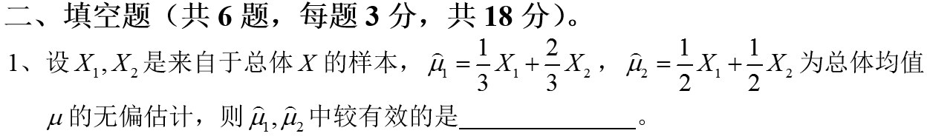
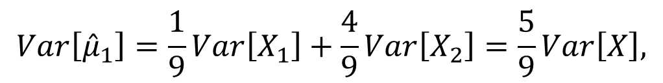


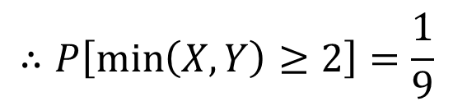
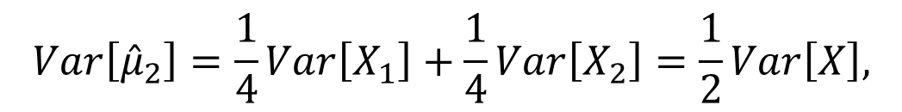
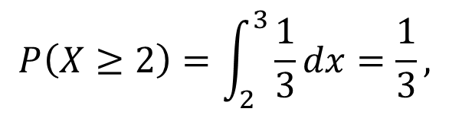
$$Var\left[{\hat{μ}}_{1}\right]=\frac{1}{9}Var\left[X_{1}\right]+\frac{4}{9}Var\left[X_{2}\right]=\frac{5}{9}Var\left[X\right],$$
解：
$$Var\left[{\hat{μ}}_{2}\right]=\frac{1}{4}Var\left[X_{1}\right]+\frac{1}{4}Var\left[X_{2}\right]=\frac{1}{2}Var\left[X\right],$$
$$∴Var\left[{\hat{μ}}_{2}\right]≤Var\left[{\hat{μ}}_{1}\right],$$
${\hat{μ}}_{2}$更有效
解：
$$P\left[\min\left(X,Y\right)≥2\right]=P\left(X≥2,Y≥2\right)=P\left(X≥2\right)P\left(Y≥2\right)={(P\left(X≥2\right)) }^{2}$$
$$P\left(X≥2\right)=\int_{2}^{3}{\frac{1}{3}dx}=\frac{1}{3},$$
$$∴P\left[\min\left(X,Y\right)≥2\right]=\frac{1}{9}$$

Slide 5
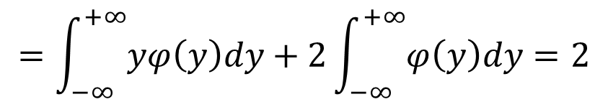
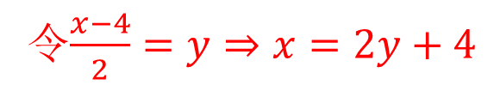
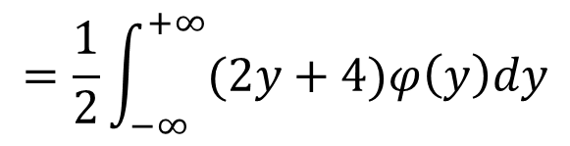
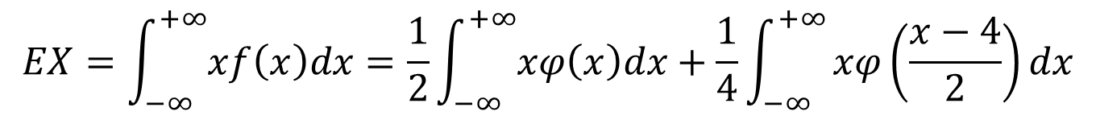

解：
$X$的密度函数为$f\left(x\right)=F^{′}\left(x\right)=0.5φ\left(x\right)+0.25φ\left(\frac{x−4}{2}\right)$
$$EX=\int_{−∞}^{+∞}{xf\left(x\right)dx}=\frac{1}{2}\int_{−∞}^{+∞}{xφ\left(x\right)dx}+\frac{1}{4}\int_{−∞}^{+∞}{xφ\left(\frac{x−4}{2}\right)dx}$$
令$\frac{x−4}{2}=y⇒x=2y+4$
$$=\frac{1}{2}\int_{−∞}^{+∞}{(2y+4)φ\left(y\right)dy}$$
$$=\int_{−∞}^{+∞}{yφ\left(y\right)dy}+2\int_{−∞}^{+∞}{φ\left(y\right)dy}=2$$
解：
$$E\left(X+Y\right)=0,$$
$$Cov\left(X,Y\right)=\sqrt{VarX∙VarY}∙ρ\left(X,Y\right)=−1$$
$$Var\left(X+Y\right)=VarX+VarY+2Cov\left(X,Y\right)=1+4−2=3$$
$$P\left(\left|X+Y\right|≥6\right)=P\left(\left|\left(X+Y\right)−E\left(X+Y\right)\right|≥6\right)≤\frac{Var\left(X+Y\right)}{36}=\frac{1}{12}$$

Slide 6
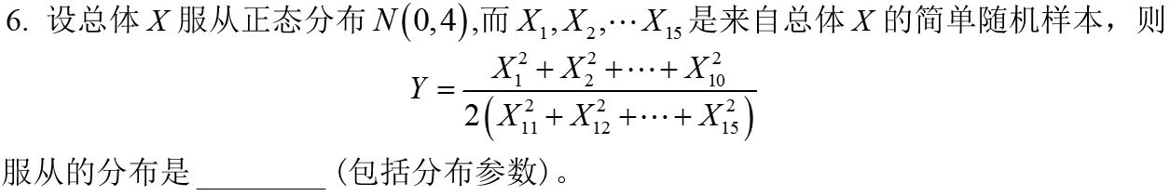




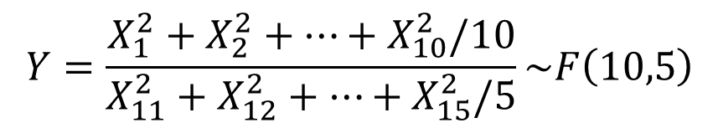


解：
$$Eξ=np=3,$$
$$Varξ=np\left(1−p\right)=3\left(1−p\right)=1.2$$
$$⇒p=0.6$$
$$⇒n=5$$
解：
$$X_{1}^{2}+X_{2}^{2}+⋯+X_{10}^{2}\sim χ^{2}\left(10\right),$$
$$X_{11}^{2}+X_{12}^{2}+⋯+X_{15}^{2}\sim χ^{2}\left(5\right),$$
$$Y=\frac{X_{1}^{2}+X_{2}^{2}+⋯+X_{10}^{2}/10}{X_{11}^{2}+X_{12}^{2}+⋯+X_{15}^{2}/5}\sim F\left(10,5\right)$$

Slide 7
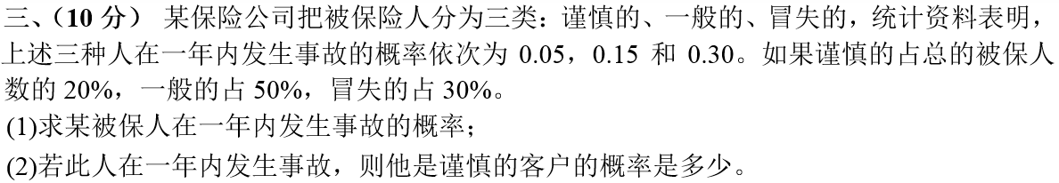



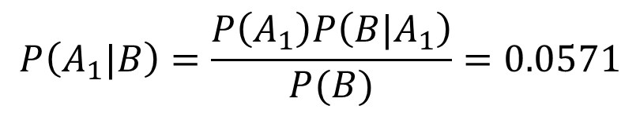



解：
设$B=\left\{\text{被保险人在一年内出了事故}\right\},$
$$A_{1}=\left\{\text{被保险人}是谨慎的\right\},$$
$$A_{2}=\left\{\text{被保险人}是一般的\right\},$$
$$A_{3}=\left\{\text{被保险}人是冒失的\right\},$$
$$已知P\left(A_{1}\right)=0.2,P\left(A_{2}\right)=0.5,P\left(A_{3}\right)=0.3,$$
$P\left({B|A}_{1}\right)=0.05,P\left({B|A}_{2}\right)=0.15,P\left({B|A}_{3}\right)=0.3,$
则由全概率公式知：
$P\left(B\right)=P\left(A_{1}\right)P\left({B|A}_{1}\right)+P\left(A_{2}\right)P\left({B|A}_{2}\right)+P\left(A_{3}\right)P\left({B|A}_{3}\right)=0.175$
$$P\left(A_{1}|B\right)=\frac{P\left(A_{1}\right)P\left({B|A}_{1}\right)}{P(B)}=0.0571$$

Slide 8
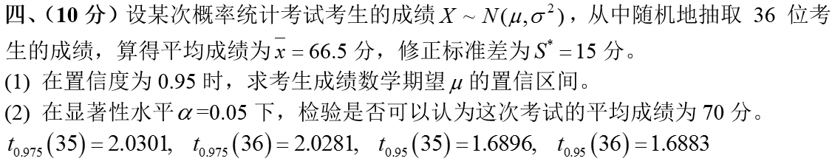




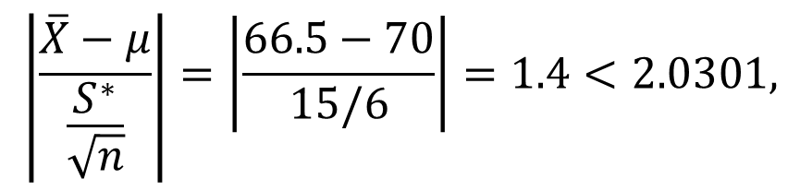
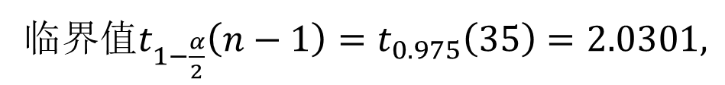
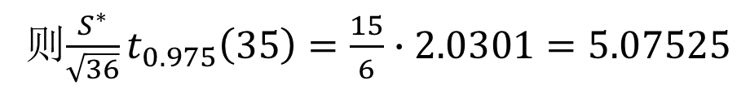
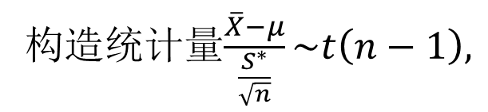
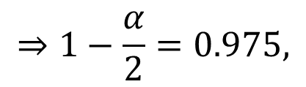

$μ$的置信区间为$\left[\overline{X}−\frac{S^{∗}}{\sqrt{n}}t_{1−\frac{α}{2}}(n−1),\overline{X}+\frac{S^{∗}}{\sqrt{n}}t_{1−\frac{α}{2}}(n−1)\right]，$
解：
$$⇒1−\frac{α}{2}=0.975,$$
则$\frac{S^{∗}}{\sqrt{36}}t_{0.975}\left(35\right)=\frac{15}{6}∙2.0301=5.07525$
已知$n=36,1−α=0.95$
故$μ$的置信区间为$[61.42,71.58]$。
$$H_{0}:μ=70,$$
构造统计量$\frac{\overline{X}−μ}{\frac{S^{∗}}{\sqrt{n}}}\sim t\left(n−1\right),$
临界值$t_{1−\frac{α}{2}}\left(n−1\right)=t_{0.975}\left(35\right)=2.0301,$
$$\left|\frac{\overline{X}−μ}{\frac{S^{∗}}{\sqrt{n}}}\right|=\left|\frac{66.5−70}{15/6}\right|=1.4<2.0301,$$
接受原假设，
故可以认为这次考试的平均成绩为70分。

Slide 9
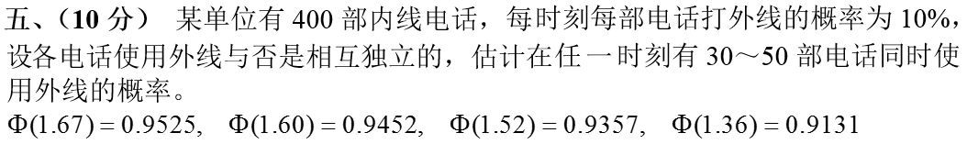
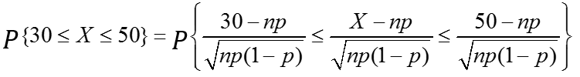
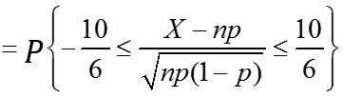

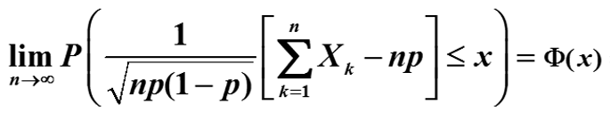
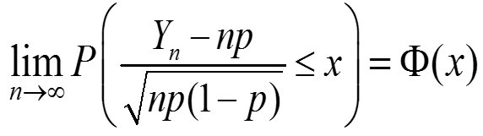
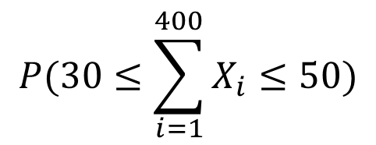
解：
$$P(30≤\sum_{i=1}^{400}{X_{i}}≤50)$$
令$X_{i}=\left\{\begin{matrix}0, 第i部电话未使用外线 \\ 1,第i部电话正使用外线\end{matrix}，则X_{i}\sim B\left(1,0.1\right),i=1,⋯,400,\right.$

Slide 10
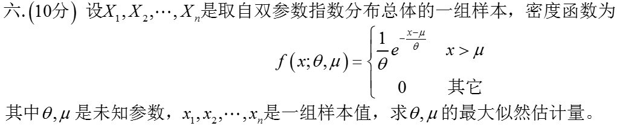



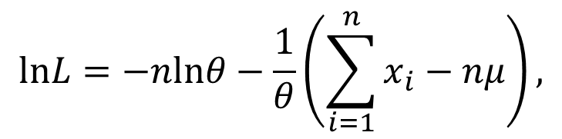
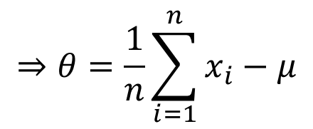
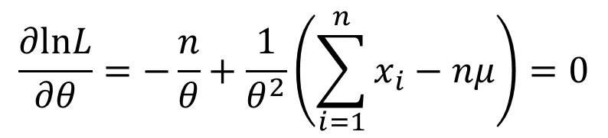
解：
似然函数：
$$lnL=−nlnθ−\frac{1}{θ}\left(\sum_{i=1}^{n}{x_{i}}−nμ\right),$$
$$\frac{∂lnL}{∂θ}=−\frac{n}{θ}+\frac{1}{θ^{2}}\left(\sum_{i=1}^{n}{x_{i}}−nμ\right)=0$$
$$⇒θ=\frac{1}{n}\sum_{i=1}^{n}{x_{i}}−μ$$

Slide 11










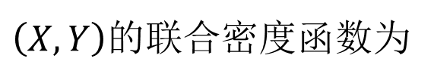


$$y$$
解：
记三角形区域为$G=\{(x,y)|0≤x,y≤1,x+y≥1\},\text{则}S_{G}=1/2,$
$$1$$
$$(1,1)$$
$\left(X,Y\right)$的联合密度函数为
$$0$$
$$1$$
$$x$$
$$DU=EU^{2}−{\left(EU\right)}^{2}=EX^{2}+EY^{2}+2EXY−{\left(EX+EY\right)}^{2}=1+\frac{5}{6}−\frac{16}{9}=\frac{1}{18}$$
$$DU=D\left(X+Y\right)=DX+DY+2Cov\left(X,Y\right)$$
$$=DX+DY+2(EXY−EX∙EY)$$
$$=EU^{2}−{\left(EU\right)}^{2}=EX^{2}+EY^{2}+2EXY−{\left(EX+EY\right)}^{2}$$

Slide 12
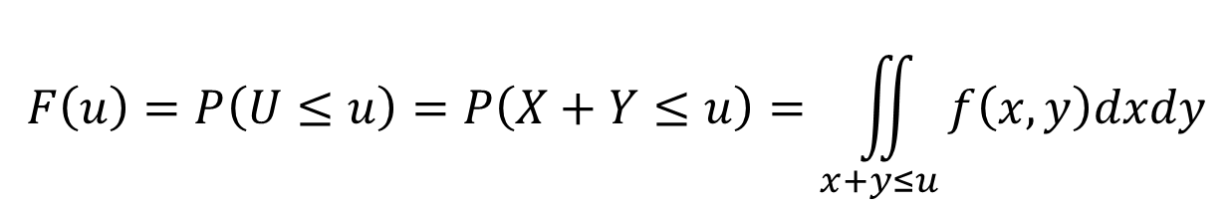



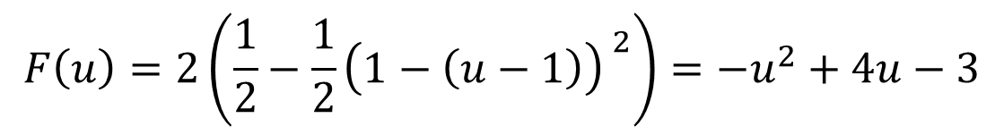
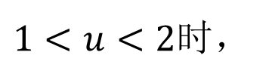
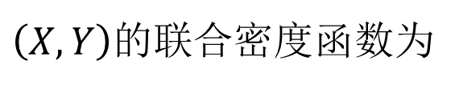
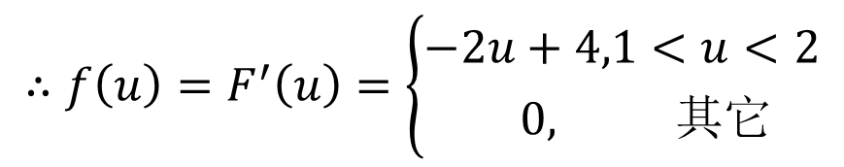
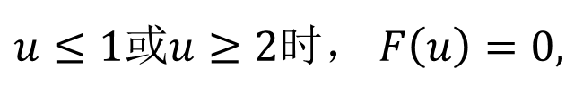
$$x+y=u$$
$$y$$
解：
记三角形区域为$G=\{(x,y)|0≤x,y≤1,x+y≥1\},\text{则}S_{G}=1/2,$
$$u$$
$$1$$
$$(1,1)$$
$\left(X,Y\right)$的联合密度函数为
$$x$$
$$0$$
$$1$$
设$U$的分布函数为$F\left(u\right),$密度函数为$f\left(u\right),$则
$$F\left(u\right)=P\left(U≤u\right)=P\left(X+Y≤u\right)=\iint_{x+y≤u}{f\left(x,y\right)dxdy}$$
$u≤1$或$u≥2$时， $F\left(u\right)=0,$
$$F\left(u\right)=2\left(\frac{1}{2}−\frac{1}{2}{\left(1−\left(u−1\right)\right) }^{2}\right)={−u}^{2}+4u−3$$
$1<u<2$时，
$$∴f\left(u\right)=F^{′}\left(u\right)=\left\{\begin{matrix}−2u+4,1<u<2 \\ 0, 其它\end{matrix}\right.$$

Slide 13
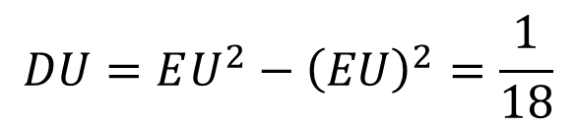
$$EU=\int_{−∞}^{+∞}{uf\left(u\right)du=\int_{1}^{2}{u\left(−2u+4\right)du}=\left(−\frac{2}{3}u^{3}+2u^{2}\right)|_{1}^{2}=\frac{4}{3}}$$
解：
$$EU^{2}=\int_{−∞}^{+∞}{u^{2}f\left(u\right)du=\int_{1}^{2}{u^{2}\left(−2u+4\right)du}=\left(−\frac{1}{2}u^{4}+\frac{4}{3}u^{3}\right)|_{1}^{2}=\frac{11}{6}}$$
$$DU=EU^{2}−{\left(EU\right)}^{2}=\frac{1}{18}$$

Slide 14
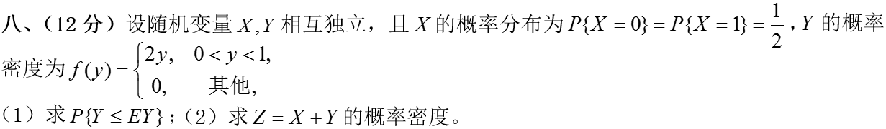









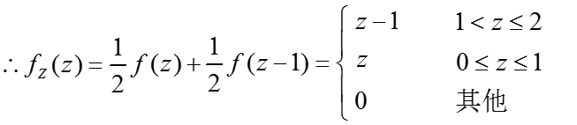
解：
$$=P\left(X=0\right)P\left(Y≤z−X | X=0\right)+P\left(X=1\right)P\left(Y≤z−X | X=1\right)$$

