Slide 1
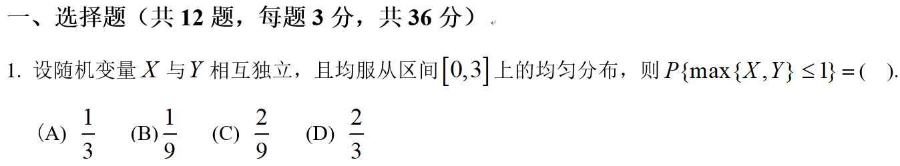
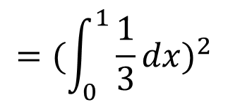


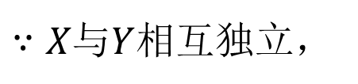
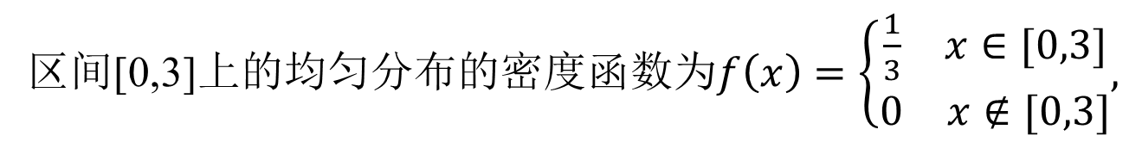
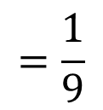

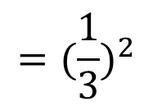
$$B$$
区间[0,3]上的均匀分布的密度函数为$f\left(x\right)=\left\{\begin{matrix}\begin{matrix}\frac{1}{3} & x∈[0,3]\end{matrix} \\ \begin{matrix}0 & x∉[0,3]\end{matrix}\end{matrix},\right.$
解：
$∵X与Y$相互独立，
$$∴P\left\{\max\left\{X,Y\right\}≤1\right\}=P(X≤1,Y≤1)$$
$$=P\left(X≤1\right)P(Y≤1)$$
$$={(\int_{0}^{1}{\frac{1}{3}}dx)}^{2}$$
$$={(\frac{1}{3})}^{2}$$
$$=\frac{1}{9}$$

Slide 2
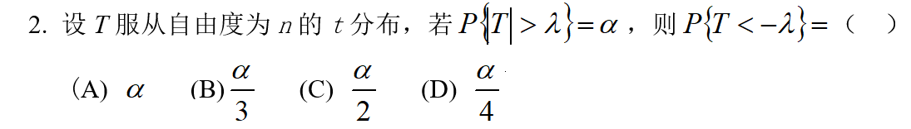

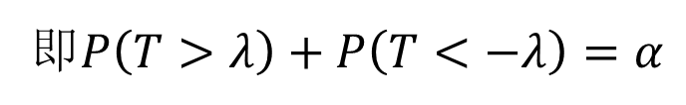
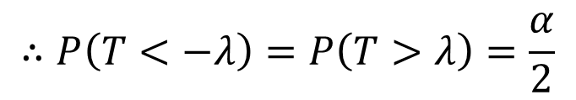
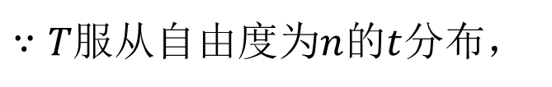
$$C$$
解：
$P\left(\left|T\right|>λ\right)=α⇒P\left((T>λ)∪(T<−λ)\right)=α$，
即$P\left(T>λ\right)+P\left(T<−λ\right)=α$
$$∴P\left(T<−λ\right)=P\left(T>λ\right)=\frac{α}{2}$$
$∵T$服从自由度为$n$的$t$分布，

Slide 3
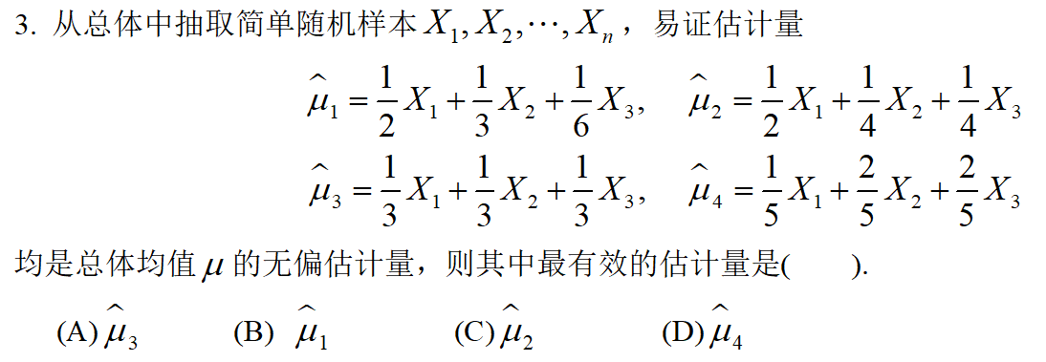
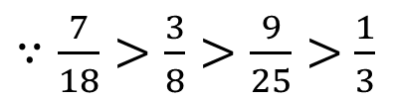
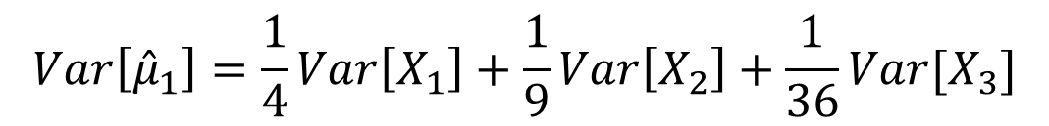
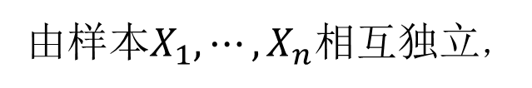
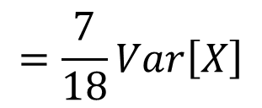

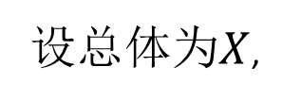
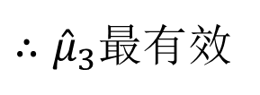
$$A$$
解：
设总体为$X$,
由样本$X_{1},⋯,X_{n}$相互独立，
$$Var\left[{\hat{μ}}_{1}\right]=\frac{1}{4}Var\left[X_{1}\right]+\frac{1}{9}Var\left[X_{2}\right]+\frac{1}{36}Var[X_{3}]$$
$$=\frac{7}{18}Var\left[X\right]$$
同理$Var\left[{\hat{μ}}_{2}\right]=\frac{3}{8}Var\left[X\right],Var\left[{\hat{μ}}_{3}\right]=\frac{1}{3}Var\left[X\right],Var\left[{\hat{μ}}_{4}\right]=\frac{9}{25}Var\left[X\right]$
$∵\frac{7}{18}>\frac{3}{8}>\frac{9}{25}>$ $\frac{1}{3}$
$∴{\hat{μ}}_{3}$最有效

Slide 4
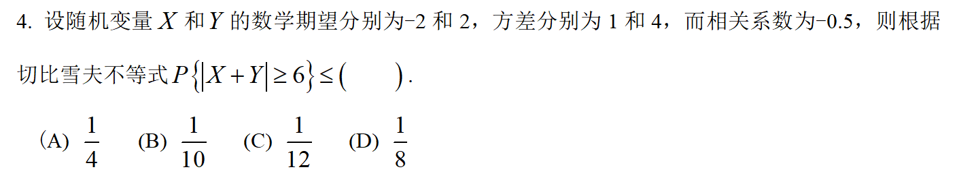
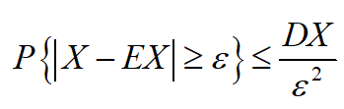
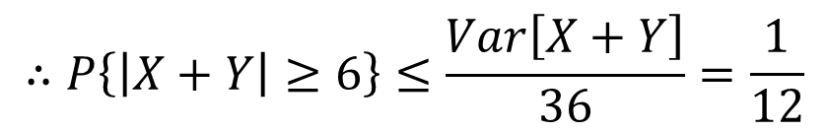



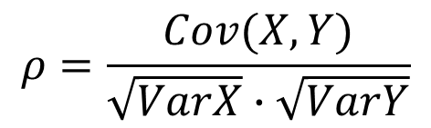
$$C$$
解：
$$E\left[X+Y\right]=EX+EY=0,$$
$$ρ=\frac{Cov(X,Y)}{\sqrt{VarX}∙\sqrt{VarY}}$$
$$⟹Cov\left(X,Y\right)=ρ∙\sqrt{VarX}∙\sqrt{VarY}=−1,$$
$$Var\left[X+Y\right]=VarX+VarY+2Cov(X,Y)$$
$$=1+4+2×\left(−1\right)=3$$
$$∴P\left\{\left|X+Y\right|≥6\right\}≤\frac{Var\left[X+Y\right]}{36}=\frac{1}{12}$$

Slide 5
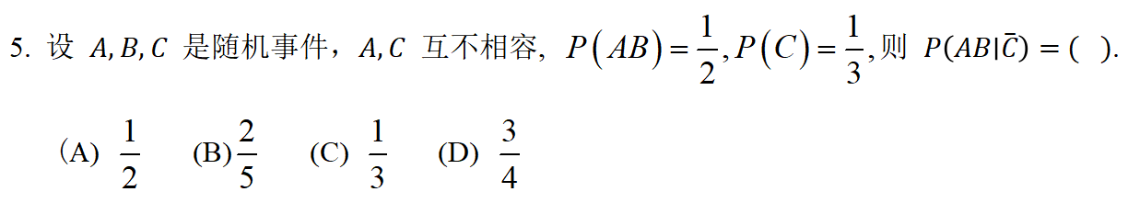
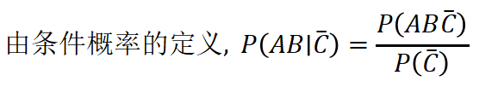



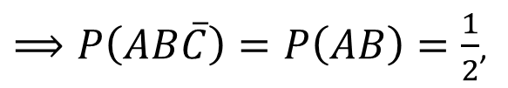

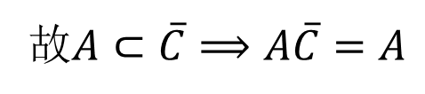

$$D$$
解：
故$A⊂\overline{C}⟹A\overline{C}=A$
$$⟹AB\overline{C}=\left(A\overline{C}\right)B=AB$$
$⟹P\left(AB\overline{C}\right)=P\left(AB\right)=\frac{1}{2}$,

Slide 6
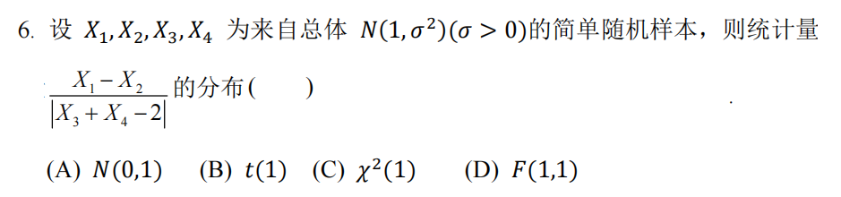
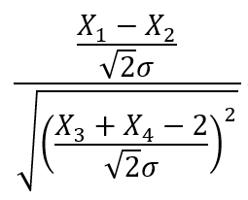


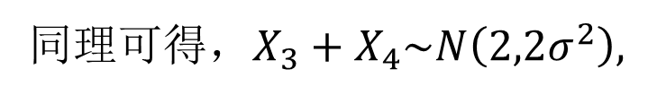

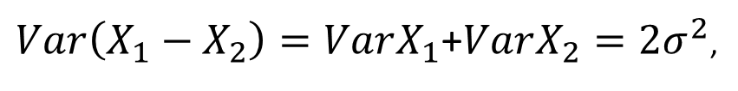
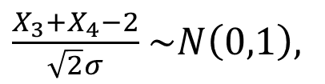

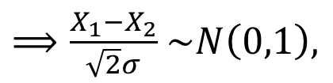


$$B$$
解：
从形式上可知，该统计量只能服从$t$分布，故选B。
$∵E\left(X_{1}−X_{2}\right)=EX_{1}−$ $EX_{2}=0$,
$Var\left(X_{1}−X_{2}\right)=VarX_{1}$+$VarX_{2}=2σ^{2}$,
$$∴X_{1}−X_{2}\sim N\left(0,2σ^{2}\right),$$
同理可得，$X_{3}+X_{4}\sim N\left(2,2σ^{2}\right),$
$⟹\frac{X_{1}−X_{2}}{\sqrt{2}σ}$ $\sim N\left(0,1\right),$
$\frac{X_{3}+X_{4}−2}{\sqrt{2}σ}$ $\sim N\left(0,1\right),$
且它们相互独立，
$$⟹$$

Slide 7
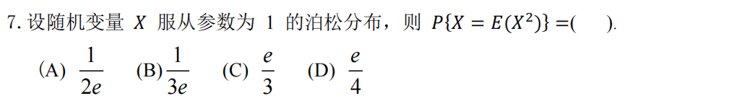
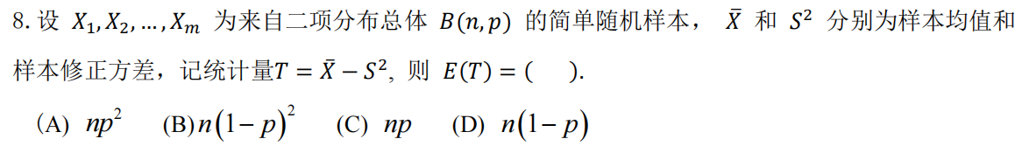

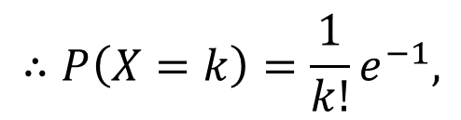
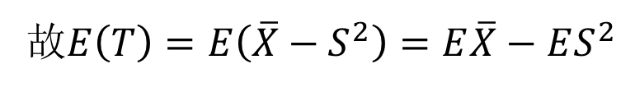

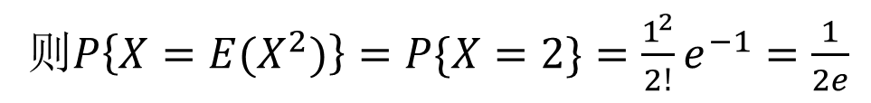

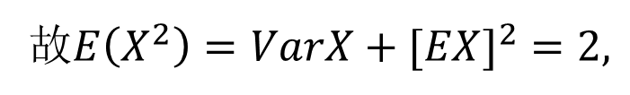


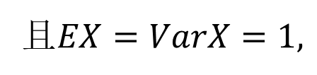


$$A$$
$$∴P\left(X=k\right)=\frac{1}{k!}e^{−1},$$
解：
$$∵X\sim P\left(1\right),$$
且$EX=VarX=1,$
故$E\left(X^{2}\right)=VarX+[EX]^{2}=2,$
则$P\left\{X=E(X^{2})\right\}=P\{X=2\}=\frac{1^{2}}{2!}e^{−1}=\frac{1}{2e}$
$$A$$
解：
$$∵X\sim B\left(n,p\right),$$
$$∴EX=np,VarX=np(1−p)$$
故$E\left(T\right)=E\left(\overline{X}−S^{2}\right)=E\overline{X}−ES^{2}$
$$=EX−VarX$$
$$=np−np\left(1−p\right)=np^{2}$$

Slide 8

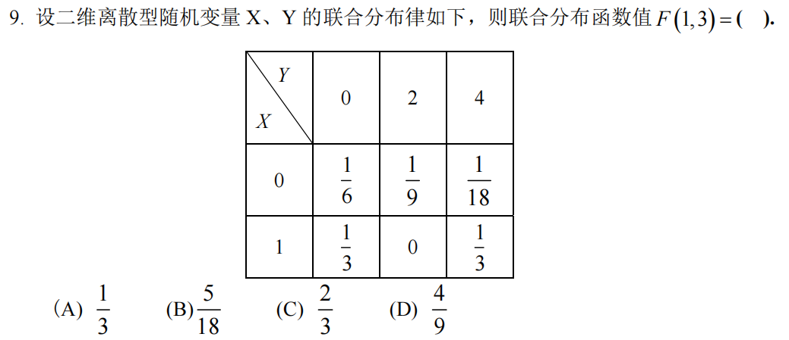


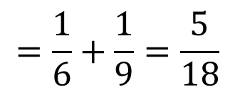
$$B$$
解：
$$F\left(0,3\right)=P\left(X≤0,Y≤3\right)=P((0,0)∪(0,2))$$
$$=\frac{1}{6}+\frac{1}{9}=\frac{5}{18}$$
$$=P\left(0,0\right)+P\left(0,2\right)$$

Slide 9
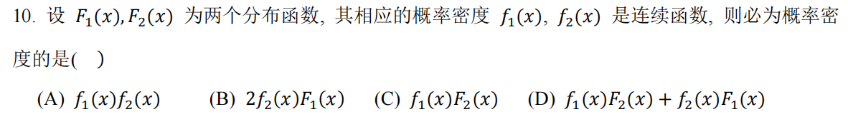
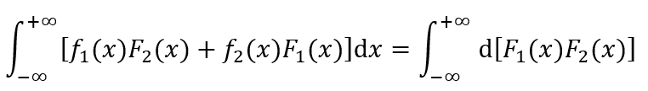
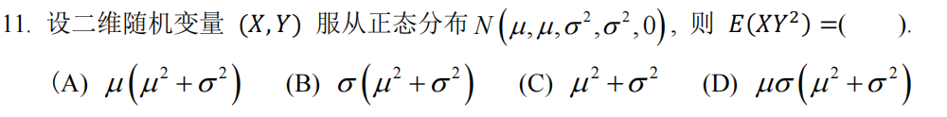



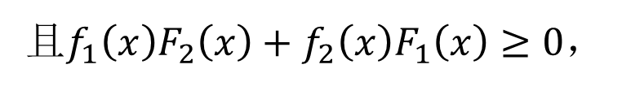
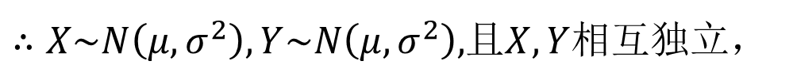
$$D$$
解：
由分布函数和密度函数的性质可知$F_{1}^{′}\left(x\right)=f_{1}\left(x\right),F_{2}^{′}\left(x\right)=f_{2}\left(x\right),$
且$f_{1}\left(x\right)F_{2}\left(x\right)+f_{2}\left(x\right)F_{1}\left(x\right)≥0，$
$$A$$
解：
$$∵(X,Y)\sim N(μ,μ,σ^{2},σ^{2},0),$$
$∴X\sim N\left(μ,σ^{2}\right),Y\sim N\left(μ,σ^{2}\right),$且$X,Y$相互独立，
故$E\left(XY^{2}\right)=EX∙EY^{2}=EX∙\left(VarY+{\left(EY\right)}^{2}\right)=μ(σ^{2}+μ^{2})$

Slide 10
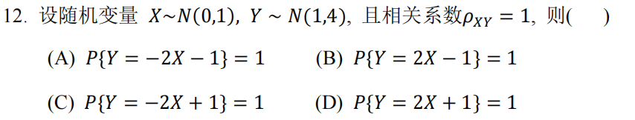

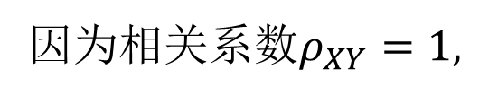
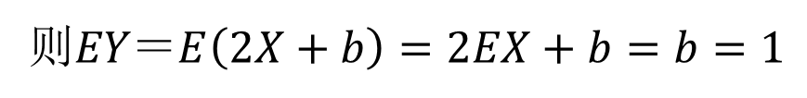

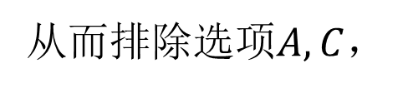

$$D$$
解：
因为相关$系数ρ_{XY}=1,$
故$X,Y$正相关，
从而排除选项$A,C$，
$$设Y＝2X+b,$$
则$EY＝E\left(2X+b\right)=2EX+b=b=1$

Slide 11
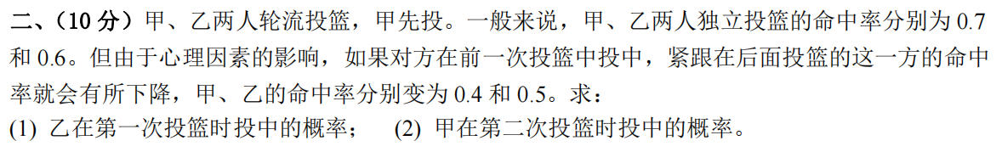



解：
记$A=\{$甲投中$\}$，$B＝\{$乙投中$\}$，
则$P\left(A\right)=0.7，P\left(B\right)=0.6，P\left(A | B\right)=0.4，P\left(B | A\right)=0.5$
记$B_{1}=\left\{\text{乙}第一次\text{投中}\right\}，A_{i}=\left\{\text{甲}第i次\text{投中}\right\}，i=1,2$
$\left(1\right) P\left(B_{1}\right)=P\left(A_{1}\right)P\left(B_{1} | A_{1}\right)+$ $P\left({\overline{A}}_{1}\right)P\left(B_{1} | {\overline{A}}_{1}\right)$
$=0.7∙0.5+$ $0.3∙0.6=0.53$
$\left(2\right) P\left(A_{2}\right)=P\left(B_{1}\right)P\left(A_{2} | B_{1}\right)+$ $P\left({\overline{B}}_{1}\right)P\left(A_{2} | {\overline{B}}_{1}\right)$
$=0.53∙0.4+$ $0.47∙0.7=0.541$

Slide 12







解：

Slide 13











$$\left[\overline{X}−t_{1−\frac{α}{2}}(n−1)\frac{S^{∗}}{\sqrt{n}},\overline{X}+t_{1−\frac{α}{2}}(n−1)\frac{S^{∗}}{\sqrt{n}}\right]$$
解：
$$\left(1\right)$$
$$的置信水平为$1−$的置信区间为
故所求区间为$[9.7869，10.2132]$
$$\left(2\right)$$
$$∵6.262<24<27.488,$$
$$∴接受H_{0}$$

Slide 14










$$1$$
$$2$$
$$x$$
解：
$$\left(1\right)$$

Slide 15





$$1$$
$$2$$
$$x$$
解：
$$\left(2\right)$$

Slide 16




解：
$⟹{\hat{θ}}_{M}=\frac{1}{4}(3−\overline{X})$,
代入上式得${\hat{θ}}_{M}=\frac{1}{4}$

Slide 17



解：

Slide 18






解：
$$\left(1\right)$$
$∵P\left\{X^{2}=Y^{2}\right\}=1$,
$$∴\left(X,Y\right)=\left(0,0\right),\left(1,±1\right),且P\left\{X^{2}≠Y^{2}\right\}=0$$
$$⟹P\left(X=0,Y=1\right)=P\left(X=0,Y=−1\right)=P\left(X=1,Y=0\right)=0$$
$$=P\left(X=0,Y=0\right)=\frac{1}{3}$$
$$P\left(Y=0\right)=P\left(X=0,Y=0\right)+P\left(X=1,Y=0\right)$$
$$=P\left(X=1,Y=1\right)=\frac{1}{3}$$
$$P\left(Y=1\right)=P\left(X=0,Y=1\right)+P\left(X=1,Y=1\right)$$
$$=P\left(X=1,Y=−1\right)=\frac{1}{3}$$
$$P\left(Y=−1\right)=P\left(X=0,Y=−1\right)+P\left(X=1,Y=−1\right)$$

Slide 19


解：
$$\left(1\right)续：$$

Slide 20






$$E(XY)=0∙\frac{1}{3}+1∙\left(−1\right)∙\frac{1}{3}+1∙1∙\frac{1}{3}=0$$
解：
$$\left(2\right)$$
$$\left(3\right)$$
从而可知$ρ_{XY}=0。$

