Slide 1
Chapter 5
Computing Components

Slide 2
Chapter Goals
  Read an ad for a computer and understand the jargon
  List the components and their function
  in a von Neumann machine
  Describe the fetch-decode-execute cycle of the von Neumann machine
  Describe how computer memory is organized and accessed

Slide 3
Chapter Goals
Name and describe different auxiliary storage devices
Define three alternative parallel computer configurations
Explain the concept of embedded systems and give examples from your own home

Slide 4
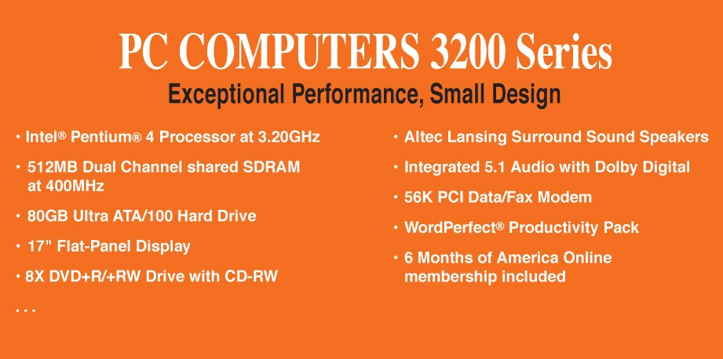
Computer Components
Consider the following ad:
Insatavialion 640 Laptop
Exceptional Performance and Portability
• 85 WHr Lithium Ion Battery
• (2) USB 2.0, HDMI, 15-pin VGA, Ethernet
10/100/1000, IEEE 1394 Firewire, Express
Card, Audio line-in, line-out, mic-in
• 14.8W X 1.2H X 10.1D, 5.6 lbs
• Microsoft0® Windows 7® Professional
• Microsoft® Office Home and Student
2007
• 36-Month subscription to McAfee
Security Center Anti-virus
• Intel® Core™ 2 Duo (2.66GHz/1066Mhz
FSB/6MB cache)
• 15.6” High Definition (1080p) LED
Backlit LCD Display (1366 x 768)
• 512MB ATI Mobility Radeon Graphics
• Built-in 2.0MP Web Camera
• 4GB Shared Dual Channel DDR2 at
800MHz
• 500GB SATA Hard Drive at 5400RPM
• 8X Slot Load DL DVD+/- RW Drive
• 802.11 a/g/n and Bluetooth 3.0

Slide 5
Computer Components
What does all this jargon mean?
Intel® Core™ 2 Duo (2.66GHz/1066Mhz
FSB/6MB cache)
4GB Shared Dual Channel DDR2 at 800 MHz
500 GB SATA Hard Drive at 5400RPM
15.6” High Definition (1080p) LED Backlit
LCD Display (1366 x 768)
8X Slot Load DL DVD+/- RW Drive
14.8”W X 1.2”H X10.1” D, 5.6 lbs.
Be patient!
If you don't
know now, you
should know
shortly

Slide 6
Computer Components (continued)
512 MB ATI Mobility Radeon Graphics
85 WHr Lithium Ion Battery
(2) USB 2.0, HDMI, 15-Pin VGA, Ethernet 10/100/1000 IEEE 1394 Firewire, Express Card, Audio line-in, line-out, mic-in
Microsoft® Windows 7® Professional
Microsoft® Office Home and Student 2007
36-Month subscription to McAfee Security Center Anti-virus

Slide 7
Sizes in Perspective
Admiral Grace Murray Hopper
  A coil of wire nearly 1,000 feet long
    Distance traveled by an electron along the wire
    in the space of a microsecond
  A short piece of wire
    In the space of a nanosecond
  A bag containing grains of pepper
    In the space of a picosecond

Slide 8
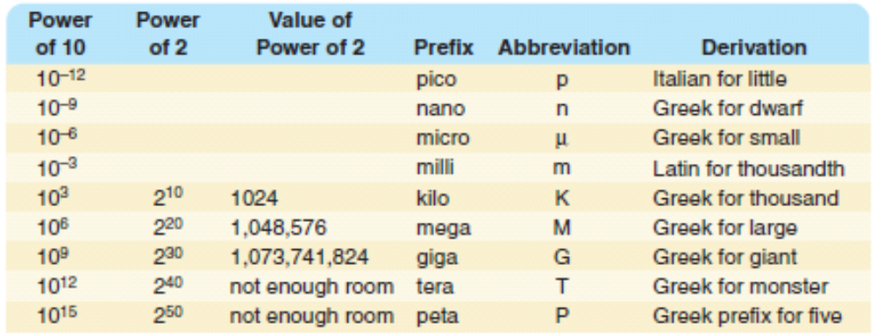
Sizes in Perspective
What is a hertz?

Slide 9
Sizes in Perspective
Intel Processor
speed 2.66 GHz
SDRAM
size 4GB
speed 800 MHz
500GB SATA at 5400 RPM
Transfer rate 300MB per second
Flat screen dot pitch .28mm
To which do these
apply?
Bigger is better
Faster is better
Smaller is better

Slide 10
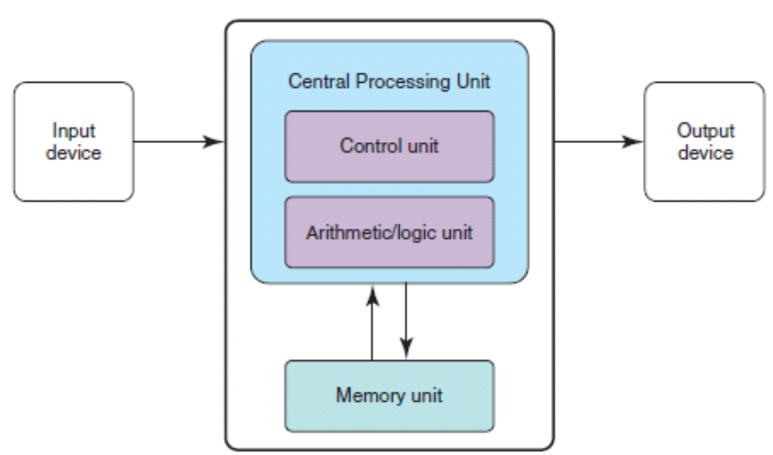
Stored-Program Concept
Figure 5.1 The von Neumann architecture

Slide 11
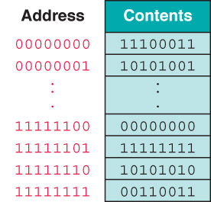

Memory
Memory
A collection of cells,
each with a unique
physical address; both
addresses and
contents are in
binary

Slide 12
Arithmetic/Logic Unit
Performs basic arithmetic operations such as adding
Performs logical operations such as AND, OR, and NOT
Most modern ALUs have a small amount of special storage units called registers

Slide 13
Input/Output Units
Input Unit
A device through which data and programs from
the outside world are entered into the computer;
Can you name three?
Output unit
A device through which results stored in the
computer memory are made available to the
outside world
Can you name two?

Slide 14
Control Unit
Control unit
The organizing force in the computer
Instruction register (IR)
Contains the instruction that is being executed
Program counter (PC)
Contains the address of the next instruction to be
executed
Central Processing Unit (CPU)
ALU and the control unit called the Central Processing Unit, or CPU

Slide 15
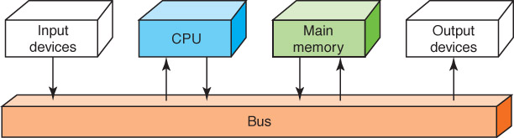
Flow of Information
Bus
A set of wires that connect all major sections
Figure 5.2 Data flow through a von Neumann architecture

Slide 16
The Fetch-Execute Cycle
Fetch the next instruction
Decode the instruction
Get data if needed
Execute the instruction
Why is it called a cycle?

Slide 17
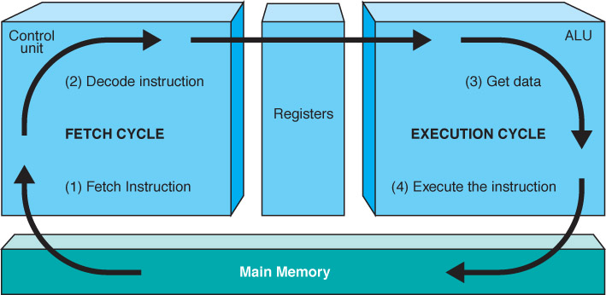
The Fetch-Execute Cycle
Figure 5.3 The Fetch-Execute Cycle

Slide 18
RAM and ROM
Random Access Memory (RAM)
Memory in which each location can be accessed and changed
Read Only Memory (ROM)
Memory in which each location can be accessed but not changed
RAM is volatile, ROM is not
What does volatile mean?

Slide 19
Secondary Storage Devices
Why is it necessary to have secondary storage devices?
Can you name some of these devices?

Slide 20
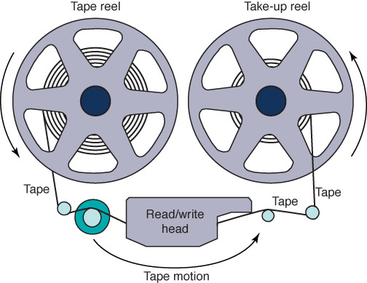
Magnetic Tape
The first truly mass auxiliary storage device was the magnetic tape drive
Tape drives have a
major problem; can
you describe it?
Figure 5.4 A magnetic tape

Slide 21
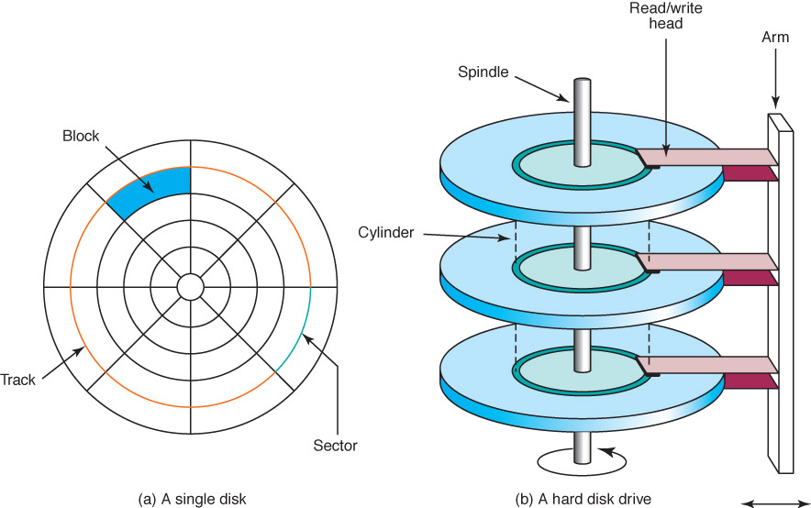
Magnetic Disks
Figure 5.5 The organization of a magnetic disk

Slide 22
Magnetic Disks
History
Floppy disks (Why "floppy"?)
1970. 8" in diameter "
late 1970, 5 1/2"
now, 3 1/2"
Zip drives
Tracks near center are more densely packed Why?

Slide 23
Magnetic Disks
Seek time
Time it takes for read/write head to be over right track
Latency
Time it takes for sector to be in position
Access time
Can you define it?

Slide 24

10.18

Slide 25
Compact Disks
CD
A compact disk that uses a laser to read information stored optically on a plastic disk; data is evenly distributed around track
CD-ROM read-only memory
CD-DA digital audio
CD-WORM write once, read many
RW or RAM both read from and written to
DVD
Digital Versatile Disk, used for storing audio and video

Slide 26
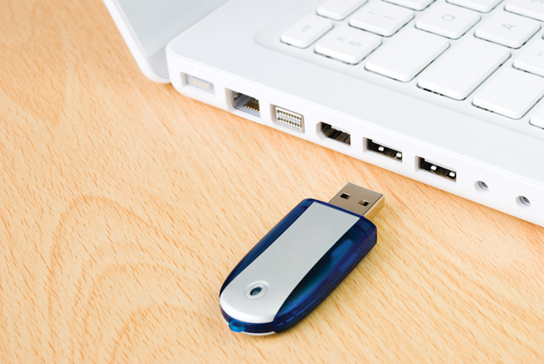
Flash Drives
Flash Memory
Nonvolatile
Can be erased and rewritten

Slide 27
Touch Screens
Touch screen
A computer monitor that can respond to the user, touching the screen with a stylus or finger
There are three types
  Resistive
  Capacitive
  Infrared
  Surface acoustic wave (SAW)

Slide 28
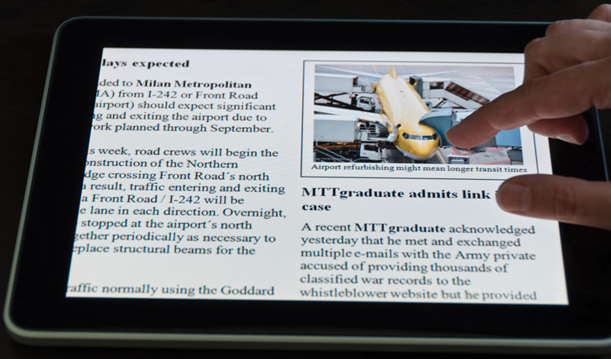
Touch Screens
Figure 5.7
A touch screen

Slide 29
Touch Screens
Resistive touch screen
A screen made up of two layers of electrically conductive material
  One layer has vertical lines, the other has horizontal lines
  When the top layer is pressed, it comes in contact with the second layer which allows electrical current to flow
  The specific vertical and horizontal lines that make contact dictate the location on the screen that was touched

Slide 30
Touch Screens
Capacitive touch screen
A screen made up of a laminate applied over a glass screen
  Laminate conducts electricity in all directions; a very small current is applied equally on the four corners
  When the screen is touched, current flows to the finger or stylus
  The location of the touch on the screen is determined by comparing how strong the flow of electricity is from each corner

Slide 31
Touch Screens
Infrared touch screen
A screen with crisscrossing horizontal and vertical beams of infrared light
  Sensors on opposite sides of the screen detect the beams
  When the user breaks the beams by touching the screen, the location of the break can be determined

Slide 32
Touch Screens
Surface acoustic wave (SAW)
A screen with crisscrossing high frequency sound waves across the horizontal and vertical axes
  When a finger touches the surface, corresponding sensors detect the interruption and determine location of the touch

Slide 33
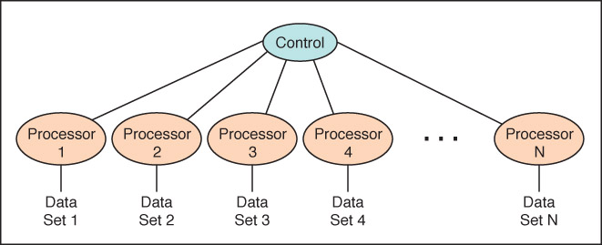
Synchronous processing
One approach to parallelism is to have multiple processors apply the same program to multiple data sets
Figure 5.8 Processors in a synchronous computing environment

Slide 34
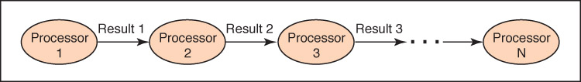
Pipelining
Arranges processors in tandem, where each processor contributes one part to an overall computation
Figure 5.9 Processors in a pipeline

Slide 35
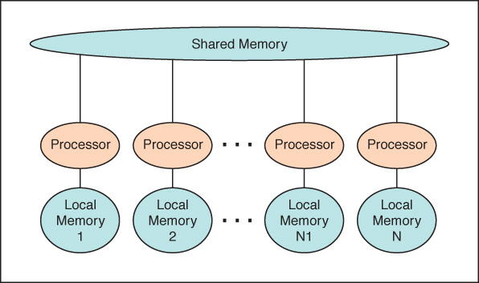
Shared Memory
Parallel Processor
Communicate through shared memory
Figure 5.10 Shared memory configuration of processors

Slide 36
Embedded Systems
Embedded systems
Computers that are dedicated to perform
a narrow range of functions as part of a
larger system
Empty your pockets or backpacks.
How many embedded systems do you have?

Slide 37
思政：中国超级计算机
国防科技大学计算机研究所——银河系列
中科院计算技术研究所—曙光系列
国家并行计算机工程技术中心——神威系列

Slide 38

作业
1:P146 30 32 37 38 39 P147 62
2:思政小论文：通过 Internet进行信息检索，
写一篇综述介绍我国高性能计算机体系架构的发展。

