Slide 1
Chapter 6
Low-Level Programming Languages and Pseudocode

Slide 2
Chapter Goals
List the operations that a computer can perform
Distinguish between machine language and assembly language
Describe the pseudocode constructs used in expressing an algorithm

Slide 3
Chapter Goals
Use pseudocode to express an algorithm
Describe two approaches to testing
Design and implement a test plan for a simple assembly-language program

Slide 4
Computer Operations
Computer
A programmable electronic device that can store, retrieve, and process data
Data and instructions to manipulate the data are logically the same and can be stored in the same place
What operations can a computer execute?

Slide 5
Machine Language
Machine language
The language made up of binary coded instructions built into the hardware of a particular computer and used directly by the computer
Why would anyone choose to use machine language?
(Hint: they had no choice. Why?)
Why would anyone choose to use machine language?
(Hint: they had no choice. Why?)

Slide 6
Machine Language
Characteristics of machine language:
  Every processor type has its own set
  of specific machine instructions
  The relationship between the processor and the instructions it can carry out is completely integrated
  Each machine-language instruction does only one very low-level task

Slide 7
Assembly Language
Assembly language
A language that uses mnemonic codes to represent machine-language instructions
Assembler
A program that reads each of the instructions in mnemonic form and translates it into the machine-language equivalent

Slide 8
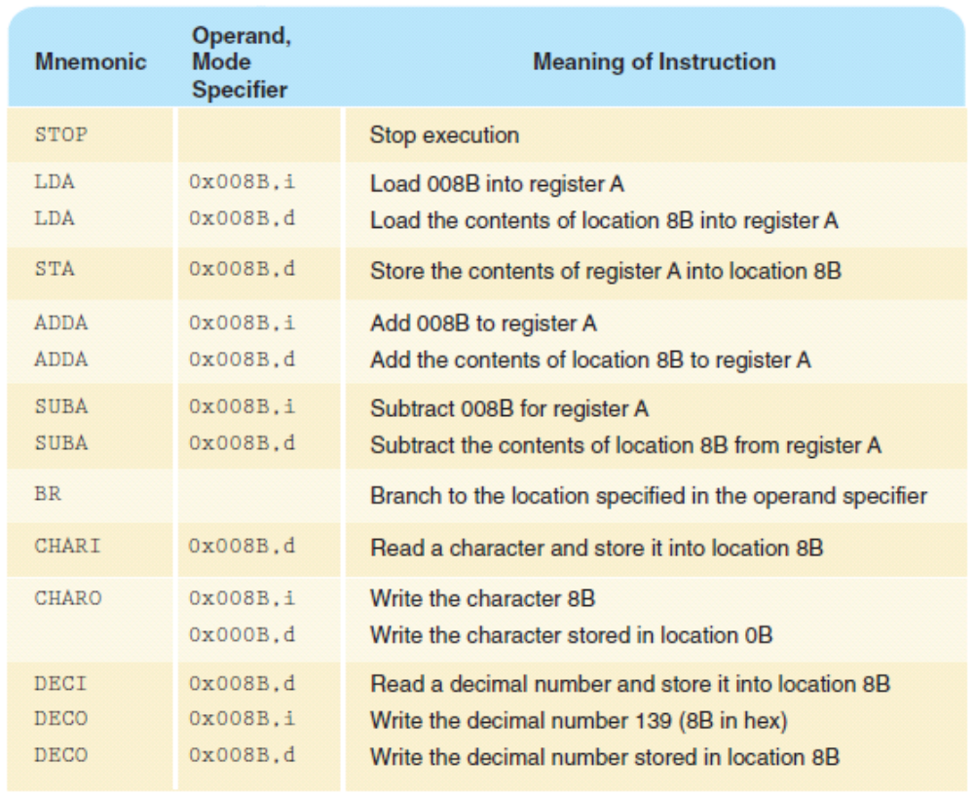
Pep/8 Assembly Language
Remember
the
difference
between
immediate
and
direct
addressing?
i : immediate
d: direct

Slide 9
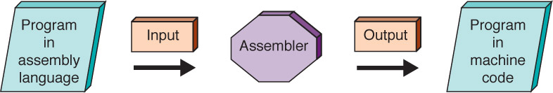
Assembly Process

Slide 10
Pseudocode
Pseudocode
A mixture of English and formatting to make the steps in an algorithm explicit
Algorithm to Convert base-10 number to other bases
While (the quotient is not zero)
Divide the decimal number by the new base
Make the remainder the next digit to the left in the answer
Replace the original decimal number with the quotient

Slide 11
Developing an Algorithm
Two methodologies used to develop computer solutions to a problem
  Top-down design focuses on the tasks to be done
  Object-oriented design focuses on the data involved in the solution
But first, let's look at a way to express algorithms: pseudocode

Slide 12
Pseudocode
Pseudocode
A way of expressing algorithms that uses a mixture of English phrases and indention to make the steps in the solution explicit
There are no grammar rules in pseudocode
Pseudocode is not case sensitive

Slide 13
Following Pseudocode
While (the quotient is not zero)
Divide the decimal number by the new base
Make the remainder the next digit to the left in the answer
Replace the original decimal number with
What is 93 in base 8?
93/8 gives 11 remainder 5
11/8 gives 1 remainder 3
1/ 8 gives 0 remainder 1
answer 1 3 5

Slide 14
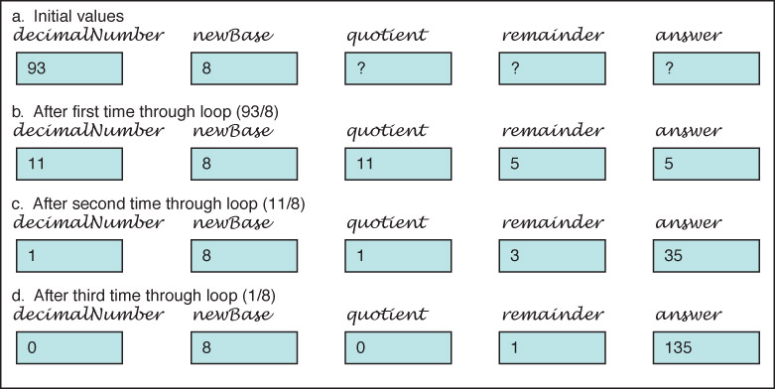
Following Pseudocode
Easier way to organize solution

Slide 15
Pseudocode for Complete Computer Solution
Write "Enter the new base"
Read newBase
Write "Enter the number to be converted"
Read decimalNumber
Set quotient to 1
WHILE (quotient is not zero)
Set quotient to decimalNumber DIV newBase
Set remainder to decimalNumber REM newBase
Make the remainder the next digit to the left in the answer
Set decimalNumber to quotient
Write "The answer is "
Write answer

Slide 16

10.25

Slide 17
Pseudocode Functionality
Variables
Names of places to store values
quotient, decimalNumber, newBase
Assignment
Storing the value of an expression into a
variable
Set quotient to 64
quotient <-- 64
quotient <-- 6 * 10 + 4

Slide 18
Pseudocode Functionality
Output
Printing a value on an output device
Write, Print
Input
Getting values from the outside word and storing them into variables
Get, Read

Slide 19
Pseudocode Functionality
Repetition
Repeating a series of statements
Set count to 1
WHILE ( count < 10)
Write "Enter an integer number"
Read aNumber
Write "You entered " + aNumber
Set count to count + 1
How many values were read?

Slide 20
Pseudocode Functionality
Selection
Making a choice to execute or skip a statement (or group of statements)
Read number
IF (number < 0)
Write number + " is less than zero."
or
Write "Enter a positive number."
Read number
IF(number < 0)
Write number + " is less than zero."
Write "You didn't follow instructions."

Slide 21
Pseudocode Functionality
Selection
Choose to execute one statement (or group of statements) or another statement (or group of statements)
IF ( age < 12 )
Write "Pay children's rate"
Write "You get a free box of popcorn"
ELSE IF ( age < 65 )
Write "Pay regular rate"
ELSE
Write "Pay senior citizens rate"

Slide 22
Pseudocode Example
Problem: Read in pairs of positive numbers and print each pair in order.
WHILE (not done)
Write "Enter two values separated by blanks"
Read number1
Read number2
Print them in order

Slide 23
Pseudocode Example
How do we know when to stop?
Let the user tell us how many
Print them in order?
If first number is smaller
print first, then second
If first number if larger
print second, then first

Slide 24
Pseudocode Example
Write "How many pairs of values are to be entered?"
Read numberOfPairs
Set numberRead to 0
WHILE (numberRead < numberOfPairs)
Write "Enter two values separated by a blank; press return"
Read number1
Read number2
IF(number1 < number2)
Print number1 + " " + number2
ELSE
Print number2 + " " number1
Increment numberRead

Slide 25
Walk Through
Data Fill in values during each iteration
3 numberRead number1 number2
55 70
2 1
33 33
numberOfPairs
What is the output?

Slide 26
Translating Pseudocode
To What?
Assembly language
Very detailed and time consuming
High-level language
Easy as you'll see in Chapter 9

Slide 27
Testing
Test plan
A document that specifies how many times and with what data the program must be run in order to thoroughly test it
Code coverage (clear-box testing)
An approach that designs test cases by looking at
the code
Data coverage (black-box testing)
An approach that designs test cases by looking at the allowable data values

Slide 28
Testing
Test plan implementation
Using the test cases outlined in the test plan to verify that the program outputs the predicted results

Slide 29
Important Threads
Operations of a Computer
Computer can store, retrieve, and process data
Computer’s Machine Language
A set of instructions the machine’s hardware is built to recognize and execute
Machine-language Programs
Written by entering a series of these instructions in binary form

Slide 30
Important Threads
Pseudocode
Shorthand-type language people use to express algorithms
Testing Programs
All programs must be tested; code coverage testing and data coverage (black-box testing) are two common approaches

Slide 31

作业
1:P192 55

