Slide 1
Logical Design
Feistritzer Weinberger

Slide 2
Exercise 1
Integrate these views:
identify conflicts (and their conflict types)
propose scenarios and interschema properties
integrate the schemas into one schema.

Slide 3
Exercise 1 - Conflicts
Naming conflicts
homonyms: one word, different meaning
synonyms: different words, same meaning
Similarity: different names, same neighbours/constraints
Mismatch: same name, different neighbours /constraints
Structural conflicts
Identical concepts: same structure and neighbours
Compatible concepts: different structure /neighbours, but no contradiction
Incompatible concepts: structural contradiction

Slide 4
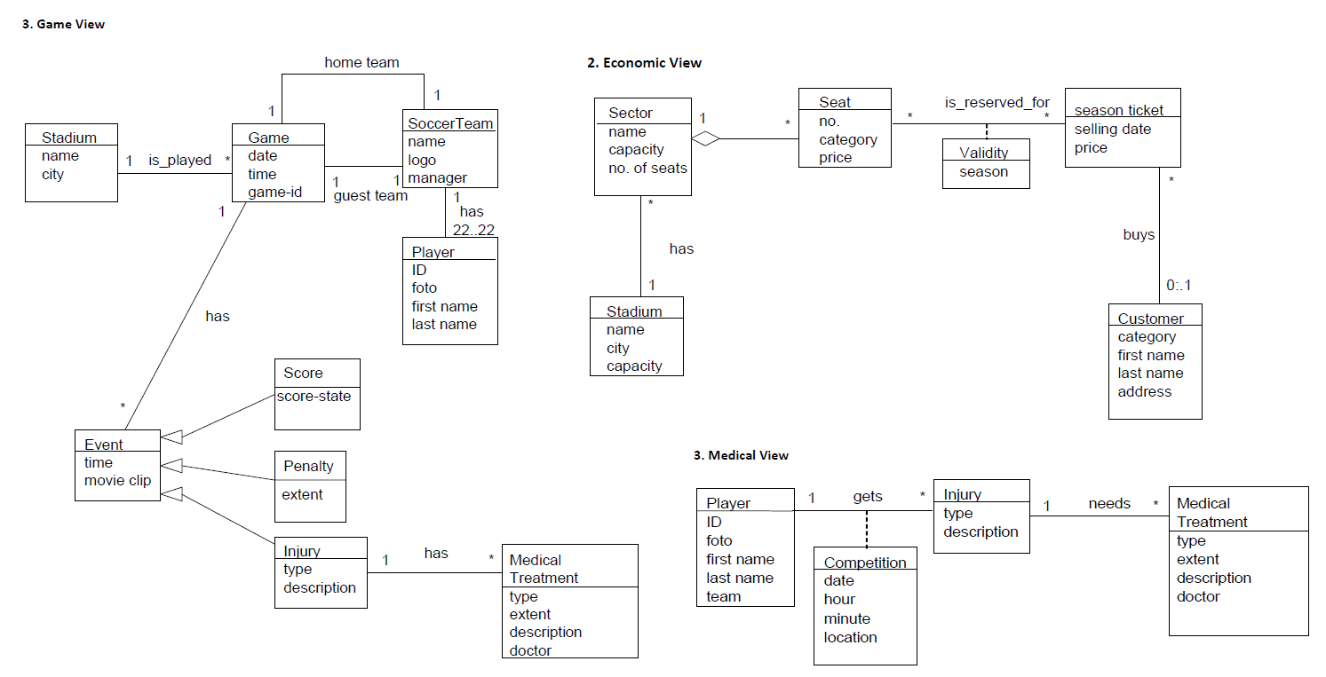
Exercise 1 – Identify Conflicts 1

Slide 5
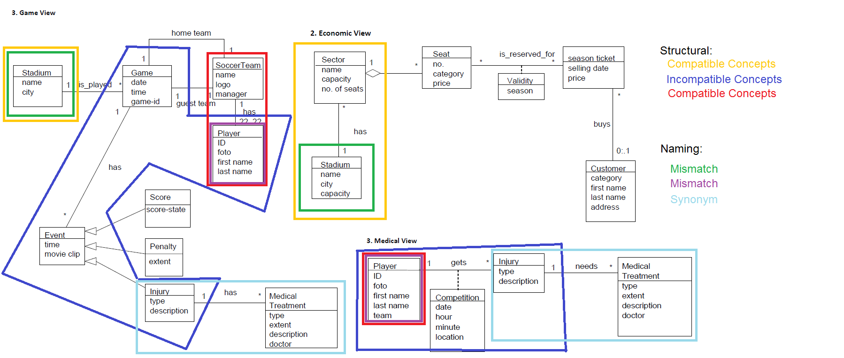
Exercise 1 – Identify Conflicts 2

Slide 6
Example 1 – Identify Conflicts 3
Stadium – Stadium: (Mismatch, Compatible Concepts)
Injury & MT – Injury & MT: (Synonym, Identical Concepts)
Game, Event, Injury, Player – Injury, Player, Competition: (Incompatible Concepts)
Player, Soccer Team – Player: (Mismatch, Compatible Concepts)

Slide 7
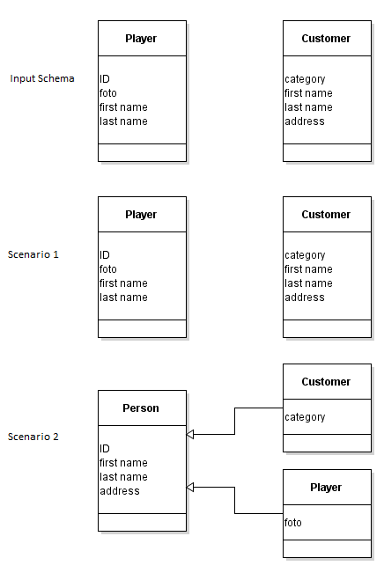
scenarios and interschema properties (1/2)

Slide 8
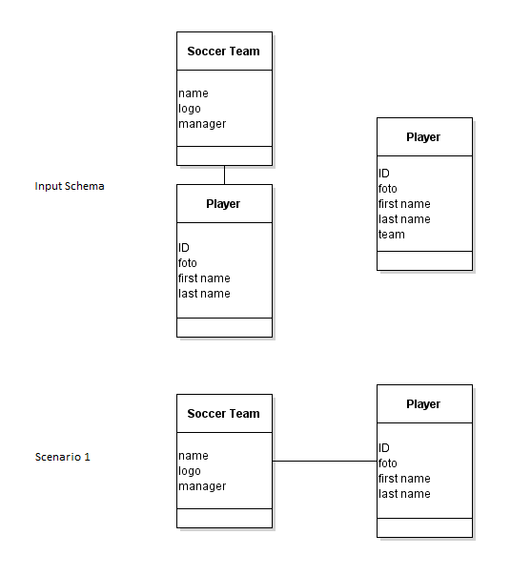
scenarios and interschema properties (2/2)

Slide 9
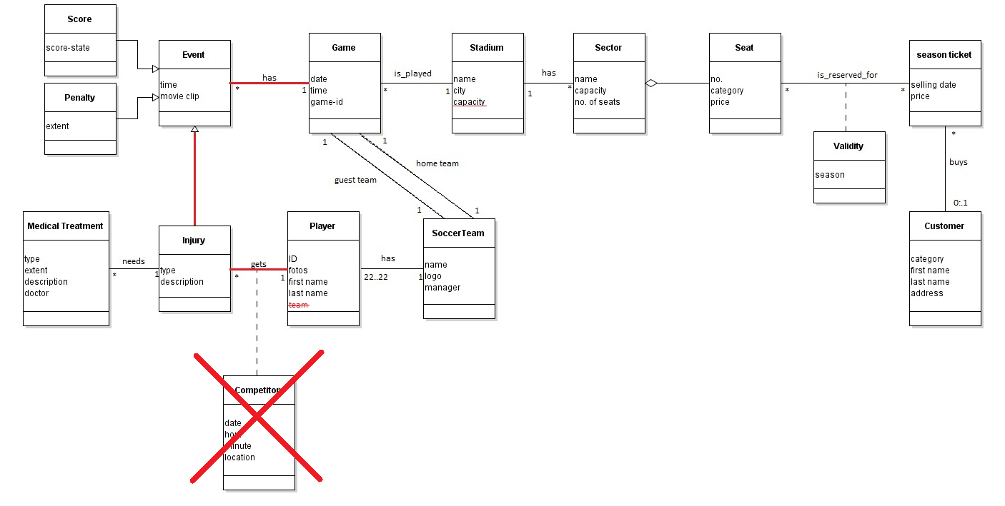
integrate the schemas

Slide 10

Exercise 2 – Determination of Quantities
N(C) = average number of instances per class
N(A) = average number of association instances per association
N(C,A) = average number of class instances per association
N(C1) x N(C1,A) = N(A) = N(C2) x N(C2,A)

Slide 11
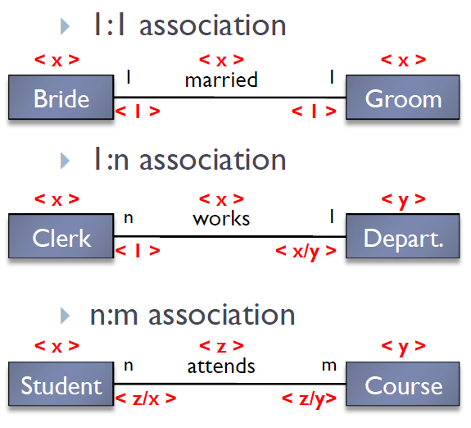
Exercise 2 – Calculation rules

Slide 12
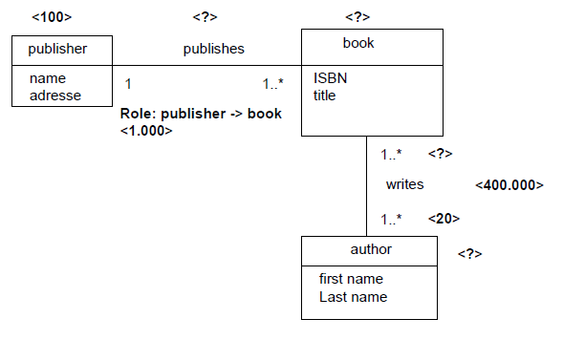
Exercise 2 – Determination of Quantities
<100.000>
<100.000>
<4>
<20.000>
N(publisher) x N (publisher, publishes ) = N (publishes) = N(book)
N(book) = N(publishes) = 100 x 1.000 = 100.000
N(author) = N(writes) / N(writes, author)
N(author) = 400.000 / 20 = 20.000
N(book, writes) = N (writes) / N(books)
N(book, writes) = 400.000 / 100.000 = 4

Slide 13
Exercise 2 - Navigation
To get the result of a query or to execute an operation, multiple entity types and relations might have to be accessed.
Navigation path shows, which entity types and relations are accessed and in which order.
Necessary for evaluating costs of database operations

Slide 14
Exercise 3 – Redundancy
Redundancy occurs, if the same information or derivable information is stored multiple times.
Pros:
Speeds up data access (navigation path is shortened for some operations)
Cons:
Additional updates
Risk of inconsistency ( => more consistency checks needed)
Additional storage space

Slide 15
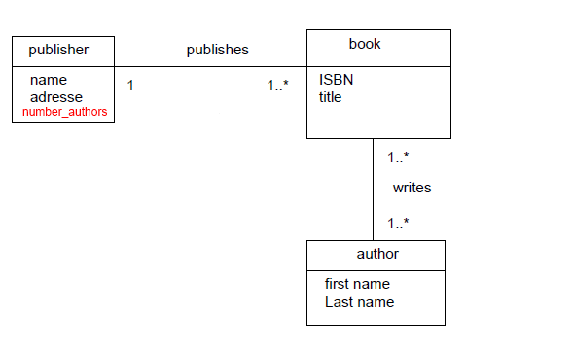
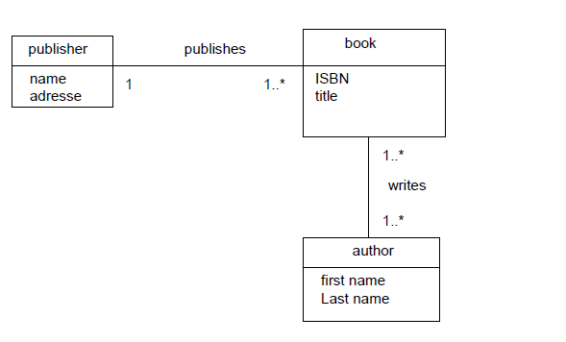
Redundant Attribute
READ: Saves access to book and writes
WRITE: Every insert and delete and some updates in book and writes forces update of number_authors in publisher

Slide 16
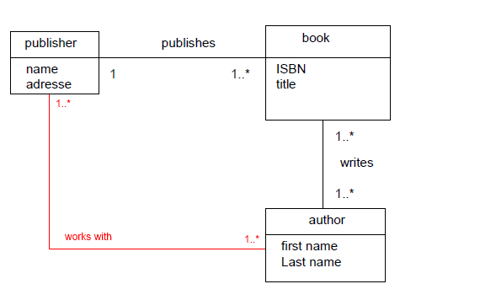
Redundant Association
READ: book class is not needed in navigation path (w.r.t publisher -> author)
WRITE: Insert/Update/Delete operations on book and writes might trigger Insert and Delete operations on works_with

Slide 17
Redundancy – How to Decide
Look at the operations influenced by the redundancy
Calculate number of accesses for these operations
with redundancy
without redundancy
If #Accesses with redundancy < #Accesses without redundancy => Keep redundancy
Else: Remove redundancy

Slide 18
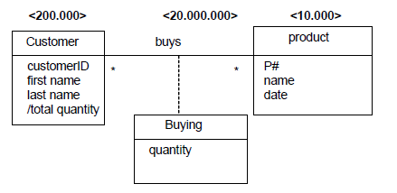
Exercise 3b
Check, if we should keep the redundant attribute total_quantity

Slide 19
Exercise 3b - Operations
Operation | Description | Frequency
T1 | Insert a new customer | 50 times / month
T2 | Insert a new product | 5 times /month
T3 | Insert of a „Buying“ | 50 times / day ( = 1000 times / month) *
T4 | Listing of total quantitiy for each customer | 2 times /month
*) Note: A month has 20 working days.
Next: calculate accesses per operation with and without redundancy, where …
… read accesses have weight 1
… write accesses have weight 2
… update accesses have weight 3

Slide 20
Exercise 3b – Data Access Table
Operation | Accesses with redundancy | Accesses without
T1 | 100 customer (write 50 * 2) = 100 accesses | 100 customer (write 50 * 2) = 100 accesses
T2 | 10 product (write 5 * 2) = 10 accesses | 10 product (write 5 * 2) = 10 accesses
T3 | 2.000 buys (write 1.000 * 2) + 3.000 customer (update 1.000 * 3) = 5.000 accesses | 2.000 buys (write 1.000 * 2) = 2.000 accesses
T4 | 400.000 customer (200.000 read twice) = 400.000 accesses | 400.000 customer (read 200.000 twice) + 40.000.000 buys (read 20.000.000 twice) = 40.400.000 accesses
Sum | = 405.110 accesses per month | = 40.402.110 accesses per month

Slide 21
Exercise 3b – Conclusion
Accesses per month without redundancy:
40.402.110
Accesses per month with redundancy:
405.110
Therefore: Keep redundancy!

Slide 22
Exercise 4
Explain the notions total, partial, exclusive, and overlapping in the context of generalization.
What kind of flattening strategies exist for generalization hierarchies? Explain them with an example of your own.
How can you determine, which flattening strategy should be used? What data do you need for the decision?

Slide 23
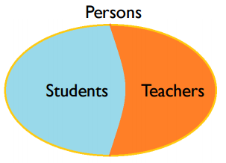
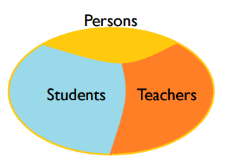
total vs partial
total
every instance of a super-class is also an instance of a (direct) sub-class children
partial
otherwise

Slide 24
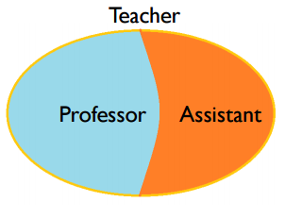
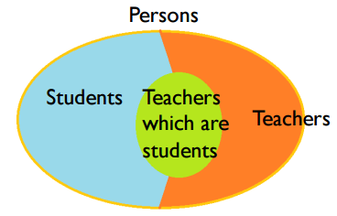
exclusive vs overlapping
exclusive
no instance of the super-class belongs to more than one sub-class
overlapping
otherwise

Slide 25
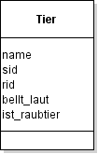
Flattening(1/3)
Ceiling
nur Superclasse
hat alle Attrubute von Subclassen
overlapping oder partiale Generalisierung
Notes:
+ eine klasse beinhaltet alle attribute
viele attrrubute bleiben leer
Beziehungen gehen verloren

Slide 26
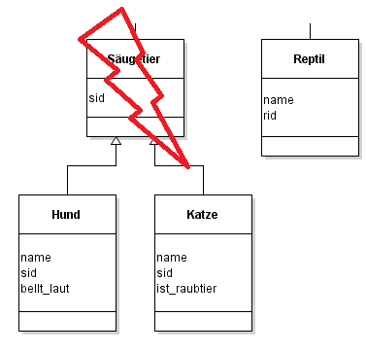
Flattening(2/3)
Floor
nur Klassen die Blätter im generalization hirarchy tree sind
totaler oder exklusiver Generaliseirung
Notes:
+ es gibt eine klasse pro typ
- mman benötigt union operation damit man alle instanzein einer superklasse erhält

Slide 27
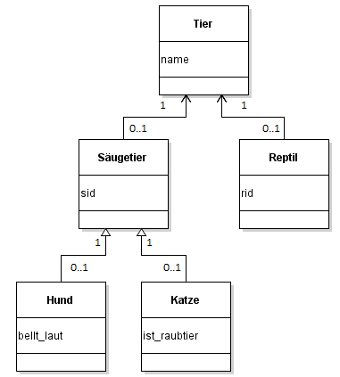
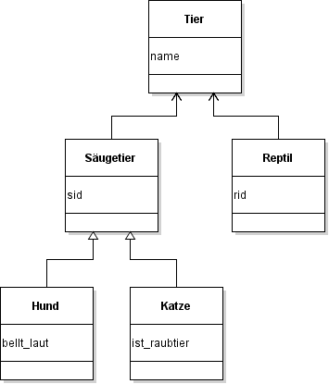
Flattening(3/3)
Cohesion
each generalization is represented as 1:1 relation
Notes:
+ alle klassen bleiben bestehen mit assoziationen
benötigt join operation um alle instanzen einer superklasse zu bekommen
semantik der generalisierung geht verloren

Slide 28
Which Flattening Strategy?
Two operation sets
S1 set of operations, which access attributes of the super-class
S2 set of operations, which access attributes of super-class and one sub-class
Calculate access counts for S1 and S2
Decide
if S2 dominates → floor
else analyse data manipulation operations
if domination of operations that ..
..access attributes of both super- and sub-class → ceiling
..access attributes of either super- or sub-class → cohesion

Slide 29
Exercise 5
What is vertical partitioning, what is horizontal partitioning? Explain it with an example of your own.
Why might partitioning be necessary?
What do you have to consider before partitioning – how do you decide?

Slide 30
Vertical partitioning(1/2)
split class vertically
new classes have different set of attributes
needs join operation to retrieve original set of instances

Slide 31
Horizontal partitioning
split class horizontally
new classes have same set of attributes
multiplication of original associations required
needs union operation to retrieve original set of instances

Slide 32
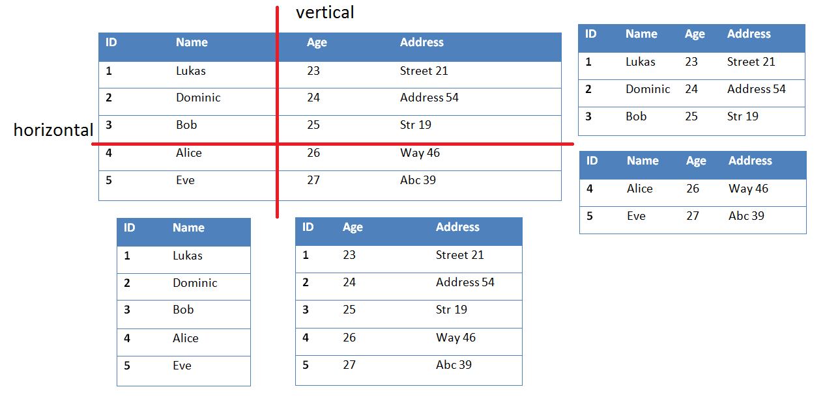
vertical / horizontal example

Slide 33
why partitioning?
horizontal partitioning
many operations on different sets of instances
vertical partitioning
many operations on different sets of attributes
split huge attributes (BLOBs)
security aspects
reduce networking traffic in distributed databases

Slide 34
consider before partitioning
which sets of instances are in use?
which sets of attributes are in use?
change programmaticaly access to db

