Slide 1
Logical Design
Feistritzer, Weinberger

Slide 2
Exercise 1
Integrate these views:
identify conflicts (and their conflict types)
propose scenarios and interschema properties
integrate the schemas into one schema.

Slide 3
Exercise 1 - Conflicts
Naming conflicts
homonyms: one word used for two different concepts
synonyms: two different words used for the same concept
Conflict resolution
similarity: different names, same neighbours/constraints
If synonym → rename
mismatch: same name, different neighbours /constraints
If homonym → rename
Otherwise → maybe generalization or structural conflict

Slide 4
Exercise 1 - Conflicts
Structural conflicts
Identical concepts: same structure and neighbours
→ Great! Do nothing!
Compatible concepts: different structure /neighbours, but no contradiction
→ Adapt one input schema
Incompatible concepts: structural contradiction
→ If design error: adjust
→ otherwise: choose one variant! Ideally the one that covers all cases

Slide 5
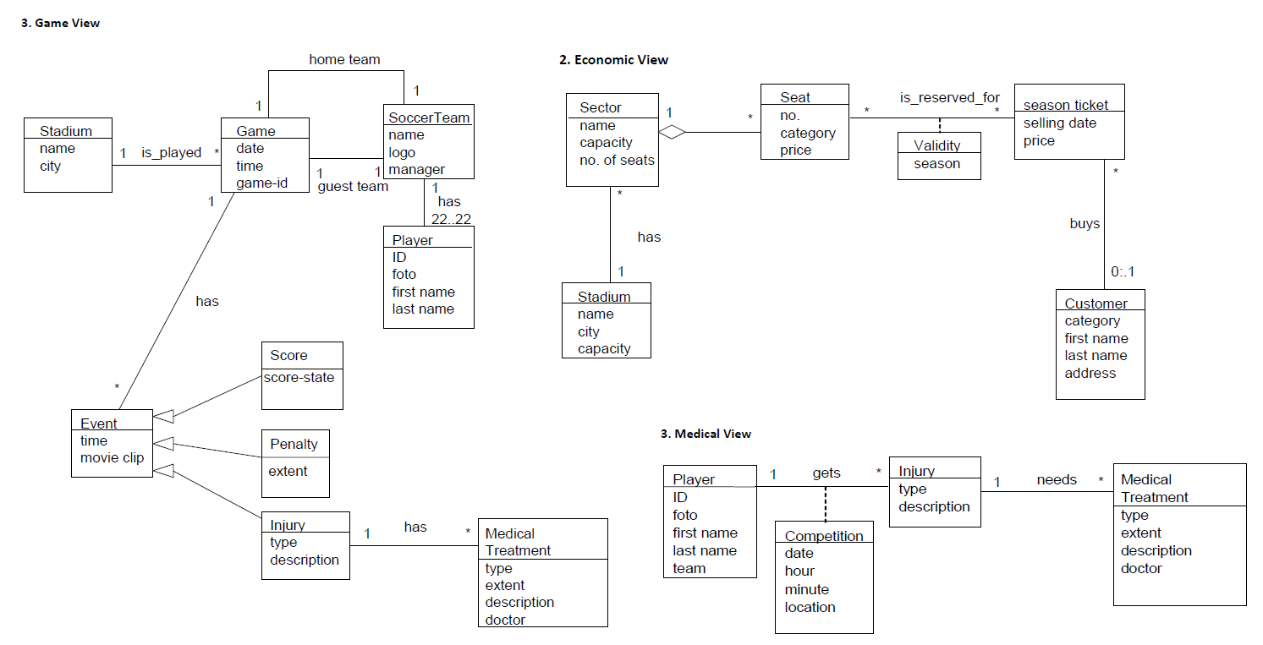
Exercise 1 – Identify Conflicts

Slide 6
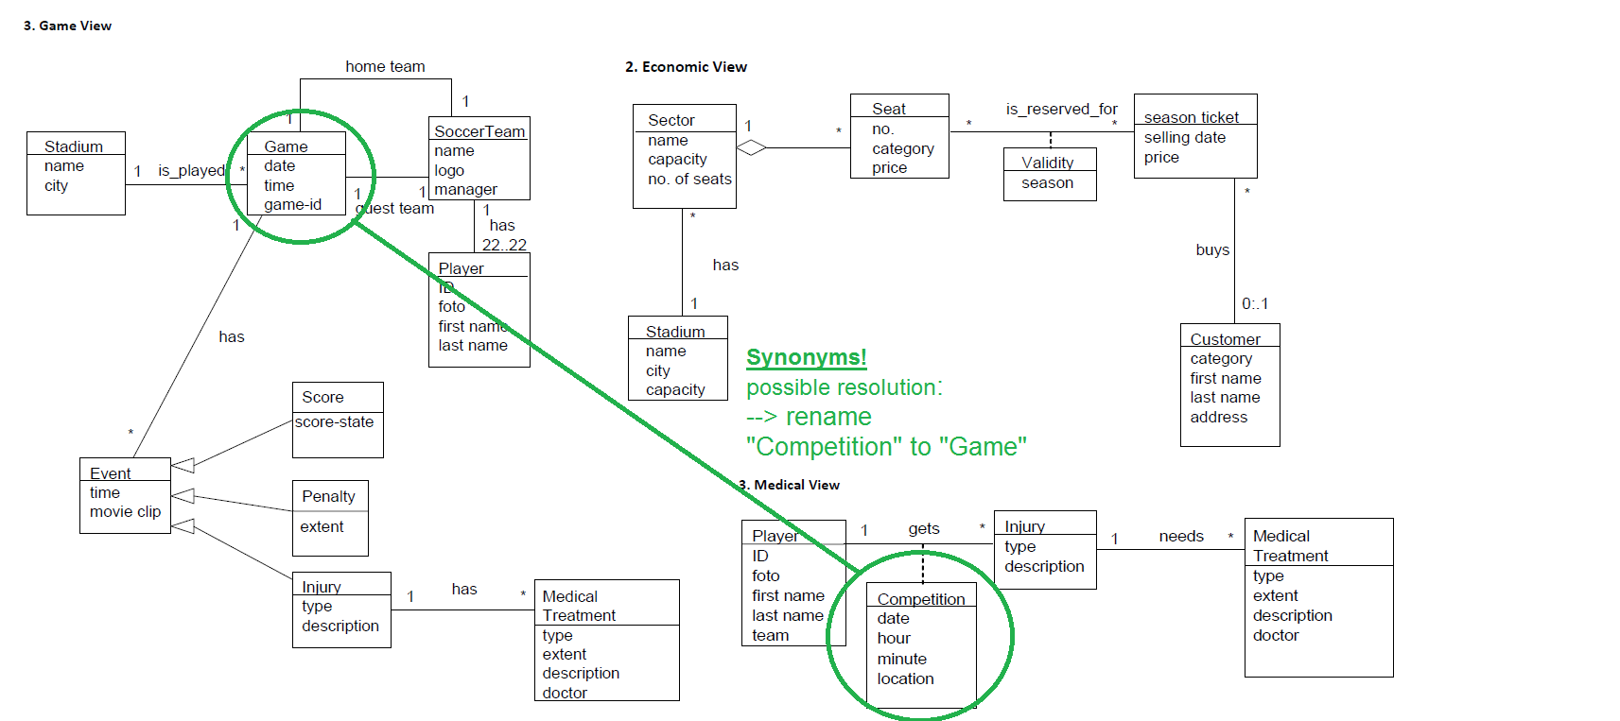
Exercise 1 – Identify Conflicts 1a

Slide 7
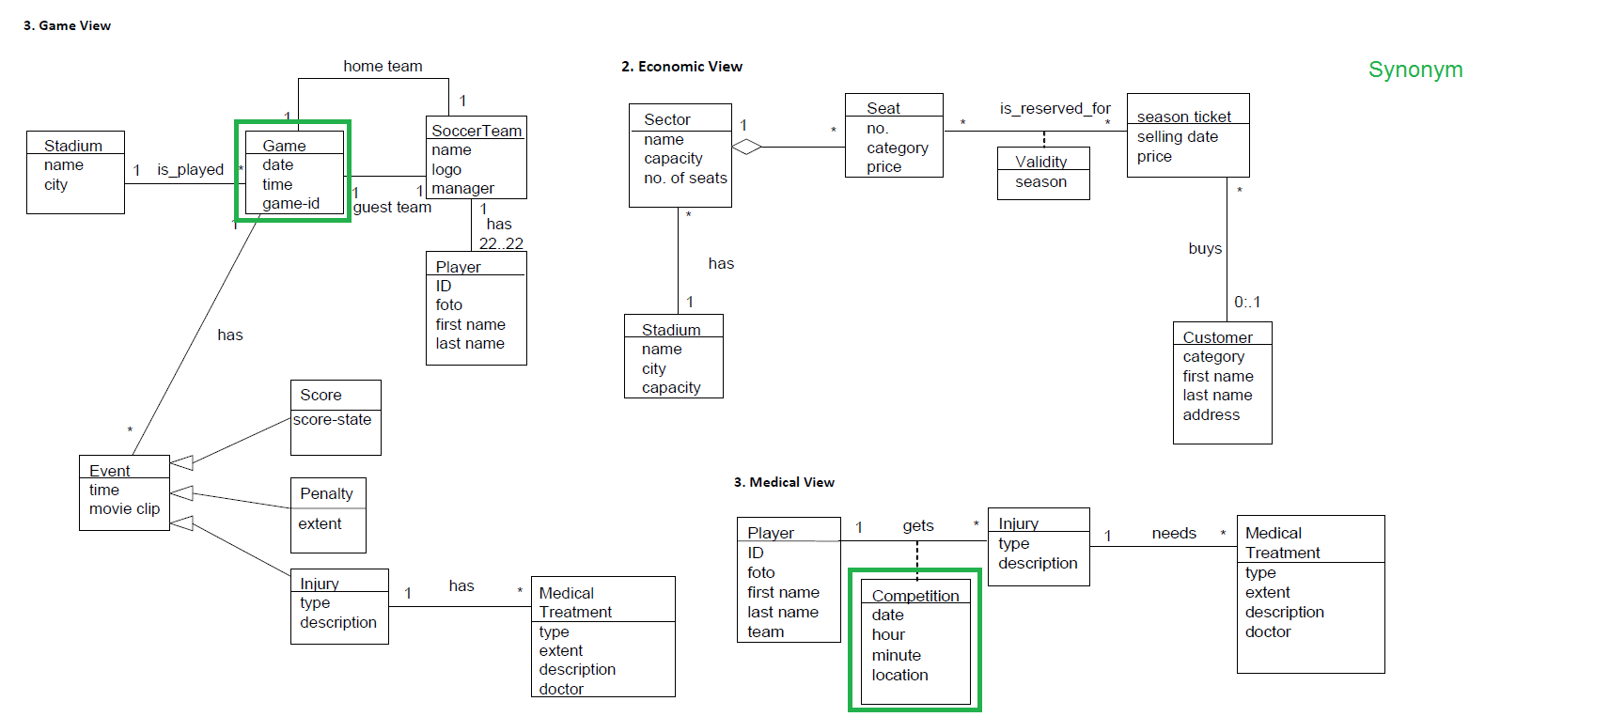
Exercise 1 – Identify Conflicts 1b

Slide 8
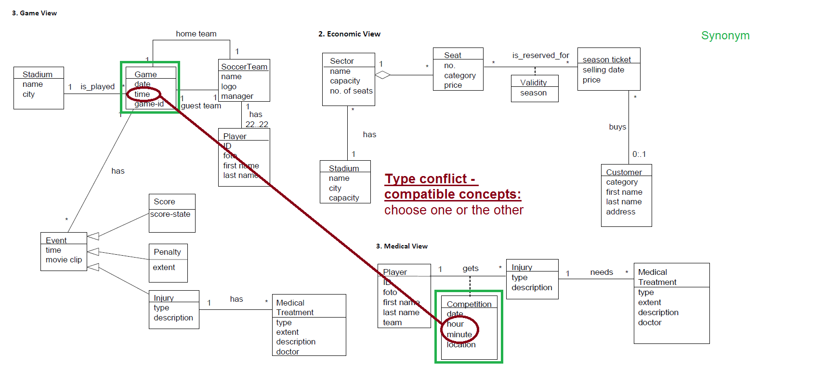
Exercise 1 – Identify Conflicts 2a

Slide 9
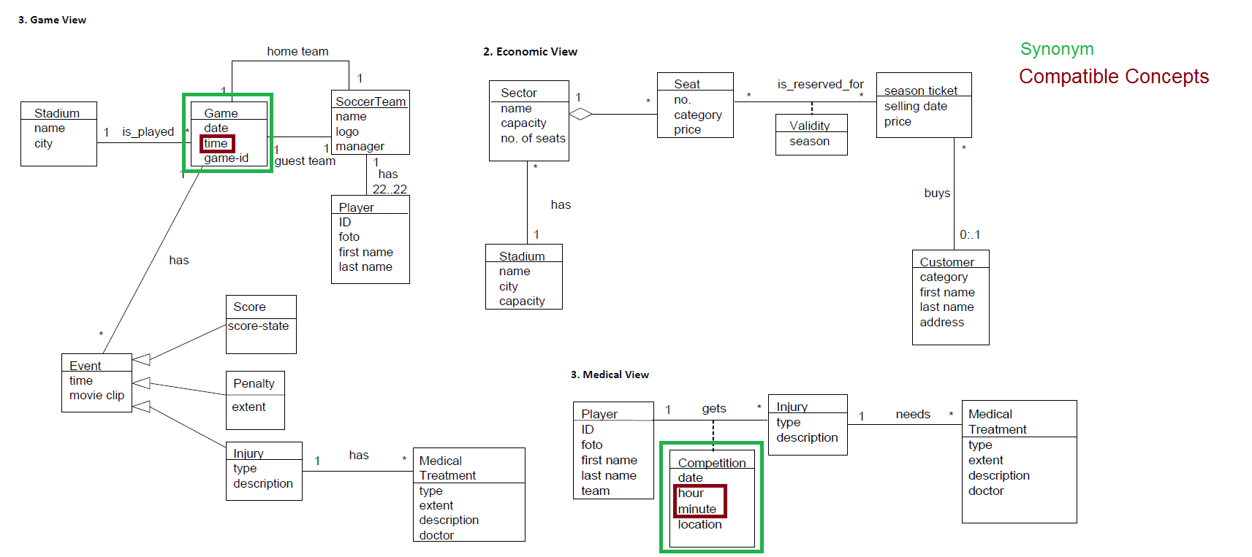
Exercise 1 – Identify Conflicts 2b

Slide 10
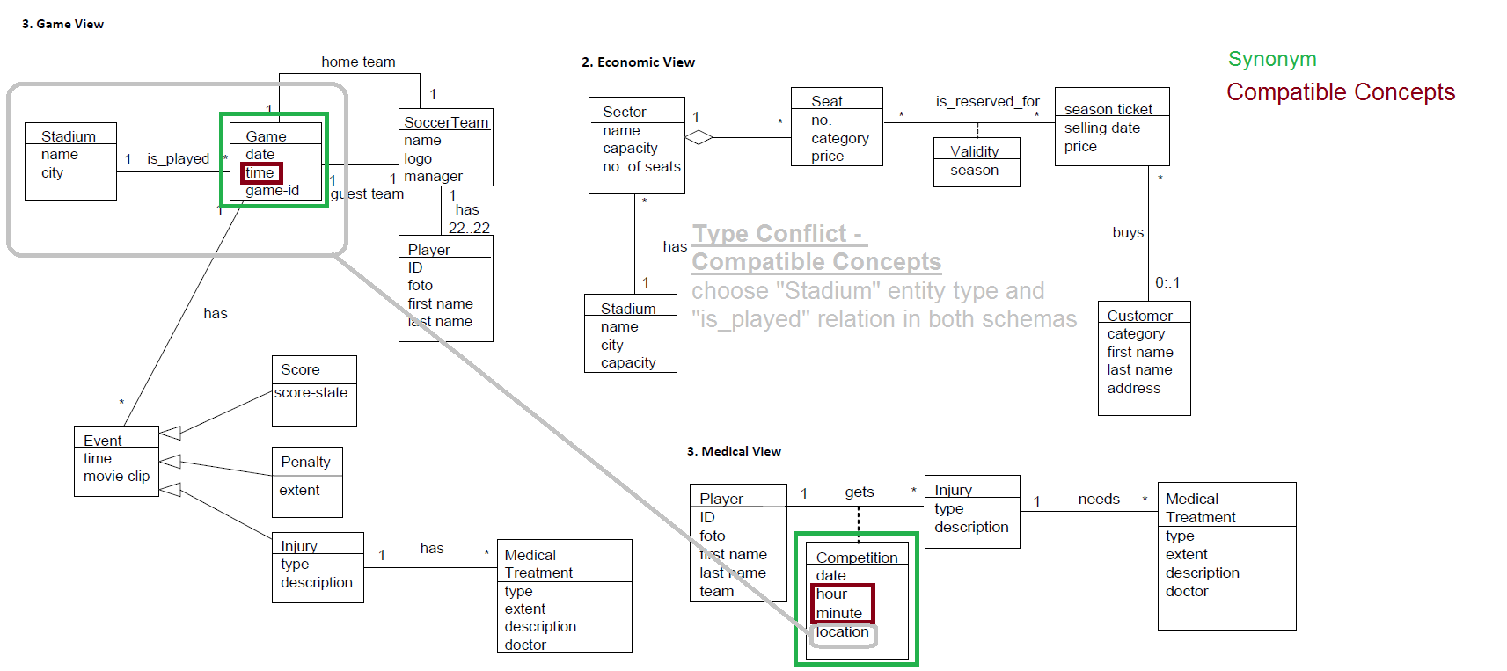
Exercise 1 – Identify Conflicts 3a

Slide 11
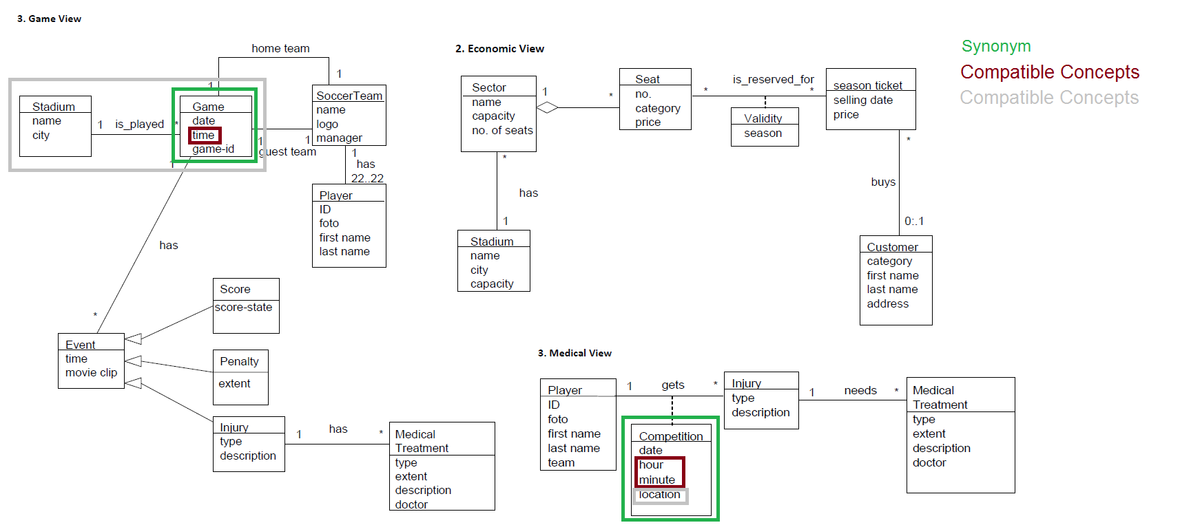
Exercise 1 – Identify Conflicts 3b

Slide 12
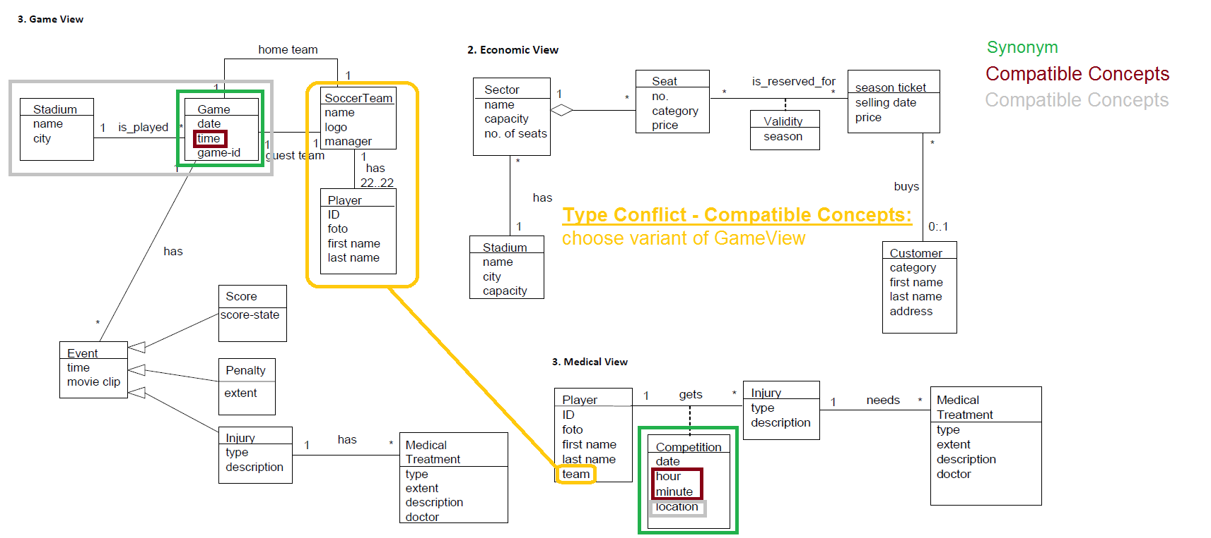
Exercise 1 – Identify Conflicts 4a

Slide 13
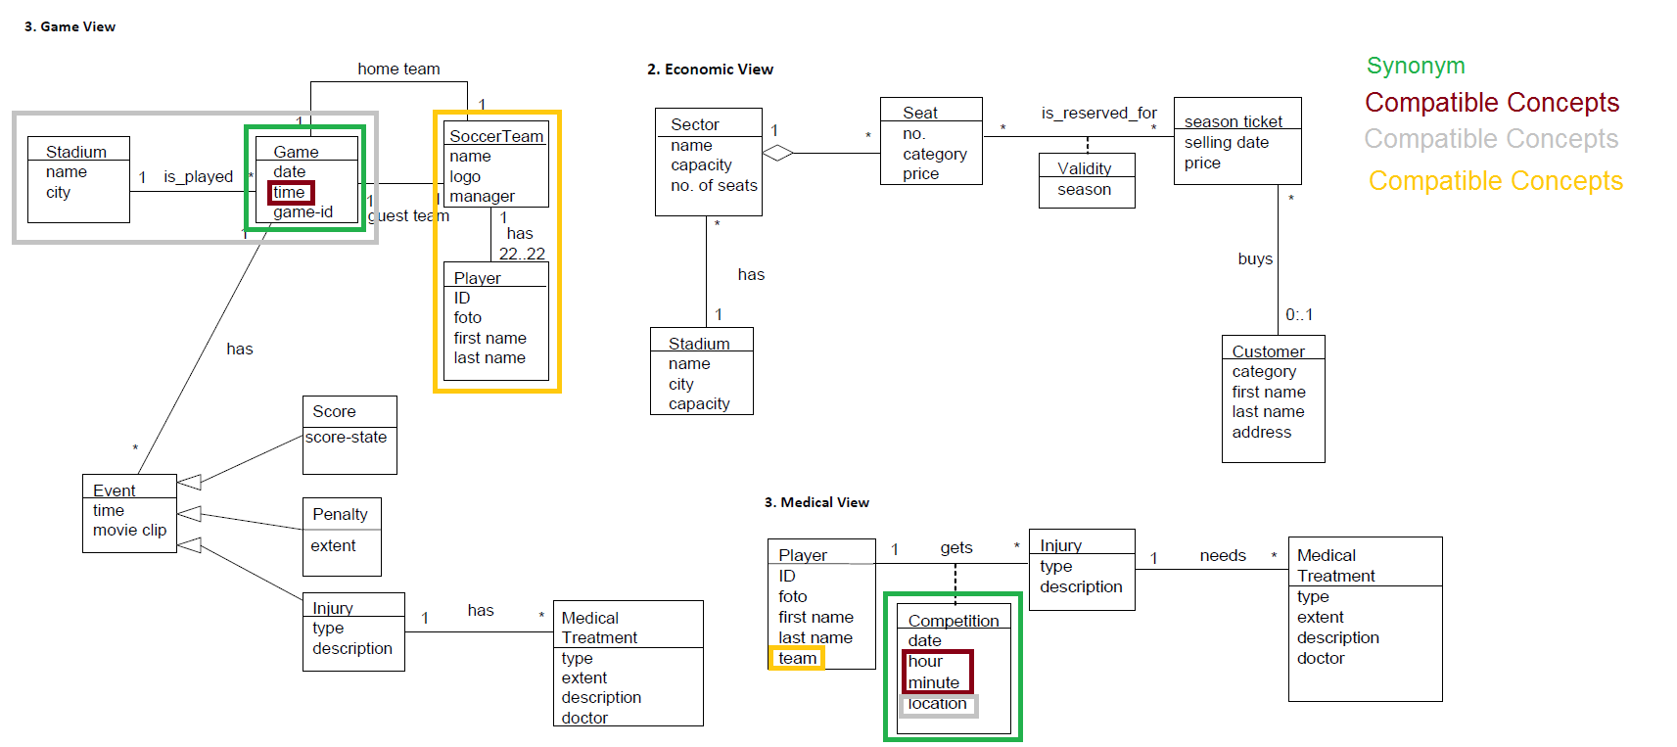
Exercise 1 – Identify Conflicts 4b

Slide 14
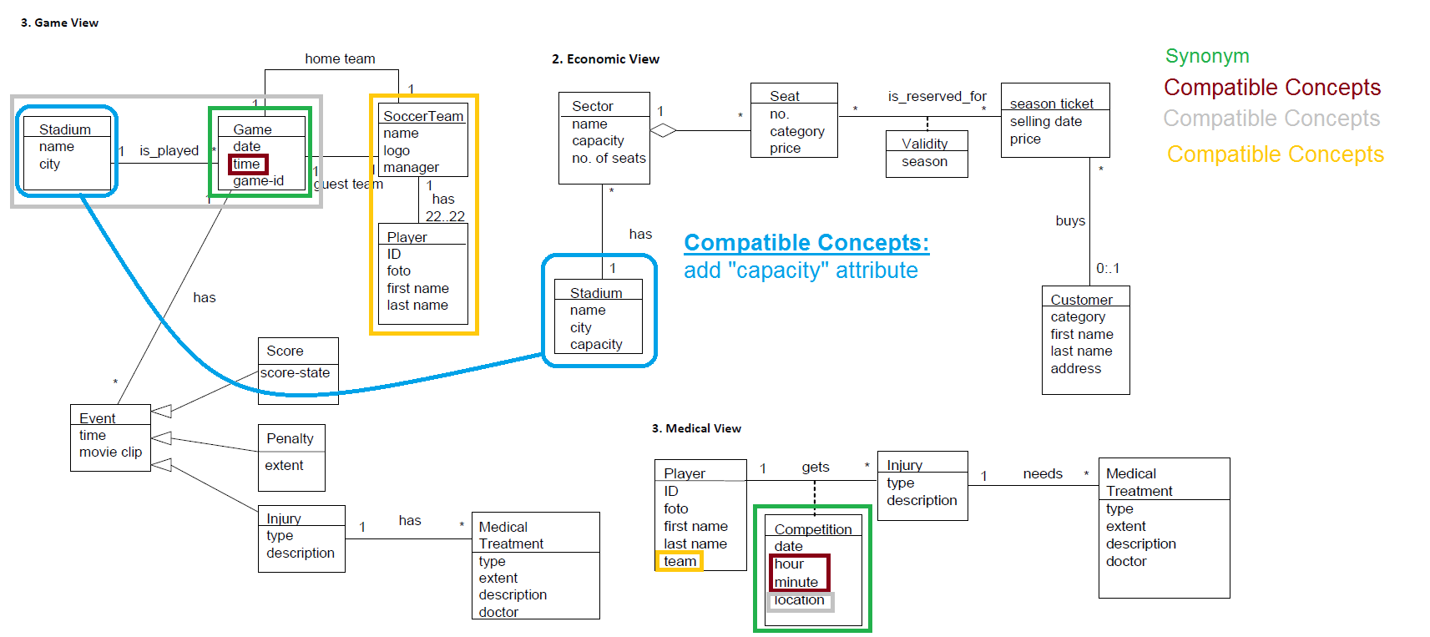
Exercise 1 – Identify Conflicts 5a

Slide 15
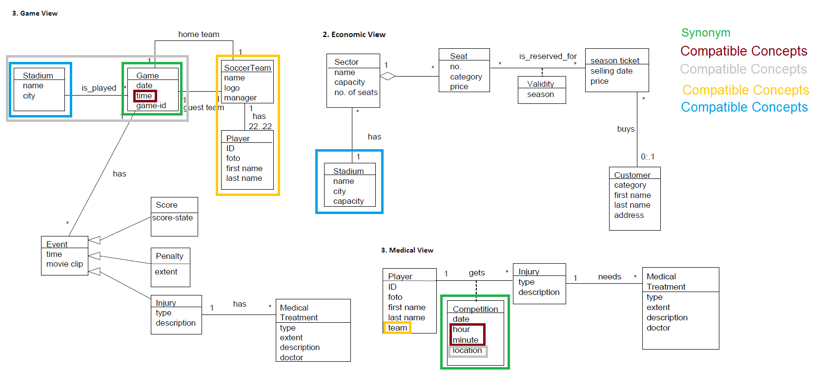
Exercise 1 – Identify Conflicts 5b

Slide 16
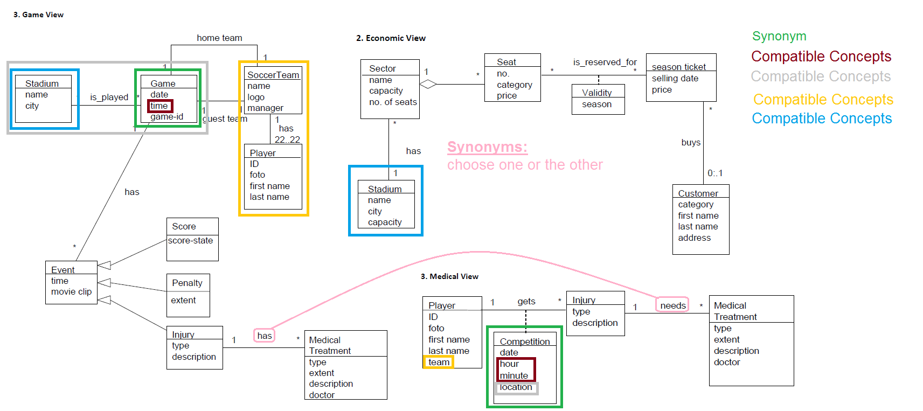
Exercise 1 – Identify Conflicts 6a

Slide 17
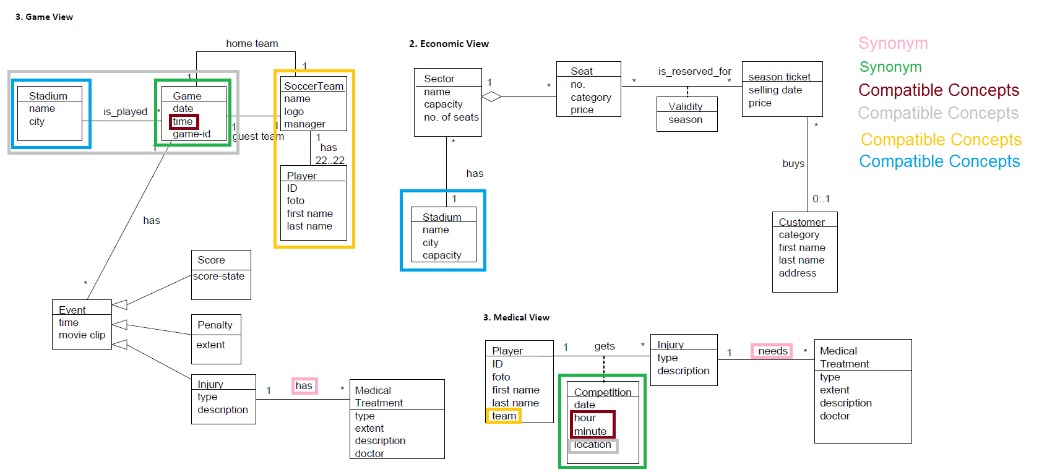
Exercise 1 – Identify Conflicts 6b

Slide 18
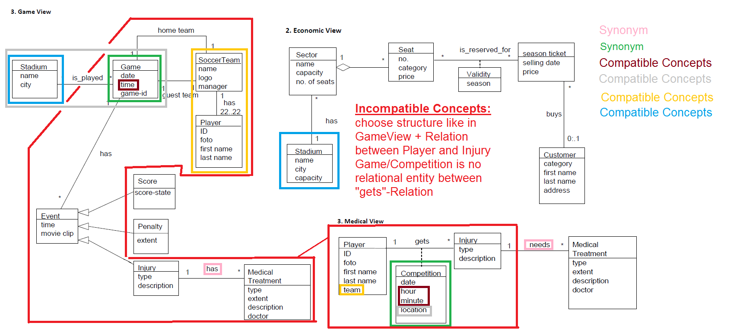
Exercise 1 – Identify Conflicts 7a

Slide 19
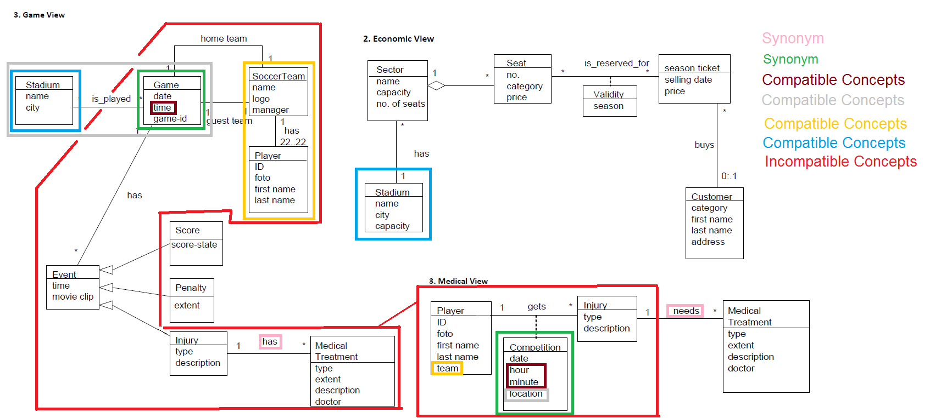
Exercise 1 – Identify Conflicts 7b

Slide 20
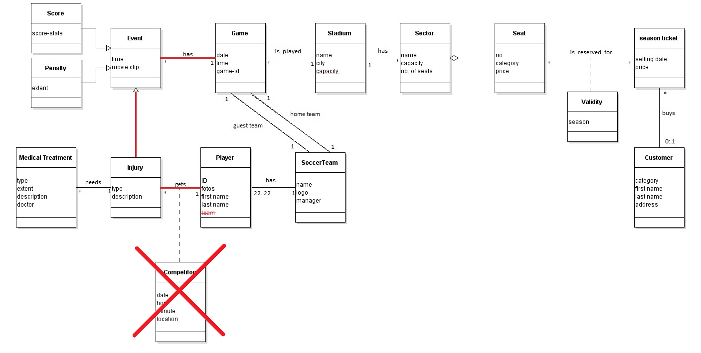
Exercise 1 – Schema without conflicts

Slide 21
scenarios and interschema properties (1/2)
Interschema properties are …
… semantic relationships holding between a set of objects in one schema and a different set of objects in another schema
… realized as part of generalization hierarchy or relation

Slide 22
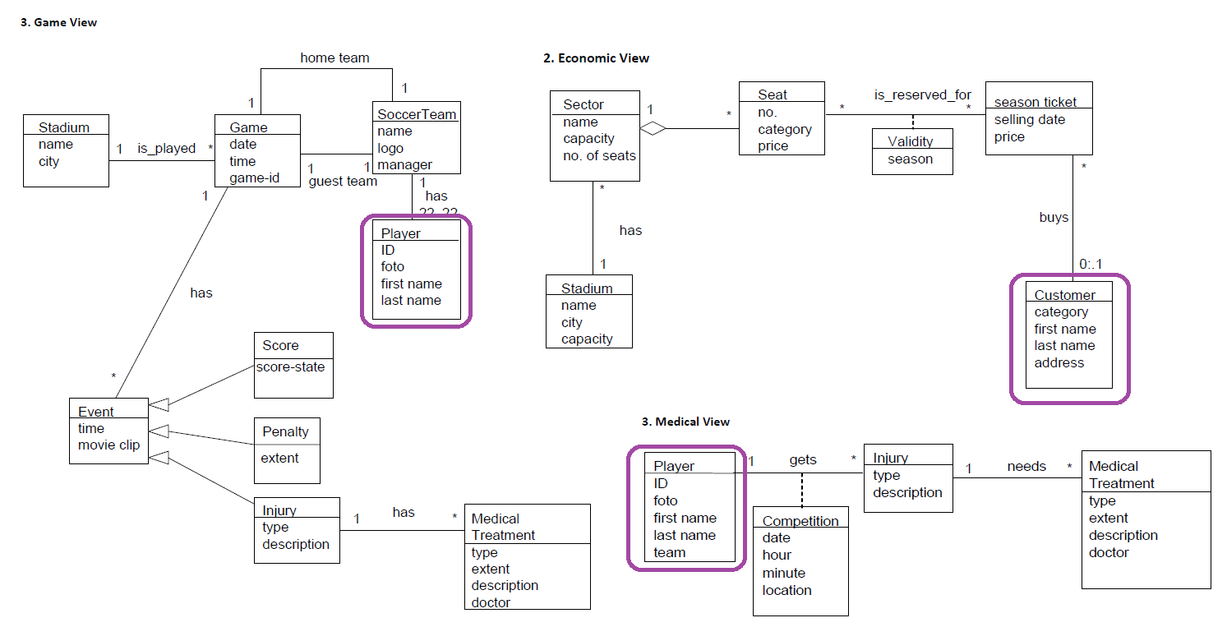
Interschema properties – Player/Customer

Slide 23
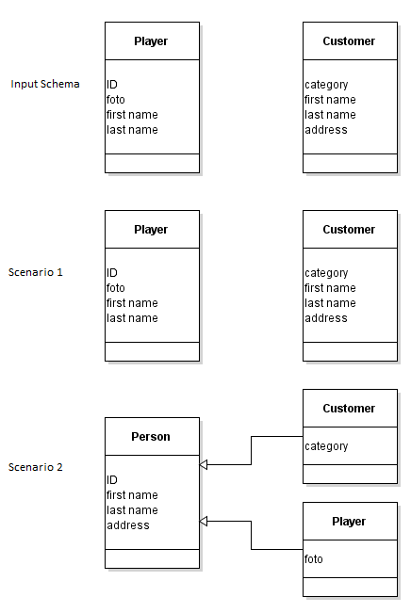
scenarios and interschema properties (1/2)
One possibility: leave both entity types as they are
Another possibility: create generalization hierarchy

Slide 24
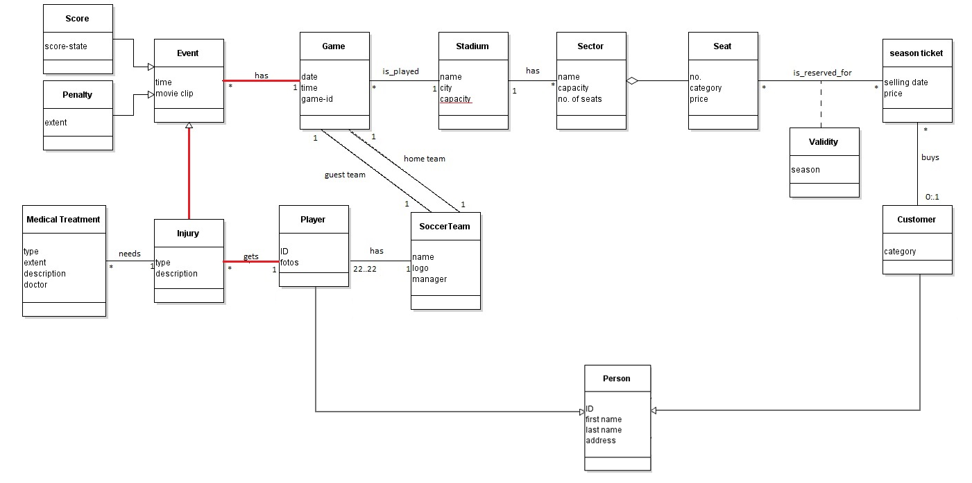
Interschema properties – Scenario 2

Slide 25

Exercise 2 – Determination of Quantities
N(C) = average number of instances per class
N(A) = average number of association instances per association
N(C,A) = average number of class instances per association
N(C1) x N(C1,A) = N(A) = N(C2) x N(C2,A)

Slide 26
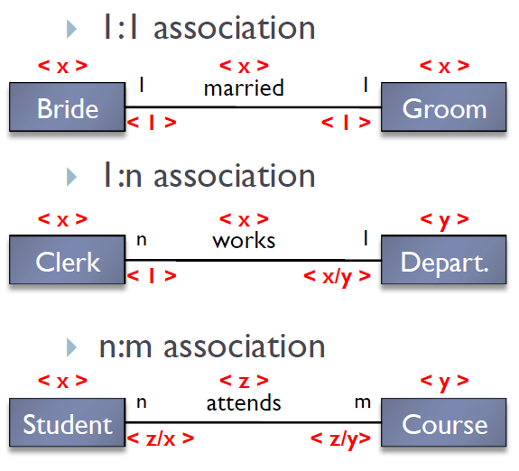
Exercise 2 – Calculation rules

Slide 27
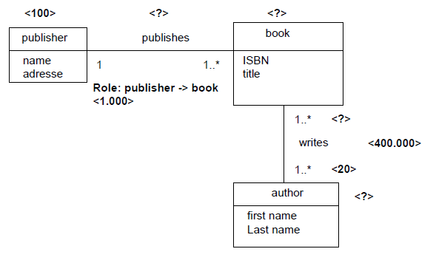
Exercise 2 – Determination of Quantities
<100.000>
<100.000>
<4>
<20.000>
N(publisher) x N (publisher, publishes ) = N (publishes) = N(book)
N(book) = N(publishes) = 100 x 1.000 = 100.000
N(author) = N(writes) / N(writes, author)
N(author) = 400.000 / 20 = 20.000
N(book, writes) = N (writes) / N(books)
N(book, writes) = 400.000 / 100.000 = 4

Slide 28
Exercise 2 - Navigation
To get the result of a query or to execute an operation, multiple entity types and relations might have to be accessed.
Navigation path shows, which entity types and relations are accessed and in which order.
Necessary for evaluating costs of database operations

Slide 29
Exercise 3 – Redundancy
Redundancy occurs, if the same information or derivable information is stored multiple times.
Pros:
Speeds up data access (navigation path is shortened for some operations)
Cons:
Additional updates
Risk of inconsistency ( => more consistency checks needed)
Additional storage space

Slide 30
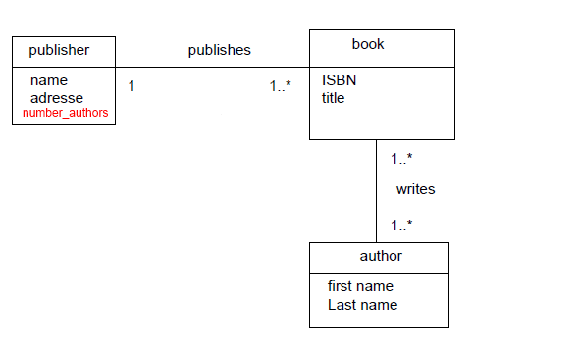
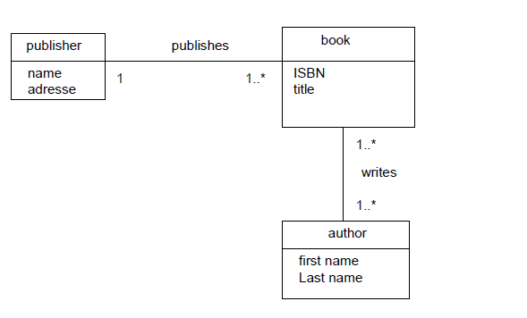
Redundant Attribute
READ: Saves access to book and writes
WRITE: Every insert and delete and some updates in book and writes forces update of number_authors in publisher

Slide 31
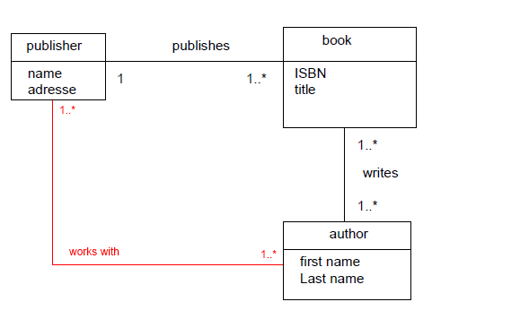
Redundant Association
READ: book class is not needed in navigation path (w.r.t publisher -> author)
WRITE: Insert/Update/Delete operations on book and writes might trigger Insert and Delete operations on works_with

Slide 32
Redundancy – How to Decide
Look at the operations influenced by the redundancy
Calculate number of accesses for these operations
with redundancy
without redundancy
If #Accesses with redundancy < #Accesses without redundancy => Keep redundancy
Else: Remove redundancy

Slide 33
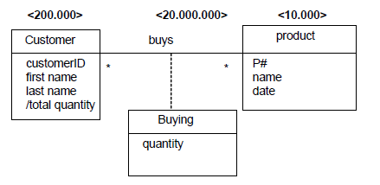
Exercise 3b
Check, if we should keep the redundant attribute total_quantity

Slide 34
Exercise 3b - Operations
Operation | Description | Frequency
T1 | Insert a new customer | 50 times / month
T2 | Insert a new product | 5 times /month
T3 | Insert of a „Buying“ | 50 times / day ( = 1000 times / month) *
T4 | Listing of total quantitiy for each customer | 2 times /month
*) Note: A month has 20 working days.
Next: calculate accesses per operation with and without redundancy, where …
… read accesses have weight 1
… write accesses have weight 2
… update accesses have weight 3

Slide 35
Exercise 3b – Data Access Table
Operation | Accesses with redundancy | Accesses without
T1 | 100 customer (write 50 * 2) = 100 accesses | 100 customer (write 50 * 2) = 100 accesses
T2 | 10 product (write 5 * 2) = 10 accesses | 10 product (write 5 * 2) = 10 accesses
T3 | 2.000 buys (write 1.000 * 2) + 3.000 customer (update 1.000 * 3) = 5.000 accesses | 2.000 buys (write 1.000 * 2) = 2.000 accesses
T4 | 400.000 customer (200.000 read twice) = 400.000 accesses | 400.000 customer (read 200.000 twice) + 40.000.000 buys (read 20.000.000 twice) = 40.400.000 accesses
Sum | = 405.110 accesses per month | = 40.402.110 accesses per month

Slide 36
Exercise 3b – Conclusion
Accesses per month without redundancy:
40.402.110
Accesses per month with redundancy:
405.110
Therefore: Keep redundancy!

Slide 37
Exercise 4
Explain the notions total, partial, exclusive, and overlapping in the context of generalization.
What kind of flattening strategies exist for generalization hierarchies? Explain them with an example of your own.
How can you determine, which flattening strategy should be used? What data do you need for the decision?

Slide 38
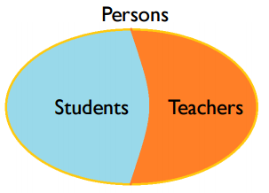
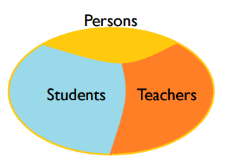
total vs partial
total
every instance of a super-class is also an instance of a (direct) sub-class children
partial
otherwise

Slide 39
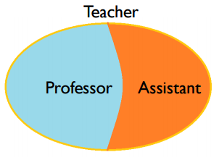
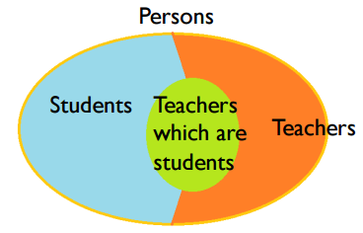
exclusive vs overlapping
exclusive
no instance of the super-class belongs to more than one sub-class
overlapping
otherwise

Slide 40
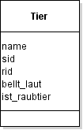
Flattening(1/3)
Ceiling
Only super-class
Has all attributes of sub-classes
overlapping or partial generalization
Notes:
+ eine klasse beinhaltet alle attribute
viele attrrubute bleiben leer
Beziehungen gehen verloren

Slide 41
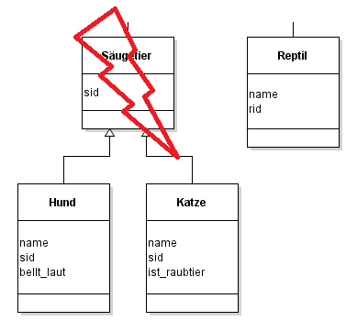
Flattening(2/3)
Floor
Only classes which are leaves in generalization hierarchy tree
Total or exclusive generalization
Notes:
+ es gibt eine klasse pro typ
- mman benötigt union operation damit man alle instanzein einer superklasse erhält

Slide 42
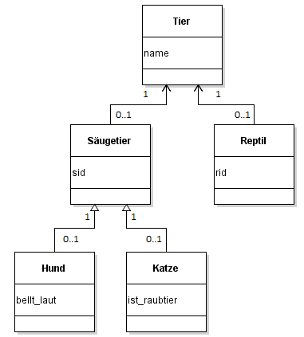
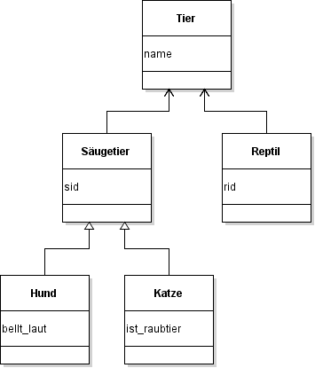
Flattening(3/3)
Cohesion
each generalization is represented as 1:1 relation
Notes:
+ alle klassen bleiben bestehen mit assoziationen
benötigt join operation um alle instanzen einer superklasse zu bekommen
semantik der generalisierung geht verloren

Slide 43
Which Flattening Strategy?
Two operation sets
S1 set of operations, which access attributes of the super-class
S2 set of operations, which access attributes of super-class and one sub-class
Calculate access counts for S1 and S2
Decide
if S2 dominates → floor
else analyse data manipulation operations
if domination of operations that ..
..access attributes of both super- and sub-class → ceiling
..access attributes of either super- or sub-class → cohesion

Slide 44
Exercise 5
What is vertical partitioning, what is horizontal partitioning? Explain it with an example of your own.
Why might partitioning be necessary?
What do you have to consider before partitioning – how do you decide?

Slide 45
Vertical partitioning(1/2)
split class vertically
new classes have different set of attributes
needs join operation to retrieve original set of instances

Slide 46
Horizontal partitioning
split class horizontally
new classes have same set of attributes
multiplication of original associations required
needs union operation to retrieve original set of instances

Slide 47
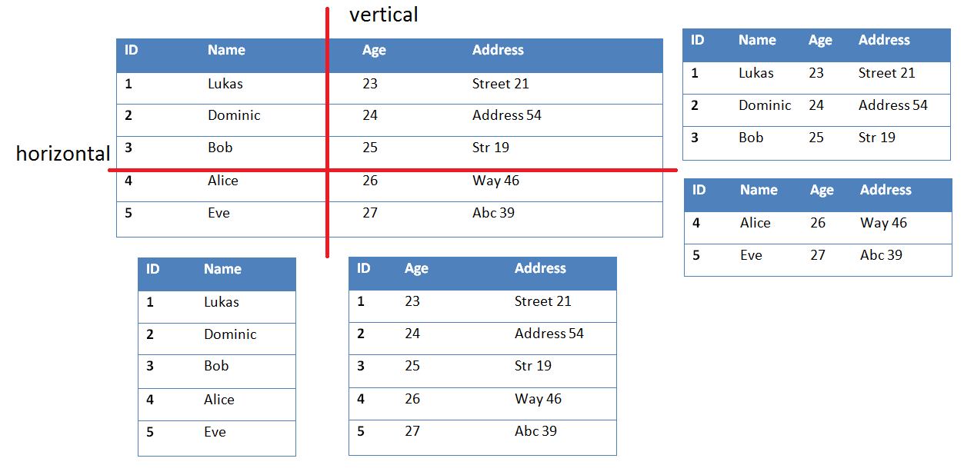
vertical / horizontal example

Slide 48
why partitioning?
horizontal partitioning
many operations on different sets of instances
vertical partitioning
many operations on different sets of attributes
split huge attributes (BLOBs)
security aspects
reduce networking traffic in distributed databases

Slide 49
consider before partitioning
which sets of instances are in use?
which sets of attributes are in use?
change programmaticaly access to db

