Slide 1


DDOS Detection using K-MEANS and Sliding Window
By:
Buhari Aliyu
Supervised by:
Prof. Yousra CHABCHOUB

Slide 2
Content
Project Overview
Literature Review
KMeans Algorithm
Methodology
Implementation
Results and Analysis
Performance Evaluation
Future Work
Conclusion
Acknowledgements

Slide 3


Project Overview: Introduction
DDoS attacks :
Distributed Denial of Service (DDoS) attacks refer to a type of cyber assault where multiple compromised systems, often transformed into a botnet through malware, are used to overwhelm a target system, application, or network with a flood of internet traffic.

Slide 4
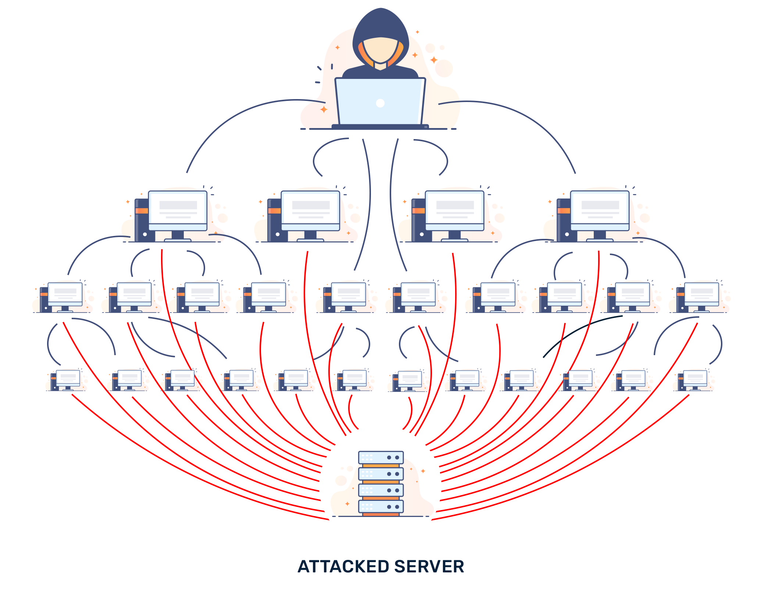
Types of DDoS attacks
Volumetric Attacks: UDP Flood, ICMP Flood.
Protocol Attacks: SYN Flood, Ping of Death.
Application-layer Attacks: HTTP Flood, Slowloris
Transport-Layer Attacks: Port Scanning, ICMP Flood

Slide 5
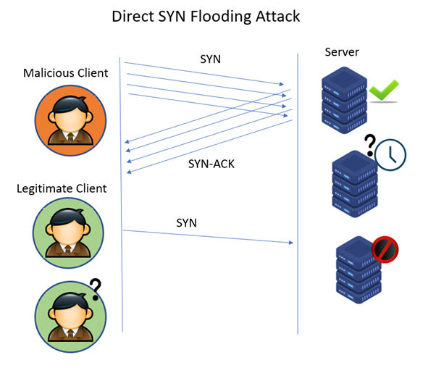
SYN Flooding Attack
The SYN Flood is a form of Denial of Service (DoS) attack. To understand it, we first need to have a basic grasp of the TCP (Transmission Control Protocol) three-way handshake that's typically used to establish a connection between a client and a server over the internet.
The TCP Three-Way Handshake:
SYN: The client requests a connection by sending a SYN (synchronize) message to the server.
SYN-ACK: The server acknowledges this request by sending SYN-ACK back to the client.
ACK: The client responds with an ACK (acknowledge), and the connection is established.

Slide 6
SYN Flooding Attack :How the Attack Works
In a SYN flooding attack, the attacker sends a large number of SYN packets (the first step in the handshake) to a target server from spoofed IP addresses. The server, believing these are legitimate attempts to establish a connection, responds to each one with a SYN-ACK (the second step). However, since the IP addresses are spoofed (or fake), the final ACK (the third step) is never received.
This causes the server to wait for responses, effectively filling up its connection table with half-open connections. Once this table is full, the server cannot handle any new incoming connection requests, leading to a denial of service for legitimate users.

Slide 8
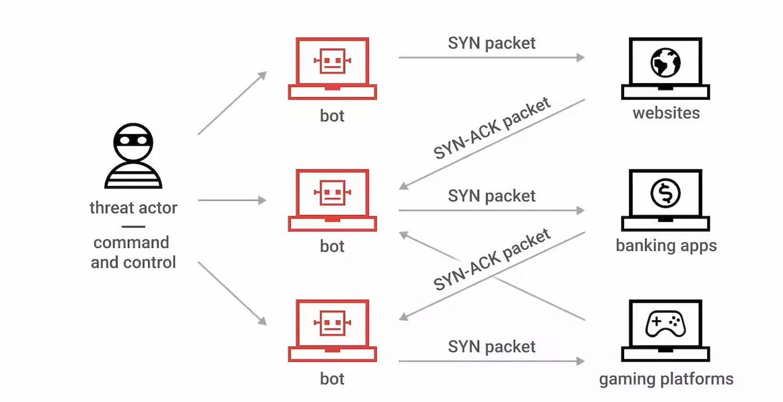
Importance of detecting DDoS attacks
Maintaining Service Availability, Improving Security Posture, Economic Impact, Reputation Damage, Infrastructure Reliability.

Slide 9

Project Overview: Objectives
The primary objective of this project is to develop an innovative approach to detect SYN flooding attacks using the sliding window technique combined with the isolation forest algorithm.

Slide 10

Role of AI/ML in detecting DDoS attacks
Artificial Intelligence (AI) and Machine Learning (ML) are revolutionizing numerous domains, and cybersecurity is no exception. Their application in detecting DDoS attacks is driven by the need to promptly identify and respond to ever-evolving threats.
Adaptive Learning, Anomaly Detection, Scalability, Predictive Analysis.

Slide 11
Literature Review
Gu et al. (2017): Proposed Multiple Features based Constraint K-means (MF-CKM) algorithm, using packet-level features for attack identification. Challenges include IP spoofing and need for some labeled data.
Soheily-Khah et al. (2018): Combined K-means and Random Forest (kM-RF) approach, focusing on ISCX benchmark dataset. Proved more effective than traditional machine learning methods in accuracy and detection.
Pramana et al. (2015): Modified k-means clustering algorithm for enhanced DDoS detection, showing promising results on DARPA 98 dataset with improved detection rate accuracy and reduced false positives.

Slide 12
KMeans Algorithm
K-means clustering is a type of unsupervised learning, which is used when you have unlabeled data (i.e., data without defined categories or groups). ​
The goal of the K-means clustering algorithm is to find groups in the data, with the number of groups represented by the variable K. The algorithm works iteratively to assign each data point to one of K groups based on the features that are provided. Data points are clustered based on feature similarity.​
Note: The ‘K’ in K-means represent the number of cluster

Slide 13
Methodology
The sliding window technique will be implemented to analyze network traffic data for detecting SYN flooding attacks. In this approach, network data will be divided into discrete time windows. Each window will contain a set of TCP connection requests over a short time interval. By analyzing these intervals, patterns indicative of SYN flooding, such as a high number of incomplete connection requests, can be identified.
This technique allows for continuous monitoring and analysis of network traffic, enabling the detection of attacks as they occur.

Slide 14
Implementation
Tools:
Pycharm
Jupyter Notebook
Programming Language: Python
Python Libraries:
Pandas
Sckit Learn
Matplotlib
Dataset: Orange TCP dump dataset 2007

Slide 15
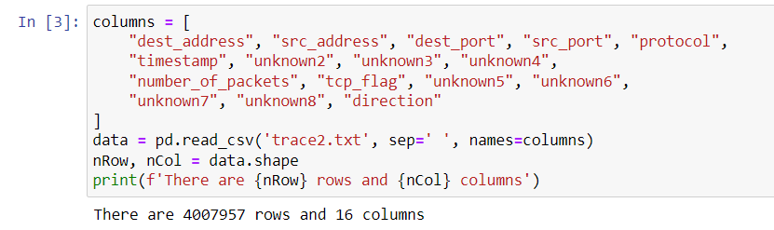
Implementation

Slide 16
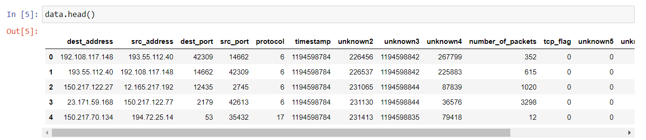
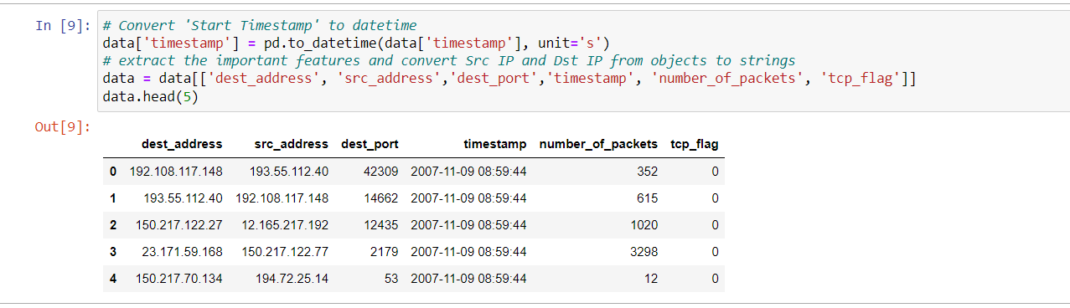
Implementation

Slide 17
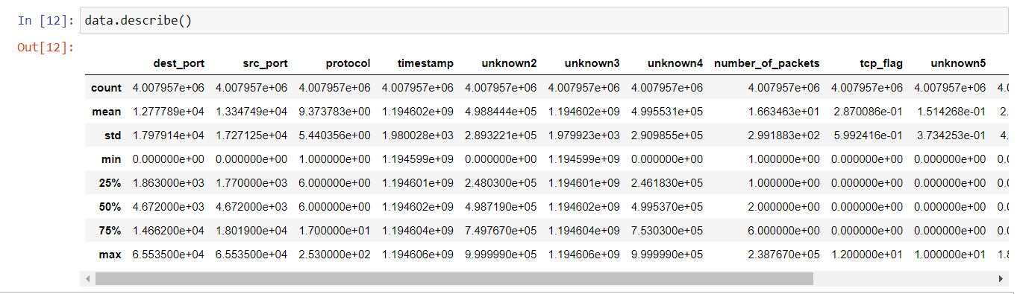
Implementation

Slide 18
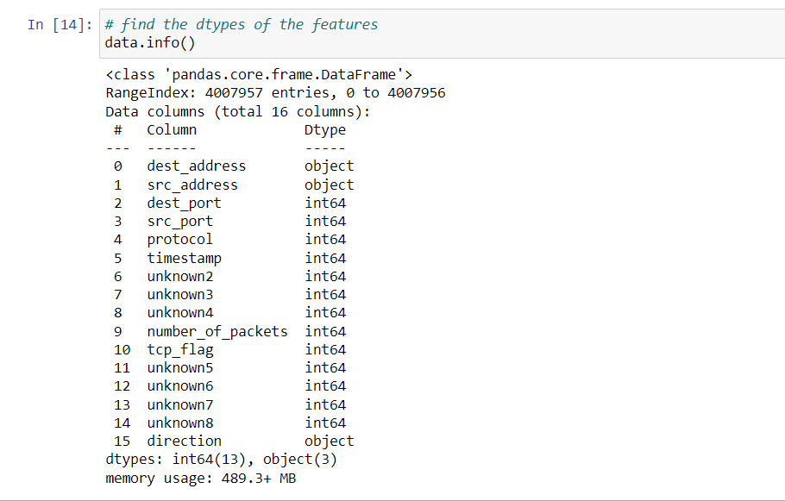
Implementation

Slide 19
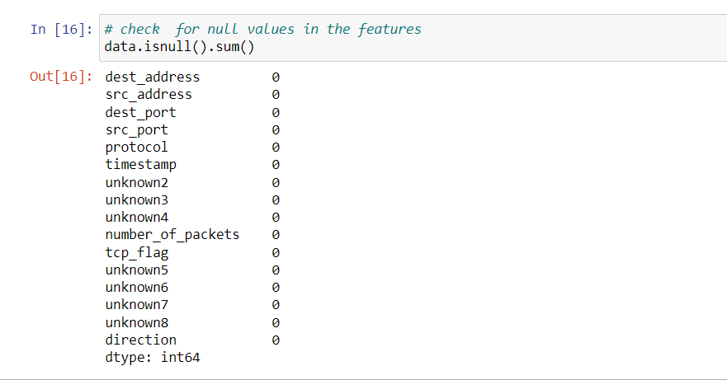
Implementation

Slide 20
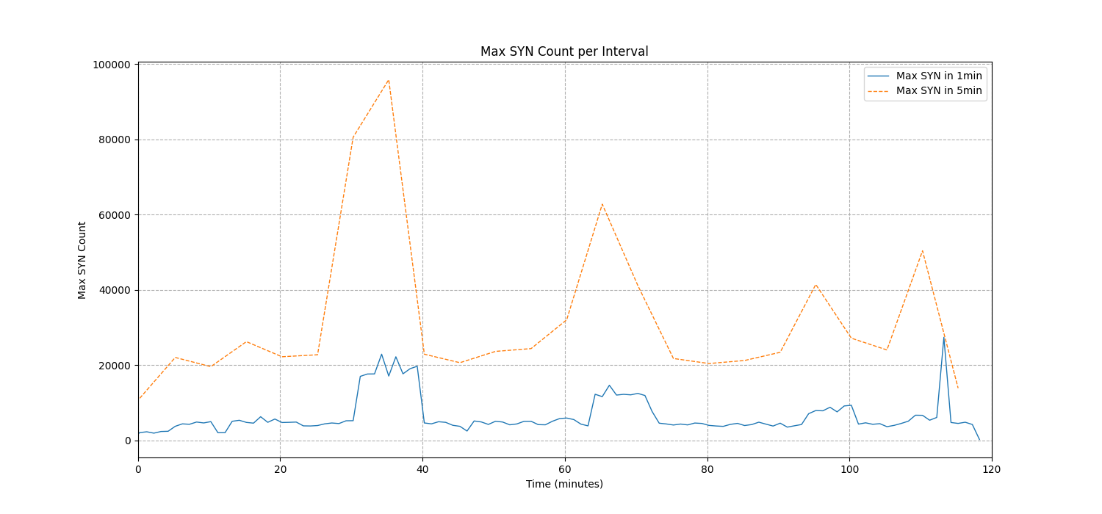
Implementation
Trace file analysis

Slide 21
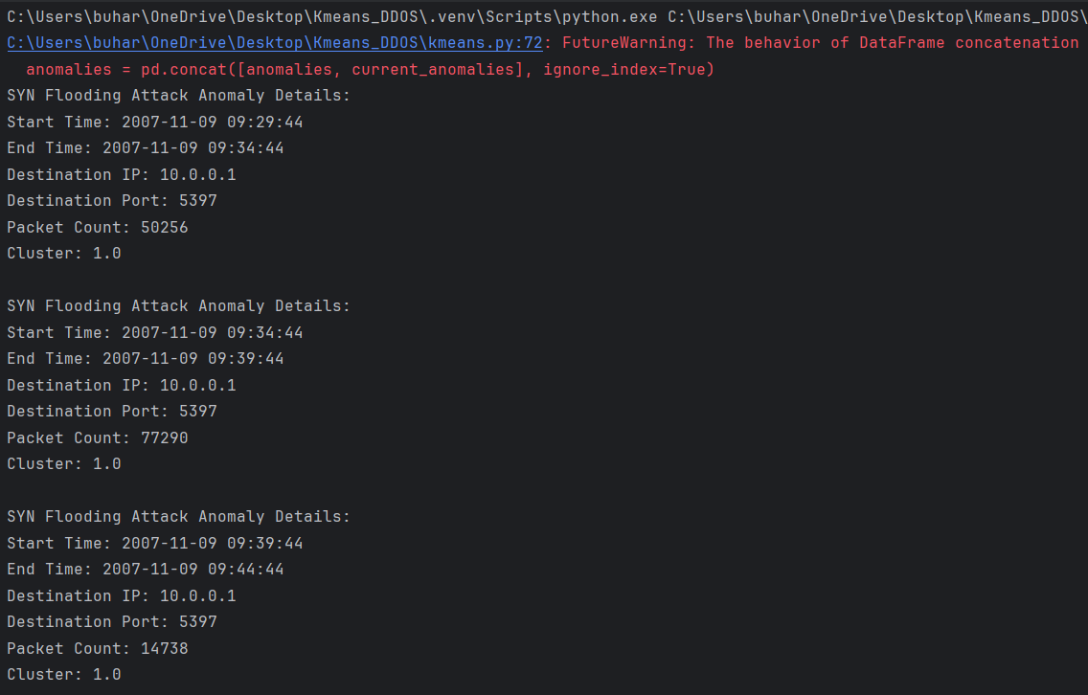
Results and Analysis

Slide 22
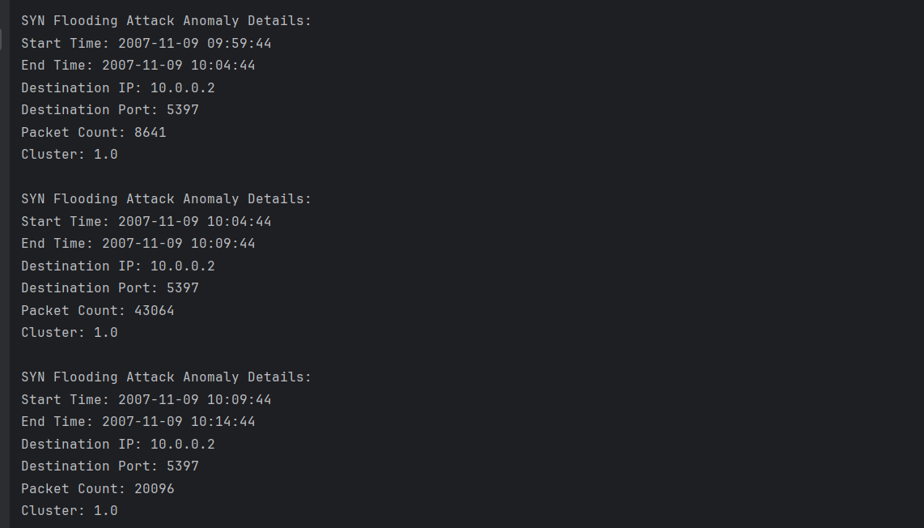
Results and Analysis

Slide 23
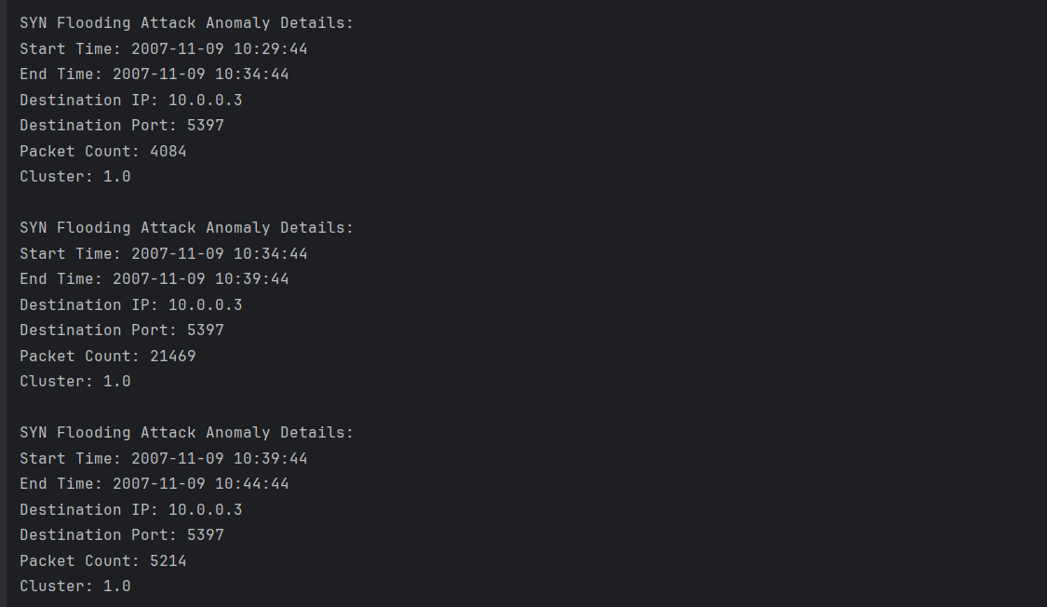
Results and Analysis

Slide 24
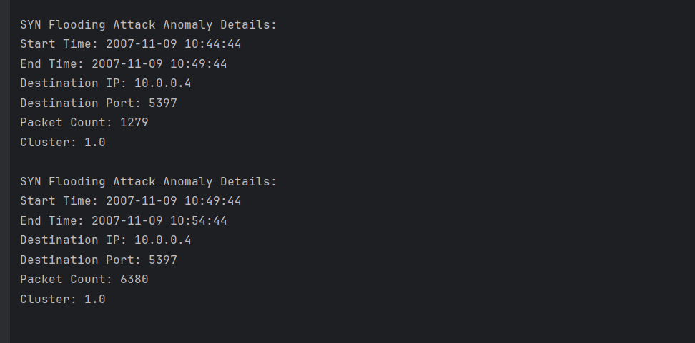
Results and Analysis

Slide 25
Results and Analysis
DDoS Attack Analysis for IP Address 10.0.0.1
First Window:
Start Time: 2007-11-09 09:29:44
End Time: 2007-11-09 09:34:44
Packet Count: 50256
Observations: A significant volume of traffic was identified, suggesting an abnormal activity that likely marks the beginning of the SYN flood attack.

Slide 26
Results and Analysis
DDoS Attack Analysis for IP Address 10.0.0.2
The system detected multiple DDoS attack windows targeting the IP address 10.0.0.2. The details are as follows:
First Window:
Start Time: 2007-11-09 10:44:44
End Time: 2007-11-09 10:49:44
Packet Count: 1279
This initial attack window indicates the beginning of the attack with a substantial number of packets suggesting an attempted SYN flood.

Slide 27
Results and Analysis
DDoS Attack Analysis for IP Address 10.0.0.3
The system reported SYN flood activity directed at IP address 10.0.0.3, detailed as follows:
First Window:
Start Time: 2007-11-09 10:29:44
End Time: 2007-11-09 10:34:44
Packet Count: 4084
Initial signs of a DDoS attack are observed with an influx of packets.
A sharp increase in packet count signifies an escalation in the attack.

Slide 28
Results and Analysis
DDoS Attack Analysis for IP Address 10.0.0.4
For the IP address 10.0.0.4, the following attack windows were detected:
First Window:
Start Time: 2007-11-09 10:44:44
End Time: 2007-11-09 10:49:44
Packet Count: 1279
The attack onset is marked by a noticeable increase in traffic volume.
The continued high volume of packets suggests that the attack is ongoing.

Slide 29
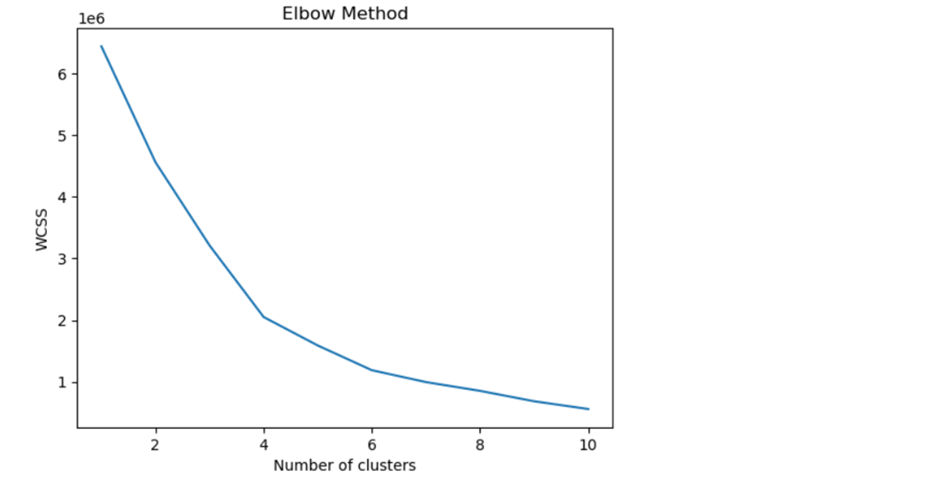
Model Evaluation

Slide 30
Model Evaluation: Cluster Analysis
Cluster Analysis
A closer examination of Cluster 1.0, which encapsulated all detected anomalies, revealed a pattern consistent with SYN flood attack characteristics:

Slide 31
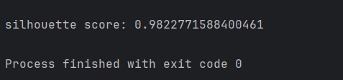
Silhouette Score
The model get Silhouette Score of 0.9822 which shows the algorithms perform well in clustering and identifying the ddos attack.

Slide 32
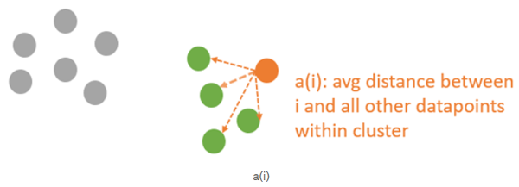
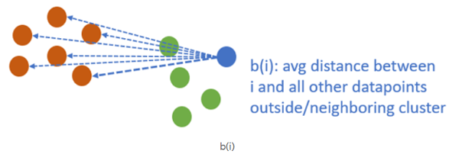
Silhouette Score
A silhouette score of 0.9822 is indicative of highly distinct and well-separated clusters. Such a score is typically interpreted as the model having a strong discriminatory ability. The high silhouette score lends credibility to the clustering process, underscoring the model's effectiveness in segregating normal traffic from potential attack vectors.

Slide 33
Challenges
Computational
Scalability

Slide 34
Future Work
Integration of Additional Features
Hybrid Models
Scalability Testing
Automated Response Systems

Slide 35
Conclusion
In conclusion, this project has demonstrated the potential of machine learning techniques, specifically KMeans clustering, in the identification of DDoS attacks within network traffic. Despite challenges such as data complexity, feature selection, and the need for continuous adaptation to evolving threats, the developed model represents a significant step towards more resilient cybersecurity measures. It underscores the importance of integrating AI-driven solutions in network security frameworks to proactively detect and mitigate the ever-growing threat of DDoS attacks

Slide 36
References
G. Münz, et al, “Traffic Anomaly Detection Using K-Means Clustering”, In Proc. of Leistungs-, Zuverlässigkeits- und Verlässlichkeitsbewertung
Gu, Y., Wang, Y., Yang, Z., Xiong, F., Gao, Y., 2017. Multiple-features-based semisupervised clustering DDoS detection method. Math. Problems Eng. 2017.
Soheily-Khah S., Marteau P.-F., Béchet N., ‘‘Intrusion Detection in Network Systems Through Hybrid Supervised and Unsupervised Machine Learning Process: A Case Study on the ISCX Dataset”, in Data Intelligence and Security (ICDIS), 2018 1st International Conference on, 2018, 219-226.

Slide 37
THANK YOU FOR LISTENING!!!
ANY QUESTIONS?

