Slide 1
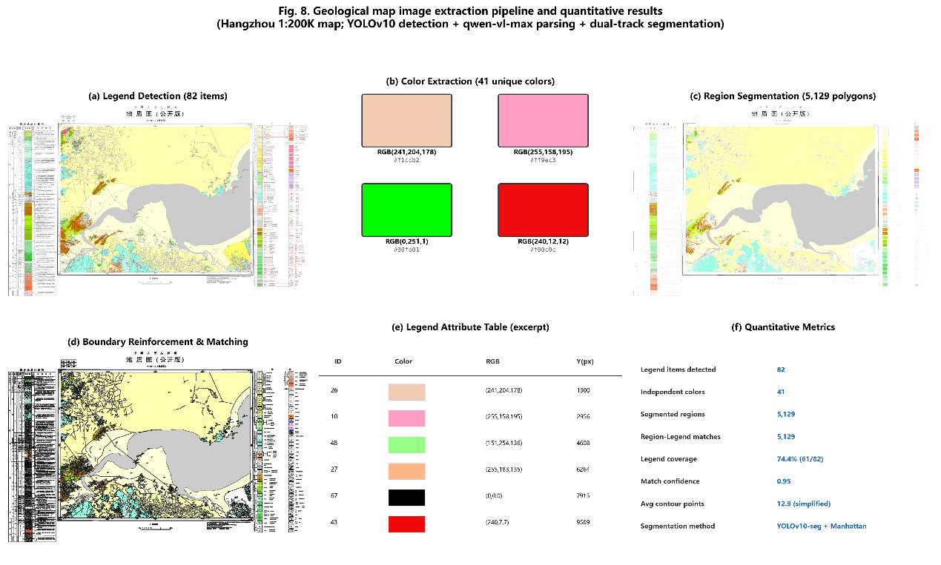
(b) Color Extraction (41 unique colors)
(a) Legend Detection (82 items)
(c) Region Segmentation (5,129 polygons)
RGB(241,204,178)
RGB(255,158,195)
#f1ccb2
#ff9ec3
RGB(0,251,1)
RGB(240,12,12)
#00fb01
#f00c0c
(e) Legend Attribute Table (excerpt)
(f) Quantitative Metrics
(d) Boundary Reinforcement & Matching
ID | Color | RGB | Y(px)
26 |  | (241,204,178) | 1300
10 |  | (255,158,195) | 2956
48 |  | (151,254,136) | 4608
27 |  | (255,183,135) | 6264
67 |  | (0,0,0) | 7915
43 |  | (240,7,7) | 9569
Legend items detected
82
Independent colors
41
Segmented regions
5,129
Region–Legend matches
5,129
Legend coverage
74.4% (61/82)
Match confidence
0.95
Avg contour points
12.9 (simplified)
Segmentation method
YOLOv10-seg + Manhattan
Top to bottom: younger to older strata

