Slide 1
Alpha Auction
Kai Jameson
Avery Bolingbroke
Cole Buhman
Jaden Taylor
Laural Bingham

Slide 2
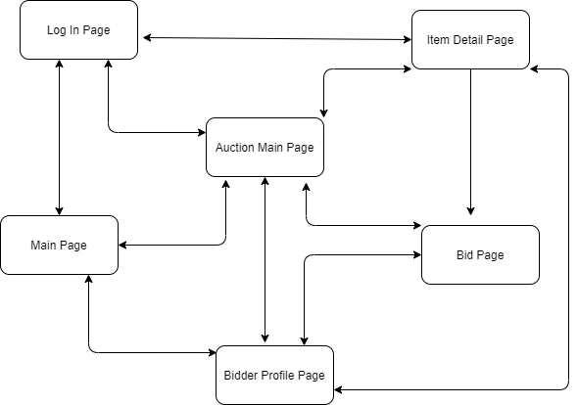
Navigation Tree

Slide 3
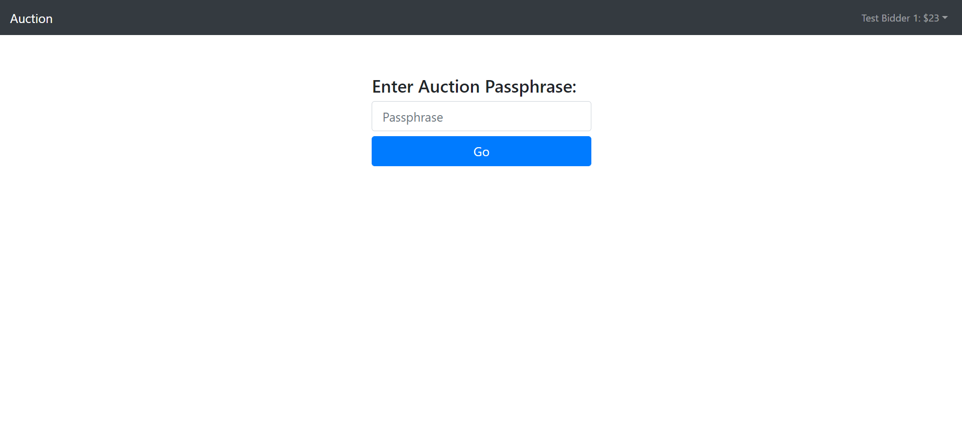
Default Landing Page

Slide 4
Frameworks
Django
Bootstrap
jQuery

Slide 5
Database Design
Bidder
Field | Type | Attr
Id | String | PK
Email | String | Unique
Password | String
Auctions | AuctionList
_favorites | ItemList
First_name | String
Last_name | String
_columns | Int
_currentAuction | Auction | F_K Auction
Bid
Field | Type | Attr
Id | Int | PK, A_I
_bidder | String | F_K Bidder
_bidPrice | Double
_item | Int | F_K Item
_timestamp | Timestamp

Slide 6
Database Design (cont.)
Auction
Item
Field | Type | Attr
Id | Int | PK, A_I
_startTime | Timestamp
_endTime | Timestamp
_name | String
_passphrase | String
Field | Type | Attr
Id | int | PK, A_I
_name | String
_description | String
Images | String
_isLive | Bool
_currentPrice | Int
_minIncrement | Int
_auction | Int | F_K Auction
_category | Category
Image
Field | Type | Attr
Image | Image
Item | Item | FK_Item

