Slide 1

Team 01

Slide 2

Plan
Process
Application demonstration
Usability test and feedback
Universal design
Conclusion

Slide 3
Teamwork & time use
Building relationships
Escape room
Mandatory attendance
Effective collaboration
Coding
Project report & documentation

Slide 4
Development process
Agile development
Scrum
Initial setback
Daily stand-up meetings
Better overview on Gitlab
Restructuring issue boards
High – medium - low priority

Slide 5
Software showcase

Slide 6
Feedback

Slide 7
Usability Testing
Threes test rounds
12 tests in total
Client in each test round
Notes:
In this project, we conducted three iterations of usability tests. These were in accordance with the three Scrum sprints outlined by the progression of the project. Twelve tests were conducted in total, with the client as the only permanent test user. In the first round we tested the prototyped wireframes, thereafter the MVP and lastly the final product.
The reason why we as a team decided on conducting three rounds of user tests, beyond what was required, lay in the fact that we saw the final test as an opportunity to evaluate the final product as well as identifying potential improvements for future iterations.

Slide 8
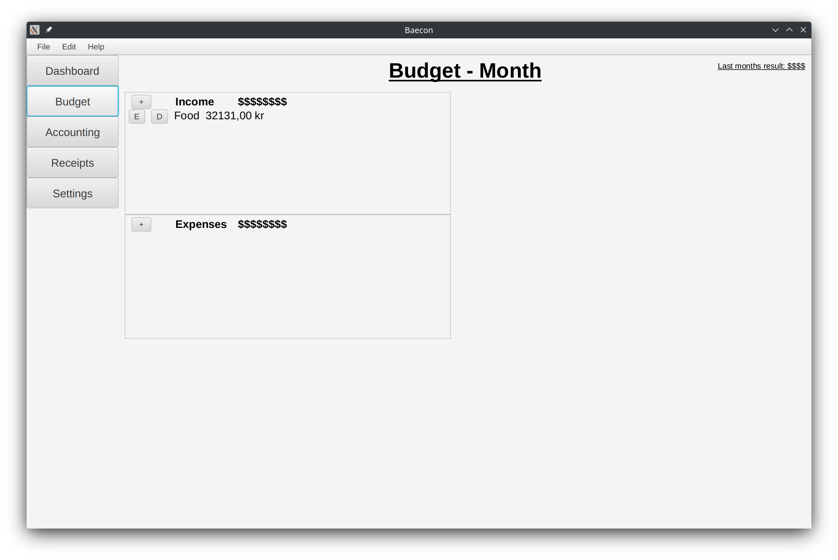
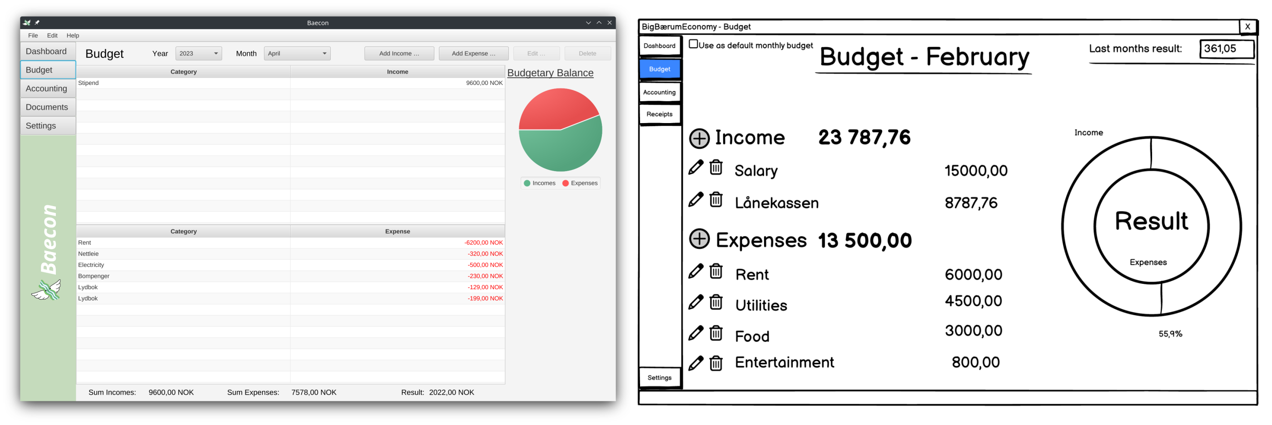
Feedback
“it is evident that the pages are made by different people”
“more consistent formatting”
Notes:
I would like to highlight how we handled the conflicting feedback that appeared around the budget page in the MVP test. Here you can see the appearance of the budget page in the end of each of the sprints, first the wireframe, then the MVP and lastly in the final product. On the one hand, the client expressed satisfaction with the appearance, this could be justified by the resemblance to the wireframe that the client had influenced earlier in the project.
On the other hand, the remaining test user expressed the desire for a coherent application, with one pointing out it is evident that the pages are made by different people. And another on wished for a more consistent formatting.
In sum, this provoked a conflict of interest. Where on the one hand, the client’s inputs had throughout the project weighed heavily, as he was intended as the final user. On the other hand, with support from the writings of the Danish expert in user friendliness of software Jakob Nielsen, it was spoken for the positive effects of a consistent and familiar application. As a team we discussed the pros and cons, an ended up with the familiarity argument as the decisive one. Therefore, in the final sprint, the budget page underwent a revision, where for example table views were added for making a coherent application.
It would also be worth mentioning that the client had nothing to delay on our decision in the final test round, this may speak for a successful decision.

Slide 9
Universal Design

Slide 10
Conclusion

Slide 11
What worked
Teamwork
Clear and realistic goals
Scheduled team meetings in person
User testing
"A Learning Experience"
The application
Notes:
Teamwork:
Really well-functioning team
Great tone and environment
Everyone participated fully
Work done as agreed
Set goals that were realistic and attainable
Scheduled work-sessions
Provided structure and accountability
Discuss and help
User testing:
Everyone participated
Great feedback
Used the feedback
A Learning Experience
Made good use of Vemund's coding experience to benefit and teach the team
Everyone took part in everything
Application:
Works!
Preview of PDF was achieved
Budgeting and Accounting pages works
Accessibility implemented

Slide 12
What could be improved
Entry handling
Database instead of .csv
Encrypted database
Import and export
Recurring entries
Dynamic delete and edit
Database
General
Dashboard logic and information
Colorblind: Shapes and patterns
Notes:
Entries:
Use database instead of CSV-files
Database is made for this
Would make all other entry-related features easier to implement in a better way.
Optional encryption of database, for security and privacy.
Import and export user data via application.
Planned, but not implemented (menu entries).
Recurring entries
Cumbersome and basic: copy-and-paste.
General:
Dashboard logic was tricky get "right" and be useful.
Solved by displaying ACCOUNTING and BUDGETING columns.
Not optimal solution
Colorblind mode
Should have graphs with patterns, not just Grey/Black.
Tried, but limited time

Slide 13
What did we learn
Git and Collaboration tools
The value of user testing
Coding complexity
Status meetings / Daily Stand-up
Notes:
Git and Collaboration:
Learned to use git as a team.
Resolve merge conflicts and branches
Issue board for planning
Become more useful the more actively they are used.
Value of user testing
Outside perspective
We are not the user
Complexity:
Code complexity increased rapidly.
Steep learning curve; Adjusted surprisingly quickly.
Stand-up:
Realized our mistake, forgot something very basic.
Planning and task now worked as planner. Not surprised.

Slide 14

arrakasta
úspěch
angitu
成功
veiksme
manuia
úspěch
úspěch
успех
úspěch
성공
succes
सफलता
successo
sukses
הצלחה
نجاح
suksess
Qapla'
sukceso
Success
llwyddiant
הַצלָחָה
edu
árangur
tagumpay
успіх
serketinî
Succès
powodzenie
sukses
уңыш
menestys
soirbheachas
موفقیت
victoria
Notes:
I, and the rest of the team, declare the project a success.

