Slide 1
Decision tree – a machine learning method to solve classification problems Mai Anh Bui

Slide 2
What is a decision tree?
A decision tree is a flowchart-like structure in which the paths from root to leaf represent classification rules.
Decision trees are the basis of random forest, a more advanced and popular tool in machine learning and classification method.
Color
Yellow
Green
Lemon
Lime
Notes:
A decision tree is a flowchart-like structure in which the paths from root to leaf represent classification rules.
Decision trees are the basis of random forest, a more advanced and popular tool in machine learning and classification methods.
Decisions from all the trees are aggregated into a final decision of a random forest. In other words, the voices of all trees are heard for the final decision of the forest.

Slide 3
A decision tree…
Includes …
A node: an input measure (i.e., an attribute or a characteristic). We rely on the node as a characteristics to put items into different classes (i.e., categories)
Branches: a decision rule based on the input measure.
Leaves: class labels as a result of the split.
A node
Color
Yellow
Green
Branches
Lemon
Lime
Leaves
Notes:
A decision tree includes:
A node is an input measure (i.e., an attribute or a characteristic). We rely on the node as a characteristic to put items into different classes (i.e., categories). We start with a binary classification example in which there are only two categories to identify the object: whether it’s a lemon or a lime. Color appears in the first node, which serves an input measure that provides a criteria for the classification.
Branches indicate a decision rule based on the input feature. In this binary classification, the branches indicate whether the object’s color is either yellow or green.
Leaves: class labels as a result of the split. In this example, the objects are classified as lemon, which stays in one leaf, or lime, which stays in another leaf.

Slide 4
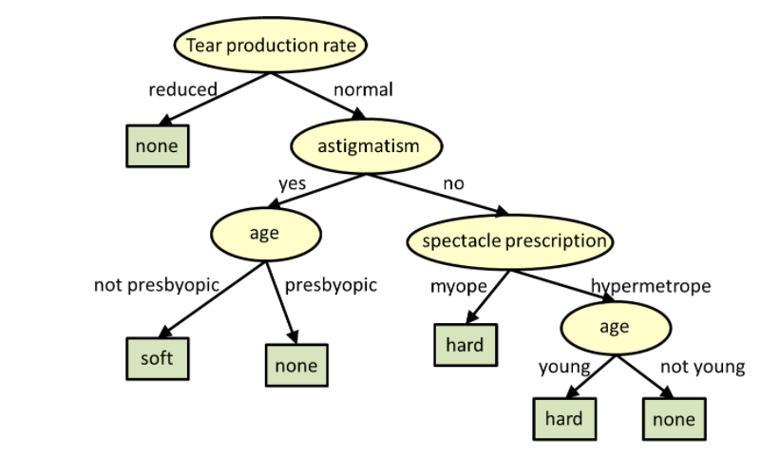
A decision tree example: Type of contact lens to wear
Source: https://www.cs.cmu.edu/~bhiksha/courses/10-601/decisiontrees/
Notes:
This example provides a decision tree with more than one node and one layer, when one node and one layer are not sufficient for an accurate classification. A classification using a decision tree shown here has more layers of the tree to figure out the suitable type of contact lens to wear. It is not a binary example, because there are three classes: people don’t wear contact lenses, wear a soft type, or wear a hard type.
The nodes in different classification layers include the input measures such as tear production rate, astigmatism, age, and spectacle prescription.
For each node, we have two branches, which are the decision rules associated with each node. That is, each input measure has two options to classify the labels. For example, in the first layer of this decision tree, the tear production rate has two branches whether the tear production rate is reduced or normal. If the tear production rate is reduced, the person is classified into the class of no contact lens. If the tear production rate is normal, we need more nodes and layers to classify.
In this example, there are three types of leaves. That is, there are three classified labels, whether the user chooses a soft, a hard, or no contact lens to wear.
The order of the nodes does not indicate the hierarchy of importance. You can start with tear production rate or start with age. The goal is to design a tree structure that reflects an accurate classification in reality or according to your intention. Nodes can appear multiple times, so do leaves; as you can see from this example, age appears twice as an input measure to help classify. This example illustrates the fact that a decision tree can include many different nodes and layers, rather than only one node and one layer like in the previous example.

Slide 5
Doctoral Universities in the Carnegie Classification of Institutions
“Includes institutions that awarded at least 20 research/scholarship doctoral degrees during the update year and also institutions with below 20 research/scholarship doctoral degrees that awarded at least 30 professional practice doctoral degrees in at least 2 programs. Excludes Special Focus Institutions and Tribal Colleges.”
Source: carnegieclassifications.acenet.edu
Notes:
What is the current Carnegie Classifications system? Does it lack equity measures? Why having another set of Classifications is helpful?

Slide 6
Classifying Doctoral Universities in the Carnegie Classification of Institutions
The nodes, i.e., input measures or characteristics, are:
≥ 20 research doctorates and ≥$5 million in research expenditures
Research Activity Index (RAI):
Aggregate RAI: science and engineering (S&E) R&D expenditures; non-S&E R&D expenditures; S&E research staff (postdoctoral appointees and nonfaculty research staff with doctorates); doctoral conferrals by broad disciplinary area (humanities, social sciences, STEM fields, and other fields)
Per-capita RAI: Per-capita S&E R&D Expenditures, Per-capita Non-S&E R&D Expenditures, Per-capita Research Staff. Data are divided by the number of full-time faculty to get the per-capita index

Slide 7
Classifying Doctoral Universities in the Carnegie Classification of Institutions
Leaves, i.e., class labels or categories, are:
R1: Very high research activity
R2: High research activity
D/PU: Doctoral/Professional Universities

Slide 8
Classifying Doctoral Universities in the Carnegie Classification
≥ 20 research doctorates and ≥$5 million in research expenditures
Yes
No
D/PU
‘Very High’ on at least one RAI index: aggregate or per-capita
Name | ≥ 20 research doctorates and ≥$5 million in research expenditures | Aggregate RAI | Per-capita RAI | Label
A | Yes | VH | VH | R1
B | No | Low | Low | D/PU
C | Yes | Low | Low | D/PU
D | Yes | High | VH | R1
E | Yes | High | Low | R2
No
Yes
‘High’ on at least one RAI index: aggregate or per-capita
R1
No
Yes
D/PU
R2
Notes:
Make it clear in the exercise: you will go through a human learning experience, in which you draw a decision tree to reflect the classification you observe in reality for institutions. As you go through the exercise, reflect on your human learning experience, and how you think it would be compared to a machine learning experience?

Slide 9

The machine also learns to create a decision tree
“ Machine learning is a branch of artificial intelligence (AI) and computer science which focuses on the use of data and algorithms to imitate the way that humans learn, gradually improving its accuracy.”
International Business Machines Corporation (IBM)
Notes:
According to IBM, “Machine learning is a branch of artificial intelligence (AI) and computer science which focuses on the use of data and algorithms to imitate the way that humans learn, gradually improving its accuracy.” A machine, like human, goes through many trials and errors to find the best decision tree to reflect classification rules.

Slide 10
Unsupervised versus Supervised Machine Learning
Unsupervised Learning
Supervised Learning
These algorithms discover hidden patterns or data groupings without the need for human intervention, analyze and cluster unlabeled datasets
Clustering: a data mining technique which groups unlabeled data based on their similarities or differences
Principal Component Analysis is an unsupervised learning and clustering method
These algorithms use labeled datasets to train algorithms to classify data or predict outcomes accurately
Classification: draws conclusions on how entities should be labeled or defined, uses an algorithm to accurately assign test data into specific categories
Decision tree is a supervised learning and classification method
Notes:
It’s a dense slide and can take a statistician and data scientist like me, going through many exercises, and up to one year to understand it in depth. An important message is that in an unsupervised learning machine learning technique, like in the PCA method, you start brand new each time for the analysis, you work with unlabeled data without any previously-known information, reinvent the wheel and look for the patterns of the institutions to cluster them into different categories. In a supervised learning method like the decision tree method, you use historically labeled data and known information from the past and build on top of what you know from the past to predict classifications in the future.

Slide 11
Benefits of the decision tree method compared to the PCA method
The decision tree detects the most important and interpretable measures when given hundreds of input measures
There are advanced decision tree models, such as the random forest and XGBoost, to give robust results
The decision tree can reproduce classification rules of external sources with a high accuracy rate, without the need for internal information
The decision tree method illustrates that an institution can reach its goal through multiple paths
The decision tree method retains the development over time of educational institutions
Notes:
[Click]The decision tree detects the most important and interpretable features when given hundreds of input measures
The decision tree method does not require the analyst to determine the best input measures; PCA, conversely, requires the analyst to theorize which variables to include and which to exclude. Given hundreds or thousands of input measures, the decision tree method identifies the best measures that can partition institutions accurately. The PCA method is a dimensionality-reduction technique, which means that institutions’ data are reduced to lower dimensions through the principal components without losing the variation inherent in it. Principal components in the PCA method have low interpretability because principal components are composites of the original measures and are not as interpretable as the original measures. However, the decision tree model gives the importance score for each input measure to notify researchers the most useful measures to classify institutions.
[Click] There are advanced decision tree models to accompany the basic decision tree model
While the PCA method provides one single principal component table to cluster institutions and each institution has one single label result, the random forest and XGBoost methods accompany the basic tree model to give more robust results. When all three tree models determine the same label for an institution, researchers can be confident about the classification result. In a case where there is difference in the results, researchers can investigate further to determine a final classification decision.
[Click] The decision tree method can reproduce classification rules with a high accuracy rate
While external researchers need to spend time and resources to understand deeply the principal component table, the cutoff values, and the methodology in the PCA method, the decision tree method with its built-in algorithm defines its own classification rules and can replicate the original classifications with a high accuracy rate. This benefit helps external researchers classify institutions correctly, without the need to understand deeply the original methodologies from multiple external sources. For example, I can replicate the Carnegie R1 and R2 classifications with a high accuracy rate without the need for a deep understanding of the original PCA method. The three decision tree models (the basic decision tree, the random forest, and the XGBoost) learn from historical 2018 Carnegie Classifications to predict 2021 Carnegie Classifications for R1 and R2 institutions with prediction accuracy rates of above 94 percent. The XGBoost model outperforms with a 95.7 percent prediction accuracy rate.
The PCA method may not be able to replicate results from other social and economic mobility sources. However, the decision tree method can learn from the external social and economic mobility sources such as from the Washington Monthly, and CollegeNet’s historical data and labels of institutions’ economic and social mobility and give us classification references when applying to our own dataset.
[Click] The decision tree method illustrates that an institution can reach its goal through multiple paths
The flow-chart of the current Carnegie Classification system illustrates one single path that an institution can reach a particular category or label. However, there is no limit in terms of how many times a leaf (i.e., a label or a category) can appear in different layers and different paths of a decision tree. This means that there are multiple ways that an institution can achieve a label. That is, there are multiple different ways that an institution can achieve the goal.
[Click] The decision tree method retains the development over time of educational institutions
The PCA method groups unlabeled educational institutions based on their similarities or differences at a given time. Each time we cluster institutions using the PCA method, we use a fresh pair of eyes to look at the institutions without relying on any historical information. The decision tree utilizes historical classifications of educational institutions, trains algorithms, identifies measures that are most important to demonstrate the existing classifications, and predicts institutions’ future outcomes accurately. If the future values of important measures can be pre-estimated, the decision tree can predict institutions’ future labels. For example, if an institution’s endowment is estimated to be increasing next year, and endowment is an important feature, the institution’s development in the upcoming year can be predicted.

Slide 12
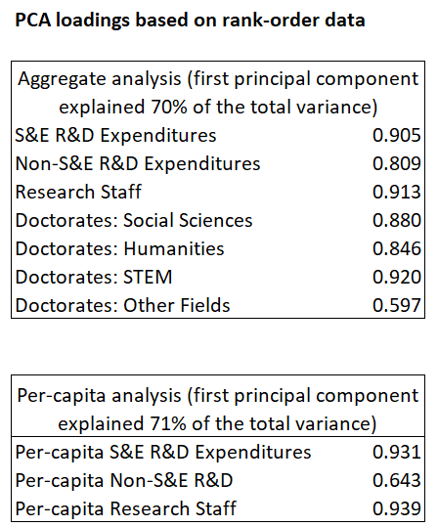
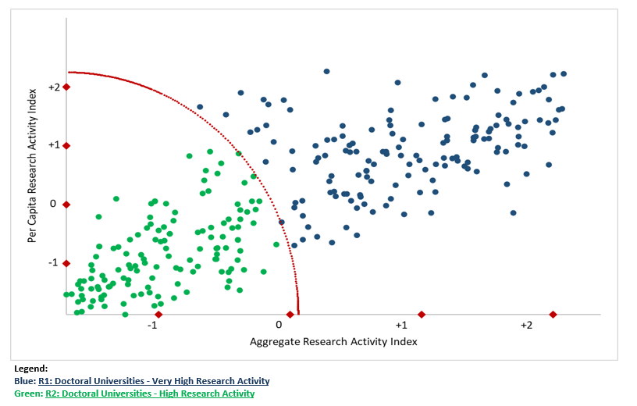
Clustering R1 and R2
Notes:
To illustrate a benefit that the decision tree can reproduce classification rules of external sources with a high accuracy rate, without the need for internal information, let’s look more closely at the current Carnegie Classification’s PCA method to cluster R1 and R2.
R1 and R2 are clustered based on 2 dimensions: aggregate research activity index, and per capita research activity index. These dimensions are the first loadings under the principal component analysis (PCA). The PCA method is a dimensionality-reduction method. For example, under the aggregate analysis, instead of using 7 variables separately as 7 dimensions to represent data, the PCA method transforms a large set of variables into one single dimension, which is the first loading, that still contains most of the information of in the large set. In this case, the first loading for the aggregate analysis represents 70 percent of the total variance in the data. And the first loading for per-capita analysis represents 71 percent of the total variance in the data.
Each institution is scored based on the two dimensions. The further that the institution is away from the origin point, the higher the research activity is. This method uses unfixed cutoff values, which are illustrated in red dots, that may create difficulty to interpret and imitate for external researchers. Let’s explore how the decision tree model can help us predict 2021 classifications for R1 and R2 by using their 2018 data and labels, without the need to understand deeply the cutoff values from the original research team.

Slide 13
Machine learning process
Learn
2018 data
Apply
2021 data
Evaluate
Feature importance
Model accuracy rate
Notes:
The machine learning process in my application in the Carnegie Classification project is a 3-step process.
First, the machine learns from 20 input measures and the pre-classified labels in 2018. In this case, I still use my judgment to include 20 input measures that can contribute to the classification. Besides the existing list of input measures in the PCA method, which includes S&E R&D expenditures, non-S&E R&D expenditures, research staff, Doctorates in STEM, Humanities, Social Sciences, and in professional fields. I include 13 additional measures that can relate to an institution’s research activities, which include research/scholarship doctoral degrees: Arts & Science, research/scholarship doctoral degrees, full-time faculty, total degrees, ACT score, enrollment, research/scholarship doctoral degrees in professional/other fields, number of first-time entering students who submitted SAT score, selectivity, region code, doctoral degrees – professional practice, doctoral degrees – other, and institution confers research/scholarship doctoral degrees. However, the decision tree model does not have a limit on the numbers of input measures to include. The model will sort through all input measures to find the most important measures to include in the tree.
Second, after learning from 2018 data, the machine can apply the model to the 20 relevant input measures in 2021, then make a prediction of the classification labels of institutions in 2021.
Finally, we can evaluate the machine learning process. We can rely the feature importance as suggested by the model, that is, the list of input measures that are important in the classification. We can also look at the model accuracy rate, that is, the percentage of correct predictions out of all predictions.

Slide 14
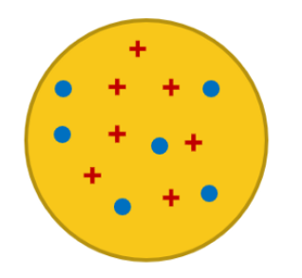
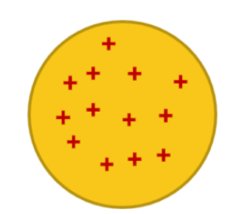
How the decision tree detects important features
Given historical data, we can determine the input measures that are important to the accurate classification.
For future prediction, input measures having higher levels of importance can be utilized more frequently. The node that can partition data into subsets that are pure has a higher level of importance.
Not Pure
Pure
Notes:
The node or measure can partition data into subsets that are pure and has a higher level of importance. “Purity” in this context as in physical science, which means the level of mixtures of elements.
[Click]
A subset is pure means that the subset contains samples of only one class. In other words, objects with similar traits are grouped together. As you see from this group, objects with different traits are grouped together; we see some pluses and some circles.
[Click]
This subset is not pure, and the node that leads to this classification has a lower level of importance, because of the node and its associated rules, objects with different traits are grouped together.
[Click] [Click] (2 times)
The node that creates a purer subset on the right-hand side has a higher level of importance. This node and its associated rules, perfectly categorize objects with the same characteristics together.
An example is to look at the classification of apples and oranges with two different nodes color and weight. Color can have a higher level of importance because red objects are put into the apple bucket, and orange objects are put into the orange bucket to create pure subsets. Weight, on the other hand, can have a lower level of importance. For example, with the classification rule whether the object is heavier than 150 grams may not give us a pure partition of apples and oranges.

Slide 15
Feature importance: what nodes are important
 | Feature Importance
Decision tree | Random forest | XGBoost
Research/scholarship doctoral degrees: Arts & Science | Research/scholarship doctoral degrees: Arts & Science | Research/scholarship doctoral degrees: Arts & Science
Research staff | Doctorates: STEM | S&E R&D Expenditures
Non-S&E R&D Expenditures | Research/scholarship doctoral degrees | Research staff
ACT score | S&E R&D Expenditures | Doctorates: Others
 | Research staff | Research/scholarship doctoral degrees
 | Non-S&E R&D Expenditures | Non-S&E R&D Expenditures
 | Doctorates: Social Science | Doctorates: Humanities
 | Full-time faculty | Doctorates: STEM
 | Doctorates: Humanities | Full-time faculty
 | Total degrees | Region code
Notes:
The decision tree models agree with the PCA method that important measures to classify are S&E R&D Expenditures, Non-S&E R&D Expenditures, Research staff, Doctorates: STEM, Social Sciences, Humanities, and in professional fields. The decision tree models detect other important measures for the R1/R2 classification such as research/scholarship doctoral degrees: Arts and Science, which ranks first in the importance score in all three decision tree models.

Slide 16
Prediction accuracy rate of decision tree models
Decision tree
94.3%
Random Forest
95 %
XGBoost
95.7 %
Notes:
Decision tree methods in machine learning are claimed to have powerful prediction power. Given 2018 data to learn from, are you curious how well the three decision tree models can predict 2021 data in our case study?
For the basic decision tree method in which only one tree is used, the prediction accuracy rate is … 94.3 percent.
For the random forest in which multiple trees are used simultaneously, the prediction accuracy rate is … 95 percent.
The XGBoost method in which the threes are built sequentially, and each subsequent tree improves on the errors of the previous tree, the prediction accuracy rate is … 95.7 percent.
These prediction accuracy rate results are consistent with the claim that these decision tree models perform well in classification.

Slide 17
Thank You!
17
Notes:
17

