Slide 1
Source code Version Control : Gitlab Tool
By : CRM Department
26 Jul 2017

Slide 2
Agenda
Objective
What is Source control?
Source control Benefit
What is Git?
Git Life Cycle
What is Gitlab?
Getting Start with Gitlab
Gitlab Basics
Gitlab Markdown
Reference

Slide 3
Objective
เพื่อให้ Source code มีความถูกต้อง (Integrity) มีความพร้อมใช้ (Availability) และสามารถตรวจสอบย้อนกลับได้ (Traceability)

Slide 4
What is Version control ?
Version Control is the ability to manage the change and configuration of an application. Versioning is a priceless process, especially when you have multiple developers working on a single application, because it allows them to easily share files. Without version control, developers will eventually step on each other’s toes and overwrite code changes that someone else may have completed without even realizing it. Using these systems allows you to check files out for modifications, then, during check-in, if the files have been changed by another user, you will be alerted and allowed to merge them.
http://www.seguetech.com/a-review-of-software-version-control-systems-benefits-and-why-it-matters/

Slide 5
Version Control Benefits
Version control systems allow you to compare files, identify differences, and merge the changes if needed prior to committing any code. Versioning is also a great way to keep track of application builds by being able to identify which version is currently in development, QA, and production. Also, when new developers join the team, they can easily download the current version of the application to their local environment using the version control system and are able to keep track of the version they’re currently running. During development, you can also have entirely independent code versions if you prefer to keep different development efforts separate. When ready, you can merge the files to create a final working version.
Another great use for versioning is when troubleshooting an issue, you are able to easily compare different versions of files to track differences. You can compare the last working file with the faulty file, decreasing the time spent identifying the cause of an issue. If the user decides to roll back the changes, you can implement the last working file by using the correct version.
http://www.seguetech.com/a-review-of-software-version-control-systems-benefits-and-why-it-matters/

Slide 6
Source code control procedure
1. Software ที่พัฒนาโดย GLS ทั้งหมด ต้องมีการเก็บ Source code ไว้ใน Source code management tool (Source code must be stored in source code management tool for all software developed by GLS)
2. การแก้ไข/เปลี่ยนแปลงใด ๆ ใน Source code ต้องมีการปรับปรุงข้อมูลใน Source code management tool เมื่อสิ้นสุดการทำงานในแต่ละวัน (All changing/ modifying to source code must be updated in source code management tool at the end of the day)
3. ภายหลังการเปลี่ยนแปลง Source code ต้องทดสอบการทำงานของ Application ให้ถูกต้องก่อนนำ Source code ไปเก็บใน Source code management tool รวมถึงมีการกำหนด Source code version ด้วย (The application should be properly test before updating source code in source code management tool with an appropriate source code control version)
4. กรณีที่ source code ถูกแก้ไขโดย developer มากกว่า 1 คน ต้องมีกระบวนการตรวจสอบหากมีการแก้ไข source code ทับซ้อนกัน (If source code are modified by multiple developers, there should be reviewing process to prevent the overlap / duplication of source code)
5. ต้องมีกระบวนการติดตั้ง Software ในระบบ Test และ Production ให้ชัดเจน (Establish a software installation procedure for test and production environment)

Slide 7
What is Git?
Git is a system where you can create projects of different sizes with speed and efficiency. It helps you manage code, communicate and collaborate on different software projects. Git will allow you to go back to a previous status on a project or to see its entire evolution since the project was created. You could think of it as a time machine which will allow you to go back in time to whenever you’d like in your project. With Git, 3 basic issues were solved when working on projects:
It became easier to manage large projects.
It helps you avoid overwriting the team’s advances and work.
With git, you just pull the entire code and history to your machine, so you can calmly work in your own little space without interference or boundaries. It's much simpler and much more light-weight.

Slide 8
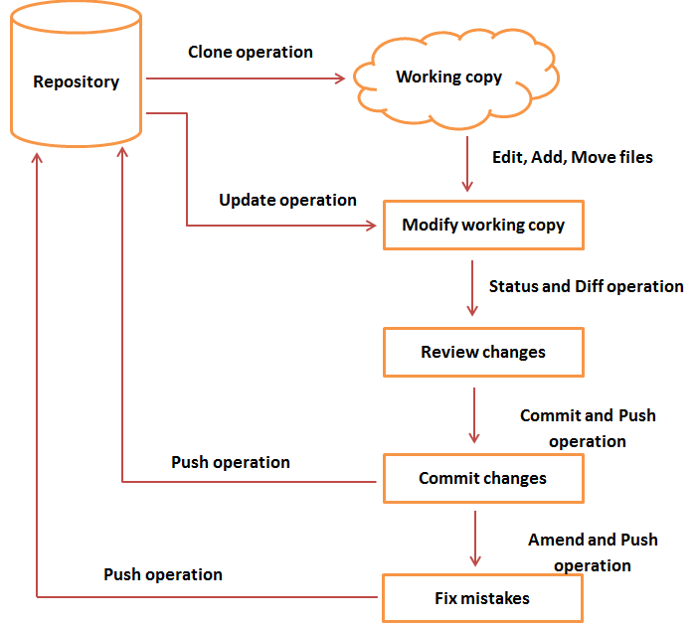
Git Life Cycle

Slide 9
What is GitLab?
GitLab is a Git-based fully featured platform for software development.
GitLab Community Edition (CE) is an open source product, self-hosted, free to use. All GitLab products contain the features available in GitLab CE. Premium features are available in GitLab Enterprise Edition (EE).

Slide 10
Getting started with GitLab
GitLab Basics: Start working on your command line and on GitLab.
GitLab Markdown: GitLab's advanced formatting system (GitLab Flavored Markdown).

Slide 11
GitLab Basics
Command line basics
Start using Git on the command line
Create a group
Create a project
Create a branch
Create a merge request
Tags
Create an issue

Slide 12
GitLab Basics: Command line basics

Slide 13
GitLab Basics : Command line basics - 1
A clone of the project will be created in your computer.
git clone PASTE HTTPS OR SSH HERE
Go into a project, directory or file to work in it
cd NAME-OF-PROJECT-OR-FILE
Go back one directory or file
cd ../
View what’s in the directory that you are in
ls (on window -> dir)

Slide 14
GitLab Basics : Command line basics - 2
Create a directory
mkdir NAME-OF-YOUR-DIRECTORY
Create a README.md or file in directory
touch README.md (on window -> type NUL > README.md)
nano README.md (on window -> notepad README.md)
Remove a file
rm NAME-OF-FILE (on window - > del NAME-OF-FILE)
Remove a directory and all of its contents
rm -rf NAME-OF-DIRECTORY (on window - > rmdir NAME-OF-DIRECTORY)

Slide 15
GitLab Basics: Using Git on the command line

Slide 16
GitLab Basics : Using Git on the command line – 1
Using Git on the command line
Check Git version you have on your computer.
git -–version
Set username
git config --global user.name "YOUR_USERNAME"
Verify username
git config --global user.name
Set email
git config --global user.email "your_email@example.com"
Verify email
git config --global user.email

Slide 17
GitLab Basics : Using Git on the command line – 2
View the information
git config --global --list
Go to the master or branch
git checkout master
Download the latest changes in the project
git pull REMOTE NAME-OF-BRANCH -u
Create a branch
git checkout -b NAME-OF-BRANCH
View the changes you've made
git status

Slide 18
GitLab Basics : Using Git on the command line – 3
Add changes to commit
git add CHANGES IN RED
git commit -m "DESCRIBE THE INTENTION OF THE COMMIT"
Send changes to git.bdms.co.th
git push REMOTE NAME-OF-BRANCH
Delete all changes in the Git repository, but leave unstaged things
git checkout .
Delete all changes in the Git repository, including untracked files
git clean -f

Slide 19
GitLab Basics : Using Git on the command line – 4
Ignore file (skip add changes)
.gitignore
Merge created branch with master branch
git checkout NAME-OF-BRANCH
git merge master
Merge master branch with created branch
git checkout master
git merge NAME-OF-BRANCH

Slide 20
GitLab Basics : Using Git on the command line – 5
Tags
# Lightweight tag
git tag my_lightweight_tag
# Annotated tag
git tag -a v1.0 -m ‘Version 1.0’
git tag
git push origin –tags
List both remote-tracking branches and local branches.
git branch -a

Slide 21
GitLab Basics : Using Git on the command line – 6
Fetch all remotes.
git fetch --all
Need Help?
git help <verb>
git <verb> --help

Slide 22
Overview Structure
Group Name
Created by : System Admin
and Assign Owner or Master role in group
Project Name
Created by : Owner or Master role
Member 1
Member 2
Assigned by : Owner or Master

Slide 23
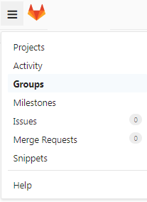
Gitlab Basics
How to create a group in Gitlab
Your projects in GitLab can be organized in 2 different ways: under your own namespace for single projects, such as your-name/project-1 or under groups. If you organize your projects under a group, it works like a folder. You can manage your group members' permissions and access to the projects.
To create a group:
1. Expand the top left sidebar by clicking the three bars at the upper left corner and then navigate to Groups.

Slide 24
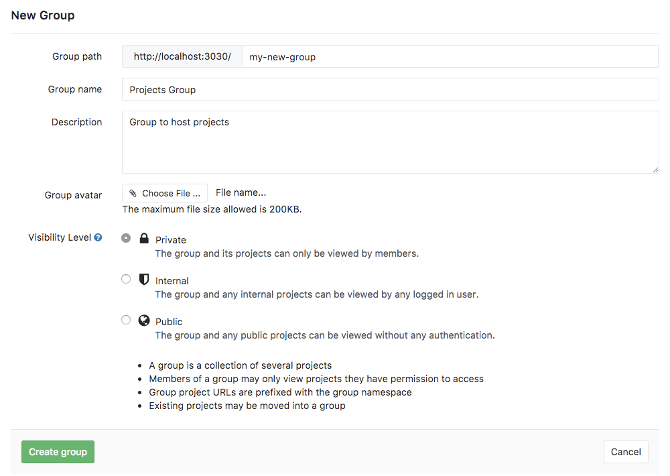
Gitlab Basics
How to create a group in GitLab
To create a group:
2. Once in your groups dashboard, click on New group.

Slide 25
Gitlab Basics
How to create a group in GitLab
To create a group:
3. Fill out the needed information:
Set the "Group path" which will be the namespace under which your projects will be hosted (path can contain only letters, digits, underscores, dashes and dots; it cannot start with dashes or end in dot).
The "Group name" will populate with the path. Optionally, you can change it. This is the name that will display in the group views.
Optionally, you can add a description so that others can briefly understand what this group is about.
Optionally, choose and avatar for your project.
Choose the visibility level.
4. Finally, click the Create group button.

Slide 26
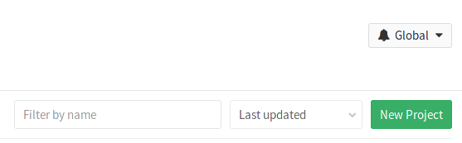
GitLab Basics
Add a new project to a group
There are 2 different ways to add a new project to a group:
Select a group and then click on the New project button.

Slide 27
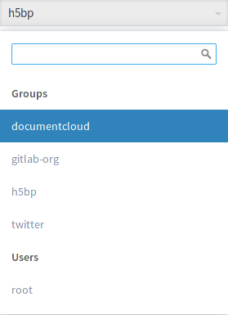
GitLab Basics
Add a new project to a group
While you are creating a project, select a group namespace you've already created from the dropdown menu.

Slide 28
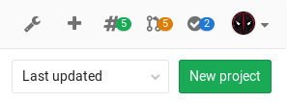
GitLab Basics
How to create a project in GitLab
1. In your dashboard, click the green New project button or use the plus icon in the upper right corner of the navigation bar.

Slide 29
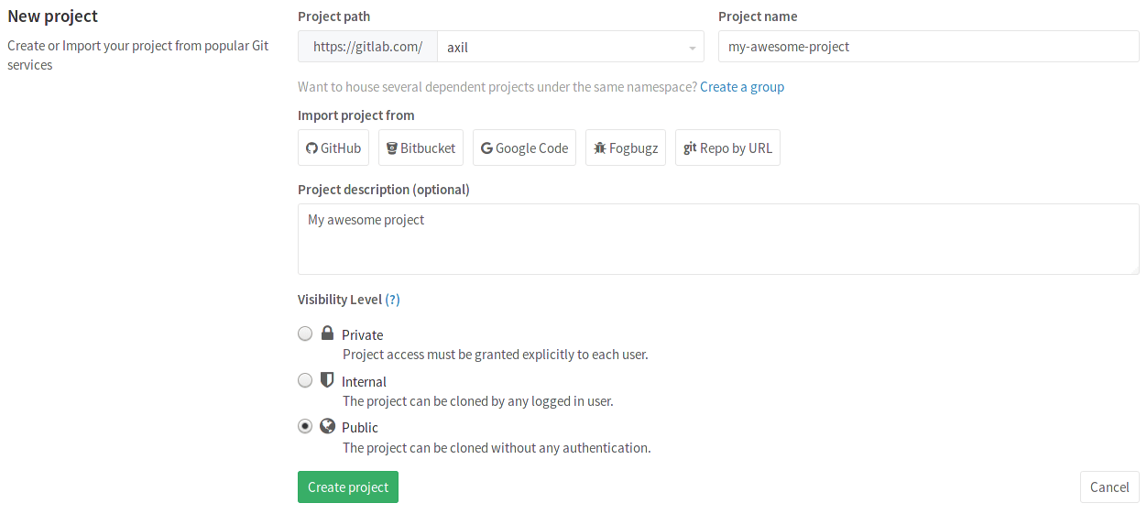
GitLab Basics
How to create a project in GitLab
2. This opens the New project page.

Slide 30
GitLab Basics
How to create a project in GitLab
3. Provide the following information:
Enter the name of your project in the Project name field. You can't use special characters, but you can use spaces, hyphens, underscores or even emoji.
If you have a project in a different repository, you can import it by clicking an Import project from button provided this is enabled in your GitLab instance. Ask your administrator if not.
The Project description (optional) field enables you to enter a description for your project's dashboard, which will help others understand what your project is about. Though it's not required, it's a good idea to fill this in.
Changing the Visibility Level modifies the project's viewing and access rights for users.
4. Click Create project.

Slide 31
GitLab Basics
How to create a branch
A branch is an independent line of development.
New commits are recorded in the history for the current branch, which results in taking the source from someone’s repository (the place where the history of your work is stored) at certain point in time, and apply your own changes to it in the history of the project.
To add changes to your GitLab project, you should create a branch. You can do it in your terminal or by using the web interface.

Slide 32
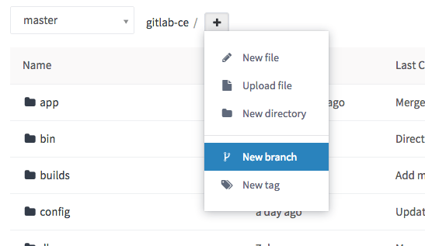
GitLab Basics
How to create a branch
Create a new branch from a project's dashboard
If you want to make changes to several files before creating a new merge request, you can create a new branch up front. From a project's files page ,choose New branch from the dropdown.

Slide 33
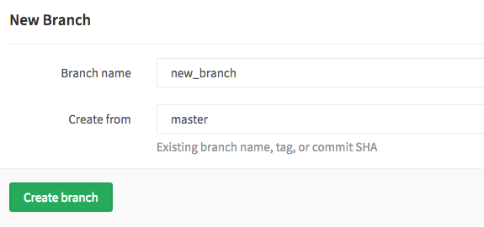
GitLab Basics
How to create a branch
Create a new branch from a project's dashboard
Enter a new Branch name. Optionally, change the Create from field to choose which branch, tag or commit SHA this new branch will originate from. This field will autocomplete if you start typing an existing branch or tag. Click Create branch and you will be returned to the file browser on this new branch.

Slide 34
GitLab Basics
How to create a branch
Create a new branch from a project's dashboard
You can now make changes to any files, as needed. When you're ready to merge the changes back to master you can use the widget at the top of the screen. This widget only appears for a period of time after you create the branch or modify files.

Slide 35
GitLab Basics
How to create a merge request
Merge requests are useful to integrate separate changes that you've made to a project, on different branches. This is a brief guide on how to create a merge request. For more information, check the merge requests documentation.
Before you start, you should have already created a branch and pushed your changes to GitLab.
You can then go to the project where you'd like to merge your changes and click on the Merge requests tab.

Slide 36

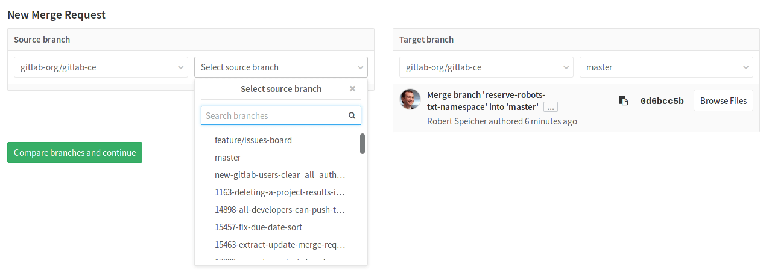
GitLab Basics
How to create a merge request
Click on New merge request on the right side of the screen.
Select a source branch and click on the Compare branches and continue button.

Slide 37
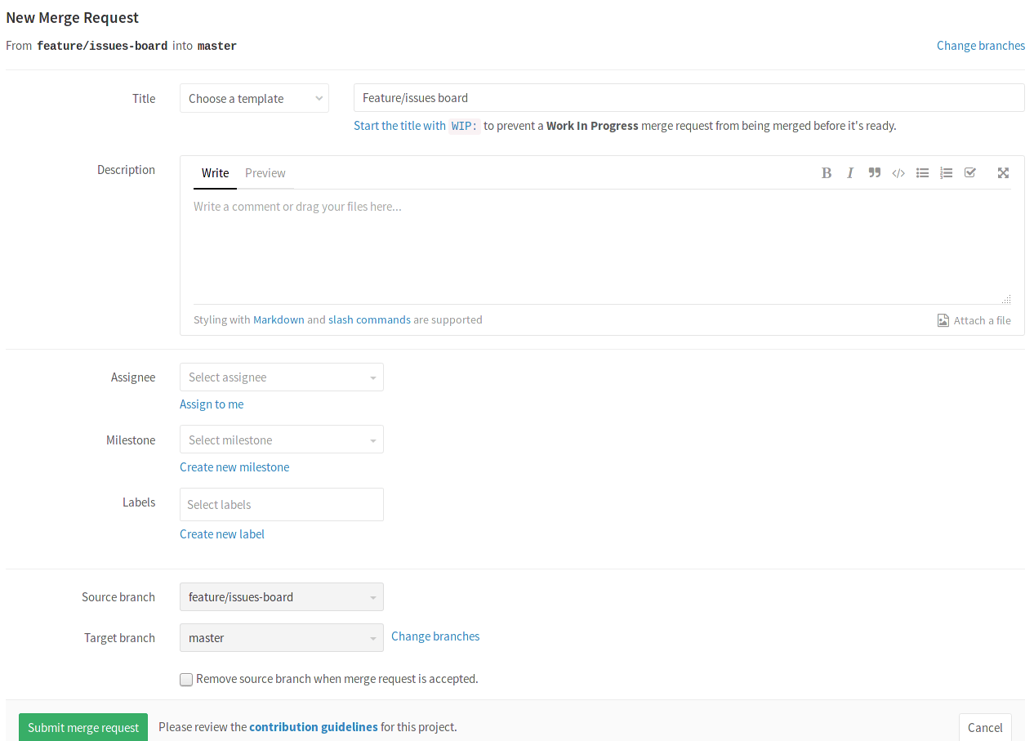
GitLab Basics
How to create a merge request
At a minimum, add a title and a description to your merge request. Optionally, select a user to review your merge request and to accept or close it. You may also select a milestone and labels.

Slide 38
GitLab Basics
How to create a merge request
When ready, click on the Submit merge request button. Your merge request will be ready to be approved and published.

Slide 39
GitLab Basics
Tags
Useful for marking deployments and releases
Annotated tags are an unchangeable part of Git history
Soft/lightweight tags can be set and removed at will
Many projects combine an annotated release tag with a stable branch
Consider setting deployment/release tags automatically

Slide 40
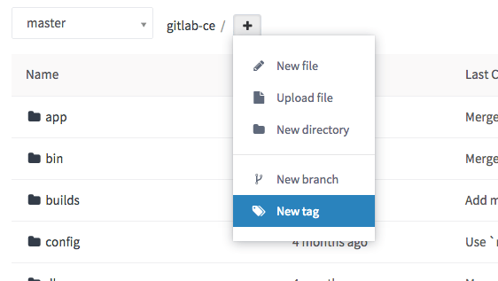
GitLab Basics
Create a new tag
Tags are useful for marking major milestones such as production releases, release candidates, and more. You can create a tag from a branch or a commit SHA. From a project's files page, choose New tag from the dropdown.

Slide 41
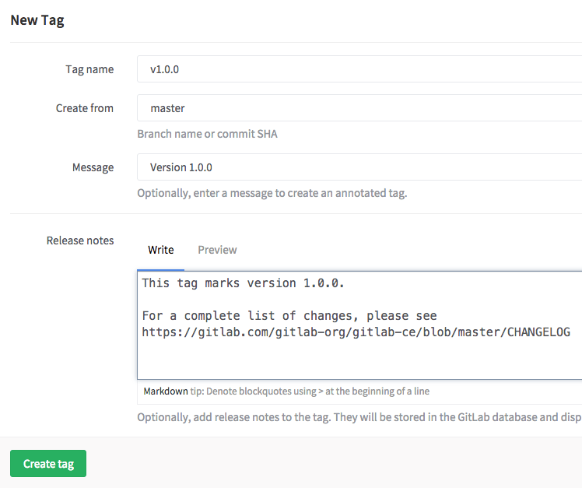
GitLab Basics
Create a new tag
Give the tag a name such as v1.0.0. Choose the branch or SHA from which you would like to create this new tag. You can optionally add a message and release notes. The release notes section supports markdown format and you can also upload an attachment. Click Create tag and you will be taken to the tag list page.

Slide 42
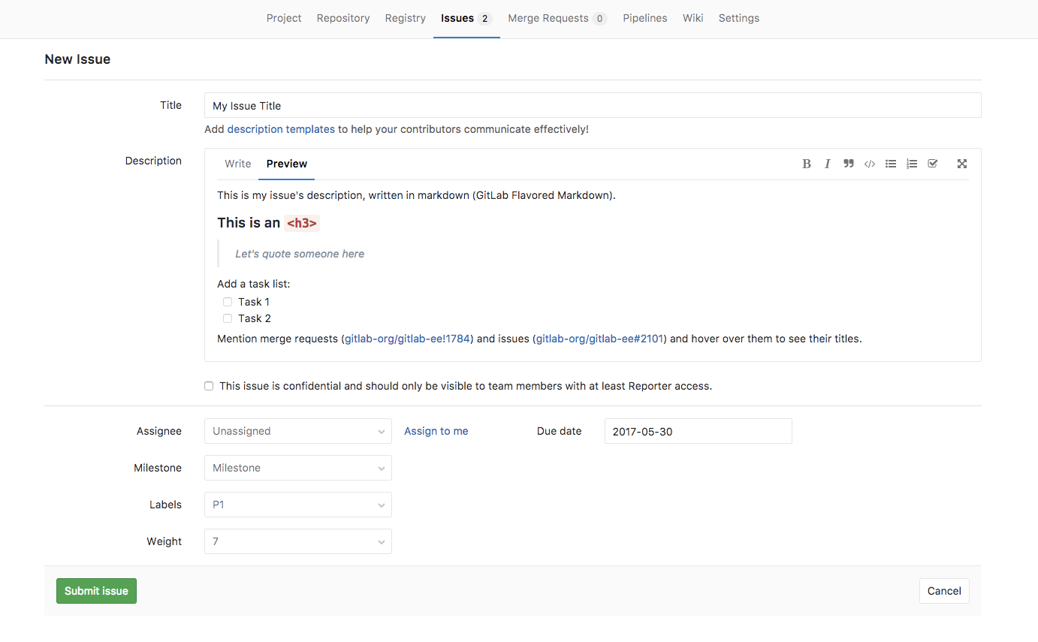
GitLab Basics
Create a new Issue
When you create a new issue, you'll be prompted to fill in the information illustrated on the image below.

Slide 43
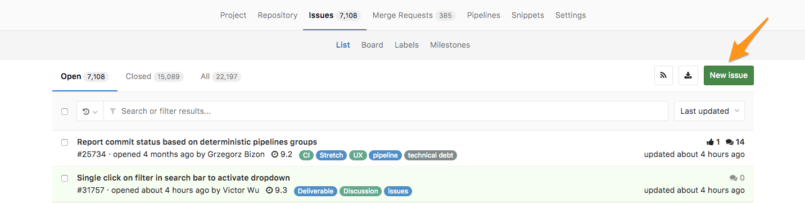
GitLab Basics
Create a new Issue
New issue from the Issue Tracker
Navigate to your Project's Dashboard > Issues > New Issue to create a new issue:

Slide 44
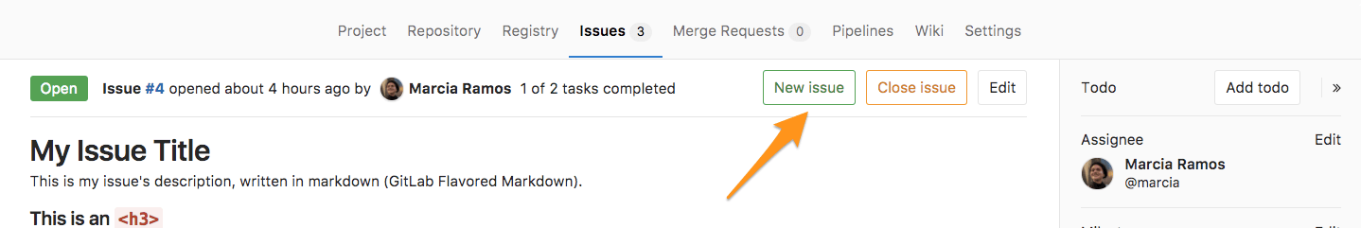
GitLab Basics
Create a new Issue
New issue from an opened issue
From an opened issue in your project, click New Issue to create a new issue in the same project:

Slide 45
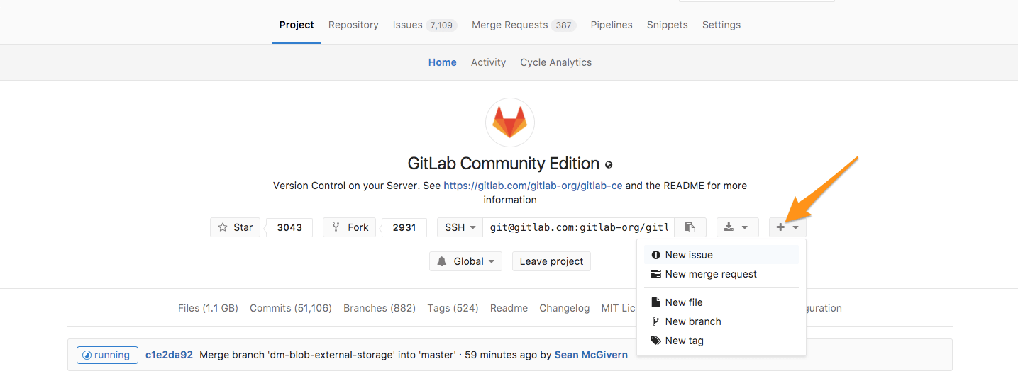
GitLab Basics
Create a new Issue
New issue from the project's dashboard
From your Project's Dashboard, click the plus sign (+) to open a dropdown menu with a few options. Select New Issue to create an issue in that project:

Slide 46
User account
User permissions: Learn what each role in a project (external/guest/reporter /developer/master/owner) can do.
Permissions
Users have different abilities depending on the access level they have in a particular group or project. If a user is both in a group's project and the project itself, the highest permission level is used. On public and internal projects the Guest role is not enforced. All users will be able to create issues, leave comments, and pull or download the project code. When a member leaves the team the all assigned Issues and Merge Requests will be unassigned automatically. GitLab administrators receive all permissions.

Slide 47
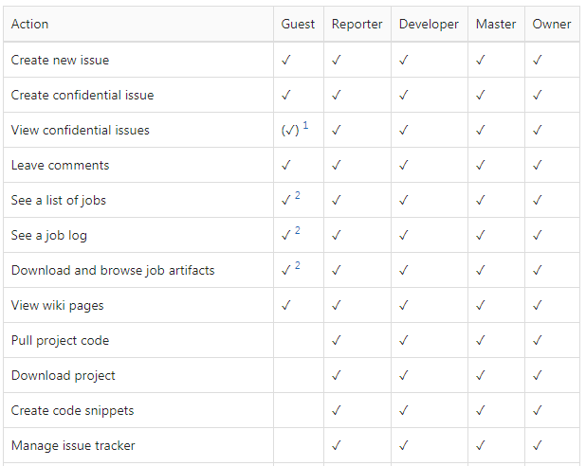
User account
Project
The following table depicts the various user permission levels in a project.

Slide 48
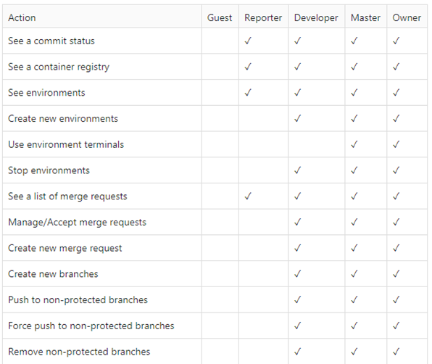
User account
Project
The following table depicts the various user permission levels in a project.

Slide 49
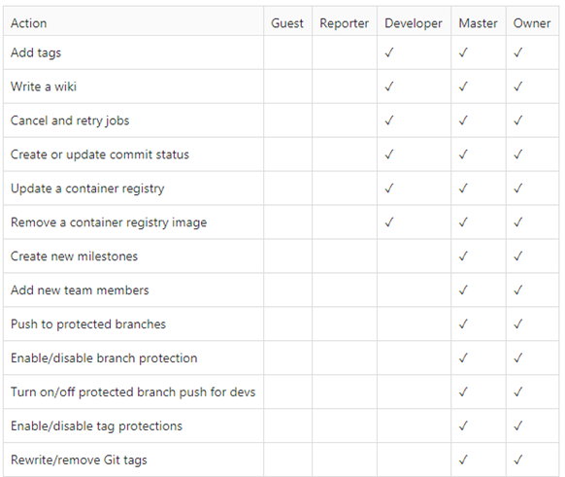
User account
Project
The following table depicts the various user permission levels in a project.

Slide 50
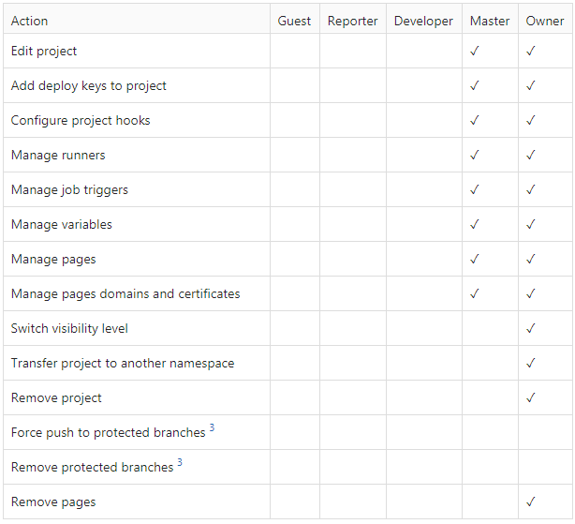
User account
Project
The following table depicts the various user permission levels in a project.

Slide 51
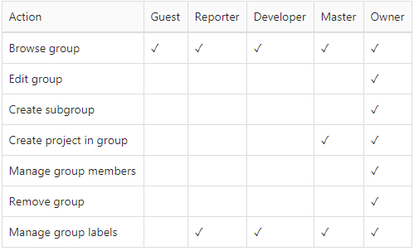
User account
Group
Any user can remove themselves from a group, unless they are the last Owner of the group. The following table depicts the various user permission levels in a group.

Slide 52
Application Owner ID

Slide 53
GitLab with GLS Project
Source Code Version Control
Running Number 3 Digit (1.2.3)
1 – Major = เปลี่ยนโครงสร้าง, New release
2 – Minor Change = new function ไม่กระทบโครงสร้าง
3 – Developer Change = fix bug
Tag Version Control with Tags API
Manage Group & Sub group

Slide 54
Branch Concept
Master
Hotfix
Release
Develop
Master
REQ #1
V0.0.1
REQ #2
V0.0.1
REQ #3
V1.0.0
V0.0.2
V1.0.0
REQ #4
V1.1.0
REQ #5
V1.2.0
BUG #1
V1.1.0
V0.0.2
BUG #2
V1.2.0

Slide 55

Git flow and its problems

Slide 56
GitLab Markdown
GitLab Flavored Markdown (GFM)
GitLab uses "GitLab Flavored Markdown" (GFM). It extends the standard Markdown in a few significant ways to add some useful functionality. It was inspired by GitHub Flavored Markdown.

Slide 57
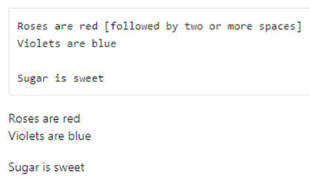
GitLab Markdown
GitLab Flavored Markdown (GFM)
Newlines
A paragraph is simply one or more consecutive lines of text, separated by one or more blank lines. Line-breaks, or soft returns, are rendered if you end a line with two or more spaces:

Slide 58
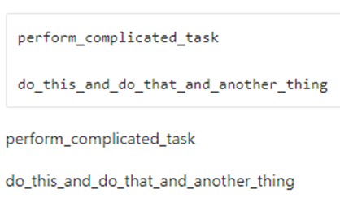
GitLab Markdown
GitLab Flavored Markdown (GFM)
Multiple underscores in words
It is not reasonable to italicize just part of a word, especially when you're dealing with code and names that often appear with multiple underscores. Therefore, GFM ignores multiple underscores in words:

Slide 59
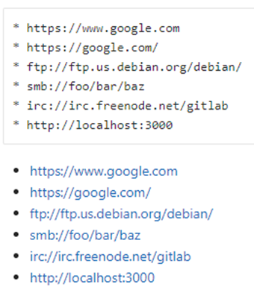
GitLab Markdown
GitLab Flavored Markdown (GFM)
URL auto-linking
GFM will auto link almost any URL you copy and paste into your text:

Slide 60
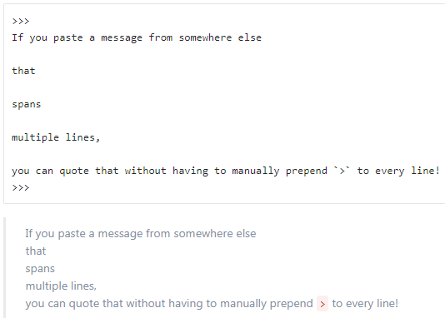
GitLab Markdown
GitLab Flavored Markdown (GFM)
Multiline Blockquote
On top of standard Markdown blockquotes, which require prepending > to quoted lines, GFM supports multiline blockquotes fenced by >>>:

Slide 61
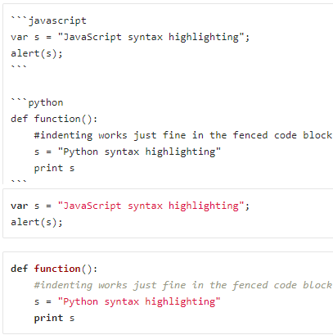
GitLab Markdown
GitLab Flavored Markdown (GFM)
Code and Syntax Highlighting
Blocks of code are either fenced by lines with three back-ticks ```,or are indented with four spaces. Only the fenced code blocks support syntax highlighting:

Slide 62

GitLab Markdown
GitLab Flavored Markdown (GFM)
Inline Diff
With inline diffs tags you can display additions or deletions .
The wrapping tags can be either curly braces or square brackets additions or deletions .
However the wrapping tags cannot be mixed as such:

Slide 63
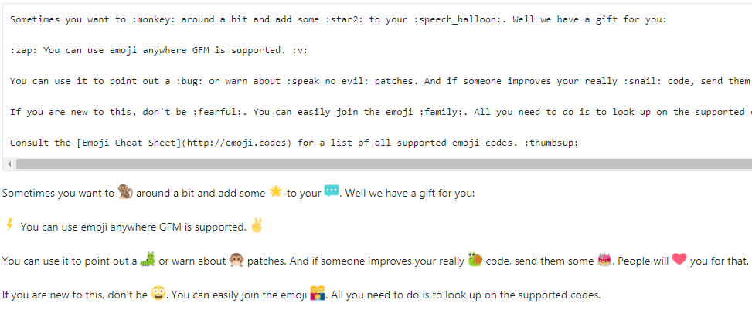
GitLab Markdown
GitLab Flavored Markdown (GFM)
Emoji

Slide 64
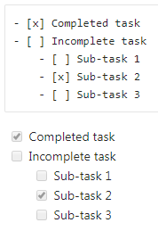
GitLab Markdown
GitLab Flavored Markdown (GFM)
Task Lists
You can add task lists to issues, merge requests and comments. To create a task list, add a specially-formatted Markdown list, like so:

Slide 65
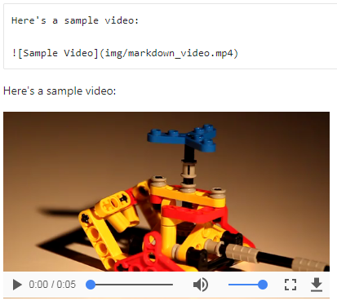
GitLab Markdown
GitLab Flavored Markdown (GFM)
Videos
Image tags with a video extension are automatically converted to a video player.
The valid video extensions are .mp4, .m4v, .mov, .webm, and .ogv.

Slide 66
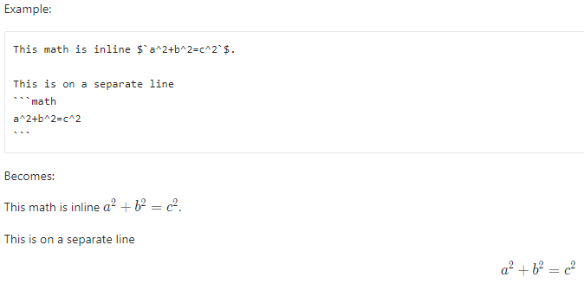
GitLab Markdown
GitLab Flavored Markdown (GFM)
Math
It is possible to have math written with the LaTeX syntax rendered using KaTeX.
Math written inside $``$ will be rendered inline with the text.
Math written inside triple back quotes, with the language declared as math, will be rendered on a separate line.

Slide 67
Reference
https://docs.gitlab.com/ce/README.html
https://git-scm.com/

