Slide 1
Data type
primitives
undefined :
Boolean :
Number :
String :
BigInt :
Symbol :
Object
Null: là object
Funtion

Slide 2
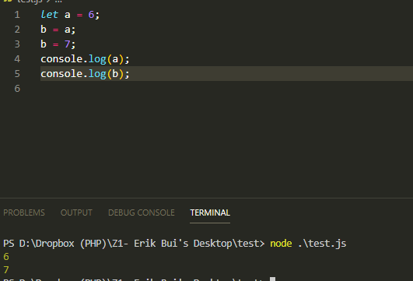
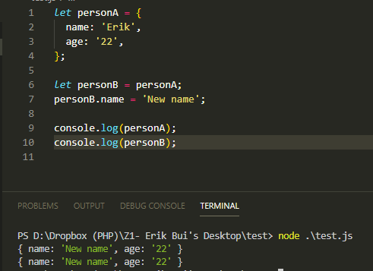
REFERENCE TYPE
Array
Object
Function

Slide 3
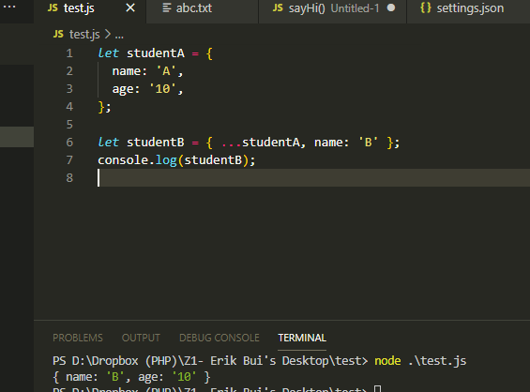
SPREAD OPERATOR

Slide 4
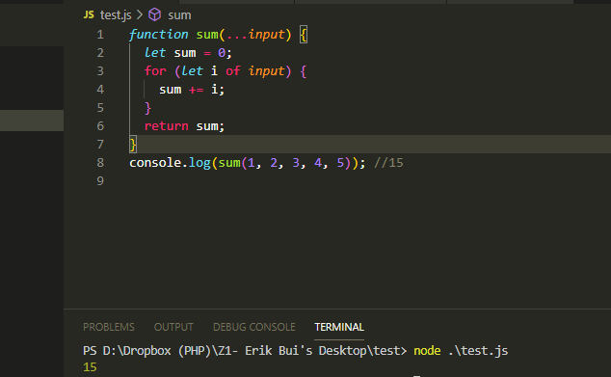
REST PARAMETER

Slide 5
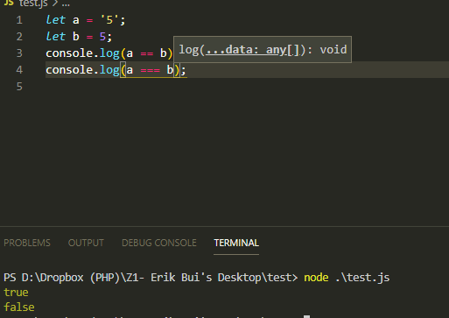
comparison operator

Slide 6

TEMPLATE STRING

Slide 7
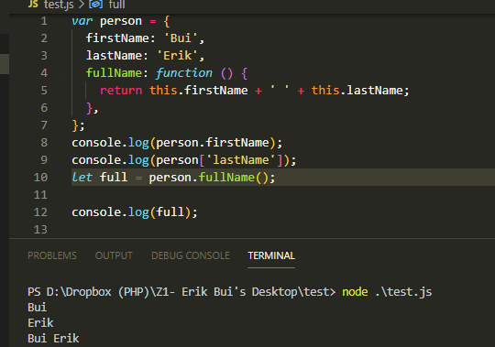
Object LITERAL

Slide 8
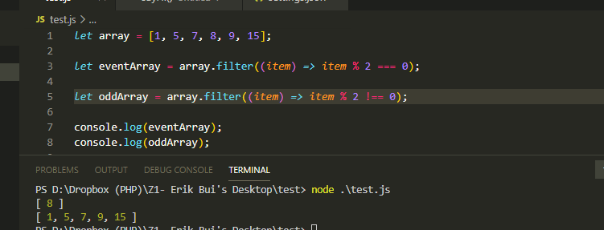
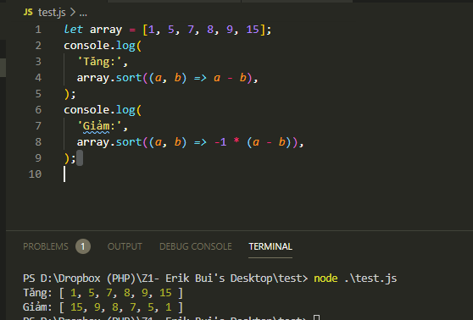
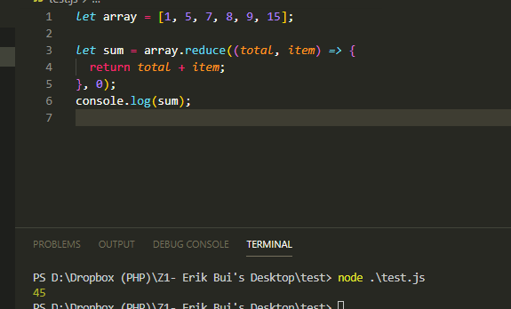

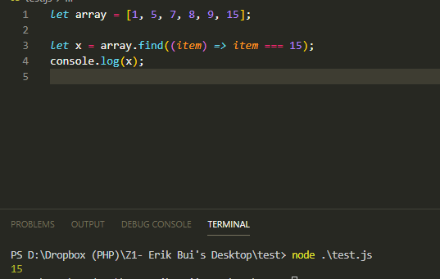
ARRAY
map, filter, reduce, find, sort…

Slide 9
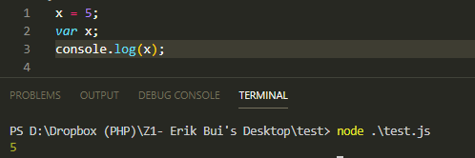
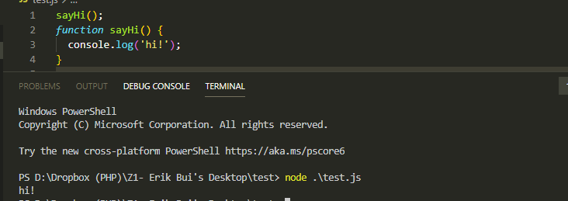

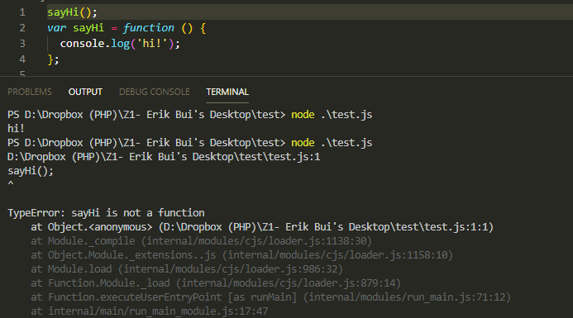
HOISTING

Slide 10
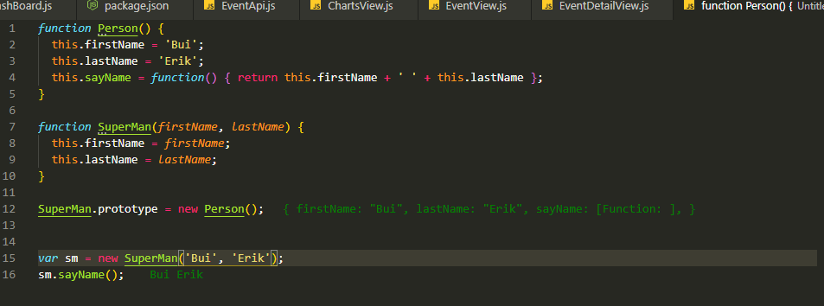
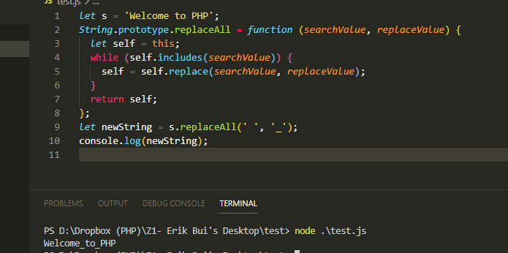
PROTOTYPE

Slide 11
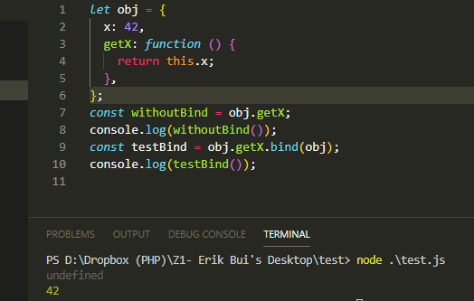
BIND, APPY, CALL

Slide 12



VAR, LET, CONST

Slide 13
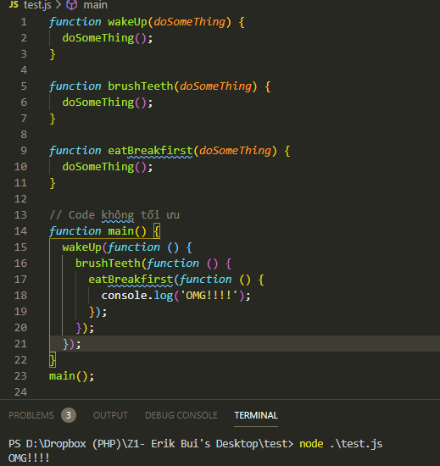
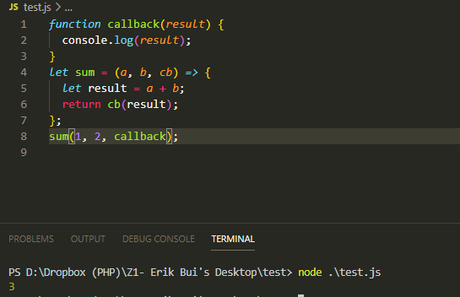
CALLBACK, CALLBACK HELL

Slide 14
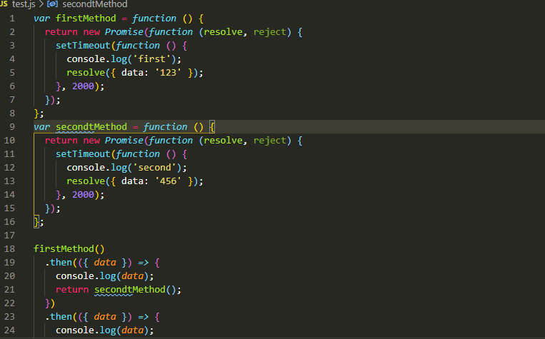
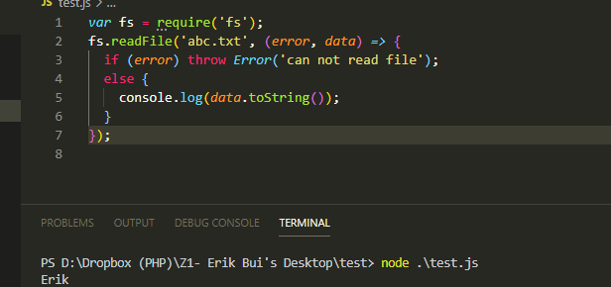
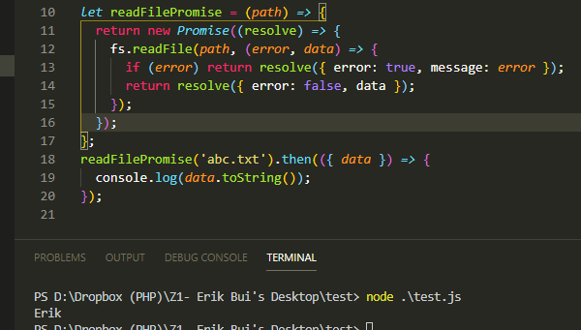
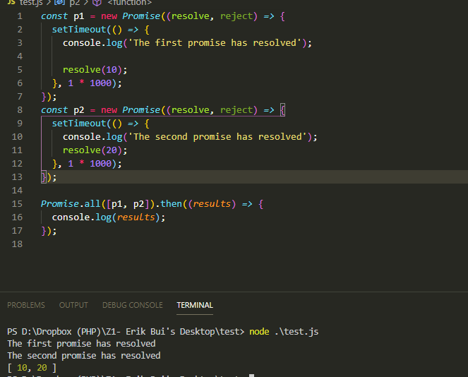
PROMISE, CONVERT CALLBACK TO PROMISE

Slide 15

ASYNC, AWAIT

Slide 16

ClOUSURE

Slide 17
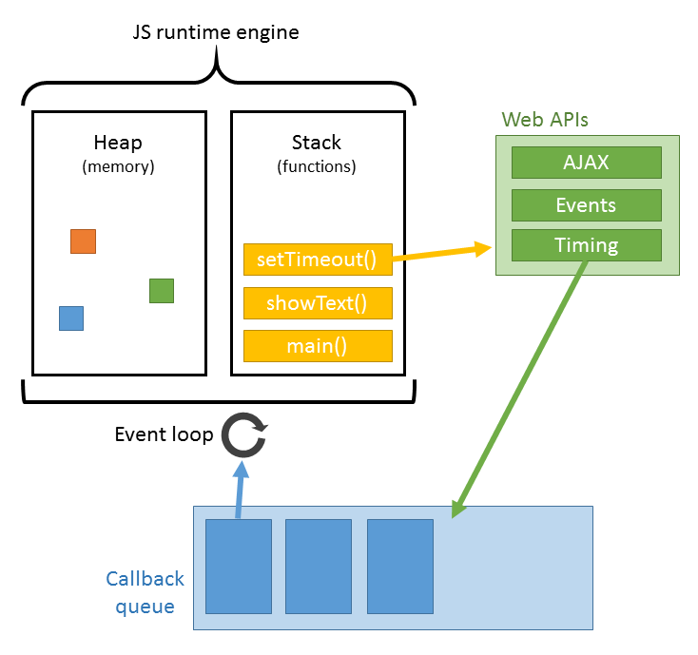

Event LOOP

