Slide 1
Controllers
Routing
Request object

Slide 2
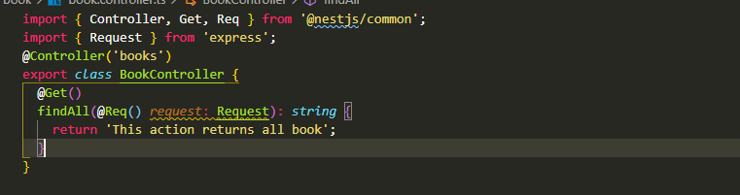
Controllers
Routing
Request object

Slide 3
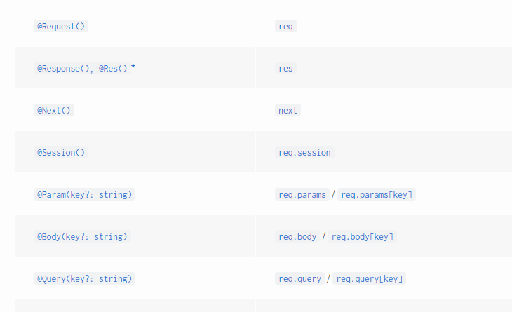
Controllers
Routing
Request object

Slide 4
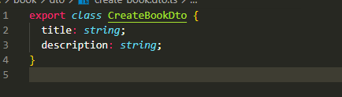

Controllers
Routing
Request object
Request payload

Slide 5
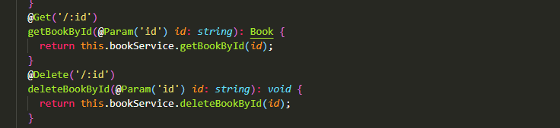
Controller
Routing
Request object
Request payload
Route param
Redirect

Slide 6
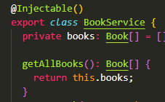
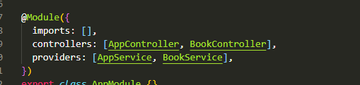
Provider
Dependency injection
Provider registration

Slide 7
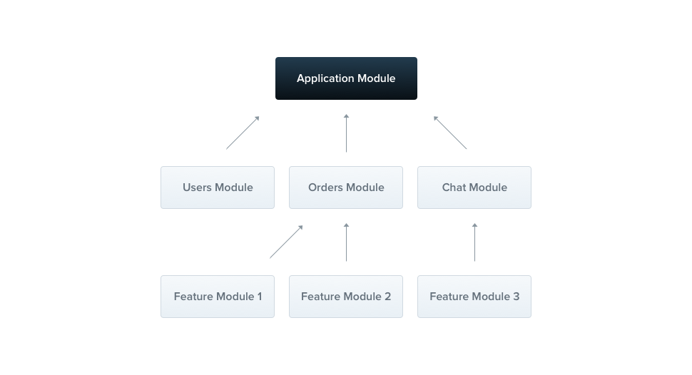
Modules

Slide 8
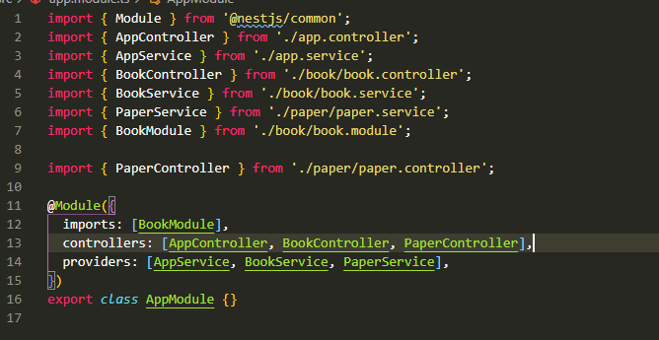
Modules

Slide 9
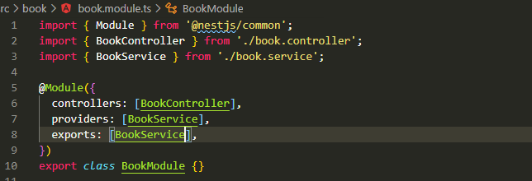
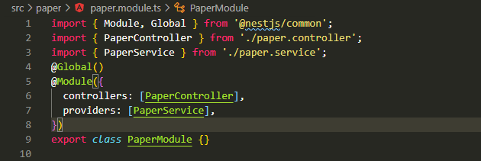
Modules
Share module
Global module

Slide 10
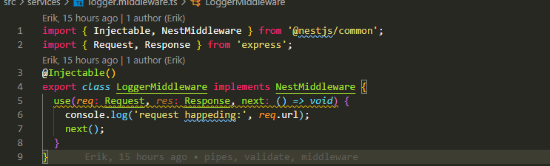
Middleware

Slide 11
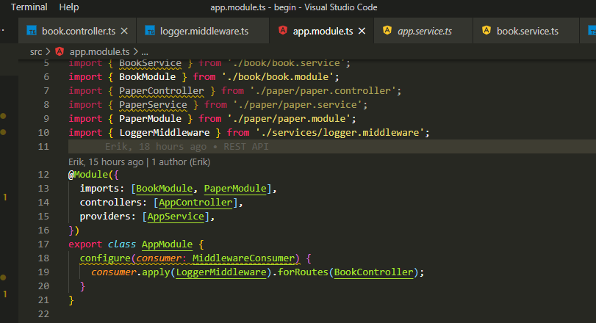
Middleware
Applying middleware

Slide 12
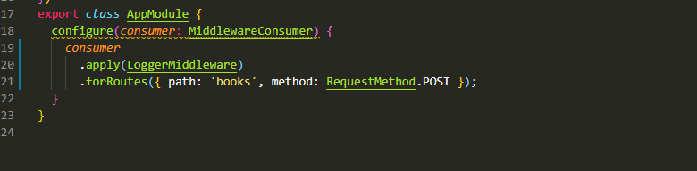
Middleware
Applying middleware

Slide 13
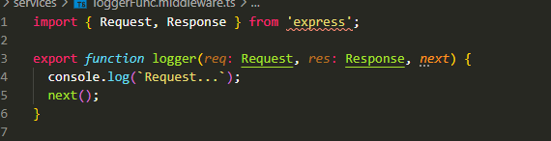
Middleware
Fuction middleware

Slide 14
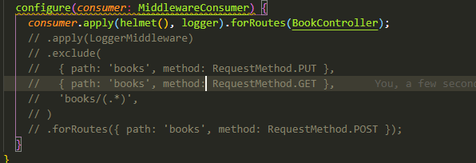
Middleware
Fuction middleware

Slide 15
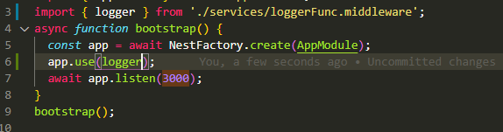
Middleware
Global middware

Slide 16

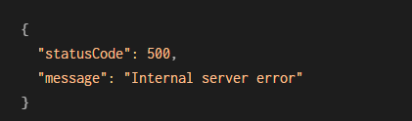
Exception filters

Slide 17
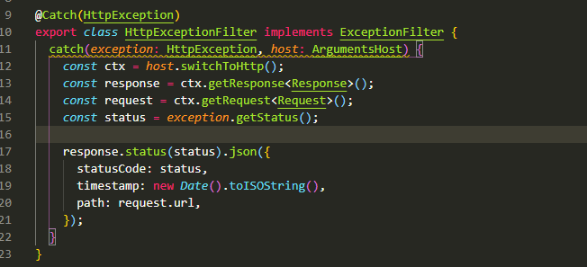
Exception filters
Custom exception

Slide 18
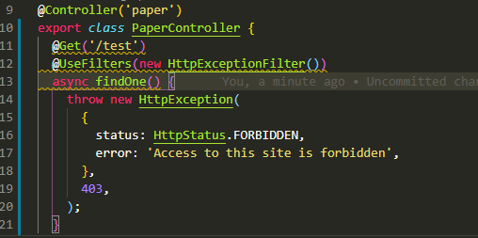
Exception filters
Apply exception

Slide 19
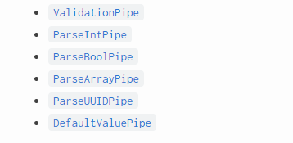
Pipes
Transformation
Validation

Slide 20
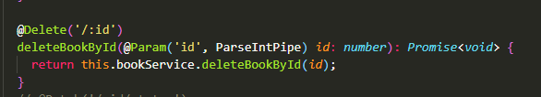
Pipes
Binding pipes

Slide 21
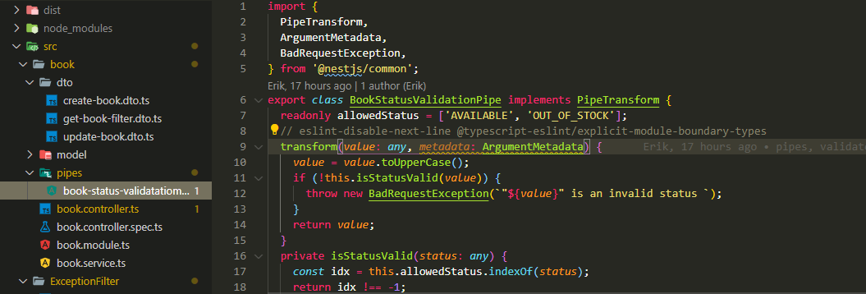
Pipes
Custom pipes

Slide 22
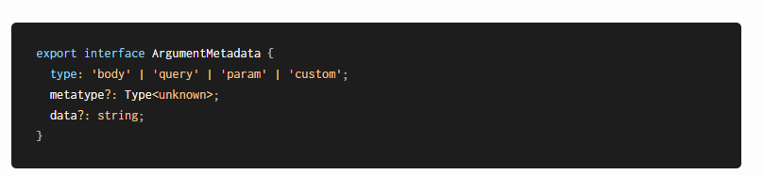
Pipes
Custom pipes

Slide 23
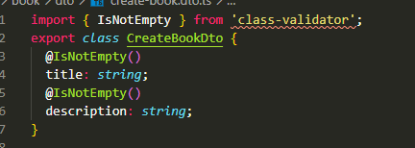
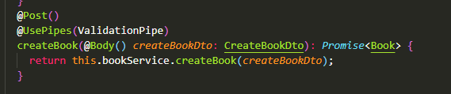
Pipes
Schema based validation

