Slide 1

Stream the flow
A presentation about Kafka, Akka and Spark
Sébastien DIAZ , CEO Buisson Diaz Conseil
http://www.buissondiaz.com

Slide 2
Principles of the demonstration
Never stop the flow
Accept to be late
Accept to lose your data
Support VVV(VV)
Volume
Velocity
Variety
(Veracity)
(Value)
http://www.buissondiaz.com

Slide 3
Flow Description
Combination of more than 45 RSS sources
Include: Wall Street Journal, The Economist, Reuters, Bloomberg,….
<?xml version="1.0" encoding="UTF-8" ?>
<rss version="2.0">
<channel>
<title>Page</title>
<link>https://XXX</link>
<description>Free</description>
<item>
<title>Tuto</title>
<link>https://XXXX</link>
<description>New</description>
</item>
</channel>
</rss>
http://www.buissondiaz.com

Slide 4
Demonstrated Technologies
One Broker :
Kafka
Three Streaming Solutions
Java 8
Akka Stream
Spark Structured Streaming
Languages
Java
Python
Scala
http://www.buissondiaz.com

Slide 5
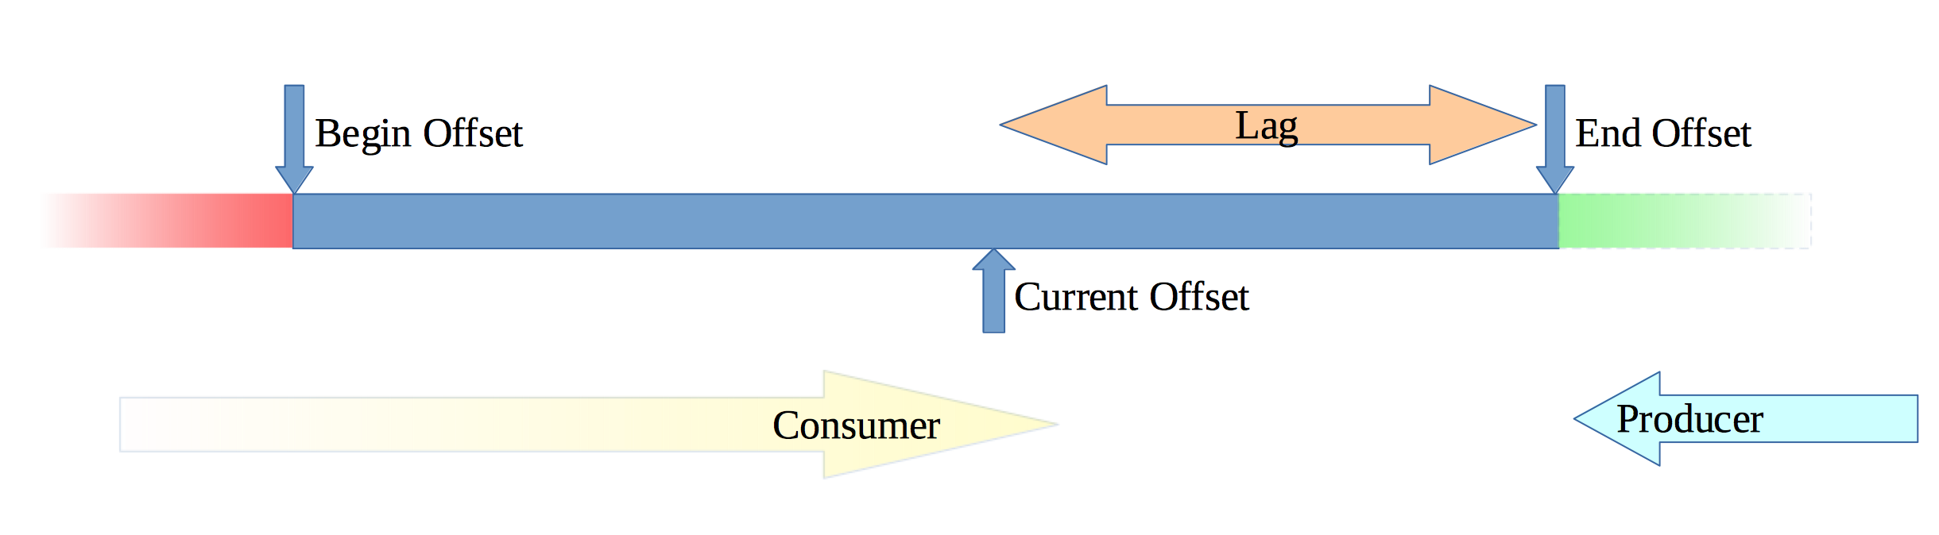
Kafka and Topics
http://www.buissondiaz.com

Slide 6
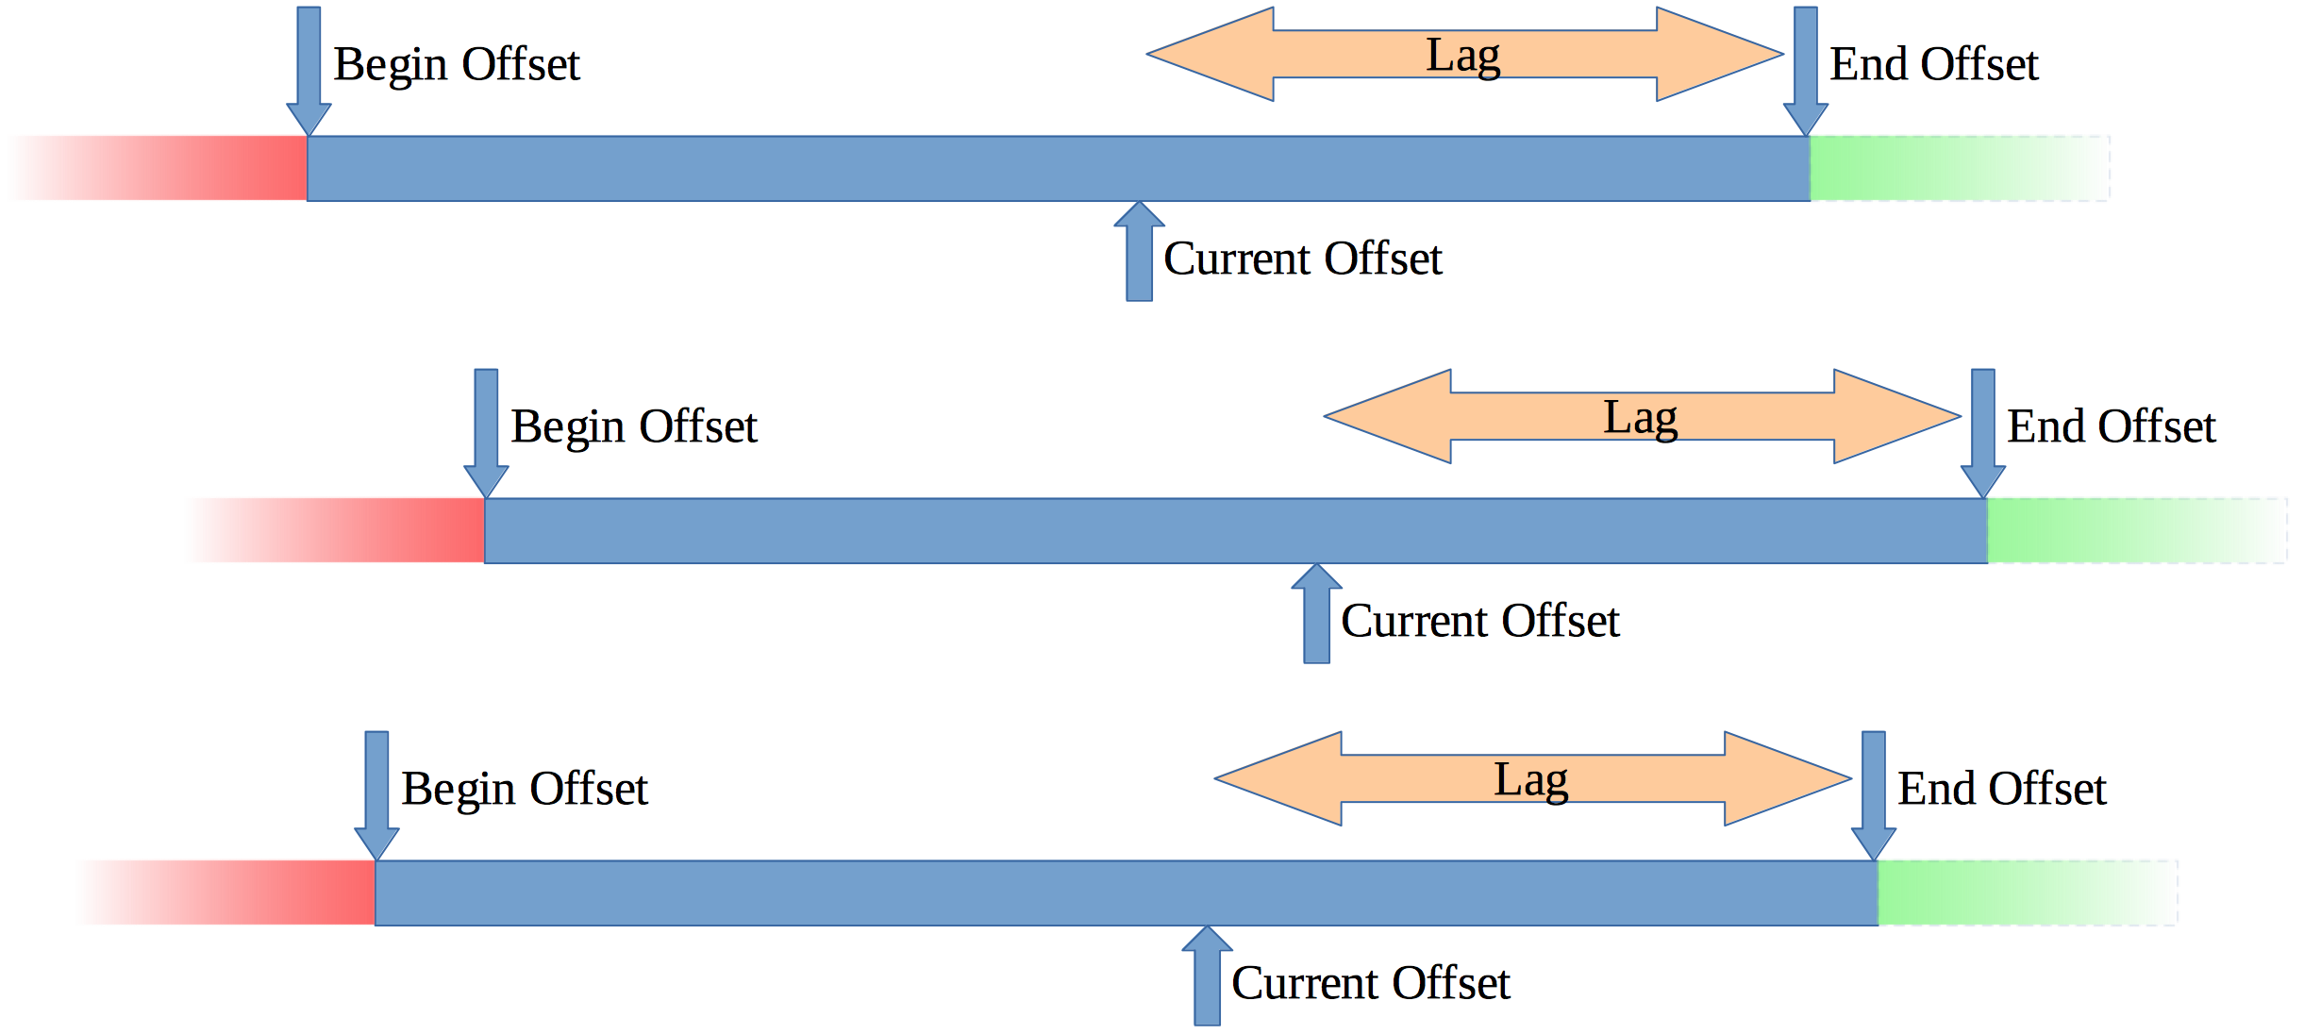
Kafka and Partitions
http://www.buissondiaz.com

Slide 7
Kafka Features
Replication
Store
Distributed
Fault tolerence cluster
Consumer Group
ACL
SSL 1/2 ways
JAAS Support
http://www.buissondiaz.com

Slide 8
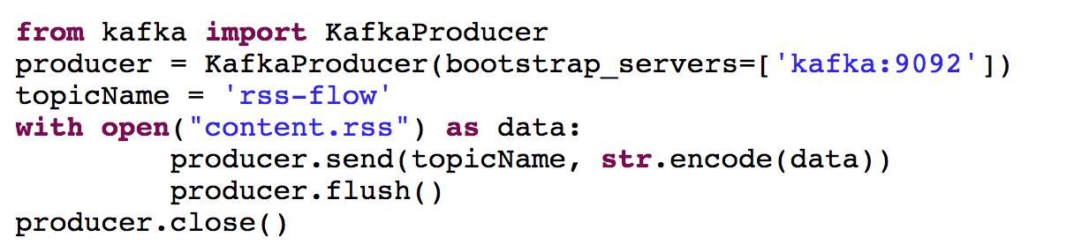
Push the Flow
http://www.buissondiaz.com

Slide 9
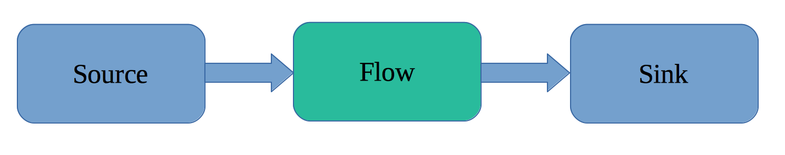
Akka Stream
Reactive
Non Blocking
Asynchronous
Distributable
Cluster
http://www.buissondiaz.com

Slide 10
MapReduce
Invented By Google
https://static.googleusercontent.com/media/research.google.com/en//archive/mapreduce-osdi04.pdf
2 operations:
Map
Transformation
Reduce
Associate map and reduce recursively
http://www.buissondiaz.com

Slide 11
Operations
Basic
Map
Flat Map
Reduce
Filter
Foreach
Collect
Advanced
Detach
Drop
Fold
Grouped
Limit
Scan
Take
Watch
Lazy
http://www.buissondiaz.com

Slide 12
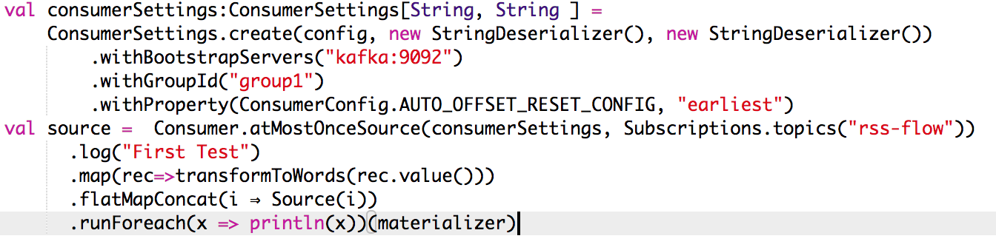
Open the stream
http://www.buissondiaz.com

Slide 13
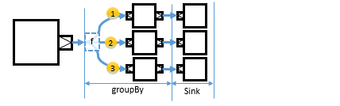
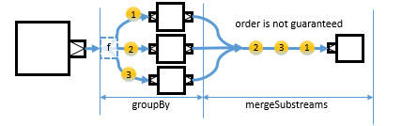
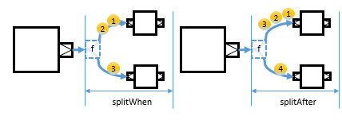
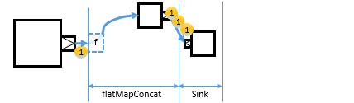
Substream
http://www.buissondiaz.com

Slide 14
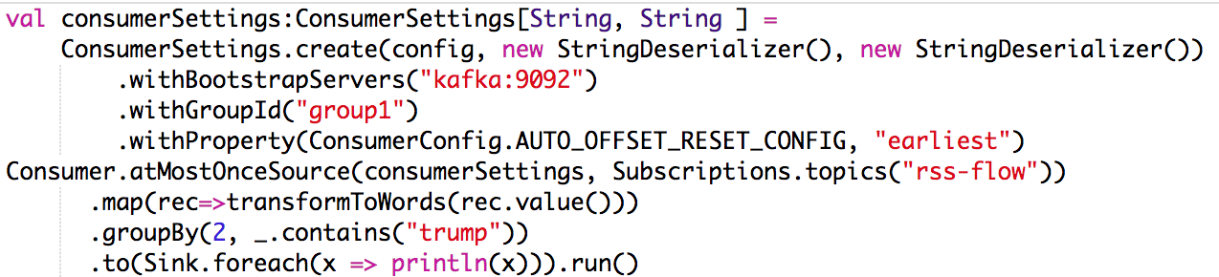
Check GroupBy
http://www.buissondiaz.com

Slide 15
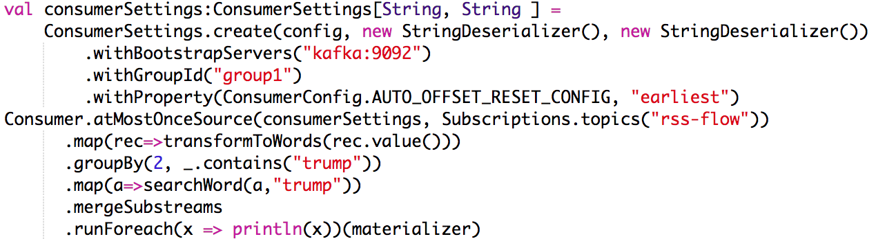
Check GroupBy and merge
http://www.buissondiaz.com

Slide 16
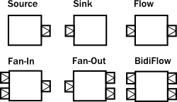
Graph on Flow
Fan In
Merge
Zip
Concat
Fan Out
Broadcast
Balance
Unzip
http://www.buissondiaz.com

Slide 17
TF IDF as Transformation
TF : Term Frequency
The raw count of a term in a document
IDF : Inverse Document Frequency
Common or rare across all documents
http://www.buissondiaz.com

Slide 18
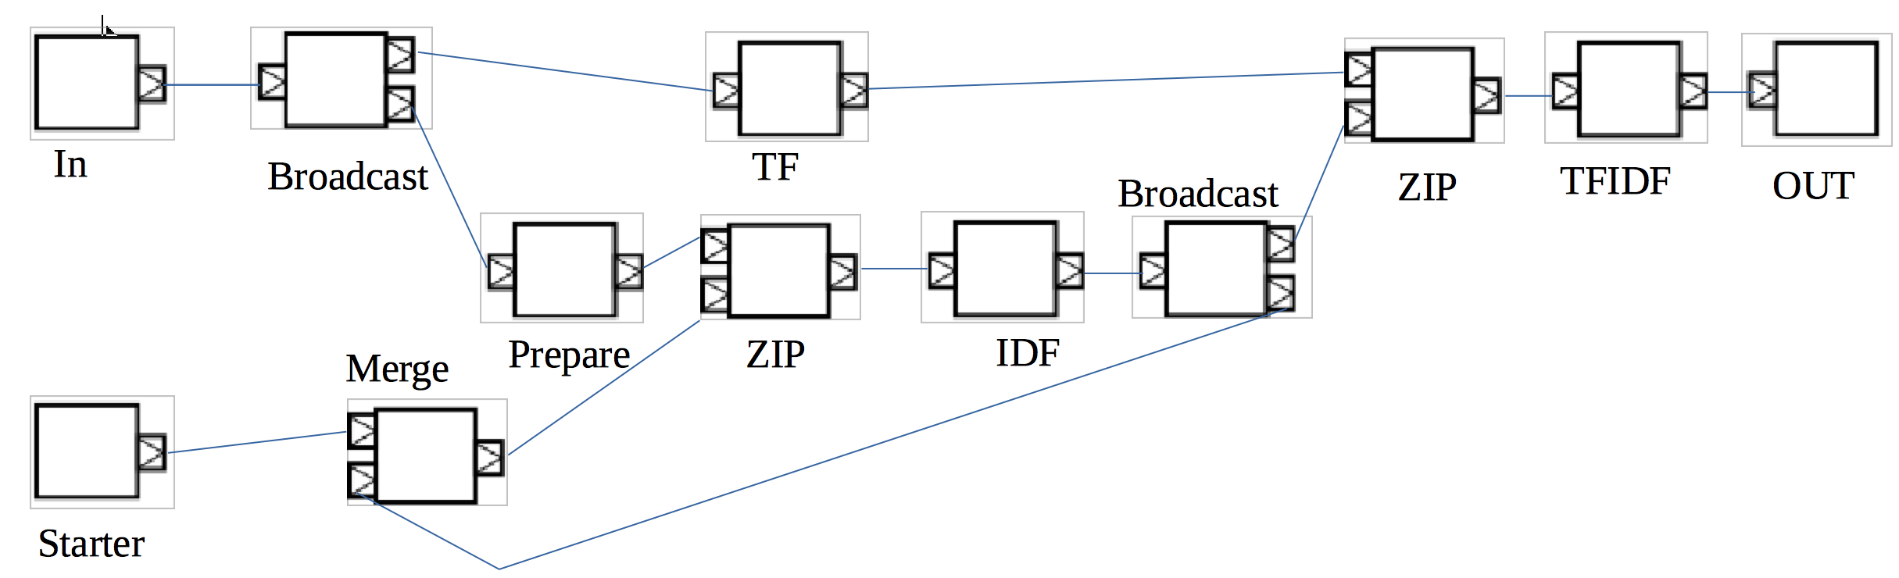
Graph of TF IDF’
http://www.buissondiaz.com

Slide 19
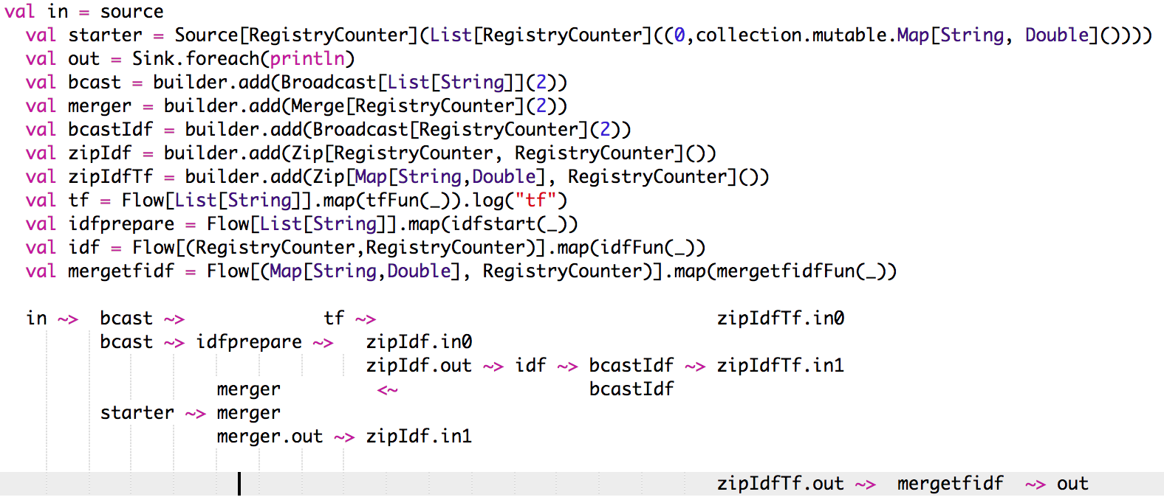
Graph Code
http://www.buissondiaz.com

Slide 20
Errors and Recovery
mapError : Transform the error
recover : Transform and log the error
revoverWith : Switch to another Source
recoverWithRetries : Switch to another Source with retry
Delayed restart
http://www.buissondiaz.com

Slide 21
When It’s huge or complex !
New strategies
Windows based
Remove (out of the time,… )
Add Batch
New platform
Spark
Hadoop
Meteosat Second Generation : > 100 TB / Day
http://www.buissondiaz.com

Slide 22
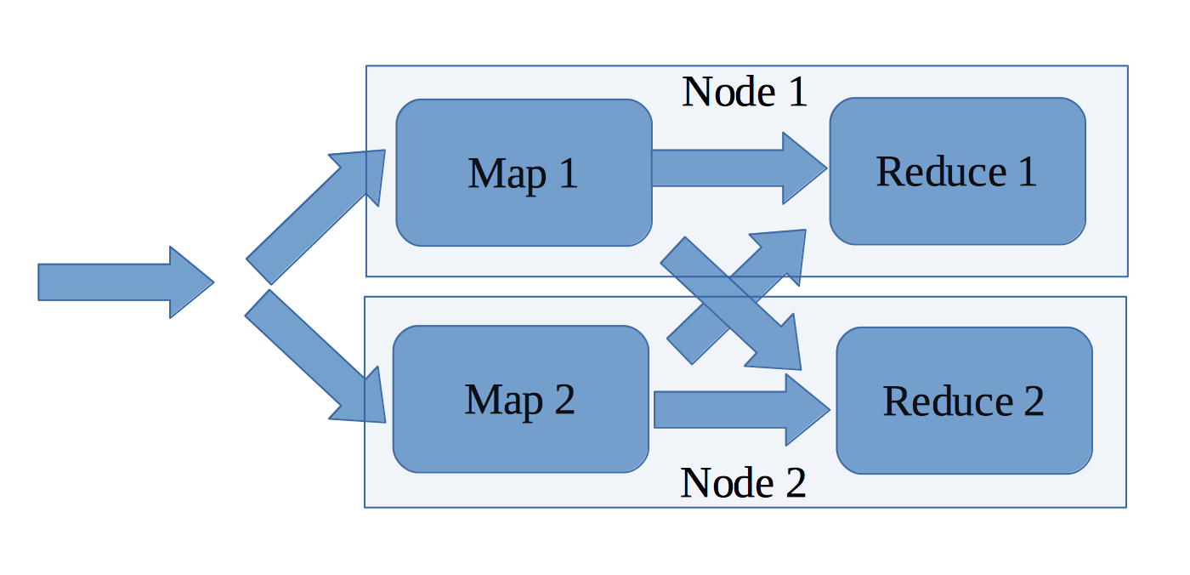
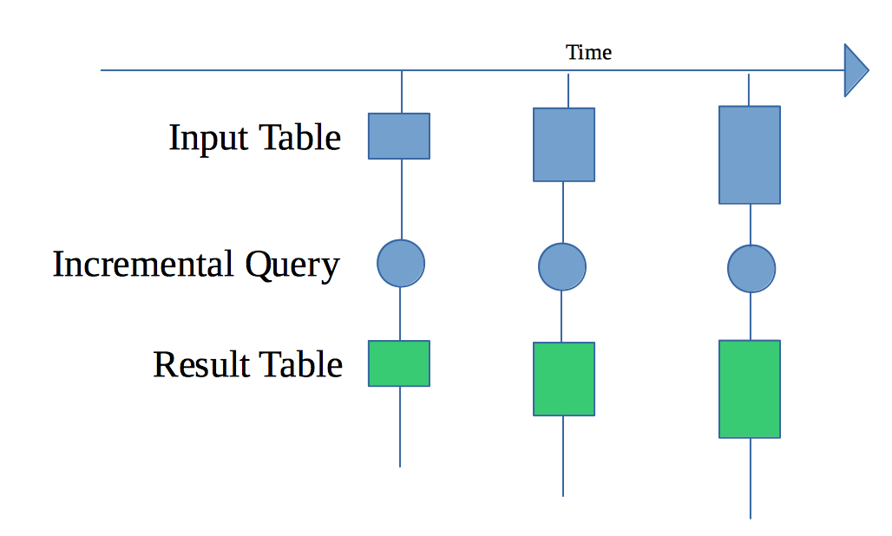
Spark Structered Streaming
Fast
Scalable
Fault – Tolerence
SQL Engine
Incremental or Continous
http://www.buissondiaz.com

Slide 23
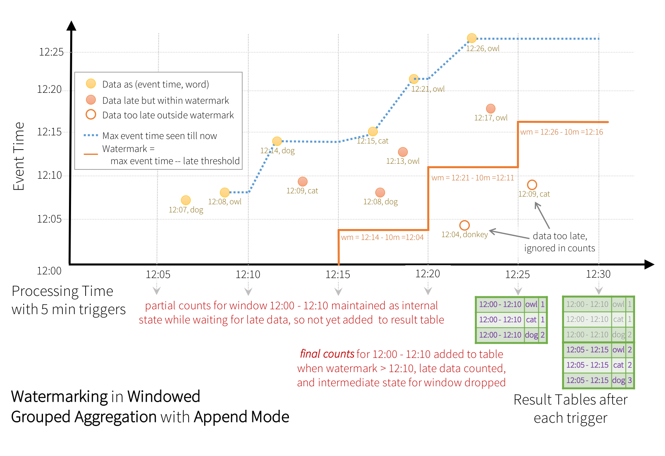
Windows and Watermark

Slide 24
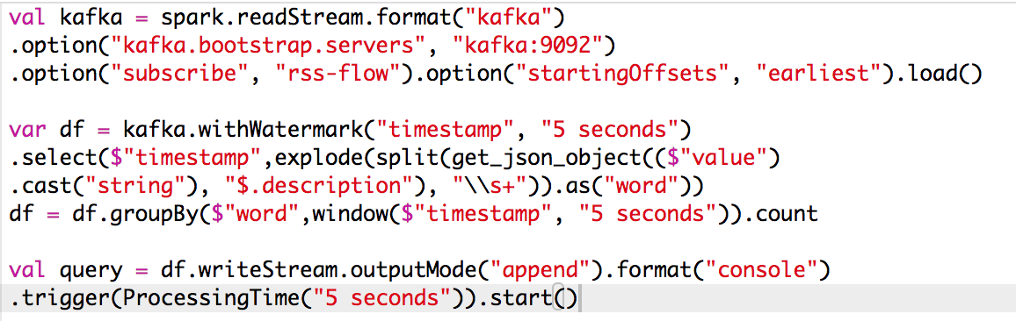
Simple Incremental Streaming
http://www.buissondiaz.com

Slide 25
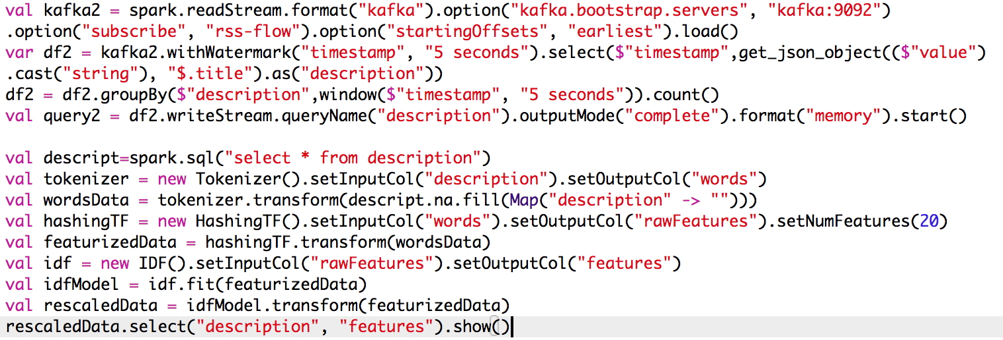
And TF IDF
http://www.buissondiaz.com

Slide 26
Thank you
See the original code demo on : https://github.com/buidiaconseil/DemoKafkaAkkaSpark
http://www.buissondiaz.com

Slide 27
New SMKRACK Architecture
Spark : Processing
Mesos : Cluster Management
Kubernetes : Cluster Management
++ Redis : Cache
Akka : Actor model
Cassandra : Nosql and Big Table
Kafka : Stream

