Slide 1
Stream the flow
A presentation about Kafka, Akka and Spark

Slide 2
Principles of the demonstration
Never stop the flow
Accept to be late
Accept to loose your data
Support VVV(VV)
Volume
Velocity
Variety
(Veracity)
(Value)

Slide 3
Flow Description
Combination of more than 45 RSS sources
Include: Wall Street Journal, The Economist, Reuters, Bloomberg,….
<?xml version="1.0" encoding="UTF-8" ?>
<rss version="2.0">
<channel>
<title>Page</title>
<link>https://XXX</link>
<description>Free</description>
<item>
<title>Tuto</title>
<link>https://XXXX</link>
<description>New</description>
</item>
</channel>
</rss>

Slide 4
Demonstrated Technologies
One Broker :
Kafka
Three Streaming Solutions
Java 8
Akka Stream
Spark Structured Streaming
Languages
Java
Python
Scala

Slide 5
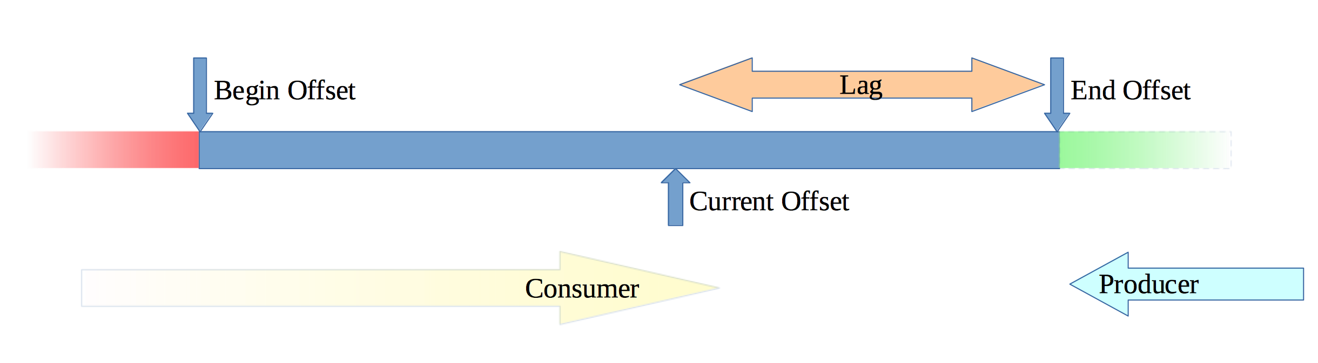
Kafka and Topics

Slide 6
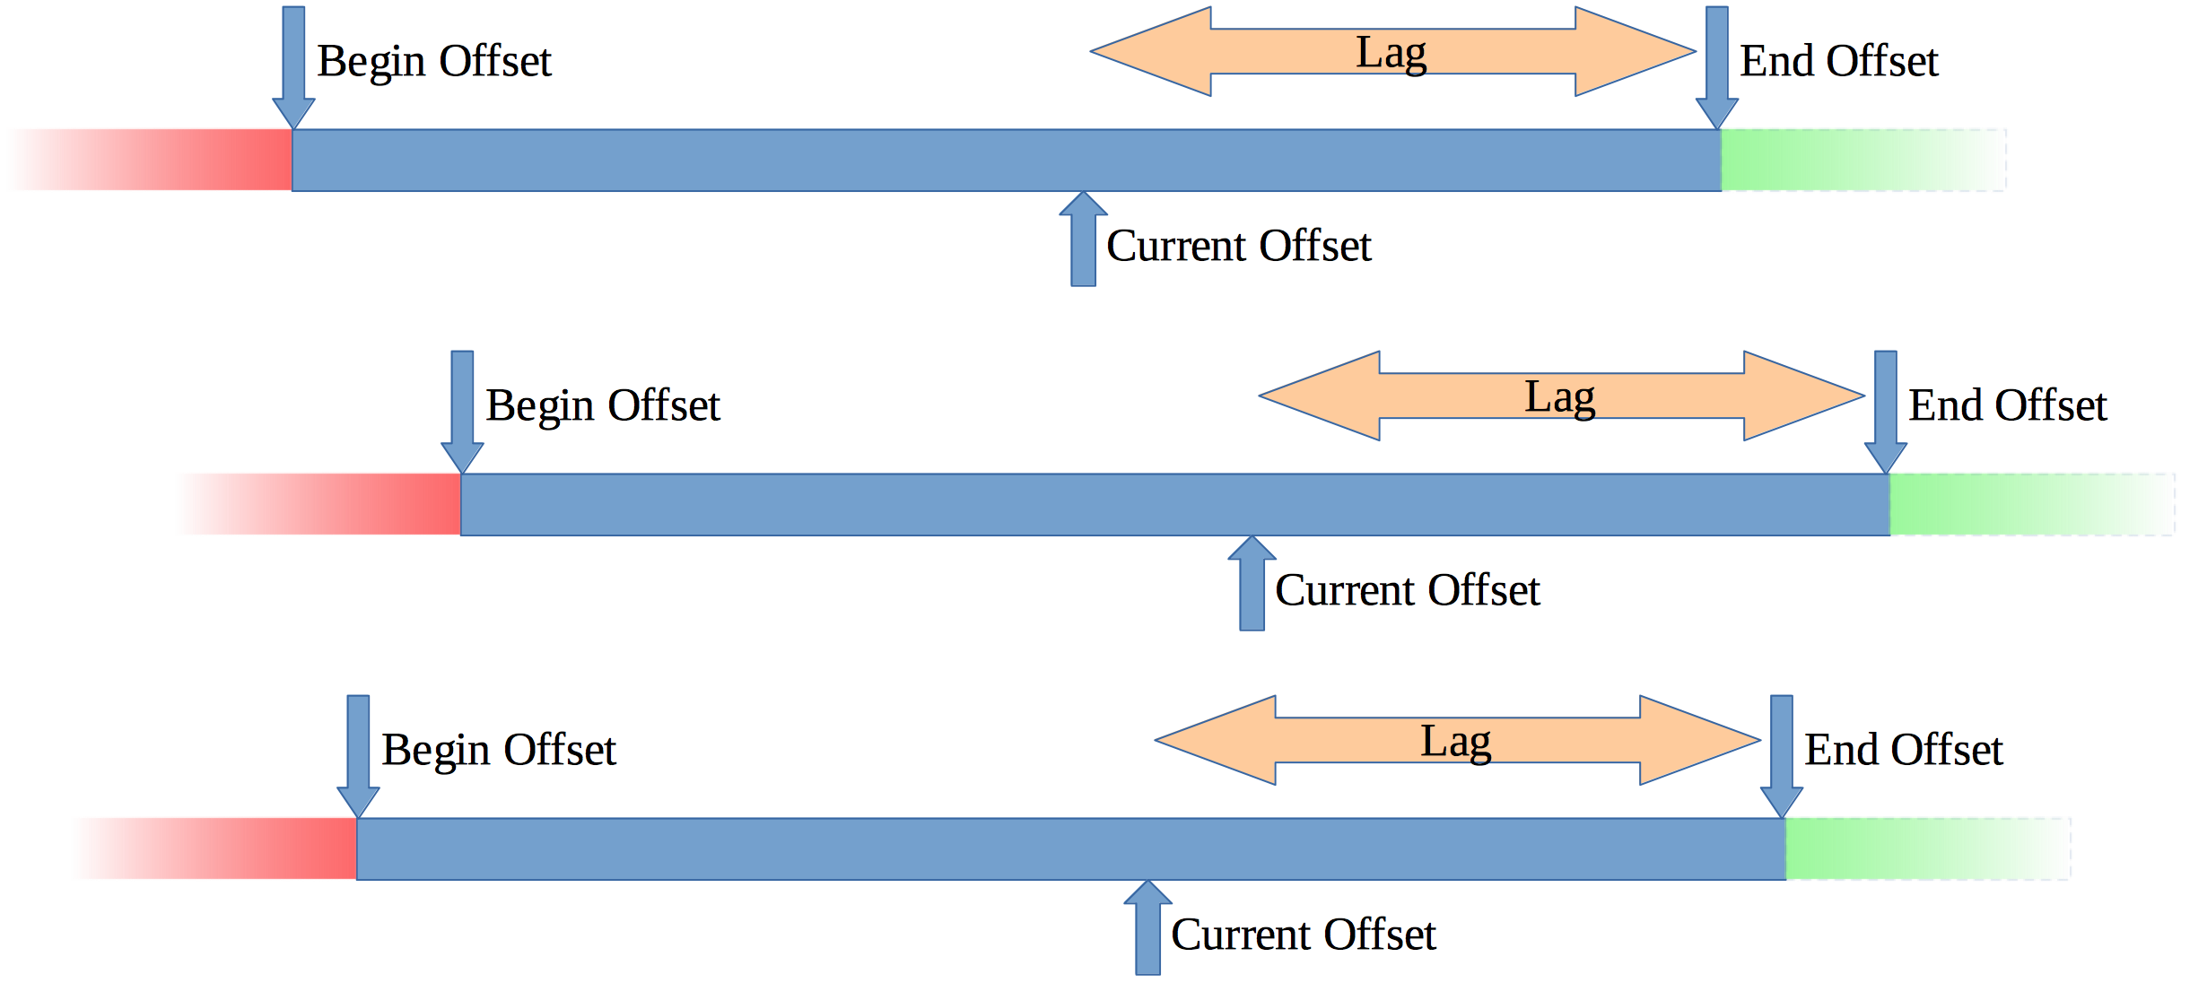
Kafka and Partitions

Slide 7
Kafka Features
Replication
Store
Distributed
Fault tolerence cluster
Consumer Group
ACL
SSL 1/2 ways
JAAS Support

Slide 8
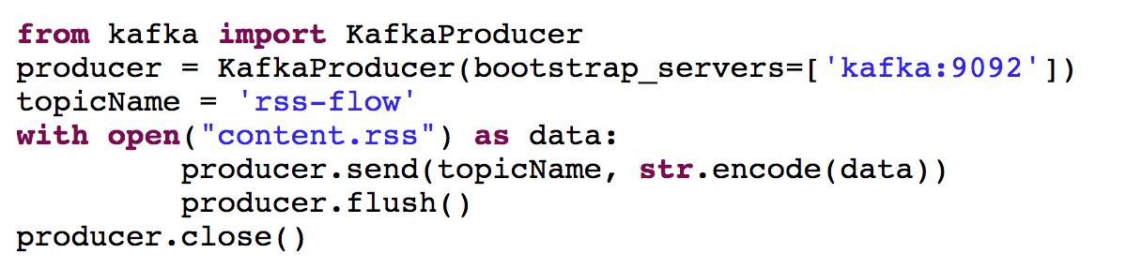
Push the Flow

Slide 9
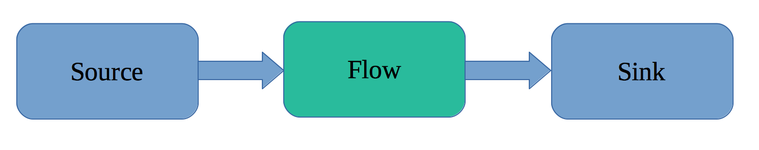
Akka Stream
Reactive
Non Blocking
Asynchronous
Distributable
Cluster

Slide 10
MapReduce
Invented By Google
https://static.googleusercontent.com/media/research.google.com/en//archive/mapreduce-osdi04.pdf
2 operations:
Map
Transformation
Reduce
Associate map and reduce recursively

Slide 11
Operations
Basic
Map
Flat Map
Reduce
Filter
Foreach
Collect
Advanced
Detach
Drop
Fold
Grouped
Limit
Scan
Take
Watch
Lazy

Slide 12
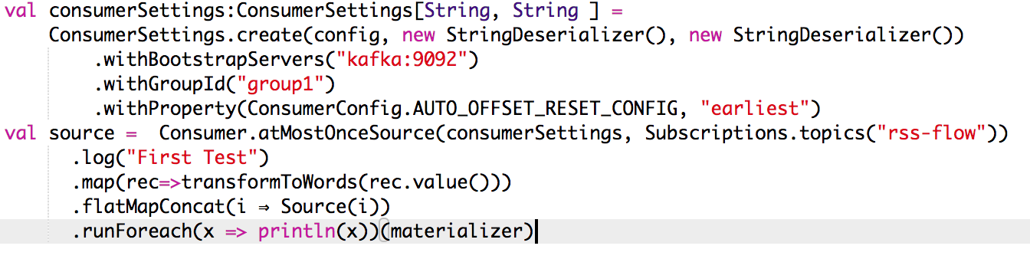
Open the stream

Slide 13
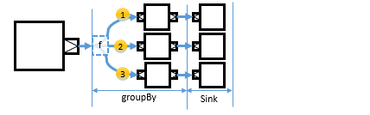
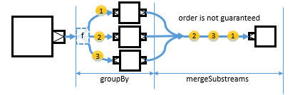
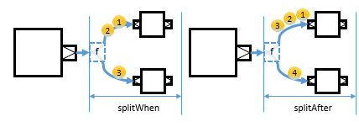
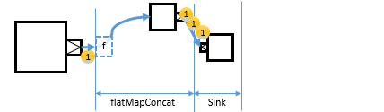
Substream

Slide 14
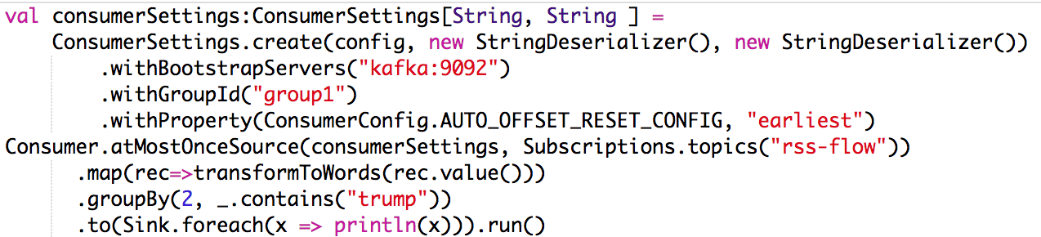
Check GroupBy

Slide 15
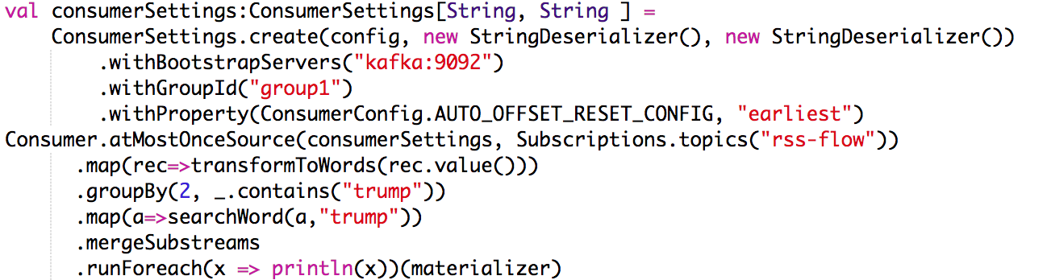
Check GroupBy and merge

Slide 16
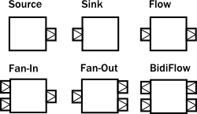
Graph on Flow
Fan In
Merge
Zip
Concat
Fan Out
Broadcast
Balance
Unzip

Slide 17
TF IDF as Transformation
TF : Term Frequency
The raw count of a term in a document
IDF : Inverse Document Frequency
Common or rare across all documents

Slide 18
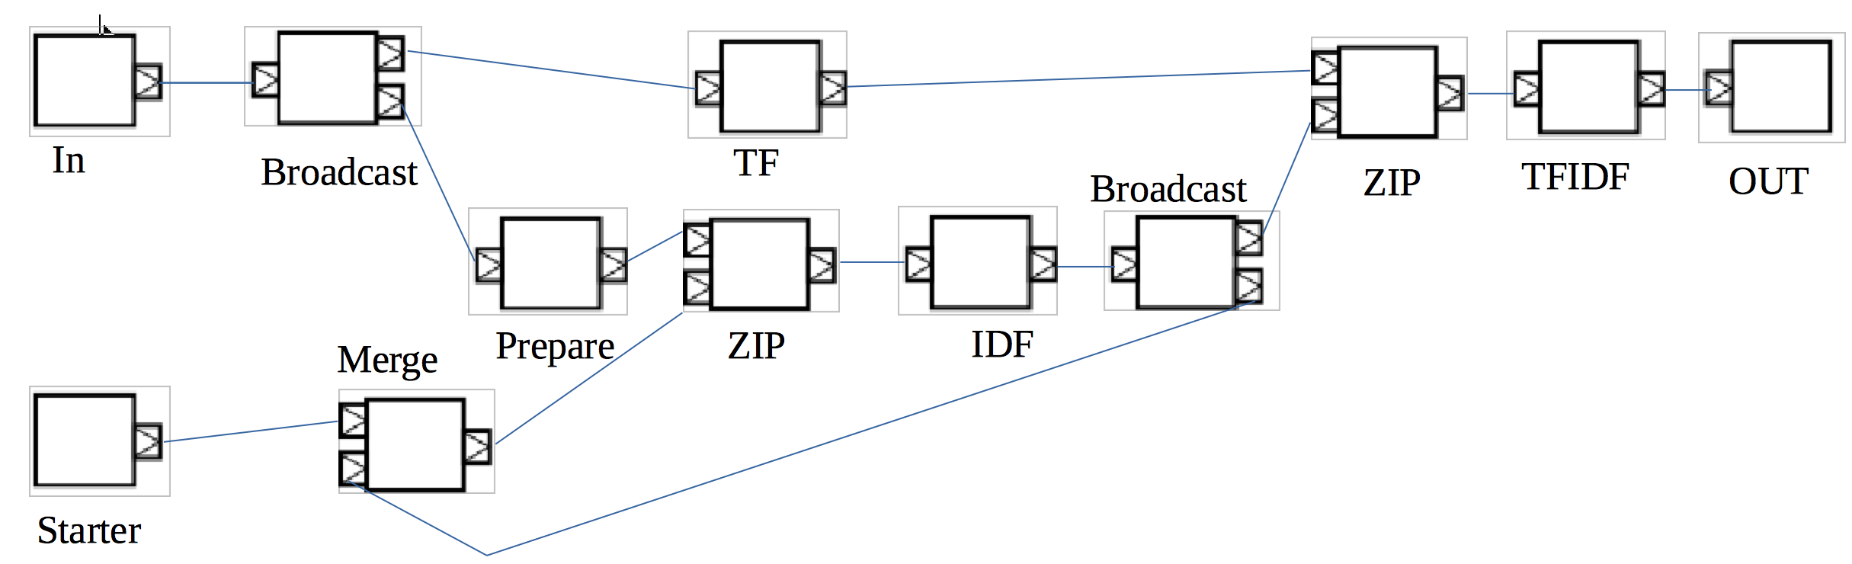
Graph of TF IDF’

Slide 19
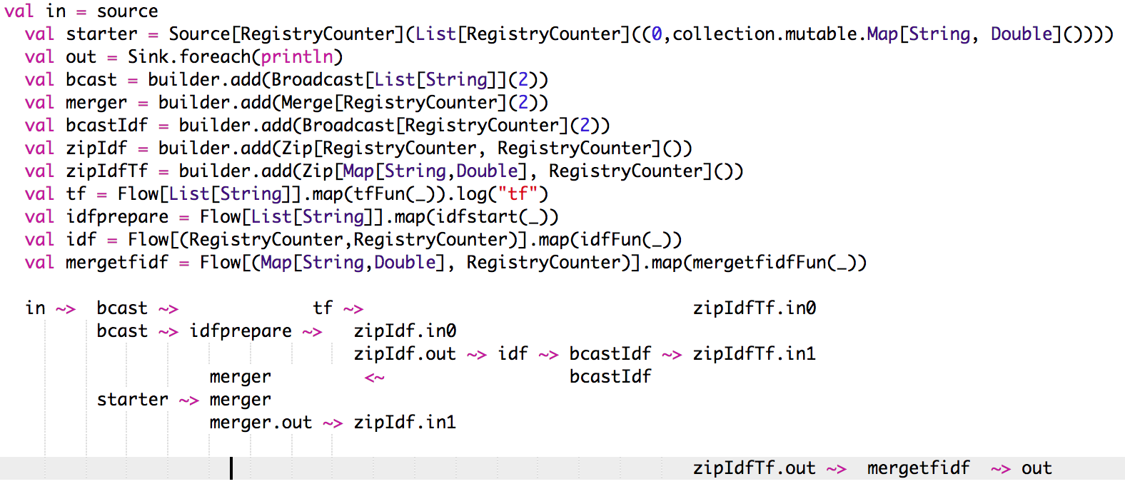
Graph Code

Slide 20
Errors and Recovery
mapError : Transform the error
recover : Transform and log the error
revoverWith : Switch to another Source
recoverWithRetries : Switch to another Source with retry
Delayed restart

Slide 21
When It’s huge or complex !
New strategies
Windows based
Remove (out of the time,… )
Add Batch
New platform
Spark
Hadoop
Meteosat Second Generation : > 100 TB / Day

Slide 22
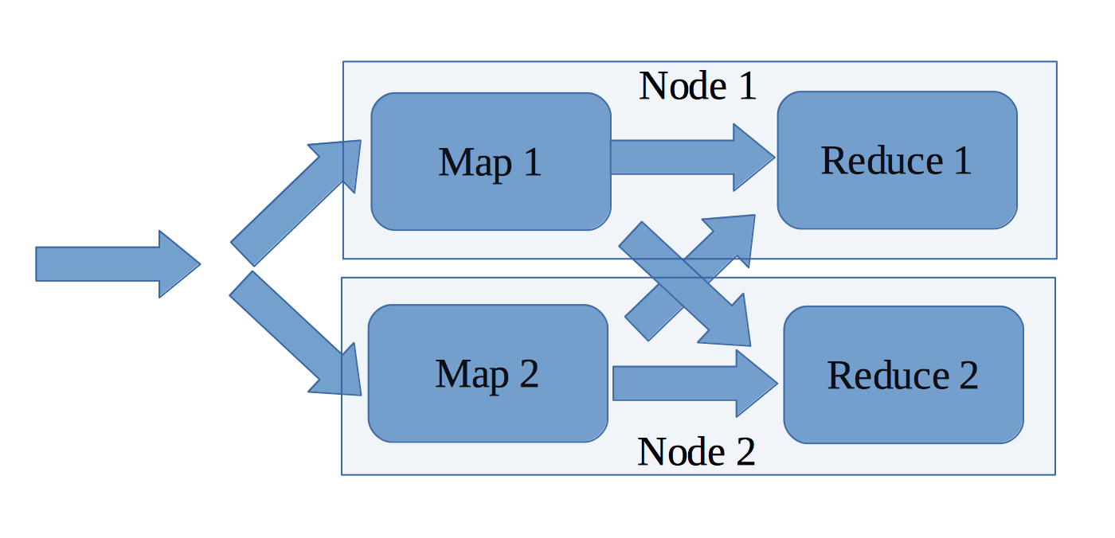
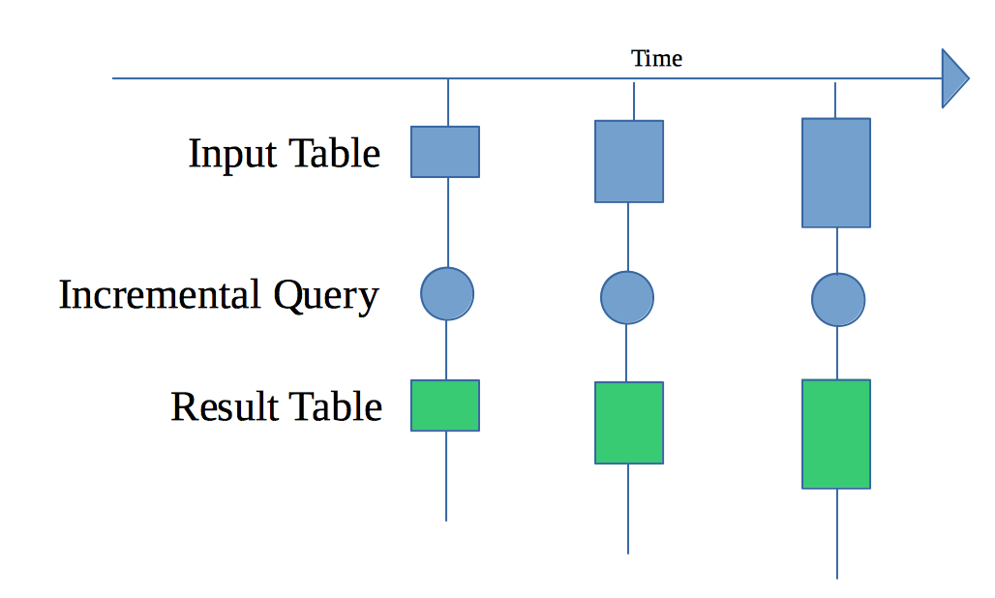
Spark Structered Streaming
Fast
Scalable
Fault – Tolerence
SQL Engine
Incremental or Continous

Slide 23
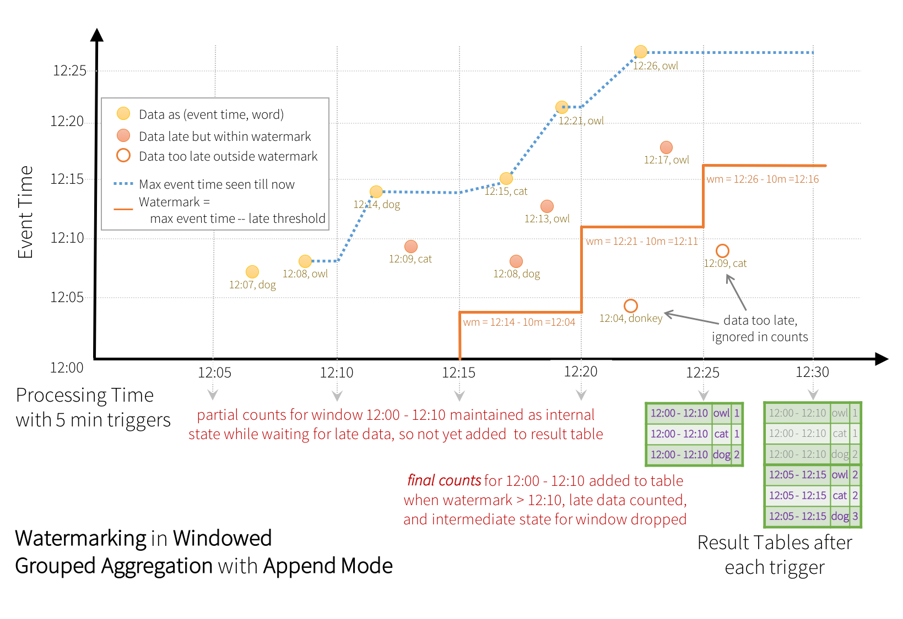
Windows and Watermark

Slide 24
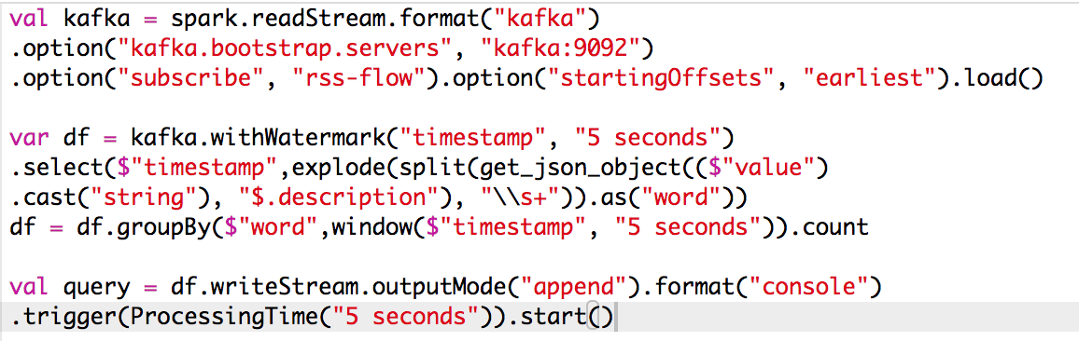
Simple Incremental Streaming

Slide 25
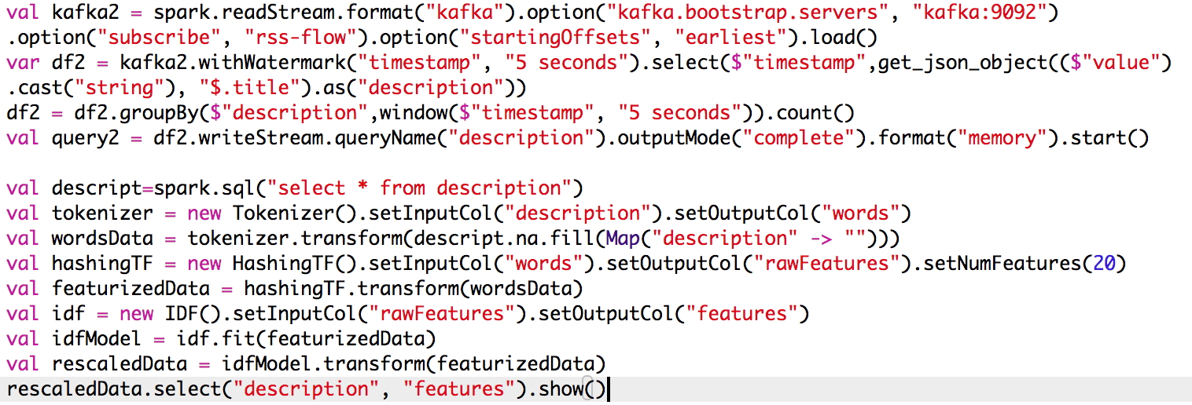
And TF IDF

Slide 26
Thank you

Slide 27
SMACK Architecture
Spark : Processing
Mesos : Cluster Management
Akka : Actor model
Cassandra : Nosql and Big Table
Kafka : Stream

