Slide 1

IT Project and Quality Management
COMP1305 Coursework
Smartphone Selection Project
Student Name: Duong Bui Dinh

Slide 2
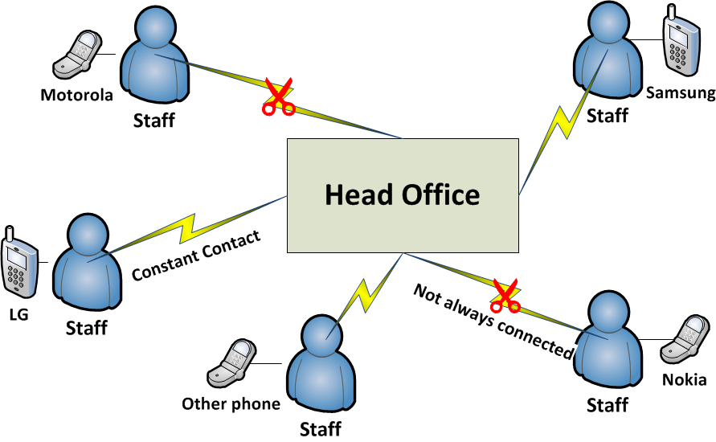
Current Problem
Difficult to manage
Not constant contact between Staffs and Head Office

Slide 3
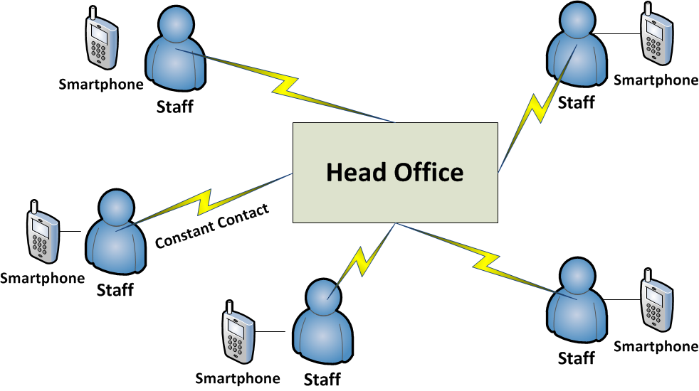
Problem Solving
Difficult to manage Easy to manage, Synchronization
Not constant contact between Staffs and Head Office Constant Contact

Slide 4
Project Strategy
What must be achieved in the project?
Smartphone meets requirement of functionality
Smartphone is best for finance
How to achieve?
Weighted Scoring Model
Total Cost of Ownership

Slide 5
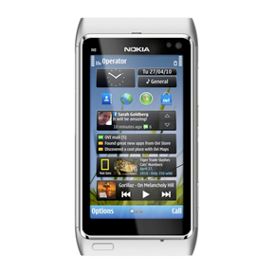
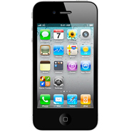
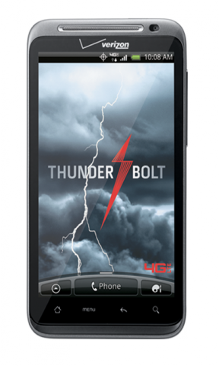
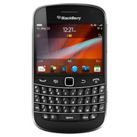
Executing Project
How does the Project Manager get four type of smart phone to make comparison?
Make survey from all staffs, sum up ideas !
Why did he has to do that?
Because the staffs will directly use the smart phone.
What are four smart phones?
iPhone 4s
Nokia N8
Black Berry 9900
HTC Thunderbolt 4G

Slide 6
Weight Scoring Model Factors and Criteria
Factors and criteria
Design
Phone Style
Display Resolution
Screen Size
Weight
Height
Multimedia
Camera
Video recorder & Quality
Email
Digital Player
Sound Quality
Call Features & Quality
3 way calling
Cold holder
Signal capturing
Battery Life & Memory & Processor
Installed Memory
RAM
Extendable memory
Standby Time
Talk time
Processor speed
Connectivity
Wifi
GPS
4G
Bluetooth
EDGE
Software requirement
free software market
commercial software market
Office software
Internet browser
Total cost of ownership
One-Time Cost
Monthly Cost
Additional Cost
Guarantee cost
Upgrade software cost
Upgrade hardware cost

Slide 7
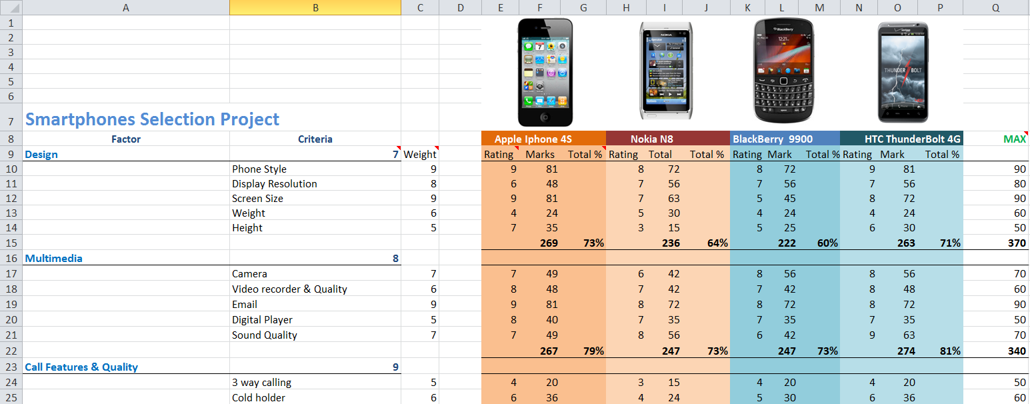
Weight Scoring Model Marks

Slide 8
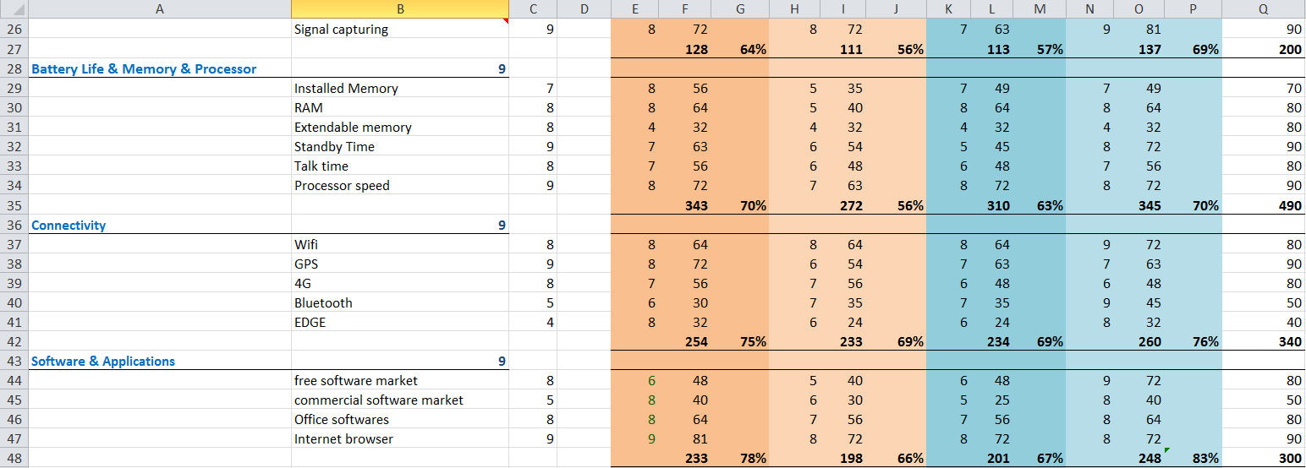
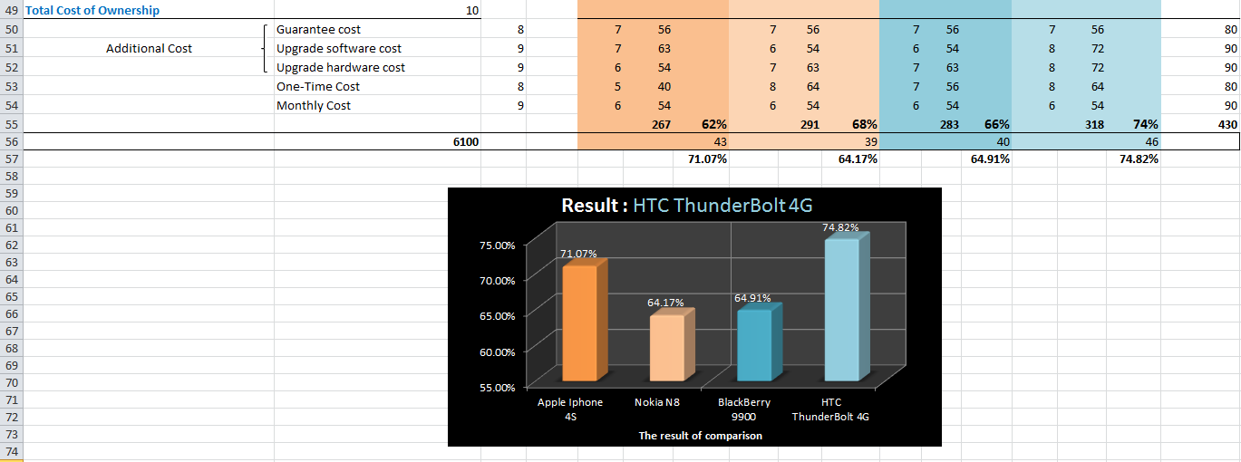
Weight Scoring Model

Slide 9
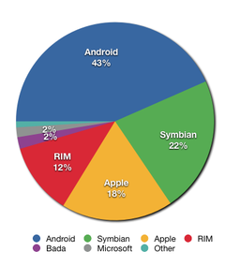
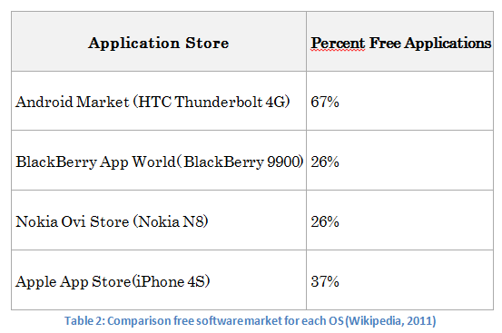
Final Result
Why the project manager selected HTC Thunderbolt 4G?
It met requirement of functionality
The total cost of ownership is the best.
Cheap cost for upgrading software and easy to upgrade
The HTC Thunderbolt 4G use Android OS, which is the
most popular smart phone OS.
The software market is the biggest
Free trend of software development
Cheap cost for upgrading hardware
Price of hardware peripheral is cheap
Figure 10: Smart Phone OS Market Share (Wikipedia 2011)

Slide 10
Thank you !

