Slide 1


Flappy Bird oop project
BUI DUC MANH – ITITIU21076
INSTRUCTOR : MR NGUYEN TRUNG NGHIA

Slide 2

PROJECT Objectives
Project Goals :
1. Implement Flappy Bird using Java OOP
2. Demonstrate core programming concepts
3. Create engaging gameplay
4. Apply software design patterns

Slide 3

GAME CONCEPT
Flappy Bird - Classic Arcade Game
Core Gameplay:
• Control a bird through pipes
• Avoid collisions
• Score points
• Simple yet challenging
Key Features:
• Physics-based movement
• Random obstacle generation
• Score tracking
• Game over handling

Slide 4

GAME CONTROL
User Interface:
• Space bar - Jump
• Automatic pipe movement
• Score display
• Game over screen
Game Flow:
1. Start game
2. Navigate through pipes
3. Score points
4. Game over
5. Restart option

Slide 5

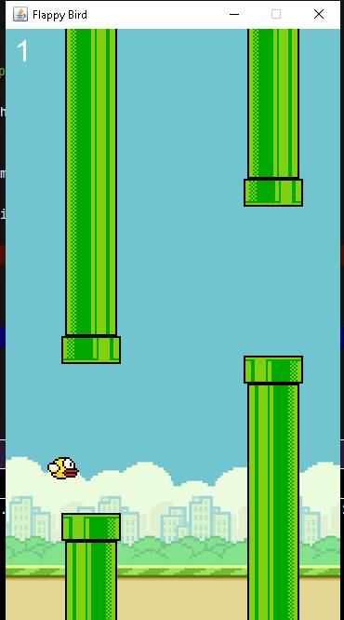
Visual Elements
Game Components:
• Bird character
• Pipe obstacles
• Background
• Score display
• Game over screen
Graphics:
• Custom sprites
• Smooth animations
• Clear visual feedback

Slide 6




Visual ELEMENTS
Bird
BottomPipe
Top Pipe

Slide 7

Visual ELEMENTS
Background

Slide 8
Class structure
Main Components:
public class FlappyBird extends JPanel {
class Bird {
// Bird properties and methods
}
class Pipe {
// Pipe properties and methods
}
}
Key Classes:
• FlappyBird - Main game class
• Bird - Player character
• Pipe - Obstacles

Slide 9
CORE ALGORITHMS
1. Physics System:
velocityY += gravity;
bird.y += velocityY;
2. Collision Detection:
boolean collision(Bird a, Pipe b) {
return a.x < b.x + b.width &&
a.x + a.width > b.x &&
a.y < b.y + b.height &&
a.y + a.height > b.y;
}
3. Pipe Generation:
int randomPipeY = (int) (pipeY - pipeHeight/4 -
Math.random()*(pipeHeight/2));

Slide 10
DEMO
Demonstration Points:
• Game startup
• Basic gameplay
• Collision detection
• Scoring system
• Game over handling
• Restart functionality

Slide 11
CONCLUSION
Project Achievements:
• Successful implementation
• OOP principles applied
• Clean architecture
• Working gameplay
Learning Outcomes:
• Java programming
• Game development
• OOP concepts
• Design pattern

