Slide 1
Visual Studio® 2008: Windows® Communication Foundation
Notes:
Module 4: Debugging
and Diagnostics
Course 6461A

Slide 2
Module 4: Debugging and Diagnostics
Logging Messages
Activity Tracing
Notes:
Course 6461A
Module 4: Debugging
and Diagnostics

Slide 3
Lesson: Logging Messages
Tracking What Is Happening in a WCF Application
Message Logging in WCF
Adding a Trace Listener to Log Messages
Controlling Message Logging
Including Security Information in Message Logs
Filtering Which Messages To Log
Viewing Messages
Demonstration: Working with Logged Information
Notes:
Course 6461A
Module 4: Debugging
and Diagnostics

Slide 4


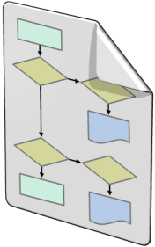

Tracking What Is Happening in a WCF Application
Message logging
On input and output
On service side or client side
Trace activities
Entering and exiting service operations
End-to-end picture of your service's behavior
Monitor system health
Windows Management Instrumentation (WMI) metrics
Beyond the scope of this course
Notes:
Explain to students the difference between message logging and tracing. Perhaps illustrate with a hypothetical example.
Also explain that there are other techniques to gather information about what the service is doing by using Windows® Management Instrumentation (WMI) metrics, but these are beyond the scope of this course.
Course 6461A
Module 4: Debugging
and Diagnostics

Slide 5
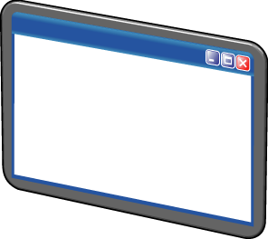




Message Logging in WCF
WCF Client
Service Log
Client Log
WCF Service
Notes:
Explain that you can configure a message logger on both the client and server.
Also explain that you must not log sensitive information. You protect the contents of a message by using message-level security.
Course 6461A
Module 4: Debugging
and Diagnostics

Slide 6
Adding a Trace Listener to Log Messages
Add a trace listener to the System.ServiceModel.MessageLogging trace source to enable logging
<system.diagnostics>
<sources>
<source name="System.ServiceModel.MessageLogging">
<listeners>
<add name="messages"
type="System.Diagnostics.XmlWriterTraceListener"
initializeData="c:\logs\messages.svclog" />
</listeners>
</source>
</sources>
<trace autoflush="true" />
</system.diagnostics>
Notes:
Explain to students the elements in the code example.
Particularly note that flushing is useful to ensure that the log reflects the current state of message exchange.
Course 6461A
Module 4: Debugging
and Diagnostics

Slide 7

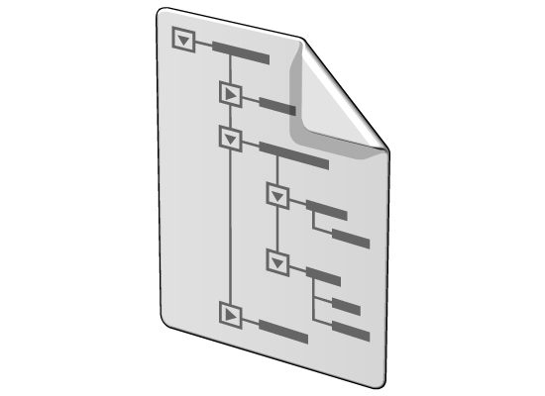
Controlling Message Logging
<system.serviceModel>
<diagnostics>
<messageLogging
logEntireMessage="true"
logMalformedMessages="false"
logMessagesAtServiceLevel="true"
logMessagesAtTransportLevel="false"
maxMessagesToLog="3000"
maxSizeOfMessageToLog="2000"/>
</diagnostics>
</system.serviceModel>
Notes:
Explain the difference between:
Service-level logging - When messages enter or exit user code.
Transport level logging - When message exit the service and go onto the wire (out of the
channel).
Explain the attributes in the messageLogging element.
Course 6461A
Module 4: Debugging
and Diagnostics

Slide 8
Including Security Information in Message Logs
By default, keys and personally identifiable information (PII) such as user name and password are not logged
Enable at application level
<system.diagnostics>
<sources>
<source name="System.ServiceModel.MessageLogging"
logKnownPii="true">
<listeners>
<!-- Your listener -->
</listeners>
</source>
</sources>
</system.diagnostics>
Enable at machine level
<configuration>
<system.ServiceModel>
<machineSettings enableLoggingKnownPii="true"/>
</system.ServiceModel>
</configuration>
Notes:
Explain that security information is not logged by default.
Also explain that you can enable security information logging by using a combination of application-level and machine-level configuration.
Course 6461A
Module 4: Debugging
and Diagnostics

Slide 9



Filtering Which Messages to Log
<messageLogging
logEntireMessage="true"
logMalformedMessages="true"
logMessagesAtServiceLevel="true"
logMessagesAtTransportLevel="false"
maxMessagesToLog=“3000">
<filters>
<add nodeQuota="10"
xmlns:soap="http://www.w3.org/2003/05/soap-envelope">
/soap:Envelope/soap:Header
</add>
</filters>
</messageLogging>
Notes:
Explain the elements required to define a filter.
Also explain the purpose of the nodeQuota attribute, and explain that it addresses a potential performance issue.
Course 6461A
Module 4: Debugging
and Diagnostics

Slide 10
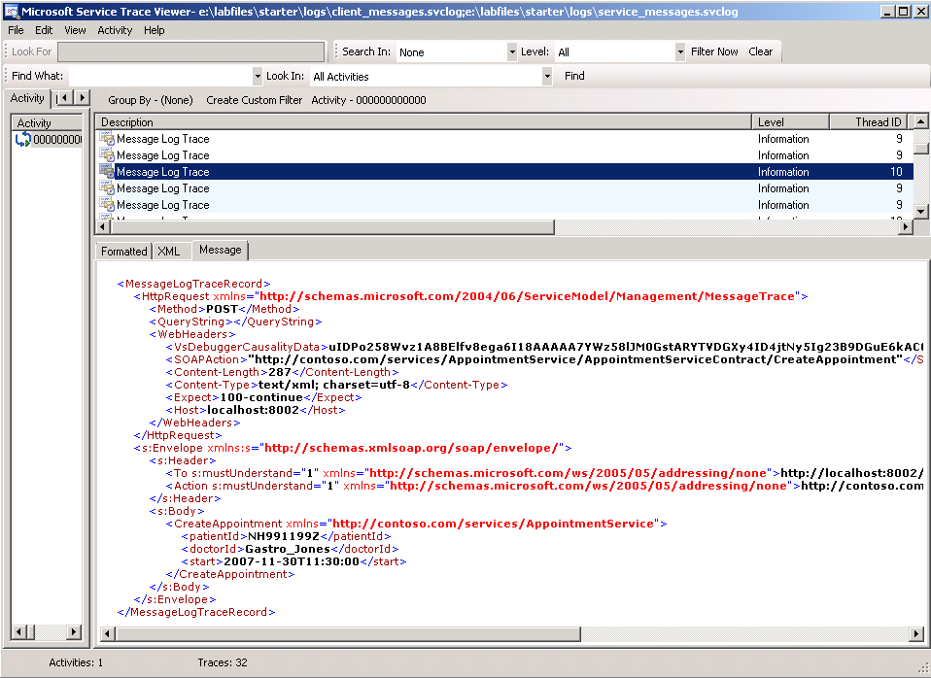
Viewing Messages
You can use the Service Trace Viewer Tool to view logged messages
Notes:
Explain how you can use the Microsoft® Service Trace Viewer to view logged messages.
Course 6461A
Module 4: Debugging
and Diagnostics

Slide 11
Demonstration: Working with Logged Information
In this demonstration, you will see how to:
Implement logging for a WCF service
Work with the generated messages
Notes:
The solution code for this demonstration can be found at either of the following locations:
If you are using Microsoft Visual Basic® development system, the solution is in the E:\Democode\Solution\VB\Demo1\ folder.
If you are using Microsoft Visual C#® development tool, the solution is in the E:\Democode\Solution\CS\Demo1\ folder.
High-level demonstration steps:
Run Microsoft Visual Studio® 2008 development system as an administrator.
Open the Demo1 solution from either of the following locations:
If you are using Visual Basic, open the solution from the E:\Democode\Starter\VB\Demo1\ folder.
If you are using Visual C#, open the solution from the E:\Democode\Starter\CS\Demo1\ folder.
Explain that in this case there are two services—the BankService and the DepositService.
In the Microsoft Service Configuration Editor window, open the BankSelfHost’s configuration file.
Explain that because both services in this solution are hosted by the same self hosted application, you only have to configure message tracing in the self hosts configuration file to log messages for both the BankService and the DepositService.
Do the following in the Microsoft Service Configuration Editor.
Enable log auto flush
Enable message logging
Save the log file to E:\Democode\Starter\Logs\service_messages.svclog
Log the entire message
Log both transport and service messages
Set the trace level to Information
Open the BankServiceClient’s configuration file in the Microsoft Service Configuration Editor.
Course 6461A
Module 4: Debugging
and Diagnostics

Slide 12
Notes Page Over-flow Slide. Do Not Print Slide. See Notes pane.
Notes:
Do the following in the Microsoft Service Configuration Editor.
Enable log auto flush
Enable message logging
Save the log file to E:\Democode\Starter\Logs\client_messages.svclog
Log the entire message
Log both transport and service messages
Set the trace level to Information
Run the solution.
Open the Service Trace Viewer tool (this is on the Microsoft Windows SDK v6.0A menu).
In the Service Trace Viewer tool, open the client_messages.svclog and the service_messages.svclog log files. (E:\Democode\Starter\Logs)
Walk the students through some of the messages, and point out the method calls and the data exchange.
Course 6461A
Module 4: Debugging
and Diagnostics

Slide 13
Lesson: Activity Tracing
Enabling Activity Tracing
Custom Activity Tracing
End-to-End Service Tracing
Demonstration: Working with Activity Trace Information
Notes:
Course 6461A
Module 4: Debugging
and Diagnostics

Slide 14
Enabling Activity Tracing
Add a trace listener for System.ServiceModel source
Critical/Error/Warning
Information/Verbose/ActivityTracing
<system.diagnostics>
<trace autoflush="true" />
<sources>
<source name="System.ServiceModel"
switchValue="Information, ActivityTracing"
propagateActivity="true">
<listeners>
<add name="traceActivity"
type="System.Diagnostics.XmlWriterTraceListener"
initializeData= "c:\logs\activity.svclog" />
</listeners>
</source>
</sources>
</system.diagnostics>
Notes:
Explain the elements in the code example on the slide.
Explain the purpose of the following properties:
Autoflush
SwitchValue
For more information about different levels of tracing, see "Service Trace Viewer Tool" at http://msdn2.microsoft.com/en-us/library/ms732023.aspx
Course 6461A
Module 4: Debugging
and Diagnostics

Slide 15
Custom Activity Tracing
Create your own trace source to trace domain code events
Create an activity ID to identify the operation
Generate trace information
TraceSource ts = new TraceSource("bankServiceTraceSource");
Guid oldActivityID = Trace.CorrelationManager.ActivityId;
Guid newActivityID = Guid.NewGuid();
ts.TraceTransfer(0, "transfer", newActivityID);
Trace.CorrelationManager.ActivityId = newActivityID; ts.TraceEvent(TraceEventType.Start, 0, "Add request");
string msg = String.Format(
"Tried to withdraw {0} from account {1}", amount, account);
ts.TraceInformation(msg);
ts.TraceTransfer(0, "transfer", oldActivityID);
ts.TraceEvent(TraceEventType.Stop, 0, "Add request");
Trace.CorrelationManager.ActivityId = oldActivityID;
Notes:
Walk the students through the code on the slide.
For more information, see Emitting User-Code Traces at http://msdn2.microsoft.com/en-us/library/aa738759.aspx
Course 6461A
Module 4: Debugging
and Diagnostics

Slide 16
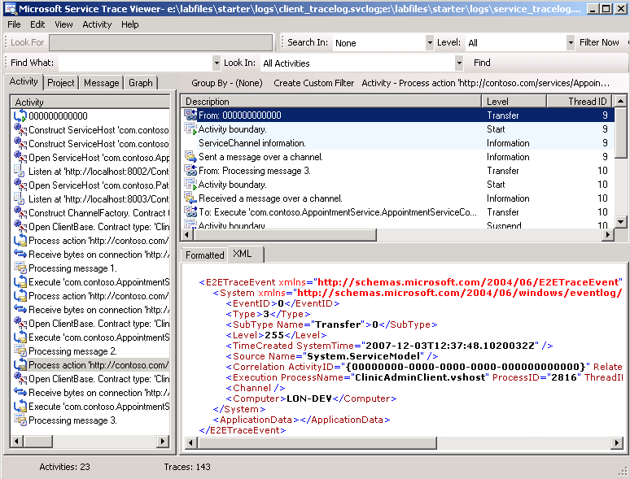
End-to-End Service Tracing
<source name="System.ServiceModel"
switchValue="Information, ActivityTracing"
propagateActivity="true">
Notes:
Explain how to correlate activities in WCF:
Log for the client and log for the service
Open the log files and merge
Course 6461A
Module 4: Debugging
and Diagnostics

Slide 17
Demonstration: Working with Activity Trace Information
In this demonstration, you will see how to:
Implement activity tracing for a WCF service
Work with the generated messages
Notes:
The solution code for this demonstration can be found at either of the following locations:
If you are using Visual Basic, the solution is in the E:\Democode\Solution\VB\Demo2\ folder.
If you are using Visual C#, the solution is in the E:\Democode\Solution\CS\Demo2\ folder.
High-level demonstration steps:
Run Visual Studio 2008 as an administrator.
Open the Demo2 solution from either of the following locations:
If you are using Visual Basic, open the solution from the E:\Democode\Starter\VB\Demo2\ folder.
If you are using Visual C#, open the solution from the E:\Democode\Starter\CS\Demo2\ folder.
In the Microsoft Service Configuration Editor window, open the BankSelfHost’s configuration file.
Explain that because both services in this solution are hosted by the same self hosted
application, we only need to configure tracing in the self hosts configuration file to log
messages for the BankService and the DepositService.
In the Microsoft Service Configuration Editor window, perform the following steps:
Enable log auto flush
Enable tracing
Save the log file to E:\Democode\Starter\Logs\service_tracelog.svclog
Set the trace level to Information
Point out the Propagate activity checkbox
In the Microsoft Service Configuration Editor window, open the BankServiceClient’s configuration file.
Course 6461A
Module 4: Debugging
and Diagnostics

Slide 18
Notes Page Over-flow Slide. Do Not Print Slide. See Notes pane.
Notes:
In the Microsoft Service Configuration Editor window, perform the following steps:
Enable log auto flush
Enable tracing
Save the log file to E:\Democode\Starter\Logs\client_tracelog.svclog
Set the trace level to Information
Run the solution.
Open the Service Trace Viewer tool (this is on the Microsoft Windows SDK v6.0A menu).
In the Service Trace Viewer tool, open the client_tracelog.svclog and the service_tracelog.svclog (E:\Democode\Starter\Logs)
Walk the students through some of the activities, and point out the end-to-end process.
Module 4: Debugging
and Diagnostics
Course 6461A

Slide 19
Lab: Message Logging and Activity Tracing
Exercise 1: Generating Logging Information for a Service
Exercise 2: Enabling End-to-end Tracing for a Service
Logon information
Virtual machine | 6461A-LON-DEV-04
User name | Student
Password | Pa$$w0rd
Estimated time: 30 minutes
Notes:
Lab Goal: Log messages and trace the progress of calls to services.
Exercise 1: Log messages as they come in and out of the service. Examine the logged messages.
Exercise 2: Enable end-to-end tracing and examine the trace using the Service Trace viewer .
Course 6461A
Module 4: Debugging
and Diagnostics

Slide 20
Lab Review
What happens if you do not set the LogEntireMessage property to true?
If you wanted to log trace activities that potentially could cause an error, what trace switch would you use?
Notes:
Use the questions on the slide to guide the debriefing after students have completed the lab exercises.
Answer 1
Only the message header is logged, and not the header and body.
Answer 2
Warning.
Course 6461A
Module 4: Debugging
and Diagnostics

Slide 21
Module Review and Takeaways
Review Questions
Best Practices
Tools
Notes:
Review Questions
Point the students to the appropriate section in the course so that they are able to answer the questions presented in this section.
Best Practices
Help the students to understand the best practices presented in this section. Ask students to consider these best practices in the context of their own business situations:
Consider the type of information that you log in your log files such as sensitive user data
that may be protected by legislation.
Keep log files secure from unauthorized access.
Tools
Point students to the SvcTraceViewer.exe tool, which they can use to view log files.
Course 6461A
Module 4: Debugging
and Diagnostics

