Slide 1
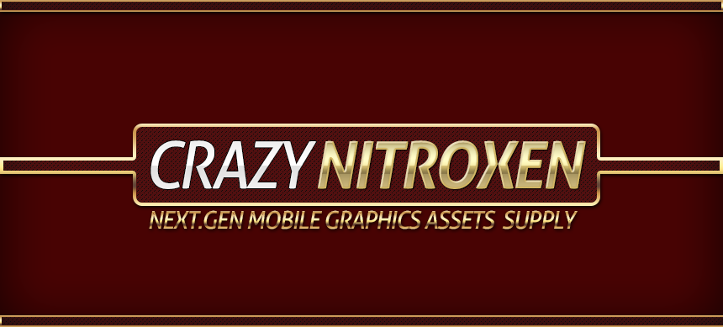
CAT WARRIOR ASSET MANUAL

Slide 2
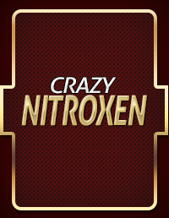
INDEX OF CONTENTS
OVERVIEW
PACKAGE INFORMATION
1. Project assets.
2. 3dsmax file.
3. Substance custom material with custom mobile shader.
SUPPORT
direct contact http://www.leegoonz.com/#!contact/cvrh
facebook
https://www.facebook.com/crazynitroxen

Slide 3
PACKAGE INFORMATION

Slide 4

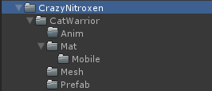
PROJECT INFORMATION :: DIRECTORY
Directory | Descriptions
CatWarrior | Include base mesh and materials with textures for only this product. .[PC , Mobile]
Shaders | Include crazy nitroxen custom shaders.[PC , Mobile / Shared assets]
Shared Textures | Public crazy nitroxen shared texture included.
Substance | Crazy nitroxen custom substance materials included .[PC , Mobile / Shared assets]
Scenes | It made to each scenes for each type of date for platforms.
Scripts | Animation preview scripts.
Directory | Descriptions
Anim | Basic animation set for cat warrior.[legacy only] {But if you need to mechanim data you should be use 3dsmax date for yourself.}
Mat | Materials for PC and Mobile subfolder with mobile assets included for cat warrior.
mesh | Cat warrior base mesh included. [ PC , Mobile ]
Prefab | Cat warrior prefab asset included.

Slide 5
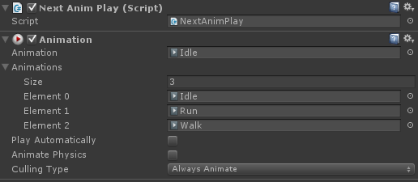
PROJECT INFORMATION :: Component
NextAnimPlay.cs
It is check your Animation list and add <list> with play.
Hot key is space bar and pressed do they can be playing next anim.

Slide 6
3DSMAX
ORIGINAL Setup data
Required 3dsmax 2014 or higher.

Slide 7
3DSMAX FILES :: LISTS
Mesh data
Cat_Warrior_Scale_Fix_Unity_Standard.max
While you exporting to Base mesh that you use this file.
Animation files

Slide 8
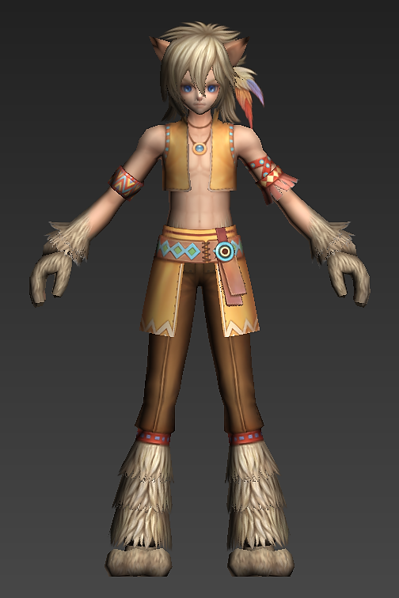
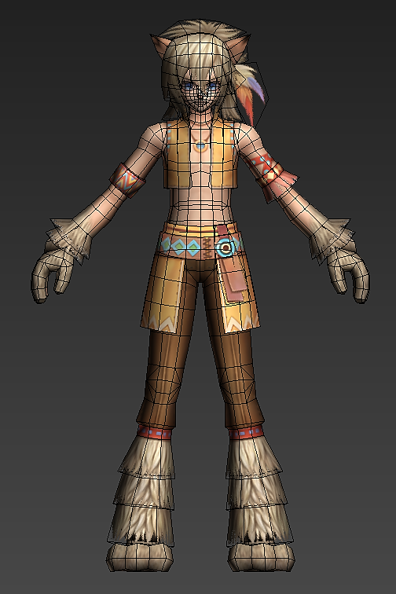
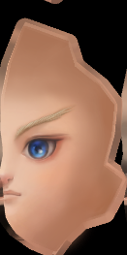
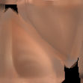

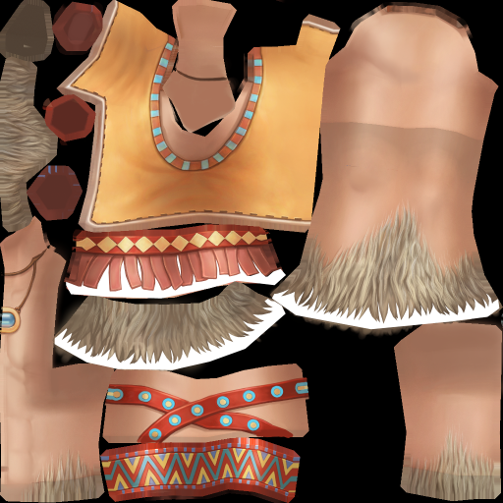
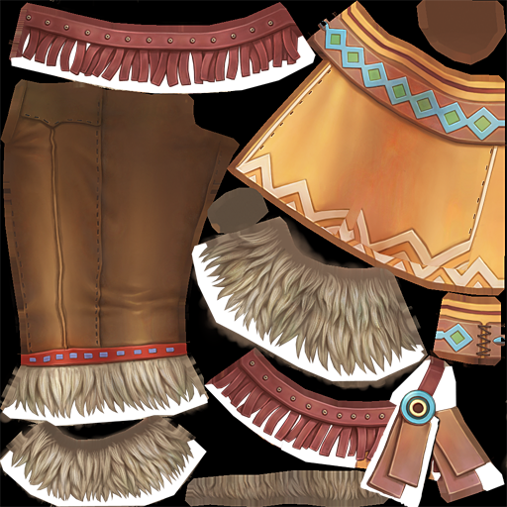
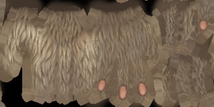
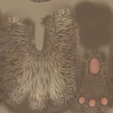
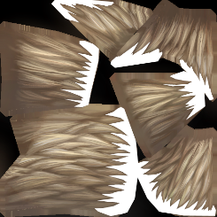
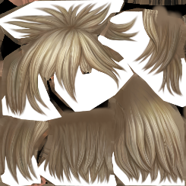
PROJECT INFORMATION :: BASE MESH
2083 Triangle.
8 Mesh parts(8 Draw call).
All texture made by hand painting style.
3dsmax data path : ./3dsmax_source/CatWarrior-3dsmax.7z

Slide 9
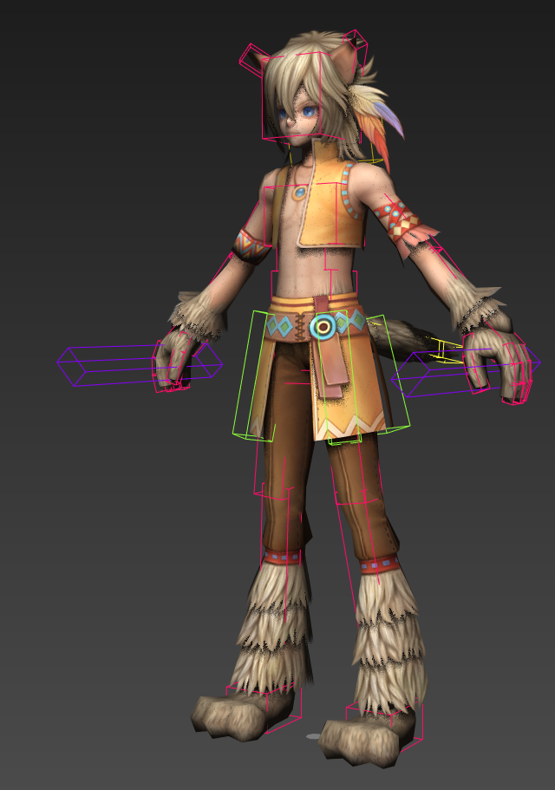
3DSMAX FILE :: SKELETON INFORMATIONS
Weapon Dummy
Biped prop [R]
Secondary
Animation
Biped xtra
You should do ‘secondary animation biped xtra’ that is setting up in unity3d via ragdoll system for physically secondary action.
Weapon Dummy
Biped prop [L]
Stable biped dummy bone when I use just biped prop system.

Slide 10
SUBSTANCE
Public texture lighting

Slide 11
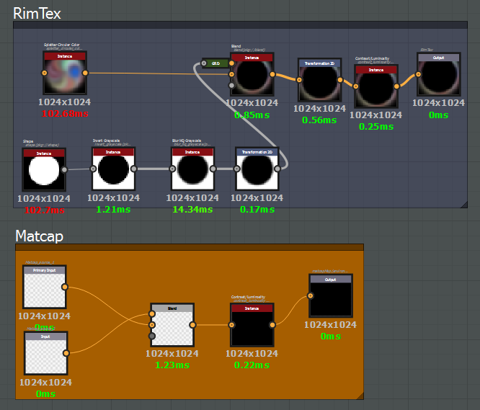
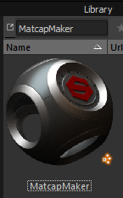
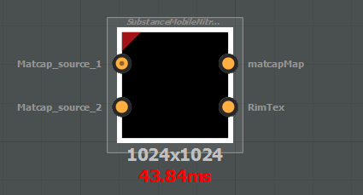
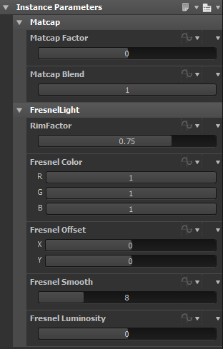
CUSTOM SUBSTANCE MATERIALS WITH CUSTOM SHADERS.
SubstanceMobileNitroxenLighting.sbs
SubstanceMobileNitroxenLighting.sbsar
Matcap Factor.
Matcap lighting strength.
Matcap Blend.
From blending two Matcap raw texture create to final lighting texture.
RimFactor.
Fresnel lookup texture scale.
Fresnel Color.
Change texture colors.
Fresnel Color.
Offset Fresnel mask texture.
Fresnel Smooth.
More smoothy.
Fresnel Luminosity.
Fresnel lighting bright value changer.

Slide 12
STUDY FILE PACK
Substance custom node

Slide 13
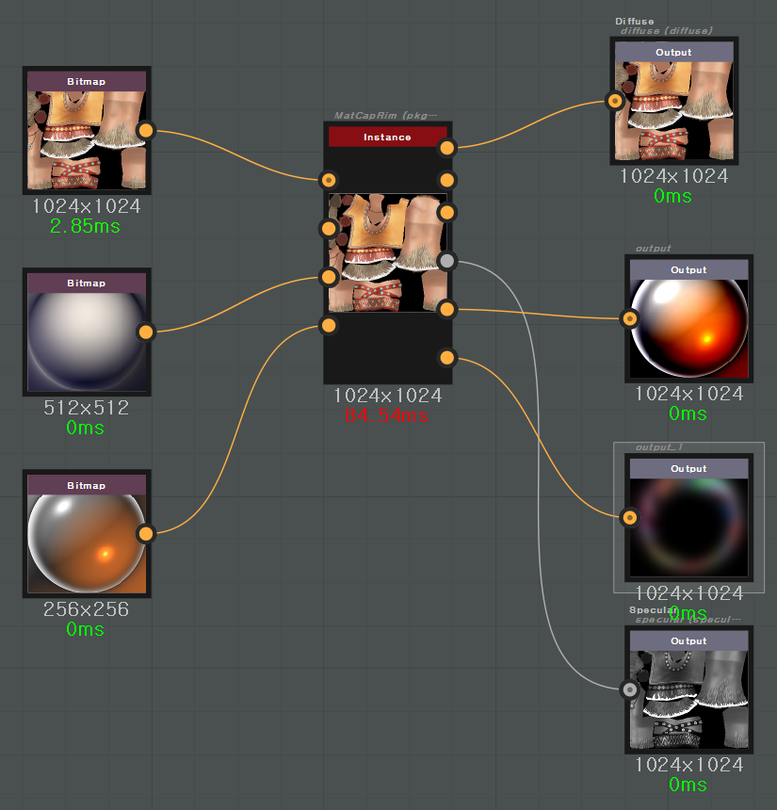
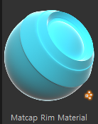
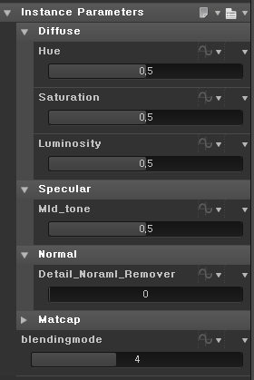
CUSTOM SUBSTANCE MATERIALS WITH CUSTOM SHADERS.
Crazy Nitroxen Custom Matcap map creator.
All right reserves crazy nitroxen since 2014.
Diffuse.
Hue , saturation , Luminosity value controller.
Specular generator.
Automatic generation from diffuse map to sepcular texture.
Fresnel lookup.
Automatic generation from procedural shape based texture.
Matcap.
When you were blending used by two matcap textures you should choice blending type.

Slide 14
Information Movie
[Download via Dropbox]
https://www.dropbox.com/sh/e8oyf7smxpz9ou4/AAA1ZR-V3mg05u7HG5rxrgUUa

