Slide 1






AWS Cloud
Availability Zone 1
VPC
Public subnet
NAT Gateway
Instance
Private subnet
EC2 Instance (private web server)
Instance
Instance

Slide 2



AWS Cloud
Availability Zone 1
Availability Zone 2
VPC
Public subnet
Application Load Balancer
Amazon ECS on AWS Fargate
Instance
Private subnet
Instance
Containers
Instance
Containers

Slide 3
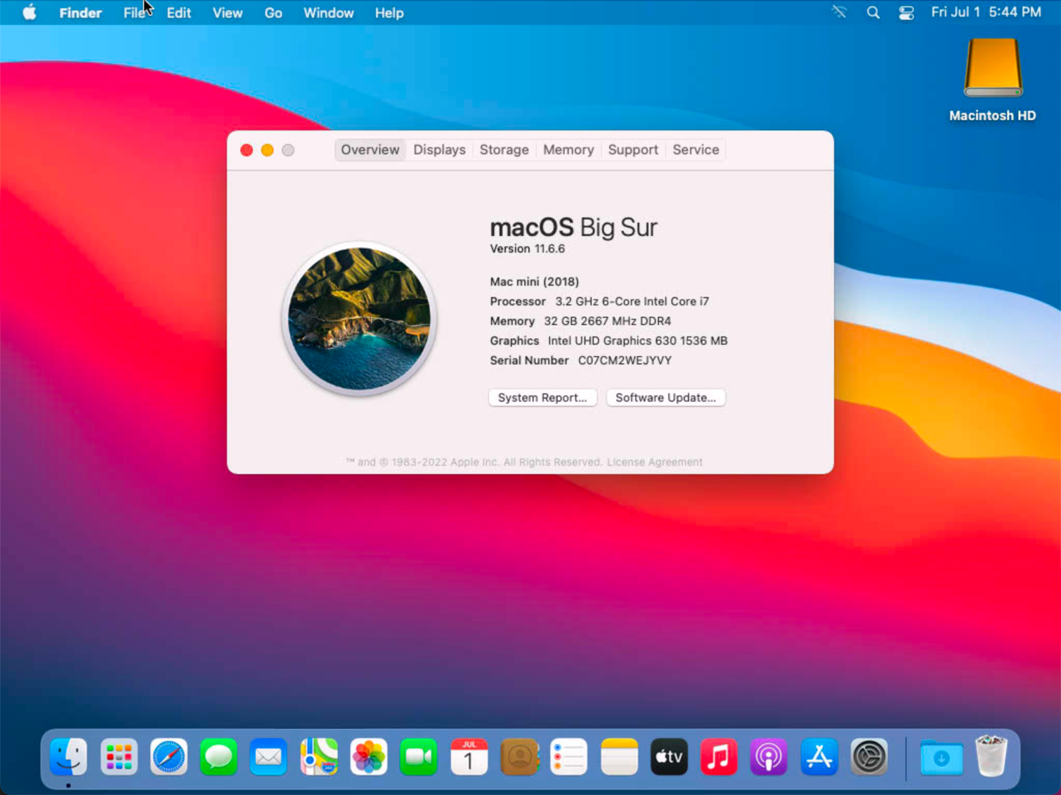
vnc://localhost:5900
ARD (5900)
SSH (22)
Instance
localhost
SSH Tunnel
ssh –L 5900:localhost:5900 ec2-user@instance

Slide 4
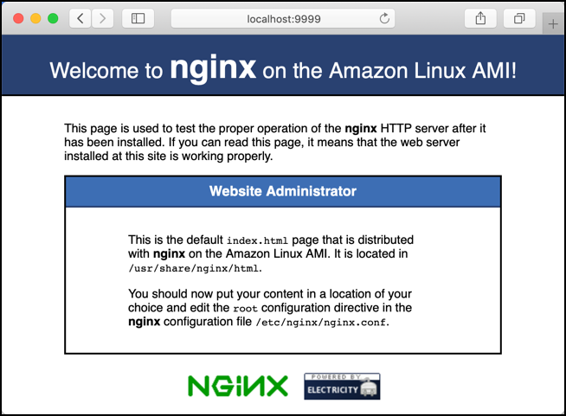
http://localhost:9999
Web (80)
SSM Agent
Instance
localhost
SSM Session Manager Tunnel
aws ssm start-session --target instance … --parameters '{"portNumber":["80"],"localPortNumber":["9999"]}'

