Slide 1
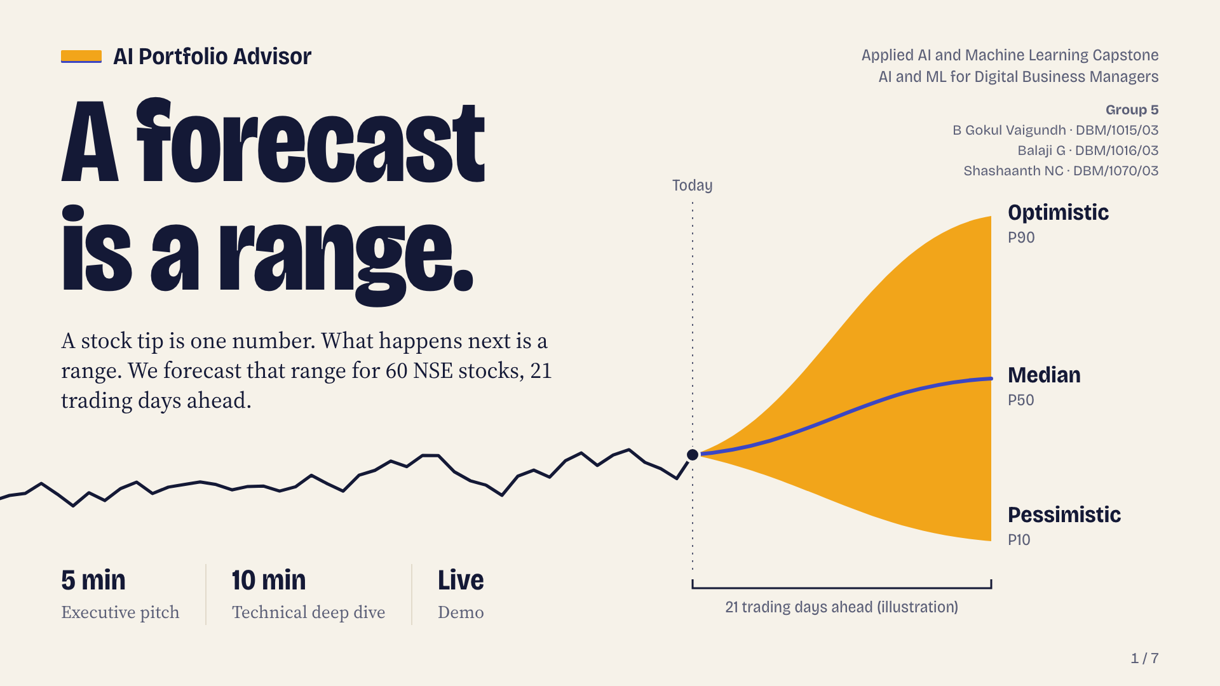
Notes:
A forecast is a range.
Section: Executive pitch
AI Portfolio Advisor: profile-aware NSE stock recommendations with a pessimistic, median and optimistic (P10, P50, P90) 21-trading-day forecast from three LightGBM quantile models, for 60 NSE stocks. Agenda: 5-minute executive pitch, 10-minute technical deep dive, live demo. Group 5: B Gokul Vaigundh (DBM/1015/03), Balaji G (DBM/1016/03), Shashaanth NC (DBM/1070/03).

Slide 2
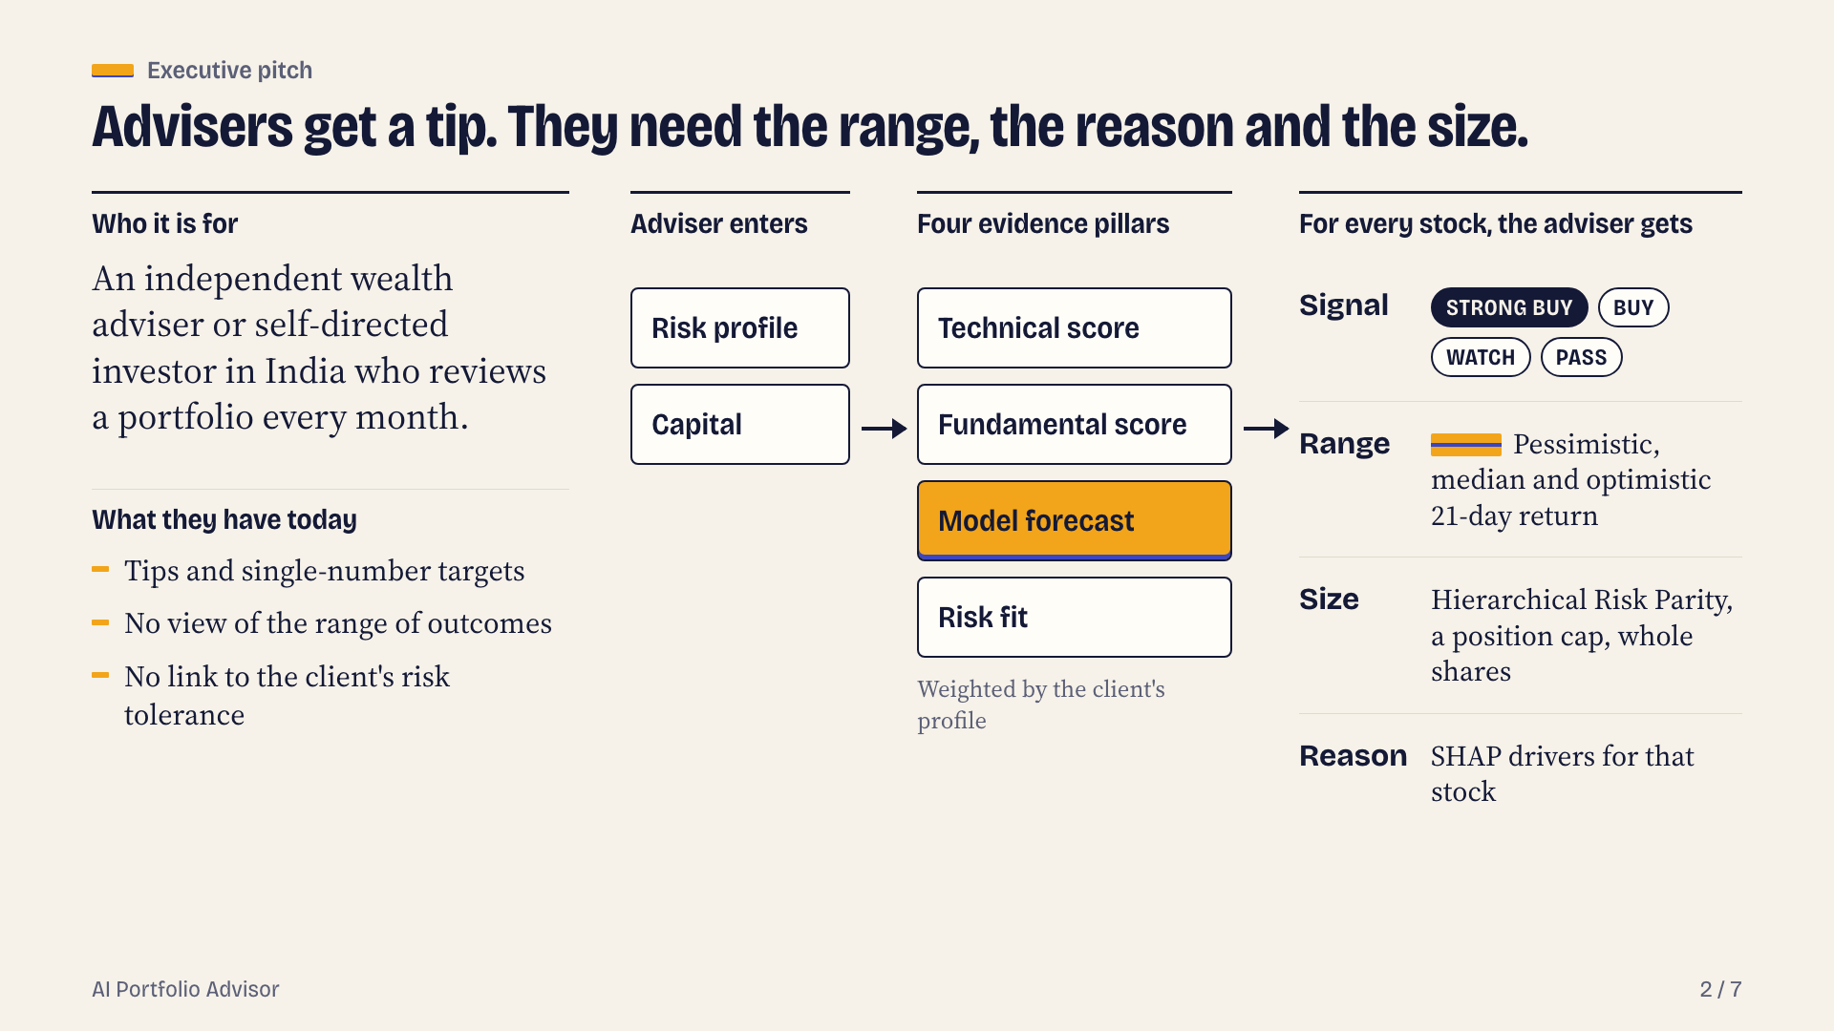
Notes:
Advisers get a tip. They need the range, the reason and the size.
Section: Executive pitch
Target user: an independent wealth adviser or self-directed investor in India who reviews a portfolio monthly. Today picks come from tips and single-number targets with no view of the range of outcomes or fit with risk tolerance. The product takes a risk profile and capital, blends four evidence pillars (technical score, fundamental score, model forecast, risk fit) by profile weights, and returns a ranked book marked STRONG BUY / BUY / WATCH / PASS with a P10/P50/P90 21-day return, a position size from Hierarchical Risk Parity and SHAP drivers per stock.

Slide 3
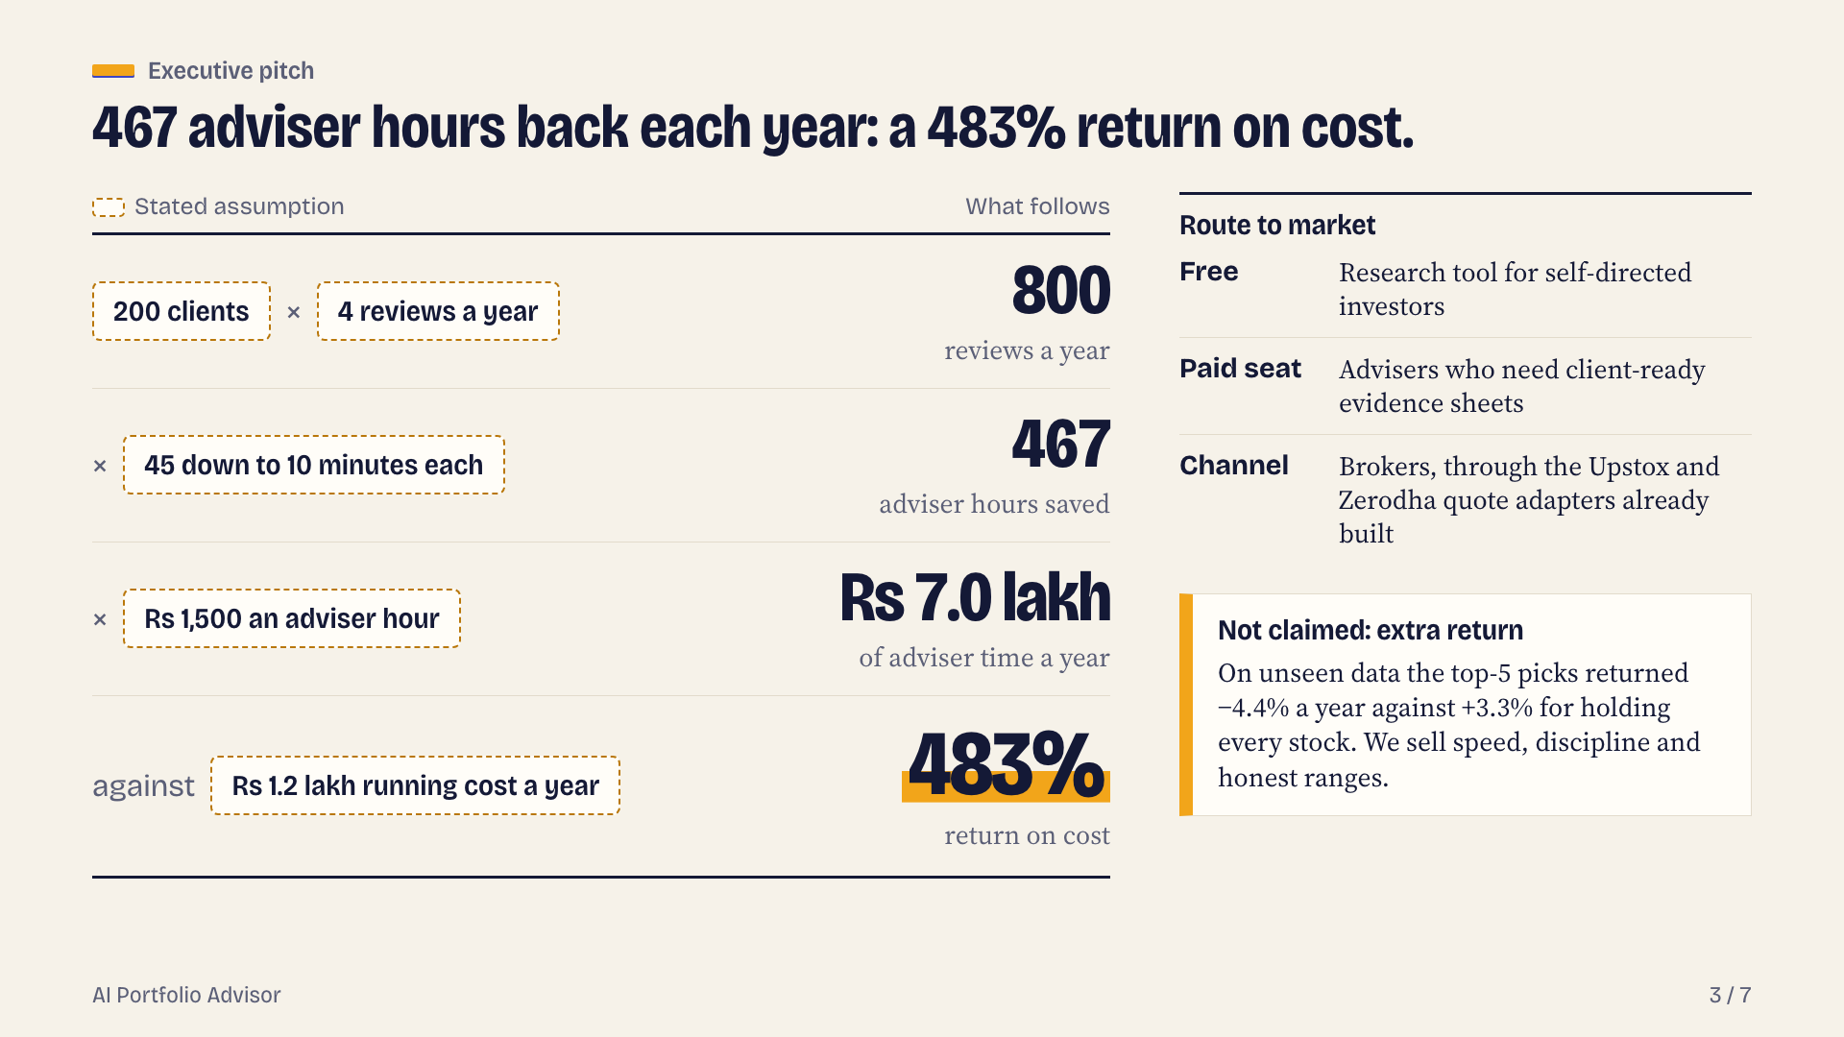
Notes:
467 adviser hours back each year: a 483% return on cost.
Section: Executive pitch
ROI is an adviser time-saving case built on stated assumptions: 200 clients x 4 reviews a year = 800 reviews; screening time cut from 45 to 10 minutes saves 35 minutes each = 467 hours a year; at Rs 1,500 per adviser hour that is Rs 7.0 lakh (Rs 700,000); against an assumed running cost of Rs 1.2 lakh a year the return on cost is 483%. Market strategy: free research tool for self-directed investors; paid seat for advisers who need client-ready evidence sheets; brokers as a channel through the existing Upstox / Zerodha live-quote adapters. Not claimed: extra return. Hold-out top-5 strategy returned -4.4% a year against +3.3% for holding all stocks equally.

Slide 4
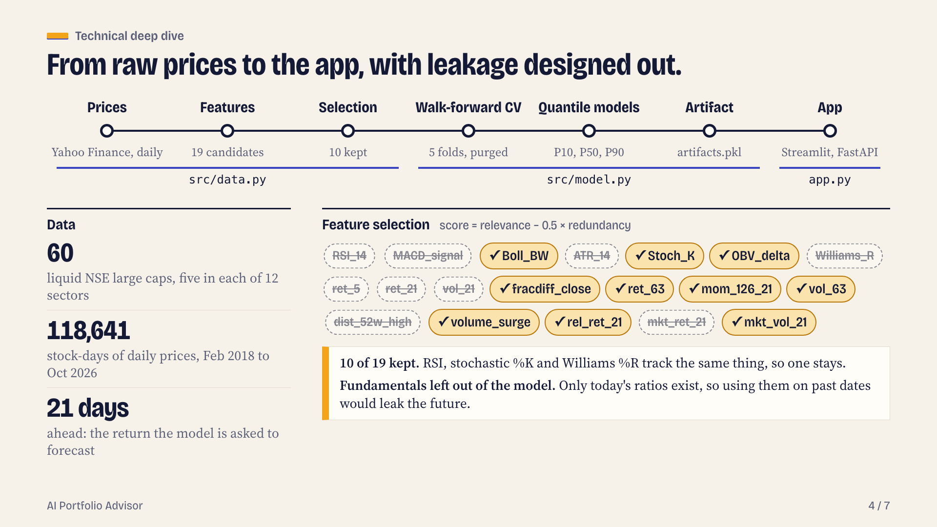
Notes:
From raw prices to the app, with leakage designed out.
Section: Technical deep dive
Architecture: prices -> features -> selection -> purged walk-forward CV -> quantile models -> artifact -> app. src/data.py downloads Yahoo Finance prices, builds 19 candidate features, selects features and defines the splits. src/model.py tunes, cross-validates, trains three LightGBM quantile models, evaluates the hold-out, computes SHAP, backtests and exports data/artifacts.pkl and reports/metrics.json. app.py is the Streamlit interface; src/portfolio_advisor/core.py is the decision engine. Data: 60 liquid NSE large caps, five per sector across 12 sectors, daily adjusted prices 2018-02-19 to 2026-10-08, 118,641 stock-days; label = return over the next 21 trading days. Feature selection: greedy mutual-information relevance minus 0.5 x redundancy on development data only; kept 10 of 19: mkt_vol_21, fracdiff_close, rel_ret_21, volume_surge, mom_126_21, Stoch_K, vol_63, ret_63, OBV_delta, Boll_BW. Company fundamentals were removed from the model because only today's ratios exist, so using them on past dates would leak future information.

Slide 5
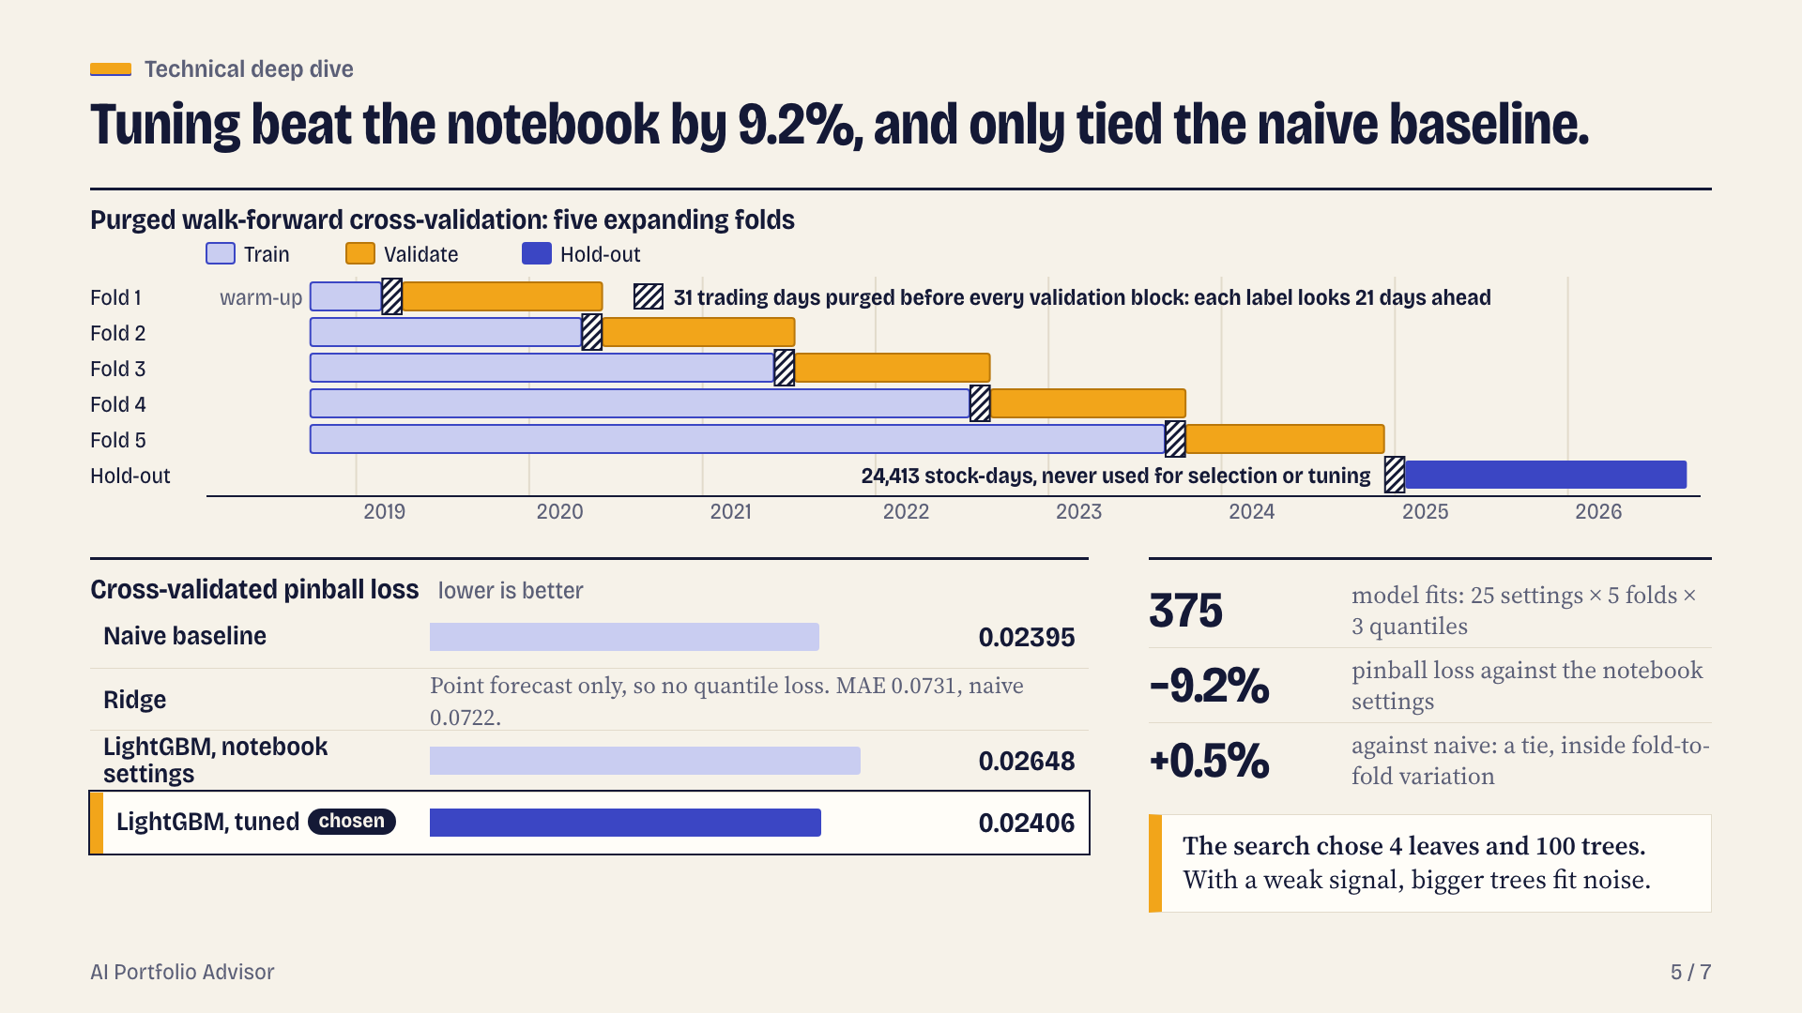
Notes:
Tuning beat the notebook by 9.2%, and only tied the naive baseline.
Section: Technical deep dive
Validation: purged walk-forward cross-validation, 5 expanding folds. Each fold trains on the past and validates on the next block, with 31 trading days removed in between because each label looks 21 days ahead. Hold-out 2025-01-23 to 2026-09-09 (24,413 stock-days) never used for selection or tuning. Search: random search over 25 settings x 5 folds x 3 quantiles = 375 model fits, scored by mean pinball loss. CV pinball loss: naive baseline 0.02395; LightGBM notebook settings 0.02648; LightGBM tuned 0.02406 +/- 0.00529; Ridge is a point forecast with no quantiles (CV MAE 0.0731 vs naive 0.0722). Tuning improved on the notebook settings by 9.2%. Against the naive no-feature baseline the tuned model is 0.5% worse, inside fold-to-fold variation. Chosen settings: n_estimators=100, learning_rate=0.02, num_leaves=4, min_child_samples=50, subsample=0.8, colsample_bytree=0.5, reg_lambda=0. With a weak signal, complex trees fit noise.

Slide 6
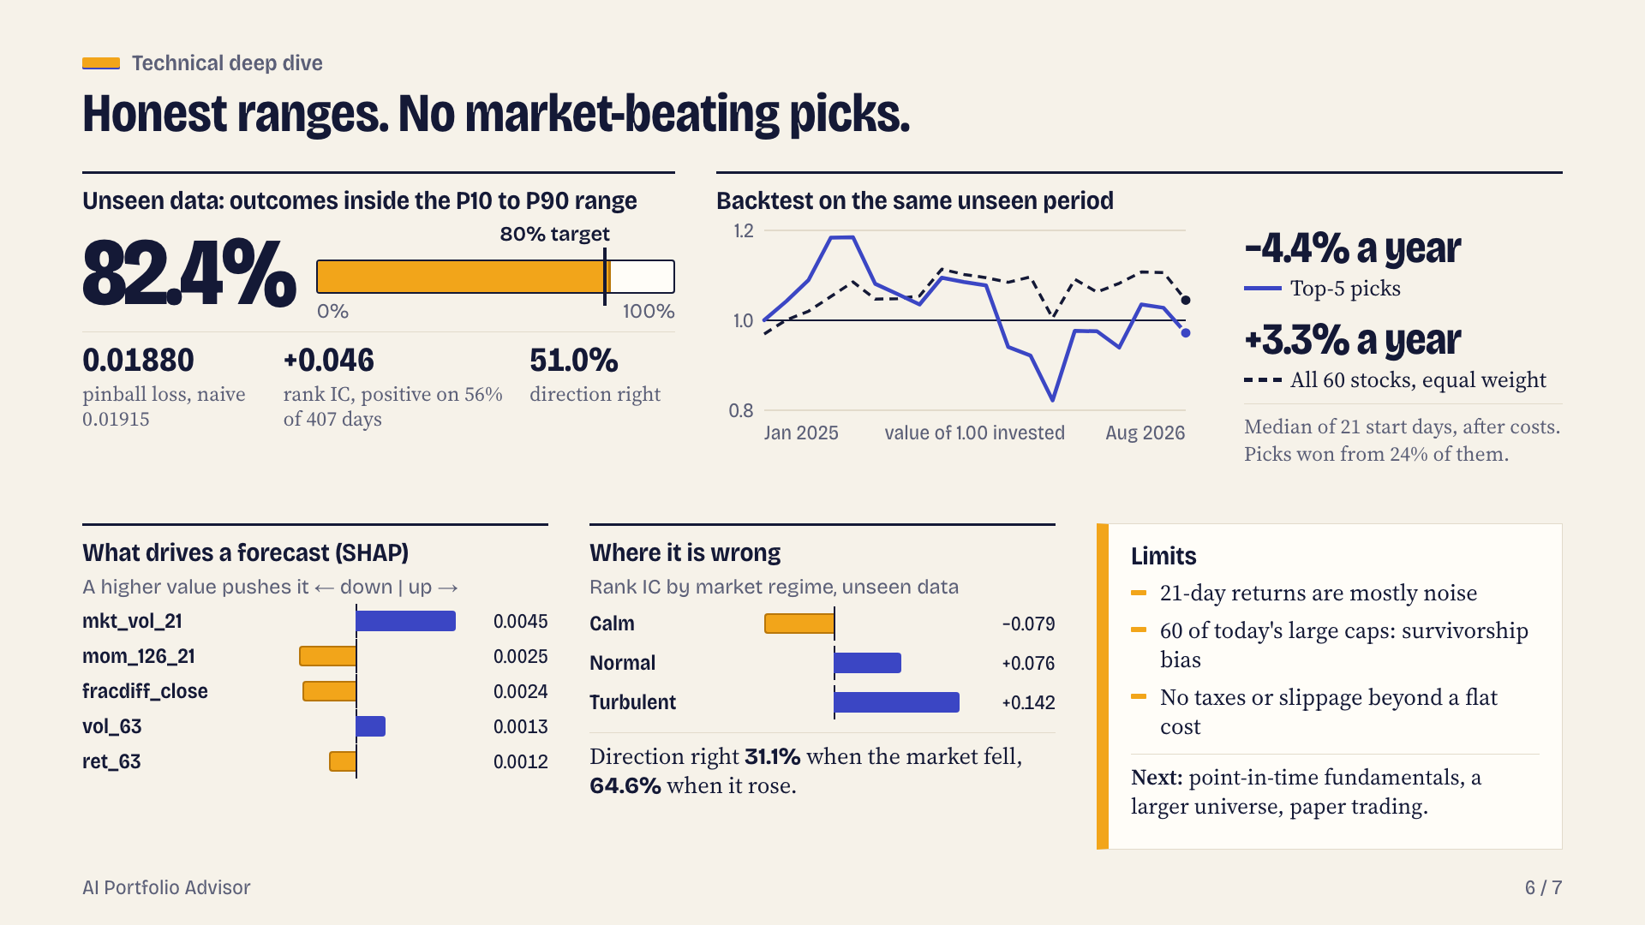
Notes:
Honest ranges. No market-beating picks.
Section: Technical deep dive
Hold-out period 2025-01-23 to 2026-09-09, 24,413 stock-days never used for selection or tuning. P10-P90 coverage 82.4% against an 80% target. Pinball loss: LightGBM 0.01880 vs naive 0.01915. Rank information coefficient +0.046, positive on 56% of 407 days. Direction right 51.0% of the time. Backtest on the hold-out (every 21 trading days hold the 5 highest median forecasts, equal weight, 20 bps cost; benchmark = all stocks equal weight): strategy -4.4% a year vs benchmark +3.3% a year, median over 21 start days; excess -6.4% (range -16.8% to +7.1%); beat the benchmark from 24% of start days. In cross-validation folds the excess was +1.6% a year (range -4.3% to +16.6%). SHAP (TreeExplainer on the median model), largest drivers: mkt_vol_21, mom_126_21, fracdiff_close, vol_63, ret_63. Error analysis: calm markets rank IC -0.079, normal +0.076, turbulent +0.142; direction right 31.1% when the market fell and 64.6% when it rose. Limits: 21-day returns are mostly noise; universe is 60 of today's large caps (survivorship bias) and one country; the backtest ignores taxes, market impact and slippage beyond a flat cost. Next: point-in-time fundamentals, a market-relative target, a larger universe including delisted names, a controlled paper-trading period.

Slide 7
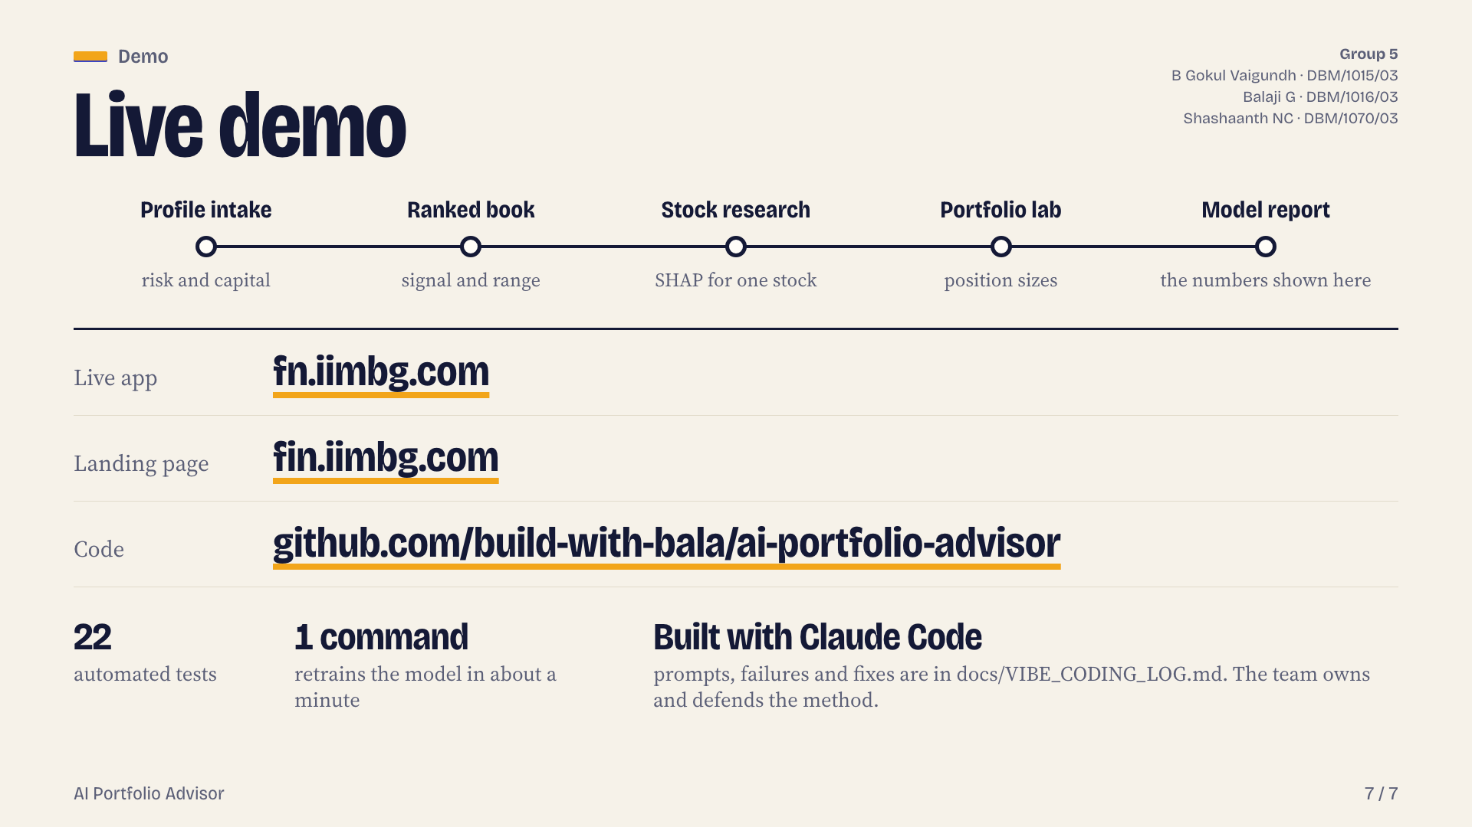
Notes:
Live demo
Section: Demo
Live demo steps: profile intake, ranked book, stock research with SHAP, portfolio lab, model report. Live app https://fn.iimbg.com . Landing page https://fin.iimbg.com . Code https://github.com/build-with-bala/ai-portfolio-advisor . Engineering: built with Claude Code and verified by the team; 22 automated tests; one command (python -m src.model) retrains from the committed data snapshot in about a minute; prompts, failures and fixes are in docs/VIBE_CODING_LOG.md. Team: Group 5: B Gokul Vaigundh (DBM/1015/03), Balaji G (DBM/1016/03), Shashaanth NC (DBM/1070/03).
PowerPoint cannot carry the HTML animations and builds; the animated version is at https://fin.iimbg.com/deck/

