Slide 1
Telco Customer Analytics
Classification • Regression • K-Means & Hierarchical Clustering

Slide 2
Agenda
Dataset overview and key statistics
Exploratory data analysis (EDA) highlights
Modeling approach and preprocessing
Churn classification results
Revenue regression results
Customer segmentation: K-Means and Hierarchical
Insights and recommendations

Slide 3
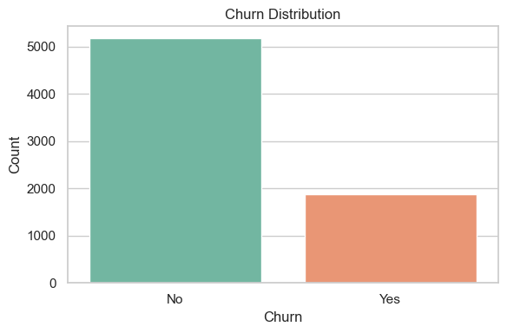
Dataset Overview
Total Customers
7,043
Churn Rate
26.5%
Avg Tenure
32.4 mo
Avg Monthly
$64.76
Key attributes: demographics, services, contracts, billing, and tenure.
Goal: predict churn, estimate revenue, and segment customers.

Slide 4
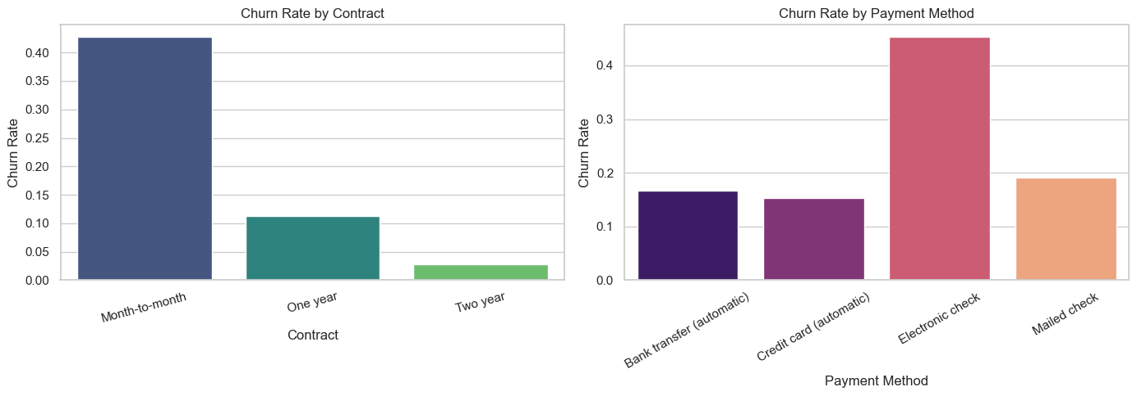
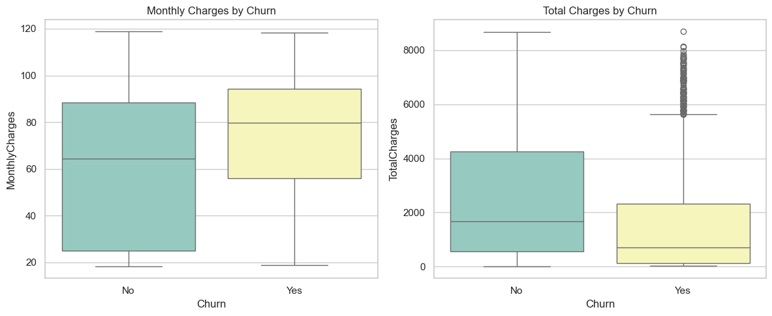
EDA Highlights — Churn Drivers

Slide 5
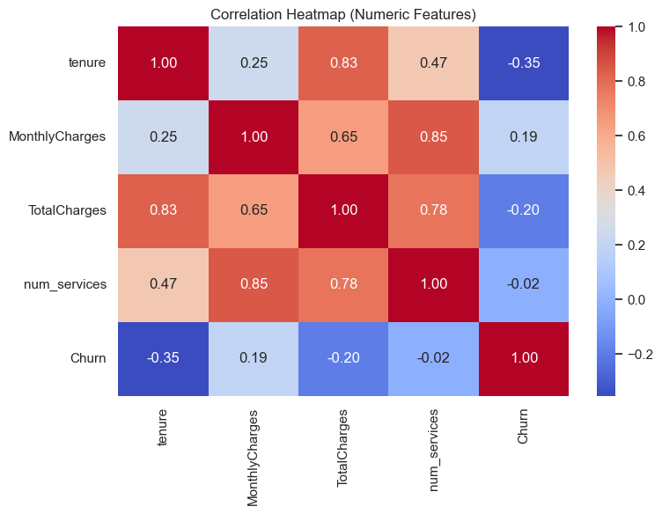
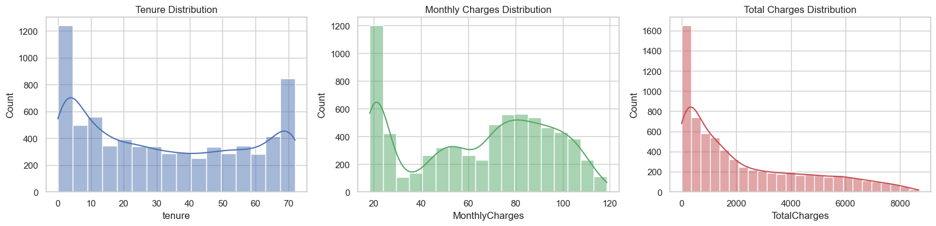
EDA Highlights — Distributions & Correlations

Slide 6
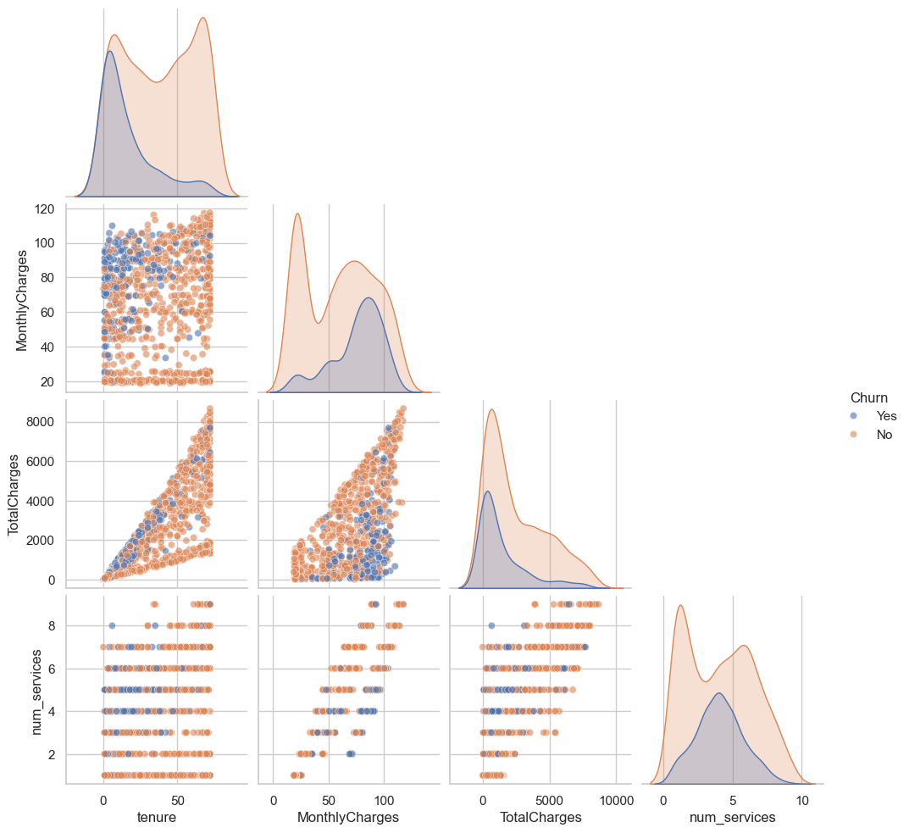
EDA — Feature Relationships

Slide 7
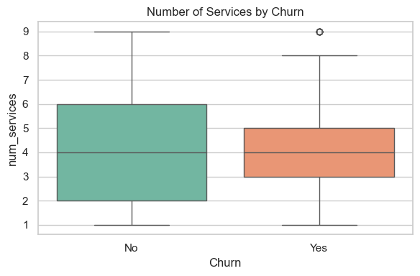
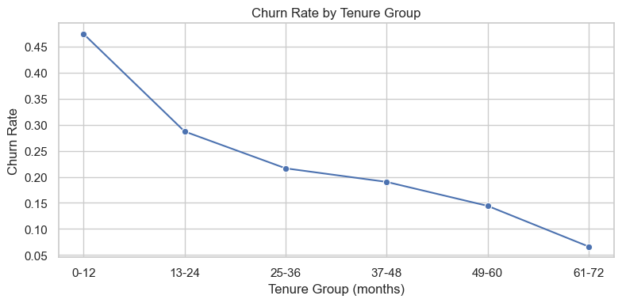
EDA — Services & Tenure

Slide 8
Modeling Approach
Preprocess
Train/Test
Modeling
Evaluation
Insights
Encoding: OneHot for categoricals; scaling for numeric features
Models: Logistic Regression, Decision Tree, Random Forest, HistGradientBoosting
Regression: Linear, Random Forest, Gradient Boosting
Clustering: K-Means and Agglomerative (Hierarchical)

Slide 9
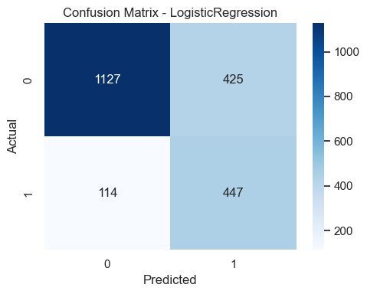
Churn Classification — Results
Unnamed: 0 | model | accuracy | precision | recall | f1 | roc_auc
0 | LogisticRegression | 0.745 | 0.513 | 0.797 | 0.624 | 0.844
2 | RandomForest | 0.771 | 0.554 | 0.713 | 0.624 | 0.837
1 | DecisionTree | 0.795 | 0.615 | 0.604 | 0.610 | 0.829
3 | HistGradientBoosting | 0.790 | 0.629 | 0.510 | 0.563 | 0.829

Slide 10
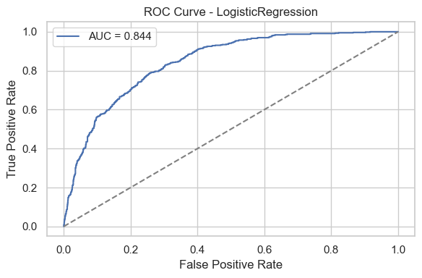
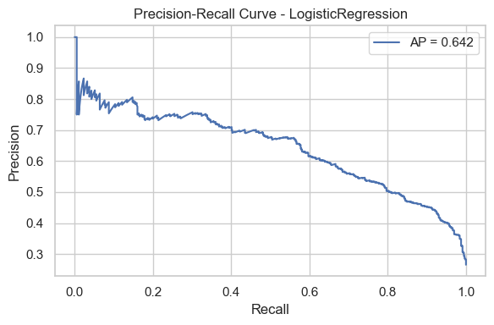
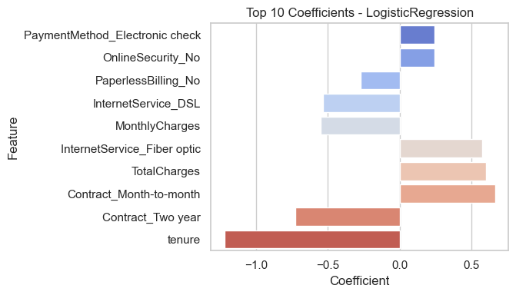
Churn Classification — Diagnostics

Slide 11
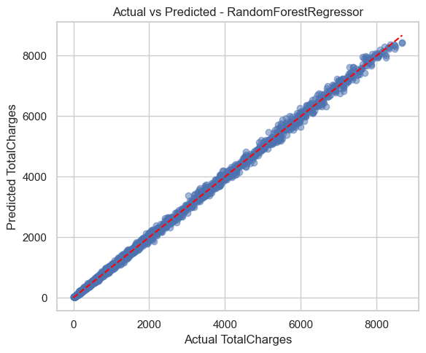
Revenue Regression — Results
Unnamed: 0 | model | MAE | RMSE | R2
1 | RandomForestRegressor | 53.713 | 80.682 | 0.999
2 | GradientBoostingRegressor | 73.883 | 105.304 | 0.998
0 | LinearRegression | 560.250 | 692.530 | 0.907

Slide 12
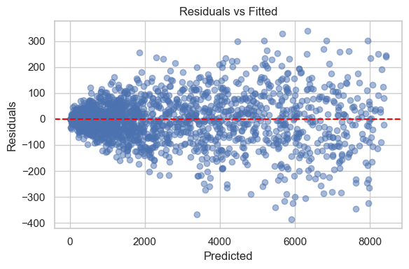
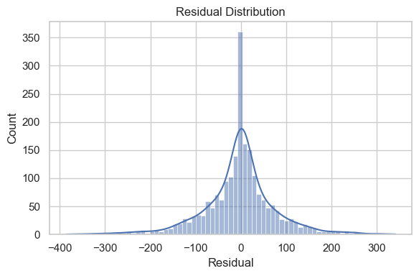
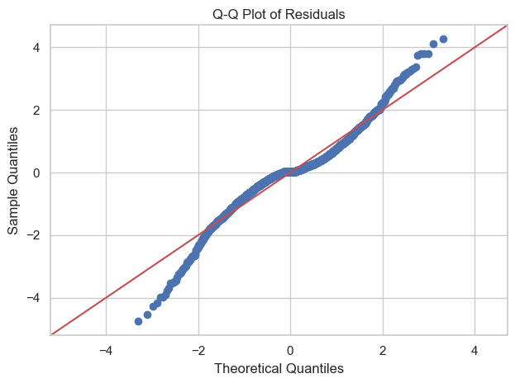
Revenue Regression — Diagnostics

Slide 13
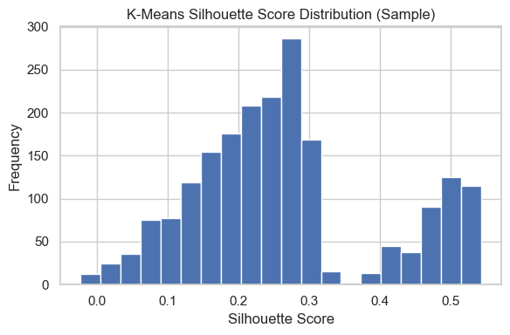
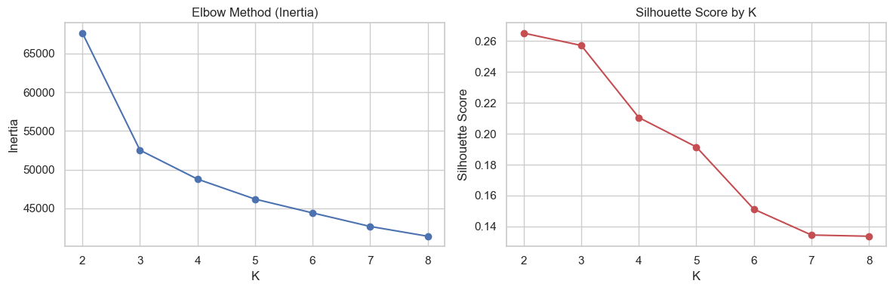
K-Means — Choosing K

Slide 14
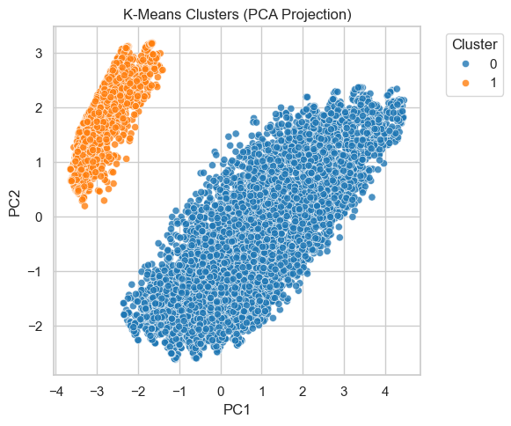
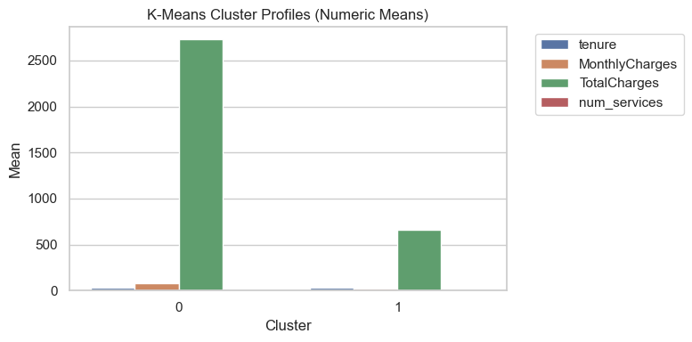
K-Means — Cluster Structure

Slide 15
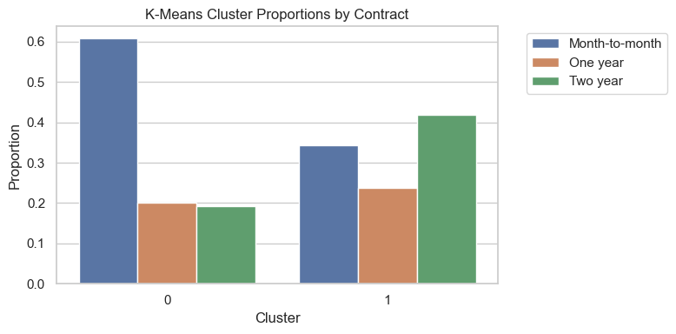
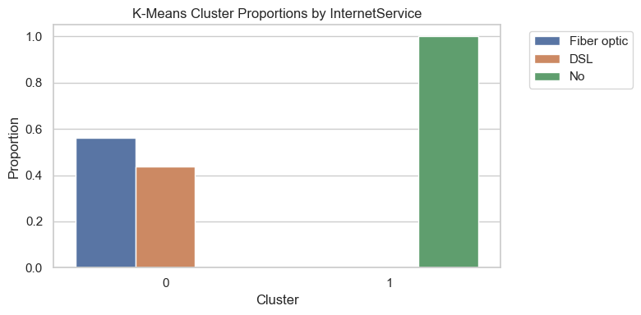
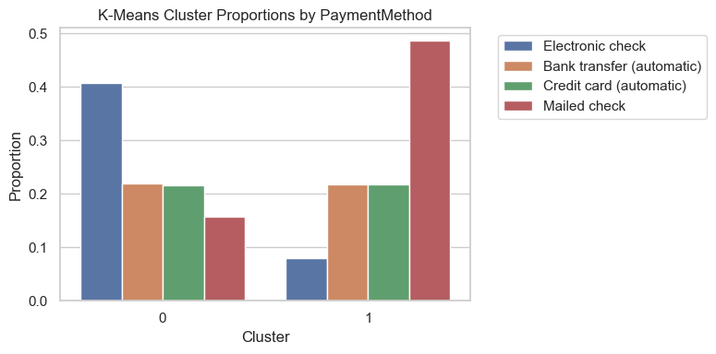
K-Means — Categorical Profiles

Slide 16

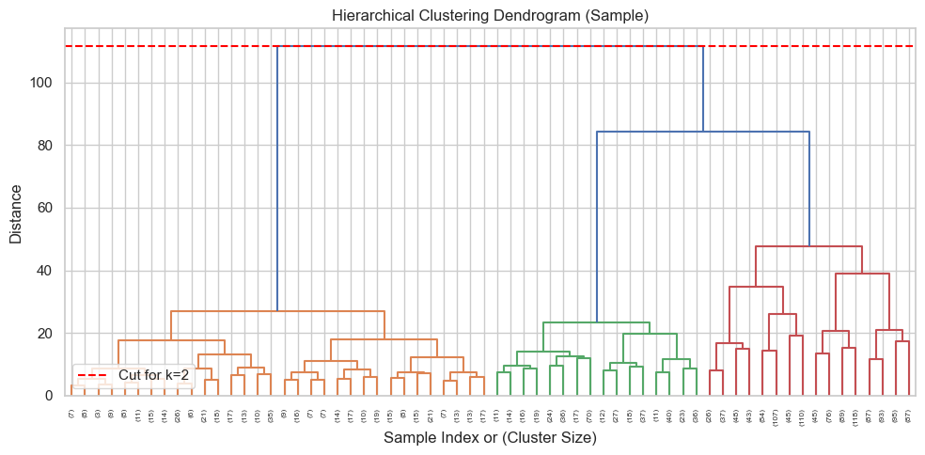
Hierarchical Clustering

Slide 17
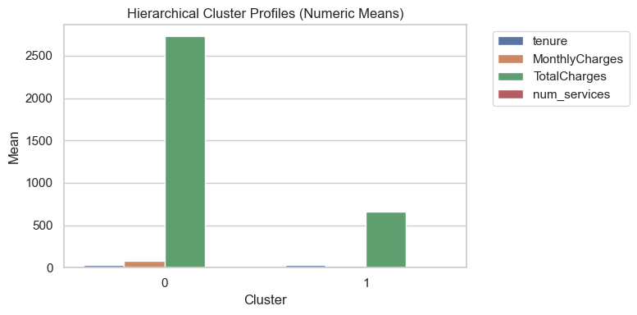

Hierarchical — Profiles

Slide 18


Hierarchical — Categorical Profiles

Slide 19
Insights & Recommendations
Contract type and tenure are the strongest churn drivers; prioritize retention for month-to-month customers.
Higher service count correlates with lower churn; bundle offers can increase stickiness.
Regression shows TotalCharges is strongly driven by tenure and MonthlyCharges; focus on long-term value growth.
K-Means and Hierarchical clusters reveal distinct segments — tailor marketing by segment needs.

Slide 20
Thank You
Questions & Discussion

