Slide 1
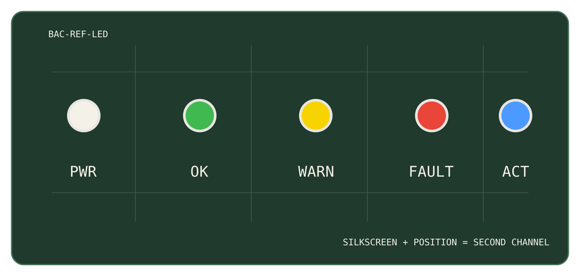
Open hardware, built to be understood.
DECK TYPE · OCTOBER 2026
One sentence on what this deck is for and who it is for.
AUTHOR · 2026-10-27 · V0.1
Notes:
Title, light (Ops): internal and technical decks. The right half is a photo slot – real hardware, true to life, no filters (Identity Guide §6). Delete the slot for a text-only title.

Slide 2
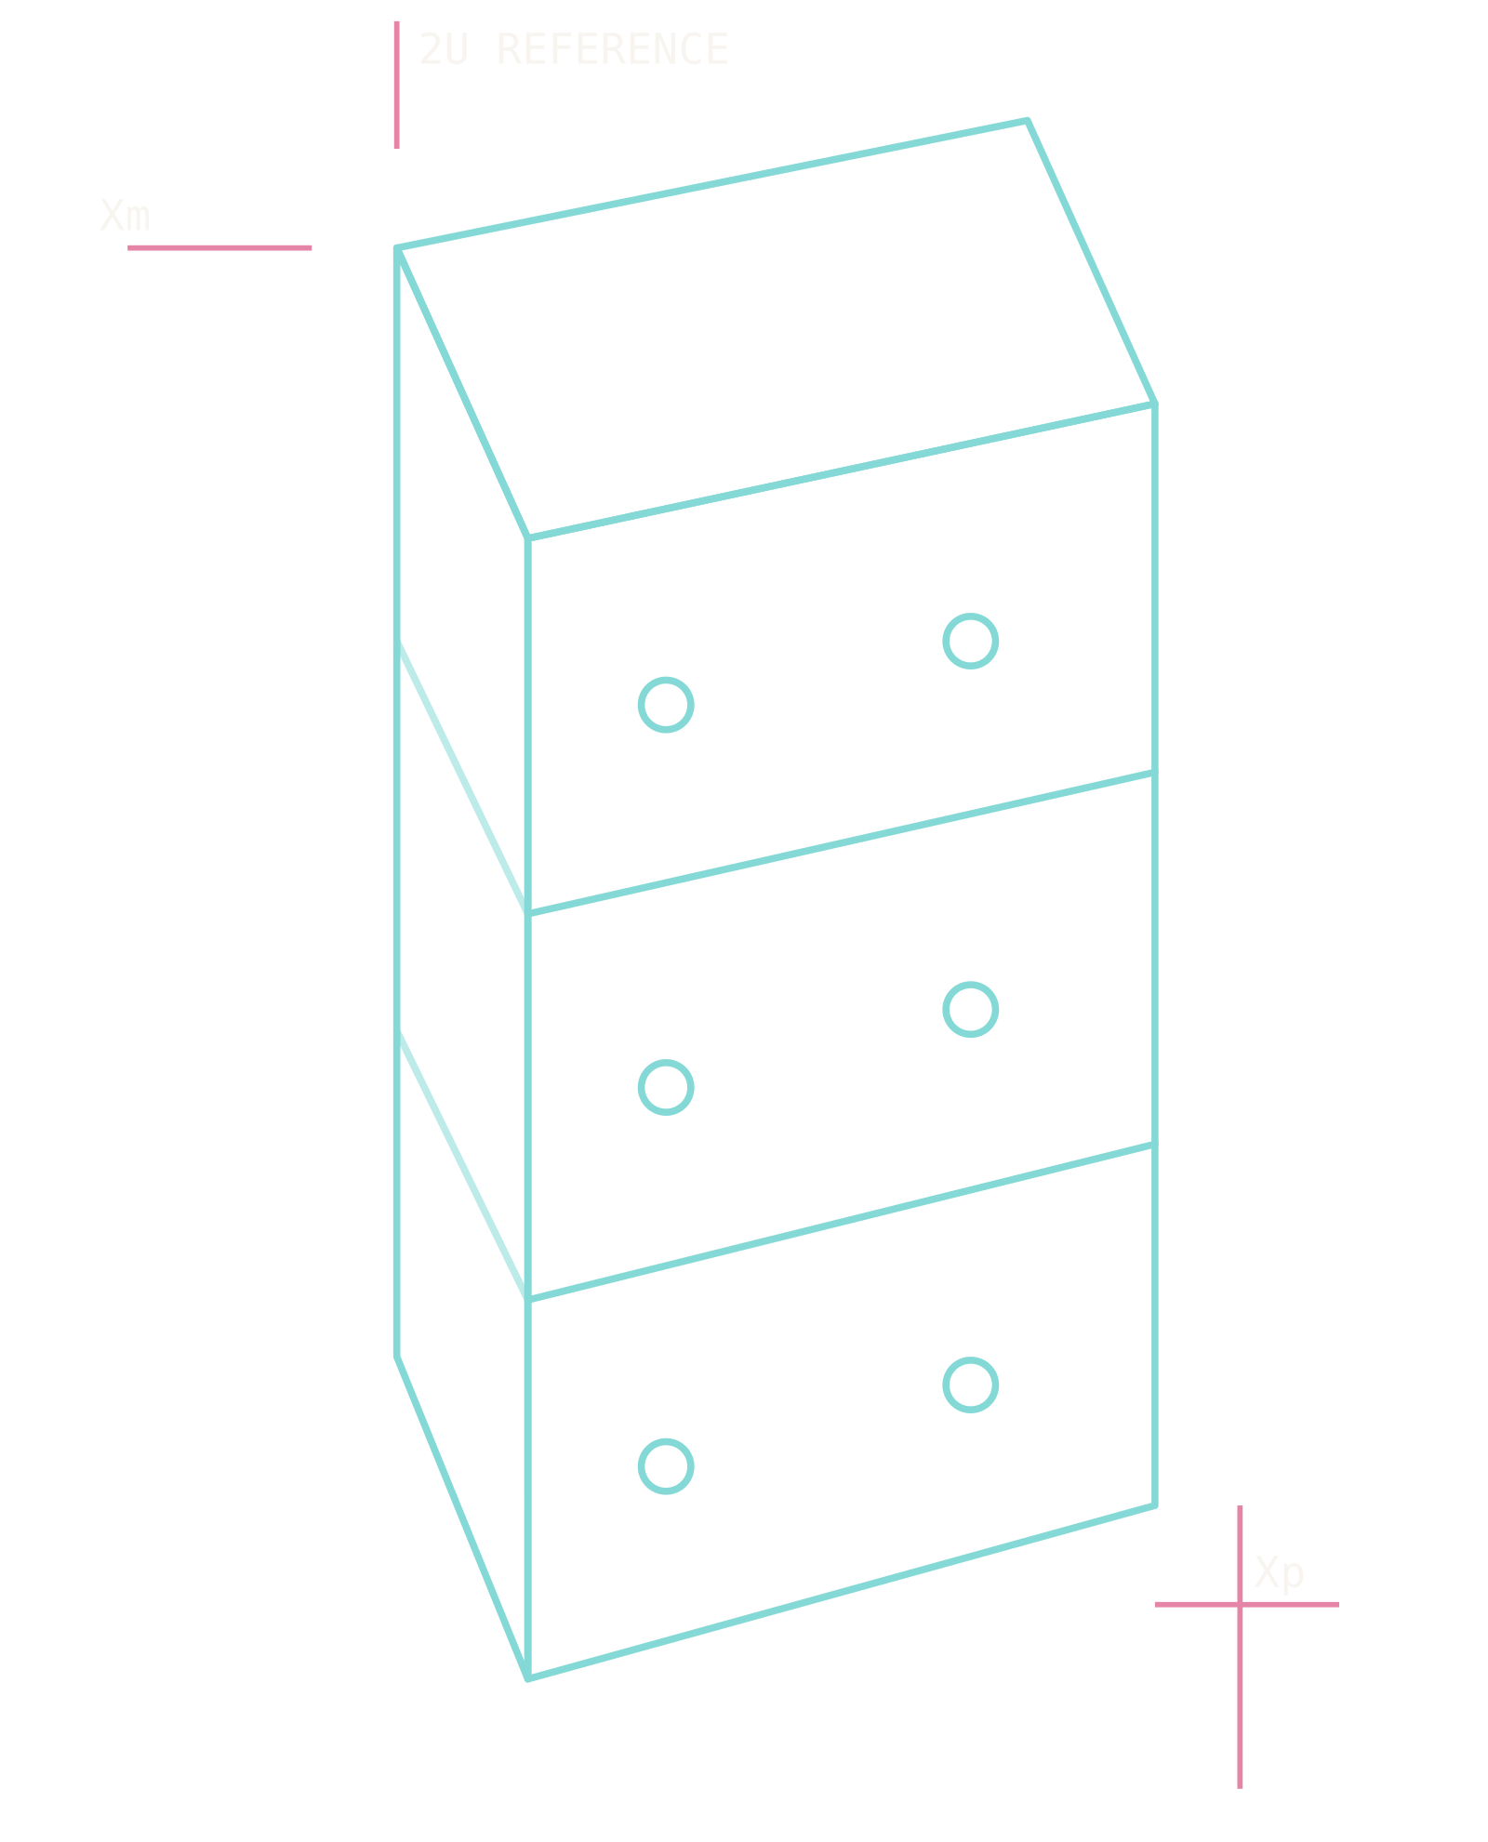
Space is for everyone.
MEDIA KIT · OCTOBER 2026
The Mission variant for outward-facing decks: sales, media, launches.
AUTHOR · 2026-10-27
Notes:
Title, Mission (dark hero): outward-facing decks only. The eyebrow takes Plasma Rose, the kicker stays BAC Yellow. The viewport on the right is the product-render slot; a photo or a CAD-derived outline both belong there.

Slide 3
Section divider
SECTION
01

Slide 4
Section divider on the Mission surface
SECTION
02

Slide 5
Title and body
ABOUT
Sentence case for titles and prose, one idea per slide.
Bullets are plain; no icons in the list, no emoji anywhere.
Figures and units in IBM Plex Mono – 100×100×227 mm, 12'059 CHF – so columns line up.
Caveats are part of the content – (WIP), TBD, PRELIMINARY – not hidden.

Slide 6
Two columns
COMPARISON
LEFT
Before, option A, the problem, the hardware.
Three to five lines per column; the slide carries one comparison.
RIGHT
After, option B, the proposal, the software.
Keep the two columns parallel in structure.

Slide 7
Image and caption
HARDWARE
Hardware photography, true to life, no filters (Identity Guide §6).
The caption says what the picture shows and why it matters here.
FIG. 01 · EPS MAIN BOARD, BENCH BUILD

Slide 8
Key figures
CHANNEL
YOUTUBE · 2026-10
AUDIENCE
NEXT MILESTONE
6'836
83 %
2027-Q1
Subscribers
Ages 25–44
OPEN HARDWARE
DEV KIT V1
12
2U
Dev Kit v1 ships
Boards released
Form factor
Notes:
Composed on the title-only layout. One hero card per deck lifts the single most important item (info blue, white text, the short red rule is decorative – Identity Guide §6). Stats are sunken cards: mono source label, mono figure, sans label.

Slide 9
Timeline
TIMELINE
2020
2024
2025
2026
Project start
YouTube devlog
First suborbital test
Development kits on sale
Notes:
Timeline on the title-only layout: a --border-strong line, hollow marks, the current step filled BAC Yellow (the one dominant yellow use on the slide).

Slide 10
Table
SPECIFICATIONS
PARAMETER | VALUE | NOTE
Form factor | 2U | 100×100×227 mm
Bus voltage | 3.3 V / 5 V / 12 V | bacBus
Battery | 2S2P | Li-ion, development only
Mass | TBD | (WIP) – measured on the flight build
Notes:
Tables: a strong header rule, hairline row rules, no outer border and no fills (Identity Guide §5.4). Header labels in mono uppercase, values in IBM Plex Mono.

Slide 11
Engineering should be understandable.
BUILD A CUBESAT · IDENTITY GUIDE §2

Slide 12
Let's talk
hello@buildacubesat.space
buildacubesat.space
+41 31 561 93 45
nihil.space GmbH · Egghölzlistrasse 20 · 3006 Bern
MEDIA KIT · 2026-10-27

Slide 13
Blank layout – for full-bleed images, diagrams and charts composed by hand.

