Slide 1
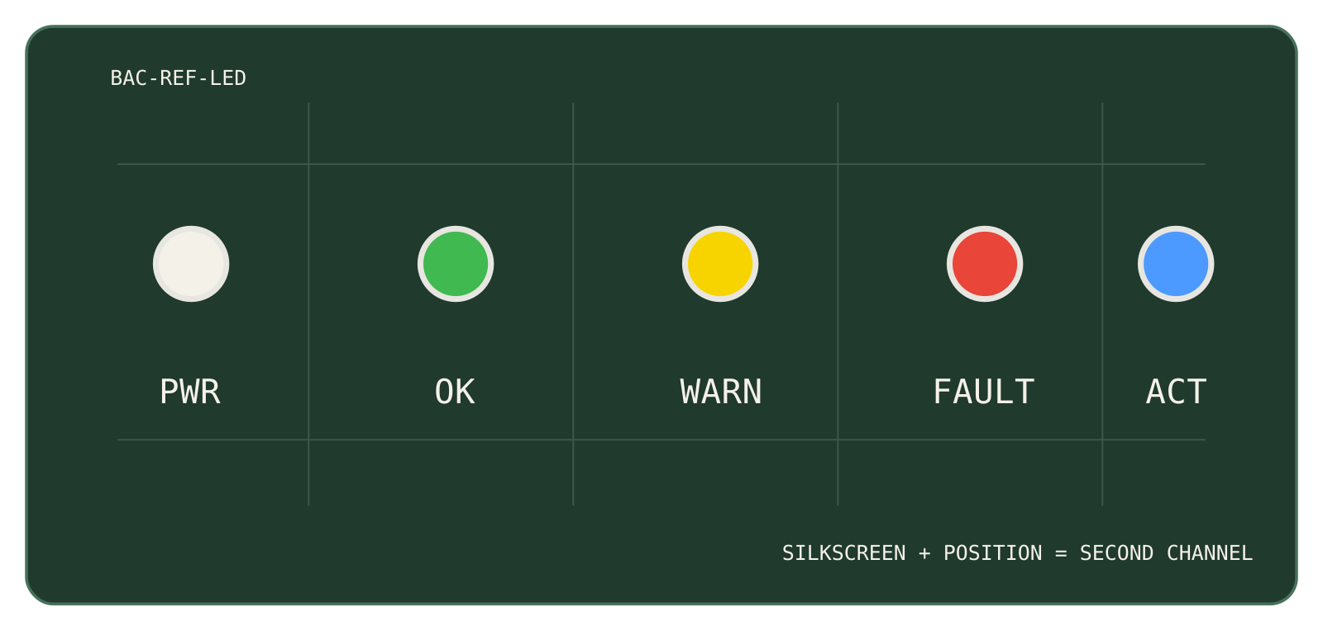
Open hardware, built to be understood.
DECK TYPE · OCTOBER 2026
One sentence on what this deck is for and who it is for.
AUTHOR · 2026-10-27 · V0.1
Notes:
Title on paper: internal and technical decks. The right half is a photo slot – real hardware, true to life, no filters (Identity Guide §6). Delete the slot for a text-only title.

Slide 2
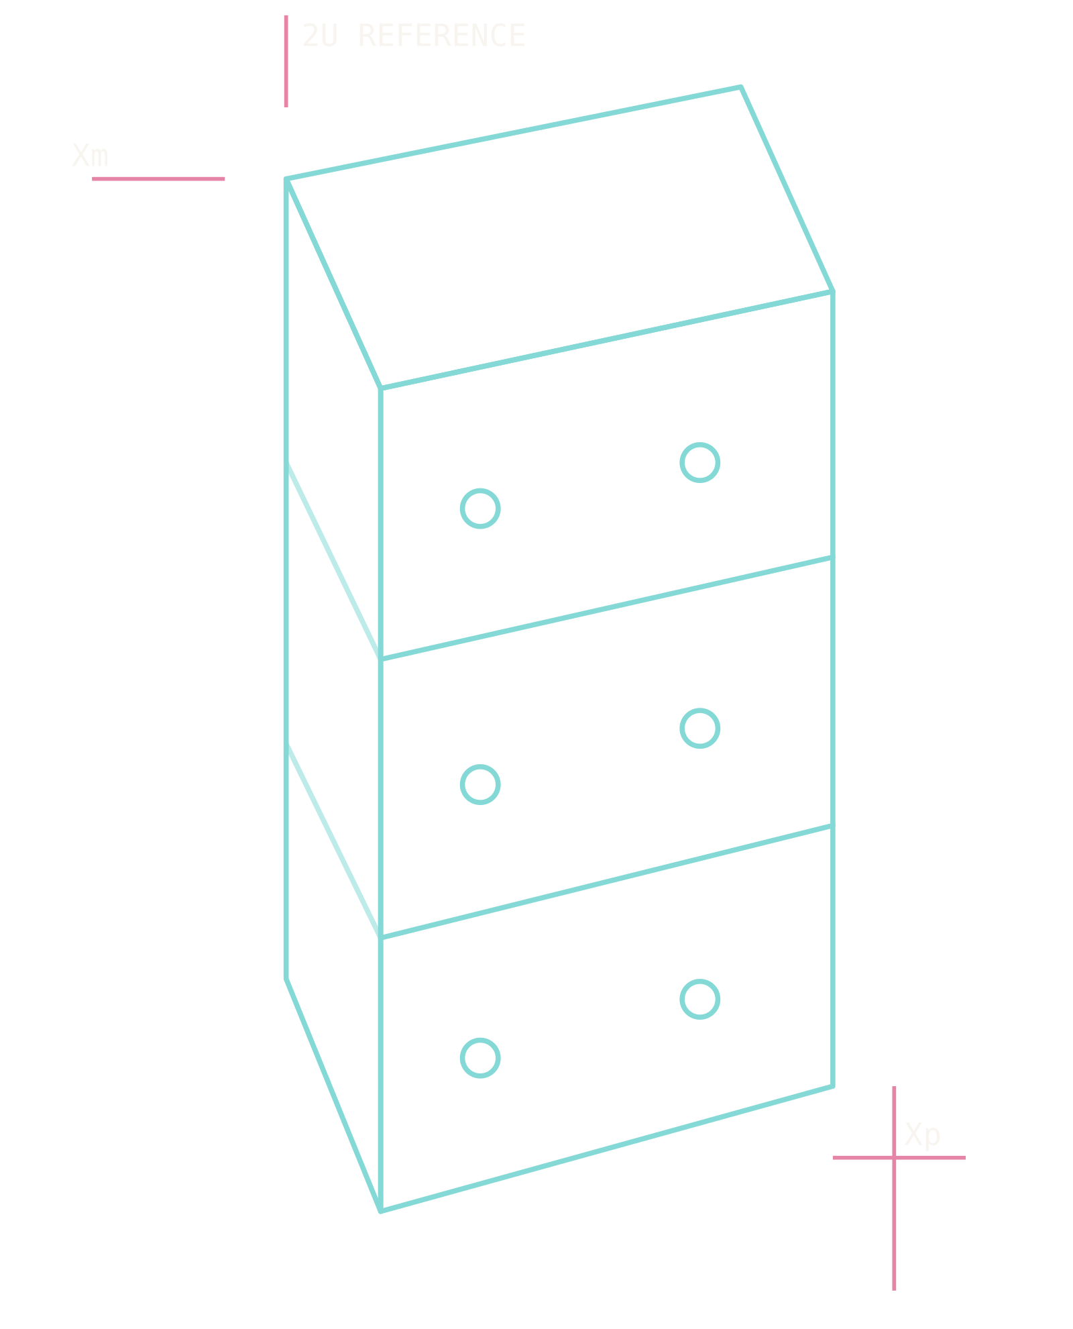
Space for everyone.
MEDIA KIT · OCTOBER 2026
The Mission variant for outward-facing decks: sales, media, launches.
AUTHOR · 2026-10-27
Notes:
Title on the nebula: outward-facing decks. The eyebrow takes Plasma Rose, the kicker stays BAC Yellow. The viewport on the right is the product-render slot; a photo or a CAD-derived outline both belong there.

Slide 3
Section divider
SECTION
01

Slide 4
Section divider on the Mission surface
SECTION
02

Slide 5
Title and body
ABOUT
Sentence case for titles and prose, one idea per slide.
Bullets are plain; no icons in the list, no emoji anywhere.
Figures and units in IBM Plex Mono – 100×100×227 mm, 12'059 CHF – so columns line up.
Caveats are part of the content – (WIP), TBD, PRELIMINARY – not hidden.

Slide 6
Two columns
COMPARISON
LEFT
Before, option A, the problem, the hardware.
Three to five lines per column; the slide carries one comparison.
RIGHT
After, option B, the proposal, the software.
Keep the two columns parallel in structure.

Slide 7
Image and caption
HARDWARE
Hardware photography, true to life, no filters (Identity Guide §6).
The caption says what the picture shows and why it matters here.
FIG. 01 · EPS MAIN BOARD, BENCH BUILD

Slide 8
Key figures
CHANNEL
YOUTUBE · 2026-10
AUDIENCE
NEXT MILESTONE
6'836
83 %
2027-Q1
Subscribers
Ages 25–44
OPEN HARDWARE
DEV KIT V1
12
2U
Dev Kit v1 ships
Boards released
Form factor
Notes:
Composed on the title-only layout. One hero card per deck lifts the single most important item (info blue, white text, the short red rule is decorative – Identity Guide §6). Stats are paper wells with a nebula top rule: mono source label, mono figure, sans label.

Slide 9
From a bench project to a kit on sale
TIMELINE
2020
2024
2025
2026-12
2027-01
Project start
YouTube devlog
Suborbital test
Dev Kit v1 orders
Dev Kit v1 ships
Build a CubeSat begins
Every design step in public
First flight of BAC hardware
2U development kit, open hardware
First kits leave Bern
NEXT
Dev Kit v1 orders open in December; shipping early January 2027.
Notes:
Timeline on the nebula (TITLE_ONLY_MISSION). Done steps in Orbital Teal with a solid line, the current step BAC Yellow (the slide's one yellow besides the kicker), the steps ahead hollow on a dashed line. Dates in mono. The callout is a viewport-ink card with a teal edge and a Plasma Rose label. Up to five steps fit.

Slide 10
Table
SPECIFICATIONS
PARAMETER | VALUE | NOTE
Form factor | 2U | 100×100×227 mm
Bus voltage | 3.3 V / 5 V / 12 V | bacBus
Battery | 2S2P | Li-ion, development only
Mass | TBD | (WIP) – measured on the flight build
Notes:
Tables: a strong header rule, hairline row rules, no outer border and no fills (Identity Guide §5.4). Header labels in mono uppercase, values in IBM Plex Mono.

Slide 11

Engineering should be understandable.
Build a CubeSat
IDENTITY GUIDE · §2 VOICE & TONE
Notes:
Quote: one sentence, the speaker's portrait (a square photo, cropped round by the frame) with name and role, and a photo of what they talk about on the right. Delete the photo slot for a quote that stands alone; the quote box then takes the full width.

Slide 12
Let's talk
RESOURCES
Documentation
docs.buildacubesat.space
Hardware
hello@buildacubesat.space
buildacubesat.space
+41 31 561 93 45
nihil.space GmbH · Egghölzlistrasse 20 · 3006 Bern
bac.page/hardware
YouTube
youtube.com/@buildacubesat
MEDIA KIT · 2026-10-27

Slide 13
Blank layout – for full-bleed images, diagrams and charts composed by hand.

