Slide 1
Course 2 Module 5 Programming Assignment Assignment is to ETL MIMIC data into the OMOP CONDITION_OCCURRENCE table
Detailed instructions with Slide Notes

Slide 2
ETL Steps
Assignment is to ETL MIMIC data into the OMOP CONDITION_OCCURRENCE table
Understand source/target data models
Profile source tables
Create ETL mappings
Write transformation code
Execute transformation
Perform data quality assessment
Package documentation
Notes:
This is an overview of the seven steps for ETL. The assignment focuses on Steps 1 thru 4 and Step 6
Place your finished deliverables into one or more slides. Add notes to provide additional information/context about what you have done

Slide 3
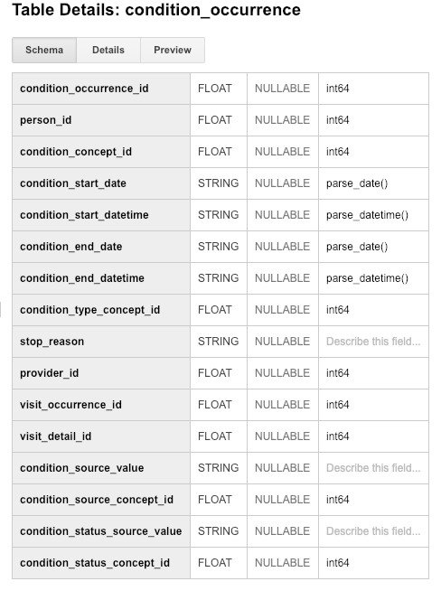
Step 1: Understand source/target data models
CONDITION_OCCURRENCE is the TARGET OMOP table. We need to perform ETL for the following:
person_id- A required field with takes “bigint” values, it’s a foreign key identifier to the Person who is experiencing the condition.
visit_occurrence_id- An optional field which takes integer values, it’s a foreign key to the visit in the VISIT_OCCURRENCE table during which the Condition was diagnosed.
condition_source_value- An optional field that takes up to 50 characters that contains source code for condition (same as source). This code is mapped to a Standard Condition Concept in the Standardized Vocabularies
Notes:
Reference: https://github.com/OHDSI/CommonDataModel/wiki/CONDITION_OCCURRENCE
Condition_source_value code is mapped to a Standard Condition Concept in the Standardized Vocabularies

Slide 4
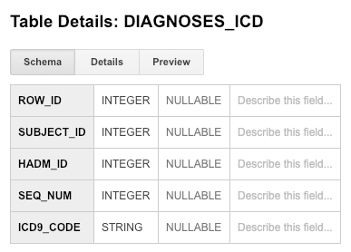
Step 1: Understand source/target data models
CONDITION_OCCURRENCE is the TARGET OMOP table.
Notes:
Paste into one or more slides, the key table or tables from MIMIC that hold data that can be used to fill in the OMOP CONDITION_OCCURRENCE table.
Choose the MIMIC table screenshots from this slide to indicate which MIMIC table or tables would be used in the ETL process. Delete the MIMIC tables that you will not use.

Slide 5
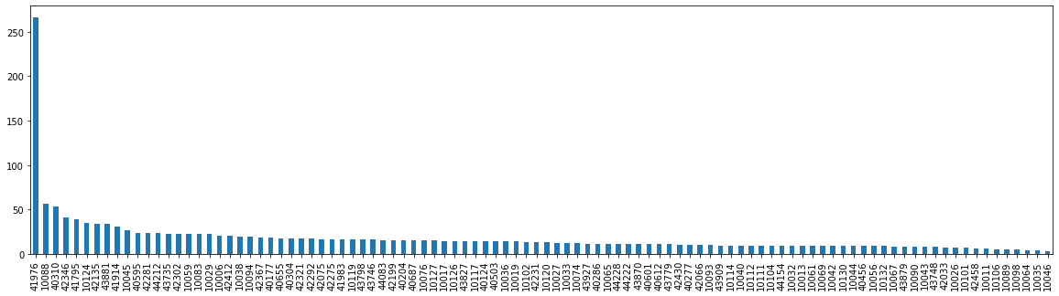
Step 2: Profile source table or tables
MIMIC DIAGNOSES_ICD table
The distribution is heavily skewed
It indicates some patients had lot more ICU visits than others
Rest of the patients had uniform distribution
Notes:
Use the White Rabbit data profiling Excel spreadsheet that is linked to the assignment to describe key profiling findings from the table or tables you identified in ETL Step 1. See rubric for the types of topics to include here.

Slide 6
Step 3: Create ETL Mappings
Notes:
SUBJECT_ID -> person_id: Both of them refer to a patient.
HADM_ID -> visit_occurance_id: They both refer to admission to the hospital.
ICD9_CODE: Each code corresponds to a single diagnostic concept, condition_source_value: refer to a condition that was diagnosed during the visit so they analogous.

Slide 7
Step 3: Create ETL Mappings
Explanation:
SUBJECT_ID -> person_id: Both of them refer to a patient.
HADM_ID -> visit_occurance_id: They both refer to admission to the hospital.
ICD9_CODE: Each code corresponds to a single diagnostic concept, condition_source_value: refer to a condition that was diagnosed during the visit so they analogous.

Slide 8
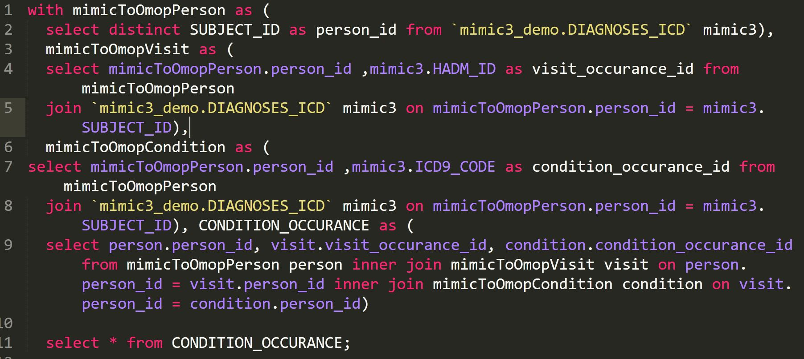
Step 4: Write transformation code

Slide 9
Step 4: Write transformation code
I choose to create simpler tables and then used JOINS to retrieve the Target table
First set create a table for Person
Second set of statement creates a Visit table
Third creates a Condition table
Then I put them together using INNER JOINS
Display the results

Slide 10
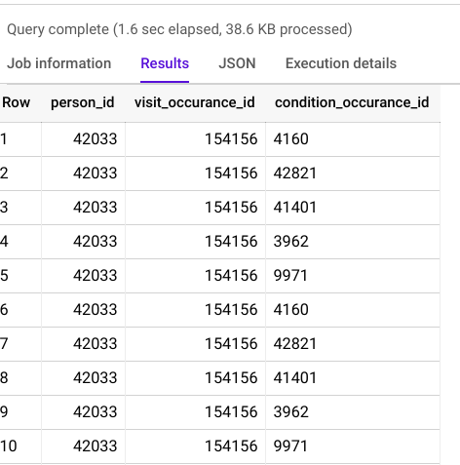
Step 5: Execute transformation code
Notes:
Execute the ETL code from Step 4 but do not submit output table. Use output table for Step 6.
There is no submission for this Step.

Slide 11
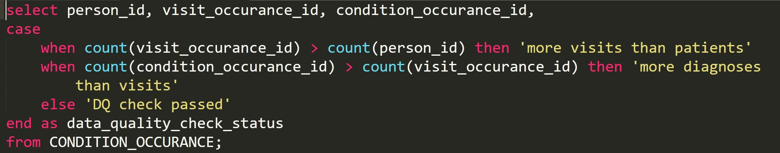
Step 6: Perform data quality assessment
The number of visits should not exceed the total number of subjects, each record should correspond to one visit
The number of Diagnoses should not exceed the number of visits, it might be possible that a visit results in no condition being diagnosed.
Notes:
Paste the output from your data quality SQL executed on the OMOP CONDITION_OCCURRENCE table generated in Step 5 into this slide.
OK to paste link to a GoogleDoc instead.

Slide 12
Step 7: Package documentation
Congratulations! The materials in the previous slides constitute a complete ETL package.
There is no submission for this Step.

