Slide 1
IDS project Proposal for a data model
André Borrmann, BIMtech UG / Technical University Munich

Slide 2
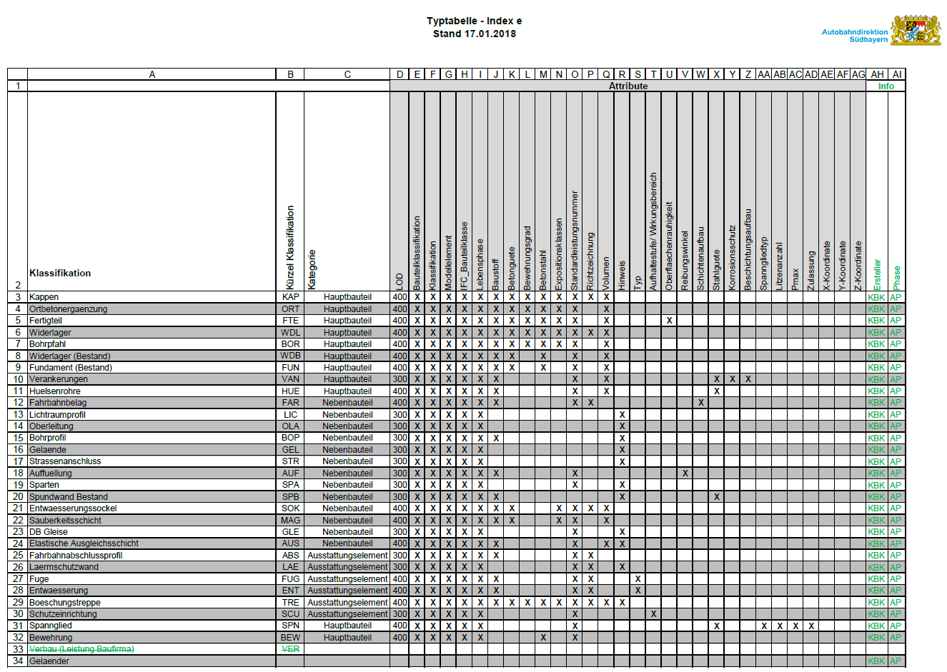
Use Case

Slide 3
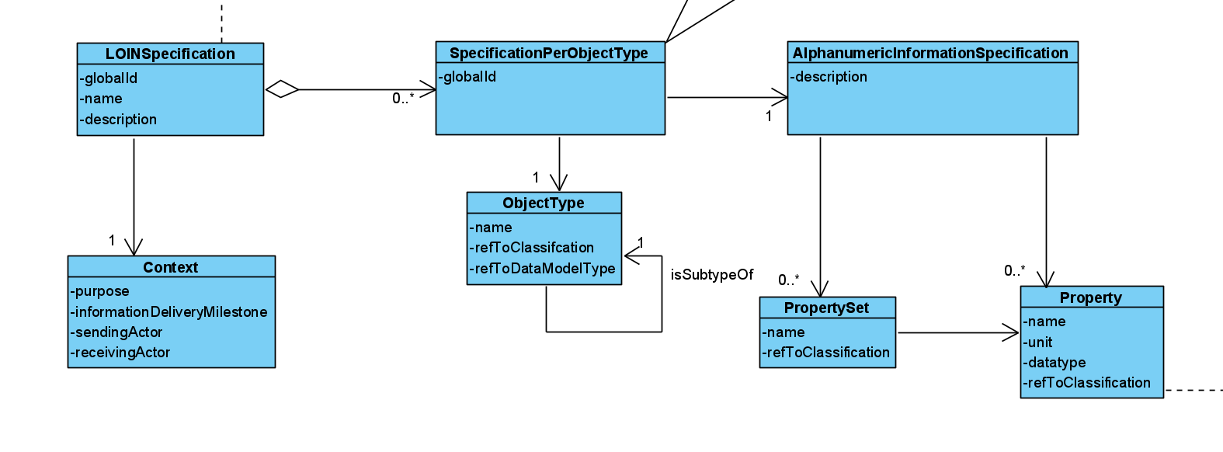
UML Class diagram
can be renamed to ISGspecification if wanted
a LOIN specification will have requirements for each object type
Underlying rational:
Simplicity
Use-case driven
Link to data model, e.g. IFC-Entities
Possibility to integrate classification systems
Compatibility with CEN17412 (here focus is on semantic data)
each object type can be associated with a classification
context is optional (comes from CEN17412)
each object property type can be associated with a classification
properties can be bundled in PropertySets or associated directly

Slide 4
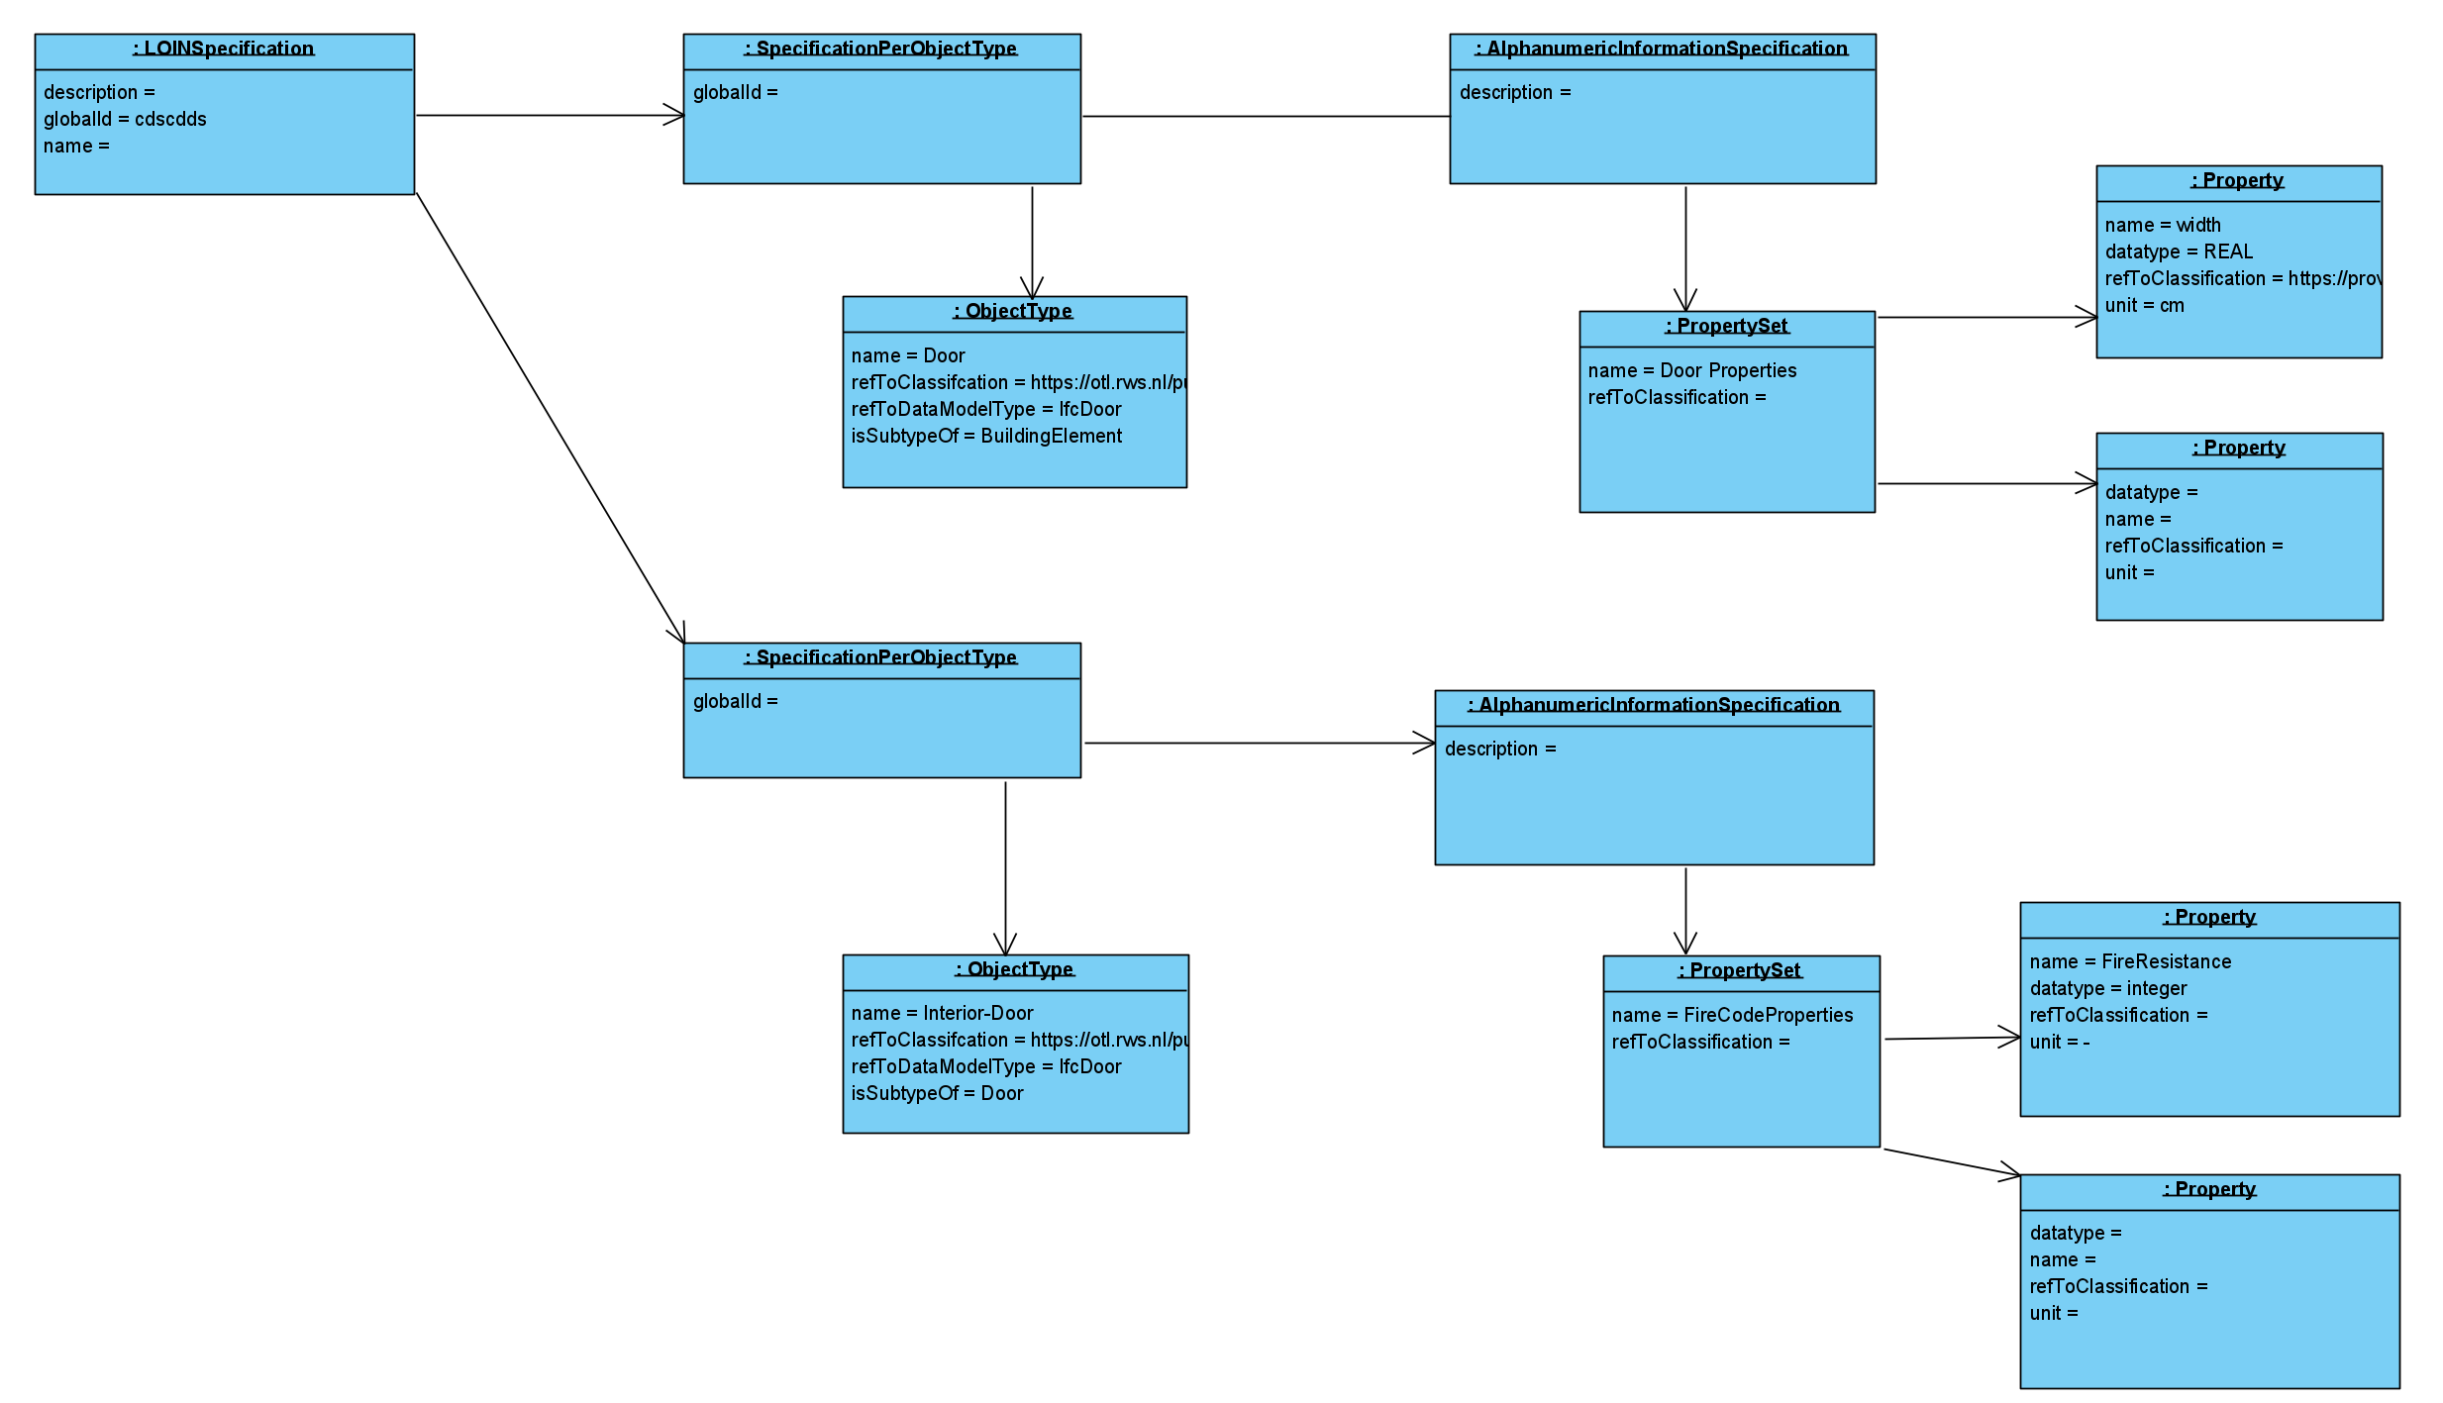
UML Instance diagram
Door
Interior Door

Slide 5
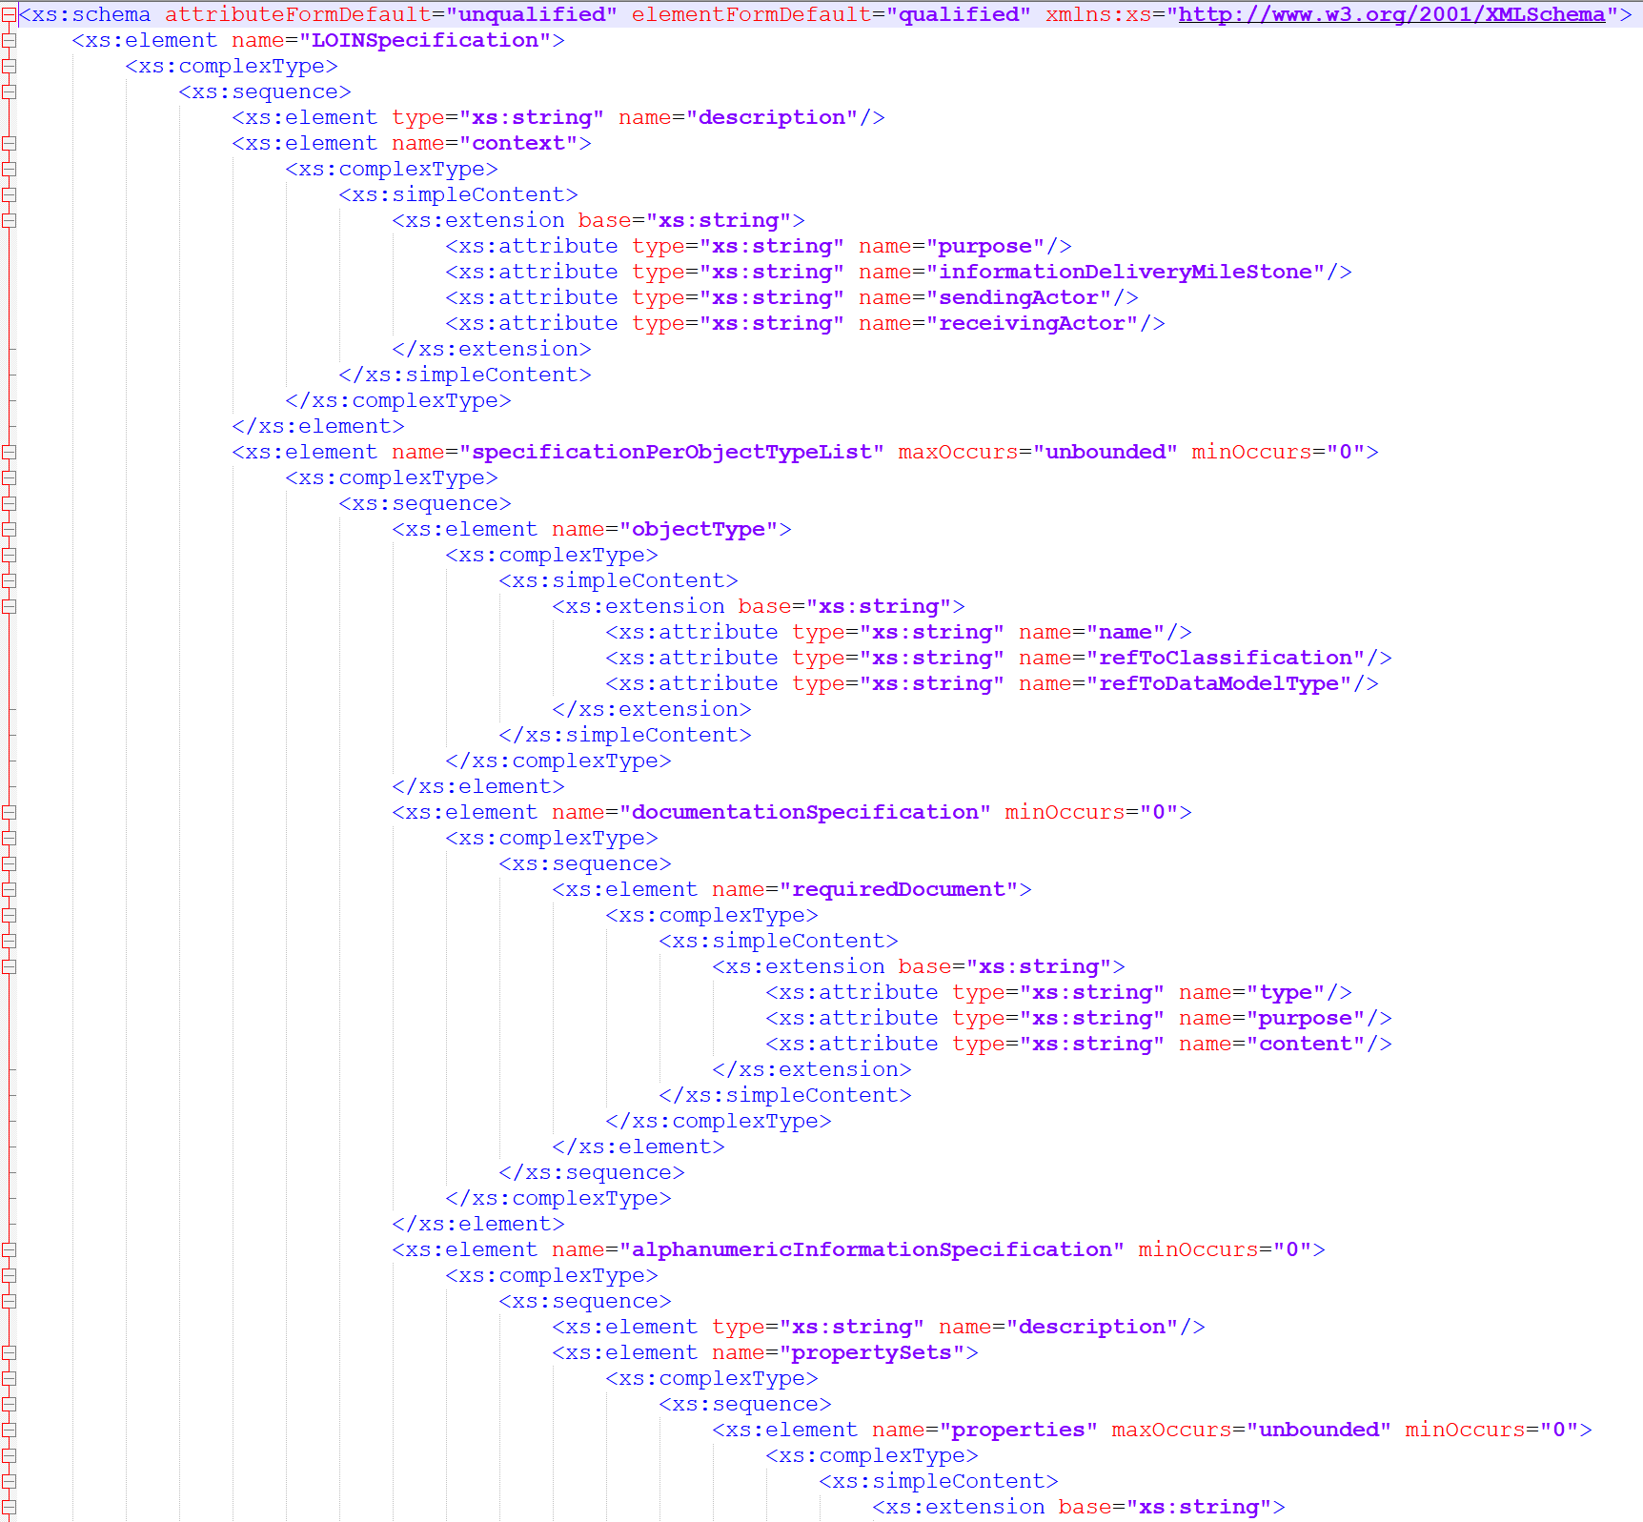
XML Schema
straight-forward encoding of UML model into XML schema

Slide 6
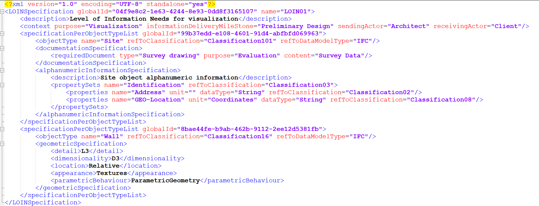
XML Instance
an example
a simple example

Slide 7
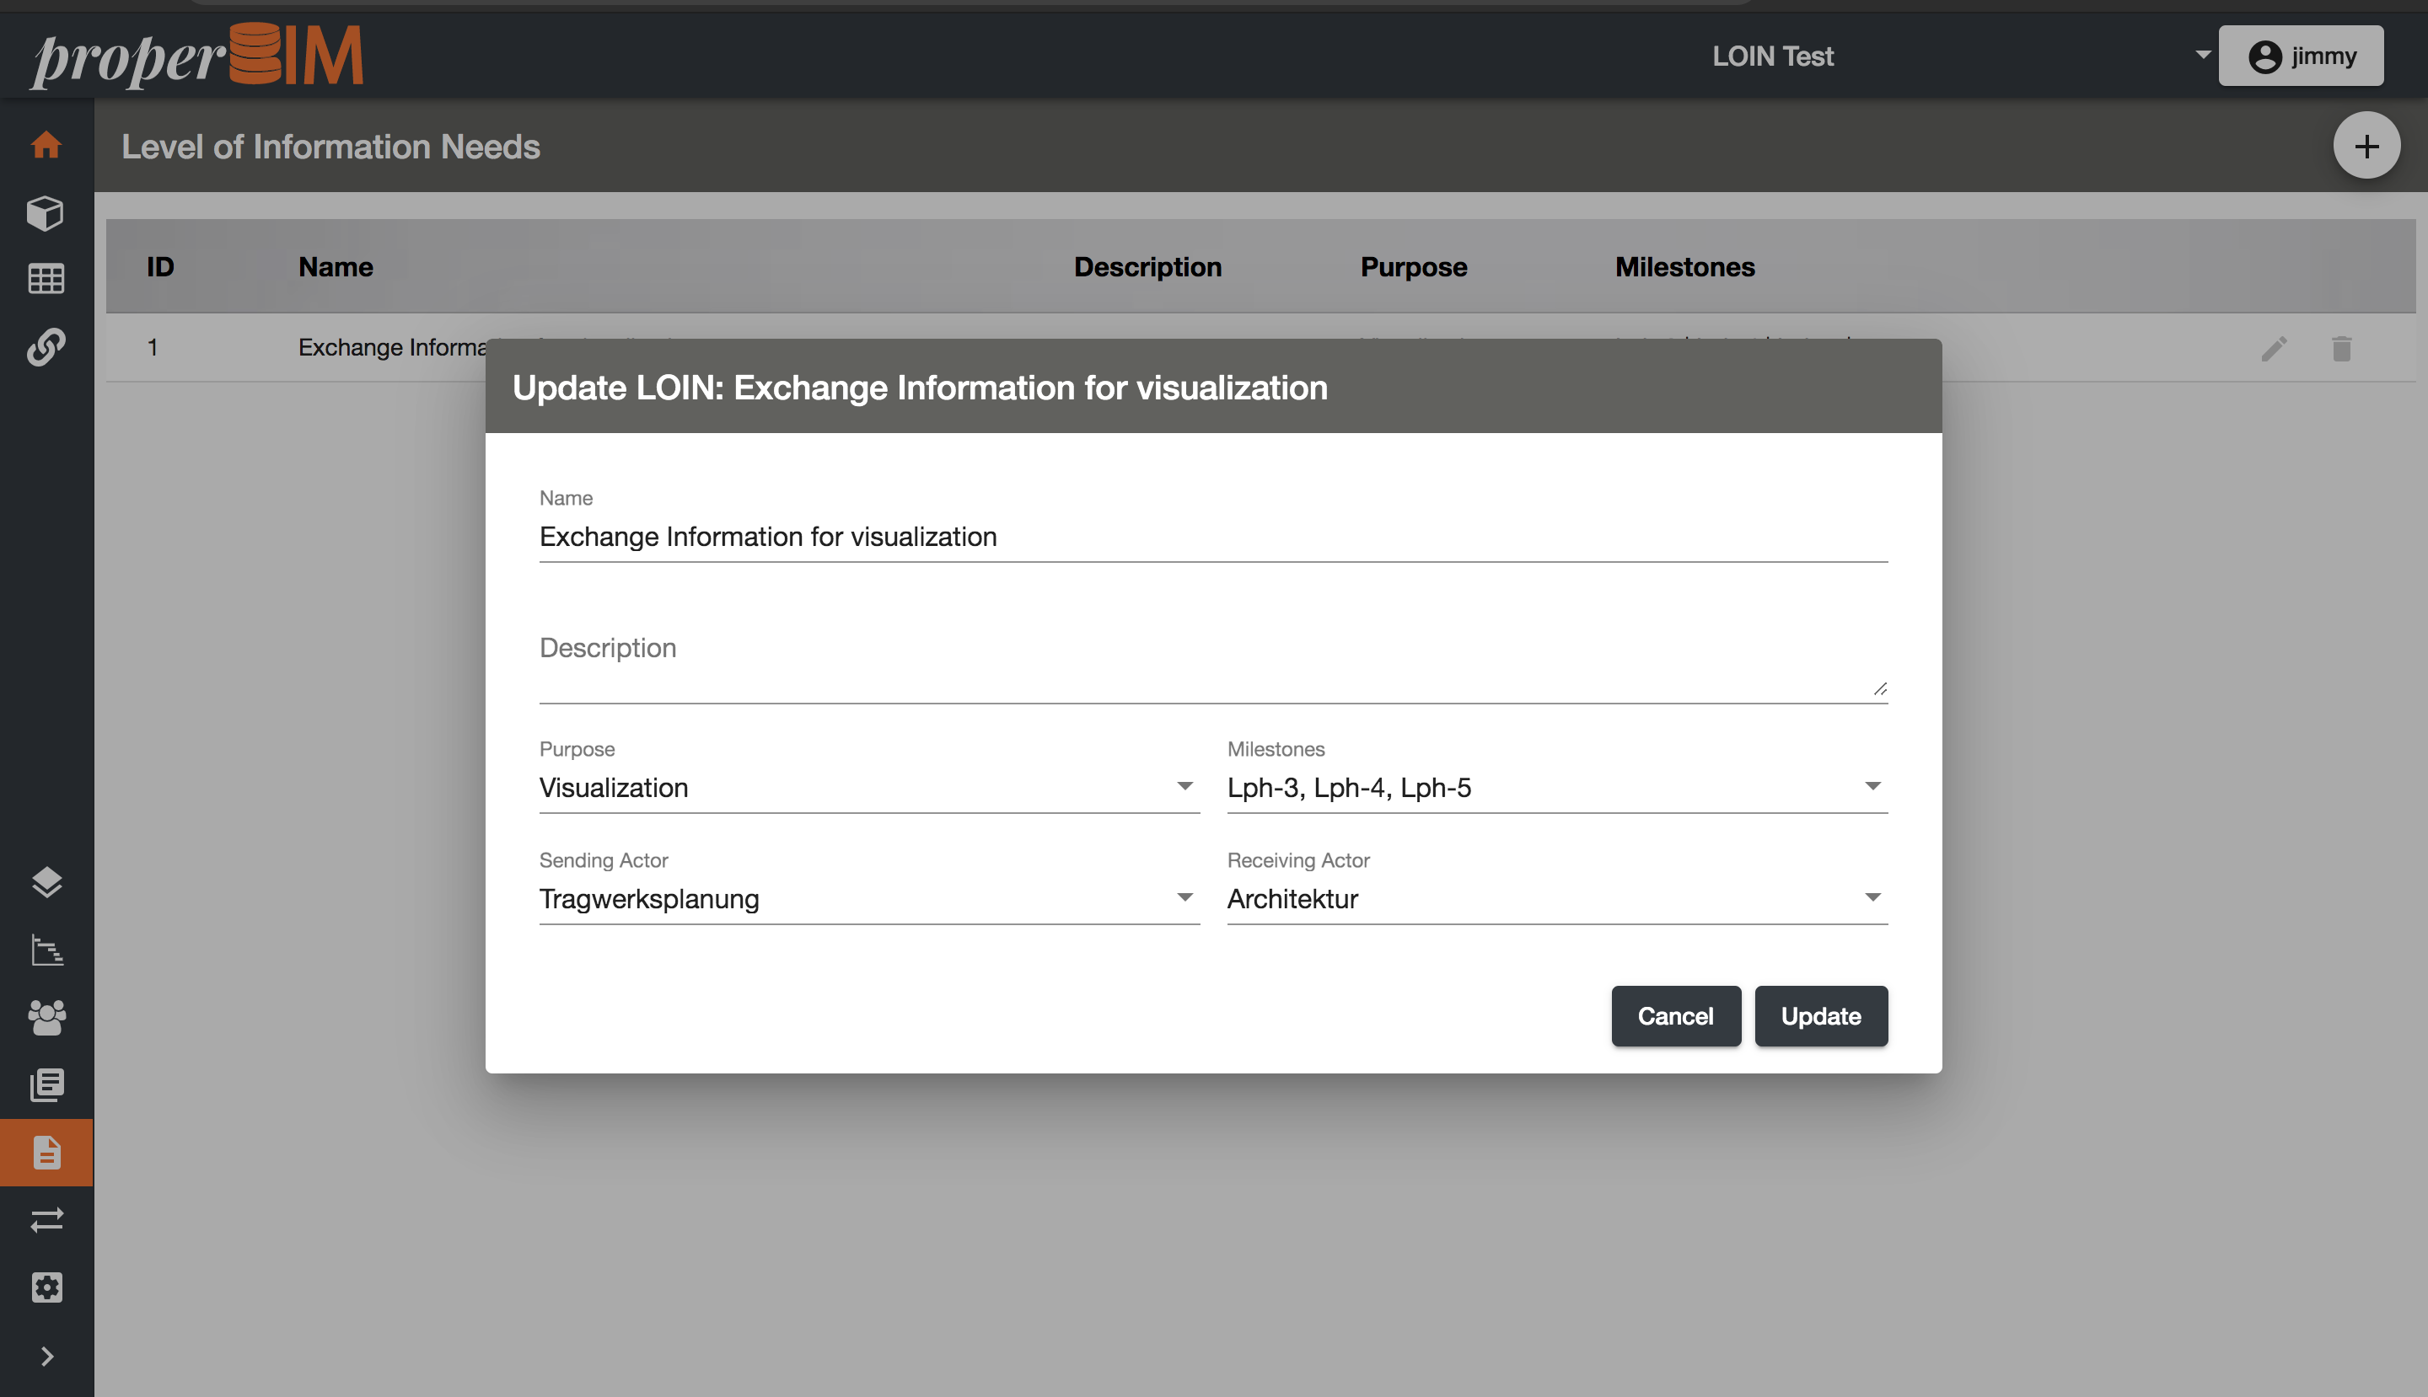
Prototypical implementation

