Slide 1
bSi IDS Meeting #04 Technical Discussion
16 December 2020 Matthias Weise, AEC3 Germany

Slide 2
Question/Checklist towards IDS 0.1
Dataformat? Options: XML, JSON, CSV
Wording/Standard? Options: CEN 17412 (LOIN), ISO 29481-3 (IDM), ISO 19650, ..
Metadata to be captured?
1 or many InformationDeliveryMilestone-Purpose/Exchange Information Requirement-Use Case
No link to IFC Implementation Levels or MVD (see discussion about *, **, *** IFC or IFC Reference View), or seen as Geometry
Out of scope: Actor/Domain (sending/receiving)
Scope for Data Requirements and Mapping to IFC
Object Selection IFC constructs: Entity + TypeEntity (IFC2x3), PredefinedType, ObjectType, ClassificationReference, Classification Property Setting(s)
Data Requirement (Property) IFC constructs: existance of Properties (IFC and user defined) + allowed enumerations, ..?
IDS #04, 16.12.2020, Matthias Weise (AEC3)

Slide 3
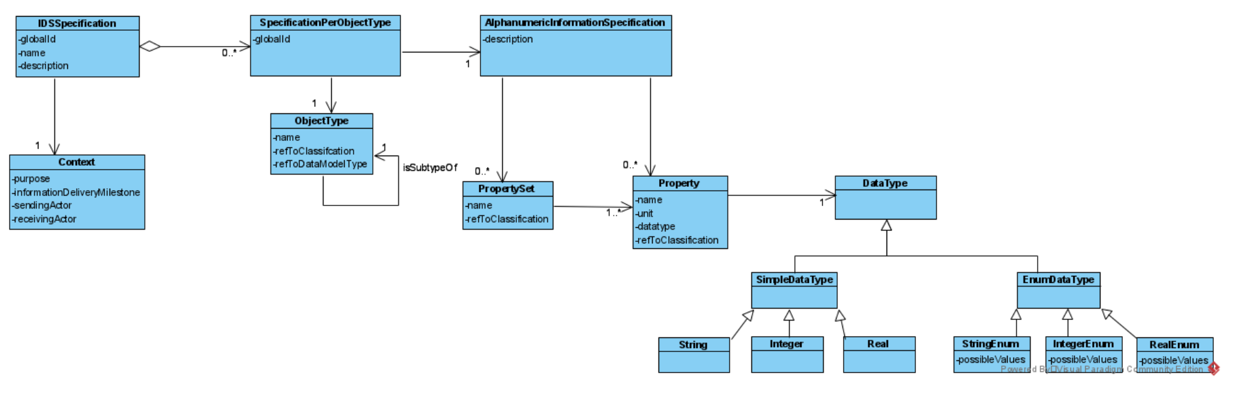
Proposal by André Borrmann (ISO 17412), v0.4
Remark to question #3 (1 vs. many purposes): If we want to support many we would need a link to purpose/Context on property level (see solution in mvdXML)
Meta data
Select part A)
Requirement part B)
Split into PropertySet and Property due to IFC?
Agreement about encoding of units? New input in the call: cum_code proposed by André, see discussion with Arie Maybe optional for existing IFC-Properties (otherwise we add redundancy)?
Needed? What are the implications? I think we agreed in the call to remove.
My concern here is that we add two, potentially conflicting inheritance hierarchies, one coming from IDS and one that is built-in in IFC.
IDS #04, 16.12.2020, Matthias Weise (AEC3)
Notes:
Link to IFC via refToClassification?
refToDataModelType = Link to IFC data format?, can we mix specifications for different objects?

Slide 4
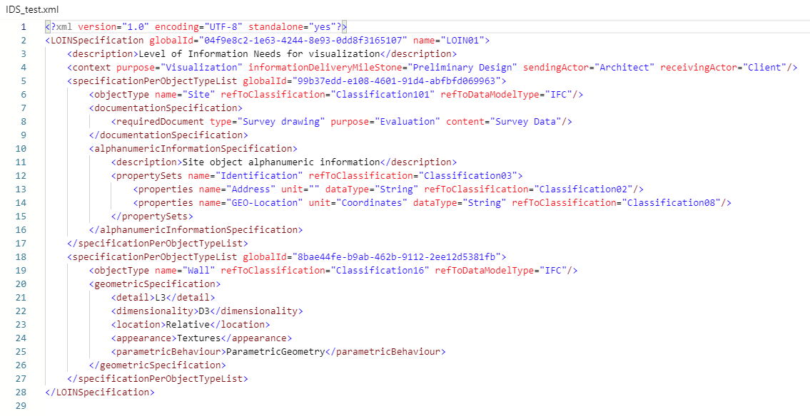
Mapping to IFC not clear
IfcSite? Posted example is a bit confusing, discussion answered that question -> This is the user name.
Which version of IFC? I would expect IfcSite here (according to given example in the call, but how to encode IFC version – added to name? We also need to add the classification property it should be used for object selection.
Meaning of Classification101? I guess we need an agreement how to encode. Otherwise it does not help.
How to differentiate between end-user names and IFC spec names? Feuerwiderstandsklasse <-> FireRating
Partially answerted in the call (refToClassification seems to be used for the IFC part). However, this seems to be inconsistent with usage of refToClassification in <objectType>. Also, it would not allow to have a link to classification and IFC at the same time. As presented in the call: I would avoid adding the IFC version to the property name. Use a separate field, maybe on object level.
User defined property with Pset = Identification + Property = Address, GEO-Location?
IDS #04, 16.12.2020, Matthias Weise (AEC3)

Slide 5
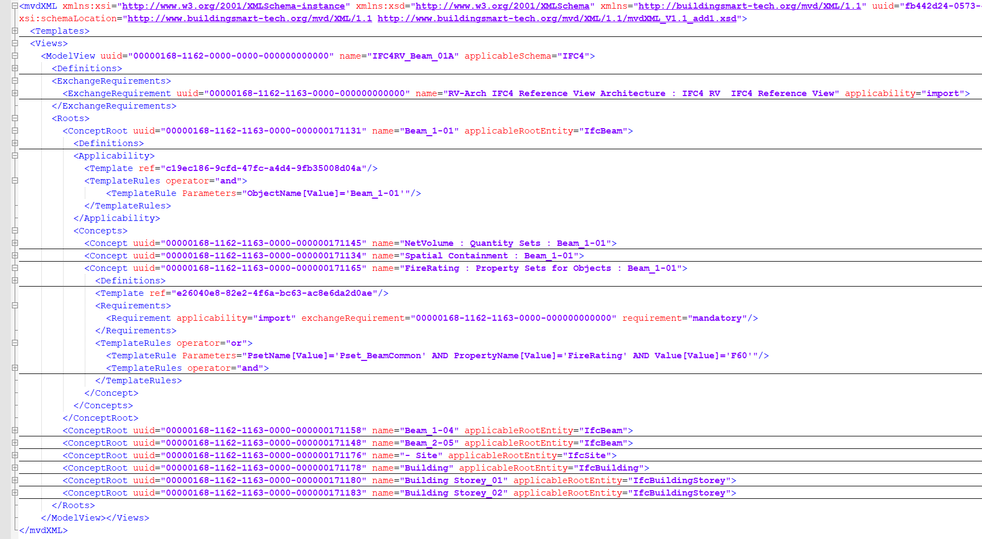
Meta data
Cross check with mvdXML
Similar principles, different meta-data
#3: many purposes/exchange requirements are allowed (see link from property/concept to ExchangeRequirement)
Select part A)
Requirement part B)
IDS #04, 16.12.2020, Matthias Weise (AEC3)

Slide 6
Thank you!
Questions?
Contact: mw@aec3.de

