Slide 1
bSi IDS Meeting #04 Technical Discussion
16 December 2020 Matthias Weise, AEC3 Germany
… with some answers, statements and requests for further discussion from André Borrmann 13/01/2021

Slide 2
Question/Checklist towards IDS 0.1
Dataformat? Options: XML, JSON, CSV
Wording/Standard? Options: CEN 17412 (LOIN), ISO 29481-3 (IDM), ISO 19650, ..
Metadata to be captured?
1 or many InformationDeliveryMilestone-Purpose/Exchange Information Requirement-Use Case
No link to IFC Implementation Levels or MVD (see discussion about *, **, *** IFC or IFC Reference View), or seen as Geometry
Out of scope: Actor/Domain (sending/receiving)
Scope for Data Requirements and Mapping to IFC
Object Selection IFC constructs: Entity + TypeEntity (IFC2x3), PredefinedType, ObjectType, ClassificationReference, Classification Property Setting(s)
Data Requirement (Property) IFC constructs: existance of Properties (IFC and user defined) + allowed enumerations, ..?
IDS #04, 16.12.2020, Matthias Weise (AEC3)

Slide 3
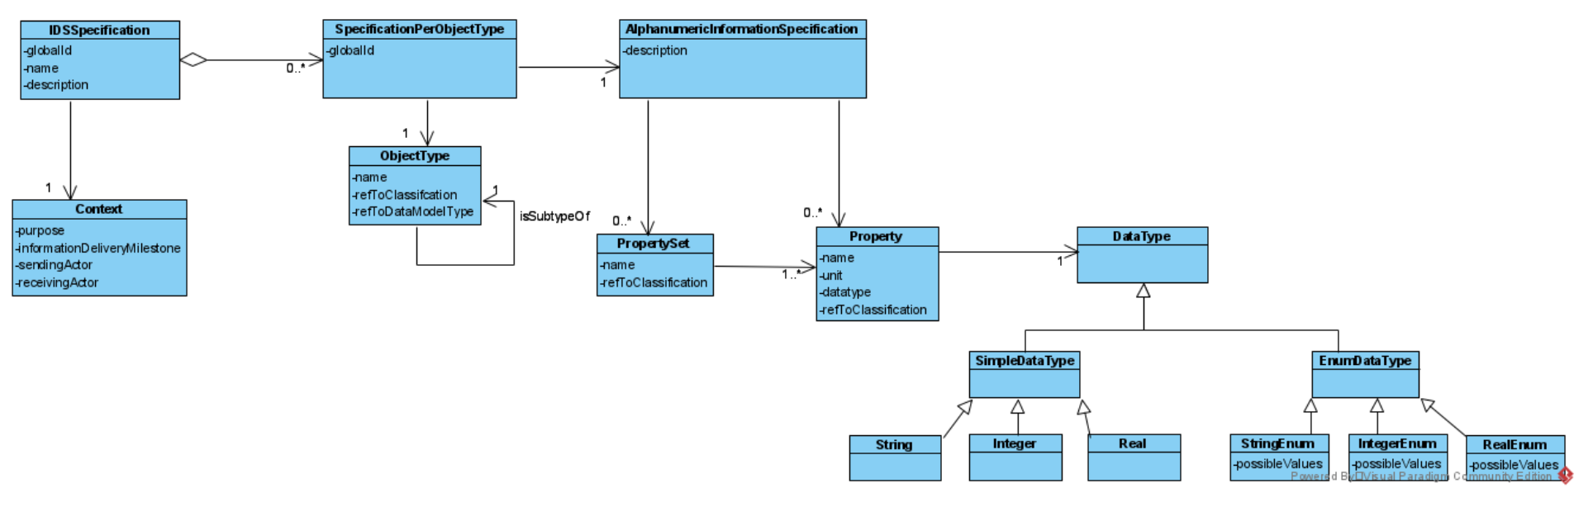
Proposal by André Borrmann (ISO 17412), v0.4
IMHO, this would make things much more complex. I propose to have exactly one purpose per IDSspecification. Of course, you can have multiple IDSspecifications per project. And I could also imagine that we reuse property definitions across different Specifications…
Yes and no. Some end users like to have the properties being grouped, others do not. So I would support bot.h
Remark to question #3 (1 vs. many purposes): If we want to support many we would need a link to purpose/Context on property level (see solution in mvdXML)
Meta data
Select part A)
Requirement part B)
Split into PropertySet and Property due to IFC?
Agreement about encoding of units? New input in the call: cum_code proposed by André, see discussion with Arie Maybe optional for existing IFC-Properties (otherwise we add redundancy)?
Needed? What are the implications? I think we agreed in the call to remove.
My concern here is that we add two, potentially conflicting inheritance hierarchies, one coming from IDS and one that is built-in in IFC.
No agreement so far. It was also debated in CEN. Seems to be a bigger issue than I would have expected. ISO 23387 might provide a solution, or we "copy" the IFC way of handling it. I would not release IFC-Properties from the duty of specifying entities, as this would create chaos, in my opinion. Inconsistencies can be easily checked.
We can call it "select" part, but I am not sure if it is really necessary. Depends on the "point of departure" of the reader of the data model.
IDS #04, 16.12.2020, Matthias Weise (AEC3)
Notes:
Link to IFC via refToClassification?
refToDataModelType = Link to IFC data format?, can we mix specifications for different objects?

Slide 4
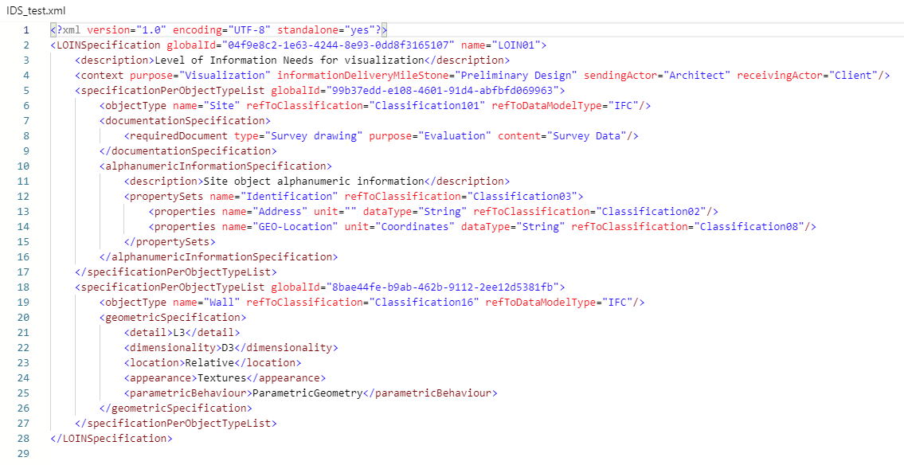
Mapping to IFC not clear
IfcSite? Posted example is a bit confusing, discussion answered that question -> This is the user name.
Correct. The XML instance example is not yet very elaborated and not entirely consistent with the UML model. Sorry for that, but it is really work in progress (with only limited resources).
Correct. The XML instance example is not yet very elaborated. But yes, properties have end user name.
Which version of IFC? I would expect IfcSite here (according to given example in the call, but how to encode IFC version – added to name? We also need to add the classification property it should be used for object selection.
Yes, should be IFCsite.
What about IFC2x3 and IFC4x1?
Meaning of Classification101? I guess we need an agreement how to encode. Otherwise it does not help.
Yes, more work is required here. We can go for URLs or for Names, whatever we prefer
How to differentiate between end-user names and IFC spec names? Feuerwiderstandsklasse <-> FireRating
Partially answerted in the call (refToClassification seems to be used for the IFC part). However, this seems to be inconsistent with usage of refToClassification in <objectType>. Also, it would not allow to have a link to classification and IFC at the same time. As presented in the call: I would avoid adding the IFC version to the property name. Use a separate field, maybe on object level.
User defined property with Pset = Identification + Property = Address, GEO-Location?
Yes, that's a good option.
I would still like to have both, the refToClassification (not IFC) and refToDatModeltype (IFC) on object type level. for the properties, we should discuss pros and cons again.
IDS #04, 16.12.2020, Matthias Weise (AEC3)

Slide 5
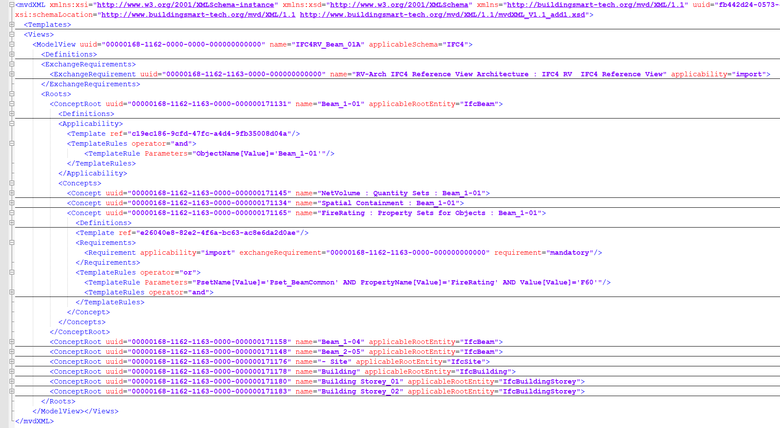
Meta data
Cross check with mvdXML
Similar principles, different meta-data
#3: many purposes/exchange requirements are allowed (see link from property/concept to ExchangeRequirement)
Select part A)
Requirement part B)
IDS #04, 16.12.2020, Matthias Weise (AEC3)

Slide 6
Thank you!
Questions?
Contact: mw@aec3.de

