Slide 1
BUILDING SERVERLESS APPLICATIONS ON AMAZON WEB SERVICES
Jenee Benjamin
Agatha oliveira

Slide 2
AGENDA
Application
AWS Services
Amazon S3
Amazon API Gateway
AWS Lambda
Amazon DynamoDB
Workshop
Questions

Slide 3
AGENDA
Application
AWS Services
Amazon S3
Amazon API Gateway
AWS Lambda
Amazon DynamoDB
Workshop
Questions

Slide 4
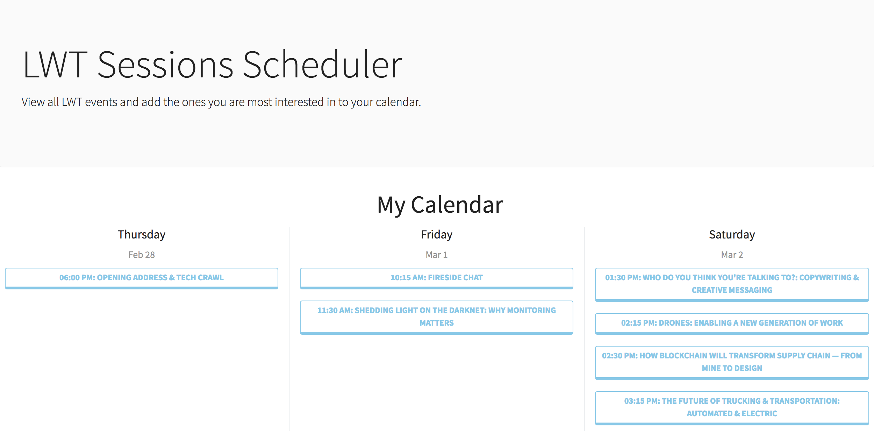
application
Notes:
Here is the application that we plan on building.
LWT Session Scheduler – you will be able to add events to your schedule. You will use AWS services to build your own LWT scheduler application

Slide 5
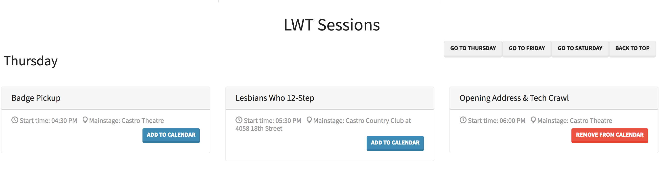
application

Slide 6
AGENDA
Application
AWS Services
Amazon S3
Amazon API Gateway
AWS Lambda
Amazon DynamoDB
Workshop
Questions

Slide 7
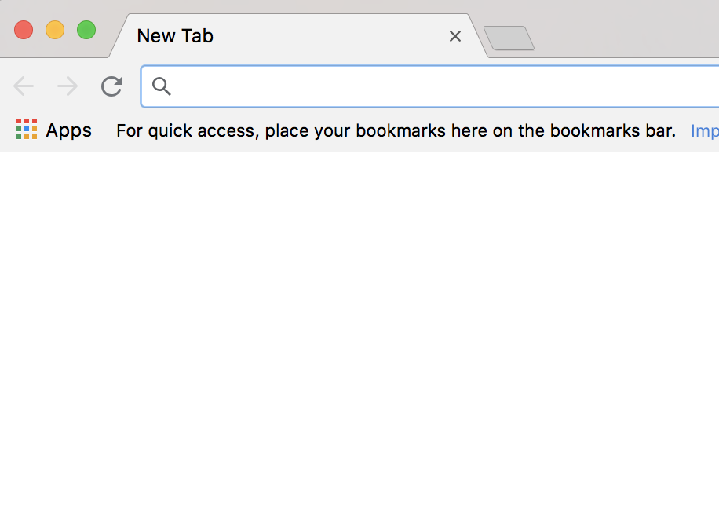


ARCHITECTURE
Domain Name
client
user

Slide 8

ARCHITECTURE
Amazon Route 53
Domain Name
client
user

Slide 9
ARCHITECTURE
Static Content
Amazon Route 53
Domain Name
client
user

Slide 10

ARCHITECTURE
Amazon S3
Static Content
Amazon Route 53
Domain Name
client
user

Slide 11
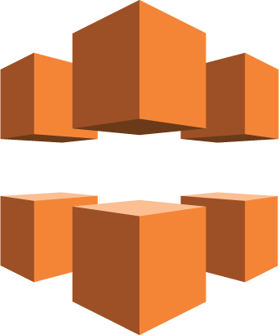
ARCHITECTURE
Amazon S3
Amazon CloudFront
Static Content
Amazon Route 53
Domain Name
client
user

Slide 12
AMAZON S3
Built to store and retrieve any amount of data from anywhere
Stores data as objects within resources called buckets
Designed to deliver
Durability
Availability
Scalability
Secure by default
Notes:
Built to store and retrieve any amount of data from anywhere
You can store as many objects that you want. Each can be up to 5 terabytes in size.
Stores data as objects within resources called buckets
Buckets are similar to file folders and store objects, which consist of data and its descriptive metadata.
Within a bucket, objects are identified via a key
Designed to deliver
Durability: S3 offers 11 9s of durability. There is built in replication of data and safeguards against accidental and fraudulent deletion to avoid data loss.
Availability: S3 offers 99.99% availability. This means that the data is reachable 99.99% of the time.
Scalability: S3 automatically scales to high request rates.
Secure by default: By default only bucket and object owners have access to the S3 resources they create. S3 supports access control to define who, how and when the data can be accessed; It also has encryption and auditing logging features.

Slide 13
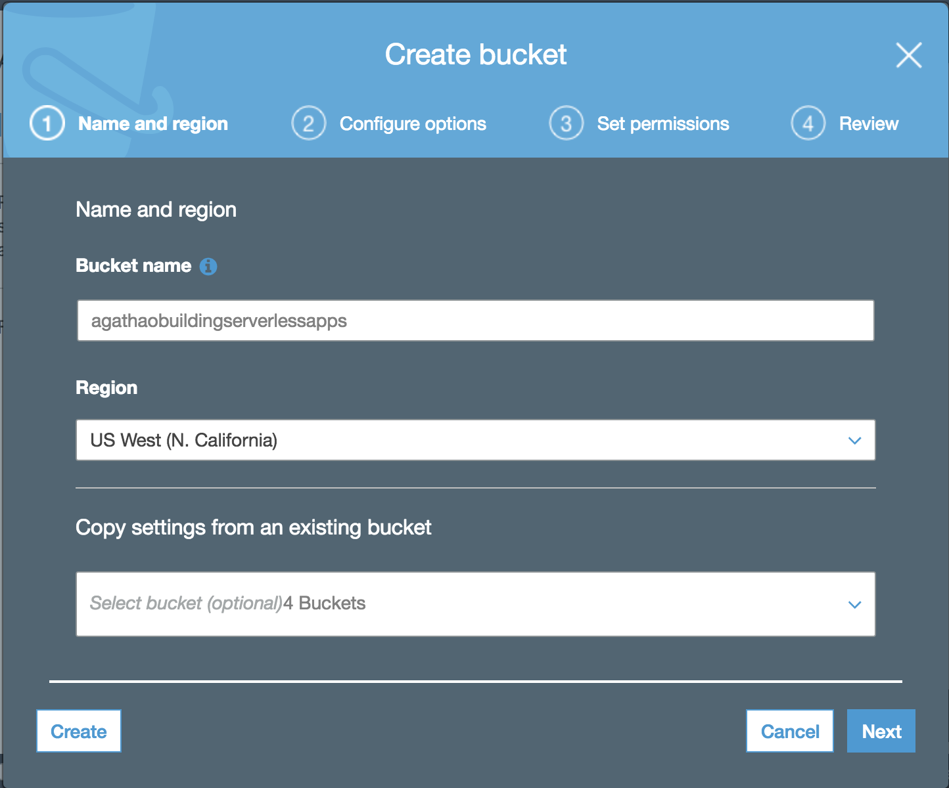
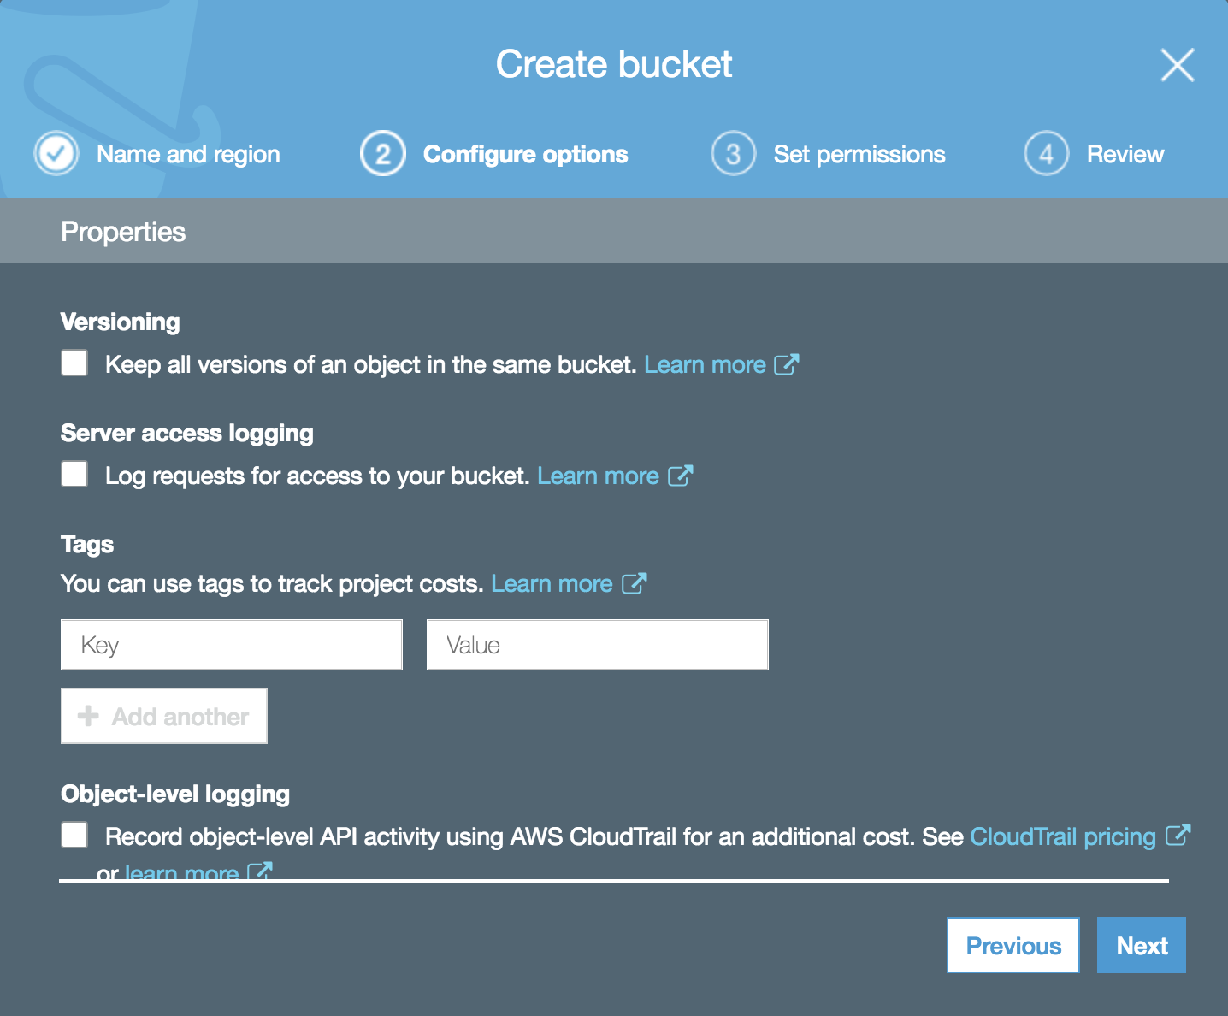
AMAZON S3

Slide 14
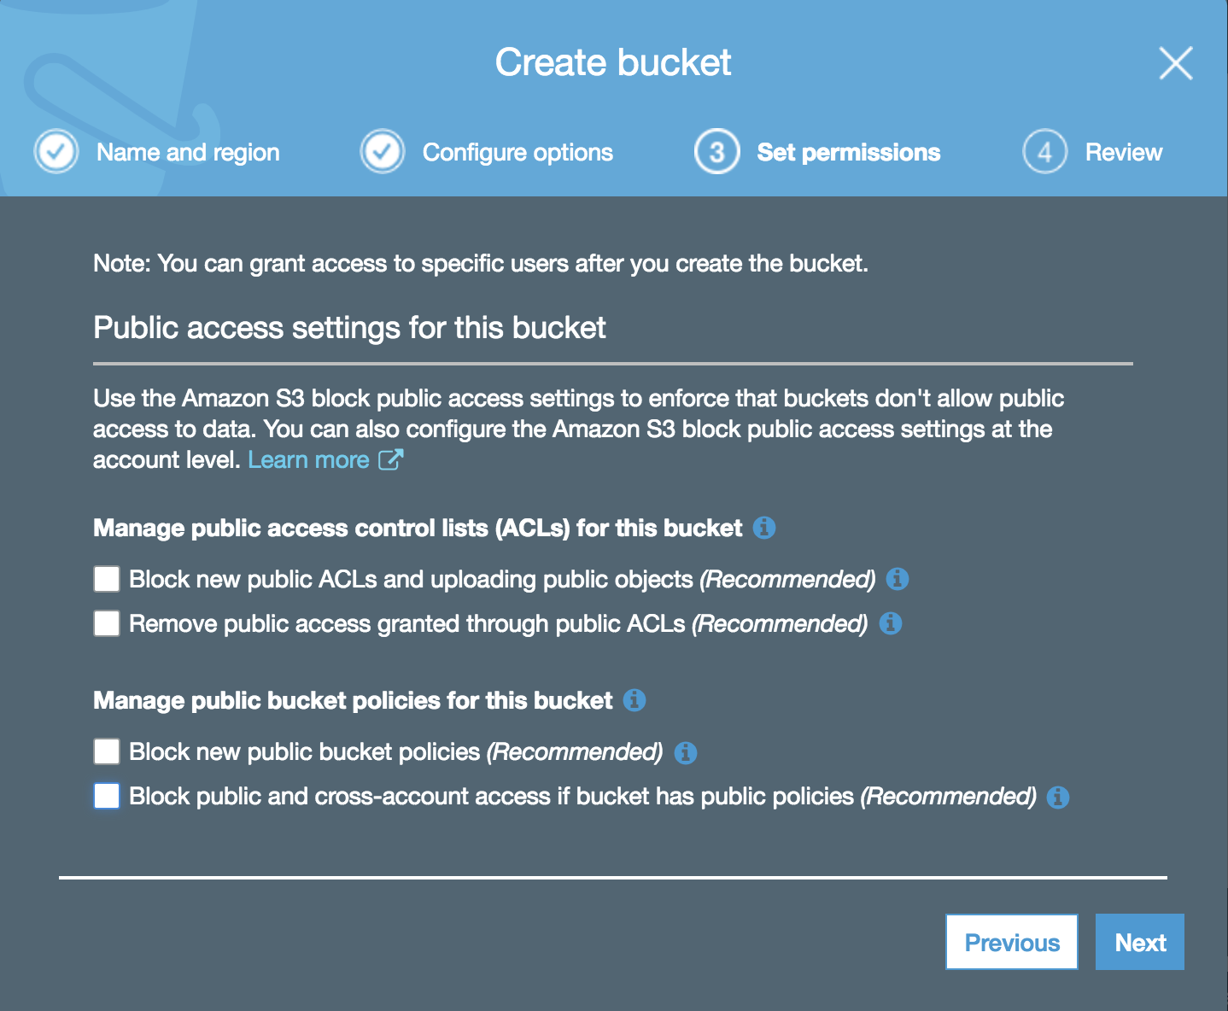
AMAZON S3

Slide 15
AGENDA
Application
AWS Services
Amazon S3
Amazon API Gateway
AWS Lambda
Amazon DynamoDB
Workshop
Questions

Slide 16
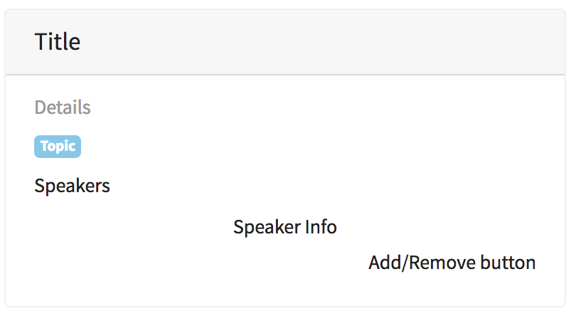
ARCHITECTURE
Amazon S3
Amazon CloudFront
Static Content
Amazon Route 53
APIs
Domain Name
client
user

Slide 17

ARCHITECTURE
Amazon S3
Amazon CloudFront
Static Content
APIs
Amazon Route 53
Amazon API Gateway
Domain Name
client
user

Slide 18
AMAZON API GATEWAY
Service to publish, maintain, monitor, and secure APIs at any scale.
Handles traffic management and API version management.
Create APIs that act as a “front door” for applications running on Amazon Elastic Compute Cloud (Amazon EC2), code running on AWS Lambda, or any web application.
Notes:
Service to publish, maintain, monitor, and secure APIs at any scale.
Using the Amazon API Gateway console, you can define your REST API and its associated resources and methods, manage your API lifecycle, generate your client SDKs, and view API metrics.
After your API is deployed, Amazon API Gateway provides you with a dashboard to visually monitor calls to your services using Amazon CloudWatch
To authorize and verify API requests to AWS services, you can use Identity and Access Management (IAM) and access policies to authorize access to your APIs and all your other AWS resources; API keys on Amazon API Gateway, with fine-grained access permissions on each API key, that can be distributed to third-party developers to access your APIs; and Amazon Cognito.
Handles traffic management and API version management.
Helps you manage traffic through throttling
You can run multiple versions of your API at the same time
You can set up a cache with customizable keys and time-to-live in seconds for your API data to avoid hitting your back-end services for each request.
Amazon API Gateway lets you simultaneously run multiple versions of the same API, allowing you to quickly iterate, test, and release new versions.

Slide 19
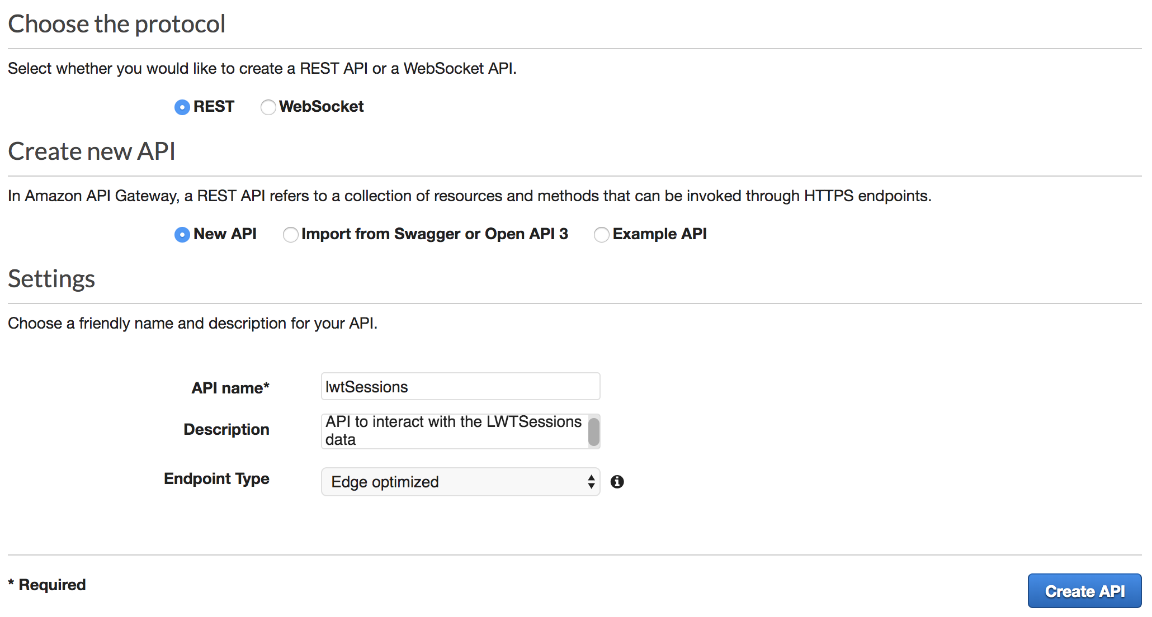
AMAZON API GATEWAY

Slide 20
AGENDA
Application
AWS Services
Amazon S3
Amazon API Gateway
AWS Lambda
Amazon DynamoDB
Workshop
Questions

Slide 21
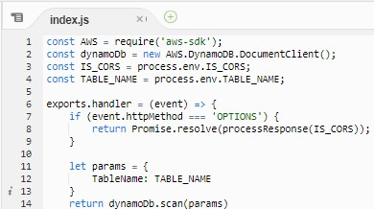
ARCHITECTURE
Amazon S3
Amazon CloudFront
Static Content
Business Logic
APIs
Amazon Route 53
Amazon API Gateway
Domain Name
client
user
Notes:
Picking up from where Agatha was,
So far, we have half of our application mapped out.
Our client is able to access domain name for the scheduler website.
We have the website code for rendering the page elements in S3.
And we have the API endpoint that the website code will hit to do things– but do what?
Well, we are pretty much still missing the backend.
Click
We are missing the code
Click.
We are missing the business logic for our application when the API endpoint is hit

Slide 22

ARCHITECTURE
Amazon S3
AWS Lambda
Amazon CloudFront
Static Content
APIs
Amazon Route 53
Business Logic
Amazon API Gateway
Domain Name
client
user
Notes:
Picking up from where Agatha was,
So far, we have half of our application mapped out.
Our client is able to access domain name for the scheduler website.
We have the website code for rendering the page elements in S3.
And we have the API endpoint that the website code will hit to do things– but do what?
Well, we are pretty much still missing the backend.
Click
We are missing the code
Click.
We are missing the business logic for our application when the API endpoint is hit

Slide 23
AWS Lambda
Lets you run code without provisioning or managing servers
Author and deploy your code to AWS Lambda
Execute code in response to triggers
Notes:
Lambda lets you run your code w/o provisioning or managing servers
You can run code for virtually any type of application or backend service - all with zero administration.
All you have to do is write and upload your code.
Lambda takes care of everything required to run and scale your code.
You can set up your code to automatically trigger
From other AWS services
For example, you can configure your lambda so that uploading a file to S3 can kick off your code. you can even have an Alexa action invoke it
Essentially any changes in data, shifts in system state, actions by users can be set up to trigger your function.
For our application, we automatically run code in response to HTTP requests via Amazon API Gateway

Slide 24
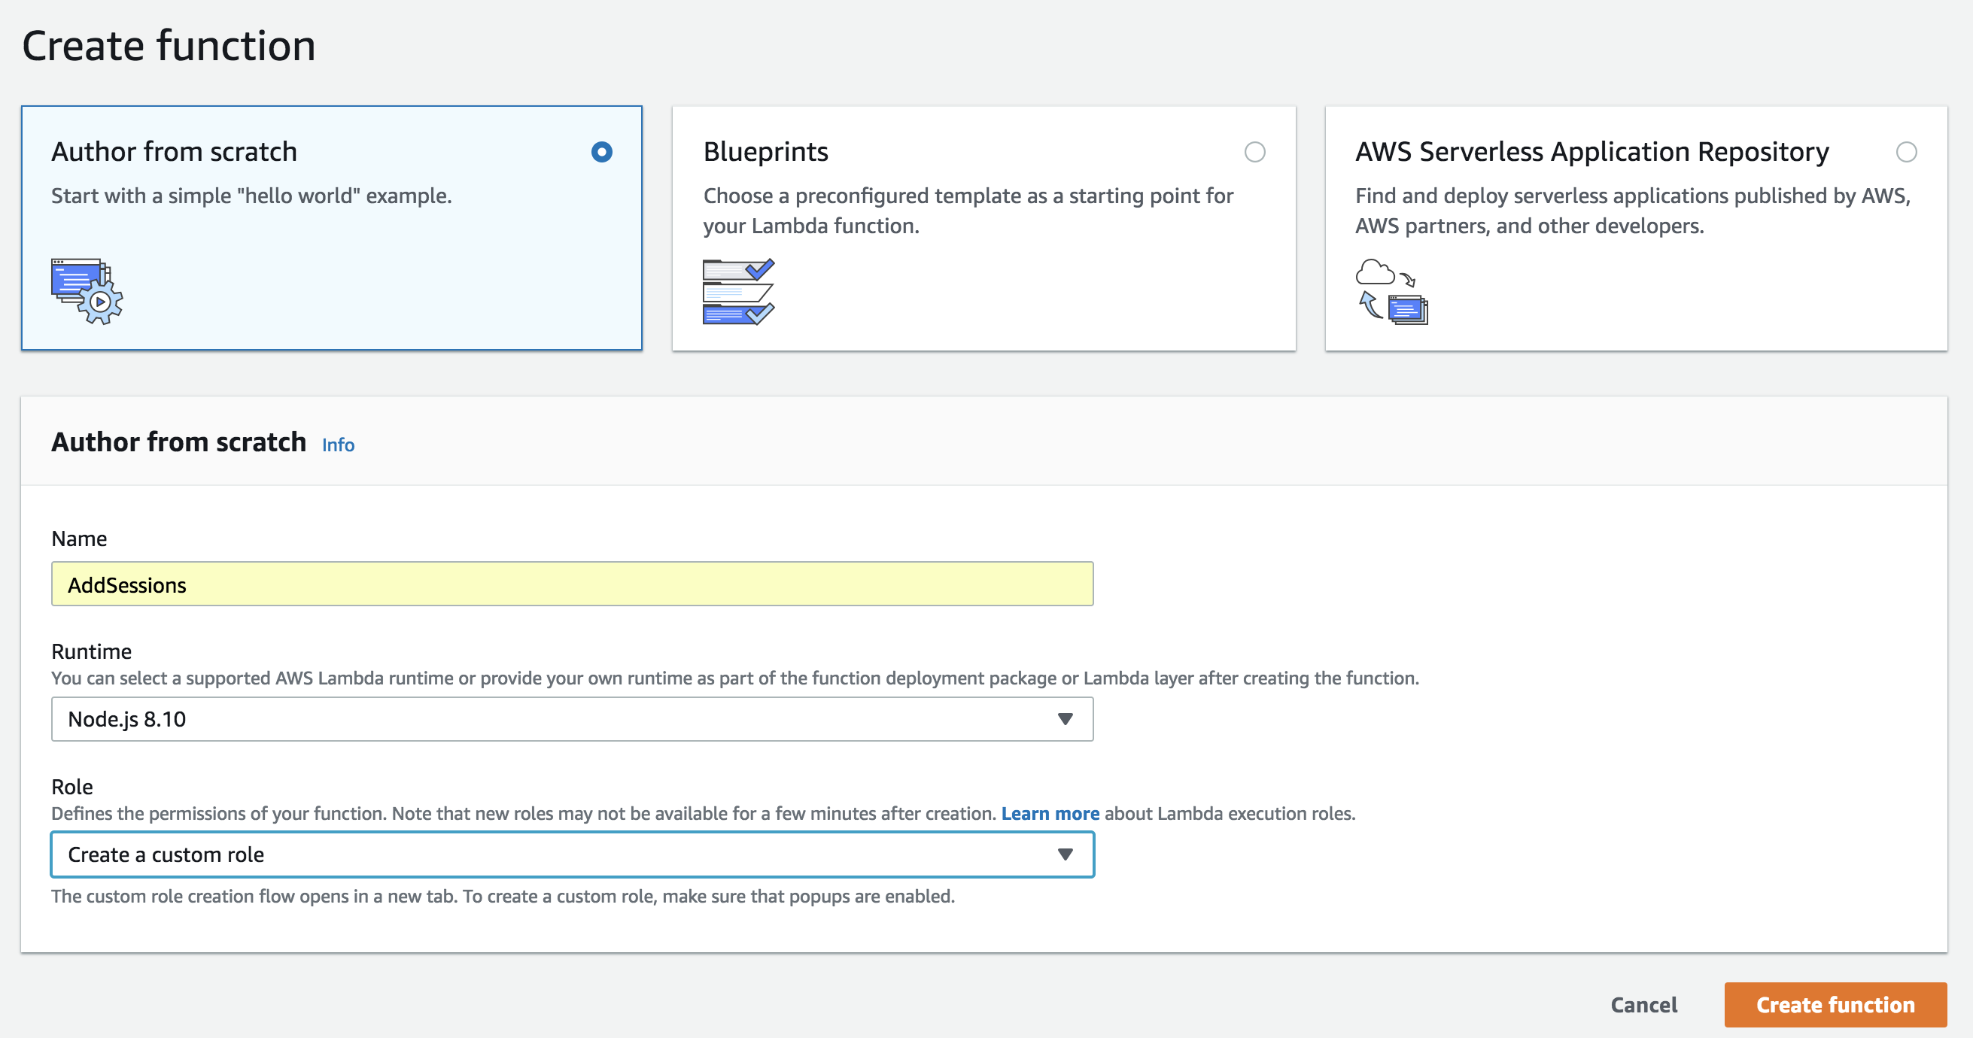
AWS LAMBDA
-
Notes:
Here is what the page will look like when we are setting up our lambda function.
-When we create a function from scratch
-Name for the function
-Then we have the runtime environment
For our application backend, we will use Node.js, but Lambda supports many others.
-Then, we create or decide on a role for the function. Specifies the permissions that our Lambda will have to other AWS services. For our application, we need access to the data storage layer and we can allow access to Cloudwatch which enables you to monitor store logs for your functions
Click Create Function

Slide 25
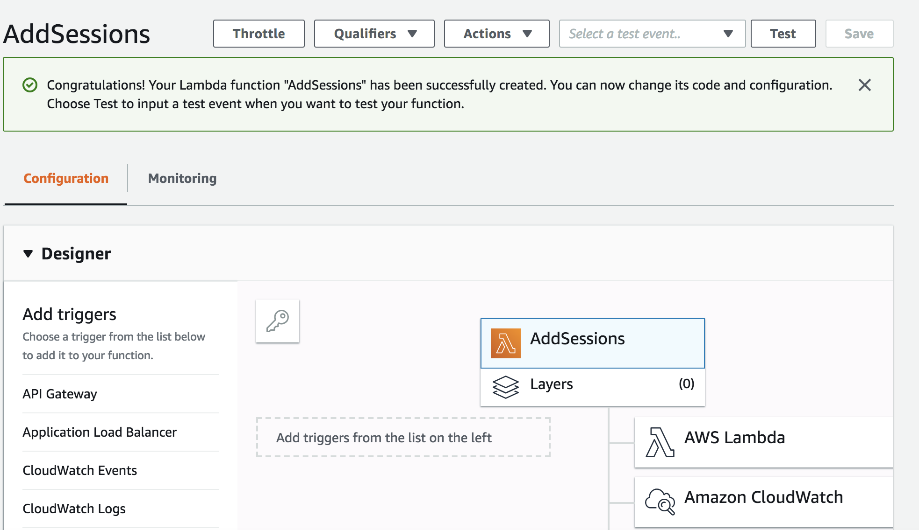
AWS LAMBDA
-
Notes:
Once the function is created, we have this dashboard.
-left side- triggers, we have not set up from where the code gets invoked. right side- list of services that the lambda has access to.
To summarize, when it comes to setting up your application to use lambdas
authoring code & deploying code to AWS Lambda, set up triggers to execute the code
That’s all. Lambda takes care of the rest.

Slide 26
AGENDA
Application
AWS Services
Amazon S3
Amazon API Gateway
AWS Lambda
Amazon DynamoDB
Workshop
Questions

Slide 27
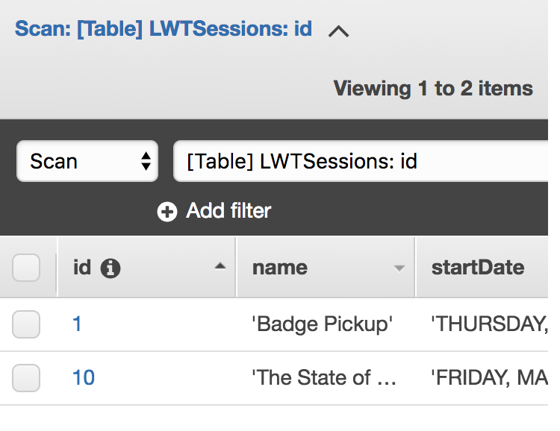
ARCHITECTURE
Amazon S3
AWS Lambda
Data
Storage
Amazon CloudFront
Static Content
APIs
Amazon Route 53
Business Logic
Amazon API Gateway
Domain Name
client
user
Notes:
So now, we have this architecture.
We have-
Functions to get content for the site for rendering,
Functions that update content as you rearrange events on your application
Functions to return the data
But are we missing?
-Something important
We’re missing the actual session information and we’re missing the data storage for it.
-
So, we need a data storage to hold all the data

Slide 28

ARCHITECTURE
AWS Lambda
Data
Storage
Amazon S3
Amazon CloudFront
Static Content
Amazon DynamoDB
APIs
Amazon Route 53
Business Logic
Amazon API Gateway
Domain Name
client
user
Notes:
So now, we have this architecture.
We have-
Functions to get content for the site for rendering,
Functions that update content as you rearrange events on your application
Functions to return the data
But are we missing?
-Something important
We’re missing the actual session information and we’re missing the data storage for it.
-
So, we need a data storage to hold all the data

Slide 29
Amazon dynamodb
A non-relational database that delivers reliable performance at any scale
Supports key-value data structures that are designed to scale easily
Delivers seamless, automatic scaling of throughput and storage scaling via APIs and the AWS Management Console.
Built-in security, backup and restore, and in-memory caching
Notes:
What is DynamoDB?
A non-relational database that delivers reliable performance at any scale
– let’s unpack that a bit
Non-relational database
Non-relational or NoSql databases offer flexible schema design.
Unlike RDBs, your schemas are tailored to the specific requirements of your use cases. This allows for the most common and important queries to be as fast and as inexpensive as possible.
Reliable performance at any scale
globally scalable data store – replicas of your data in other regions to make sure that it is more available.
Guaranteed availability with a 99.99% Standard SLA (non-global tables or if you don’t try to failover) and at least 99.999% Global Table SLA if all of your DynamoDB tables in the applicable AWS region are part of global tables (the Global Table SLA )
uses key-value data structures that scale easily for applications that require highly responsive data access. This can be done with automatic scaling of throughput and storage scaling via APIs and the AWS Management Console.
Built-in security, backup and restore, and in-memory caching
Data is secured with encryption
continuously backs up your data for protection. When enabled, DynamoDB maintains incremental backups of your table for the last 35 days until you explicitly turn it of
there is also in-memory caching supported for those high-performance applications that need microsecond response times.
DynamoDB on its own supports millisecond response times

Slide 30
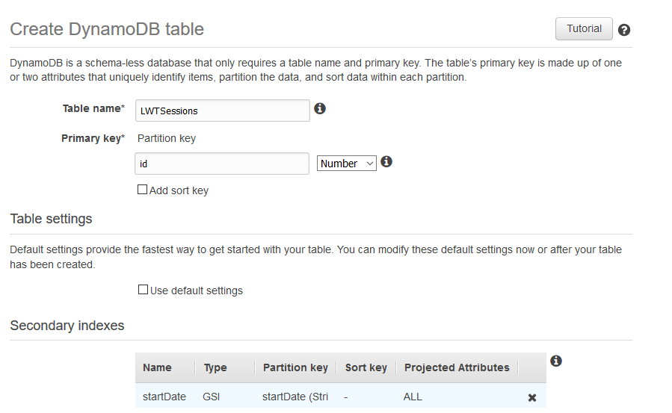
Amazon dynamodb
Notes:
Amazon DynamoDB provides fast access to items in a table by specifying primary key values. Each item (row) is a key-value pair whose primary key is the only required attribute for items in a table and uniquely identifies each item.
However, many applications might benefit from having one or more secondary (or alternate) keys available, to allow efficient access to data with attributes other than the primary key.
To address this, you can create one or more secondary indexes on a table, and issue Query or Scan requests against these indexes.

Slide 31
ARCHITECTURE
AWS Lambda
Data
Storage
Amazon S3
Amazon CloudFront
Static Content
Amazon DynamoDB
APIs
Amazon Route 53
Business Logic
Amazon API Gateway
Domain Name
client
User Management / Authentication
user
Notes:
So now, we have this architecture.
We have-
Functions to get content for the site for rendering,
Functions that update content as you rearrange events on your application
Functions to return the data
But are we missing?
-Something important
We’re missing the actual session information and we’re missing the data storage for it.
-
So, we need a data storage to hold all the data

Slide 32


ARCHITECTURE
AWS Lambda
Data
Storage
Amazon S3
Amazon CloudFront
Static Content
Amazon DynamoDB
APIs
Amazon Route 53
Business Logic
Amazon API Gateway
Domain Name
client
AWS STS
user
User Management / Authentication
Amazon Cognito
Notes:
So now, we have this architecture.
We have-
Functions to get content for the site for rendering,
Functions that update content as you rearrange events on your application
Functions to return the data
But are we missing?
-Something important
We’re missing the actual session information and we’re missing the data storage for it.
-
So, we need a data storage to hold all the data

Slide 33
ARCHITECTURE
AWS Lambda
Data
Storage
Amazon S3
Static Content
Amazon DynamoDB
APIs
Business Logic
Amazon API Gateway
client
user
Notes:
So now, we have this architecture.
We have-
Functions to get content for the site for rendering,
Functions that update content as you rearrange events on your application
Functions to return the data
But are we missing?
-Something important
We’re missing the actual session information and we’re missing the data storage for it.
-
So, we need a data storage to hold all the data

Slide 34
AGENDA
Application
AWS Services
Amazon S3
Amazon API Gateway
AWS Lambda
Amazon DynamoDB
Workshop
Questions

Slide 35
WORKSHOP
Workshop instructions are on GitHub
https://github.com/buildingserverlessapps/LWT2019-BuildingServerlessApps
Notes:
Each person will build their own LWT Scheduler application. We have provided soft copies of worksheets with the directions for building your serverless applications. The link is here.
Agatha and I will be walking around to assist. We will save 10 minutes for questions you would like to ask any questions in the open forum.
Alright, time to build.

Slide 36
AGENDA
Application
AWS Services
Amazon S3
Amazon API Gateway
AWS Lambda
Amazon DynamoDB
Workshop
Questions

Slide 37


questions
Agatha Oliveira
agathao@amazon.com
Jenee Benjamin
jeneeb@amazon.com
Notes:
Questions about Amazon?
Parts of the workshop?

