Slide 1

An Introduction to .NET

Slide 2
What is .NET
A software frame work for the Microsoft Windows OS
Provides a large set of libraries to programme against
Uses a runtime environment for running and managing programmes

Slide 3
Development in .NET
Microsoft Visual Studio
Text editor with MS Build

Slide 4
Supported Project Types
Installed applications
Software libraries
Web applications
Web services

Slide 5
Supported languages
Microsoft specific languages: C#, VB, ASP, ...
Other languages: C++, Java, ...

Slide 6
C#: Details
Object orientated
Strongly typed
Syntactically similar to C++
Managed code:
Doesn’t support mutli-inheritance

Slide 7
ASP: Details
Web application framework
NOT FINISHED

Slide 8
Sliverlight
Uses its own mark up language XAML
Can run as an installed application on Microsoft Windows OS
Can also run on most browsers via a plug-in

Slide 9
How to develop .NET software
Visual Studio / MS Build on a Microsoft Windows OS.
MS Build: free
Visual Studio cost: free (Express) - >$10,000 (Ultimate)

Slide 10
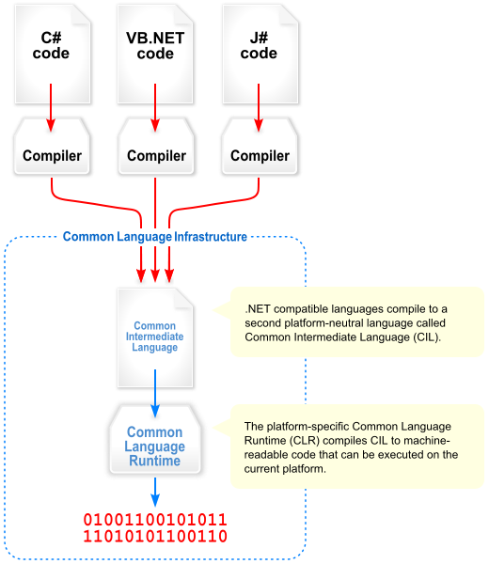
How does .NET work
Code is complied to Common Intermediate Language (CIL), which is complied to machine code before being executed by the runtime environment (CLR)

Slide 11


