Slide 1
AutoFigure: Generating and Refining Publication-Ready Scientific Illustrations
Westlake University | FigureBench + AutoFigure

Slide 2
Research Motivation
Scientific illustrations are critical but creating them requires domain expertise + design skills, often taking days
Existing datasets (Paper2Fig100K, SciCap+) only use short captions, not full paper text
PosterAgent/PPTAgent only rearrange existing content, not generate original illustrations
T2I models produce visually appealing but structurally unfaithful scientific figures

Slide 3
Gap Analysis: Three Lines Converge
Dataset gap: benchmarks rely on short text/captions, not long-context (>10K tokens)
System gap: current tools do content rearrangement, not original generation
T2I gap: diffusion models cannot maintain structural fidelity for scientific diagrams
Positioning: the last piece of the puzzle for AI Scientists

Slide 4
Core Contributions
New task: Long-context Scientific Illustration Design (input avg >10K tokens)
FigureBench: first large-scale benchmark, 3300 pairs, IRR=0.91
AutoFigure: first agent-based Reasoned Rendering framework
Designer-Critic self-refinement with test-time scaling
Erase-and-Correct strategy for text rendering artifacts

Slide 5
FigureBench
A Benchmark for Automated Scientific Illustration Generation

Slide 6
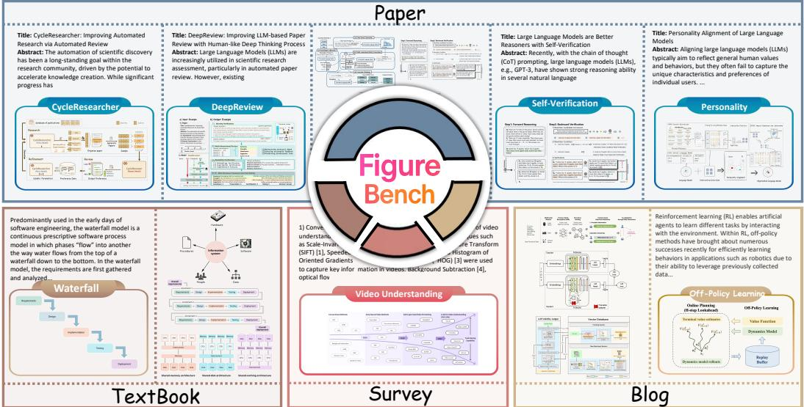
FigureBench Dataset Composition
3300 text-illustration pairs from 4 sources: Paper, Survey, Blog, Textbook
Paper: avg 12732 tokens, highest complexity
300 test + 3000 dev, strictly separated

Slide 7
FigureBench Construction & Evaluation
Funnel pipeline: 400 papers -> GPT-5 selects best figure -> 16-day annotation -> IRR=0.91
Dual evaluation: VLM-as-a-judge (3 dimensions, 8 sub-metrics) + blind pairwise comparison
Human expert evaluation: 10 first-authors assess their own papers
Dev set: fine-tuned VLM filters 3000 pairs from Research-14K

Slide 8
AutoFigure
Reasoned Rendering: Reason First, Render Second

Slide 9
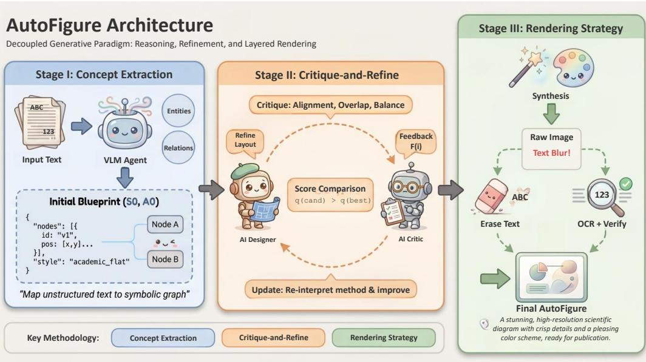
AutoFigure System Architecture
Stage I: Concept Extraction -> symbolic layout S0/A0
Stage II: Designer-Critic iterative refinement
Stage III: Style-guided rendering + Erase-and-Correct

Slide 10
Stage I: Concept Extraction & Layout
VLM Agent extracts methodology summary + entity-relation set from long text
Serialized into SVG/HTML symbolic layout S0 and style description A0
Designer-Critic loop: AI Designer generates layout, AI Critic scores on alignment/overlap/balance
Iterative refinement until convergence (0->5 iterations, Overall 6.28->7.14)

Slide 11
Stage II: Rendering & Text Correction
Style-guided rendering: (S_final, A_final) -> T2I prompt + structure image -> GPT-Image
Default Morandi-tone cartoon style, customizable per source type
Erase-and-Correct: erase all text pixels -> OCR extract strings + bboxes -> multimodal verifier aligns with ground truth -> overlay vector text
Decouples visual quality (AI rendering) from text accuracy (programmatic overlay)

Slide 12
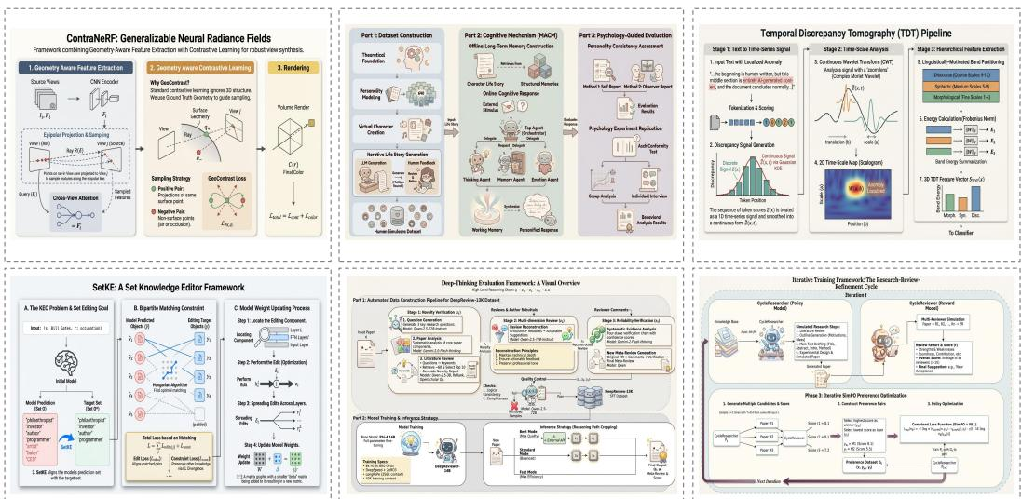
AutoFigure Generation Examples
6 examples across diverse topics: NeRF, cognition, time series, knowledge editing
Unified Morandi-tone cartoon style
Demonstrates framework generality

Slide 13
Experiments
Three-Layer Evaluation: Automatic + Human Expert + Ablation

Slide 14
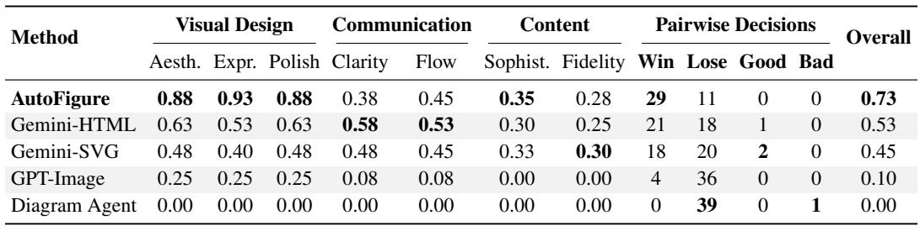
Main Results (Table 2)
AutoFigure achieves highest Overall across all 4 categories
Win-Rate: Textbook 97.5%, Survey 78.1%, Blog 75.0%, Paper 53.0%
Visual Design dimension dominates all baselines

Slide 15
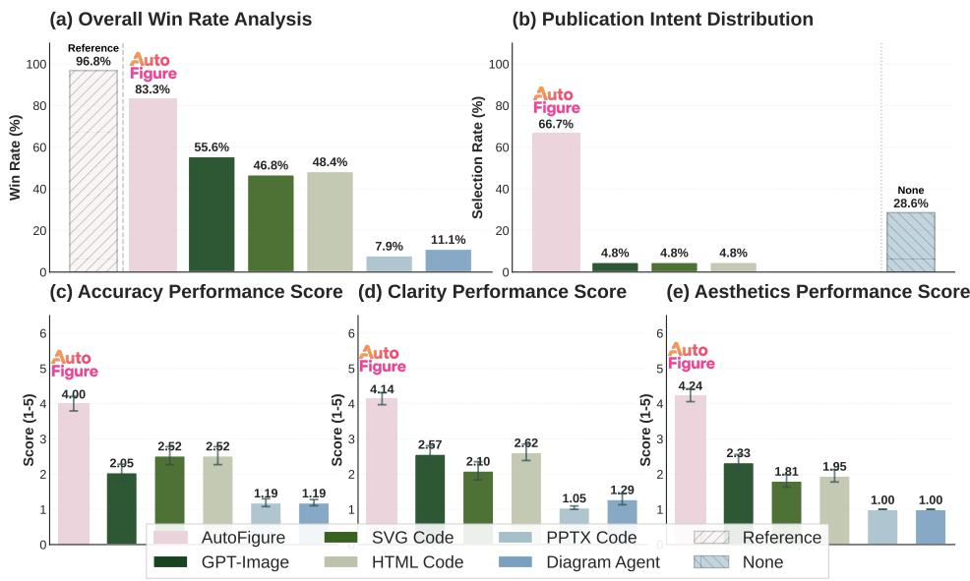
Human Expert Evaluation (Figure 4)
Win rate: AutoFigure 83.3% vs SVG Code 55.6%
66.7% first-authors willing to use AutoFigure output for publication
Likert: Accuracy 4.00, Clarity 4.14, Aesthetics 4.24 (out of 5)

Slide 16
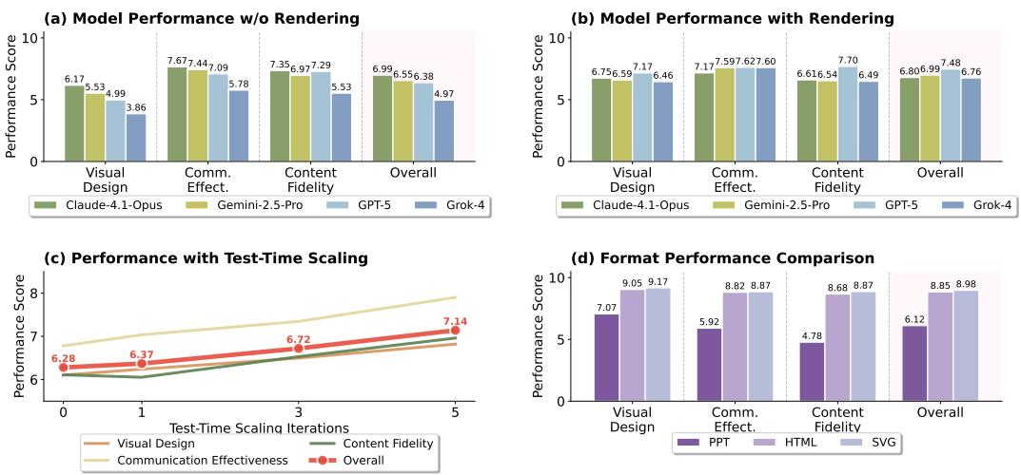
Ablation Studies (Figure 5)
Rendering stage significantly boosts Visual Design (Overall 6.38->7.48)
Test-time scaling: 0->5 iterations, Overall 6.28->7.14
Format comparison: SVG(8.98) > HTML(8.85) >> PPT(6.12)

Slide 17
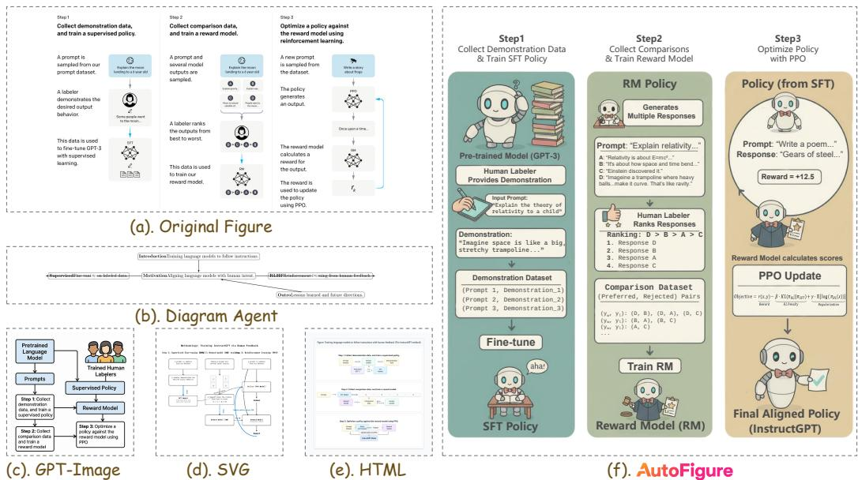
Qualitative Comparison: InstructGPT (Figure 6)
Diagram Agent: text-only flowchart, no visual design
GPT-Image: chaotic layout, poor structure
SVG/HTML: severe information loss or architecture deviation
AutoFigure: closest to original in structure + information + aesthetics

Slide 18
Conclusion & Future Directions
AutoFigure establishes the foundation for automated scientific illustration generation
Limitation: heavily relies on closed-source models (Gemini-2.5-Pro + GPT-Image), cost and reproducibility concerns
Paper Win-Rate only 53%: complex paper illustrations remain challenging
Future: open-source alternatives, interactive human-in-the-loop, dynamic/animated illustrations
Integration with AI Scientist for end-to-end paper + figure generation

