Slide 1
Nested Learning:
The Illusion of Deep Learning Architectures
Behrouz, Razaviyayn, Zhong, Mirrokni
NeurIPS 2025

Slide 2
Research Background & Motivation
• Deep stacking has 4 limits: computational depth unchanged, marginal capacity gain, suboptimal optimization, no continual learning improvement
• LLMs after pre-training resemble anterograde amnesia patients - cannot form new long-term memories
• Brain achieves continual learning via multi-timescale memory consolidation (online + offline)
• Key question: Do we need a new learning paradigm beyond layer stacking?

Slide 3
Core Problem: The Static Nature of LLMs
• LLM knowledge limited to: immediate context window (short-term) or pre-trained MLP params (long-term)
• Cannot acquire new knowledge after deployment unless info fits in context window
• Existing solutions are expensive, lack generalization, suffer catastrophic forgetting
• In-context learning is the only adaptable component, but limited to context window

Slide 4
Nested Learning Paradigm
Reinterpreting deep learning as nested optimization problems

Slide 5
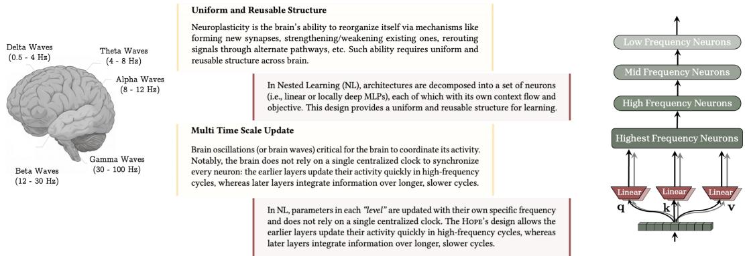
Biological Inspiration: Multi-Timescale Brain Updates
• Brain coordinates via Delta~Gamma oscillation bands
• Lower neurons: high-freq update; Higher neurons: slow integration
• NL reinterprets Transformers as linear layers with different update frequencies
• Uniform & reusable structure + multi-timescale = continual learning

Slide 6
Core Insight: Learning = Compressing Context Flow
• All DL components (networks + optimizers) are associative memory systems compressing their own context flow
• Associative Memory: operator mapping keys to values, learned by optimizing an objective
• Training = acquiring memory that maps data to Local Surprise Signal (LSS)
• Components ordered by update frequency form nested multi-level optimization problems

Slide 7
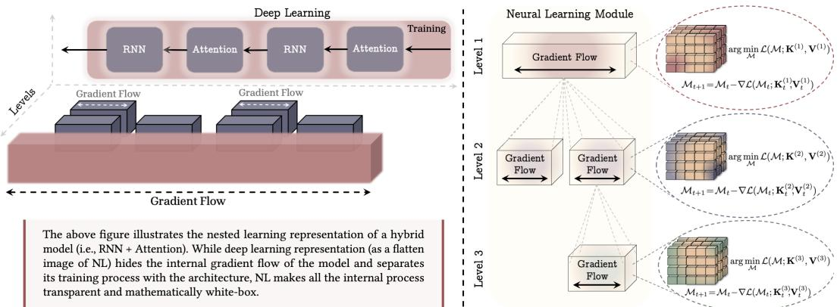
NL Paradigm vs Deep Learning Perspective
• Deep Learning: flattened view, single gradient flow, opaque internals
• NL: each sub-component has independent gradient flow & objective
• Neural Learning Module: multi-level, each level compresses context at different timescale

Slide 8
Contribution 1: Deep Optimizers
• Momentum is a key-less associative memory compressing past gradients
• Adam (with minor modification) is the optimal associative memory for gradients
• Ext 1 - Stronger Association: preconditioning (Hessian info)
• Ext 2 - Stronger Objective: delta-rule for better capacity management
• Ext 3 - Stronger Memory: MLP replaces linear (Deep Momentum GD)
• Ext 4 - Nonlinear Output: Newton-Schulz -> Muon optimizer

Slide 9
HoPE Architecture
Self-Modifying Titans + Continuum Memory System

Slide 10
Contributions 2 & 3: Self-Modifying + Continuum Memory
• Self-Modifying Titans: learns to modify its own update algorithm, dynamically adjusts q/k/v
• Continuum Memory System (CMS): chain of MLP blocks, each updated at different frequency
• CMS generalizes long/short-term memory dichotomy into continuous spectrum
• Each MLP params compress own context - representative of abstract knowledge

Slide 11
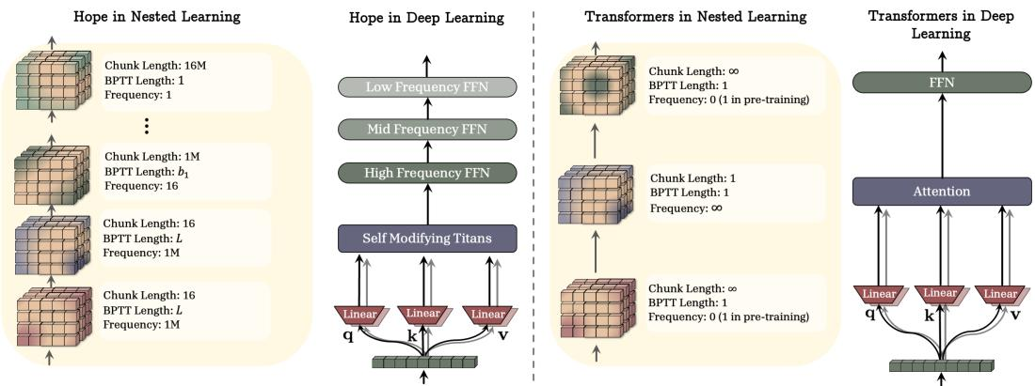
HoPE vs Transformer Architecture
• Transformer: only 2 extreme frequency levels
• HoPE fills the gap: High/Mid/Low Frequency FFN
• Chunk Length: 16 -> 1M -> 16M
• Frequency: 1M -> 16 -> 1
• Smooth spectrum vs two extremes

Slide 12
Experimental Results
760M params / 30B tokens
1.3B params / 100B tokens
• HoPE Avg: 52.26% (best)
• Titans LMM: 51.56%
• Samba: 51.08%
• Transformer++: 48.69%
• HoPE Avg: 57.23% (best)
• Titans LMM: 56.82%
• Samba: 54.00%
• Transformer++: 52.25%
Key: Dynamic q/k/v projections + deep memory -> lower perplexity & higher accuracy. Advantage grows with scale.

Slide 13
Summary & Critical Evaluation
• NL: unified, math white-box, neuroscience-grounded framework for understanding DL
• HoPE consistently outperforms Transformer++ and modern RNNs across scales
• Limitation: main paper incomplete due to page limit; many experiments only in appendix
• Performance gap modest (57.23 vs 56.82 at 1.3B) - needs larger-scale validation
• Open: Can NL guide new architecture design? CMS frequency selection theory?

