Slide 1



New Landing Page
“Register for our Live Info Sessions”
“Book a spot for a 1 on 1 chat with the Education and Career guidance counselor”
“Book a spot for a 1 on 1 chat with a Course counselor”

Slide 2
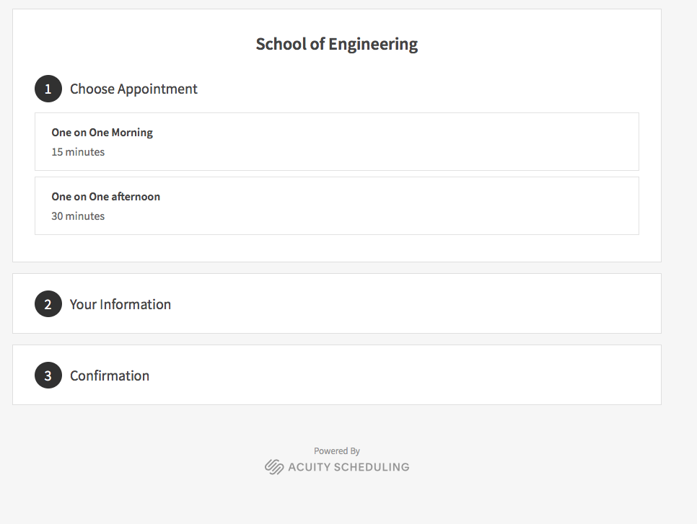
Book a spot for a 1 on 1 chat with the Education and Career guidance counselor
Select a time….

Slide 3
Book a spot for a 1 on 1 chat with a Course counselor”
Select a time….

Slide 4
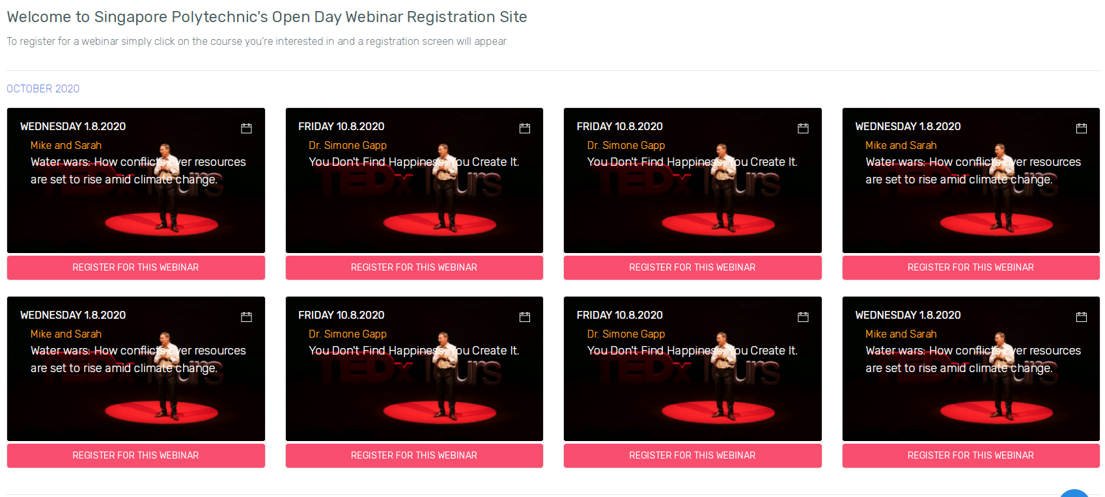
Live info sessions Page
Change Text
“7th Jan 2021”
Change Image
“10am - 1130am”
“School of Computing”
Change Text

Slide 5
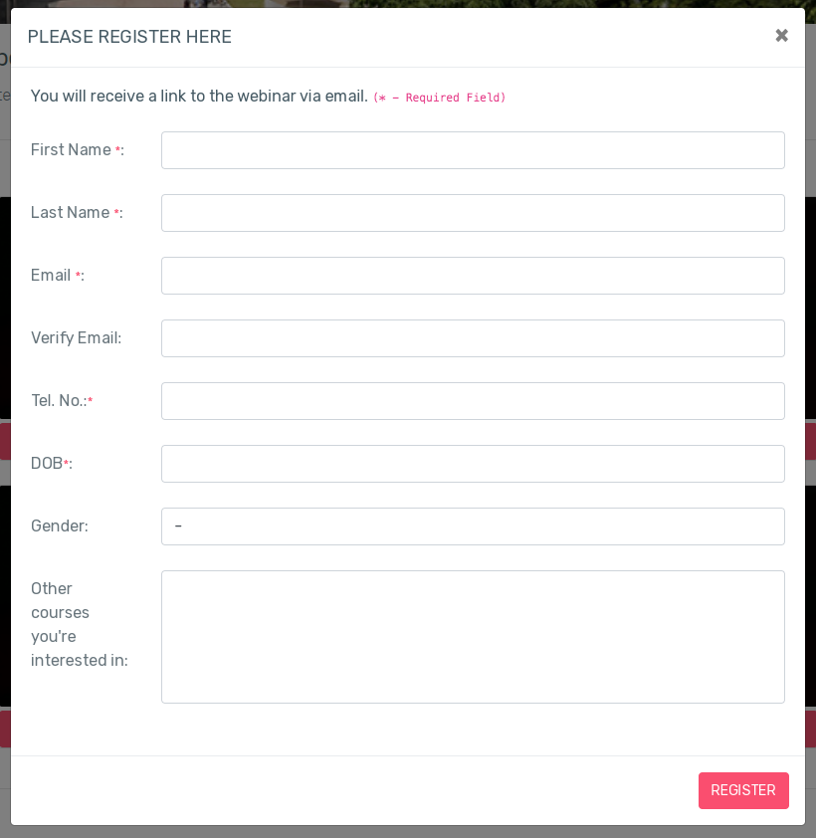
Registration Page
Change Text
“Name of prospective student”
NEW QUESTIONS
DROP DOWN -
“Type of Participant:”
Parent
O Level School Leaver
N Level School Leaver
ITE Graduate/Student
Secondary School Student (Level), School Teacher/Educator
Others (Free Text, can this be a text box ?)
DROP DOWN -
“Number of Attendees”
1
2
3
TEXT BOX
“Pre-event Questions for Panel Q&A”
DROP DOWN
Source of news about Info Session
Social Media, Mailer from SP
Others (Free Text, can this be a text box ?
Change Text
“Which School of Computing Course are you interested in ?”
Checkbox
Common Infocomm Technology Programme (S32)
Applied AI and Analytics (S30)
Infocomm Security Management (S54)
Information Technology (S69)
Business Information Technology (S82)

Slide 6
Write up list of events
Write up email reply
Changes for registration form
Ask about the email server
Register for Breakout Sessions + copy
On Card also put breakout rooms
Setup excel sheet for links
Layout

