Slide 1

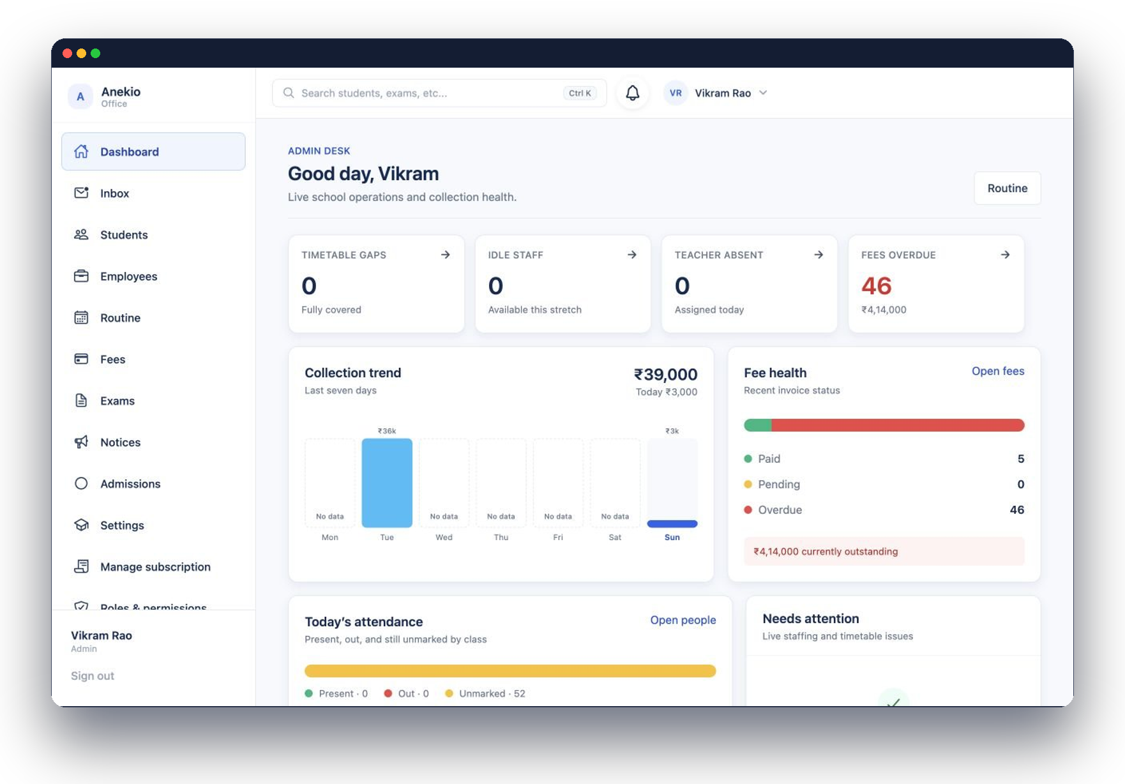
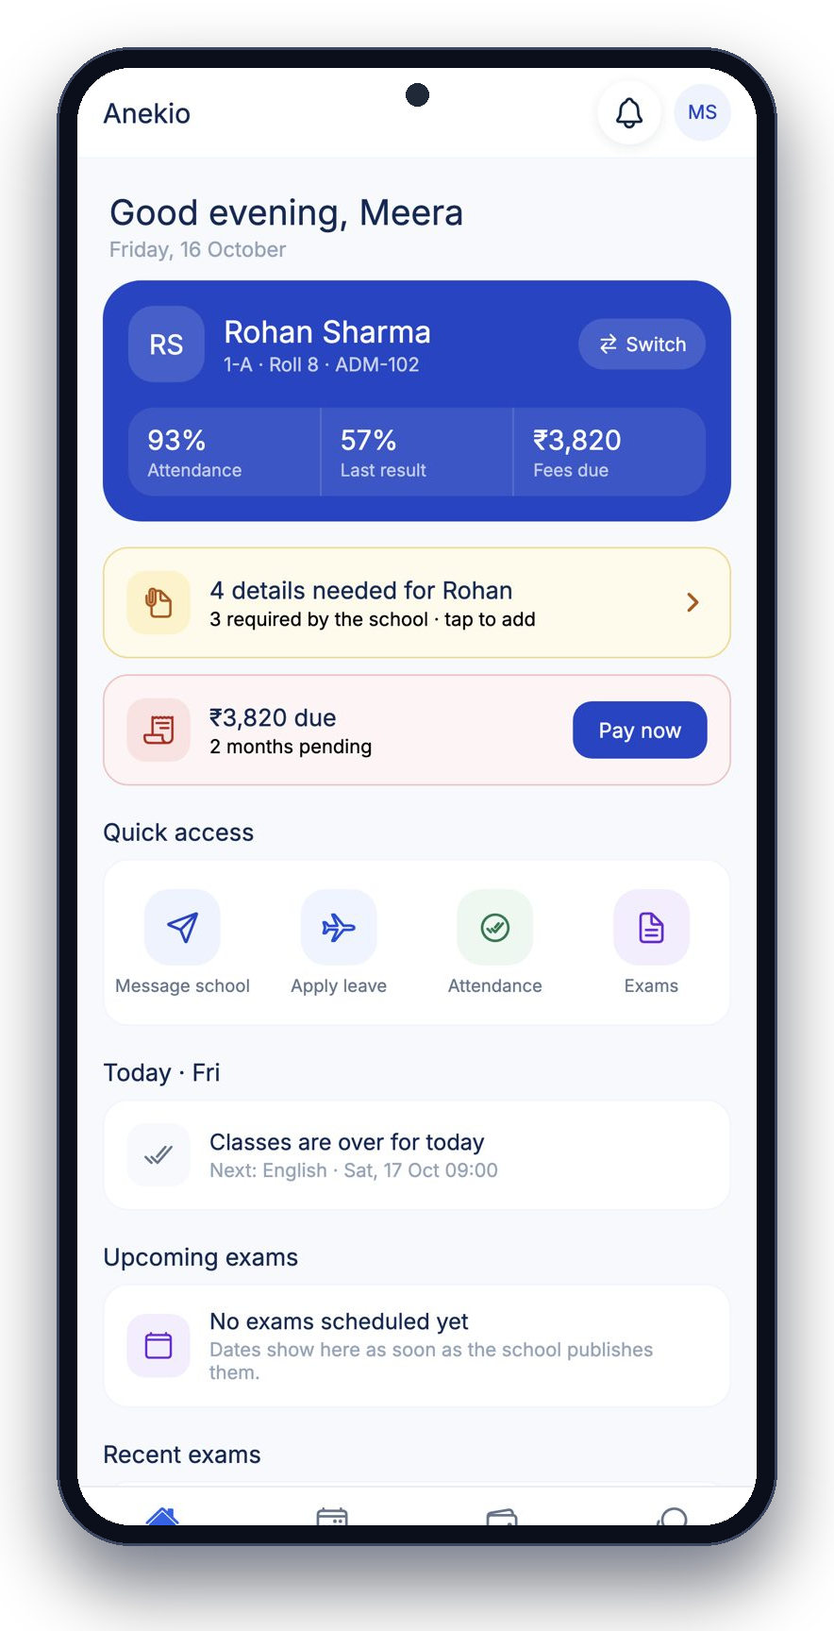
Anekio
Run your whole
school from
one record.
Admissions, fees, attendance, exams, routine, notices and the parent app — connected on the web and on Android.
School ERP for growing Indian schools
Notes:
Anekio is a school ERP built for Indian schools: one student record shared by the office, teachers and parents, on web and Android.

Slide 2
Registers, Excel and WhatsApp groups don't scale
THE PROBLEM
✕
Fees in a notebook
✕
Attendance on paper
Who paid, who's overdue and how much is a half-day reconciliation.
The office learns about absences at month end.
✕
Results by photo
✕
Parents call the office
Marks typed twice; report cards made in Word.
The same five questions, every day, to whoever picks up.
Notes:
Most schools we meet run on registers, Excel and WhatsApp. Each works alone; none of them talk to each other.

Slide 3
Capture once. Use everywhere.
ONE PLATFORM
1
2
3
Admit the student
→
Every team works on it
→
Each role sees what it needs
The admission form becomes the working student file: class, parent, documents, billing month.
Fees, attendance, exams, routine and notices read and write the same record.
Office gets control, teachers get their classes, parents get their child.
Web portal for the office · Android app for teachers and parents · the same data in both.
Notes:
The core idea: one student record. Everything else hangs off it.

Slide 4
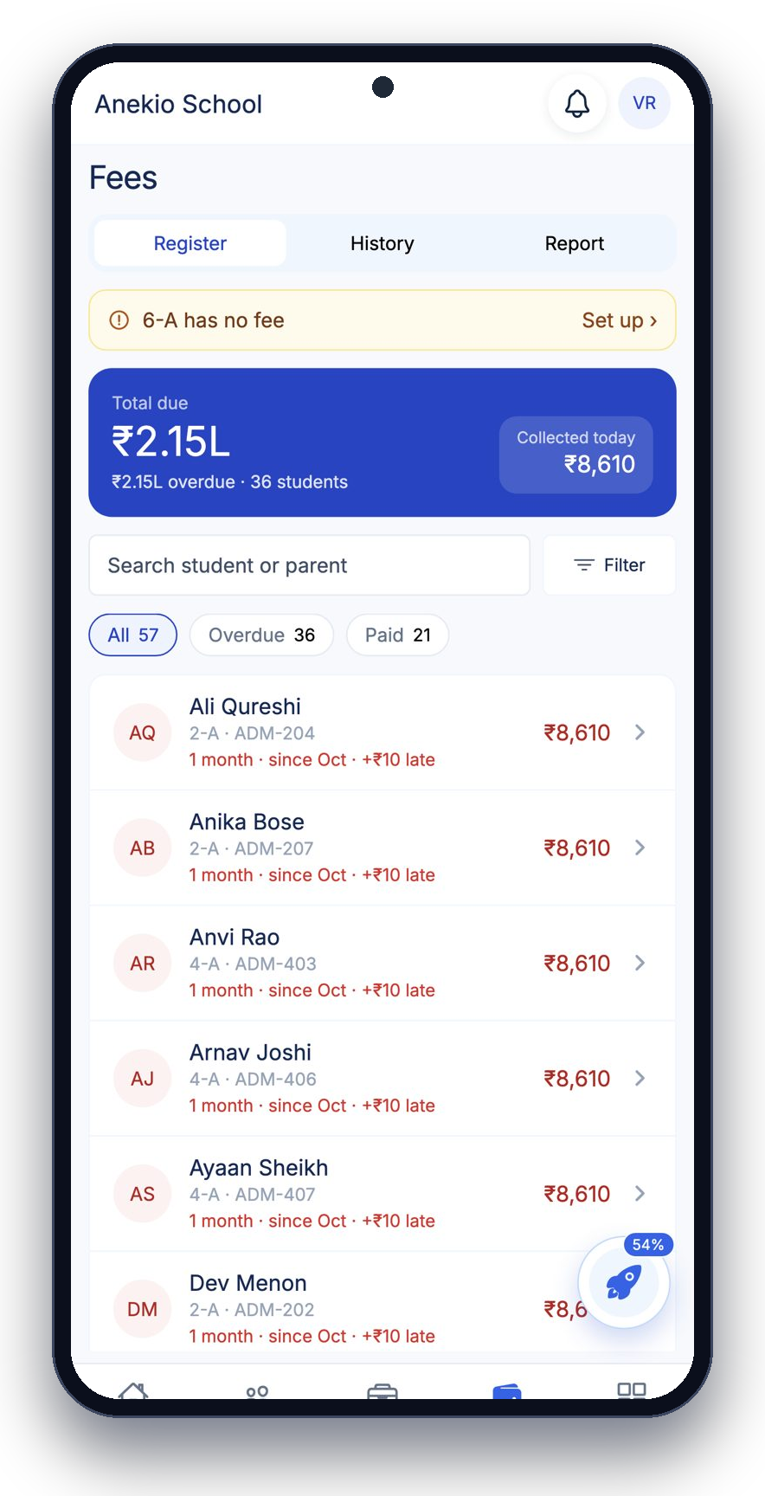
FOR THE OFFICE
See the whole day before it starts
✓
Timetable gaps, absent teachers and overdue fees on one desk
✓
Fees register with UPI, cash, pay-link and bank collection
✓
Attendance overview across every class by 10 AM
✓
Notices to parents, teachers or students with a preview
✓
Roles & permissions, decided area by area
Notes:
The admin desk: what needs attention today, collection trend, fee health. The office app mirrors it on the phone.

Slide 5
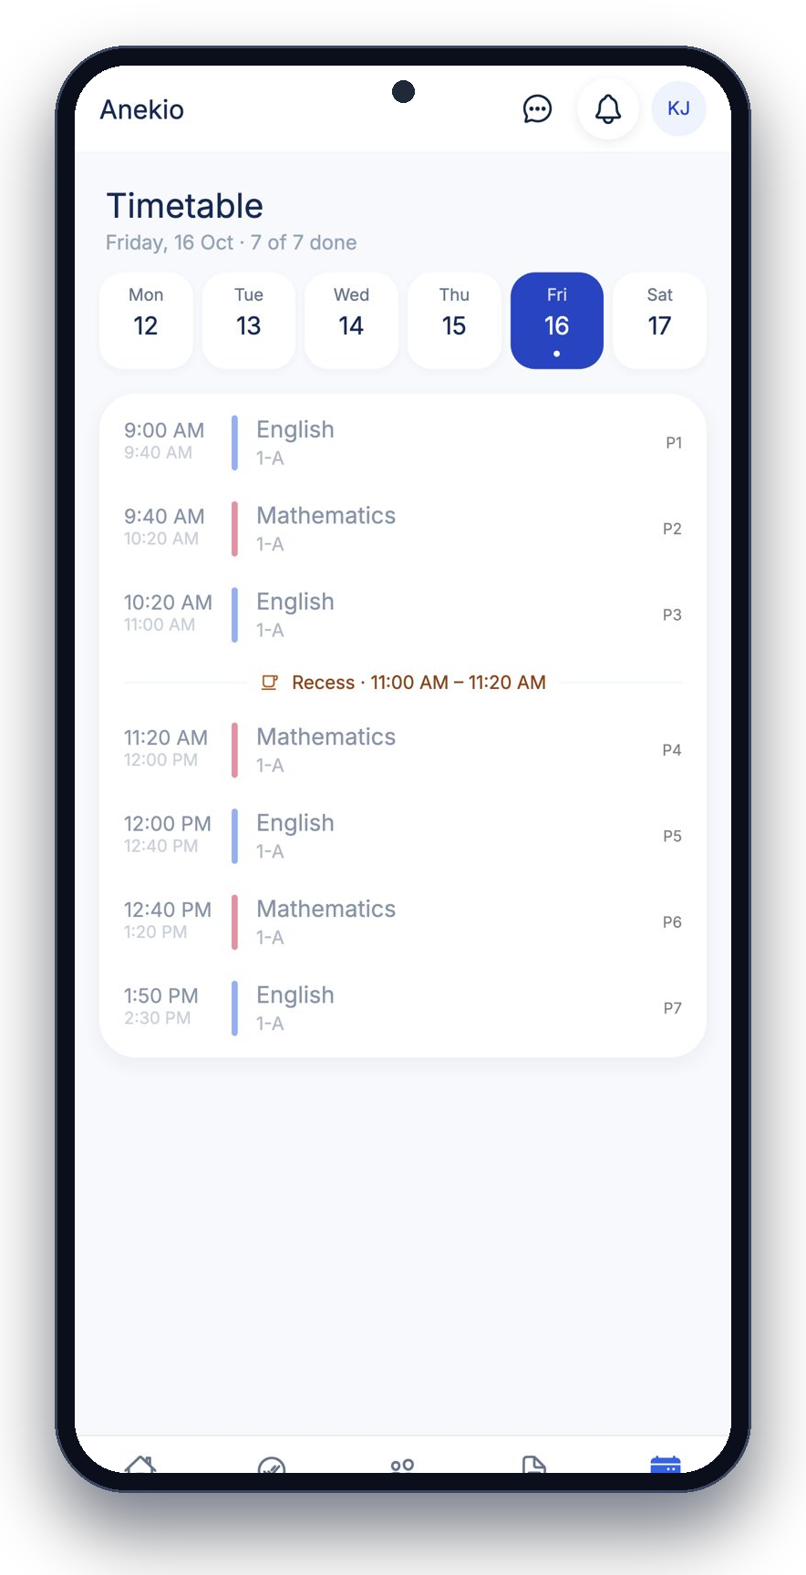
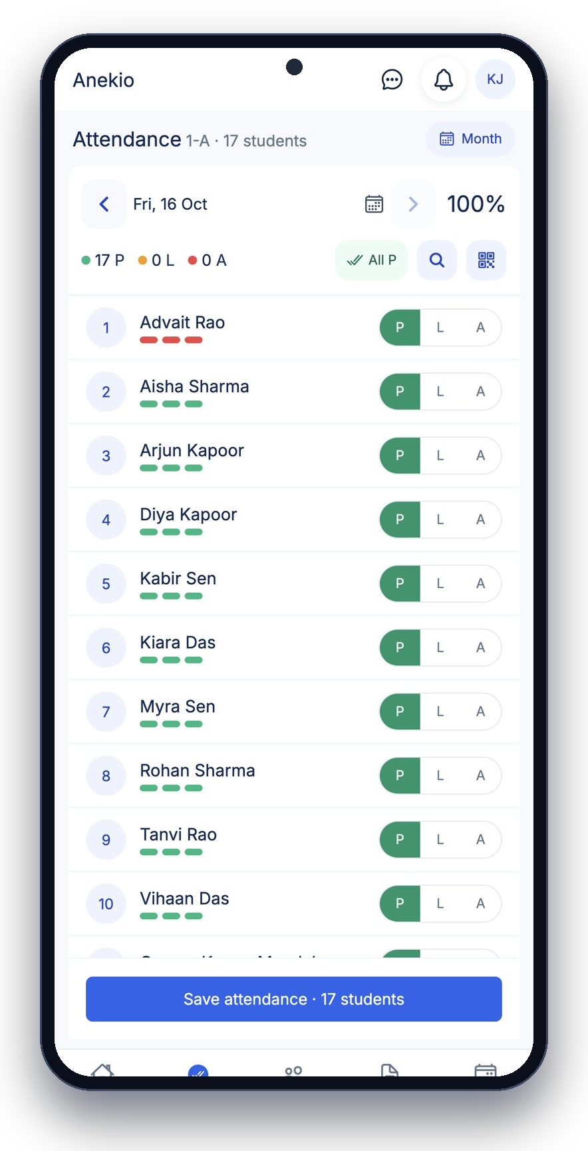
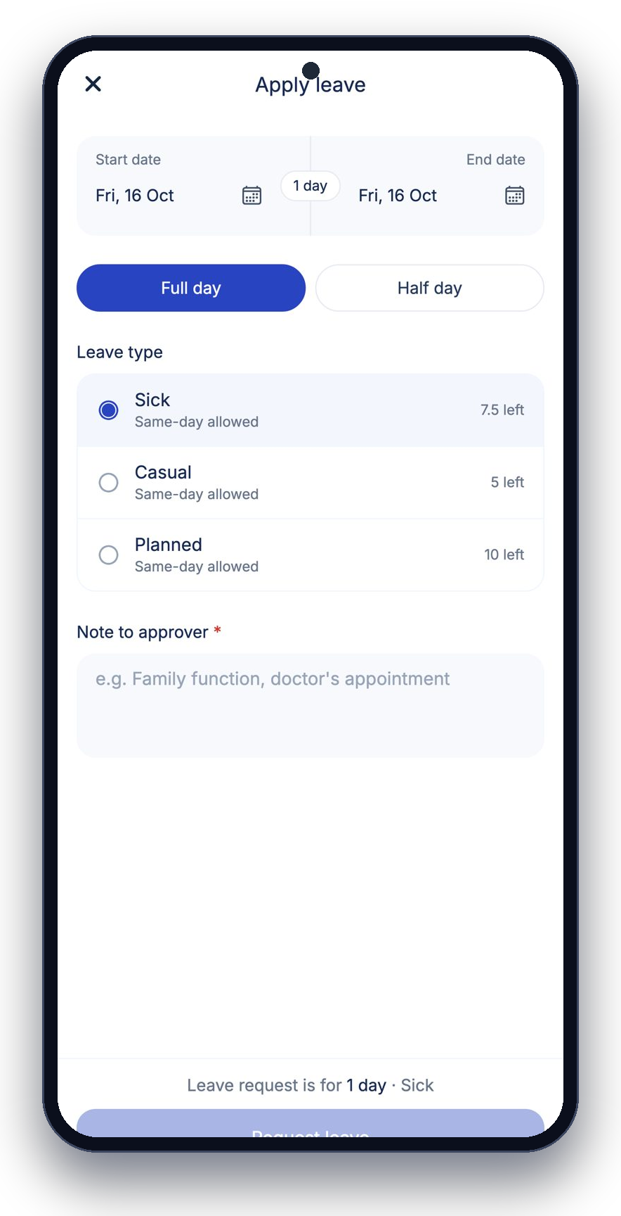
Lose the paperwork, not the control
FOR TEACHERS
✓
Mark a whole class present in under a minute (P / L / A)
✓
Own timetable with recess and rooms
✓
Question-paper handover and marks entry with deadlines
✓
Apply for leave; balance and approver shown
✓
Teacher QR for the school's attendance scanner
Notes:
Teachers do everything from the phone: attendance, their routine, leave, papers and marks.

Slide 6
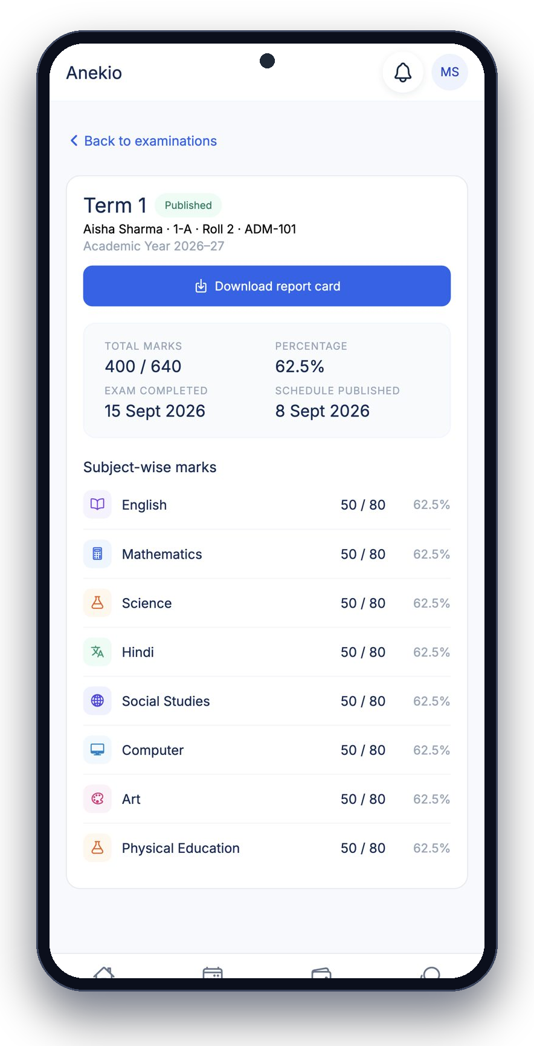
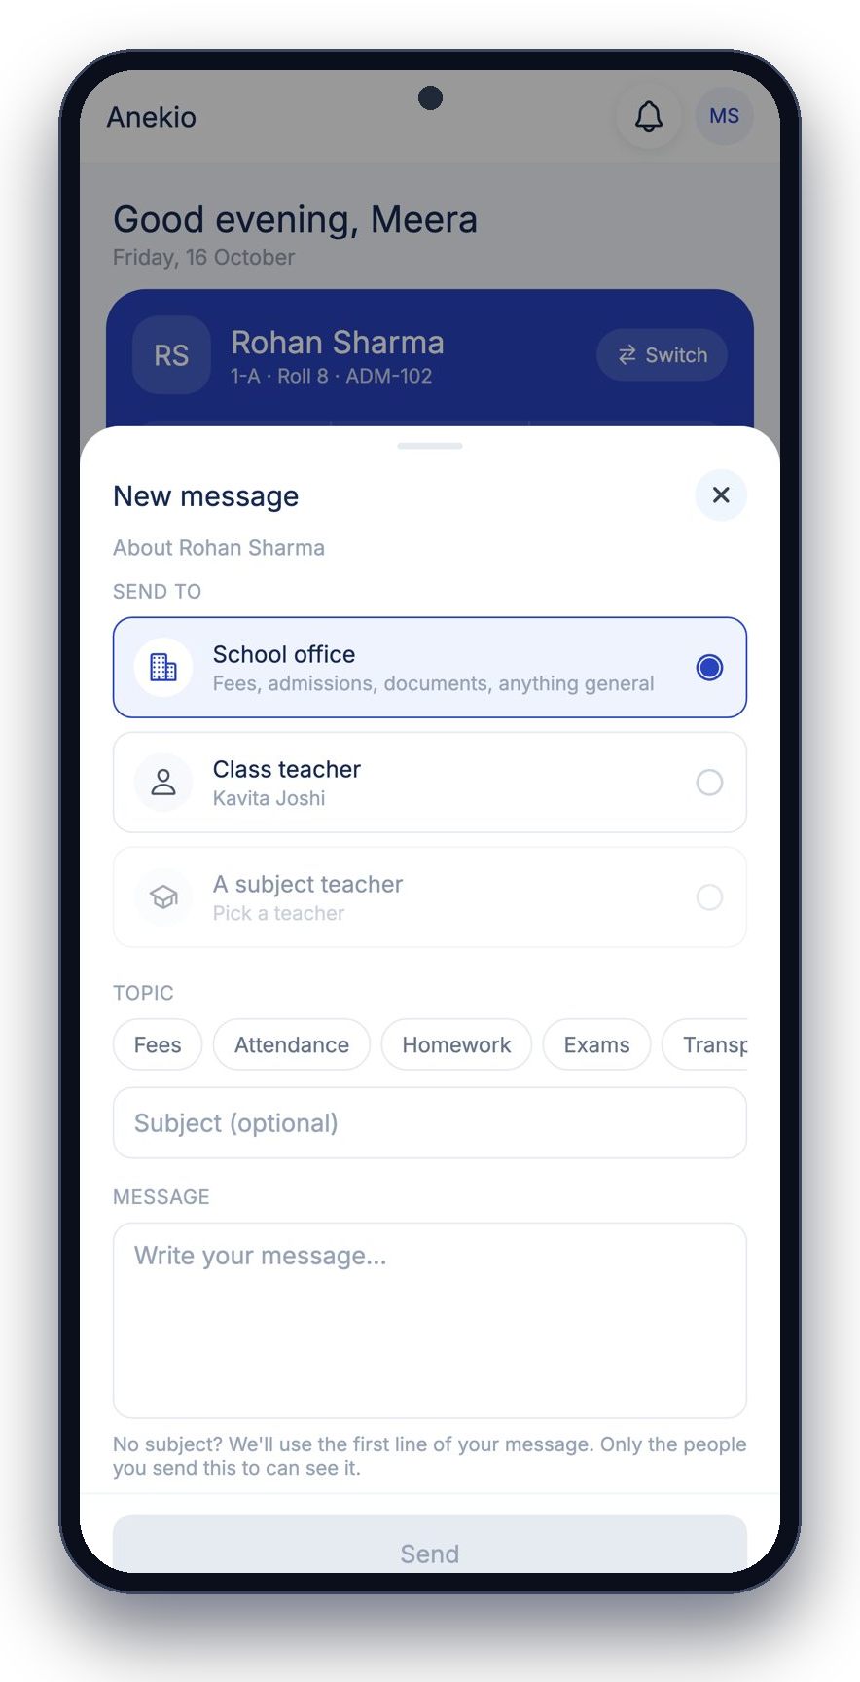
FOR PARENTS
Answers without calling the school
✓
Attendance, last result and fees due at a glance
✓
Pay now with UPI; receipts download to the phone
✓
Subject-wise marks and the report card
✓
Attendance calendar; switch between children
✓
A numbered request thread to the office or class teacher
Notes:
Parents stop calling: fees, results, attendance and notices are in the app; questions go into a tracked thread.

Slide 7
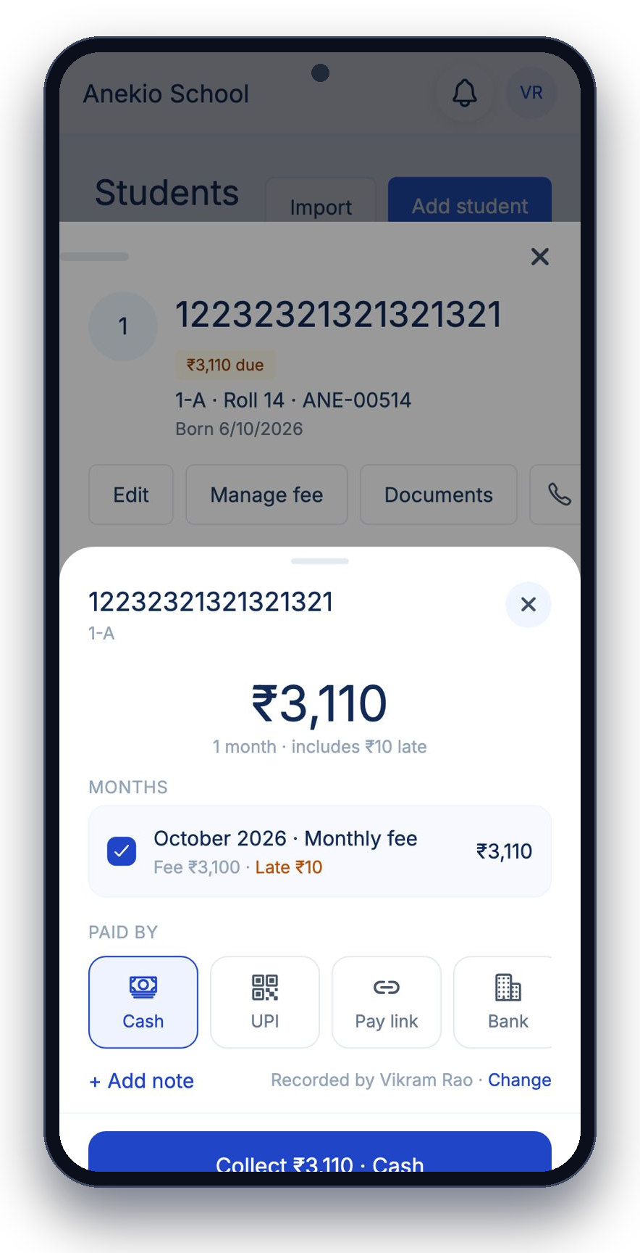
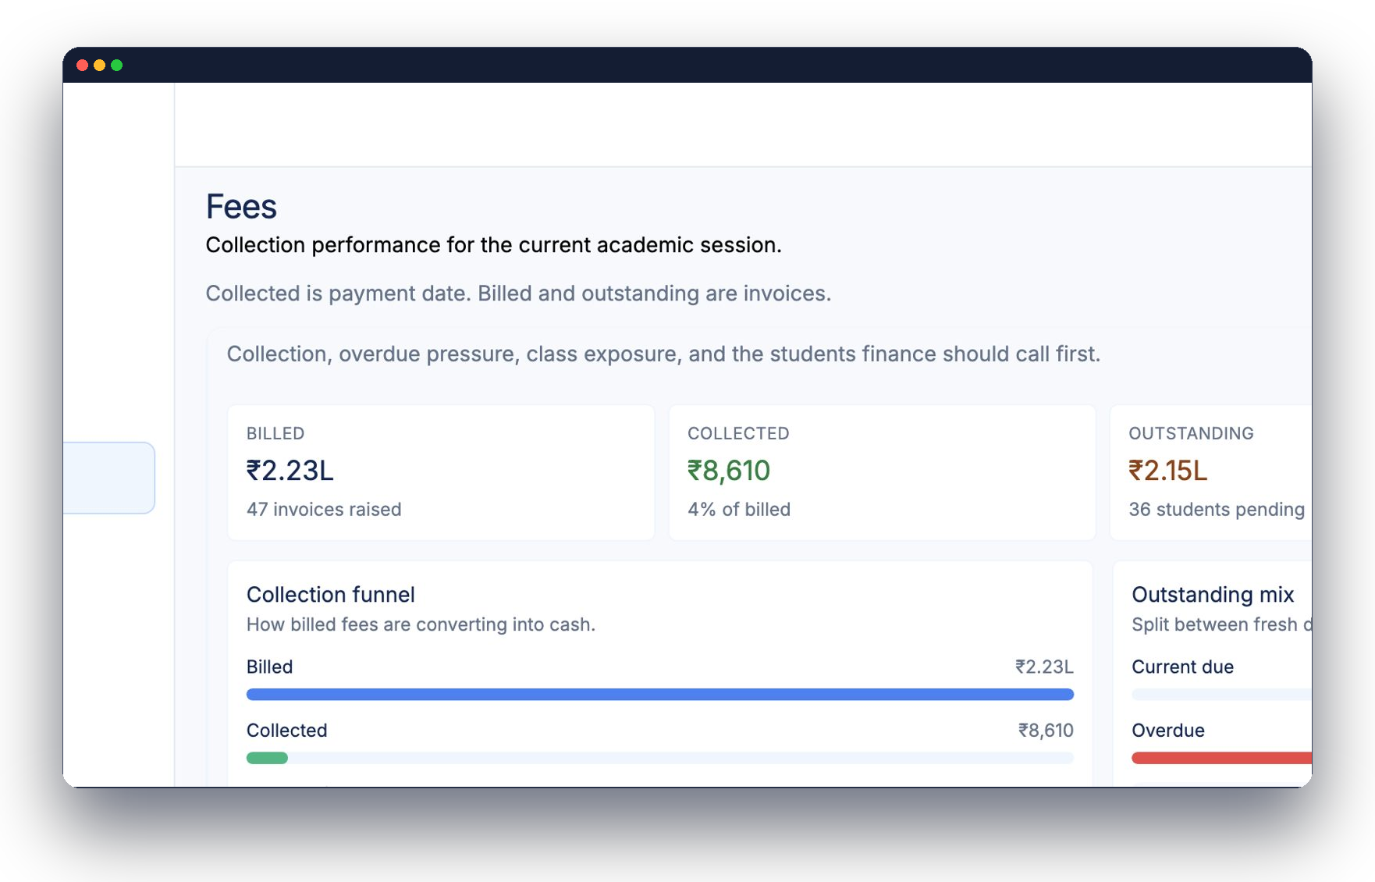
From invoice to receipt without a register
FEES & COLLECTIONS
✓
Fee structures, late rules, add-ons
✓
Billed vs collected vs outstanding
✓
Overdue list: who to call first
✓
Pay links and auto reminders
✓
Receipts with stamp, signature and QR
Notes:
Fees are the number one reason schools buy. Show the funnel: billed, collected, outstanding, and the overdue list.

Slide 8
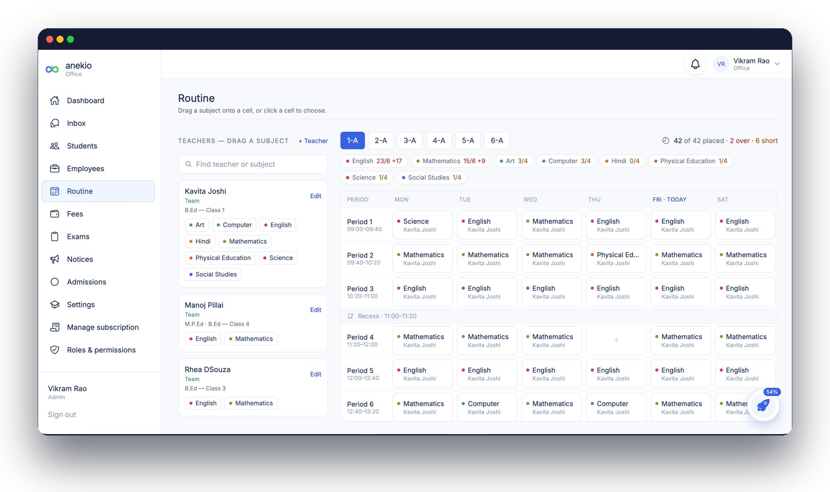
A routine that knows every teacher's day
ROUTINE & EXAMS
Routine
✓
Per-class and per-teacher views, PDF export
✓
Auto-fill empty periods from targets
✓
Substitutions when a teacher is on leave
Exams
✓
Dates and timings across classes
✓
Paper setter / checker deadlines, handover
✓
Publish once every mark is in
✓
Report cards parents can download
Notes:
The routine knows teacher load and free periods. Exams run on deadlines and publish only when complete.

Slide 9
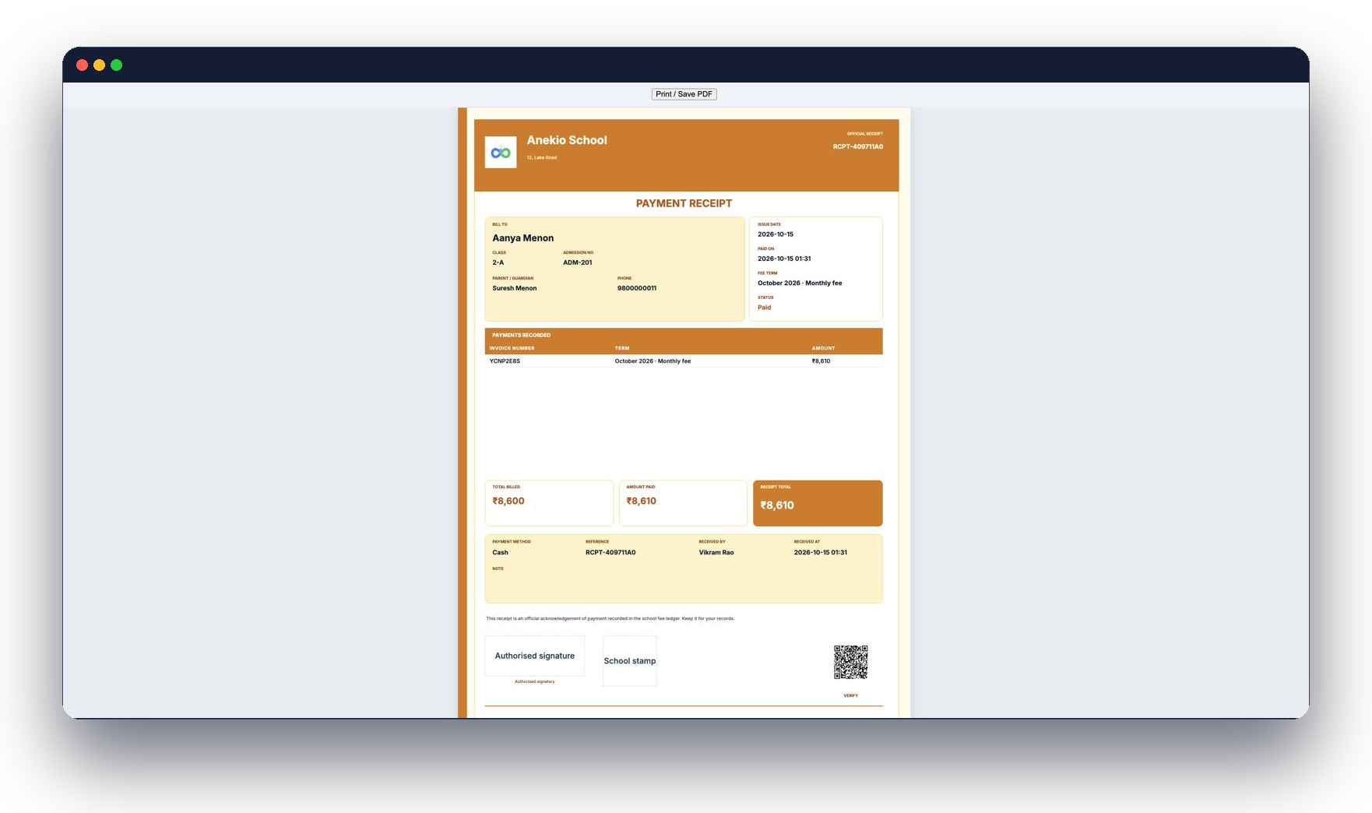
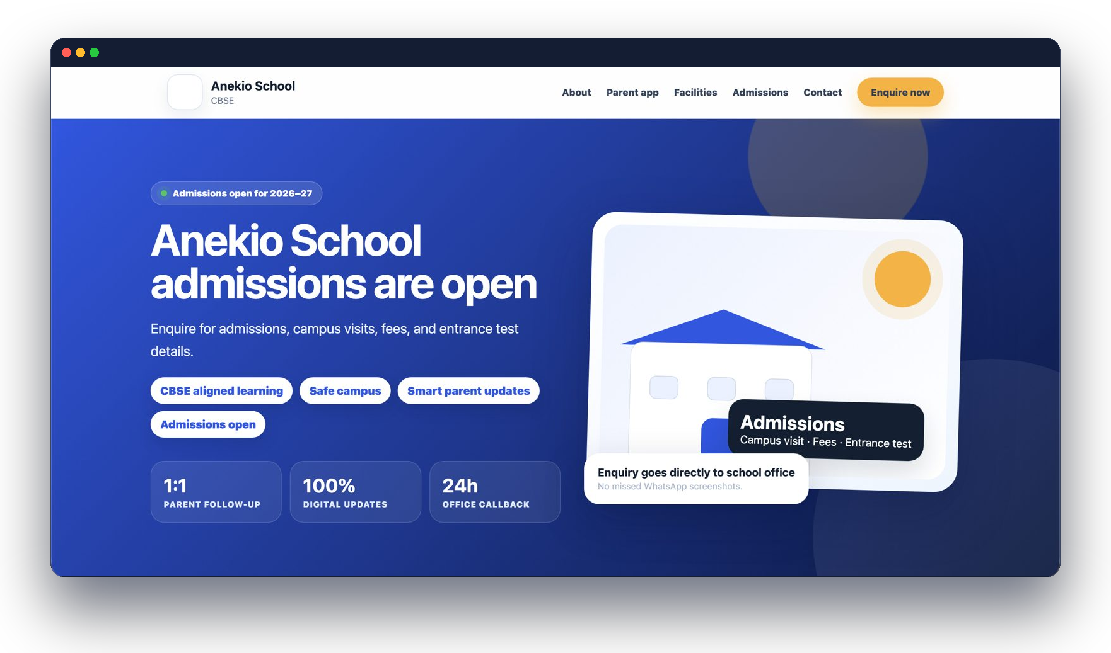
Everything looks like it came from your school
DOCUMENTS & YOUR WEBSITE
Receipts, report cards and ID cards print with your letterhead, stamp and signature.
A public school website with admissions built in — enquiries land in the office pipeline.
Notes:
Every school gets a website on its own address; admission enquiries flow straight into the CRM.

Slide 10
Modules that already know each other
EVERYTHING, CONNECTED
Admissions
Fees
Attendance
Exams
Leads, follow-ups, tests, Excel import
Invoices, UPI, receipts, reminders
Class register, QR check-in, month view
Timings, papers, marks, report cards
Routine
Parent inbox
Staff & leave
Roles
Drag-and-drop, clash detection, PDF
Request threads, notices, WhatsApp-ready
Balances, approvals, payroll with proof
Who can view or edit each area
School website
Documents
Notices
Student portal
Public site with admissions
Letterhead, stamp, signature, ID cards
Preview, then send to any group
Today, timetable, papers, fees
Notes:
Twelve modules, one record. Nothing here is a separate product to integrate.

Slide 11
Three ways to begin
GET STARTED
▶
No payment
14
Most popular
₹
Launch offer
Book a demo
Free trial
Launch now
20 minutes online. See the complete ERP on web and Android, ask questions live.
Try Anekio for 14 days with your own school data. No card needed.
Annual plan with setup support included. Pay by UPI or card.
anekio.com · support@anekio.com
Notes:
Close with the three paths. Trial is the default recommendation.

Slide 12
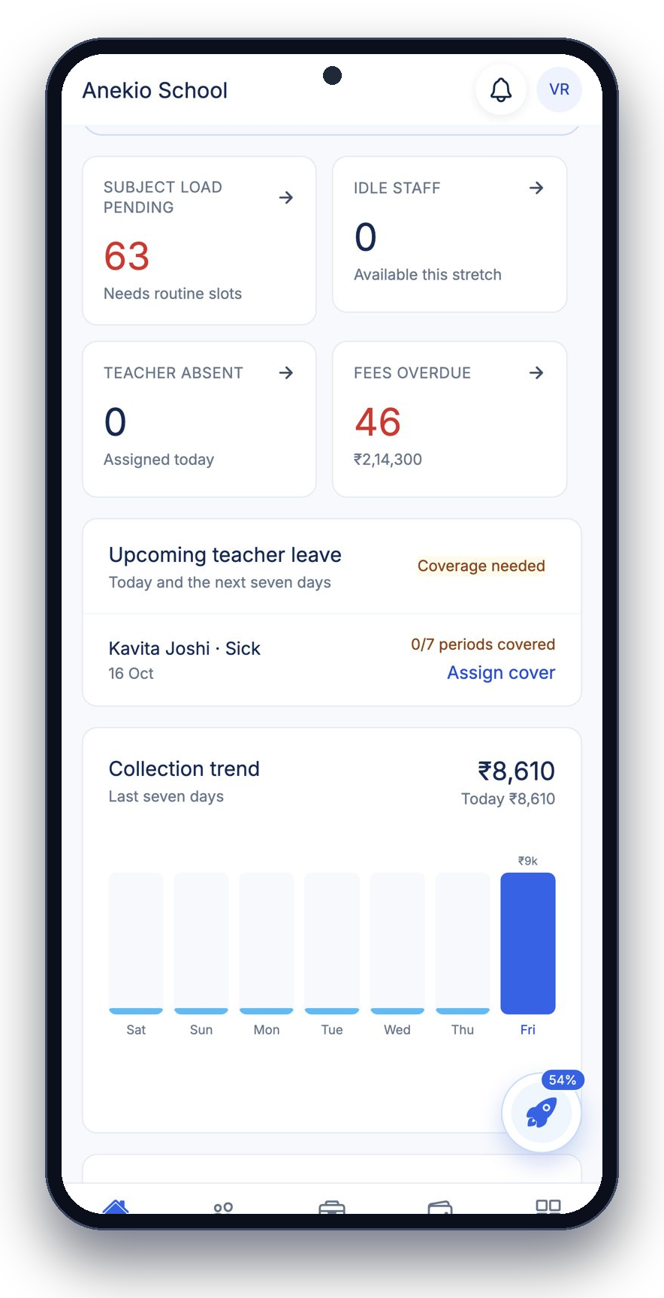
One platform.
One school record.
Every team connected.
anekio.com · support@anekio.com
Notes:
Thank you.

