Slide 1
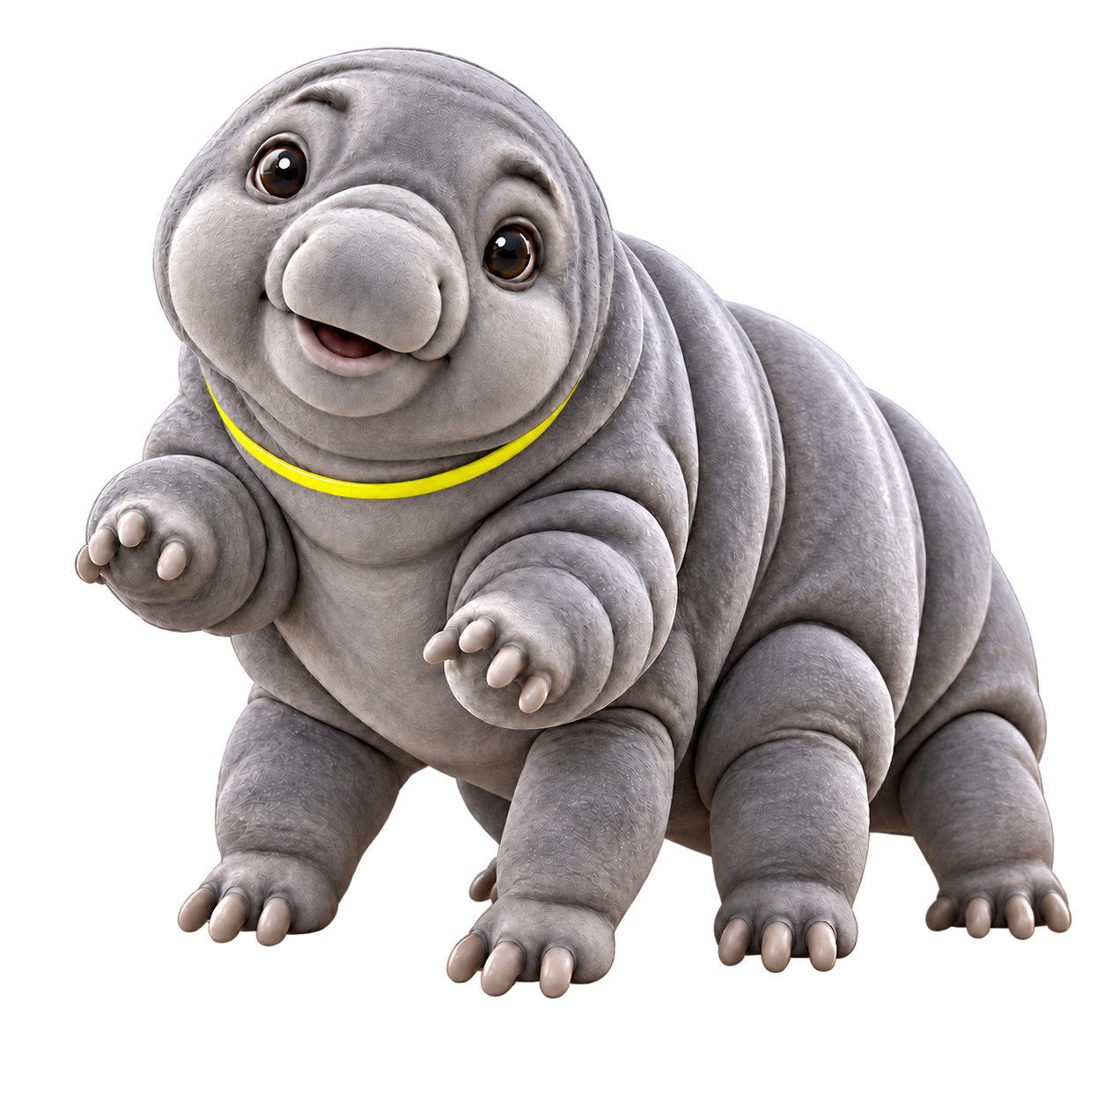
BUILDWISE MEDIA
Give AI one real
job in your
business
Meet Bob. Our team stands
behind his work.
Notes and worksheet: buildwisemedia.com/talk
Notes:
Opening for the Buildwise talk, Give AI one real job in your business. Ask the room which task keeps returning to the owner. Introduce Bob as an AI teammate with the Buildwise team checking the work. Use the companion talk notes for the 20-minute talk and 10-minute discussion. Sources: Robert-approved Bob identity and September 7, 2026 website launch plan. Bob is the approved generated character, unchanged. No live talking-Bob feature is claimed. Public materials: https://buildwisemedia.com/talk/

