Slide 1
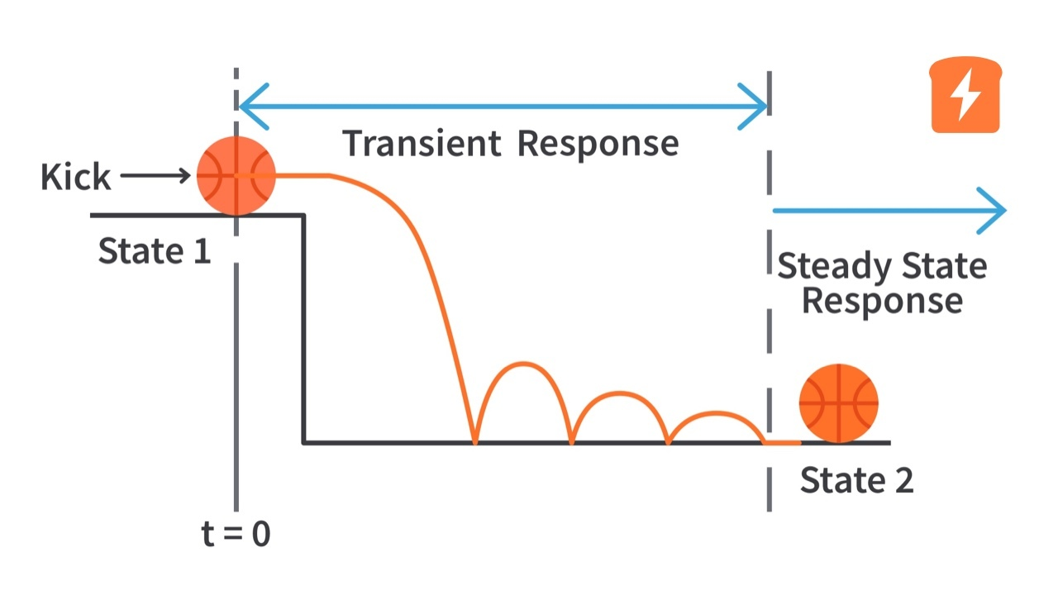
DYNAMIC CIRCUIT BEHAVIOR, OSCILLATIONS
DEPARTMENT OF ELECTRICAL AND ELECTRONIC ENGINEERING
NIGERIAN DEFENCE ACADEMY(NDA)

Slide 2
BASIC THEORY OF CAPACITORS AND INDUCTORS
A capacitor is a passive element designed to store energy in its electric field. Besides resistors, capacitors are the most common electrical components.
Notes:
Capacitors are used extensively in electronics, communications, computers, and power systems.
For example, they are used in the tuning circuits of radio receivers and as dynamic memory elements in computer systems.

Slide 3

BASIC THEORY OF CAPACITORS AND INDUCTORS
Capacitance is the ratio of Charge per plate and Voltage applied
C = q/v………. (1)
But it doesn’t depend on charge and voltage but
the physical dimension of the capacitor, so
Where A = Surface Area of each plate, d = Distance
between the plated and Є = Permittivity of free
space

Slide 4
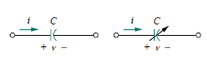
BASIC THEORY OF CAPACITORS AND INDUCTORS
Circuit symbols shows the fixed and variable capacitors.
To obtain the current-voltage relationship of the capacitor, we take the derivative of both sides of Eq. (1), since i = dq/dt
Differentiating both sides of eq. (1) gives
i = Cdv/dt ……… (2)

Slide 5
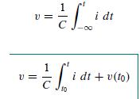

BASIC THEORY OF CAPACITORS AND INDUCTORS
The voltage-current relation of the capacitor can be obtained by integrating both sides of Eq. (2). We get

Slide 6
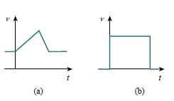
BASIC THEORY OF CAPACITORS AND INDUCTORS
A capacitor is an open circuit to dc.
The voltage on a capacitor cannot change abruptly.

Slide 7
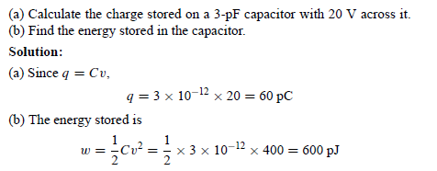

BASIC THEORY OF CAPACITORS AND INDUCTORS

Slide 8
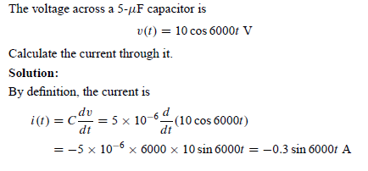
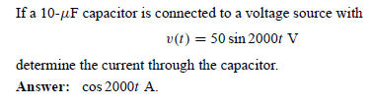
BASIC THEORY OF CAPACITORS AND INDUCTORS

Slide 9
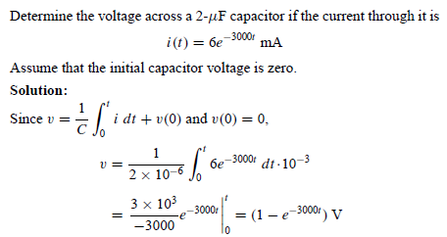

BASIC THEORY OF CAPACITORS AND INDUCTORS

Slide 10
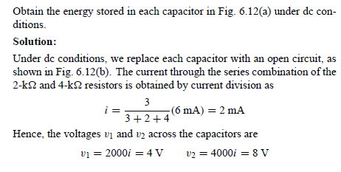
EXAMPLE 6.5

Slide 11
SERIES AND PARALLEL CAPACITORS
We know from resistive circuits that series-parallel combination is a powerful tool for reducing circuits. This technique can be extended to series parallel connections of capacitors, which are sometimes encountered. We desire to replace these capacitors by a single equivalent capacitor Ceq

Slide 12
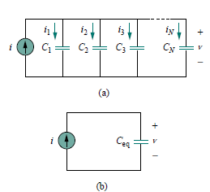
SERIES AND PARALLEL CAPACITORS
The equivalent capacitance of N parallel-connected capacitors is the sum of the individual capacitances.
Ceq = C1 + C2 + C3 +· · ·+CN

Slide 13

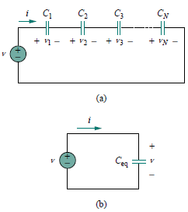
SERIES AND PARALLEL CAPACITORS
The equivalent capacitance of series connected capacitors is the reciprocal of the sum of the reciprocals of the individual capacitances

Slide 14
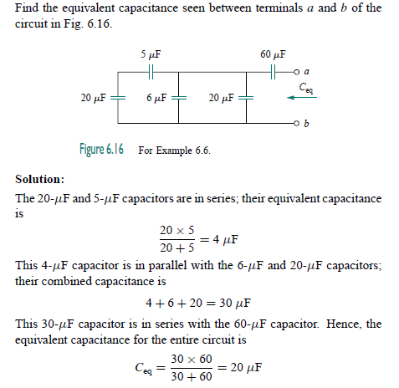
SERIES AND PARALLEL CAPACITORS

Slide 15
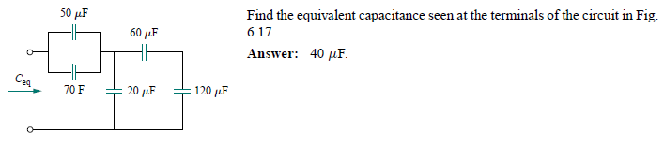
SERIES AND PARALLEL CAPACITORS

Slide 16
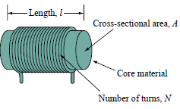
INDUCTORS
An inductor is a passive element designed to store energy in its magnetic field. Inductors find numerous applications in electronic and power systems.
They are used in power supplies, transformers, radios, TVs, radars, and electric motors.
An inductor consists of a coil of conducting wire.

Slide 17

INDUCTORS
If current is allowed to pass through an inductor, it is found that the voltage across the inductor is directly proportional to the time rate of change of the current. Using the passive sign convention,
Inductance is the property whereby an inductor exhibits opposition to the change of current flowing through it, measured in henrys (H).

Slide 18


INDUCTORS
The inductance of an inductor depends on its physical dimension and construction
where N is the number of turns, l is the length, A is the cross-sectional area, and μ is the permeability of the core.
The current-voltage relationship is obtained as

Slide 19
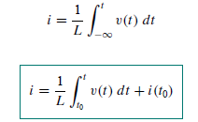
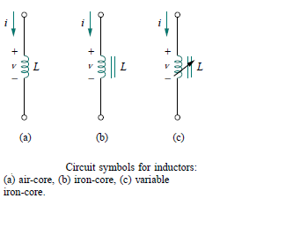
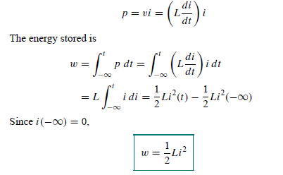
INDUCTORS
Integrating gives,

Slide 20
INDUCTORS
Note from Eq. that the voltage across an inductor is zero when the current is constant.
An inductor acts like a short circuit to dc.
An important property of the inductor is its opposition to the change in current flowing through it.
The current through an inductor cannot change instantaneously.

Slide 21
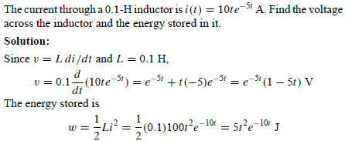

INDUCTORS

Slide 22
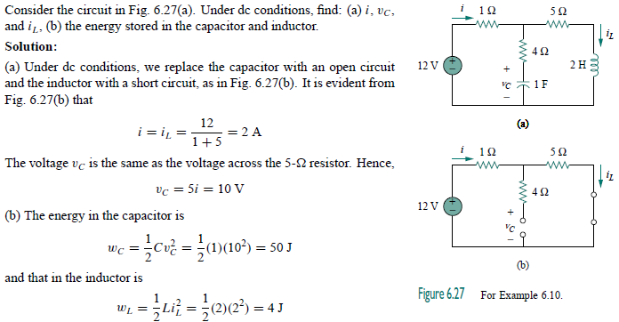
INDUCTORS

Slide 23
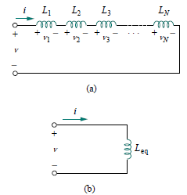

SERIES AND PARALLEL INDUCTORS
The equivalent inductance of series-connected inductors is the
sum of the individual inductances.

Slide 24
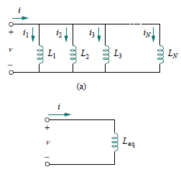

SERIES AND PARALLEL INDUCTORS
The equivalent inductance of parallel inductors is the reciprocal of the sum of the reciprocals of the individual inductances.

Slide 25
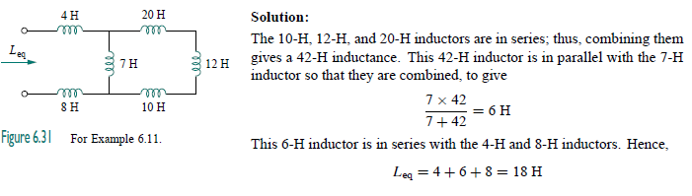
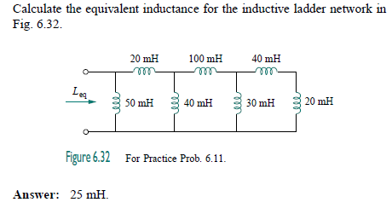
SERIES AND PARALLEL INDUCTORS

Slide 26
ELECTRICAL OSCILLATIONS LC CIRCUIT
An electronic oscillator is an electronic circuit that produces a periodic, oscillating or alternating current (AC) signal, usually a sine wave, square wave or a triangle wave, powered by a direct current (DC) source. Oscillators are found in many electronic devices, such as radio receivers, television sets, radio and television broadcast transmitter, many other devices.
Electrical oscillation refers to the periodic, repetitive variation of voltage or current in an electrical circuit. This variation, often described by a waveform, is characterized by a cyclical movement back and forth around an equilibrium point. It's a fundamental concept in electronics and communication, enabling various technologies like signal generation and device operation

Slide 27
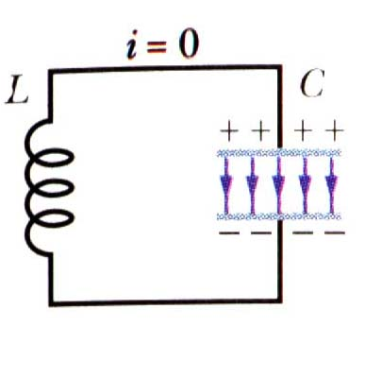
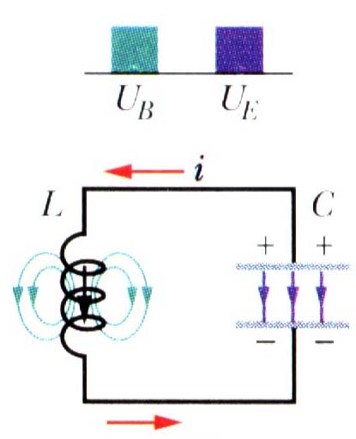
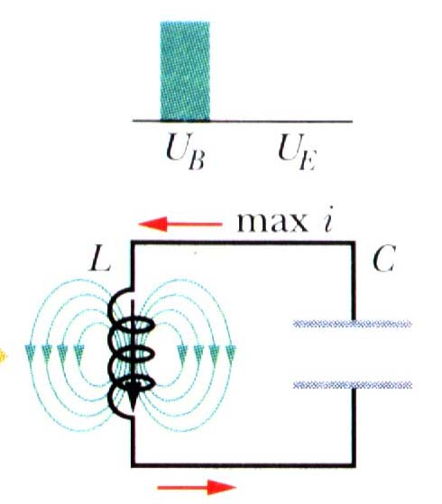
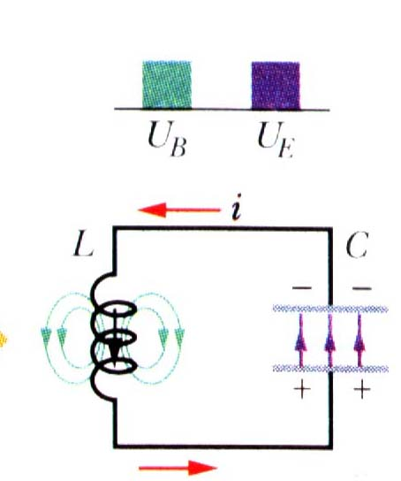
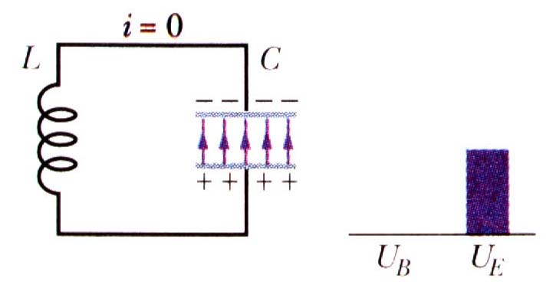
An electromagnetic oscillator
Capacitor initially charged. Initially, current is zero, energy is all stored in the capacitor.
A current gets going, energy gets split between the capacitor and the inductor.
Capacitor discharges completely, yet current keeps going. Energy is all in the inductor.
The magnetic field on the coil starts to collapse, which will start to recharge the capacitor.
Finally, we reach the same state we started with (with
opposite polarity) and the cycle restarts.

Slide 28
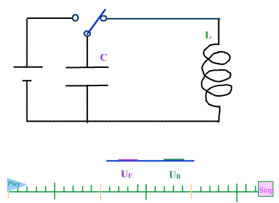

Slide 29
Electric Oscillators: the math
(the loop rule!)

Slide 30
Electric Oscillators: the math
The energy is constant and equal to what we started with.

Slide 31
Example 1 : tuning a radio receiver
FM radio stations: frequency
is in MHz.
The inductor and capacitor in my car radio are usually set at L = 1 mH & C = 3.18 pF. Which is my favorite FM station?
(a) QLSU 91.1
(b) WRKF 89.3
(c) Eagle 98.1 WDGL

Slide 32
Example 2
In an LC circuit, L = 40 mH; C = 4 μF
At t = 0, the current is a maximum;
When will the capacitor be fully charged for the first time?
ω = 2500 rad/s
T = period of one complete cycle
= 2π/ω = 2.5 ms
Capacitor will be charged after 1/4 cycle i.e at t = 0.6 ms

Slide 33
Example 4
In an LC circuit, the maximum current is 1.0 A.
If L = 1mH, C = 10 μF what is the maximum charge on the capacitor during a cycle of oscillation?
Maximum current is i₀=ωq₀ → q₀=i₀/ω
Angular frequency ω=1/√LC=(1mH 10 μF)^{-1/2} = (10⁻⁸)^{-1/2} = 10⁴ rad/s
Maximum charge is q₀=i₀/ω = 1A/10⁴ rad/s = 10⁻⁴ C

Slide 34
Damped LC Oscillator
Ideal LC circuit without resistance: oscillations go on for ever; ω = (LC)^{-1/2}
Real circuit has resistance, dissipates energy: oscillations die out, or are “damped”
Math is complicated! Important points:
  Frequency of oscillator shifts away from ω = (LC)^{-1/2}
  Peak CHARGE decays with time constant = 2L/R
  For small damping, peak ENERGY decays with time constant = L/R
C
L
R

Slide 35
ASSIGNMENT
Write short note on two RC (2) and two (2) RL oscillators.

Slide 36
Summary
Capacitor and inductor combination produces an electrical oscillator natural frequency of oscillator is ω=1/√LC
Total energy in circuit is conserved: switches between capacitor (electric field) and inductor (magnetic field).
If a resistor is included in the circuit, the total energy decays (is dissipated by R).

Slide 37
TRANSIENT
ASSIGNMENT
What is Transient?
Why Transient ?

Slide 38
First-Order Circuits
A circuit that contains only sources, resistors and an inductor is called an RL circuit.
A circuit that contains only sources, resistors and a capacitor is called an RC circuit.
RL and RC circuits are called first-order circuits because their voltages and currents are described by first-order differential equations.
R
R
i
i
v_{s}
–
+
L
v_{s}
–
+
C

Slide 39
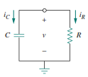
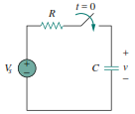
RESPONSE OF RC CIRCUIT
Source free response of RC circuit.
Forced response of RC circuit.

Slide 40
SOURCE FREE RC CIRCUITS
A source-free RC circuit occurs when its dc source is suddenly disconnected.
The energy already stored in the capacitor is released to the resistors

Slide 41

SOURCE FREE RC CIRCUITS
We assume to be the voltage v(t) across the capacitor. Since the capacitor is initially charged, we can assume that at time t = 0, the initial voltage is
With the corresponding value of the energy stored as
Applying KCL at the top node of the circuit in Figure

Slide 42
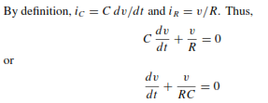
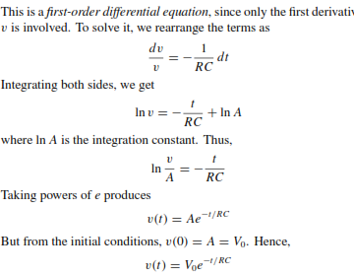
SOURCE FREE RC CIRCUITS

Slide 43
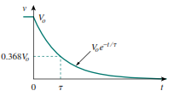
SOURCE FREE RC CIRCUITS
The natural response of a circuit refers to the behavior (in terms of voltages and currents) of the circuit itself, with no external sources of excitation.
The time constant of a circuit is the time required for the response to decay by a factor of 1/e or 36.8 percent of its initial value.

Slide 44
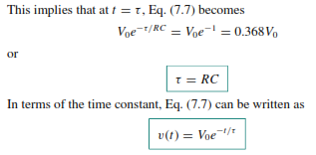
SOURCE FREE RC CIRCUITS

Slide 45



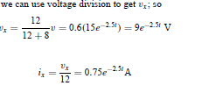
EXAMPLE
let vc(0)=15v, find vc, vx and ix

Slide 46
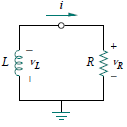
SOURCE FREE RL CIRCUITS
Consider the series connection of a resistor and an inductor, as shown in Figure

Slide 47
SOURCE FREE RL CIRCUITS
In order to determine the circuit response, which we will assume to be the current i(t) through the inductor. Select the inductor current as the response in order to take advantage of the idea that the inductor current cannot change instantaneously.
At t = 0, we assume that the inductor has an initial current I0, or

Slide 48



SOURCE FREE RL CIRCUITS
Corresponding energy stored in inductor as
Apply KVL in the loop as,
But, So above equation becomes

Slide 49

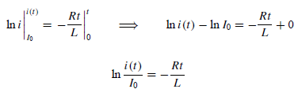
SOURCE FREE RL CIRCUITS
Rearranging and integrating terms gives
Taking the power of e we have
This shows that the natural response of the RL circuit is an exponential decay of the initial current

Slide 50
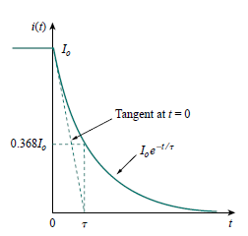
SOURCE FREE RL CIRCUITS
The current response of source free RL circuit is

Slide 51

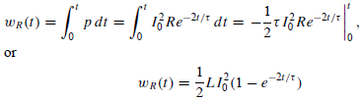
SOURCE FREE RL CIRCUITS
Voltage across the resistor can be find out as
Power dissipated across the resistor as
The energy absorbed by the resistor is

Slide 52



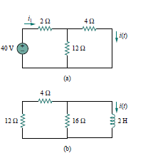


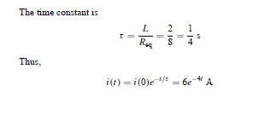
example

Slide 53
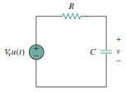
Forced response of an RC circuit
When the dc source of an RC circuit is suddenly applied, the voltage or current source can be modeled as a step function, and the response is known as a step response.
The step response of a circuit is its behavior when the excitation is the step function, which may be a voltage or a current source.

Slide 54

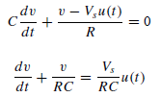
Forced response of an RC circuit
Where v(0−) is the voltage across the capacitor just before switching and v(0+) is its voltage immediately after switching. Applying KCL, we have
where v is the voltage across the capacitor. For t > 0

Slide 55
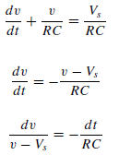
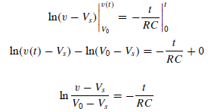
Forced response of an RC circuit
Integrating both sides and introducing the initial conditions,

Slide 56
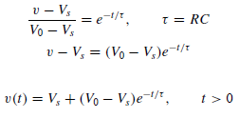

Forced response of an RC circuit
Taking the exponential of both sides
Thus,

Slide 57
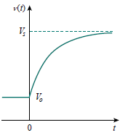

Forced response of an RC circuit
This is known as the complete response of the RC circuit to a sudden application of a dc voltage source, assuming the capacitor is initially charged. Assuming that Vs > V0, a plot of v(t) is shown in Fig.
If we assume that the capacitor is uncharged initially, we set V0 = 0

Slide 58

Forced response of an RC circuit
This is the complete step response of the RC circuit when the capacitor is initially uncharged. The current through the capacitor is obtained from

Slide 59
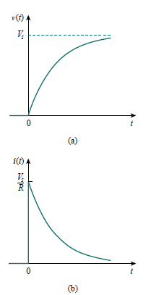
Forced response of an RC circuit
Step response of an RC circuit with initially uncharged capacitor:
(a) voltage response, (b) current response.
“ The natural response or transient response is the circuit’s temporary response that will die out with time “
“ The forced response or steady-state response is the behavior of the circuit a long time after an external excitation is applied “
The complete response of the circuit is the sum of the natural response
and the forced response.

Slide 60
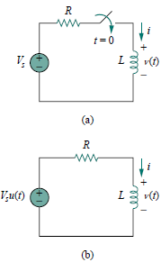

Forced response of an RL circuit
Let the response be the sum of the natural current and the forced current,
i = in + if
We know that the natural response is always a decaying exponential, that is,

Slide 61



Forced response of an RL circuit

Slide 62



Forced response of an RL circuit
Thus at t = 0,
Submitting the value of A in I gives,
This is the complete response of RL circuit

Slide 63
What is second order?
Circuits containing two storage elements.
Second-order circuit may have two storage elements of different type or the same type

Slide 64


SOURCE FREE SERIES RLC CIRCUITS
Consider the series RLC circuit shown in Figure. The circuit is being excited by the energy initially stored in the capacitor and inductor.
The energy is represented by the initial capacitor voltage Vo and initial inductor current Io. Thus, at t = 0,

Slide 65


SOURCE FREE SERIES RLC CIRCUITS
Applying KVL around the loop,
To eliminate the integral, differentiate with respect to t.
This is a second-order differential equation and is the reason for calling the RLC circuits in this chapter second-order circuits.

Slide 66

SOURCE FREE SERIES RLC CIRCUITS
To solve such a second-order differential equation requires that we have two initial conditions, such as the initial value of i and its first derivative or initial values of some i and v.
Let,
Put the value of i in 2nd order differential equation

Slide 67


SOURCE FREE SERIES RLC CIRCUITS
Above quadratic equation is called the characteristics equation of 2nd order differential equation.

Slide 68



SOURCE FREE SERIES RLC CIRCUITS
Solving quadratic equation gives
More simplified way to expressing the roots is
Where

Slide 69
SOURCE FREE SERIES RLC CIRCUITS
The roots s1 and s2 are called natural frequencies, measured in nepers per second (Np/s), because they are associated with the natural response of the circuit; ω0 is known as the resonant frequency or strictly as the undamped natural frequency, expressed in radians per second (rad/s); and α is the neper frequency or the damping factor, expressed in nepers per second.

Slide 70

SOURCE FREE SERIES RLC CIRCUITS
In terms of α and ω0, Eq. can be written as
Therefore complete response will be

Slide 71

SOURCE FREE SERIES RLC CIRCUITS

Slide 72

OVERDAMPED RESPONSE

Slide 73

CRITICALLY DAMPED RESPONSE

Slide 74

UNDER DAMPED RESPONSE

Slide 75
Example

Slide 76
Solution

Slide 77

EXAMPLE

Slide 78





SOLUTION

