Slide 1

Notes:
Welcome everyone. Today our group presents Week 11: metal–semiconductor interfaces. Every semiconductor device must be connected to the outside world with metal, and what happens where the metal touches the semiconductor decides whether the contact behaves like a diode or like a plain wire. By the end you should be able to draw the band diagrams of both kinds of contact and answer examination question 49.

Slide 2

Notes:
These are the six things you should be able to do at the end. Objectives 3, 4 and 5 are the heart of the topic, and objective 6 is examination question 49, which we solve at the end.

Slide 3
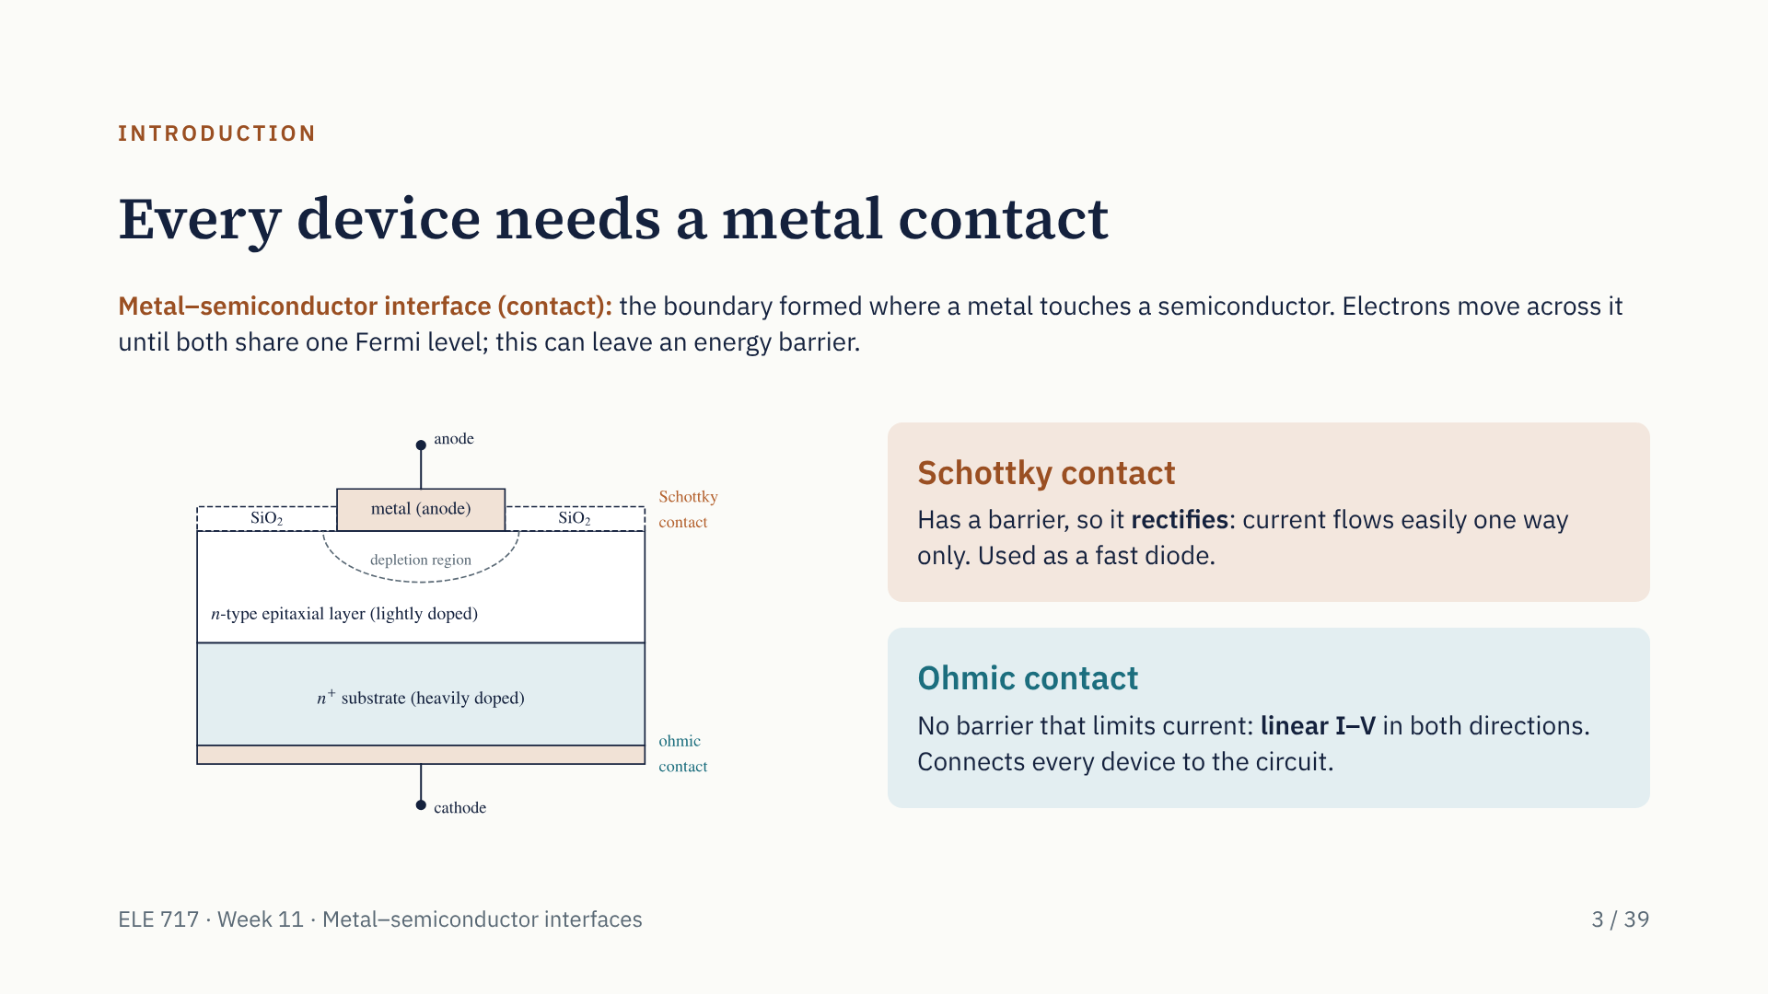
Notes:
When a metal touches a semiconductor, electrons move between them until one Fermi level runs through both. That can leave an energy barrier at the interface. If there is a barrier, the contact rectifies: that is a Schottky contact, named after Walter Schottky, who explained it with Nevill Mott in 1938–39. If there is no barrier that limits the current, the contact is ohmic. A real Schottky diode, shown here, has both: the rectifying contact on top on lightly doped n-type silicon, and an ohmic contact underneath on the heavily doped n-plus substrate.

Slide 4
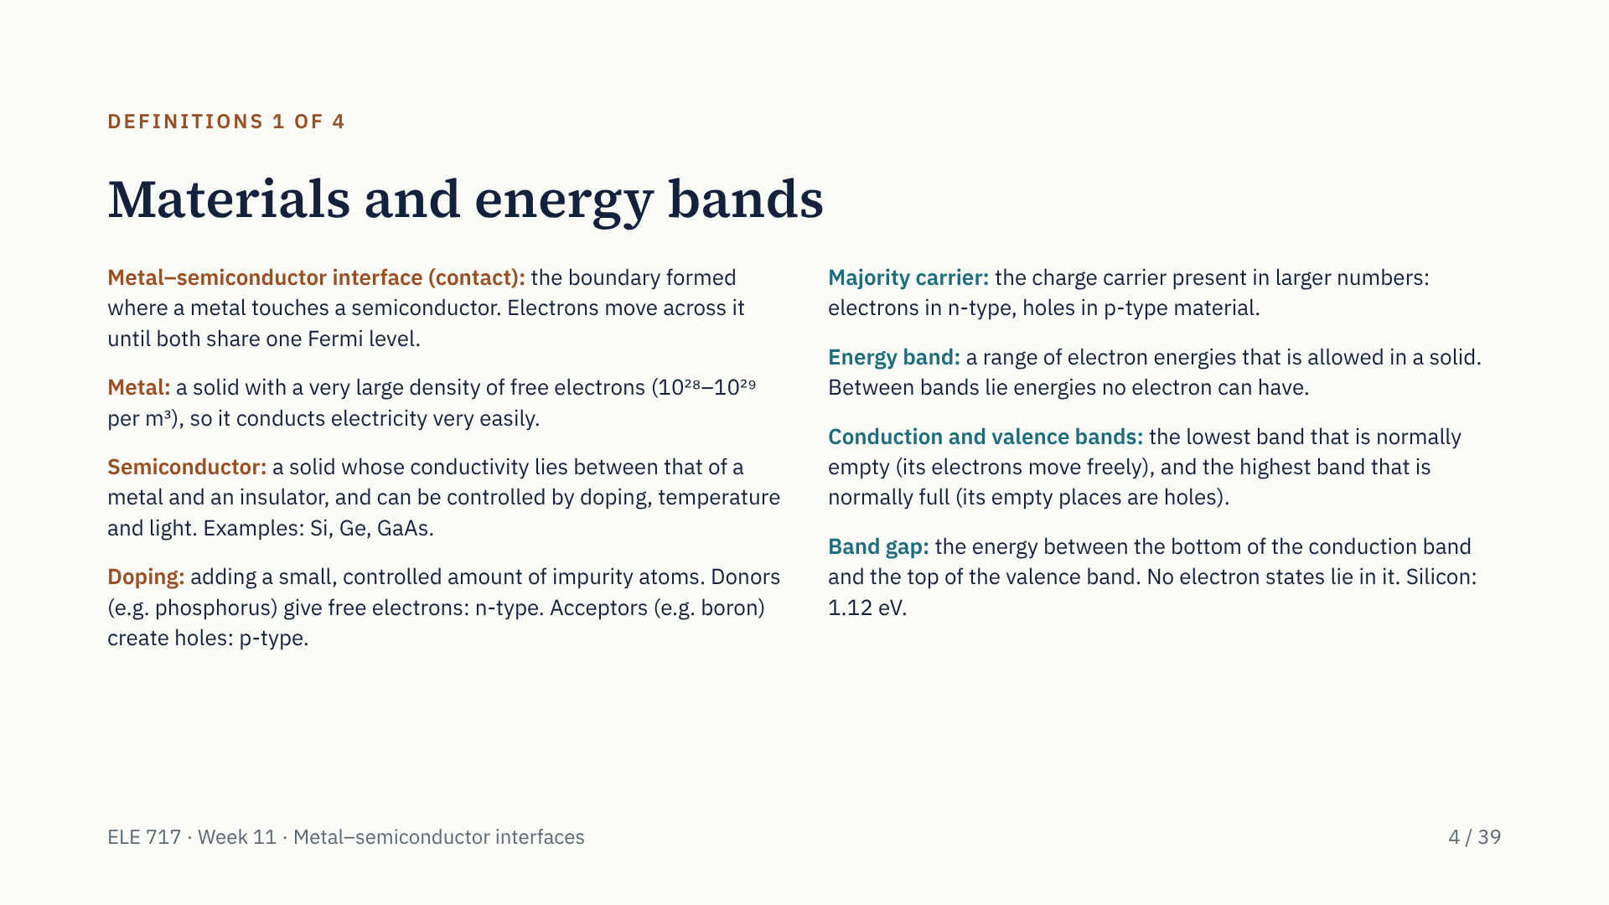
Notes:
These four slides define every concept used in the talk, so anyone can follow. Start with the interface itself: the boundary where a metal touches a semiconductor. Electrons move across it until the two share a single Fermi level. A metal has an enormous number of free electrons; a semiconductor's conductivity is controlled by doping. Donors give electrons and make n-type material; acceptors give holes and make p-type. Electrons in a solid can only have energies inside allowed bands. The conduction band is normally empty and the valence band normally full; the gap between them, 1.12 eV in silicon, has no electron states.

Slide 5
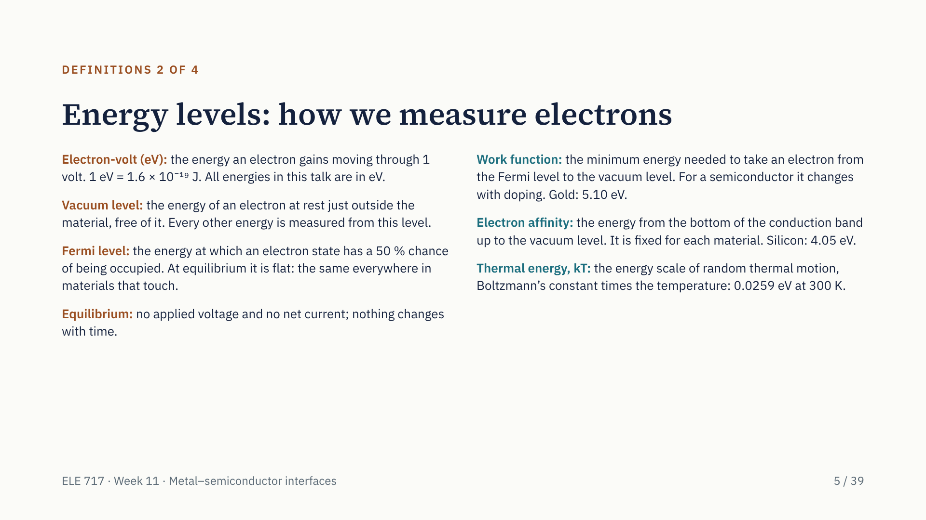
Notes:
Energies are given in electron-volts. The vacuum level is our zero: an electron at rest just outside the material. The Fermi level is the 50 percent occupation level, and the key rule of the topic is that at equilibrium it is flat. The work function is the energy from the Fermi level up to the vacuum level; the electron affinity is from the bottom of the conduction band up to the vacuum level. The difference matters: doping moves the Fermi level, so it changes the semiconductor's work function but not its electron affinity. kT, 0.0259 eV at room temperature, is the yardstick for whether a barrier is large.

Slide 6
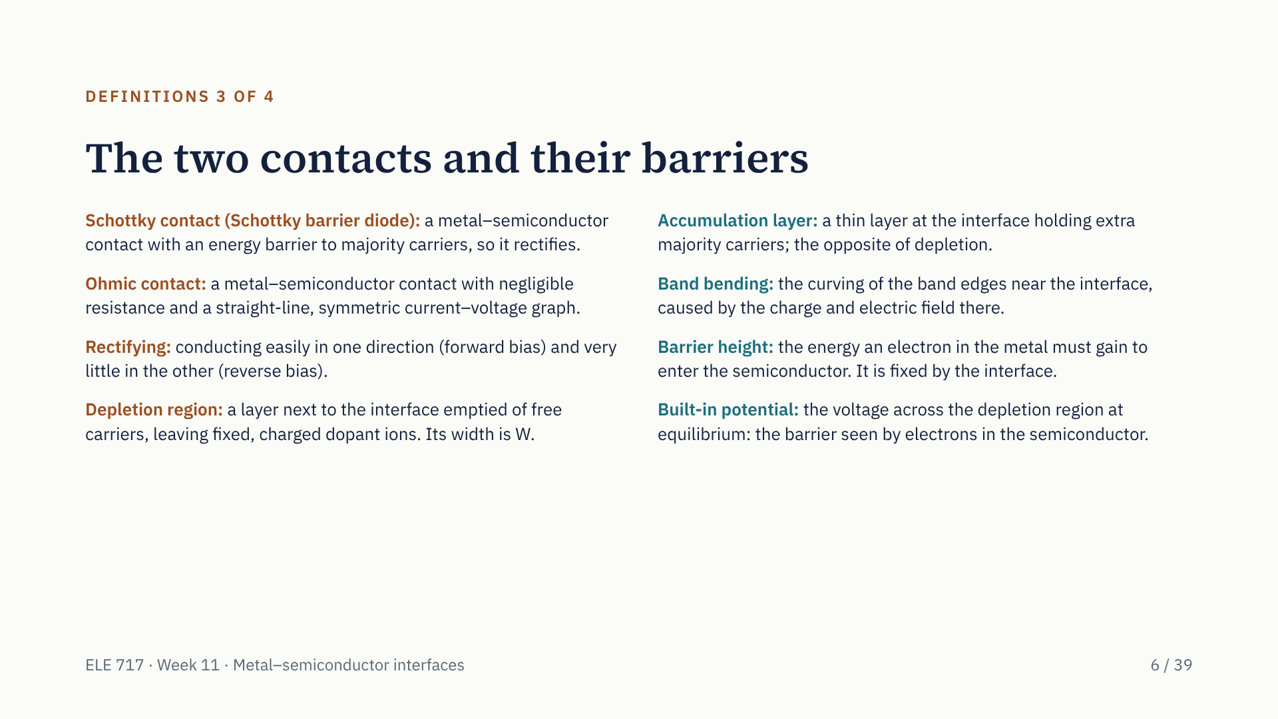
Notes:
The two kinds of contact. A Schottky contact has a barrier to majority carriers, so it rectifies: current flows easily one way only. An ohmic contact has negligible resistance and a straight-line I–V graph. A depletion region is a layer with no free carriers, only fixed ions; an accumulation layer is the opposite, with extra carriers. Band bending is how the band edges curve near the interface. There are two barriers to keep apart: the barrier height, seen by electrons in the metal and fixed by the interface; and the built-in potential, seen by electrons in the semiconductor.

Slide 7
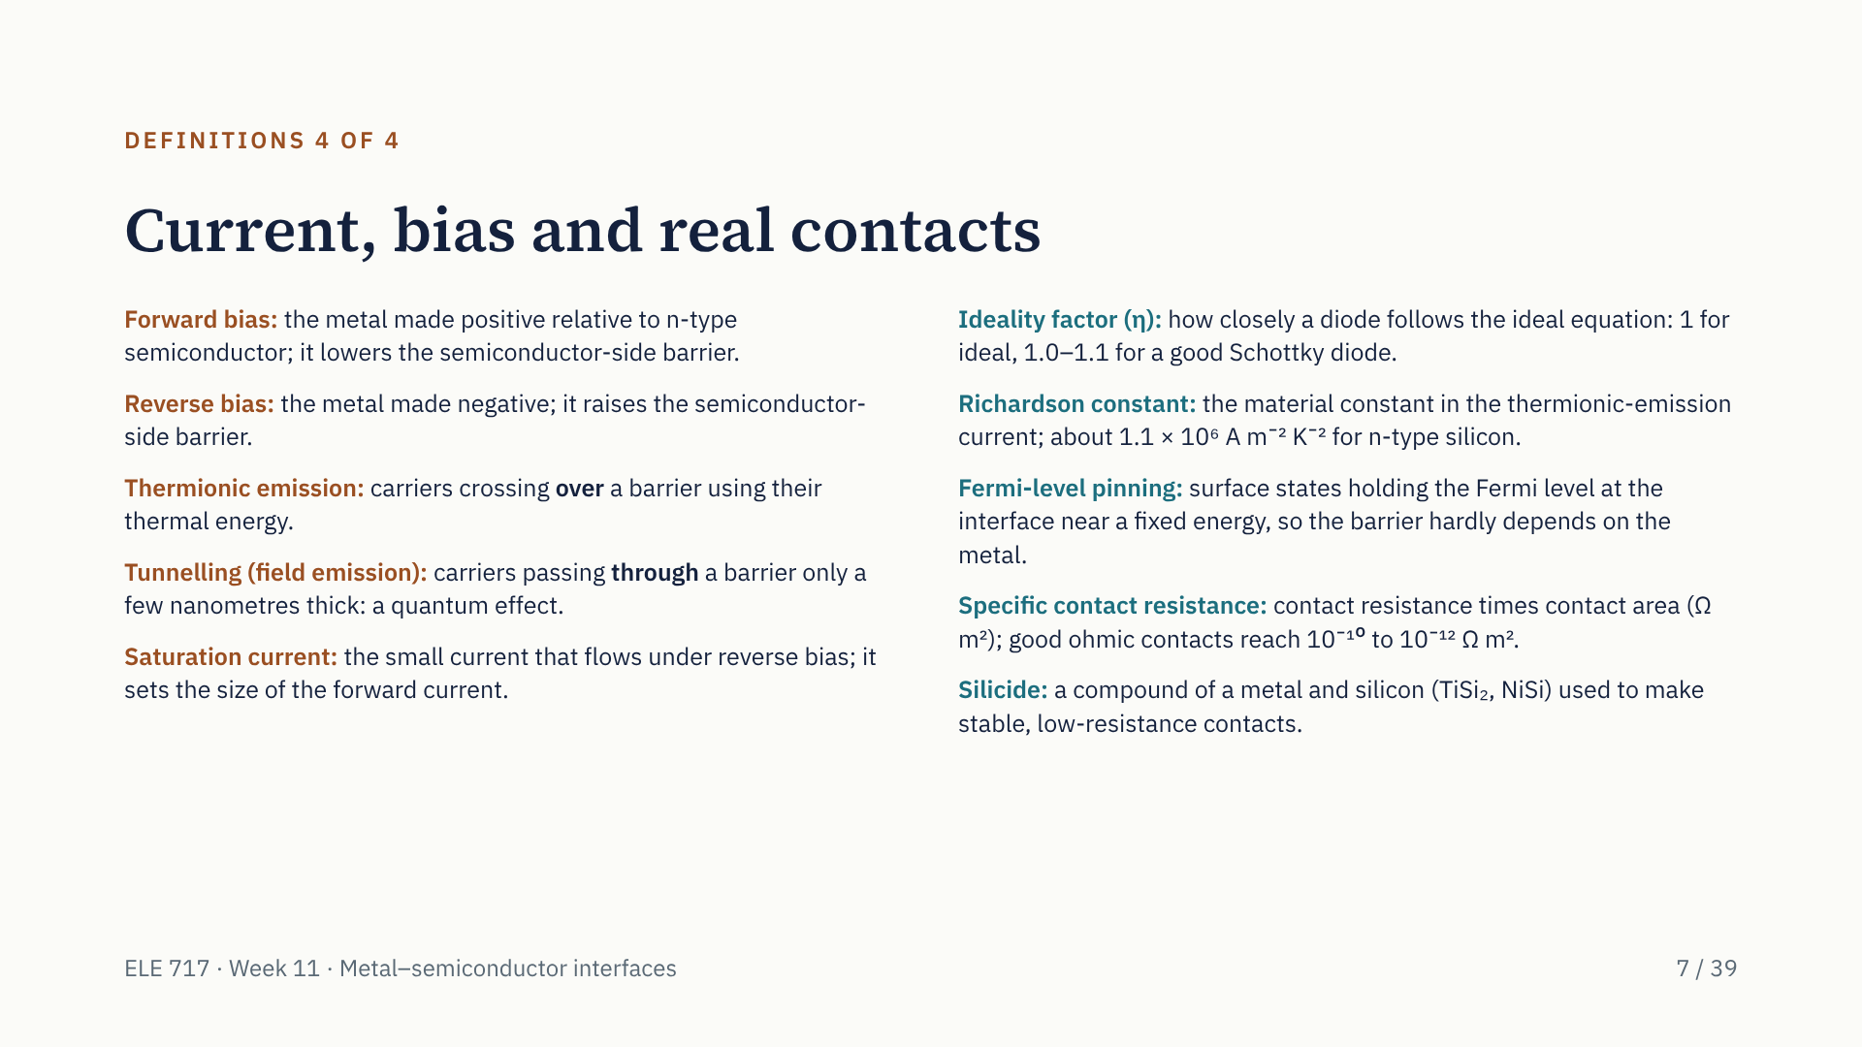
Notes:
Last set of definitions. Forward bias makes the metal positive on n-type silicon and lowers the barrier from the semiconductor side; reverse bias does the opposite. Carriers cross a barrier either over it, thermionic emission, or through it, tunnelling. The saturation current is the small reverse current, and the ideality factor tells us how ideal a diode is. The Richardson constant appears in the current equation. Fermi-level pinning explains why real barrier heights hardly depend on the metal. Ohmic contacts are rated by their specific contact resistance, and silicides are the compounds used to make good ones on silicon.

Slide 8
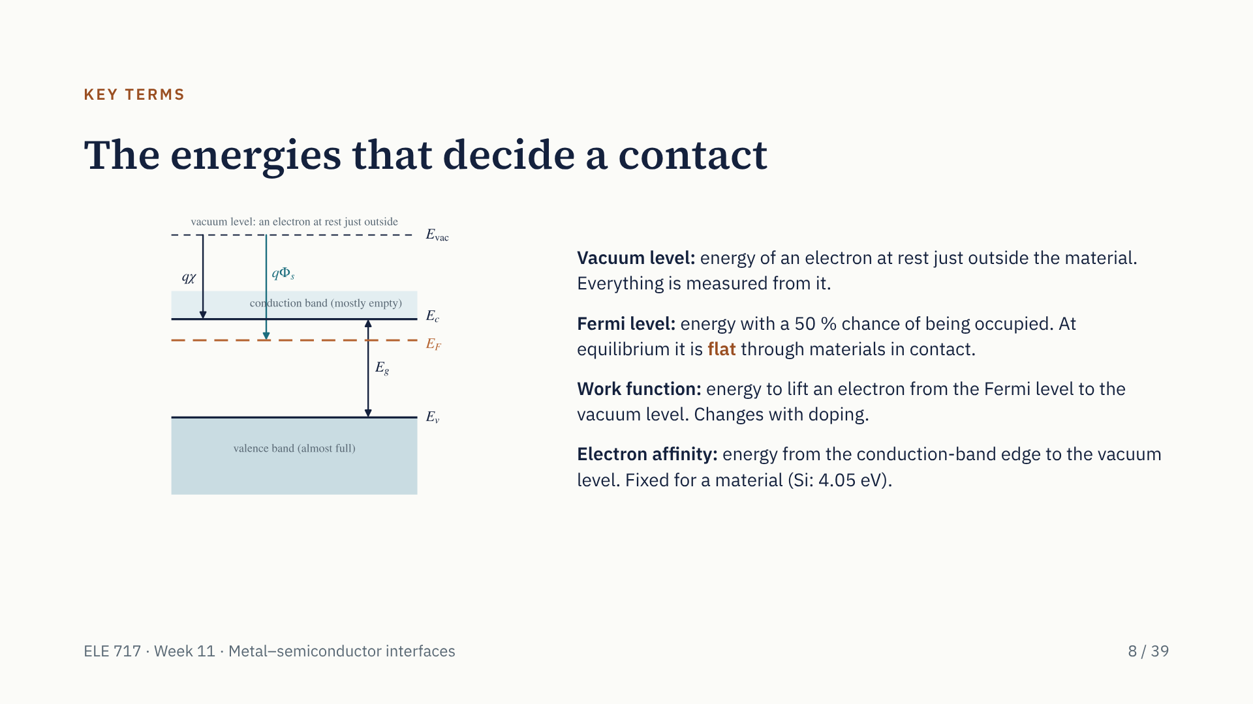
Notes:
Four energies decide what kind of contact we get. The vacuum level is our reference. The Fermi level is the 50 percent occupation level; the single most important rule today is that at equilibrium it is flat. The work function is measured from the Fermi level up to the vacuum level, so it changes when doping moves the Fermi level. The electron affinity is measured from the conduction-band edge, so it is fixed for a material: 4.05 eV for silicon. Note the conduction band starts at E_c and goes up; it is not a block reaching all the way to the vacuum level.

Slide 9
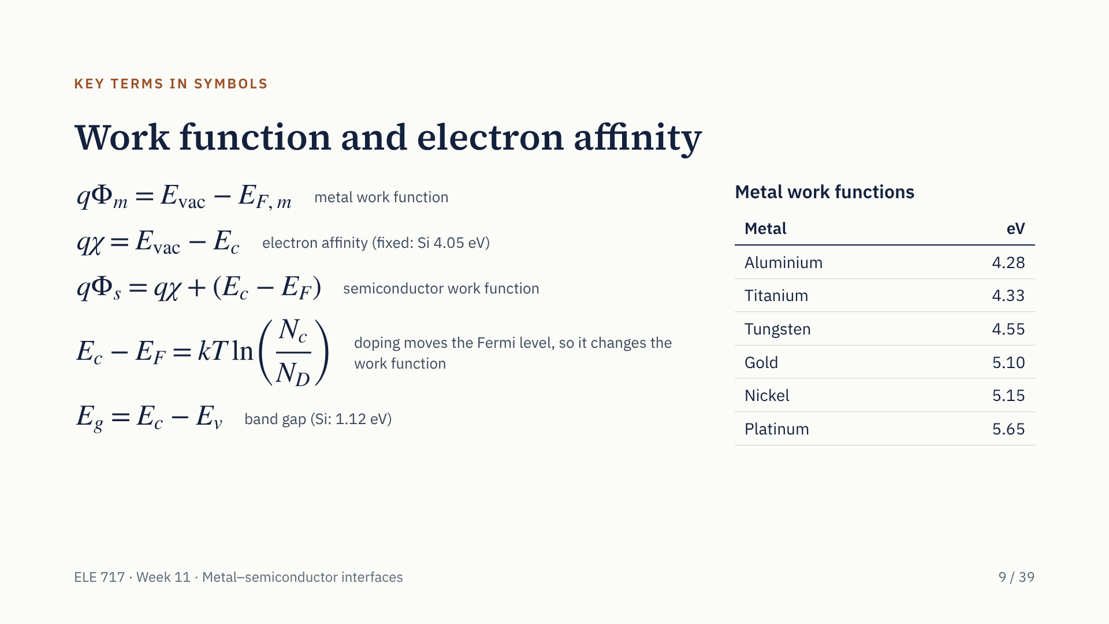
Notes:
Here are the same ideas as equations. q times phi m is the metal work function: vacuum level minus the metal's Fermi level. q chi is the electron affinity: vacuum level minus the conduction-band edge. The semiconductor work function is the electron affinity plus the gap between E_c and the Fermi level, and that gap depends on doping through E_c minus E_F equals kT ln of N_c over N_D. For n-type silicon with 10 to the 22 donors per cubic metre this gap is 0.205 eV, so the work function is 4.26 eV. Note the band gap is E_c minus E_v, not the other way round. The table gives the metals we will use.

Slide 10
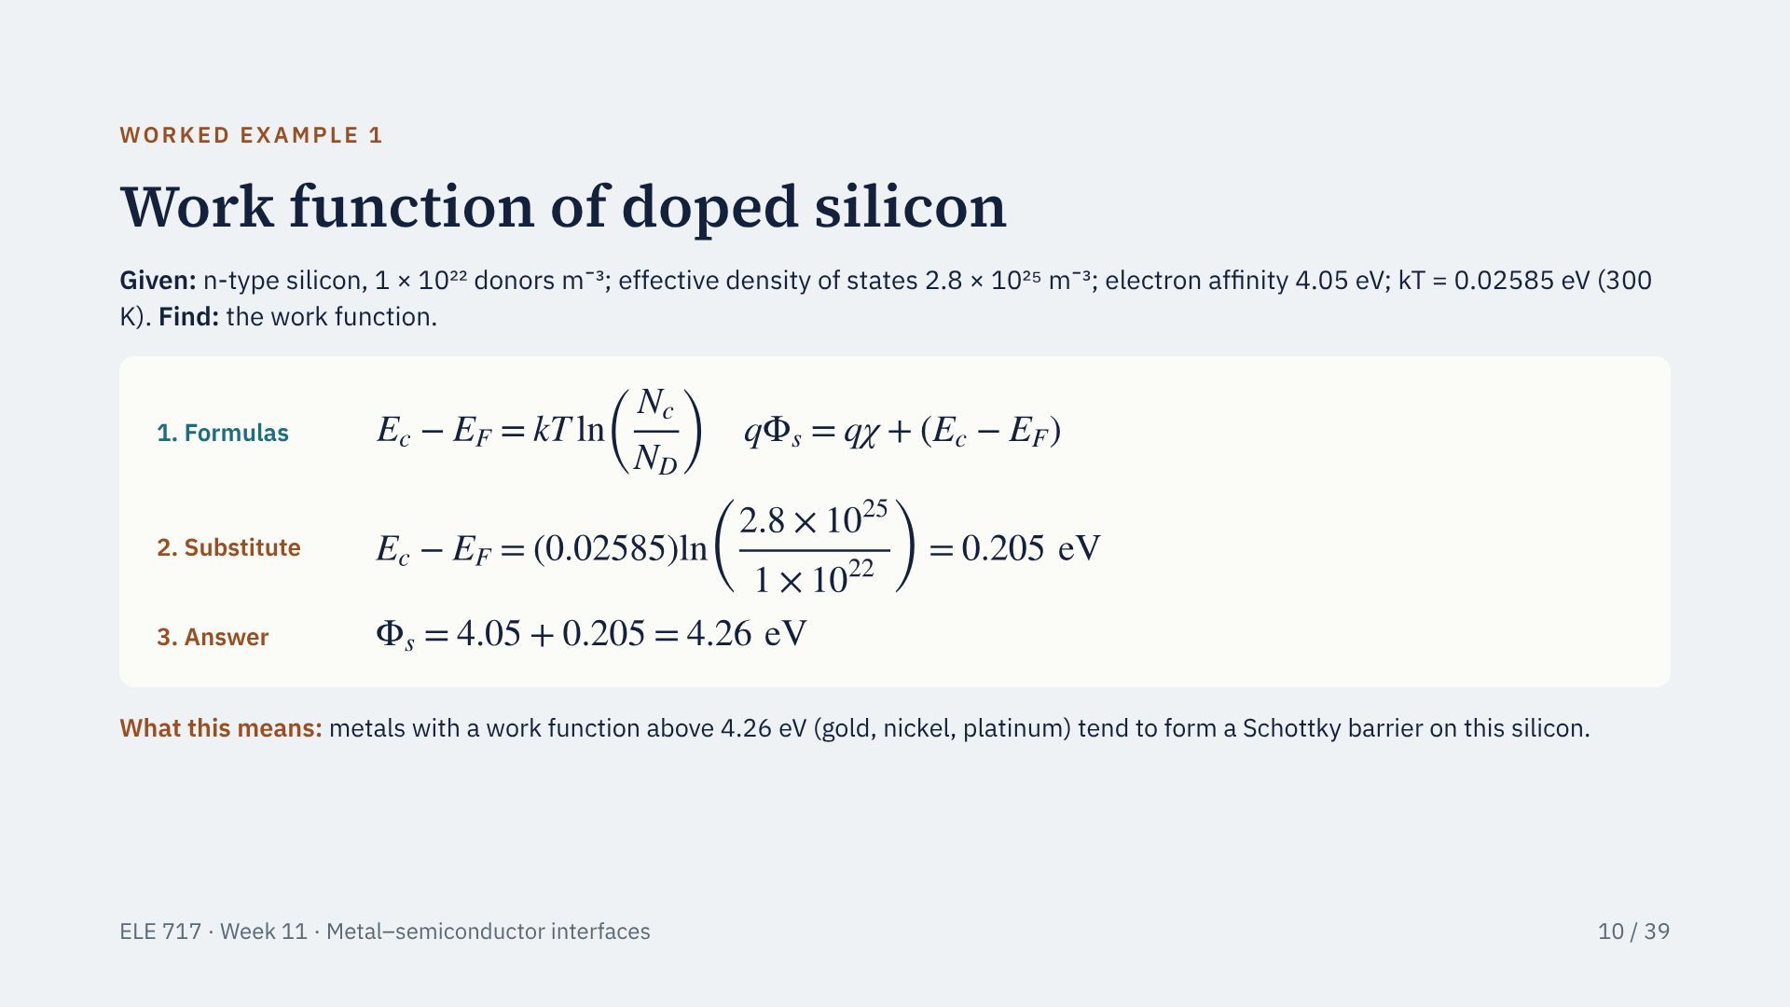
Notes:
Our first number. First write the formulas: E_c minus E_F equals kT ln of N_c over N_D, and the work function equals the electron affinity plus E_c minus E_F. Now substitute: 0.02585 times ln of 2800, which is 0.02585 times 7.94, gives 0.205 eV. Add the electron affinity, 4.05 eV: the work function is 4.26 eV. We use this silicon for the rest of the talk. Any metal with a larger work function, such as gold at 5.10 eV, forms a Schottky barrier on it.

Slide 11
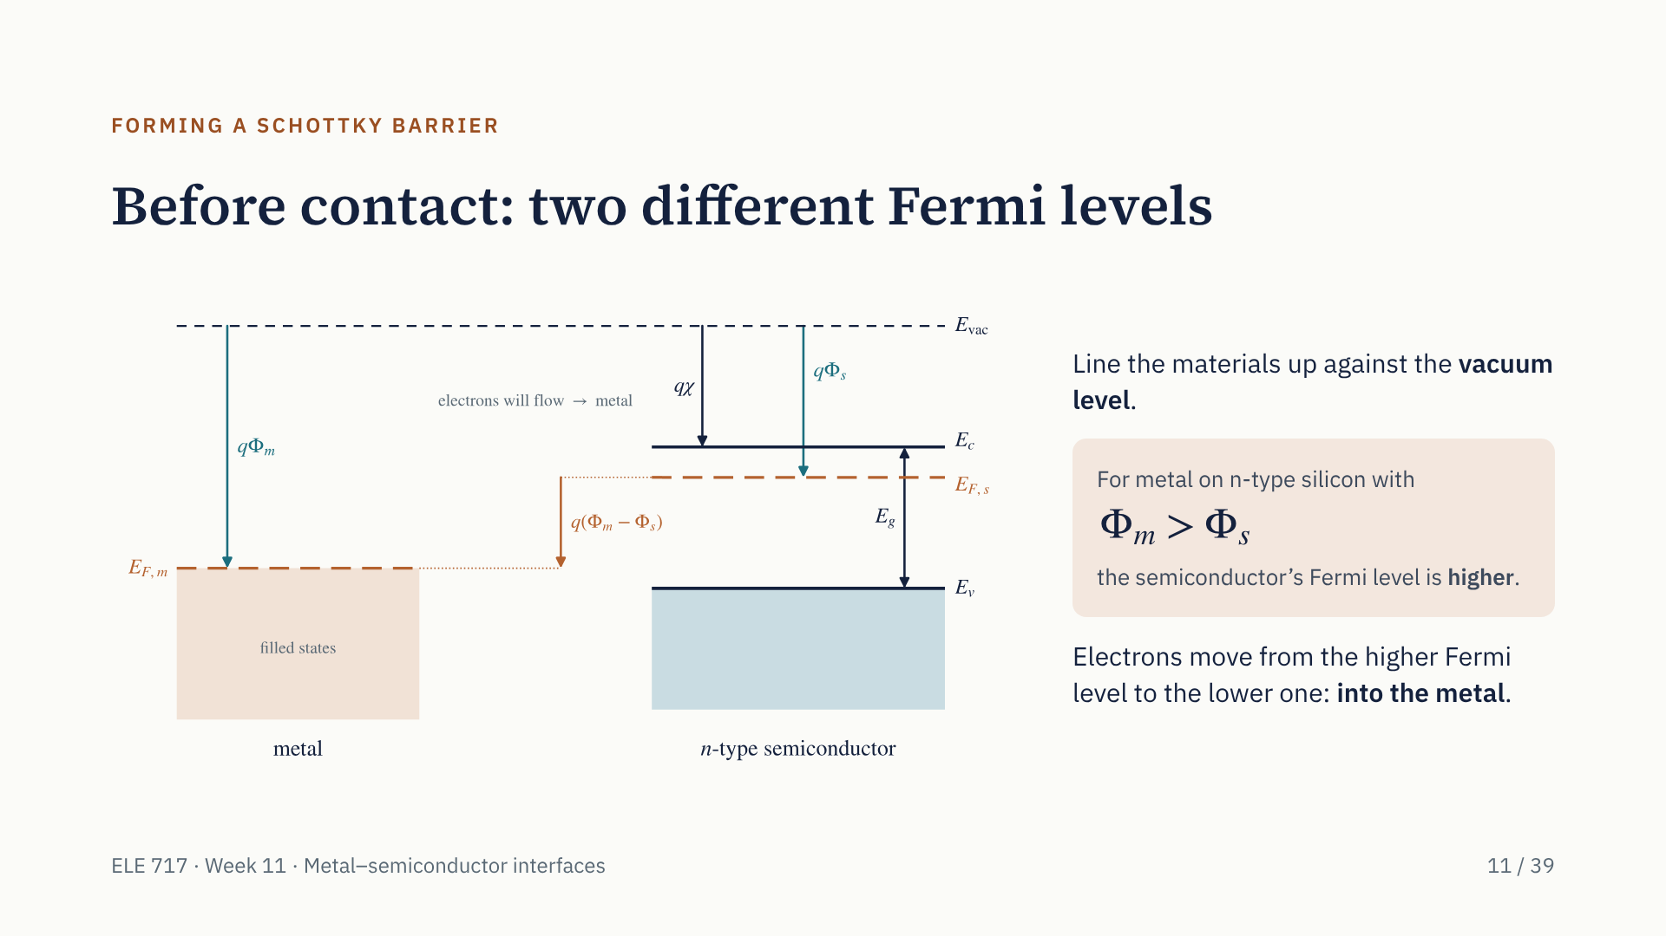
Notes:
Before the materials touch, each has its own Fermi level. We line them up against the common vacuum level. For a metal like gold on n-type silicon, the metal work function is larger than the semiconductor's, so the semiconductor's Fermi level sits higher, by q times phi m minus phi s. Electrons always flow from the higher Fermi level to the lower one, so when we make contact they will flow from the semiconductor into the metal. Watch this happen in the animation on the next slide.

Slide 12
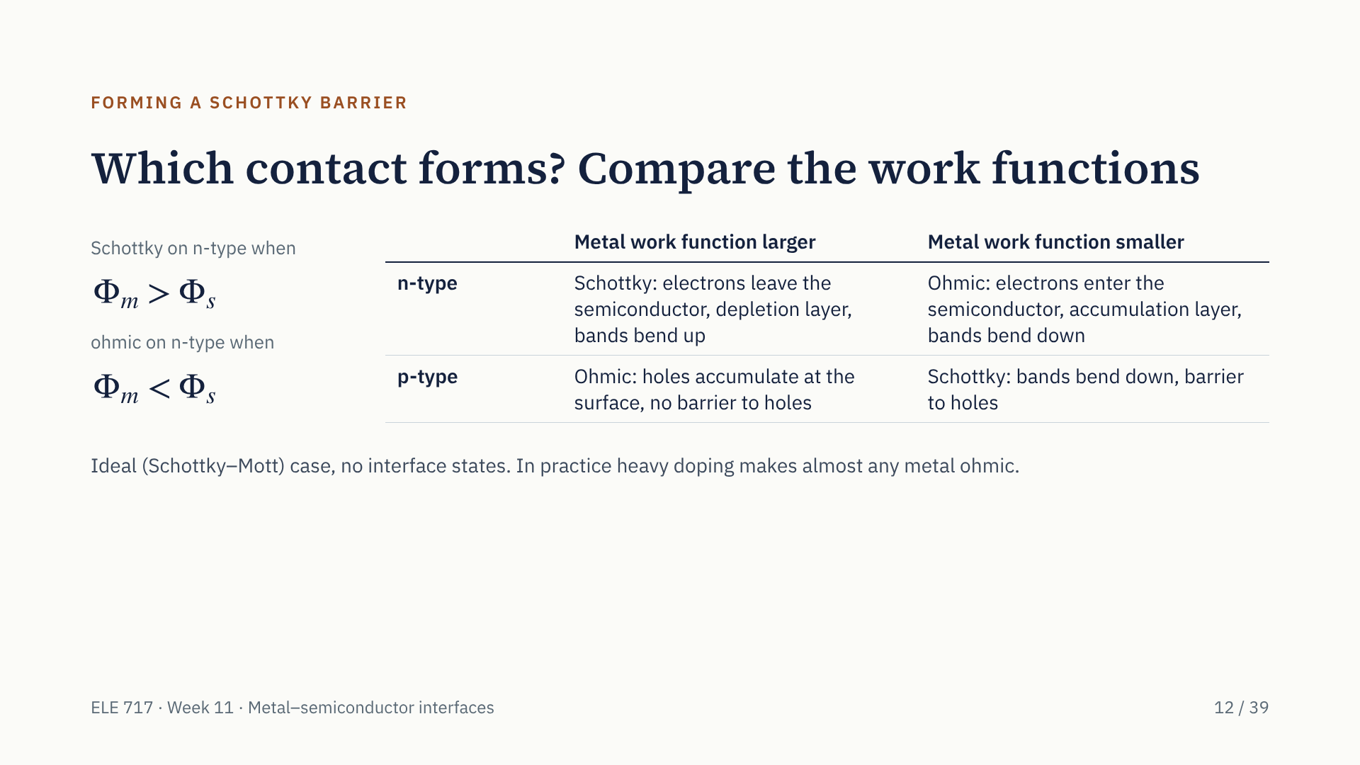
Notes:
Which kind of contact forms depends on which Fermi level is higher before contact, that is, on the two work functions. On n-type silicon, a metal with the larger work function takes electrons from the semiconductor: a depletion layer and a Schottky barrier. A metal with the smaller work function gives electrons to the semiconductor: an accumulation layer and an ohmic contact. On p-type silicon the conditions are reversed, because the majority carriers are holes. This is the ideal picture; in practice heavy doping is used to make ohmic contacts, as we will see.

Slide 13
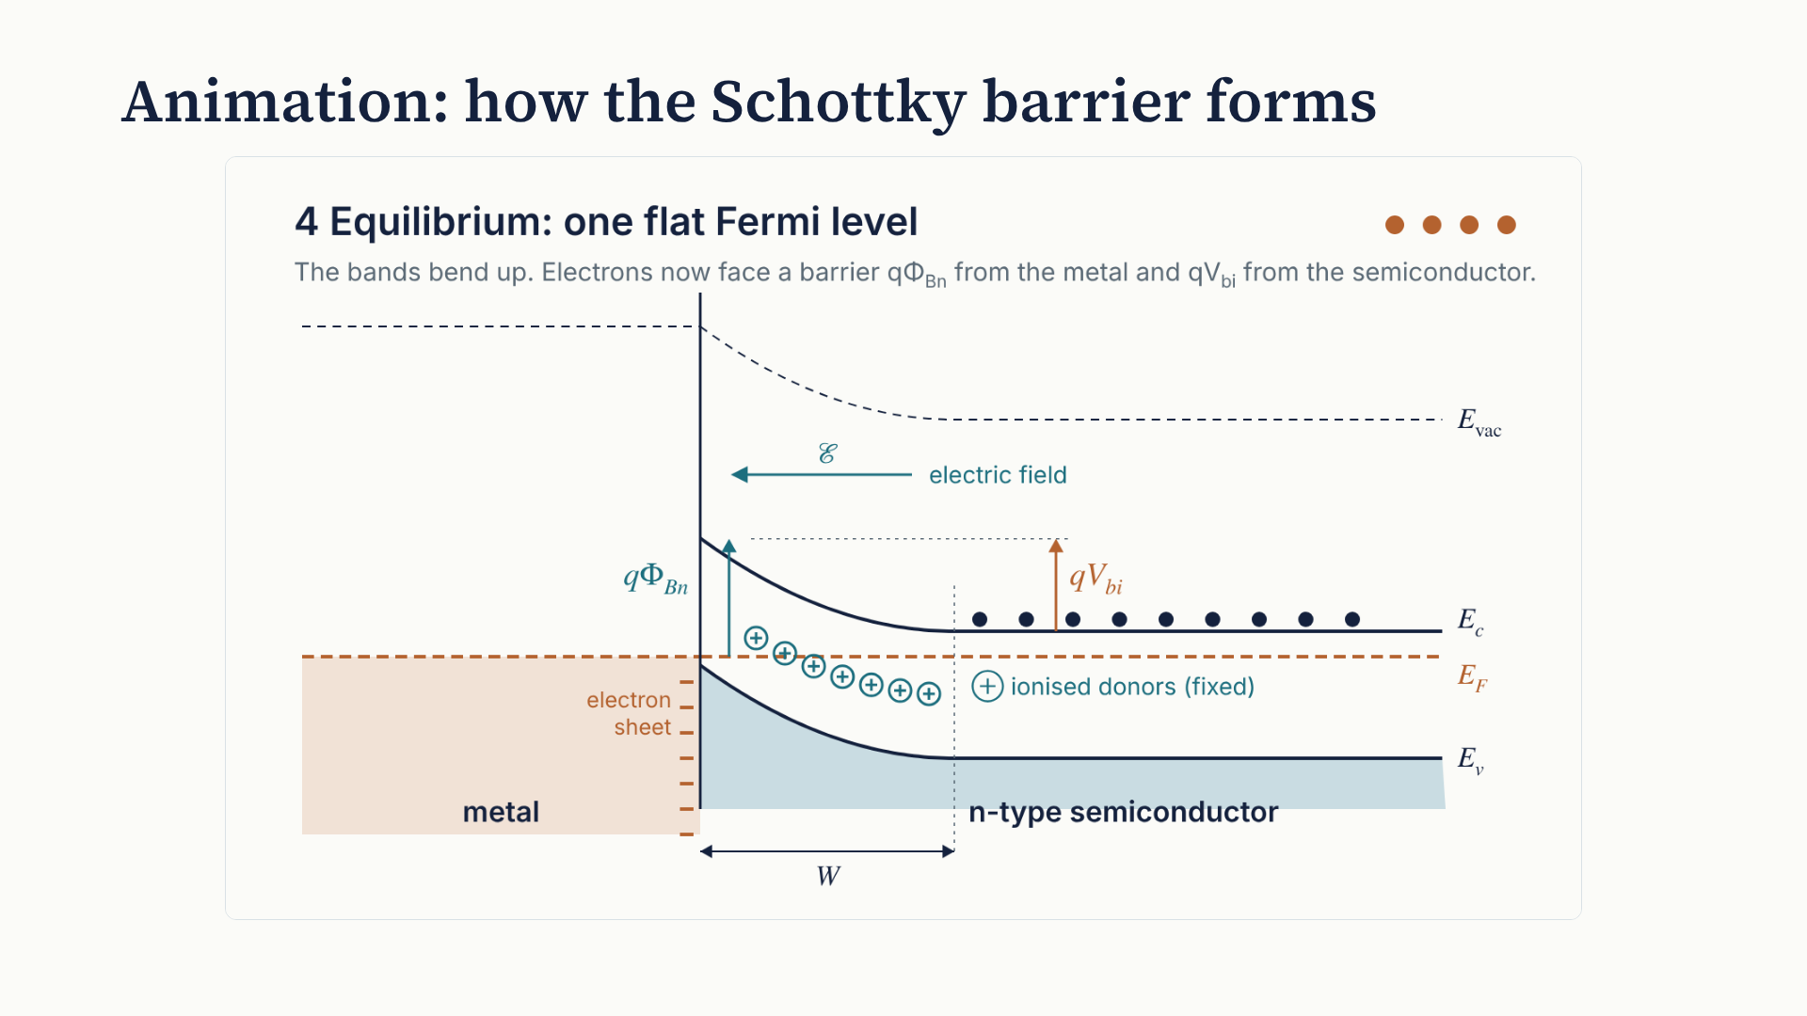
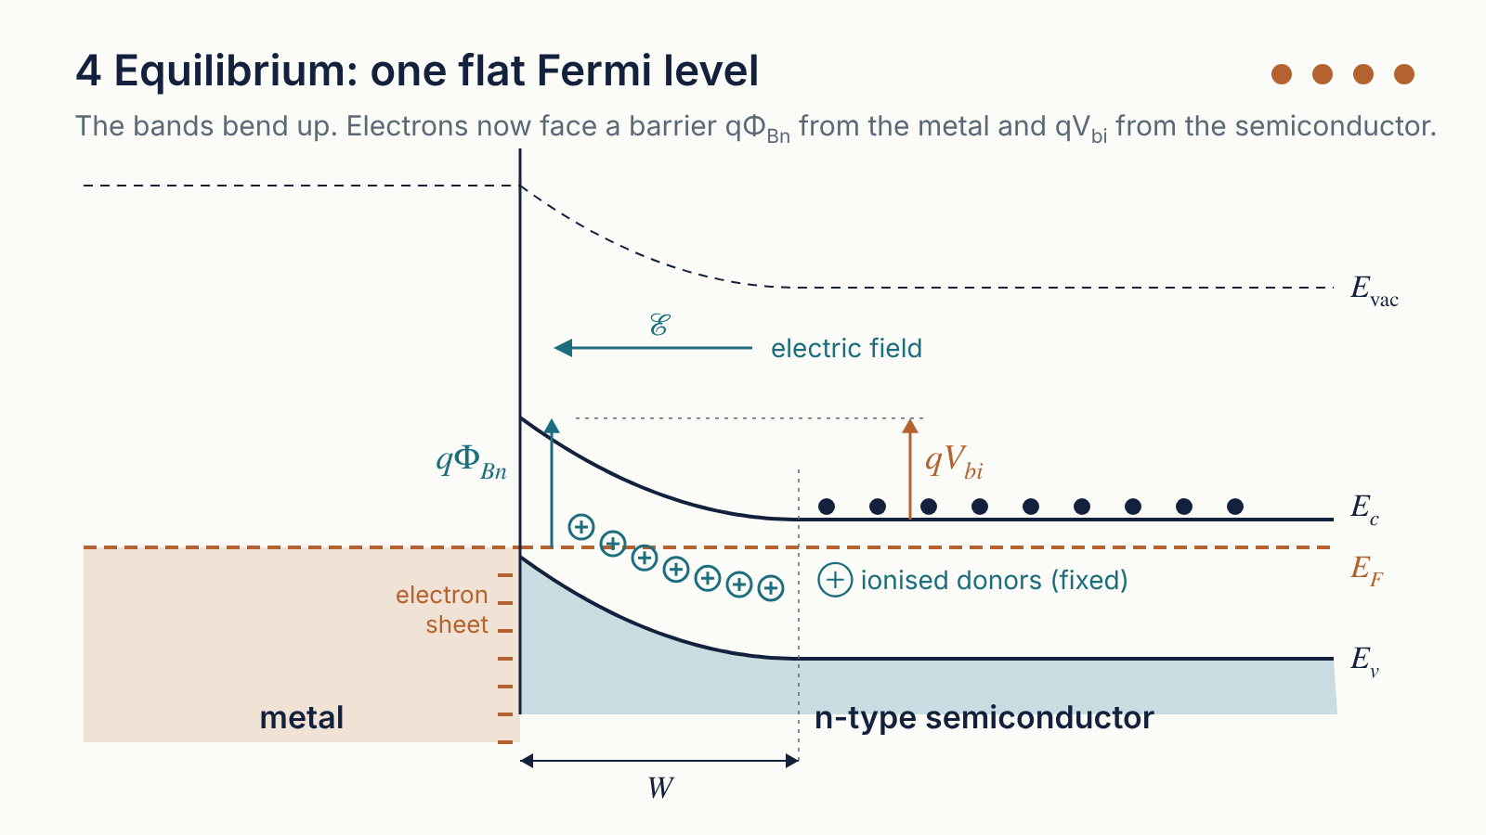
Notes:
Play the animation; it loops every 20 seconds. Step 1: before contact, the semiconductor's Fermi level is higher. Step 2: the materials touch. Step 3: electrons near the interface flow into the metal. Each one leaves behind a positive donor ion that cannot move, so a depletion region grows and an electric field appears, pointing from the ions towards the metal. The semiconductor's Fermi level falls as it loses electrons. Step 4: the flow stops when the Fermi levels are equal. The bands now bend upward near the interface. An electron in the metal faces the barrier q phi Bn; an electron in the semiconductor faces the smaller barrier q V bi. Pause on the last frame to point at the two barriers and the width W.

Slide 14
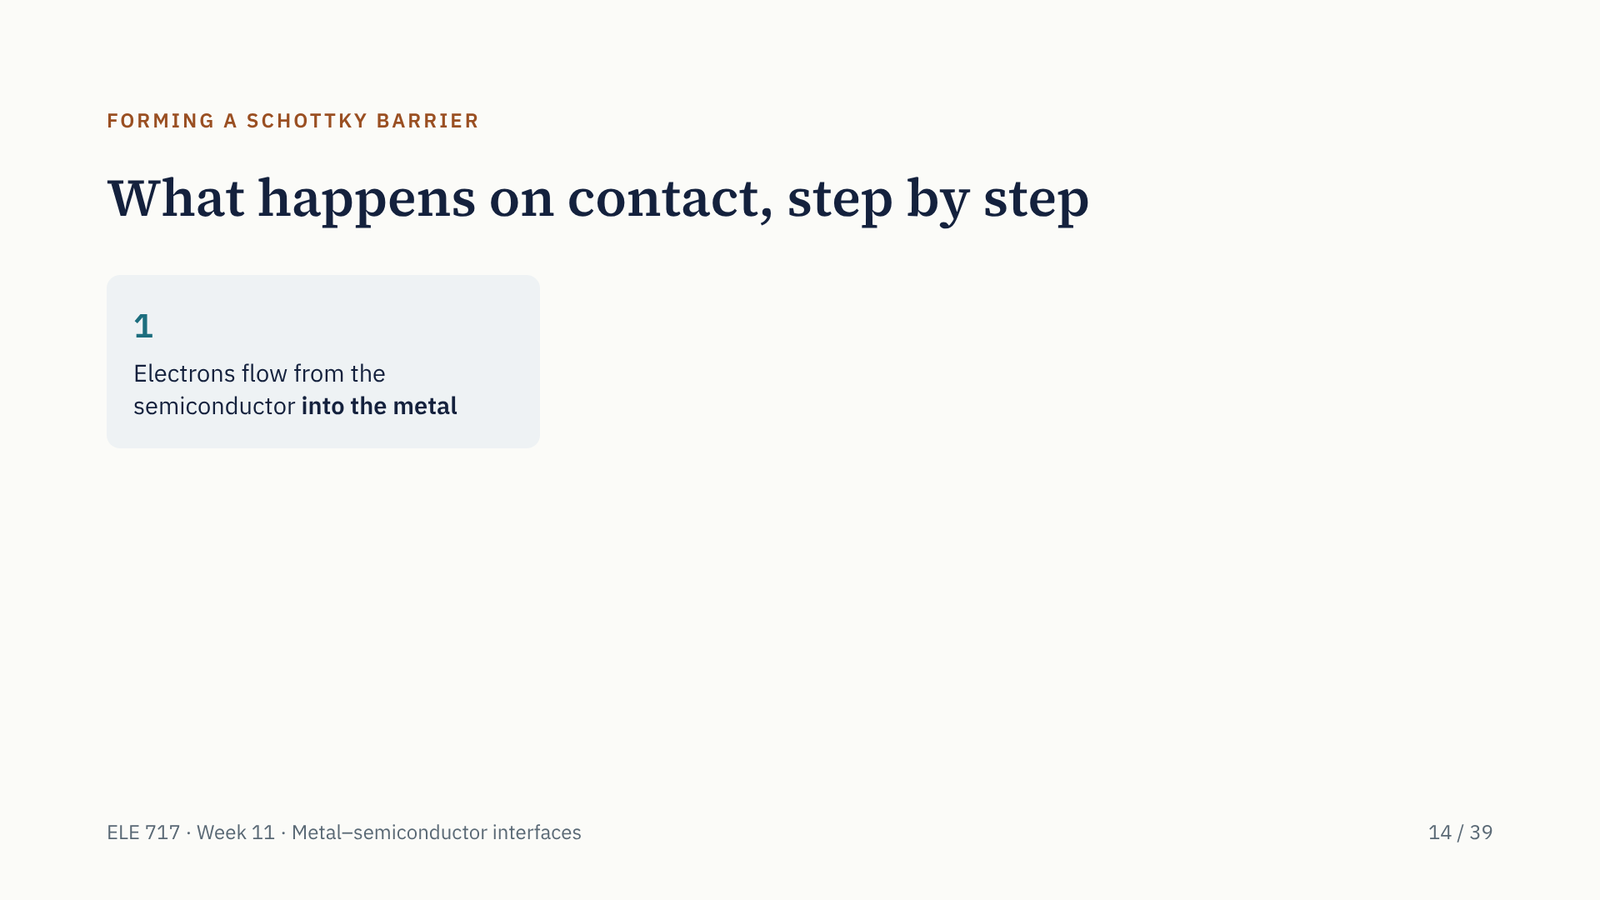
Notes:
When presenting, each step appears on its own click. Here is the animation in words, the six steps examiners look for. One: electrons flow from the semiconductor into the metal. Two: each leaves a positive donor ion that is locked in the crystal. Three: those ions form a depletion region, balanced by a thin sheet of extra electrons on the metal surface. Four: positive ions and negative sheet create an electric field. Five: the field bends the bands upward. Six: the flow stops when the Fermi levels are equal. Electrons still cross both ways, but the two flows balance, so the net current is zero. This is the ideal Schottky–Mott picture, with no interface states.

Slide 15

Notes:
When presenting, each step appears on its own click. Here is the animation in words, the six steps examiners look for. One: electrons flow from the semiconductor into the metal. Two: each leaves a positive donor ion that is locked in the crystal. Three: those ions form a depletion region, balanced by a thin sheet of extra electrons on the metal surface. Four: positive ions and negative sheet create an electric field. Five: the field bends the bands upward. Six: the flow stops when the Fermi levels are equal. Electrons still cross both ways, but the two flows balance, so the net current is zero. This is the ideal Schottky–Mott picture, with no interface states.

Slide 16

Notes:
When presenting, each step appears on its own click. Here is the animation in words, the six steps examiners look for. One: electrons flow from the semiconductor into the metal. Two: each leaves a positive donor ion that is locked in the crystal. Three: those ions form a depletion region, balanced by a thin sheet of extra electrons on the metal surface. Four: positive ions and negative sheet create an electric field. Five: the field bends the bands upward. Six: the flow stops when the Fermi levels are equal. Electrons still cross both ways, but the two flows balance, so the net current is zero. This is the ideal Schottky–Mott picture, with no interface states.

Slide 17

Notes:
When presenting, each step appears on its own click. Here is the animation in words, the six steps examiners look for. One: electrons flow from the semiconductor into the metal. Two: each leaves a positive donor ion that is locked in the crystal. Three: those ions form a depletion region, balanced by a thin sheet of extra electrons on the metal surface. Four: positive ions and negative sheet create an electric field. Five: the field bends the bands upward. Six: the flow stops when the Fermi levels are equal. Electrons still cross both ways, but the two flows balance, so the net current is zero. This is the ideal Schottky–Mott picture, with no interface states.

Slide 18

Notes:
When presenting, each step appears on its own click. Here is the animation in words, the six steps examiners look for. One: electrons flow from the semiconductor into the metal. Two: each leaves a positive donor ion that is locked in the crystal. Three: those ions form a depletion region, balanced by a thin sheet of extra electrons on the metal surface. Four: positive ions and negative sheet create an electric field. Five: the field bends the bands upward. Six: the flow stops when the Fermi levels are equal. Electrons still cross both ways, but the two flows balance, so the net current is zero. This is the ideal Schottky–Mott picture, with no interface states.

Slide 19
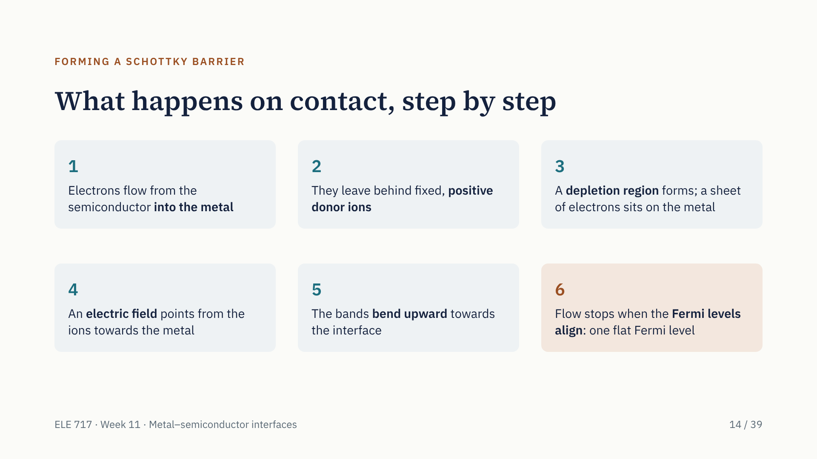
Notes:
When presenting, each step appears on its own click. Here is the animation in words, the six steps examiners look for. One: electrons flow from the semiconductor into the metal. Two: each leaves a positive donor ion that is locked in the crystal. Three: those ions form a depletion region, balanced by a thin sheet of extra electrons on the metal surface. Four: positive ions and negative sheet create an electric field. Five: the field bends the bands upward. Six: the flow stops when the Fermi levels are equal. Electrons still cross both ways, but the two flows balance, so the net current is zero. This is the ideal Schottky–Mott picture, with no interface states.

Slide 20
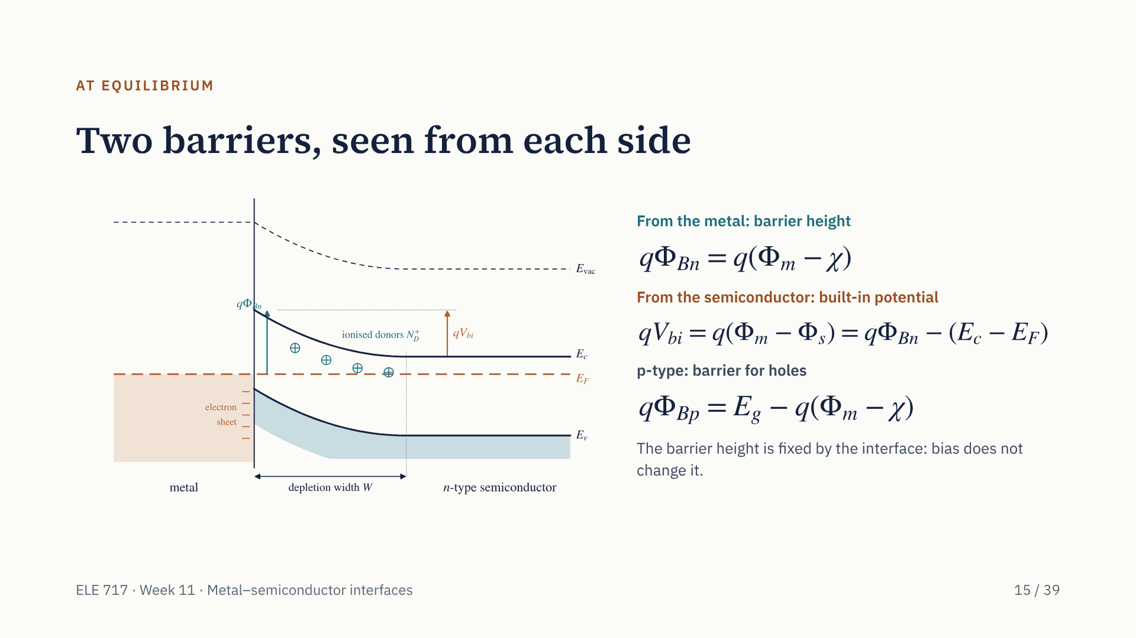
Notes:
At equilibrium there are two barriers. From the metal side, an electron must climb from the Fermi level to the conduction-band edge at the interface: that is the barrier height, q phi Bn, equal to q times phi m minus chi. This is the Schottky–Mott rule. It follows because the vacuum level is continuous at the interface. From the semiconductor side, an electron climbs only the band bending, q V bi, equal to the original difference in work functions. For p-type the barrier is for holes, E_g minus q times phi m minus chi, so for the same metal the two barriers add up to the band gap. Remember: the barrier height is fixed by the interface.

Slide 21
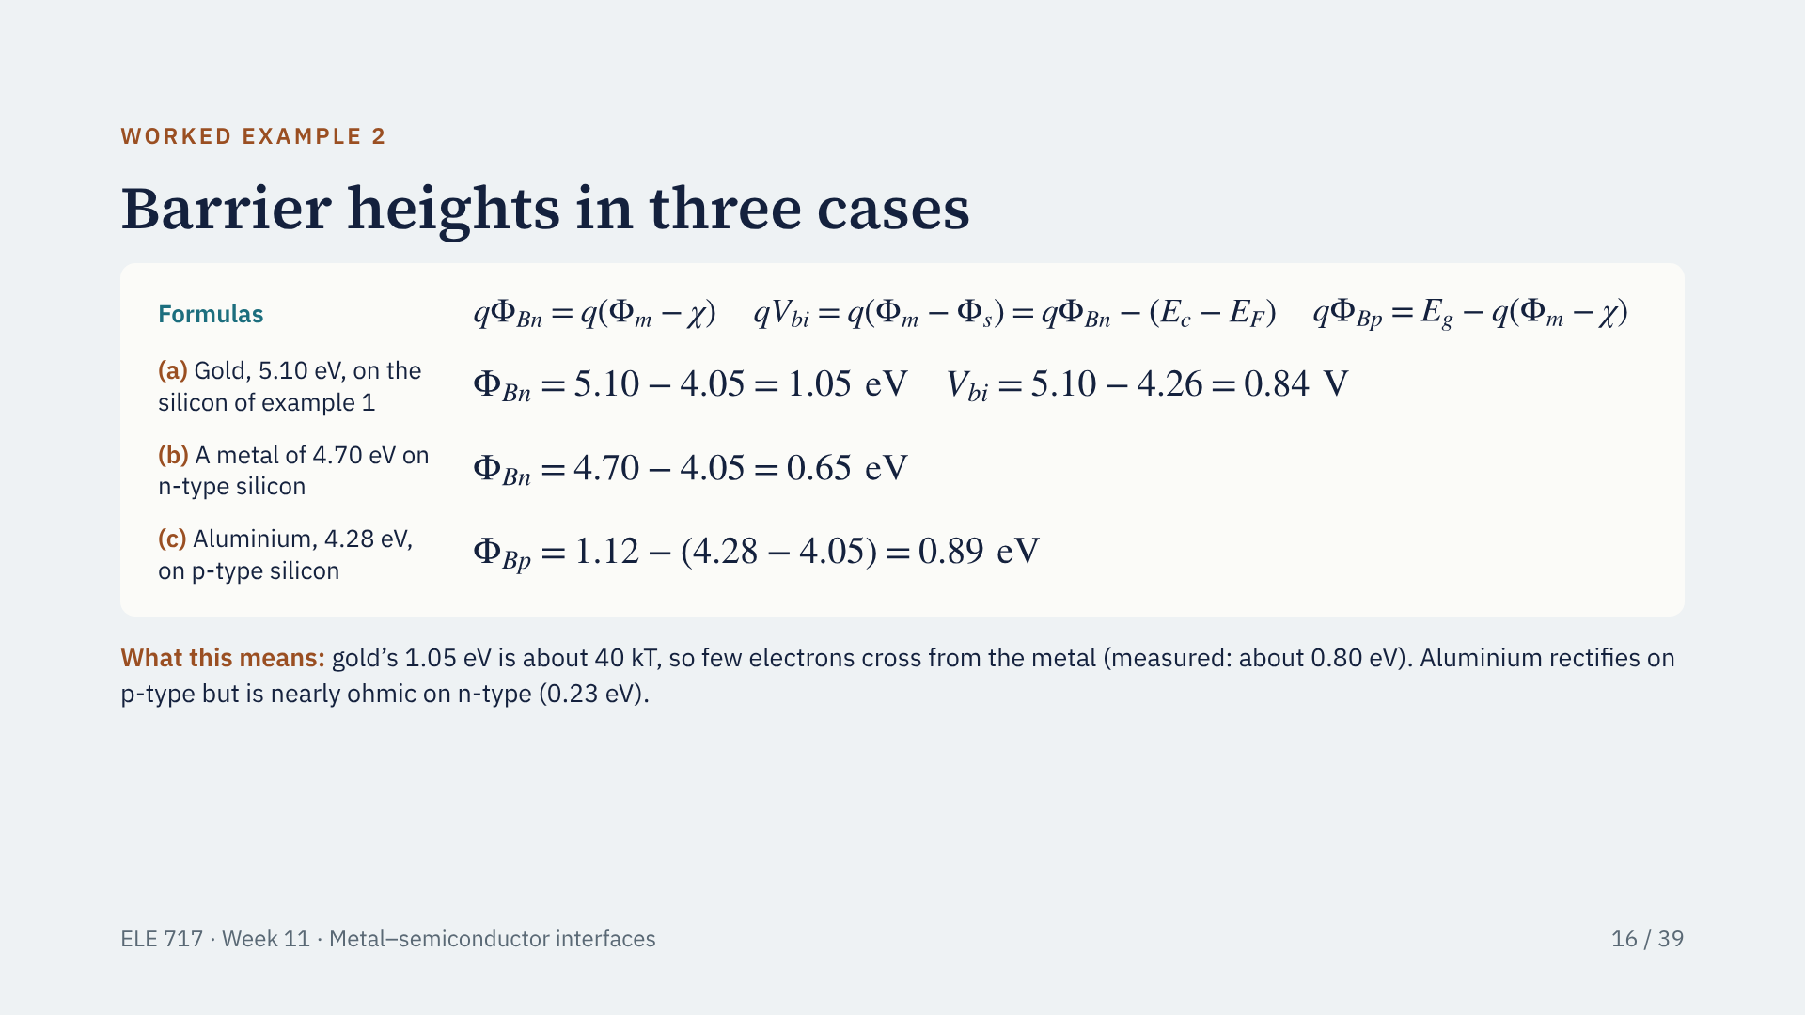
Notes:
First the three formulas: the barrier height for electrons is q times phi m minus chi; the built-in potential is q times phi m minus phi s; and for p-type the hole barrier is the band gap minus q times phi m minus chi. Now substitute. (a) Gold on our silicon: barrier height 1.05 eV, built-in potential 0.84 V; they differ by E_c minus E_F, 0.21 eV. (b) The example from our group notes: 4.70 minus 4.05 gives 0.65 eV. (c) Aluminium on p-type: 1.12 minus 0.23 gives 0.89 eV. So one metal can rectify on p-type and be nearly ohmic on n-type. Real barriers are pinned: gold measures about 0.8 eV.

Slide 22
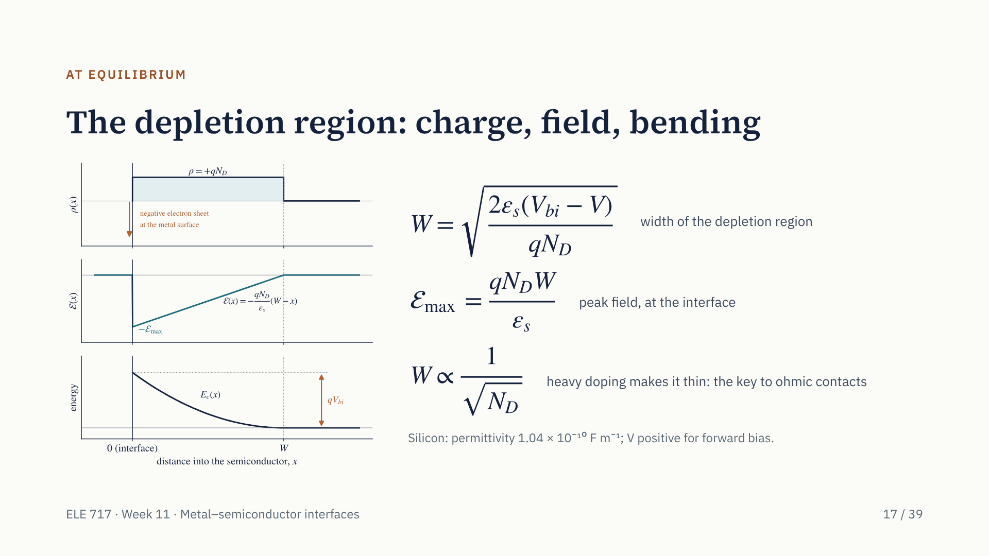
Notes:
Inside the depletion region the only charge is the fixed donors, q N_D. Solving Poisson's equation once gives a field that is largest at the interface and falls linearly to zero at W. Solving again gives the parabolic band bending. The width is the square root of 2 epsilon s times V bi minus V over q N_D. Two things to remember: reverse bias, negative V, makes W wider; and W goes as one over the square root of N_D, so heavy doping makes the region very thin. That second fact is how practical ohmic contacts work. The depletion region also behaves like a capacitor, which is the basis of C–V measurement next week.

Slide 23
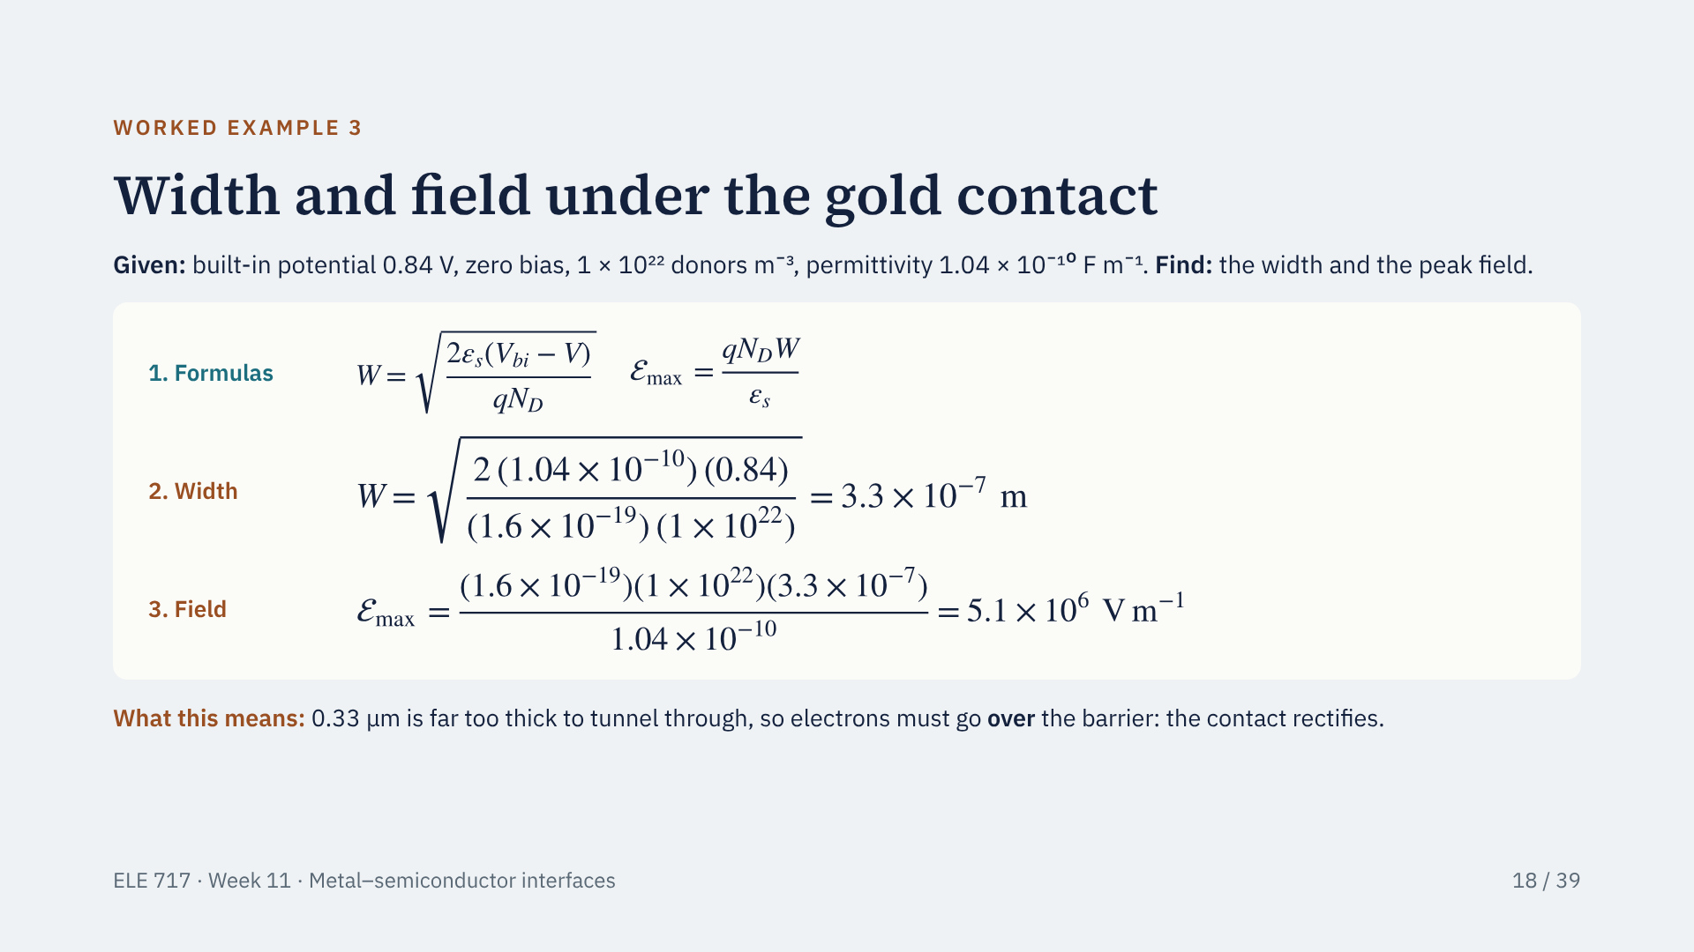
Notes:
Formulas first: the depletion width W is the square root of 2 epsilon s times V bi minus V over q N_D, and the peak field is q N_D W over epsilon s. Substitute for the gold contact at zero bias: W comes out at 3.3 times 10 to the minus 7 metres, 0.33 micrometres, and the peak field at 5.1 times 10 to the 6 volts per metre. 0.33 micrometres is about a thousand atoms thick: electrons cannot tunnel through, so they must go over the top, and the contact rectifies.

Slide 24
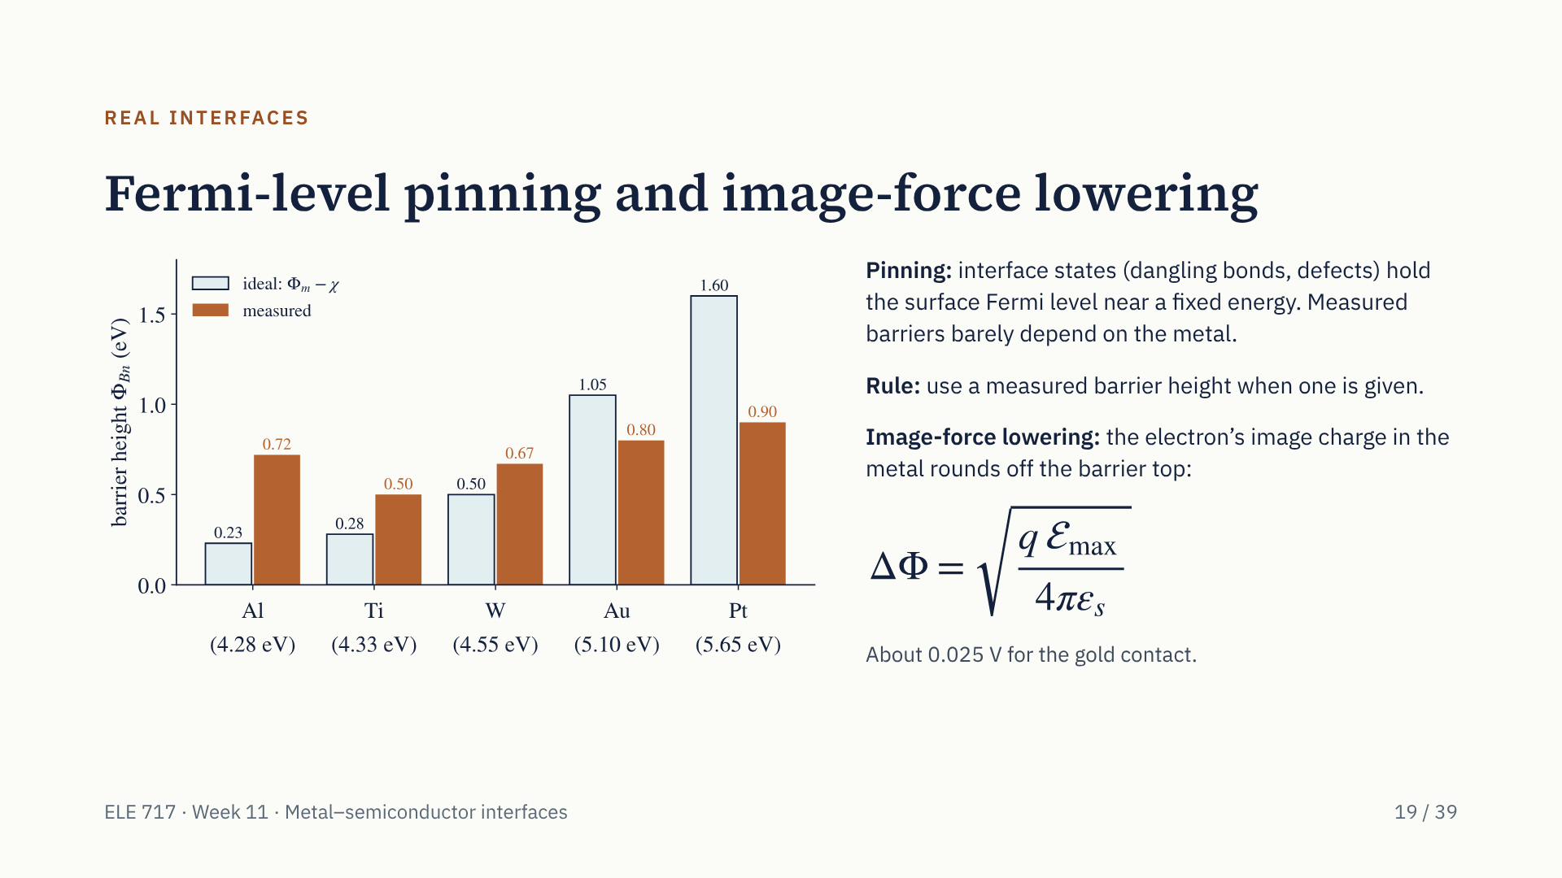
Notes:
The Schottky–Mott rule is the ideal case. Real barriers depend much less on the metal. The chart compares the ideal values, phi m minus chi, with typical measured values on n-type silicon from Sze and Ng: ideal values spread from 0.23 to 1.60 eV, measured ones only from 0.50 to 0.90 eV. The reason is interface states, dangling bonds and defects with energies in the gap, which pin the Fermi level at the surface. On gallium arsenide almost every metal gives about 0.8 eV. A second, smaller effect is image-force lowering: an electron near the metal is attracted by its image charge, which lowers the barrier slightly, about 25 millivolts for our gold example, and more under reverse bias.

Slide 25
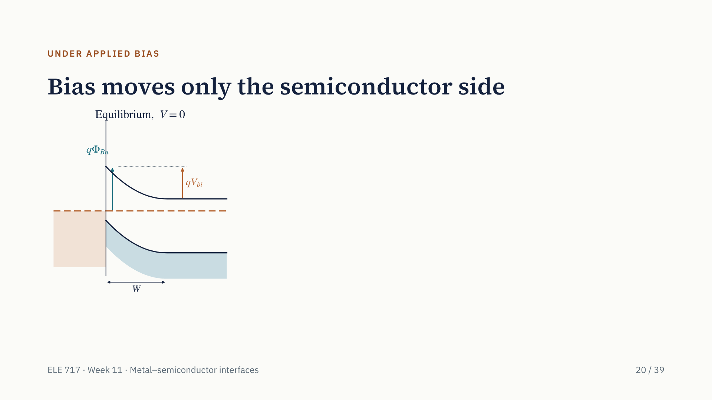
Notes:
The three panels appear one at a time. The applied voltage V is the metal's potential minus the semiconductor's, so forward bias means the metal is positive. First, equilibrium: one flat Fermi level and band bending q V bi. Second, forward bias: the semiconductor's Fermi level rises by qV, the bending falls to q times V bi minus V, W narrows, and electrons pour over into the metal. Third, reverse bias: the semiconductor's Fermi level falls, the bending rises to q times V bi plus V R, W widens, and that flow stops. In all three, the barrier from the metal, q phi Bn, is the same: it is fixed by the interface. At large reverse voltage the diode breaks down, at a lower voltage than a p–n diode.

Slide 26
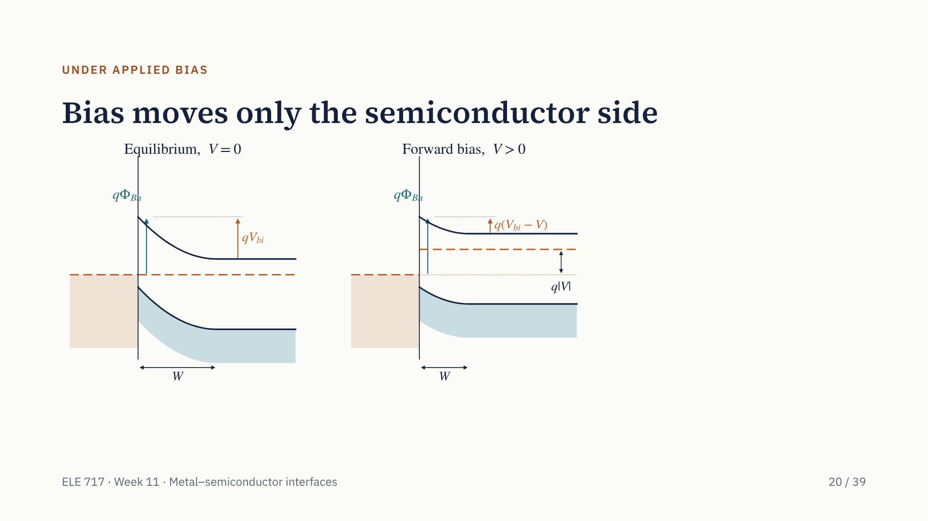
Notes:
The three panels appear one at a time. The applied voltage V is the metal's potential minus the semiconductor's, so forward bias means the metal is positive. First, equilibrium: one flat Fermi level and band bending q V bi. Second, forward bias: the semiconductor's Fermi level rises by qV, the bending falls to q times V bi minus V, W narrows, and electrons pour over into the metal. Third, reverse bias: the semiconductor's Fermi level falls, the bending rises to q times V bi plus V R, W widens, and that flow stops. In all three, the barrier from the metal, q phi Bn, is the same: it is fixed by the interface. At large reverse voltage the diode breaks down, at a lower voltage than a p–n diode.

Slide 27
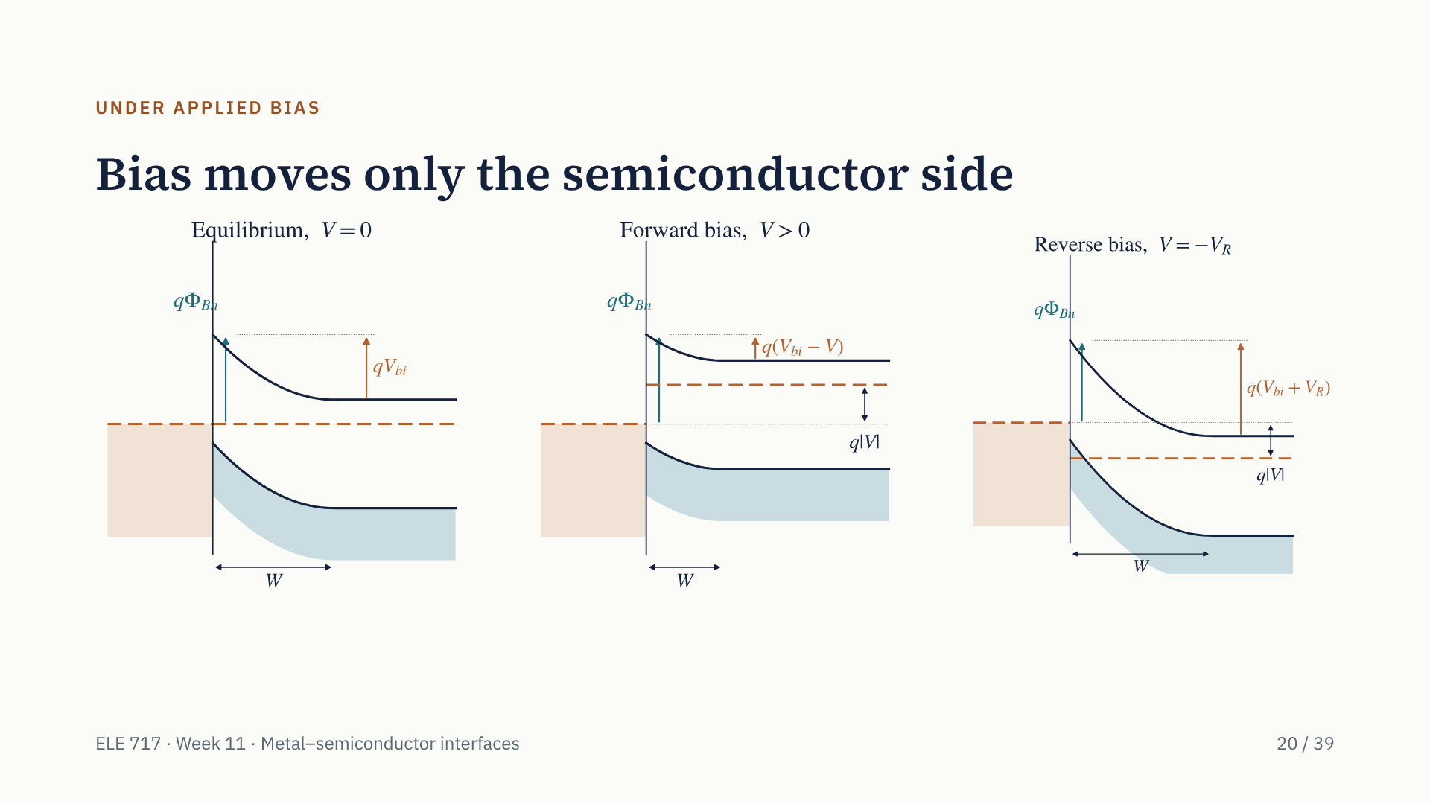
Notes:
The three panels appear one at a time. The applied voltage V is the metal's potential minus the semiconductor's, so forward bias means the metal is positive. First, equilibrium: one flat Fermi level and band bending q V bi. Second, forward bias: the semiconductor's Fermi level rises by qV, the bending falls to q times V bi minus V, W narrows, and electrons pour over into the metal. Third, reverse bias: the semiconductor's Fermi level falls, the bending rises to q times V bi plus V R, W widens, and that flow stops. In all three, the barrier from the metal, q phi Bn, is the same: it is fixed by the interface. At large reverse voltage the diode breaks down, at a lower voltage than a p–n diode.

Slide 28
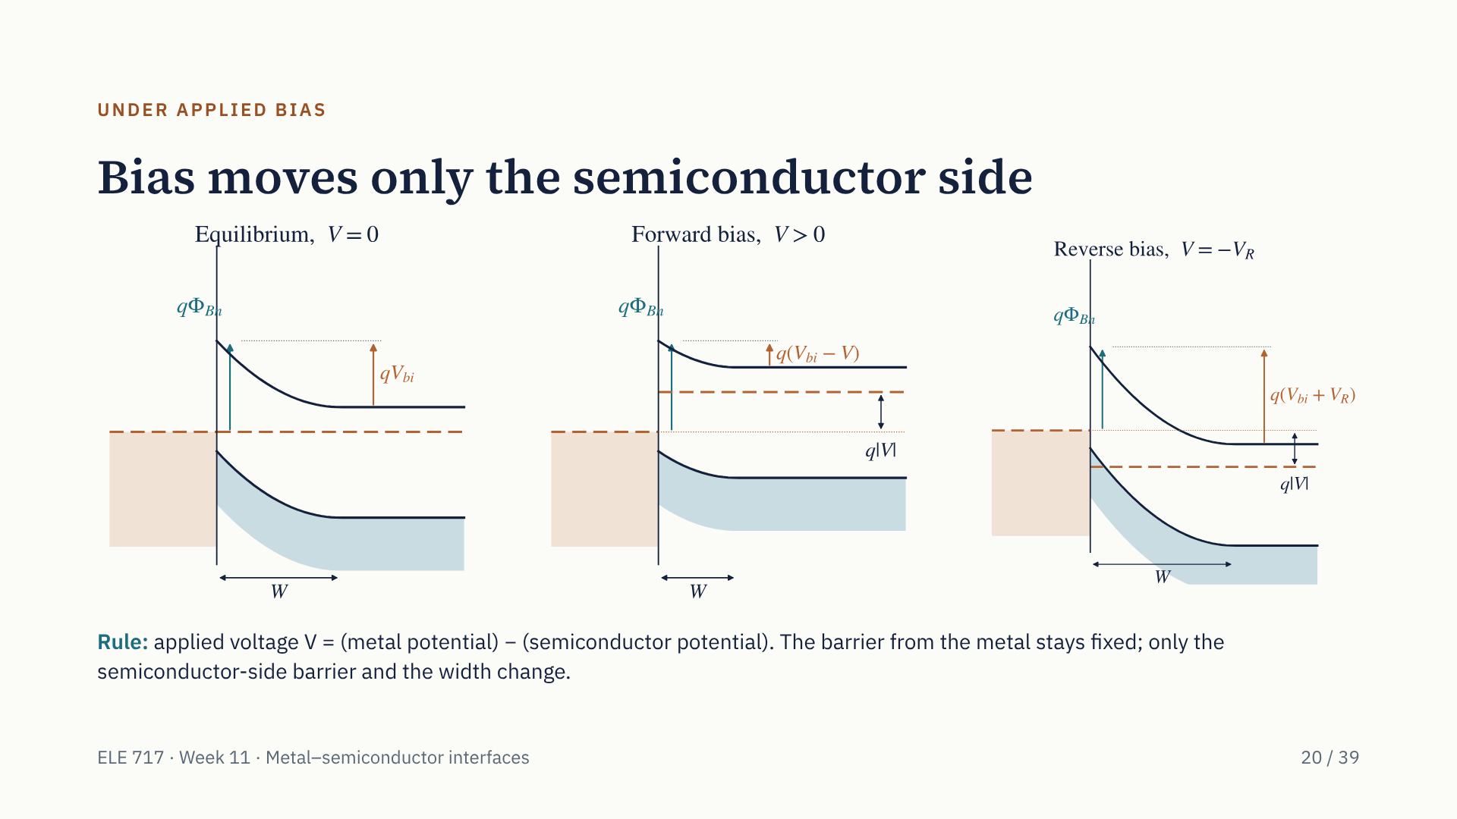
Notes:
The three panels appear one at a time. The applied voltage V is the metal's potential minus the semiconductor's, so forward bias means the metal is positive. First, equilibrium: one flat Fermi level and band bending q V bi. Second, forward bias: the semiconductor's Fermi level rises by qV, the bending falls to q times V bi minus V, W narrows, and electrons pour over into the metal. Third, reverse bias: the semiconductor's Fermi level falls, the bending rises to q times V bi plus V R, W widens, and that flow stops. In all three, the barrier from the metal, q phi Bn, is the same: it is fixed by the interface. At large reverse voltage the diode breaks down, at a lower voltage than a p–n diode.

Slide 29
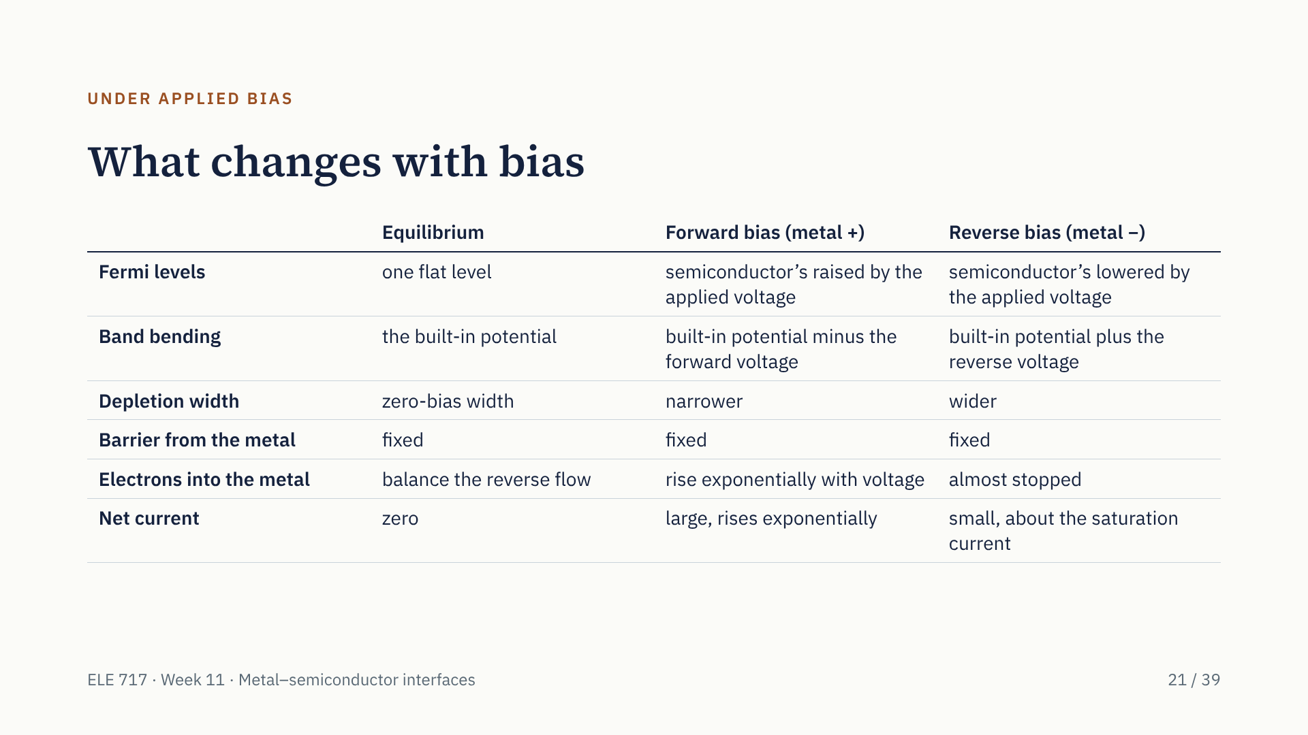
Notes:
This table sums up the three cases; it is worth copying into your notes for the exam. Note the row "barrier from the metal": fixed in every column. The flow of electrons from the metal into the semiconductor never changes, and under reverse bias it is all that is left, which is why the reverse current saturates. Under forward bias the flow from the semiconductor grows by exp of qV over kT, which is why the forward current rises exponentially.

Slide 30
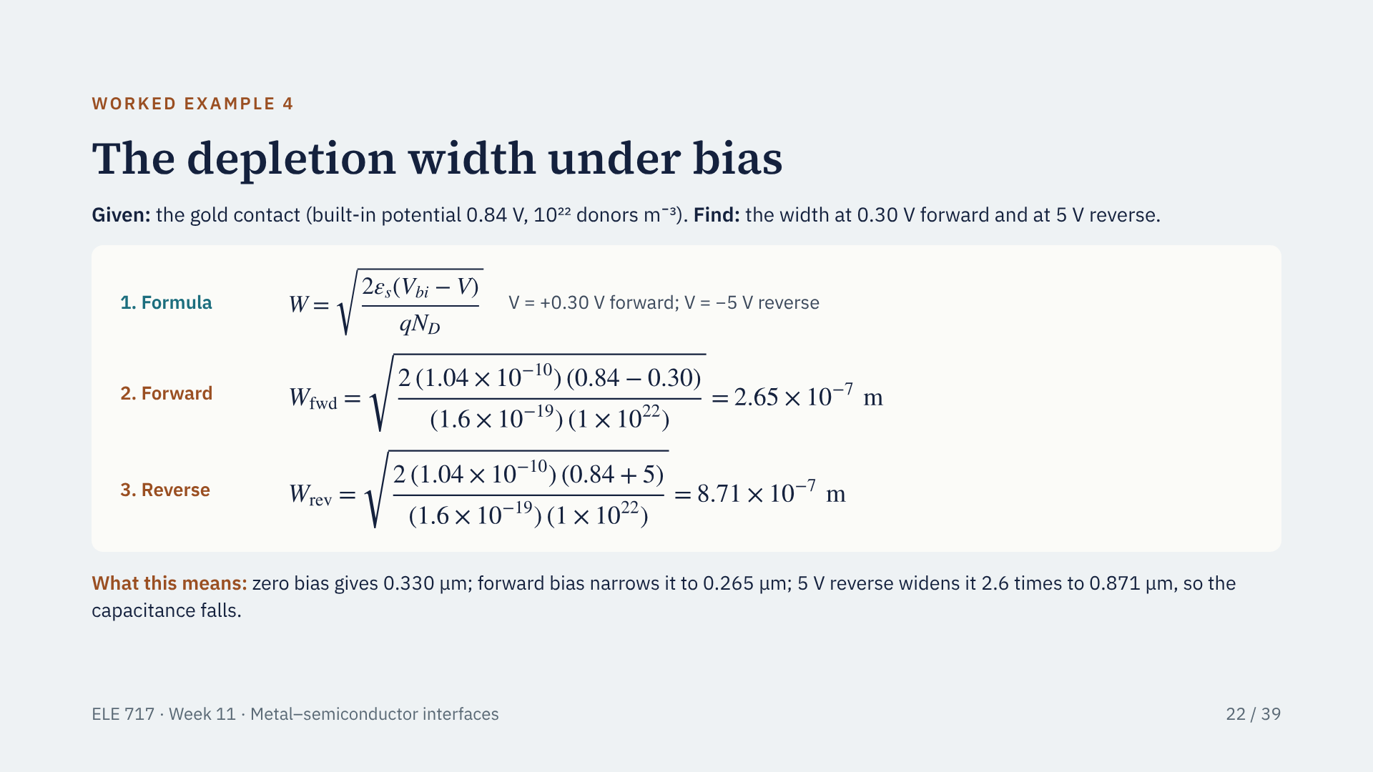
Notes:
The formula is the same width formula, with V positive for forward bias and negative for reverse. Under 0.30 V forward, V bi minus V is 0.84 minus 0.30, 0.54 V, giving 2.65 times 10 to the minus 7 metres, 0.265 micrometres. Under 5 V reverse, V is minus 5, so V bi minus V is 0.84 plus 5, 5.84 V, giving 8.71 times 10 to the minus 7 metres, 0.871 micrometres: the square root of 5.84 over 0.84, 2.6 times wider than at zero bias. A wider depletion region means a smaller capacitance, which C–V measurement uses next week.

Slide 31
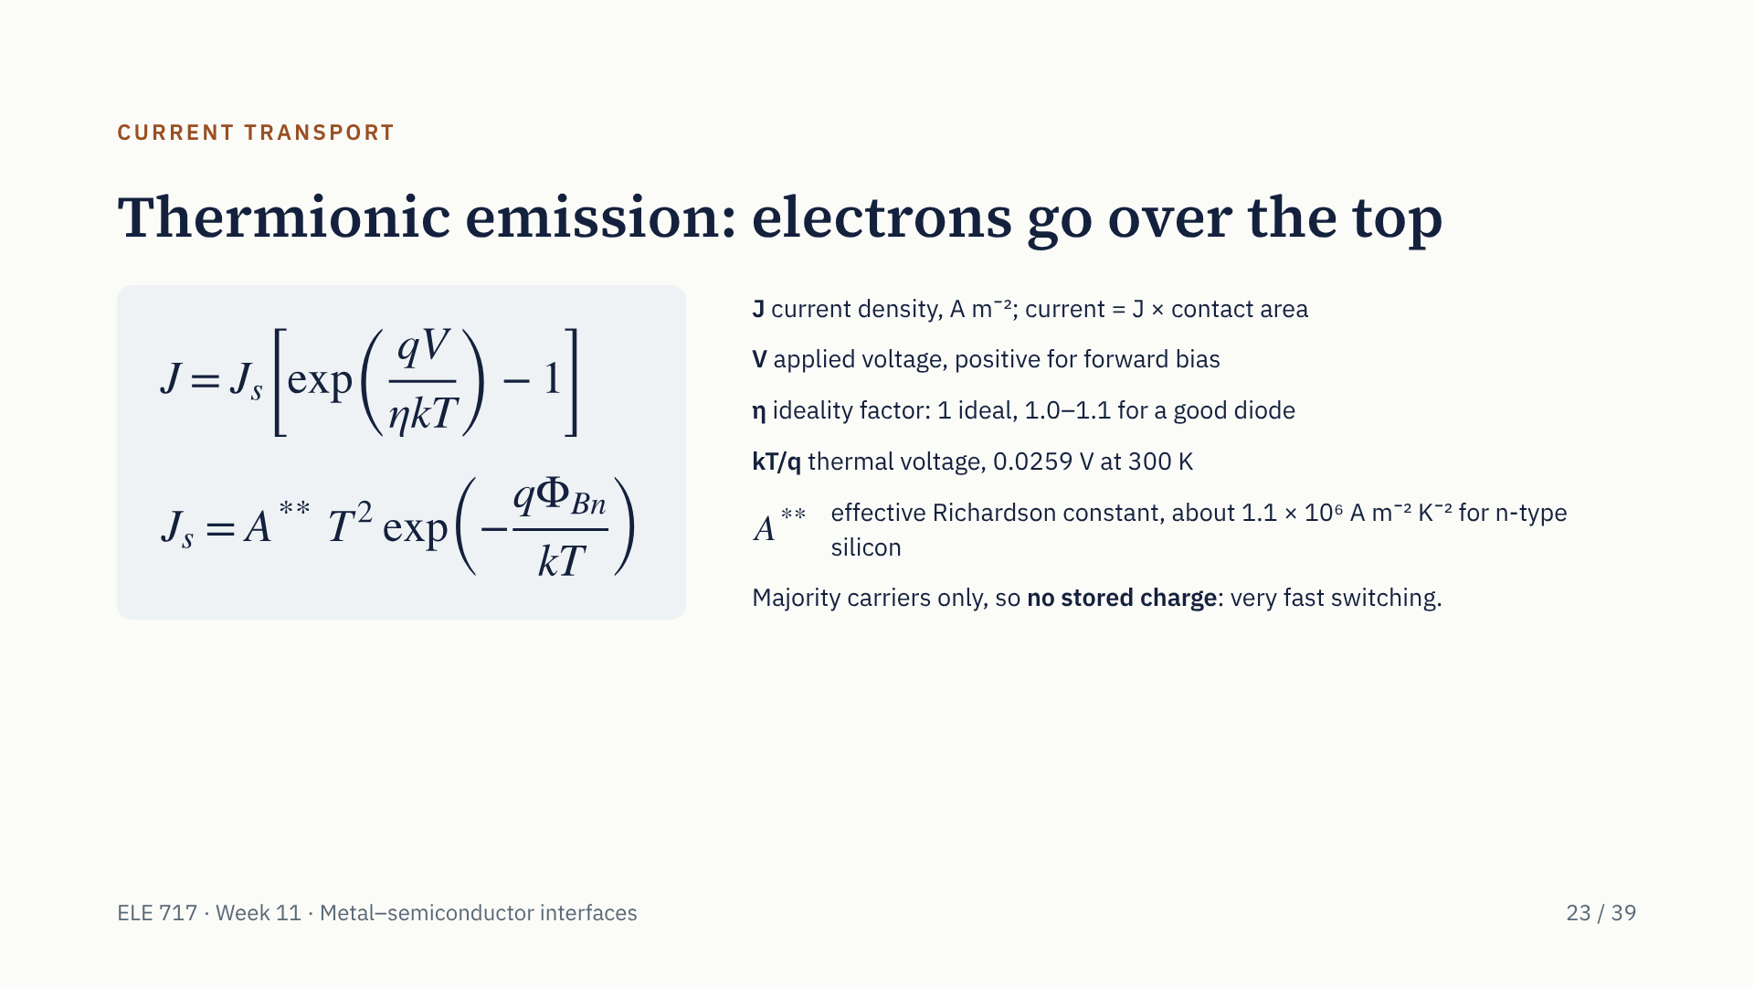
Notes:
How does current flow? By thermionic emission: majority carriers, electrons for n-type, that have enough thermal energy go over the barrier. The current density is J s times exp of qV over eta kT minus one: the same shape as a p–n diode. The saturation current density J s is A double-star T squared times exp of minus q phi Bn over kT, so it depends exponentially on the barrier height and strongly on temperature. A double-star is the effective Richardson constant. Because the current is carried by majority carriers, no minority charge is stored, so Schottky diodes switch very fast. Real diodes also show some tunnelling, recombination and series resistance, which push the ideality factor above one.

Slide 32
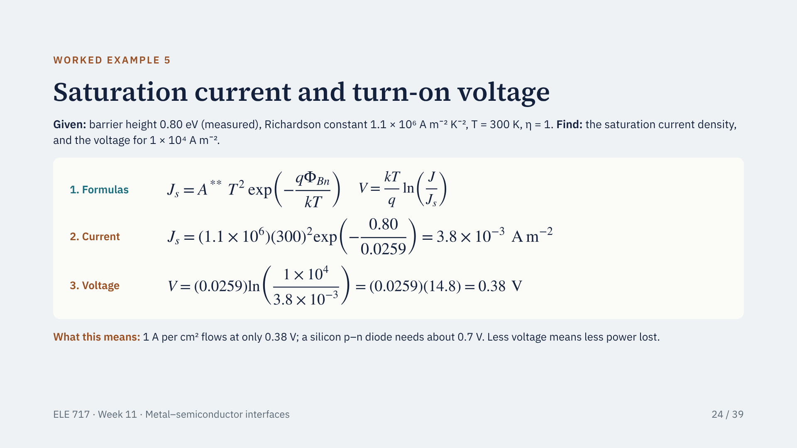
Notes:
Formulas first. The saturation current density is A double-star T squared e to the minus q phi B over kT. For forward currents much larger than J s, the minus one in the current equation can be dropped, so V equals kT over q times ln of J over J s. Substitute: J s is 1.1 times 10 to the 6 times 300 squared times e to the minus 0.80 over 0.0259, which is 9.9 times 10 to the 10 times 3.85 times 10 to the minus 14, or 3.8 times 10 to the minus 3 amperes per square metre. For 10 to the 4 amperes per square metre, V is 0.0259 times ln of about 2.6 million, which is 14.8, giving 0.38 V. A silicon p–n diode needs about 0.7 V.

Slide 33
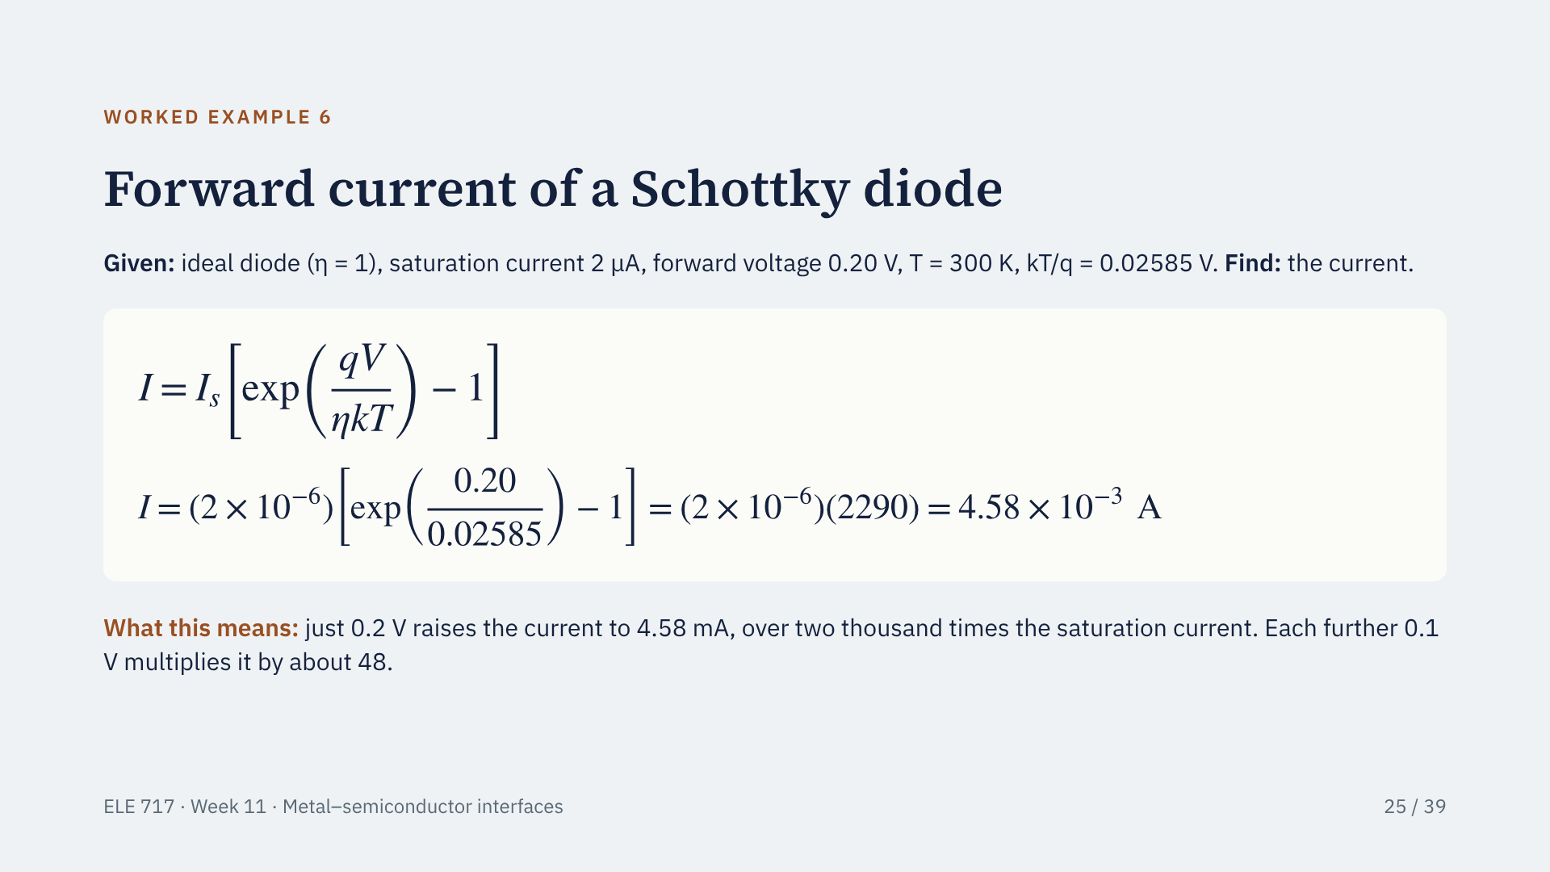
Notes:
A worked example from our group's notes. The saturation current is 2 microamps and we apply 0.20 V forward. The exponent is 0.20 divided by 0.02585, which is 7.737, and e to the 7.737 is 2291. Subtract one and multiply by 2 microamps: 4.58 milliamps. Note the Boltzmann constant must be 1.381 times 10 to the minus 23 joules per kelvin if you work from q, k and T separately; it is simpler to use kT over q equals 0.02585 V. In a real diode, series resistance and an ideality factor above one would make the current somewhat smaller.

Slide 34
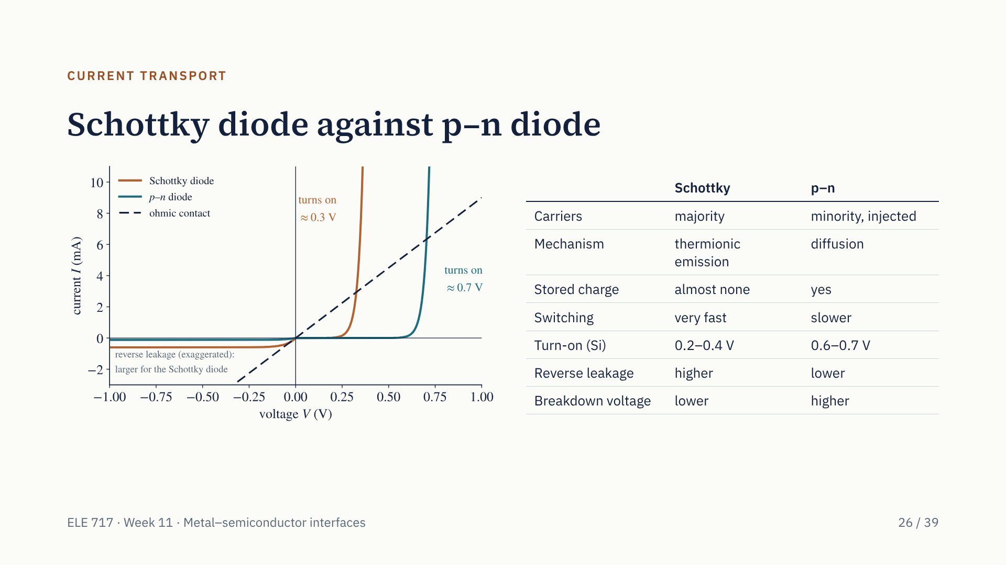
Notes:
The Schottky diode's saturation current is typically thousands to millions of times larger than a p–n diode's, so it turns on at a lower voltage: about 0.3 V on silicon instead of 0.7 V. That means less power lost when it conducts, which is why Schottky rectifiers are used in switching power supplies. The price is higher reverse leakage and a lower breakdown voltage. Because there is no stored minority charge, there is no reverse-recovery delay. The dashed line is an ohmic contact for comparison: a straight line through the origin.

Slide 35
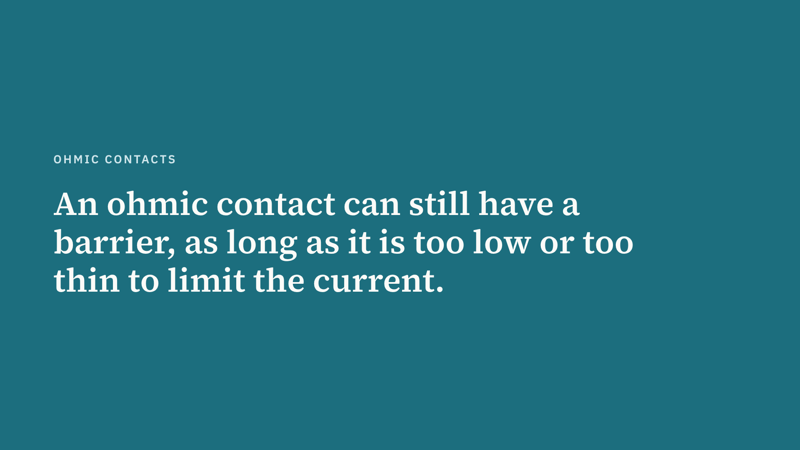
Notes:
This is the single most misunderstood point of the topic. Many students write that an ohmic contact has no barrier. The practical ohmic contact on heavily doped silicon does have a barrier, often as high as a Schottky barrier, but it is so thin that electrons tunnel straight through it.

Slide 36
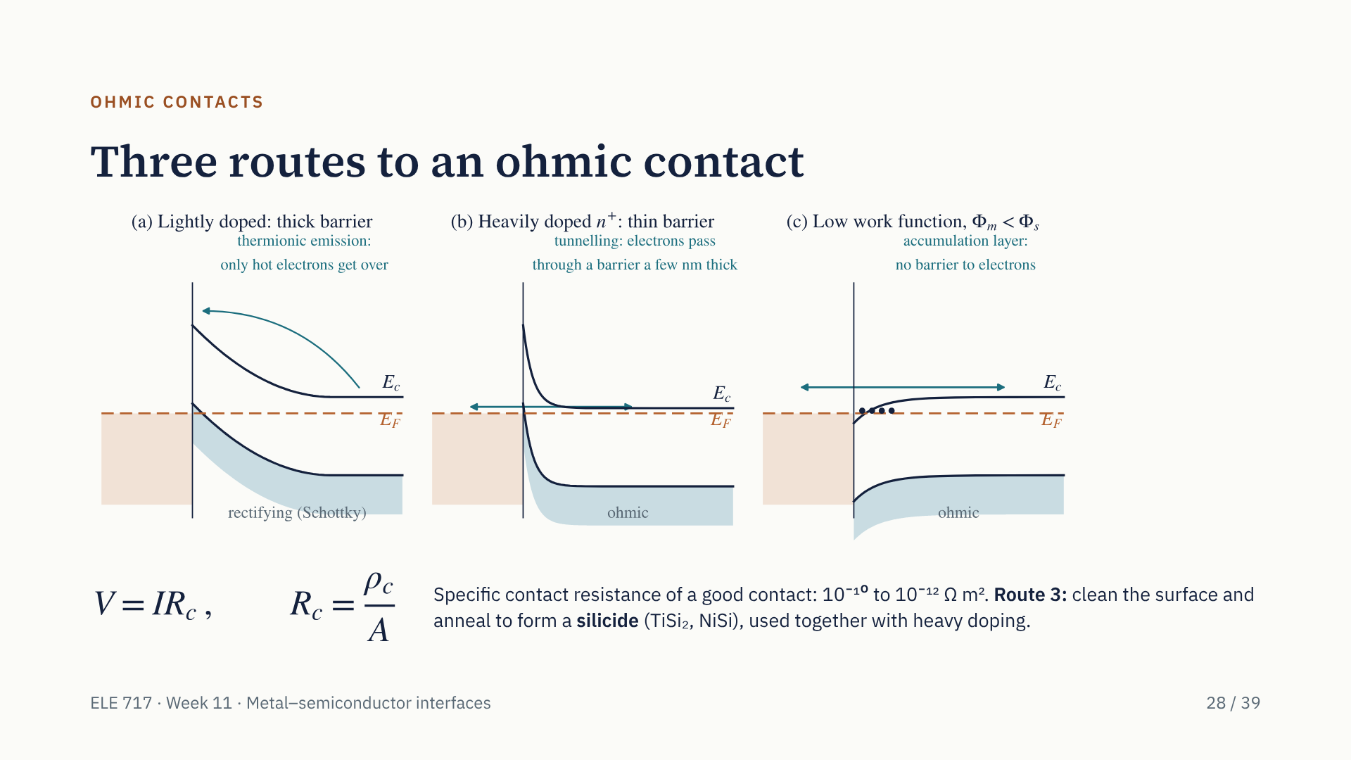
Notes:
Panel (a) is our Schottky contact again: a thick barrier that electrons can only cross by thermionic emission. There are three ways to make an ohmic contact instead. Route 1, panel (c): choose a metal with a work function smaller than the semiconductor's. Electrons then flow into the semiconductor, accumulate at the surface, the bands bend down and there is no barrier. In practice Fermi-level pinning makes this unreliable on silicon and gallium arsenide. Route 2, panel (b), the practical one: dope very heavily under the contact. The barrier height is the same, but the barrier becomes a few nanometres thin and electrons tunnel through it in both directions. Route 3: surface cleaning and annealing to form a silicide, combined with route 2. Contacts are judged by their specific contact resistance, resistance times area.

Slide 37
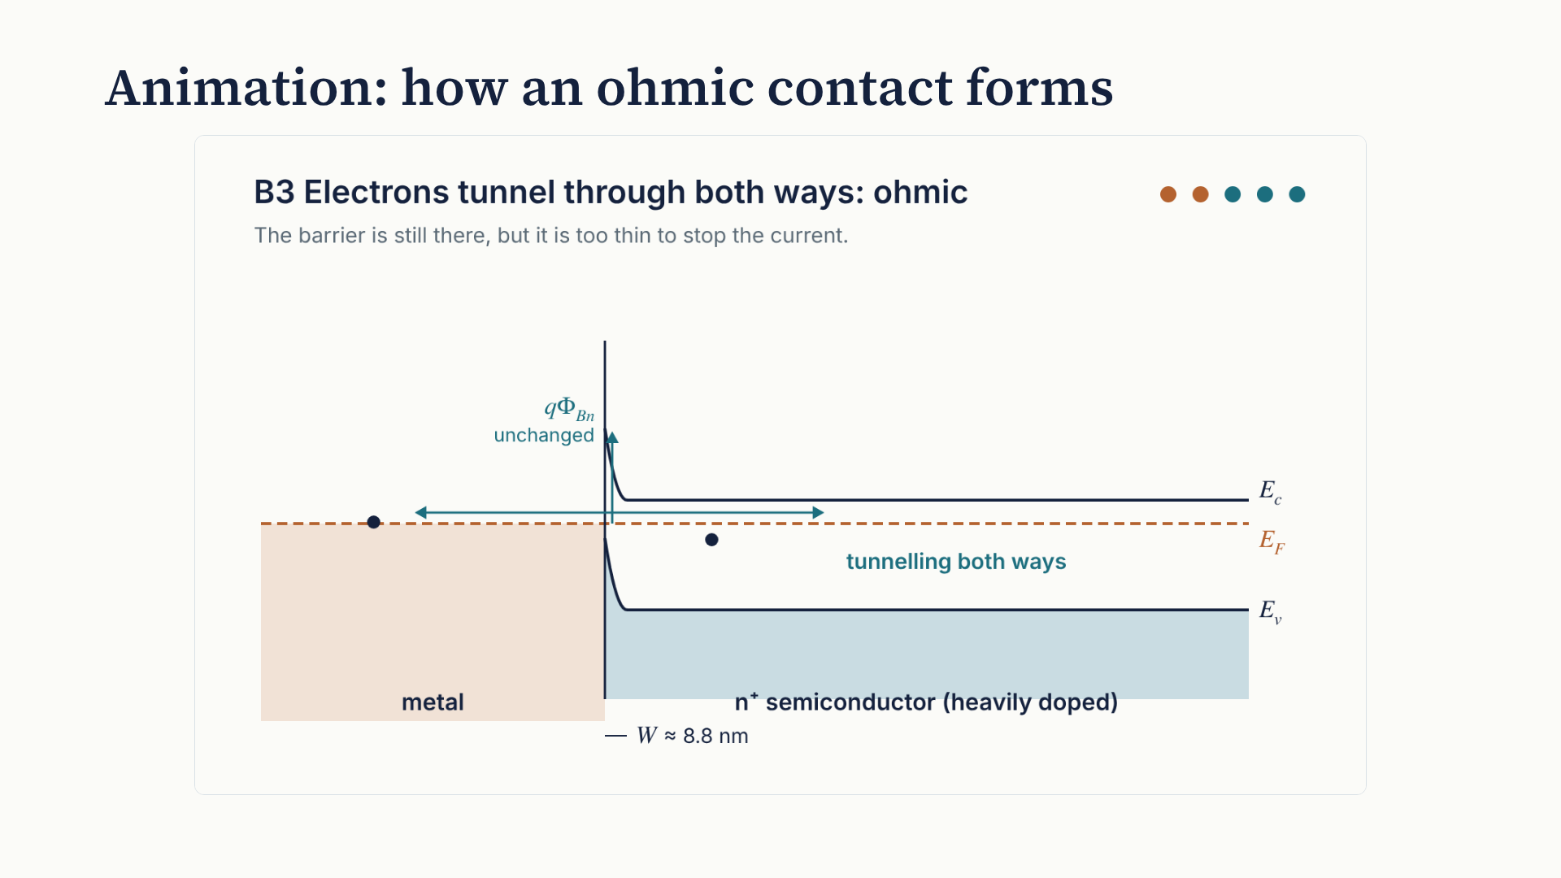
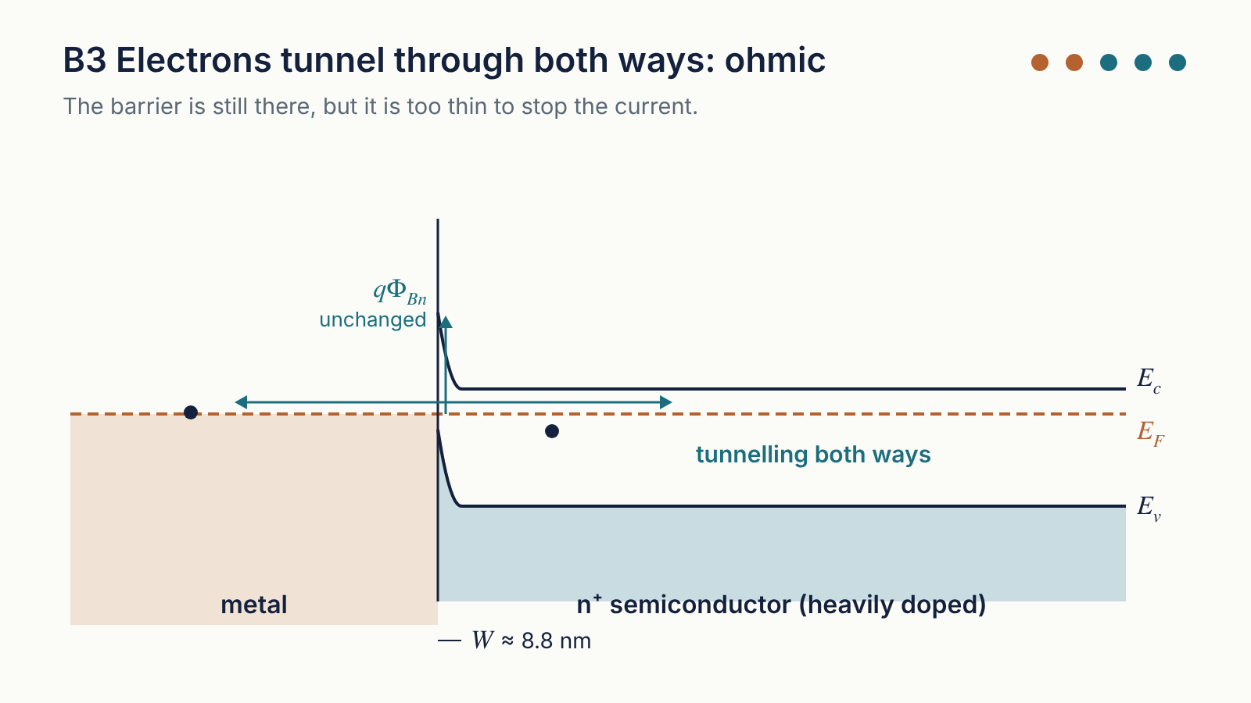
Notes:
The animation loops every 23 seconds and has two scenes. Scene A, steps A1 and A2: a metal whose work function is smaller than the semiconductor's. Before contact the metal's Fermi level is higher, so on contact electrons flow into the semiconductor and pile up at the surface in an accumulation layer. The bands bend down and there is no barrier: electrons move freely both ways. Scene B, steps B1 to B3: the practical method. First a lightly doped contact with a thick barrier: an electron bounces back. Then the doping is raised from 10 to the 22 to 10 to the 25 per cubic metre; the barrier height stays the same but the barrier thins from 279 to 8.8 nanometres. Now electrons tunnel straight through in both directions: the contact is ohmic.

Slide 38
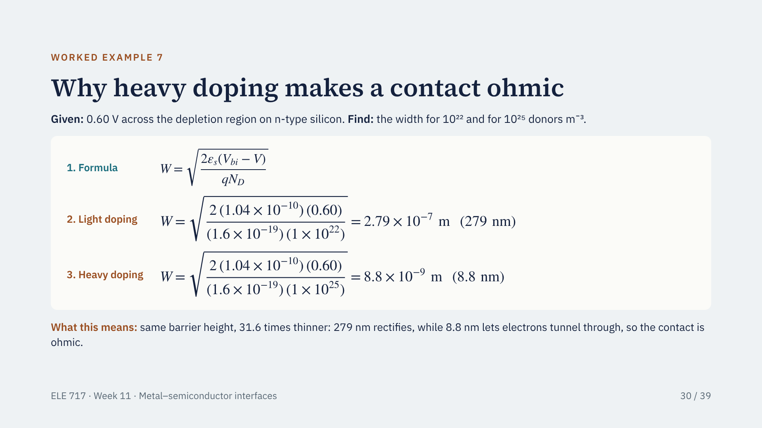
Notes:
This example, from our group notes, shows the heavy-doping route in numbers. The formula is the depletion width. With 0.6 V across the region and 10 to the 22 donors per cubic metre, W is 279 nanometres: far too thick to tunnel through, so the contact rectifies. Raise the doping a thousand times, to 10 to the 25, and W falls by the square root of a thousand, 31.6, to 8.8 nanometres. Electrons now tunnel straight through. The barrier height did not change: the thinness alone makes the contact ohmic.

Slide 39
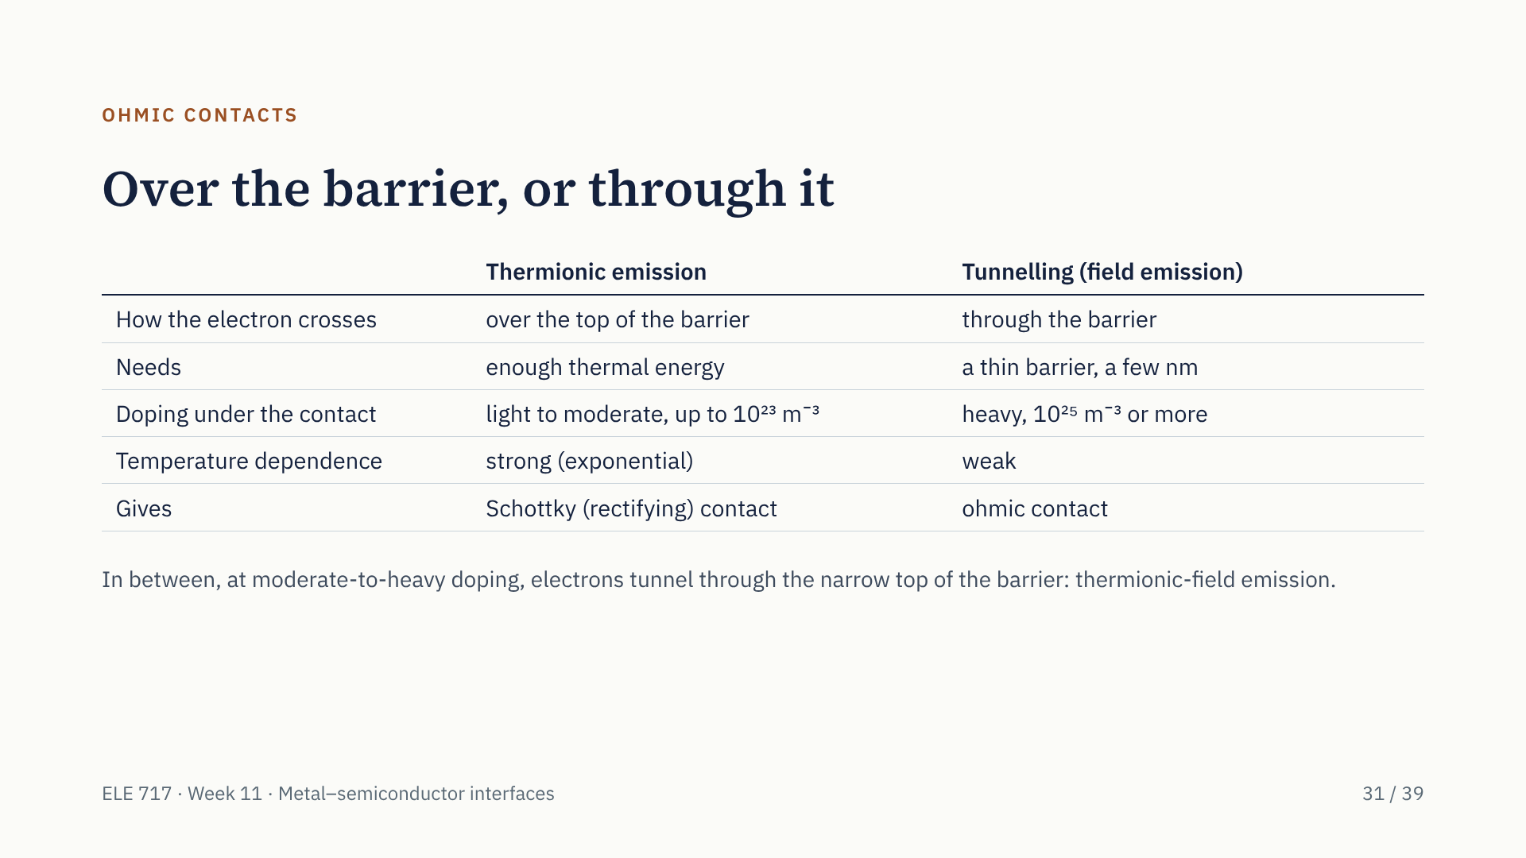
Notes:
The two ways of crossing a barrier, side by side. Thermionic emission needs thermal energy, so it depends strongly on temperature and on barrier height; it gives a rectifying Schottky contact. Tunnelling needs only a thin barrier, which heavy doping provides; it hardly depends on temperature and gives an ohmic contact. Between the two, electrons that are partly heated tunnel through the thinner top part of the barrier: this is called thermionic-field emission.

Slide 40
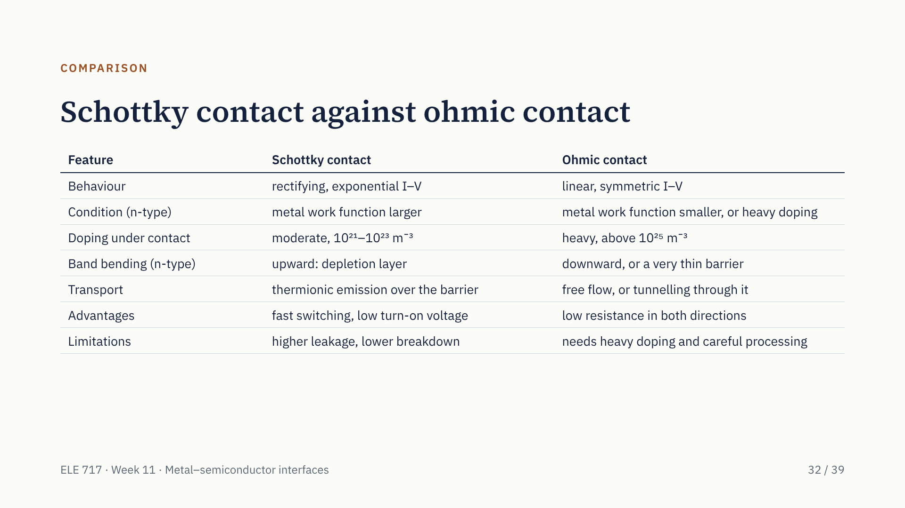
Notes:
Here is the comparison in one table; it is the table the examiner expects at the end of question 49. Read across each row: behaviour, the work-function condition for n-type, the doping, the band bending, how carriers cross, and the advantages and limitations. For p-type silicon the work-function conditions are reversed.

Slide 41
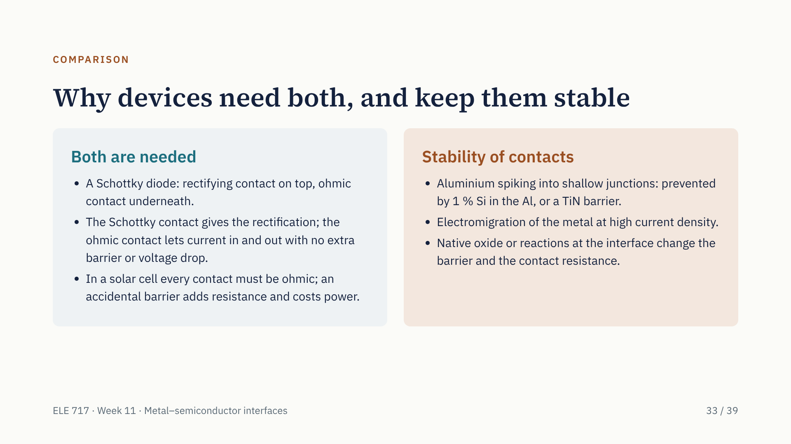
Notes:
A practical device uses both kinds of contact together. In a Schottky diode the top contact rectifies and the bottom one is ohmic, so the current can get out without a second barrier. In a solar cell every contact must be ohmic: an unintended rectifying contact adds series resistance, lowers the fill factor and reduces the output power. Contacts must also stay stable through hot processing and years of use: aluminium can spike into shallow junctions, metal can migrate under high current, and oxides or reactions at the interface change the barrier height and contact resistance.

Slide 42
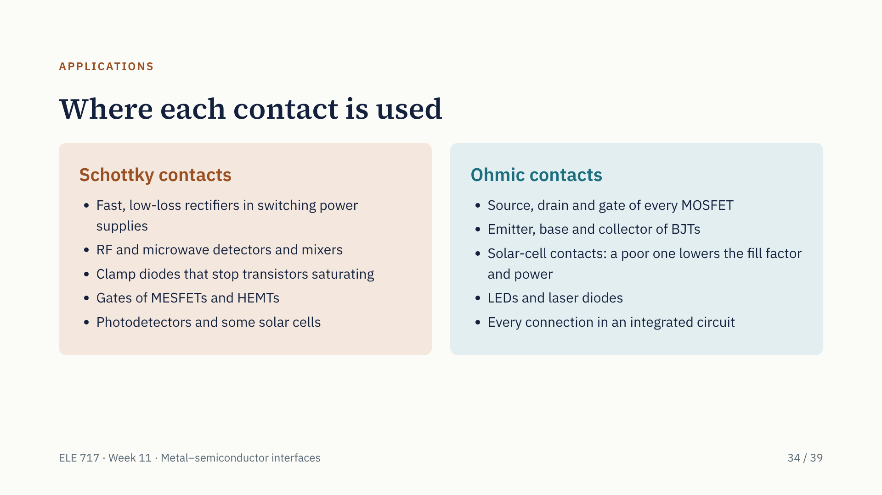
Notes:
Schottky contacts are used wherever we want speed or a low forward drop: power-supply rectifiers, RF detectors and mixers, clamp diodes, and the gates of MESFETs and HEMTs. Ohmic contacts are everywhere else: every transistor terminal and every connection on a chip. In a solar cell, a contact that is accidentally rectifying adds series resistance, lowers the fill factor and costs output power. Contacts must also stay stable: aluminium can spike into shallow junctions, and high current densities cause electromigration.

Slide 43
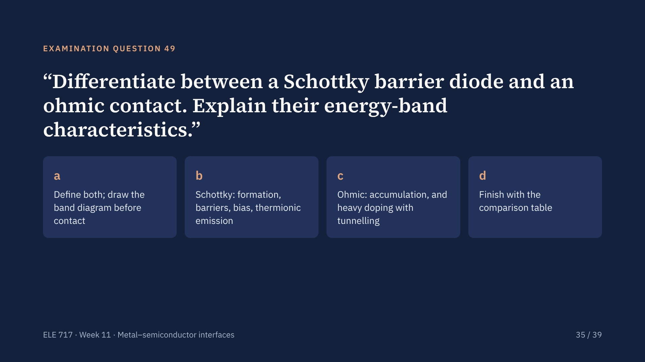
Notes:
This is the examination question for our topic. A full-mark answer has four parts: definitions and the band diagram before contact; the Schottky barrier, how it forms, its two barriers, its behaviour under bias and thermionic emission; the two band-diagram routes to an ohmic contact; and a comparison table. The next two slides give the model answer.

Slide 44
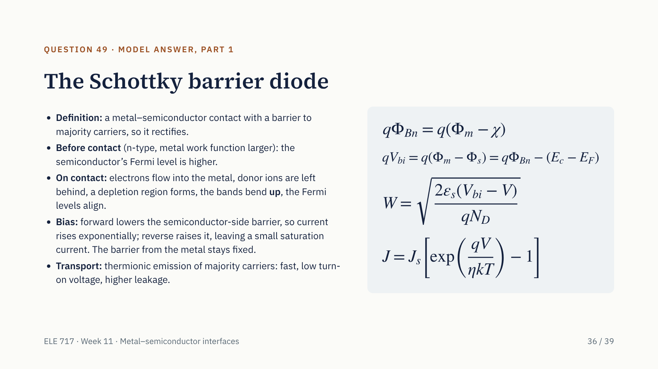
Notes:
Part one of the model answer: the Schottky diode. Define it, then describe the band diagram before contact, the formation steps, the two barriers with their formulas, the depletion width, the effect of forward and reverse bias, and thermionic emission. In the exam, draw three labelled sketches: before contact, at equilibrium, and under bias. Quote a number if you can: gold on n-type silicon gives 1.05 eV ideally, about 0.8 eV measured, with V bi of 0.84 V and W of 0.33 micrometres.

Slide 45
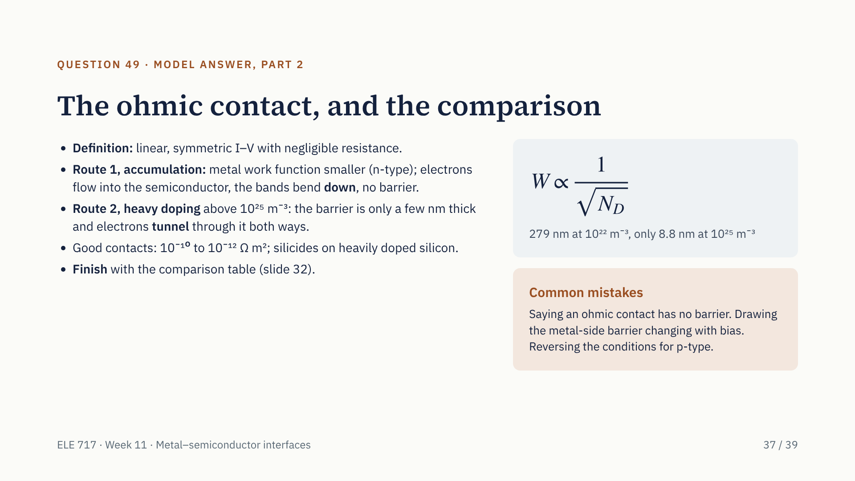
Notes:
Part two: the ohmic contact. Define it, then give both band-diagram routes: accumulation when the metal work function is smaller, with downward bending and no barrier; and heavy doping, where the barrier stays but is so thin that electrons tunnel through. Quote the 279 nanometre versus 8.8 nanometre comparison. Mention the specific contact resistance and silicides. Then finish with the comparison table. Avoid the three common mistakes listed: they cost marks every year.

Slide 46
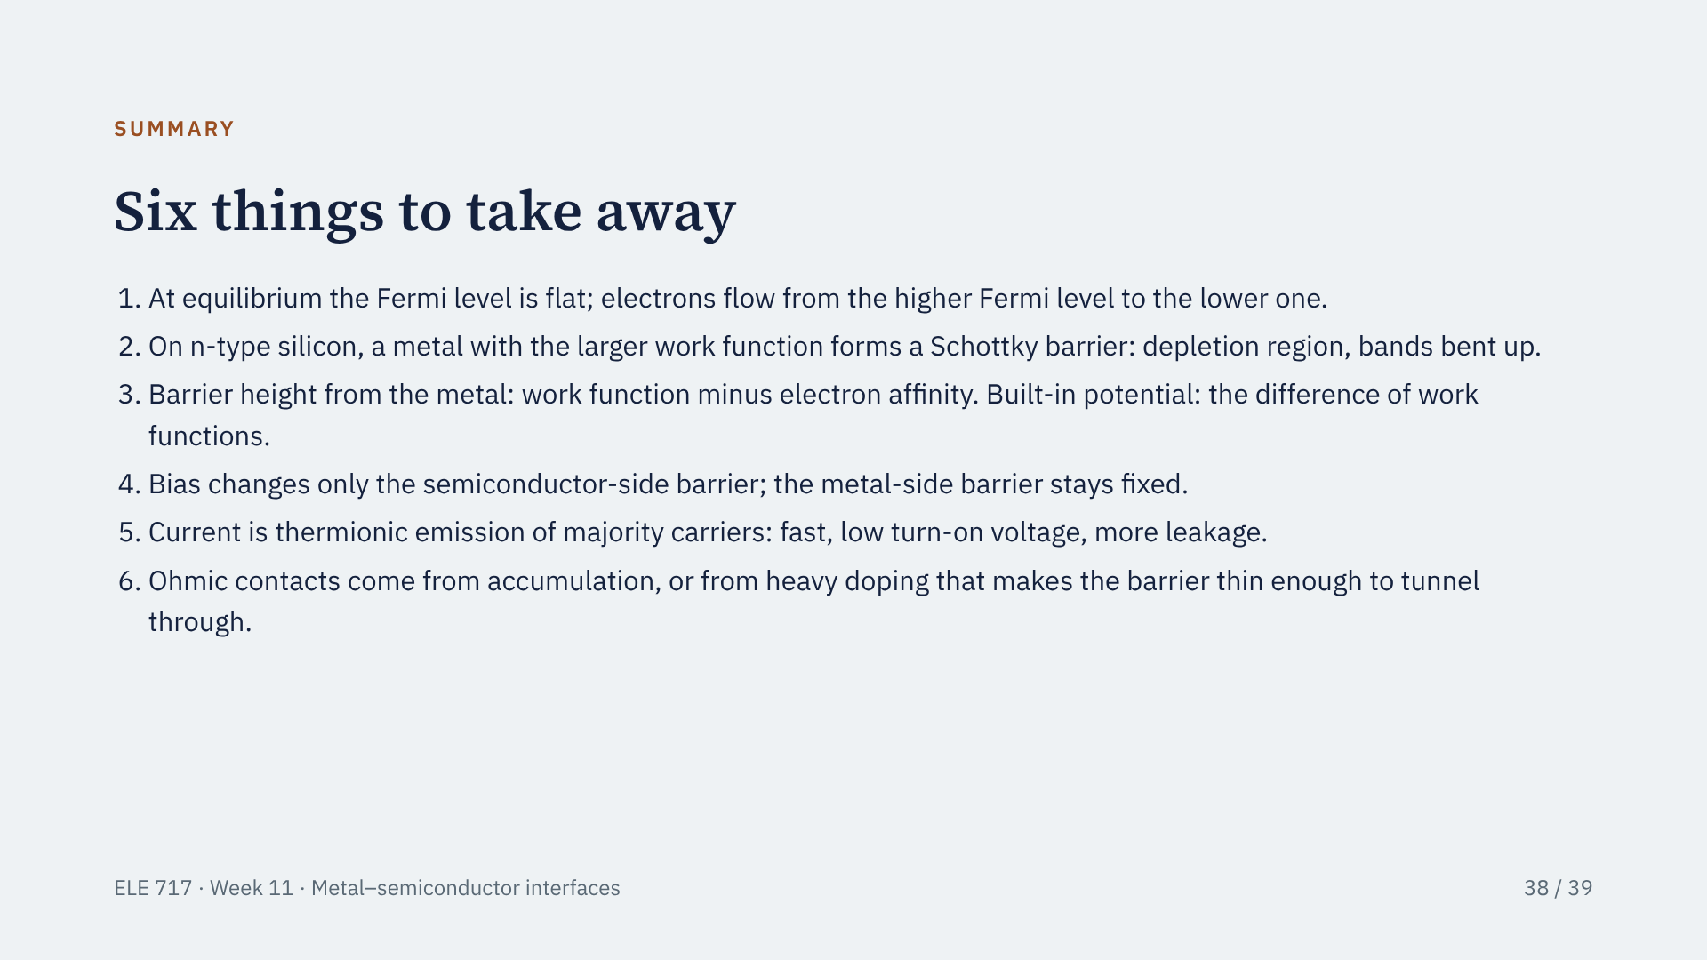
Notes:
To sum up in six points. If you remember only one thing, remember that the Fermi level is flat at equilibrium: every band diagram today follows from it. Real barriers are also set largely by Fermi-level pinning, so use measured barrier heights when they are given.

Slide 47
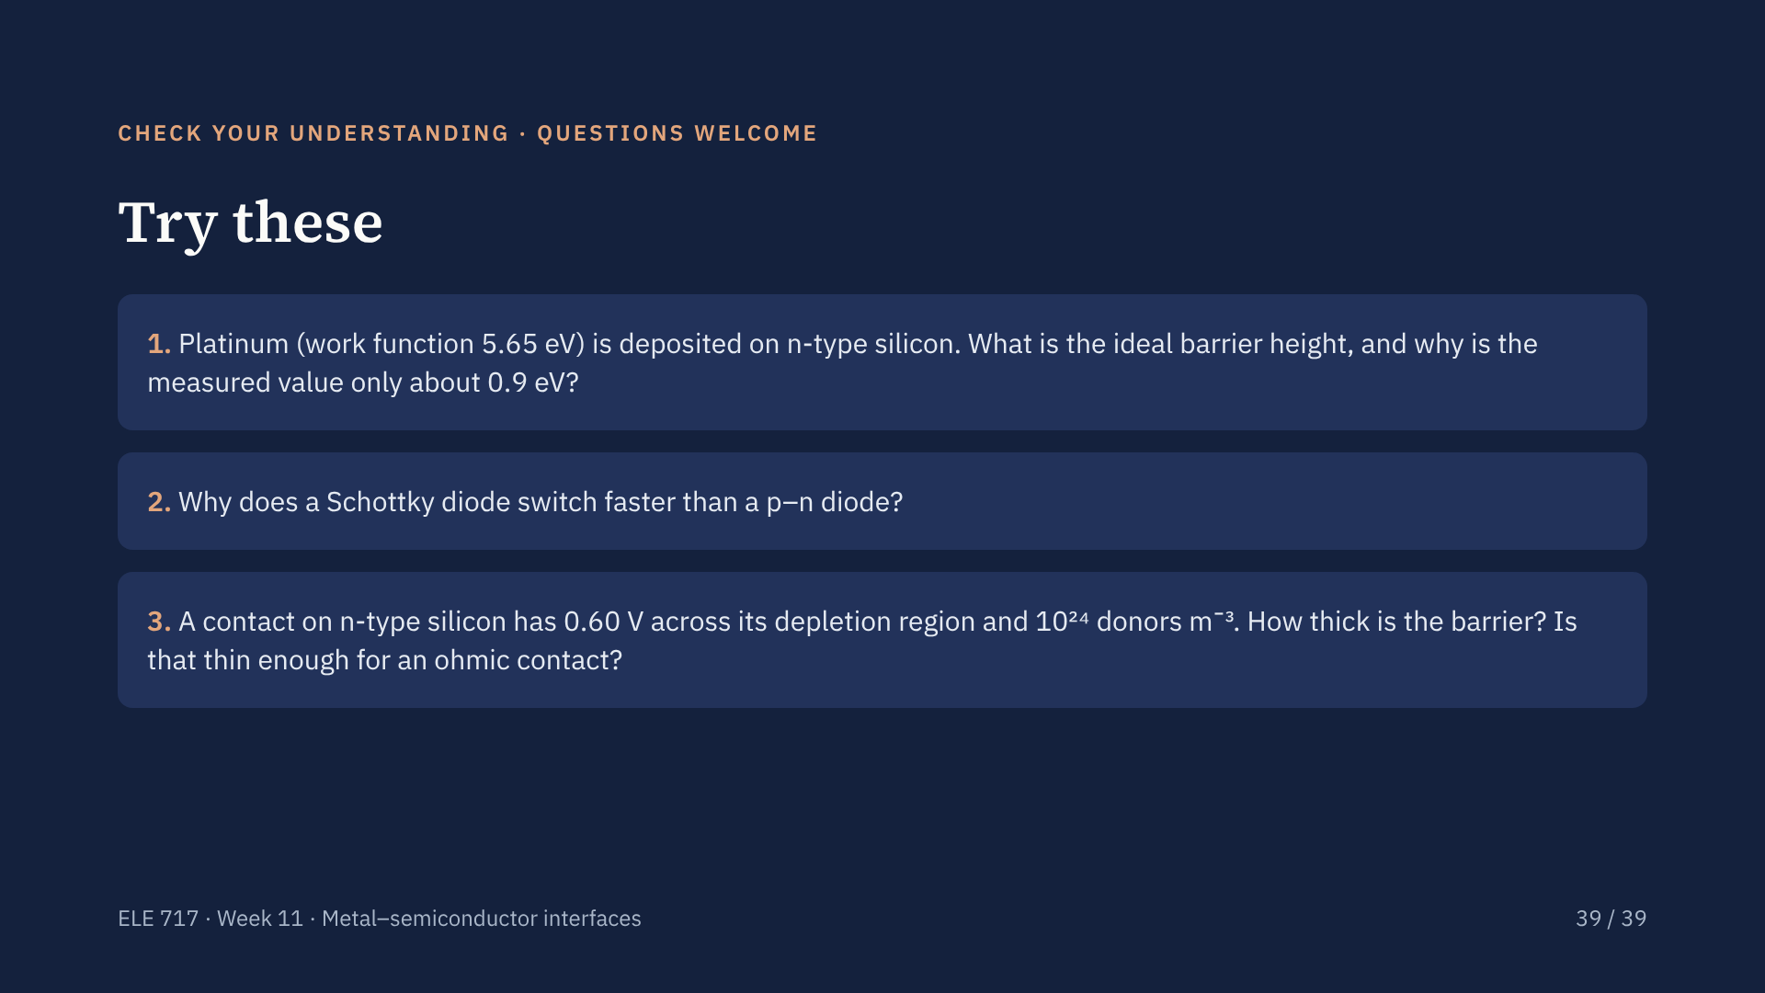
Notes:
Answers. 1: ideal barrier height = 5.65 minus 4.05 = 1.60 eV; the measured value is about 0.9 eV because interface states pin the Fermi level at the surface. 2: a Schottky diode conducts by majority carriers only, so no minority charge is stored and there is no reverse-recovery delay. 3: W = 2.79 times 10 to the minus 7 metres divided by the square root of 100, which is 2.8 times 10 to the minus 8 metres, 28 nanometres. That is still too thick for strong tunnelling; the doping must be raised to about 10 to the 25 per cubic metre, which gives 8.8 nanometres. Then invite questions from the class.

