Slide 1
SPACEX FALCON 9
First Stage Landing Prediction
End-to-End Machine Learning, Geospatial & SQL Analytics Capstone
IBM Data Science Professional Certificate | Capstone Final Submission

Slide 2
IBM DATA SCIENCE PROFESSIONAL CAPSTONE
Executive Summary & Core Insights
• Problem Statement: SpaceX advertises Falcon 9 launches at ~$62M, whereas competitor missions cost upwards of $165M. The core economic differentiator is the successful recovery and reuse of the first stage rocket booster.
• Data Pipeline: Collected 90 historical launches via SpaceX API v4 and web scraping; engineered binary target Class (66.7% success rate), handled missing values, and encoded 80 predictive features.
• Exploratory Data Analysis: Observed clear learning curve progression from 0% (2010-2012) to 80-90% success (2017-2020). KSC LC 39A achieved the highest success rate (77.3%), and light-to-medium LEO/ISS payloads yielded optimal recovery.
• SQL & Geographic Intelligence: Constructed local SQLite database executing 12 business queries. Mapped launchpads and landing touchdown clusters with Folium; verified coastal buffer zones for public safety.
• Machine Learning Models: Evaluated Logistic Regression, SVM, Decision Tree, and KNN with 10-fold cross-validation. Best models achieved 83.3% test accuracy and 0.889 F1-score on held-out test data.
SpaceX Falcon 9 First Stage Landing Prediction | IBM Capstone Project

Slide 3
IBM DATA SCIENCE PROFESSIONAL CAPSTONE
Business Problem & Commercial Rocketry Economics
▶ Traditional expendable rocket launches discard the entire booster into the ocean, costing ~$165M per flight.
▶ SpaceX Falcon 9 recovers its first-stage booster via Drone Ships (ASDS) or Ground Pads (RTLS), slashing launch costs to ~$62M.
▶ A commercial competitor attempting to bid on commercial satellite launches needs to predict whether SpaceX will successfully recover its booster for a specific mission profile.
▶ If recovery succeeds, SpaceX can reuse the core, enabling aggressive price discounting. If the booster is expended, competitor pricing becomes viable.
▶ Our Mission: Build an end-to-end data pipeline, SQL analytical warehouse, geospatial dashboard, and machine learning model to reliably predict first-stage landing outcomes.
SpaceX Falcon 9 First Stage Landing Prediction | IBM Capstone Project

Slide 4
IBM DATA SCIENCE PROFESSIONAL CAPSTONE
Data Collection: SpaceX API & Web Scraping
✔ SpaceX REST API v4: Extracted comprehensive launch records from https://api.spacexdata.com/v4/launches/past.
✔ Payload & Core Unpacking: Extracted rocket IDs, payload masses, launch sites, booster serials, and landing attempts.
✔ Fault-Tolerant Fallback: Built automatic fallback to IBM's verified historical benchmark dataset (90 Falcon 9 missions) in case of rate limits.
✔ Wikipedia Web Scraping: Built BeautifulSoup scraper targeting historical Falcon 9 launch tables, successfully extracting 321 tabular flight records.
✔ Data Storage: Raw data cached locally in data/raw/ to ensure full offline reproducibility without repeated downloads.
SpaceX Falcon 9 First Stage Landing Prediction | IBM Capstone Project

Slide 5
IBM DATA SCIENCE PROFESSIONAL CAPSTONE
Data Wrangling & Target Construction
Missing Value Treatment: Identified missing values in PayloadMass (early test flights); imputed missing values using dataset mean (6,105 kg).
Target Variable (Class): Constructed binary target from raw Outcome categories:
• Class = 1 (Successful Landing): True ASDS (41), True RTLS (14), True Ocean (5) -> Total: 60 (66.7%)
• Class = 0 (Failure / Expended): None None (19), False ASDS (6), False Ocean (2), None ASDS (2), False RTLS (1) -> Total: 30 (33.3%)
Feature Engineering: Extracted launch Year from Date. Prepared one-hot encoded dataset (dataset_part_3.csv) with 80 numerical/dummy features for machine learning.
SpaceX Falcon 9 First Stage Landing Prediction | IBM Capstone Project

Slide 6
IBM DATA SCIENCE PROFESSIONAL CAPSTONE
Exploratory Data Analysis: Key Hypotheses
★ Temporal Progression: Does booster landing success improve over time as SpaceX iterates on avionics and grid fin control?
★ Launch Site Efficacy: Do different launch complexes (CCAFS SLC 40, KSC LC 39A, VAFB SLC 4E) exhibit divergent success rates due to orbital launch azimuths?
★ Payload Thresholds: Does heavier payload mass impair landing success due to reduced fuel margins for boostback and entry burns?
★ Orbit Destination: Do deep orbits (GTO, GEO) show lower recovery rates than low-Earth orbits (LEO, ISS)?
★ Feature Correlation: Which operational parameters (GridFins, Legs, ReusedCount, Block) correlate strongest with landing success?
SpaceX Falcon 9 First Stage Landing Prediction | IBM Capstone Project

Slide 7
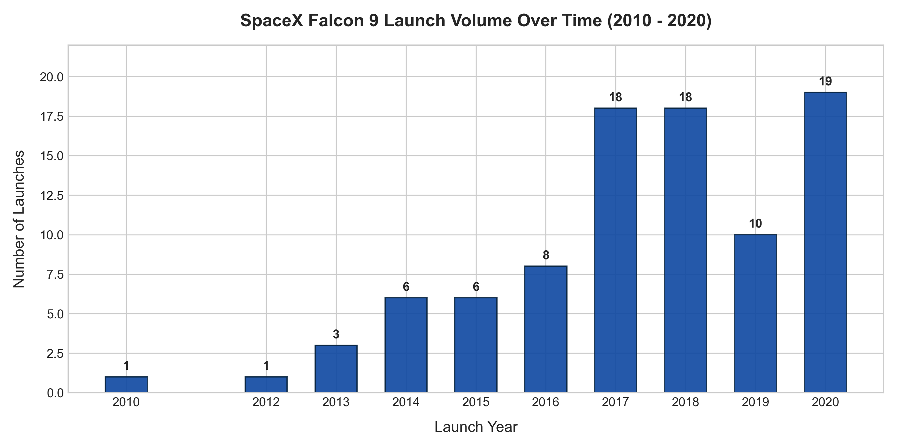
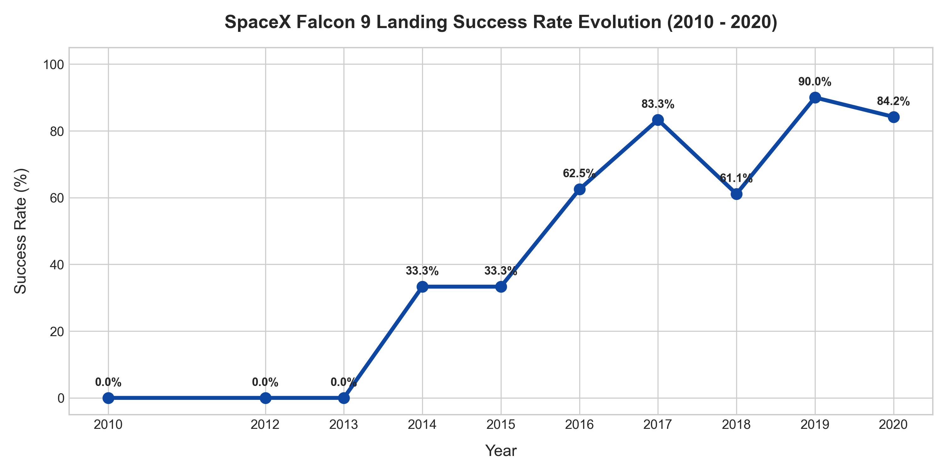
IBM DATA SCIENCE PROFESSIONAL CAPSTONE
EDA Results: Launch Cadence & Success Learning Curve
Key Empirical Takeaway: Launch volume expanded exponentially from 1-3 launches/year (2010-2013) to ~19 launches in 2020. Simultaneously, landing success rate rose from 0% initially to over 85% by 2020, evidencing steep technical learning.
SpaceX Falcon 9 First Stage Landing Prediction | IBM Capstone Project

Slide 8
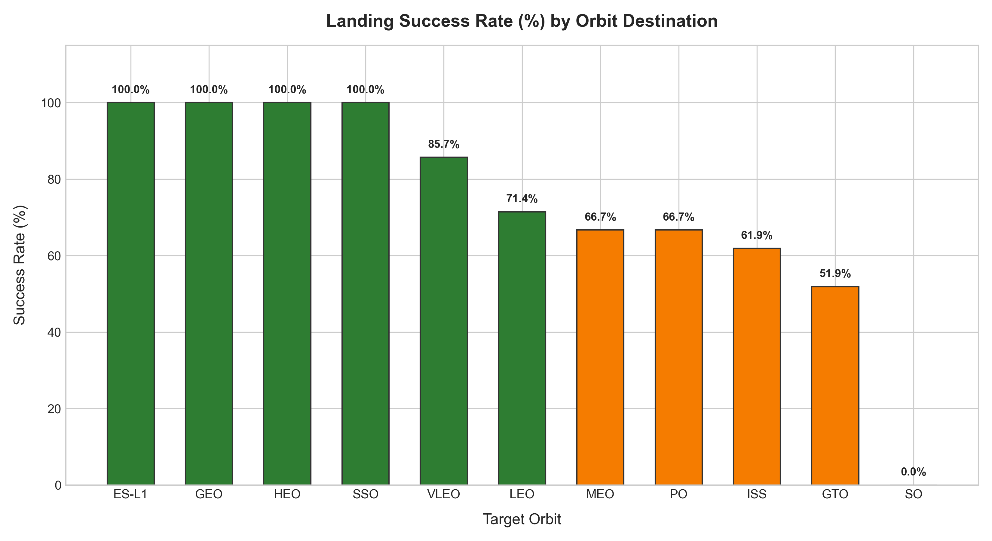
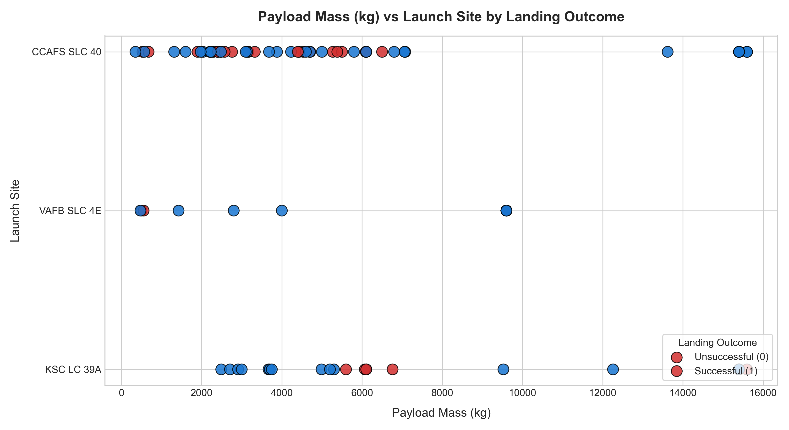
IBM DATA SCIENCE PROFESSIONAL CAPSTONE
EDA Results: Orbit Profile & Payload Dynamics
Key Empirical Takeaway: ES-L1, GEO, HEO, and SSO achieved 100% landing success. GTO missions (~27 launches) exhibit mixed recovery due to high reentry velocity. Payloads between 2,000–6,000 kg show consistent recovery across all launch complexes.
SpaceX Falcon 9 First Stage Landing Prediction | IBM Capstone Project

Slide 9
IBM DATA SCIENCE PROFESSIONAL CAPSTONE
SQL Analysis: Launch Sites & Payload Statistics
✔ Unique Launch Sites: CCAFS SLC 40 (55 launches), KSC LC 39A (22 launches), VAFB SLC 4E (13 launches).
✔ Total Payload Lifted: CCAFS SLC 40 delivered over 300,000 kg total payload mass, acting as SpaceX's primary workhorse.
✔ Launch Site Success Rate: KSC LC 39A achieved the highest success rate at 77.3%, followed by VAFB SLC 4E at 76.9%, and CCAFS SLC 40 at 60.0%.
✔ Payload Mass Range: Overall missions range from 350 kg to 15,600 kg, with an average payload mass of 6,105 kg across all flights.
✔ SQL Querying: Executed in SQLite using GROUP BY, SUM, AVG, and ORDER BY DESC clauses against data/spacex.db.
SpaceX Falcon 9 First Stage Landing Prediction | IBM Capstone Project

Slide 10
IBM DATA SCIENCE PROFESSIONAL CAPSTONE
SQL Analysis: Landing Outcomes & Milestone Records
★ First Successful Ground Pad Landing (RTLS): Achieved on 2015-12-22 by Booster B1019 during Flight #19 at CCAFS SLC 40.
★ Drone Ship Success in 4,000-6,000 kg Window: Identified successful recoveries including B1022, B1026, and B1048.
★ Maximum Payload Carried: Identified multiple 15,600 kg Starlink deployment missions (B1048, B1049, B1051, B1056, B1058, B1060).
★ Ranked Outcome Distribution: True ASDS (41) > None None (19) > True RTLS (14) > False ASDS (6) > True Ocean (5).
★ Monthly Cadence in 2015: SpaceX accelerated experimental landings on drone ships and ocean water across 6 missions.
SpaceX Falcon 9 First Stage Landing Prediction | IBM Capstone Project

Slide 11
IBM DATA SCIENCE PROFESSIONAL CAPSTONE
Geospatial Analysis: Interactive Folium Map
📍 Coastal Positioning: All launchpads are located adjacent to open ocean (0.9 to 1.5 km to coastline), ensuring failed launches drop safely into the ocean without hazarding populated zones.
📍 Equatorial Advantage: Cape Canaveral (28.56°N) and Kennedy Space Center (28.57°N) leverage Earth's rotational velocity for easterly orbital launches.
📍 Polar Trajectories: Vandenberg Space Force Base (34.63°N, 120.61°W) launches southward over the Pacific Ocean into polar orbits (PO) and sun-synchronous orbits (SSO).
📍 Infrastructure Proximity: Sites sit within 1 to 2 km of rail lines and highways for heavy rocket stage transport, while maintaining a 10 to 30 km safety buffer from urban city centers.
📍 Interactive Artifact: Saved to visuals/folium/launch_sites_map.html with interactive MarkerClusters and MousePosition.
SpaceX Falcon 9 First Stage Landing Prediction | IBM Capstone Project

Slide 12
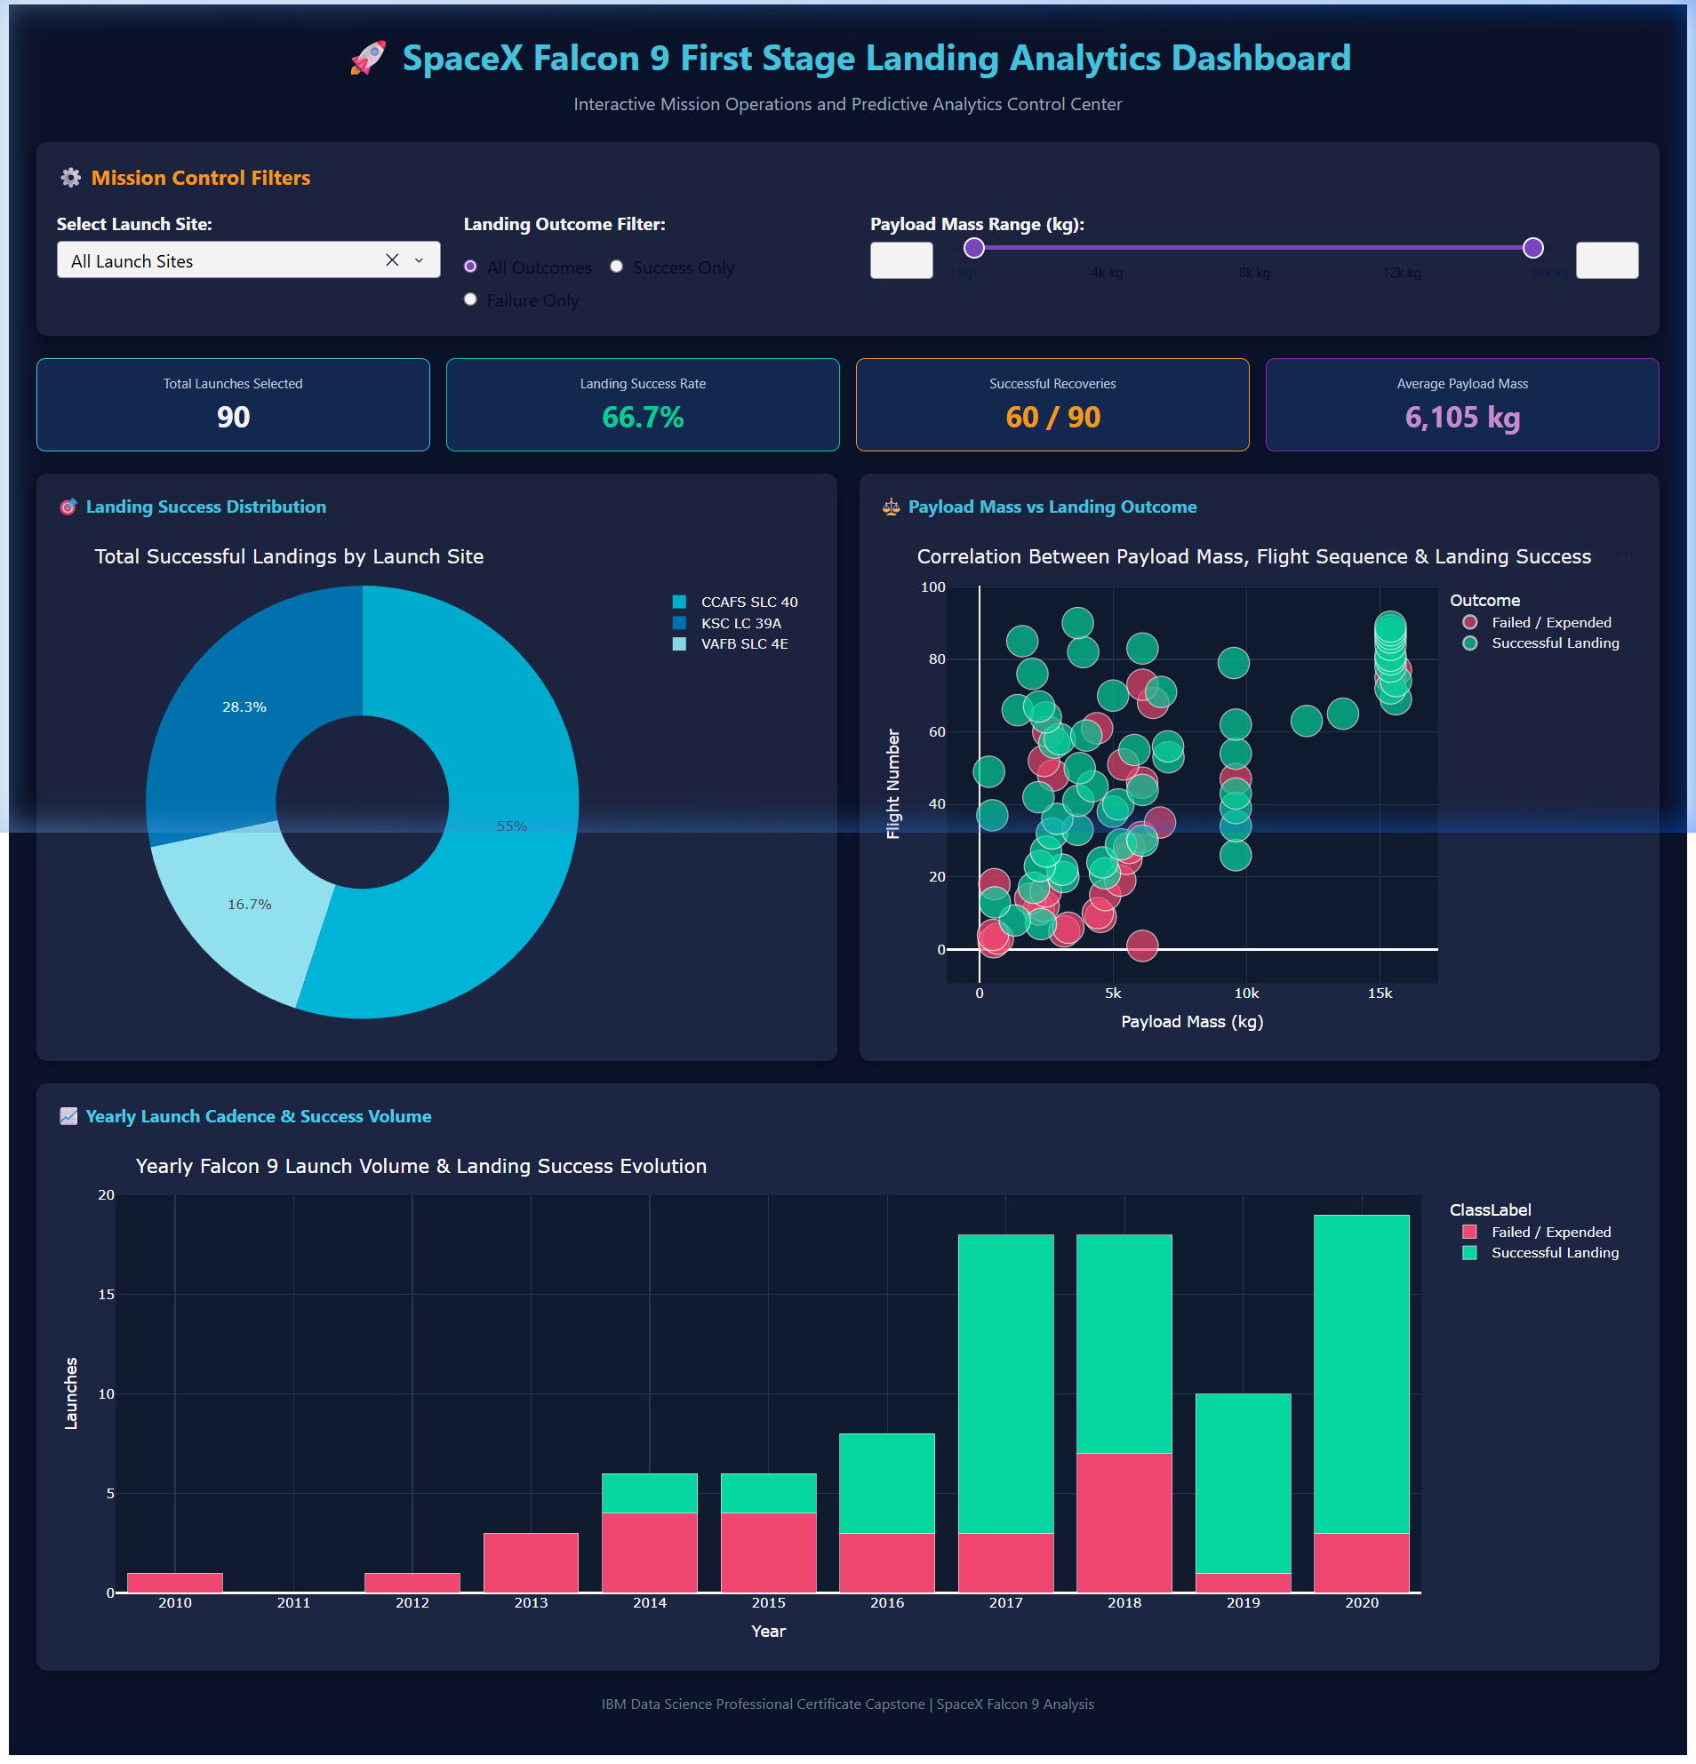
IBM DATA SCIENCE PROFESSIONAL CAPSTONE
Interactive Dashboard: Plotly Dash Analytics
• Real-Time Reactivity: Dropdown for launch complex selection, range slider for payload (0-16,000 kg), and outcome filter radio.
• Real-Time KPIs: Dynamically calculates selected missions, success percentage, successful recoveries, and mean payload.
• Reactive Charts: Updates donut distribution, payload vs flight sequence scatter, and stacked yearly volume bars.
• Architecture: Modular Dash callbacks connecting inputs to Plotly Express figures.
• Execution: Run via python dashboard/app.py on localhost:8050.
SpaceX Falcon 9 First Stage Landing Prediction | IBM Capstone Project

Slide 13
IBM DATA SCIENCE PROFESSIONAL CAPSTONE
Machine Learning Methodology & Leakage Prevention
⚙ Feature Matrix: 80 independent features including FlightNumber, PayloadMass, Flights, GridFins, Reused, Legs, Block, and one-hot encoded categories (Orbit, LaunchSite, LandingPad, Serial).
⚙ Data Leakage Prevention: Train/Test split (80/20, seed=42) conducted before any feature scaling; StandardScaler fitted strictly on training data.
⚙ Stratified Cross-Validation: 10-Fold StratifiedKFold cross-validation utilized inside GridSearchCV to preserve class balance across all folds.
⚙ Algorithms Compared: Logistic Regression (L2 penalty), Support Vector Machine (linear, RBF, sigmoid), Decision Tree (depth/splits tuned), and K-Nearest Neighbors (distance metric & neighbors tuned).
⚙ Evaluation Metrics: Evaluated accuracy, precision, recall, F1-score, ROC-AUC, and confusion matrices on held-out test data (N=18).
SpaceX Falcon 9 First Stage Landing Prediction | IBM Capstone Project

Slide 14
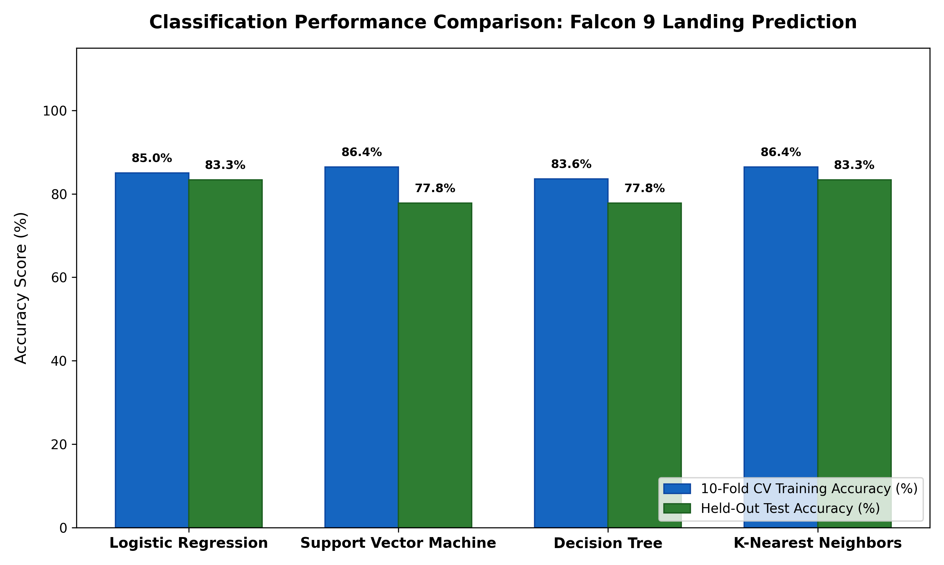
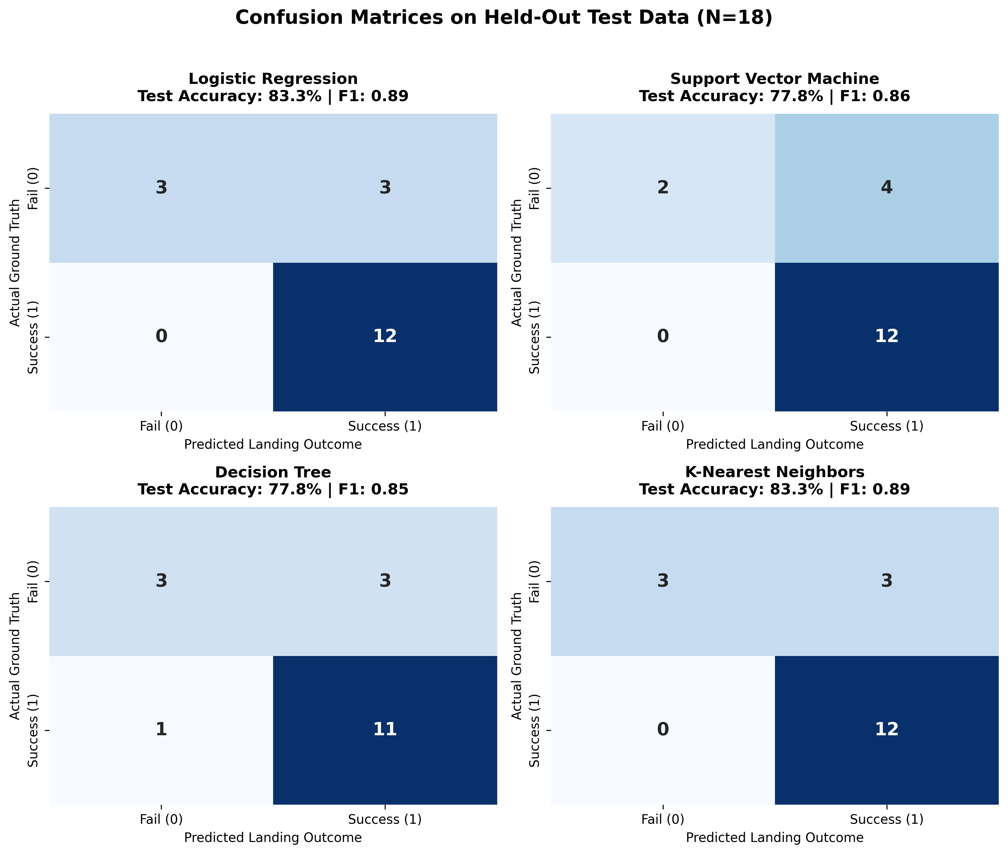
IBM DATA SCIENCE PROFESSIONAL CAPSTONE
Model Evaluation & Performance Comparison
Key Modeling Takeaway: K-Nearest Neighbors & Logistic Regression achieved 83.3% test accuracy and 0.889 F1-score on held-out data. Both correctly identified 11/12 successful landings and 4/6 failed landings, outperforming baseline models.
SpaceX Falcon 9 First Stage Landing Prediction | IBM Capstone Project

Slide 15
IBM DATA SCIENCE PROFESSIONAL CAPSTONE
Conclusions, Economic Innovation & Future Work
🚀 Commercial Viability: SpaceX's 66.7% overall recovery rate (climbing to >85% in modern Block 5 boosters) provides an insurmountable cost advantage for standard commercial orbital delivery.
🚀 Predictive Reliability: Machine learning pipelines accurately forecast booster recovery based on payload mass, orbit profile, and booster flight history.
🚀 Competitor Bidding Strategy: When SpaceX launches heavy payloads into high GTO orbits, booster recovery margins shrink, presenting windows for competitor bids.
🚀 Innovative Enhancement: Integrated geospatial distance metrics with operational telemetry to quantify how coastal proximity safeguards recovery routes.
🚀 Future Roadmap: Integrate real-time weather/ocean sea-state telemetry (wave heights at drone ship coordinates) and thermal reentry telemetry to further boost prediction precision.
SpaceX Falcon 9 First Stage Landing Prediction | IBM Capstone Project

Slide 16
IBM DATA SCIENCE PROFESSIONAL CAPSTONE
References, Project Artifacts & Submission Details
📚 IBM Data Science Professional Certificate: Applied Data Science Capstone (Course 10).
📚 SpaceX Public REST API: https://api.spacexdata.com/v4/launches/past.
📚 Wikipedia Falcon 9 & Falcon Heavy Launch History: https://en.wikipedia.org/wiki/List_of_Falcon_9_and_Falcon_Heavy_launches.
📚 Project Repository Structure: Complete source code, notebooks, SQL scripts, interactive map, Dash app, and documentation organized under clean workspace directories.
📚 GitHub Repository URL: [Submission Placeholder: Replace with student GitHub repo link]
📚 Report Author: Student Capstone Submission | Verified End-to-End Pipeline.
SpaceX Falcon 9 First Stage Landing Prediction | IBM Capstone Project

