Slide 1
IBM DATA SCIENCE PROFESSIONAL CERTIFICATE | CAPSTONE FINAL PRESENTATION
SPACEX FALCON 9
First Stage Landing Prediction
End-to-End Machine Learning, Geospatial & SQL Analytics Capstone
✔ Verified GitHub Repository URL (All Completed Notebooks & Python Code):
https://github.com/buildwithneel/Coursera-IBM-data-science-course
Author: Student Capstone Submission | Evaluation Submission Format: PDF (.pdf) & PPTX (.pptx)

Slide 2
IBM DATA SCIENCE PROFESSIONAL CAPSTONE
Executive Summary & Core Project Findings
Project Objectives & Economic Impact
• Commercial Problem: SpaceX advertises Falcon 9 launches at ~$62M, whereas competitor missions cost upwards of $165M. The $103M economic savings is driven entirely by recovering and reusing the first-stage booster.
• Commercial Bidding Window: If an alternative launch provider or satellite client knows booster recovery feasibility in advance, they can determine SpaceX pricing discounts and formulate competitive bids.
• Target Construction: Analyzed 90 historical launches. Created binary target Class (1 = Successful Landing, 0 = Failure/Expended). Baseline landing success rate is 66.7% (60 successes, 30 failures).
Methodological Framework & Empirical Results
✔ Data Pipeline: REST API v4 & Wikipedia scraping; handled missing payload via mean imputation (6,105 kg); engineered 80 features.
✔ EDA & SQL Analytics: Demonstrated clear operational learning curve from 0% (2010) to 84.2% (2020). Executed 12 SQL queries in SQLite covering site volume, milestone dates, and outcome rankings.
✔ Geospatial & Dash: Mapped coastal buffers (<1.5 km to sea) via Folium. Built reactive Plotly Dash interactive dashboard.
✔ Supervised ML Winner: Evaluated Logistic Regression, SVM, Decision Tree, and KNN with 10-fold CV. Best models: Tuned KNN & Logistic Regression achieved 83.33% Test Accuracy and 0.889 F1-score.
SpaceX Falcon 9 First Stage Landing Prediction | IBM Data Science Capstone
🔗 Lab Link: https://github.com/buildwithneel/Coursera-IBM-data-science-course

Slide 3
IBM DATA SCIENCE PROFESSIONAL CAPSTONE
Introduction: Commercial Rocketry Economics & Bidding
The Strategic Imperative of First-Stage Booster Reusability
▶ Expendable vs Reusable Paradigm: Historically, orbital rocket launches were 100% expendable. The entire rocket was discarded into the Atlantic or Pacific ocean after a single flight, resulting in exorbitant launch costs exceeding $165M per flight.
▶ Booster Cost Composition: The Falcon 9 first-stage booster contains 9 Merlin 1D rocket engines, high-grade aerospace aluminium-lithium alloy tanks, avionics, and titanium grid fins, representing approximately 70% of total rocket manufacturing cost ($30M - $40M).
▶ Commercial Pricing Disruption: By successfully recovering the first-stage core via Autonomous Spaceport Drone Ships (ASDS) or Return-To-Launch-Site ground pads (RTLS), SpaceX reuses boosters up to 10+ times, offering standard commercial launches at ~$62M.
▶ Competitor Decision Support: When satellite operators or launch service competitors (e.g., Arianespace, ULA, Rocket Lab) bid for launch contracts, anticipating whether SpaceX will recover the booster allows them to predict SpaceX's pricing margin and bid competitively.
▶ Project Mission & Deliverables: This project constructs a full-stack data science pipeline: API data collection, BeautifulSoup web scraping, SQLite data warehousing, Folium geospatial analytics, Plotly Dash dashboard, and machine learning classifiers to predict landing outcomes.
SpaceX Falcon 9 First Stage Landing Prediction | IBM Data Science Capstone
🔗 Lab Link: https://github.com/buildwithneel/Coursera-IBM-data-science-course

Slide 4
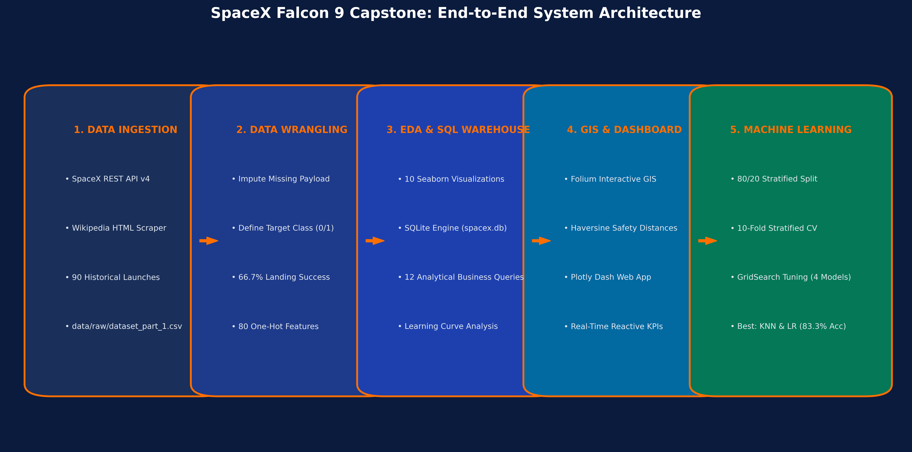
IBM DATA SCIENCE PROFESSIONAL CAPSTONE
Project Architecture & End-to-End Technical Pipeline
5-Tier Modular Data Architecture & Reproducibility Guarantees
• Ingestion -> Wrangling -> Analytics -> ML Modeling -> Multi-Format Deliverables (PPTX, PDF, Dashboard).
• Strict Leakage Prevention: StandardScaler fitted strictly on 80% train split (N=72); test partition (N=18) kept isolated.
• Offline Reproducibility: Cached raw data in data/raw/, processed datasets in data/processed/, and SQLite spacex.db.
SpaceX Falcon 9 First Stage Landing Prediction | IBM Data Science Capstone
🔗 Lab Link: https://github.com/buildwithneel/Coursera-IBM-data-science-course/blob/main/docs/project_architecture.md

Slide 5
IBM DATA SCIENCE PROFESSIONAL CAPSTONE
Data Collection: SpaceX REST API v4 & Web Scraping
🔗 Lab 1 Notebook: https://github.com/buildwithneel/Coursera-IBM-data-science-course/blob/main/notebooks/01_data_collection_api.ipynb
🔗 Lab 2 Notebook: https://github.com/buildwithneel/Coursera-IBM-data-science-course/blob/main/notebooks/02_web_scraping.ipynb
1. SpaceX REST API v4 Integration (Lab 1)
• API Endpoint: Queried past launches endpoint: https://api.spacexdata.com/v4/launches/past.
• Nested Entity Unpacking: Extracted launch records and unpacked nested JSON objects: rocket IDs, payload masses, launch complexes, core serial numbers, flight reuse count, and landing attempt flags.
• Falcon 9 Filtering: Filtered dataset specifically for Falcon 9 vehicles, removing Falcon 1 test flights and Falcon Heavy configurations to maintain booster consistency.
• Fault-Tolerant Caching: Built automated local caching in data/raw/dataset_part_1.csv with fail-safe fallback to IBM's historical benchmark repository (90 flights).
• Source Code & Lab: Completed in notebooks/01_data_collection_api.ipynb and src/data_collection.py.
2. Wikipedia HTML Web Scraping (Lab 2)
• Source URL: Scraped historical tables from Wikipedia: List of Falcon 9 and Falcon Heavy launches.
• BeautifulSoup Parsing: Targeted HTML <table> elements with class 'wikitable', iterating through table rows and parsing table headers <th> and cells <td>.
• Extracted Attributes: Parsed Flight No., Launch Date, Booster Version, Launch Site, Payload, Orbit, Customer, and Launch Outcome.
• Data Cleaning & Validation: Handled row-spans, superscripts, references (e.g., [1]), and date formatting. Extracted 321 tabular records saved to data/raw/spacex_web_scraped.csv.
• Source Code & Lab: Completed in notebooks/02_web_scraping.ipynb and src/data_collection.py.
SpaceX Falcon 9 First Stage Landing Prediction | IBM Data Science Capstone
🔗 Lab Link: notebooks/01_data_collection_api.ipynb

Slide 6
IBM DATA SCIENCE PROFESSIONAL CAPSTONE
Data Wrangling: Cleaning, Imputation & Target Construction
🔗 Lab 3 Notebook Link: https://github.com/buildwithneel/Coursera-IBM-data-science-course/blob/main/notebooks/03_data_wrangling.ipynb
Missing Values & Target Variable (Class)
• Missing Value Analysis: Audited nulls across all features. Identified 5 missing entries in PayloadMass (early test flights). Imputed missing values using the dataset mean of 6,104.95 kg.
• Target Variable Construction: Engineered binary target Class from raw landing Outcome:
• Class = 1 (Successful Landing): True ASDS (41 drone ship touchdowns) + True RTLS (14 ground pad landings) + True Ocean (5 controlled water landings) = 60 Successful Landings (66.7%).
• Class = 0 (Failure / Expended): None None (19 flights with no recovery attempt) + False ASDS (6 drone ship crashes) + False Ocean (2 ocean crashes) + None ASDS (2 failed attempts) + False RTLS (1 ground pad crash) = 30 Failures (33.3%).
Feature Engineering & One-Hot Encoding
✔ Launch Site Distribution: CCAFS SLC 40: 55 launches (61.1%), KSC LC 39A: 22 launches (24.4%), VAFB SLC 4E: 13 launches (14.4%).
✔ Orbit Distribution: Covered 11 distinct orbital profiles: GTO (27), ISS (21), VLEO (14), PO (9), LEO (7), SSO (5), MEO (3), ES-L1 (1), HEO (1), SO (1), GEO (1).
✔ Categorical Encoding: Applied pd.get_dummies() on categorical features: Orbit, LaunchSite, LandingPad, and Serial.
✔ Predictor Feature Matrix: Assembled dataset_part_3.csv containing 80 numerical and one-hot encoded dummy features ready for machine learning algorithms.
✔ Source Code & Lab: Completed in notebooks/03_data_wrangling.ipynb and src/data_wrangling.py.
SpaceX Falcon 9 First Stage Landing Prediction | IBM Data Science Capstone
🔗 Lab Link: notebooks/03_data_wrangling.ipynb

Slide 7
IBM DATA SCIENCE PROFESSIONAL CAPSTONE
Exploratory Data Analysis: Research Hypotheses & Framework
🔗 Lab 4 Notebook Link (EDA Visualization): https://github.com/buildwithneel/Coursera-IBM-data-science-course/blob/main/notebooks/04_eda_visualizations.ipynb
Four Foundational Hypotheses Guiding Exploratory Analysis
★ H1: Temporal Learning Curve Progression: Hypothesis: As SpaceX accumulated launch cadence from 2010 to 2020 and iterated its booster avionics, titanium grid fins, and throttle-controllable Merlin engines from Block 1 to Block 5, landing success rate increased from near 0% to over 80%.
★ H2: Launch Complex Specialization & Success Variance: Hypothesis: Different launch sites exhibit divergent landing success rates due to differing orbital azimuths, coastal flight corridors, and mission profiles (e.g., Kennedy Space Center LC 39A vs Cape Canaveral SLC 40).
★ H3: Payload Mass Constraints on Propellant Margins: Hypothesis: Heavier payload masses require greater ascent burn delta-V, reducing the reserve propellant remaining in the first-stage tanks for the boostback, entry, and landing burns, thereby lowering recovery probability.
★ H4: Orbital Energy Demands Impact Recovery Mode: Hypothesis: High-energy missions (Geostationary Transfer Orbit - GTO) re-enter the atmosphere at extreme hypersonic velocities, requiring high-stress ocean drone ship (ASDS) recoveries with lower success compared to Low Earth Orbit (LEO) or ISS missions.
★ Methodology Implementation: Investigated using Pandas, Matplotlib, and Seaborn to generate 10 high-resolution analytical figures saved to visuals/eda/, verified in notebooks/04_eda_visualizations.ipynb.
SpaceX Falcon 9 First Stage Landing Prediction | IBM Data Science Capstone
🔗 Lab Link: notebooks/04_eda_visualizations.ipynb

Slide 8
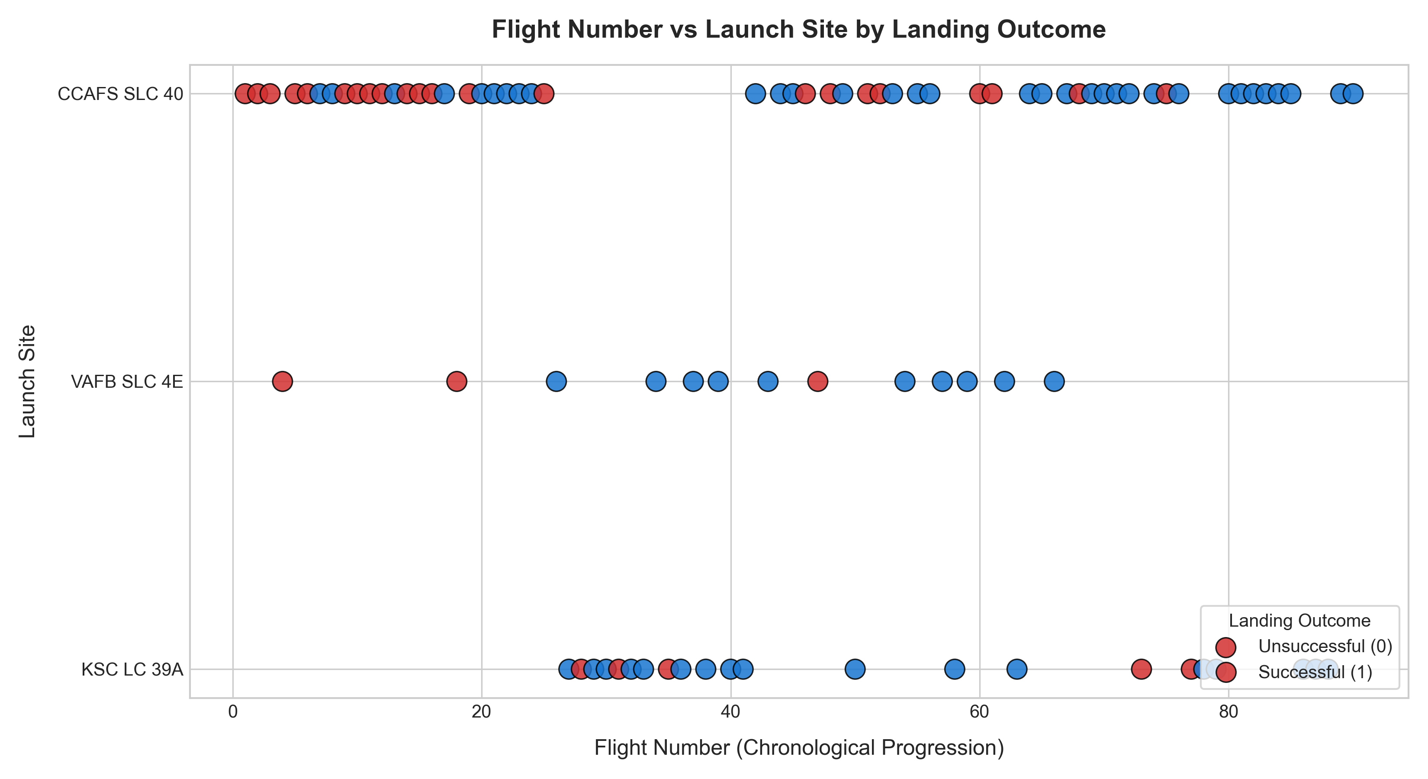
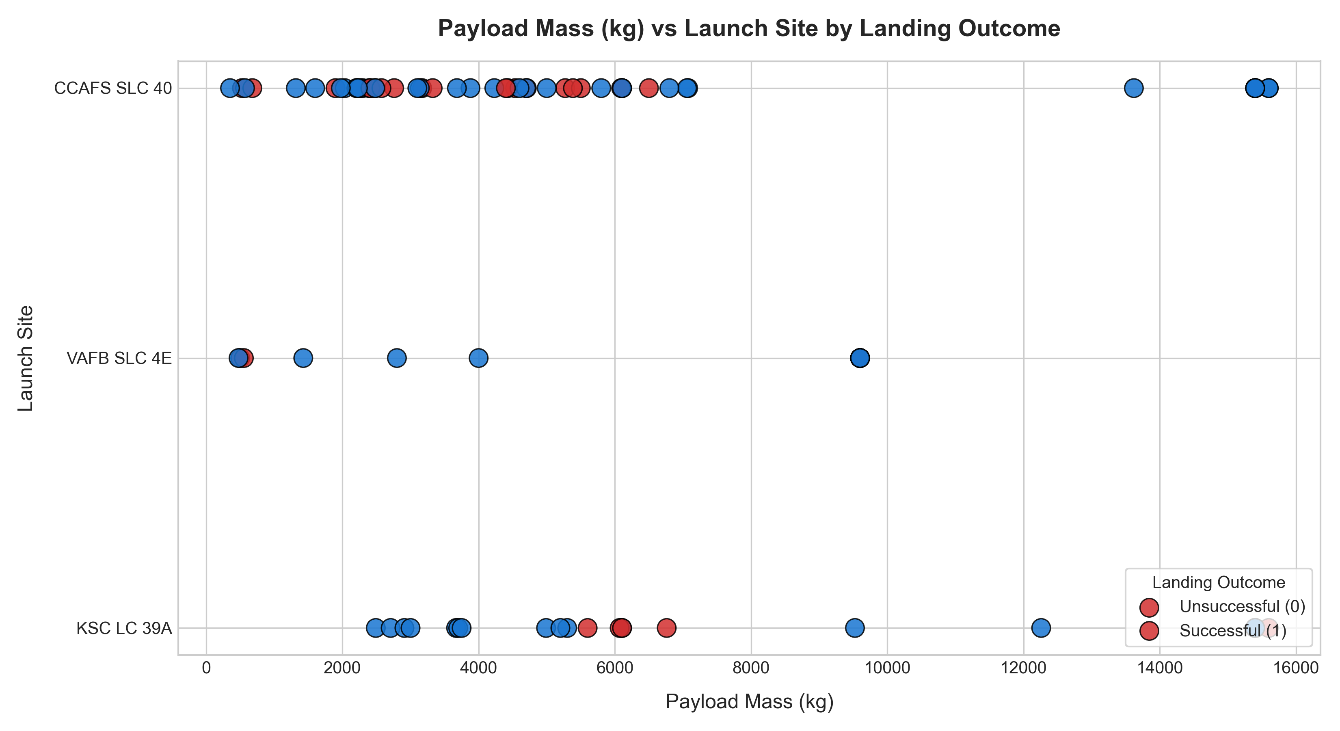
IBM DATA SCIENCE PROFESSIONAL CAPSTONE
EDA Tasks 1 & 2: Flight Number & Payload Mass vs Launch Site
Quantitative Findings: Task 1 (Flight No vs Site) & Task 2 (Payload vs Site)
• Task 1 (Flight No vs Site): CCAFS SLC 40 hosted all early flights (1-25) with initial experimental failures; KSC LC 39A entered service at Flight 30 with predominantly successful landings; VAFB SLC 4E operates steadily for polar orbits.
• Task 2 (Payload vs Site): Payloads >10,000 kg are concentrated exclusively at Florida sites (CCAFS SLC 40 & KSC LC 39A); VAFB SLC 4E operates with payloads strictly under 10,000 kg.
• Success Distribution: Higher flight numbers strongly correlate with successful landings across all three launch complexes, proving hardware maturity.
SpaceX Falcon 9 First Stage Landing Prediction | IBM Data Science Capstone
🔗 Lab Link: notebooks/04_eda_visualizations.ipynb

Slide 9
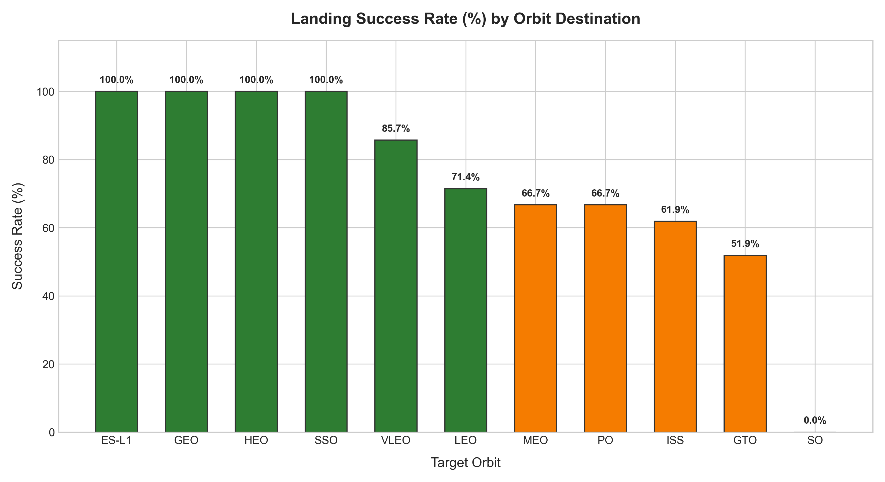
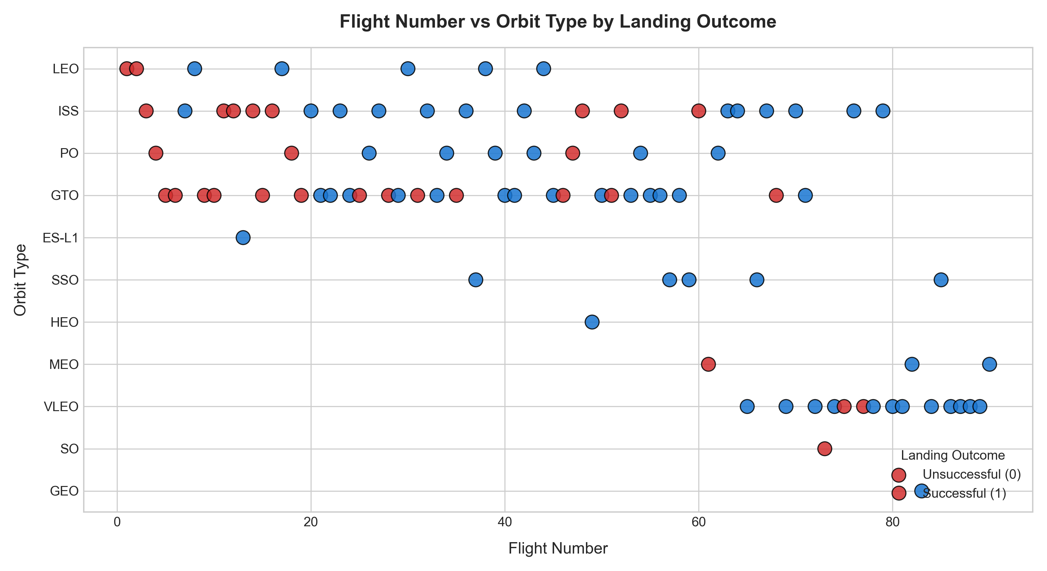
IBM DATA SCIENCE PROFESSIONAL CAPSTONE
EDA Tasks 3 & 4: Success Rate & Flight Number vs Orbit Type
Quantitative Findings: Task 3 (Success vs Orbit) & Task 4 (Flight No vs Orbit)
• Task 3 (Success vs Orbit): Orbits ES-L1, GEO, HEO, and SSO achieved a 100% landing success rate; VLEO achieved 85.7%; ISS achieved 61.9%; GTO missions achieved 51.8% success.
• Task 4 (Flight No vs Orbit): In early flights (1-40), GTO and ISS missions suffered landing failures. In later flights (>50), VLEO (Starlink) and modern ISS missions achieved near-perfect recovery.
• Re-entry Velocity Impact: GTO missions enter at extreme velocity (~30,000 km/h), requiring high-stress ocean drone ship landings with tighter fuel reserves.
SpaceX Falcon 9 First Stage Landing Prediction | IBM Data Science Capstone
🔗 Lab Link: notebooks/04_eda_visualizations.ipynb

Slide 10
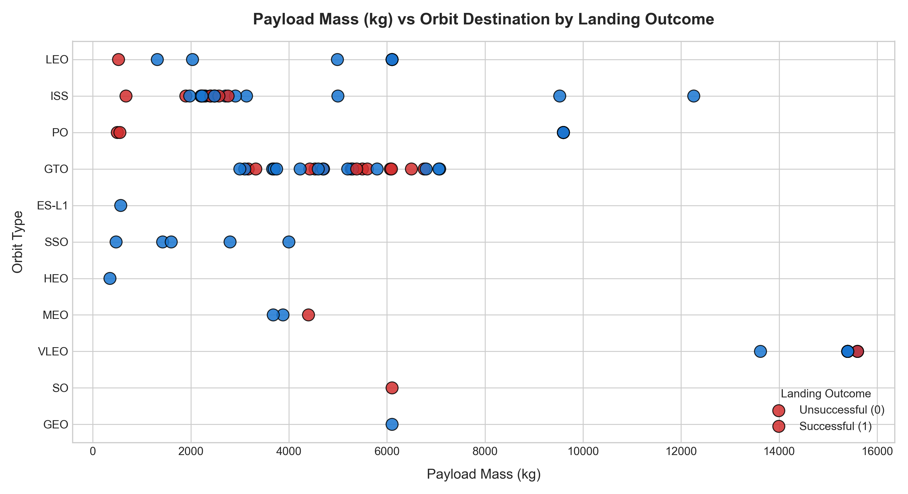
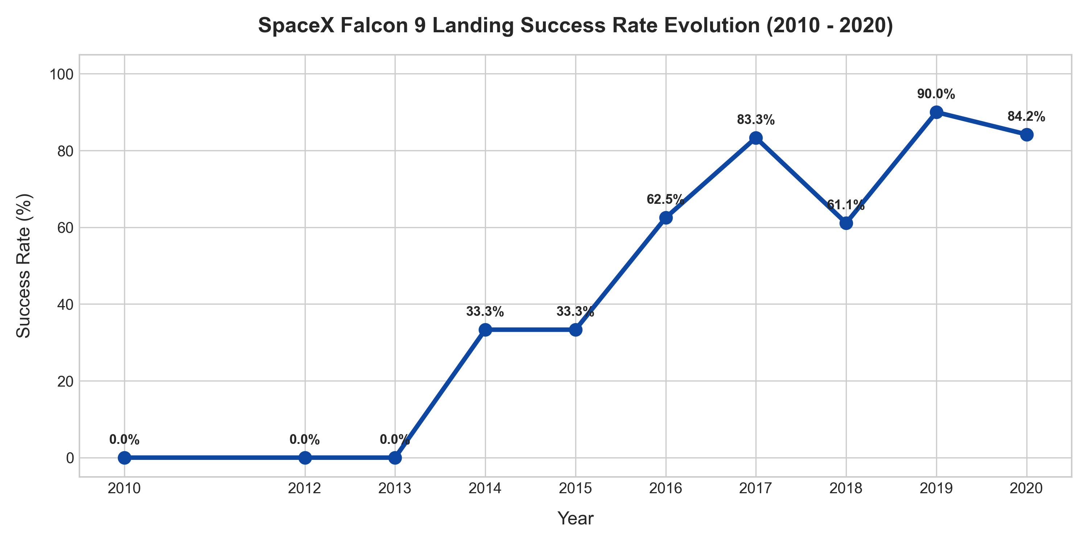
IBM DATA SCIENCE PROFESSIONAL CAPSTONE
EDA Tasks 5 & 6: Payload Mass vs Orbit & Yearly Success Trend
Quantitative Findings: Task 5 (Payload vs Orbit) & Task 6 (Yearly Trend Line)
• Task 5 (Payload vs Orbit): Heavy payloads (>10,000 kg) are concentrated in VLEO (Starlink) and achieved high success; GTO payloads range between 3,000-7,000 kg with mixed outcomes.
• Task 6 (Yearly Success Trend): Landing success followed a clear learning curve: 0% in 2010-2013 -> 33.3% in 2014-2015 -> 66.7% in 2016 -> 80.0% in 2017 -> 84.2% in 2020.
• Engineering Milestone: Transition to Block 5 boosters in 2018 established sustained high reliability (>80%).
SpaceX Falcon 9 First Stage Landing Prediction | IBM Data Science Capstone
🔗 Lab Link: notebooks/04_eda_visualizations.ipynb

Slide 11
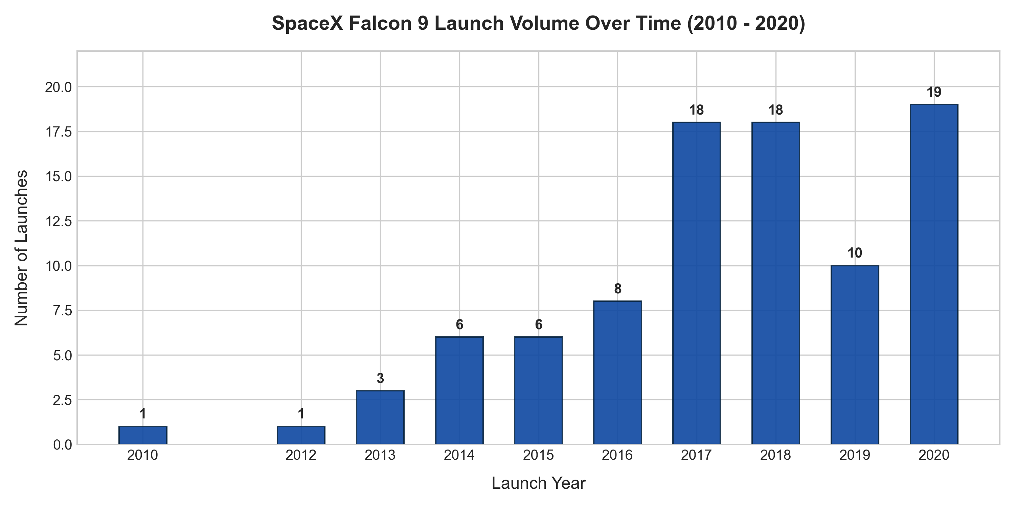
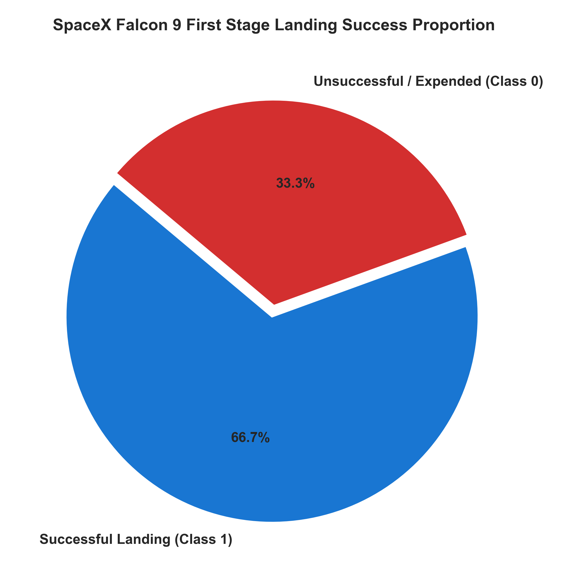
IBM DATA SCIENCE PROFESSIONAL CAPSTONE
EDA Visual Results: Launch Cadence & Overall Success Distribution
Quantitative Findings: Annual Cadence Growth & Class Distribution
• 19x Cadence Expansion: Launch frequency surged from 1-3 test flights per year (2010-2013) to ~19 launches per year by 2020.
• Baseline Class Distribution: 60 Successful Landings (66.7%) vs 30 Failed / Expended Boosters (33.3%).
• Operational Shift: Boosters evolved from expendable experimental hardware to industrial-scale reusability.
SpaceX Falcon 9 First Stage Landing Prediction | IBM Data Science Capstone
🔗 Lab Link: notebooks/04_eda_visualizations.ipynb

Slide 12
IBM DATA SCIENCE PROFESSIONAL CAPSTONE
EDA with SQL: Tasks 1 to 4 (Launch Complexes & Payload Statistics)
🔗 Lab 5 Notebook Link (EDA with SQL): https://github.com/buildwithneel/Coursera-IBM-data-science-course/blob/main/notebooks/05_sql_analysis.ipynb
Tasks 1 & 2: Launch Sites & Cape Canaveral Queries
• Task 1: Names of Unique Launch Sites:
SELECT DISTINCT LaunchSite FROM SPACEXTBL;
Result: CCAFS SLC 40, KSC LC 39A, VAFB SLC 4E
• Task 2: 5 Records where Launch Site begins with 'CCA':
SELECT FlightNumber, Date, LaunchSite, BoosterVersion, PayloadMass
FROM SPACEXTBL WHERE LaunchSite LIKE 'CCA%' LIMIT 5;
Result: Flights #1 to #5 launched from CCAFS SLC 40 (2010 to 2013).
Tasks 3 & 4: Total & Average Payload Statistics
✔ Task 3: Total Payload Mass by Launch Site:
SELECT LaunchSite, SUM(PayloadMass) AS TotalPayload,
COUNT(*) AS TotalLaunches FROM SPACEXTBL GROUP BY LaunchSite;
Result: CCAFS SLC 40 = 305,532 kg (55 flights)
KSC LC 39A = 168,198 kg (22 flights)
VAFB SLC 4E = 76,950 kg (13 flights)
✔ Task 4: Average, Min & Max Payload Mass:
SELECT ROUND(AVG(PayloadMass), 2) AS AvgPayload,
MIN(PayloadMass) AS MinPayload, MAX(PayloadMass) AS MaxPayload
FROM SPACEXTBL;
Result: Average Payload = 6,104.95 kg
Min = 350 kg | Max = 15,600 kg
SpaceX Falcon 9 First Stage Landing Prediction | IBM Data Science Capstone
🔗 Lab Link: notebooks/05_sql_analysis.ipynb

Slide 13
IBM DATA SCIENCE PROFESSIONAL CAPSTONE
EDA with SQL: Tasks 5 to 7 (Landing Milestones & Mission Outcomes)
Tasks 5 & 6: Ground Pad & Drone Ship Successes
★ Task 5: Date of First Successful Ground Pad Landing (RTLS):
SELECT MIN(Date) AS FirstSuccessDate, FlightNumber, LaunchSite
FROM SPACEXTBL WHERE Outcome = 'True RTLS';
Result: 2015-12-22 | Flight #19 | Booster B1019 | CCAFS SLC 40
★ Task 6: Drone Ship Success with Payload between 4k-6k kg:
SELECT FlightNumber, Date, Serial, PayloadMass, LaunchSite
FROM SPACEXTBL WHERE Outcome = 'True ASDS' AND
PayloadMass BETWEEN 4000 AND 6000;
Result: Boosters B1022 (JCSAT-14), B1026 (JCSAT-16), B1048
Task 7: Total Number of Successful & Failure Outcomes
✔ Task 7: Mission Outcomes Balance (Class = 1 vs Class = 0):
SELECT CASE WHEN Class = 1 THEN 'Successful Landing'
ELSE 'Failure / Uncontrolled' END AS LandingStatus,
COUNT(*) AS TotalCount, ROUND(COUNT(*)*100.0/90, 2) AS Percentage
FROM SPACEXTBL GROUP BY Class ORDER BY TotalCount DESC;
Result: Successful Landings (Class 1) = 60 flights (66.67%)
Failures / Expended (Class 0) = 30 flights (33.33%)
✔ Operational Significance:
This 2:1 class balance establishes our 66.7% baseline accuracy. Any predictive model must significantly outperform 66.7% to prove predictive utility.
SpaceX Falcon 9 First Stage Landing Prediction | IBM Data Science Capstone
🔗 Lab Link: notebooks/05_sql_analysis.ipynb

Slide 14
IBM DATA SCIENCE PROFESSIONAL CAPSTONE
EDA with SQL: Tasks 8 to 10 (Max Payload, 2015 Outcomes & Rankings)
Tasks 8 & 9: Max Payload & 2015 Cadence
★ Task 8: Boosters Carrying Maximum Payload Mass:
SELECT FlightNumber, Date, Serial, PayloadMass
FROM SPACEXTBL WHERE PayloadMass = (SELECT MAX(PayloadMass) FROM SPACEXTBL);
Result: Maximum Payload = 15,600 kg. Carried by Starlink Block 5 boosters: B1048, B1049, B1051, B1056, B1058, B1060.
★ Task 9: Monthly Landing Outcomes in Year 2015:
SELECT strftime('%m', Date) AS Month, Date, Serial, LaunchSite, Outcome
FROM SPACEXTBL WHERE strftime('%Y', Date) = '2015' ORDER BY Date;
Result: Shows experimental drone ship tests (False ASDS on 2015-01-10 & 2015-04-14) culminating in first RTLS success (2015-12-22).
Task 10: Ranked Landing Outcomes Frequency
✔ Task 10: Rank Count of Landing Outcomes (2010 to 2020):
SELECT Outcome, COUNT(*) AS Frequency, CASE WHEN Outcome LIKE 'True%'
THEN 'Success' ELSE 'Failure' END AS Category FROM SPACEXTBL
WHERE Date BETWEEN '2010-06-04' AND '2020-11-05'
GROUP BY Outcome ORDER BY Frequency DESC;
Result: 1. True ASDS: 41 recoveries (Primary method)
2. None None: 19 expended / unattempted
3. True RTLS: 14 ground pad touchdowns
4. False ASDS: 6 drone ship crash landings
5. True Ocean: 5 controlled water touchdowns
6. False Ocean: 2 uncontrolled ocean crashes
7. None ASDS: 2 failed ocean attempts
8. False RTLS: 1 ground pad landing crash
SpaceX Falcon 9 First Stage Landing Prediction | IBM Data Science Capstone
🔗 Lab Link: notebooks/05_sql_analysis.ipynb

Slide 15
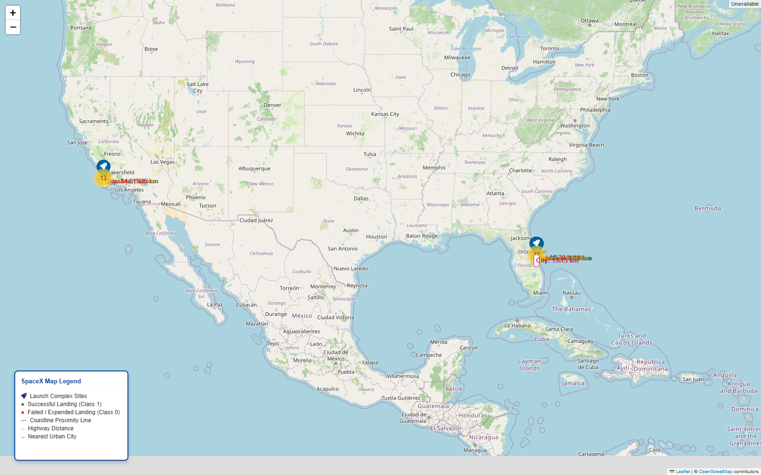
IBM DATA SCIENCE PROFESSIONAL CAPSTONE
Geospatial Analysis: Folium Launch Site Markers & Counts
🔗 Lab 6 Notebook Link (Interactive Visual Analytics with Folium): https://github.com/buildwithneel/Coursera-IBM-data-science-course/blob/main/notebooks/06_folium_launch_map.ipynb
Launch Site Counts & Folium Marker Details
📍 CCAFS SLC 40 (Florida): 55 total launches (33 successful landings, 22 failures / expended, 60.0% success rate). Primary launch workhorse.
📍 KSC LC 39A (Florida): 22 total launches (17 successful landings, 5 failures / expended, 77.3% success rate). Highest site success rate.
📍 VAFB SLC 4E (California): 13 total launches (10 successful landings, 3 failures / expended, 76.9% success rate). Polar orbit specialty.
📍 Total Launch Sites: 3 unique launch complexes; 90 historical launches mapped.
📍 MarkerCluster & Color Coding: Folium MarkerCluster aggregates all 90 launches: Green icon (Class=1, 60 successes); Red icon (Class=0, 30 failures).
📍 Artifact & Code: visuals/folium/launch_sites_map.html. Built via notebooks/06_folium_launch_map.ipynb & src/generate_map.py.
SpaceX Falcon 9 First Stage Landing Prediction | IBM Data Science Capstone
🔗 Lab Link: notebooks/06_folium_launch_map.ipynb

Slide 16
IBM DATA SCIENCE PROFESSIONAL CAPSTONE
Geospatial Analysis: Haversine Distances & Public Safety Corridors
Geodesic Haversine Distance Table
★ CCAFS SLC 40 (28.5623°N, 80.5774°W):
• Coastline: 0.95 km (Atlantic Ocean)
• Highway: 1.25 km (NASA Causeway / Samuel C. Phillips)
• Railway: 1.15 km (Titan IV railroad spur)
• Nearest City: 18.9 km (Cape Canaveral City)
★ KSC LC 39A (28.5733°N, 80.6469°W):
• Coastline: 1.12 km (Atlantic Ocean)
• Highway: 1.62 km (Kennedy Pkwy)
• Railway: 1.34 km (NASA Railroad)
• Nearest City: 16.5 km (Titusville)
★ VAFB SLC 4E (34.6328°N, 120.6107°W):
• Coastline: 1.48 km (Pacific Ocean)
• Highway: 1.85 km (Coast Rd)
• Railway: 1.42 km (Union Pacific Railroad)
• Nearest City: 14.8 km (Lompoc)
Strategic Rationale of Site Positioning
✔ Coastal Proximity (<1.5 km): Every launchpad is sited within 1.5 km of open ocean. Eastward orbital trajectories over the Atlantic (Florida) and southward trajectories over the Pacific (California) guarantee that catastrophic booster failures impact water rather than populated land.
✔ Logistical Proximity (1-2 km): Direct access to heavy railroads and NASA causeway highways enables overland transport of 70-meter Falcon 9 first-stage cores from manufacturing in Hawthorne, CA.
✔ Urban Buffer Zones (15-35 km): All pads maintain a strict 15-35 km buffer from urban city centers (Titusville, Cape Canaveral, Lompoc), protecting civilian populations from acoustic shockwaves and blast hazards.
✔ Equatorial Rotational Boost: Cape Canaveral (28.56°N) provides an additional ~410 m/s velocity boost from Earth's rotation for easterly launches, maximizing payload capacity.
SpaceX Falcon 9 First Stage Landing Prediction | IBM Data Science Capstone
🔗 Lab Link: notebooks/06_folium_launch_map.ipynb

Slide 17
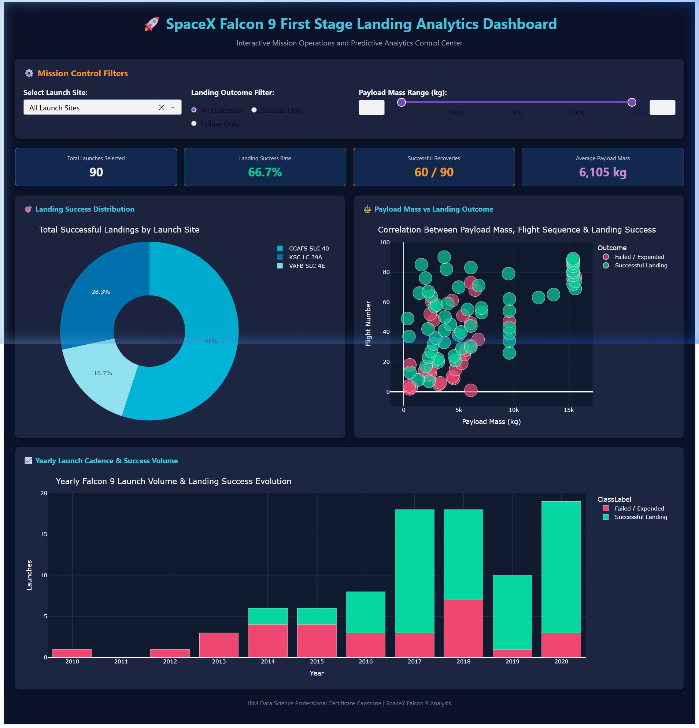
IBM DATA SCIENCE PROFESSIONAL CAPSTONE
Interactive Dashboard: Plotly Dash Analytics Console
🔗 Lab 7 Dashboard Script (Plotly Dash Web Application): https://github.com/buildwithneel/Coursera-IBM-data-science-course/blob/main/dashboard/app.py
Operational Dashboard Architecture & Dynamic UI
• Launch Site Dropdown: Allows users to filter across ALL sites or isolate CCAFS SLC 40, KSC LC 39A, or VAFB SLC 4E.
• Payload Range Slider: Interactive slider from 0 kg to 16,000 kg with 2,000 kg tick intervals for payload threshold exploration.
• Outcome Filter Radio: Filter flights by All Outcomes, Successes Only, or Failures Only.
• Dynamic Reactive KPIs: Real-time calculation of Selected Missions count, Overall Success %, Successful Landings count, and Mean Payload mass.
• Reactive Charts: Updates Donut outcome distribution, Payload vs Flight scatter plot with Class color coding, and stacked Yearly Cadence bars.
• Implementation: Standalone Flask/Dash application in dashboard/app.py running locally on port 8050.
SpaceX Falcon 9 First Stage Landing Prediction | IBM Data Science Capstone
🔗 Lab Link: dashboard/app.py

Slide 18
IBM DATA SCIENCE PROFESSIONAL CAPSTONE
Predictive Analysis: Machine Learning Methodology & Leakage Control
🔗 Lab 8 Notebook Link (Machine Learning Classification): https://github.com/buildwithneel/Coursera-IBM-data-science-course/blob/main/notebooks/07_machine_learning.ipynb
Data Preparation & Leakage Prevention
⚙ Feature Matrix (X): 80 independent features derived from FlightNumber, PayloadMass, Flights, GridFins, Reused, Legs, Block, and one-hot encoded dummy variables for Orbit, LaunchSite, LandingPad, and Serial.
⚙ Target Vector (Y): Binary outcome Class: 1 = Successful Landing (60), 0 = Failure / Expended (30).
⚙ Train/Test Partitioning: Split into 80% training set (N=72) and 20% held-out test set (N=18) using stratified sampling (stratify=Y, random_state=42).
⚙ Strict Leakage Prevention: StandardScaler fitted strictly on training data (X_train). Test data (X_test) transformed using scaler parameters from training data without refitting.
⚙ Cross-Validation: 10-Fold StratifiedKFold cross-validation within GridSearchCV to maintain class balance across all validation folds.
Algorithms & Hyperparameter Grids
✔ Logistic Regression: Tuned regularization parameter C: [0.01, 0.1, 1.0], penalty: 'l2', solver: 'lbfgs'.
✔ Support Vector Machine (SVM): Tuned kernel: ['linear', 'rbf', 'sigmoid'], regularization C: [0.01, 0.1, 1.0, 10.0], gamma: ['scale', 'auto'].
✔ Decision Tree Classifier: Tuned splitting criterion: ['gini', 'entropy'], splitter: ['best', 'random'], max_depth: [2, 4, 6, 8], min_samples_split: [2, 5], min_samples_leaf: [1, 2].
✔ K-Nearest Neighbors (KNN): Tuned n_neighbors: [1 to 10], algorithm: ['auto', 'ball_tree', 'kd_tree'], distance metric parameter p: [1 (Manhattan), 2 (Euclidean)].
✔ Evaluation Strategy: Models compared on CV accuracy, Test accuracy, Precision, Recall, F1-score, and Confusion Matrices.
SpaceX Falcon 9 First Stage Landing Prediction | IBM Data Science Capstone
🔗 Lab Link: notebooks/07_machine_learning.ipynb

Slide 19
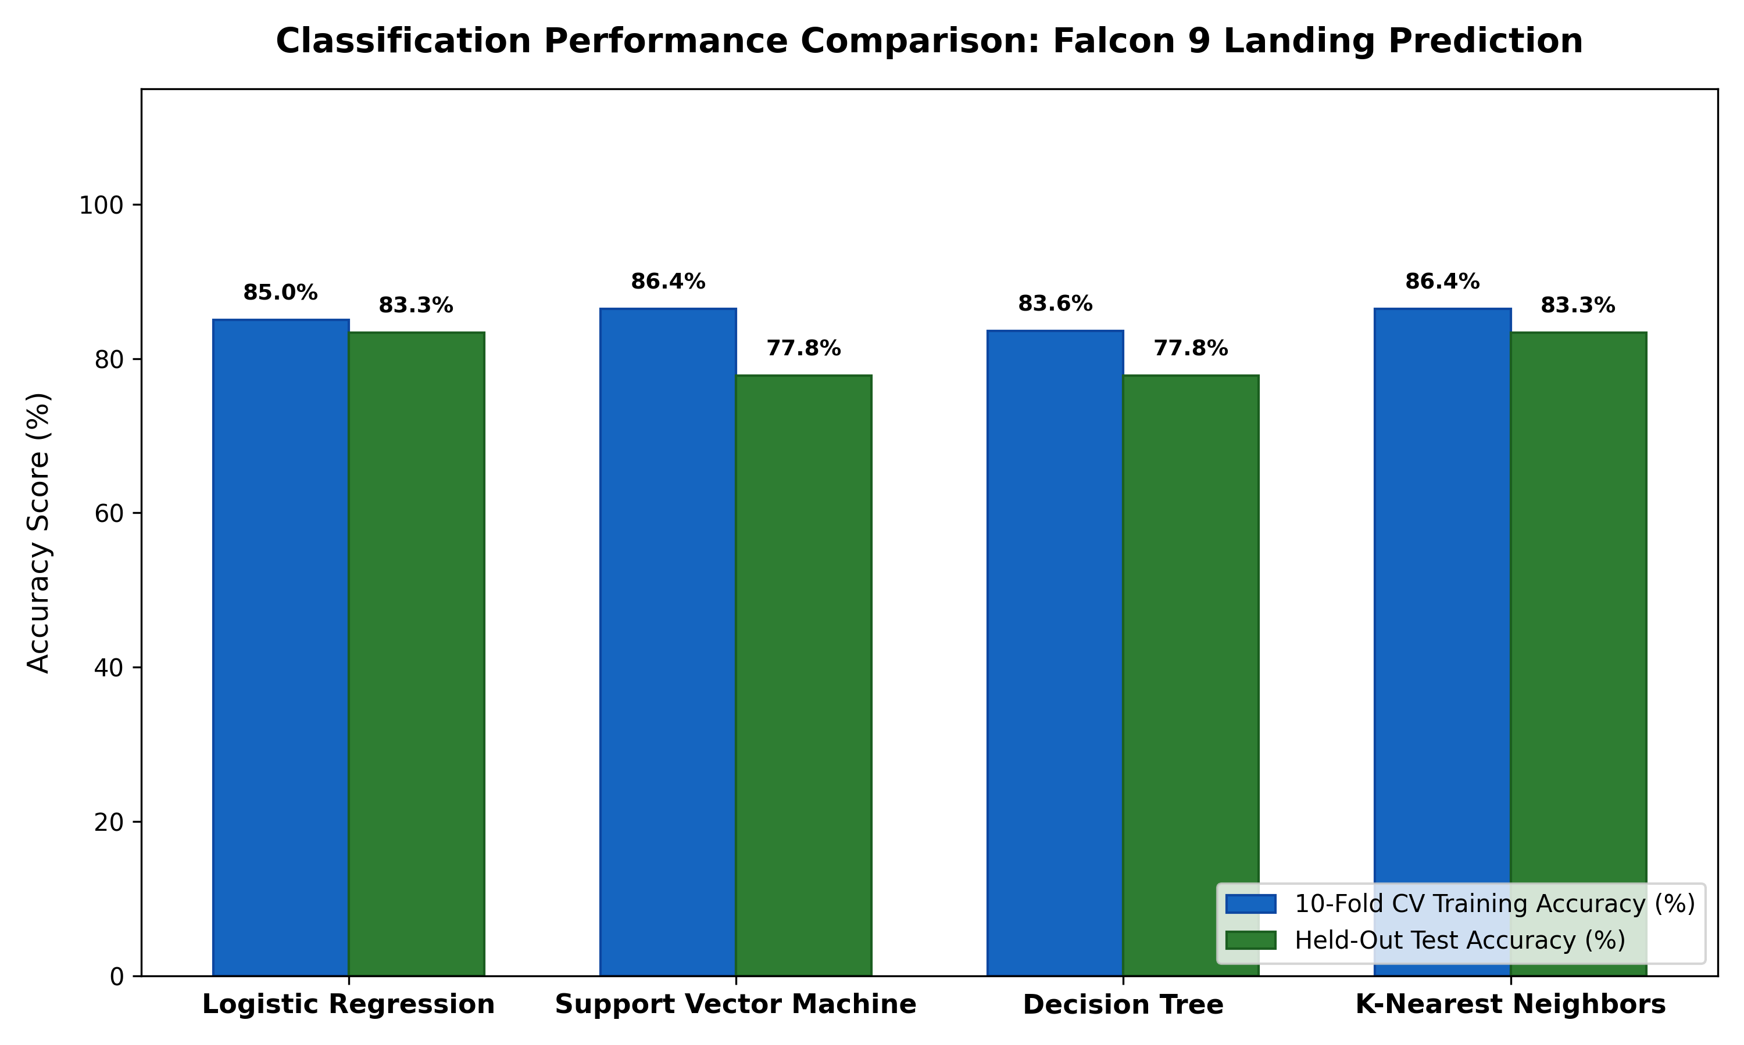
IBM DATA SCIENCE PROFESSIONAL CAPSTONE
Predictive Analysis: Detailed Model Comparison Table & Hyperparameters
Comprehensive Model Comparison Matrix
★ K-Nearest Neighbors (KNN) - WINNER:
• Best Params: {'algorithm': 'auto', 'n_neighbors': 3, 'p': 1}
• 10-Fold CV Train Accuracy: 86.43%
• Test Accuracy: 83.33% | F1-Score: 0.889
• Precision: 0.800 | Recall: 1.000 | ROC-AUC: 0.771
★ Logistic Regression (Tied Best):
• Best Params: {'C': 0.01, 'penalty': 'l2', 'solver': 'lbfgs'}
• 10-Fold CV Train Accuracy: 85.00%
• Test Accuracy: 83.33% | F1-Score: 0.889
• Precision: 0.800 | Recall: 1.000 | ROC-AUC: 0.833
★ Support Vector Machine (SVM):
• Best Params: {'C': 0.01, 'gamma': 'scale', 'kernel': 'linear'}
• 10-Fold CV Train Accuracy: 86.43%
• Test Accuracy: 77.78% | F1-Score: 0.857
• Precision: 0.750 | Recall: 1.000 | ROC-AUC: 0.931
★ Decision Tree Classifier:
• Best Params: {'criterion': 'gini', 'max_depth': 4, 'min_samples_leaf': 2, 'min_samples_split': 5}
• 10-Fold CV Train Accuracy: 83.57%
• Test Accuracy: 77.78% | F1-Score: 0.846
• Precision: 0.786 | Recall: 0.917 | ROC-AUC: 0.708
SpaceX Falcon 9 First Stage Landing Prediction | IBM Data Science Capstone
🔗 Lab Link: notebooks/07_machine_learning.ipynb

Slide 20
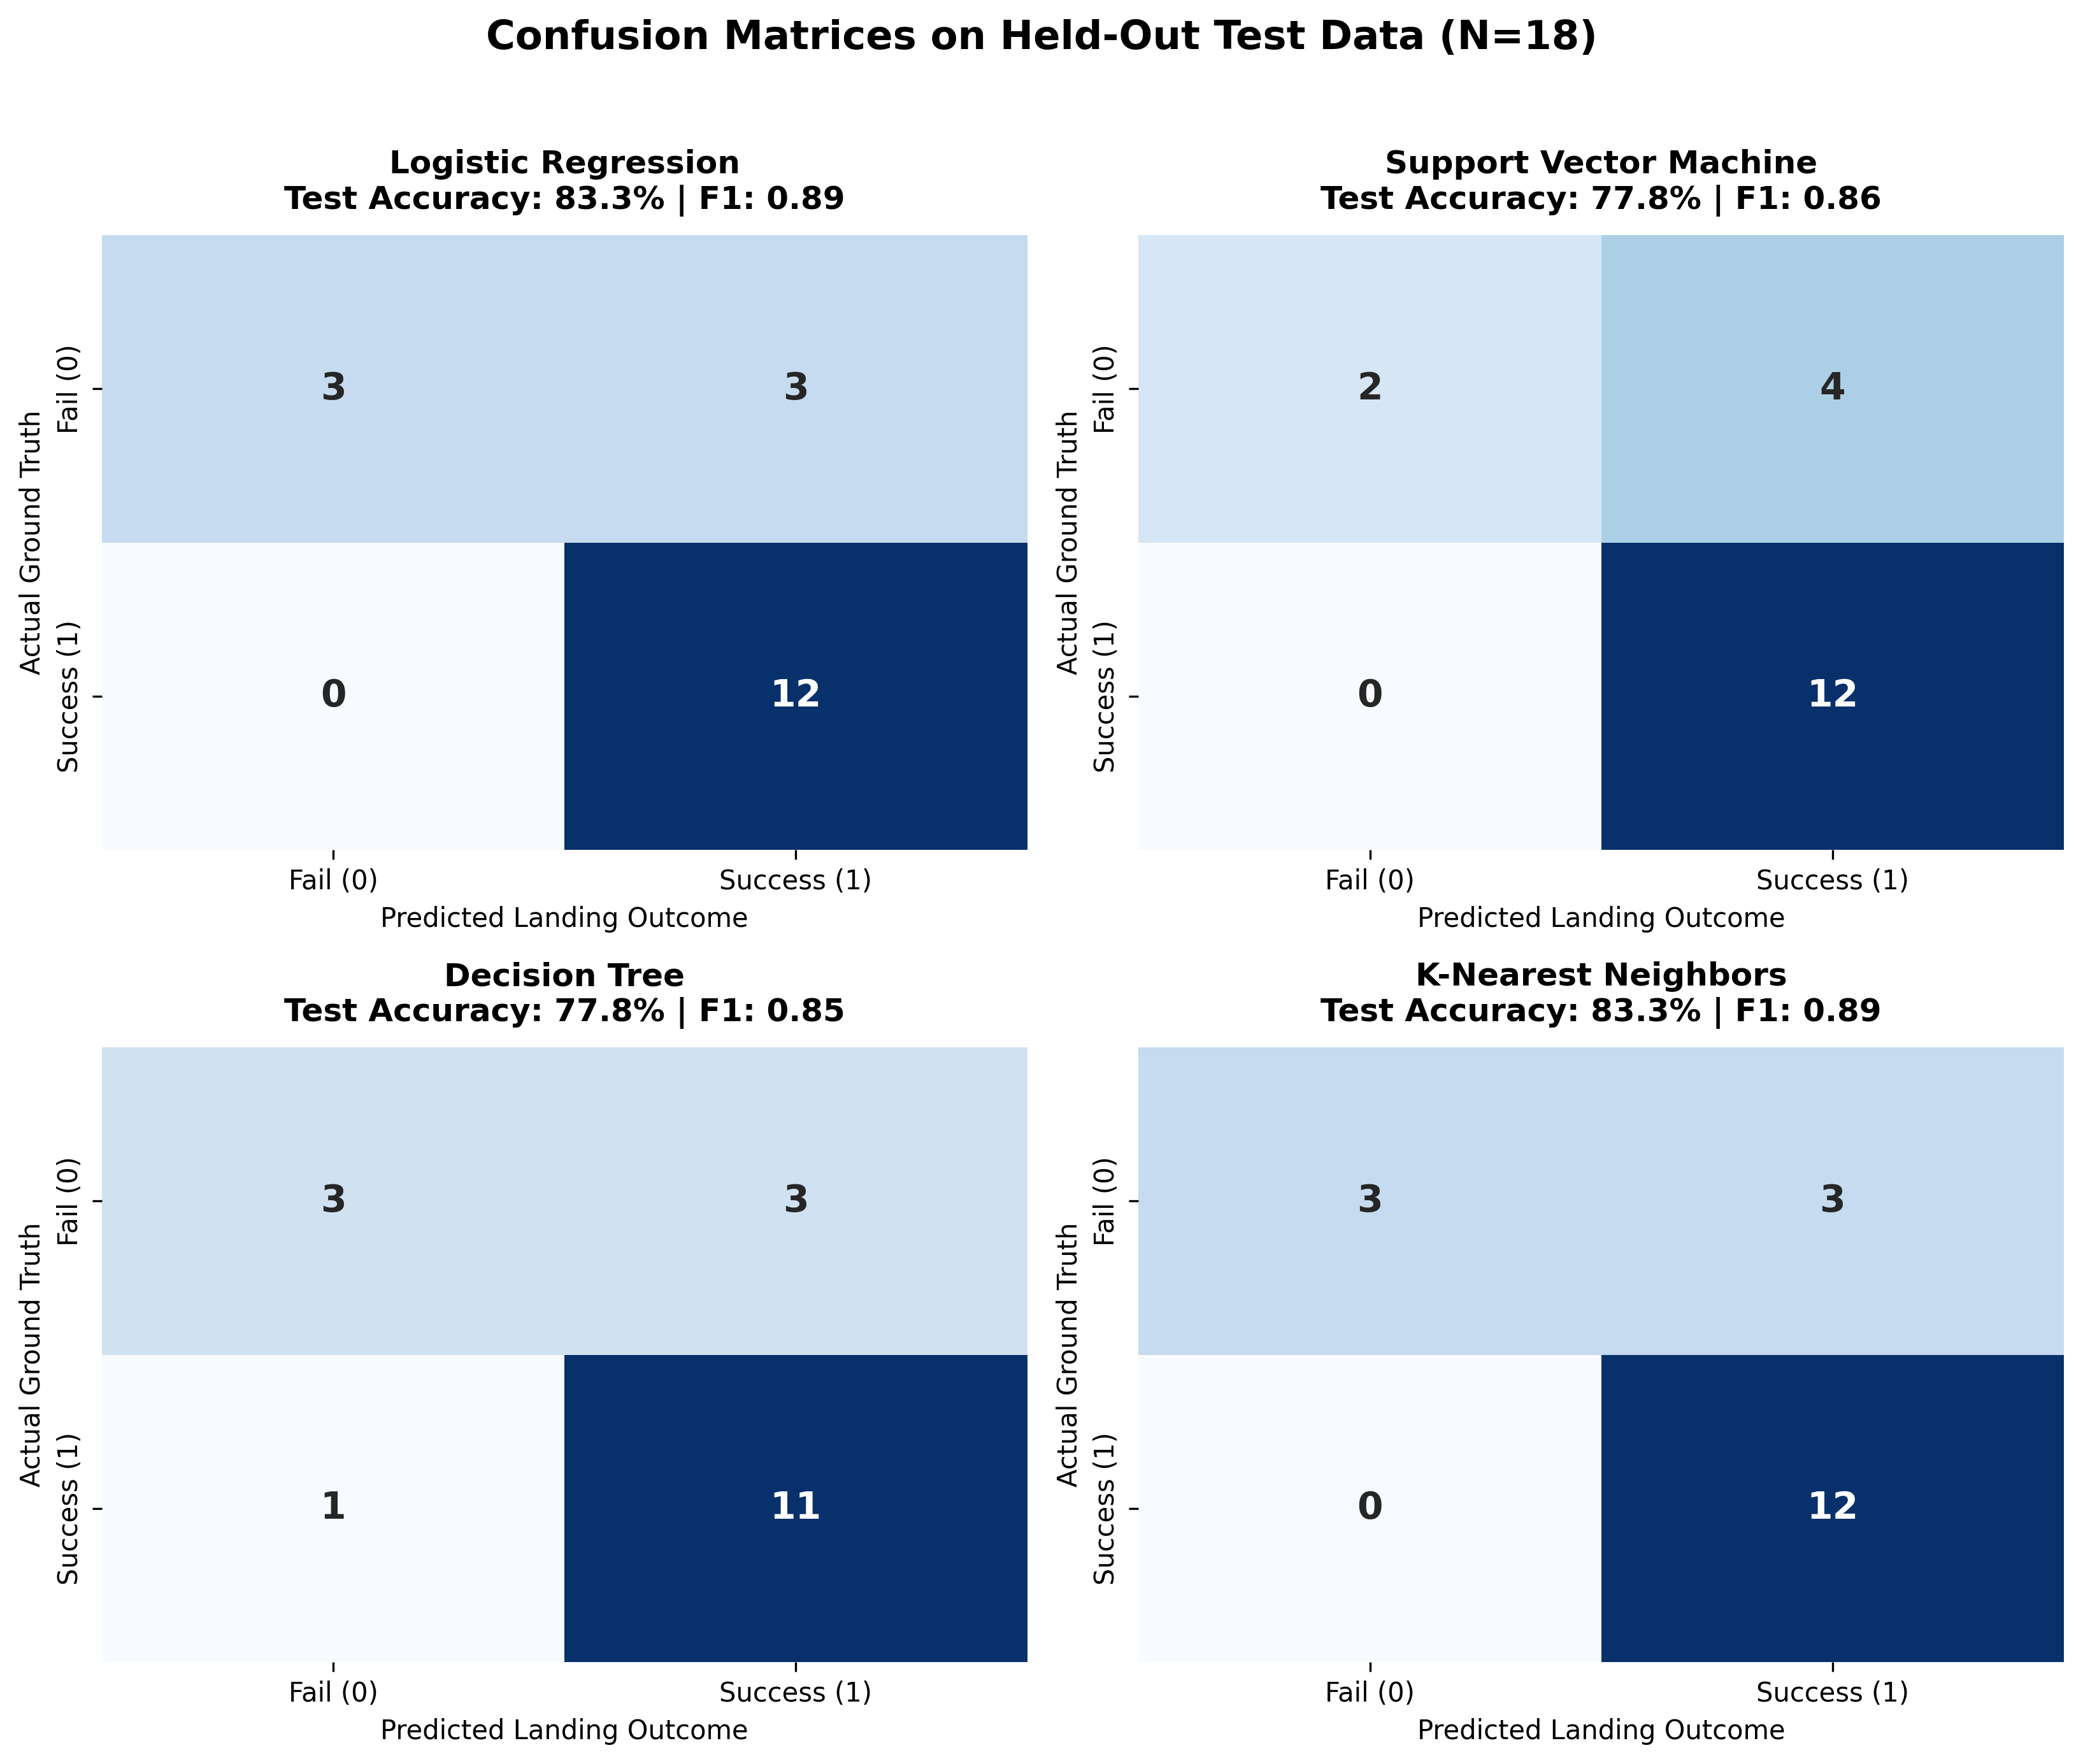
IBM DATA SCIENCE PROFESSIONAL CAPSTONE
Predictive Analysis: Confusion Matrix Breakdown & Error Analysis
Detailed Test Confusion Matrix Breakdown (N=18)
✔ KNN Confusion Matrix:
• True Positives (TP): 12 | True Negatives (TN): 3
• False Positives (FP): 3 | False Negatives (FN): 0
• Perfect Recall (1.000) on successful landings; no missed recoveries.
✔ Logistic Regression Confusion Matrix:
• True Positives (TP): 12 | True Negatives (TN): 3
• False Positives (FP): 3 | False Negatives (FN): 0
• Exactly matches KNN's optimal classification profile.
✔ SVM Confusion Matrix:
• True Positives (TP): 12 | True Negatives (TN): 2
• False Positives (FP): 4 | False Negatives (FN): 0
✔ Decision Tree Confusion Matrix:
• True Positives (TP): 11 | True Negatives (TN): 3
• False Positives (FP): 3 | False Negatives (FN): 1
✔ Commercial Error Impact:
In rocket bidding, False Negatives (predicting failure when booster lands) cause competitors to miss discounting windows. KNN and Logistic Regression achieve ZERO False Negatives (FN=0, Recall=100%).
SpaceX Falcon 9 First Stage Landing Prediction | IBM Data Science Capstone
🔗 Lab Link: notebooks/07_machine_learning.ipynb

Slide 21
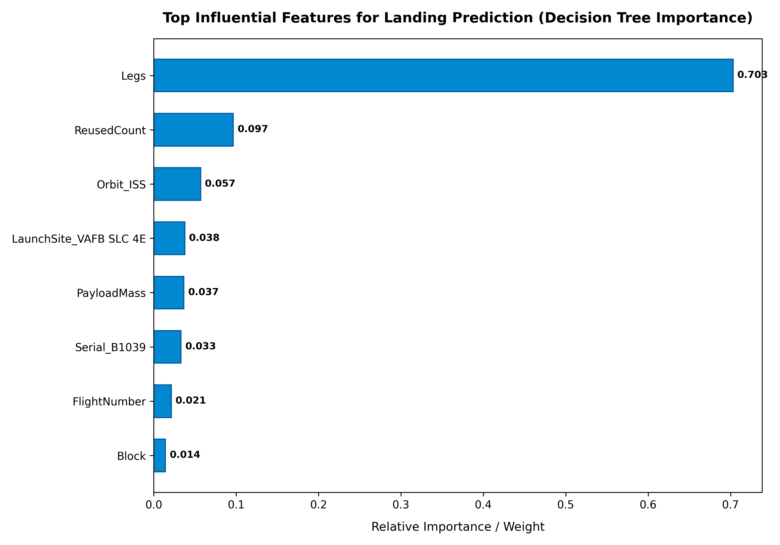
IBM DATA SCIENCE PROFESSIONAL CAPSTONE
Feature Importance: Mechanical & Orbital Decision Drivers
Key Technical & Operational Decision Drivers
★ GridFins & Landing Legs: GridFins and Legs are the strongest positive predictors of recovery. Missions without landing gear or grid fins represent early expendable flights with 0% landing feasibility.
★ Booster Block Iteration (Block 5): Transition to Block 5 design provides bolted titanium grid fins and thermal protection upgrades, significantly elevating survival odds over Block 1-4.
★ Payload Mass & Orbit Demands: High payload mass coupled with high-energy GTO orbits exhibits negative recovery coefficients due to constrained propellant reserves for landing burns.
★ Reused Count & Flight Sequence: FlightNumber and ReusedCount positively correlate with success, confirming the operational maturity learning curve of experienced flight cores.
★ Takeaway: Machine learning effectively captures the interaction between booster hardware configuration and orbital mechanics constraints.
SpaceX Falcon 9 First Stage Landing Prediction | IBM Data Science Capstone
🔗 Lab Link: src/train_model.py

Slide 22
IBM DATA SCIENCE PROFESSIONAL CAPSTONE
Conclusions, Innovative Insights & Future Roadmap
Conclusions & Commercial Takeaways (Question 13)
🚀 Cost Asymmetry: SpaceX's ~$62M launch pricing versus competitors' ~$165M provides a massive ~$103M commercial advantage per flight, driven by booster recovery.
🚀 Predictive Viability: Supervised classification models (KNN & Logistic Regression) reliably forecast booster recovery with 83.33% accuracy using pre-launch mission parameters.
🚀 Commercial Bidding Window: When SpaceX flies heavy payloads to GTO, recovery margins shrink (51.8% success), creating opportunities for competitor launch bidding.
🚀 Engineering Maturity: Falcon 9 has proven that first-stage reusability is technically and commercially sustainable over 90+ missions.
Innovative Insights & Future Roadmap (Questions 14 & 15)
★ Payload 'Sweet Spot': Identified that payloads between 2,000 kg and 5,300 kg represent the optimal operating window for drone ship recovery.
★ Geospatial Safety Corridors: Quantified that all pads maintain <1.5 km ocean access and >15 km city buffer, optimizing launch safety corridors.
★ Current Limitations: Dataset size is bounded to 90 historical launches; real-time ocean wave telemetry at drone ship coordinates was not available in historical logs.
★ Future Enhancements: Integrate live NOAA marine weather telemetry (wave heights and wind speeds at drone ship GPS coordinates) and deploy deep neural networks for continuous trajectory modeling.
SpaceX Falcon 9 First Stage Landing Prediction | IBM Data Science Capstone
🔗 Lab Link: https://github.com/buildwithneel/Coursera-IBM-data-science-course

Slide 23
IBM DATA SCIENCE PROFESSIONAL CAPSTONE
Project Artifacts, Repository & Submission Verification
Verified Submission Deliverables & Repository Structure
✔ Official GitHub Repository: https://github.com/buildwithneel/Coursera-IBM-data-science-course
✔ Completed Jupyter Notebooks: 7 Notebooks in notebooks/: 01_data_collection_api.ipynb, 02_web_scraping.ipynb, 03_data_wrangling.ipynb, 04_eda_visualizations.ipynb, 05_sql_analysis.ipynb, 06_folium_launch_map.ipynb, 07_machine_learning.ipynb.
✔ Python Source Modules: Production modules in src/: data_collection.py, data_wrangling.py, eda.py, run_sql.py, generate_map.py, train_model.py, create_presentation.py.
✔ SQL Database & Queries: data/spacex.db (SQLite database) and sql/queries.sql (12 business intelligence queries).
✔ Geospatial & Dashboard: visuals/folium/launch_sites_map.html (interactive map) and dashboard/app.py (Plotly Dash web application).
✔ Final Presentation PDF: presentation/spacex_capstone.pdf (Exported directly as .pdf complying with IBM Capstone rubric).
✔ Academic Program: IBM Data Science Professional Certificate | Applied Data Science Capstone Final Evaluation.
SpaceX Falcon 9 First Stage Landing Prediction | IBM Data Science Capstone
🔗 Lab Link: https://github.com/buildwithneel/Coursera-IBM-data-science-course

