Slide 1
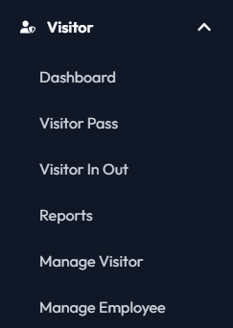
Visitor Pass

Slide 2
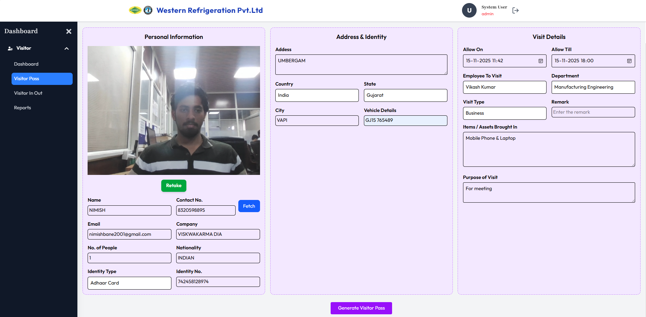
Visitor Pass Generation
Address Details:
The Address section captures the visitor’s full residential details. It ensures accurate record-keeping and helps verify visitor identity during registration.
Appointment Details:
The Appointment Details section shows the purpose of visit, meeting person, and scheduled time. It helps ensure accurate visitor routing and quick verification during entry.
Visitor Pic
Vendor’ Asset
Visitor Name
Mobile Number
Fetch button:
The Fetch button retrieves visitor details based on the entered mobile number. It auto-fills the form to save time and avoid re-entering information.
Purpose of Visit
Visitor Email ID
Visitor Company Name
ID Verification with Option like Aadhaar, Pan Card and other

Slide 3
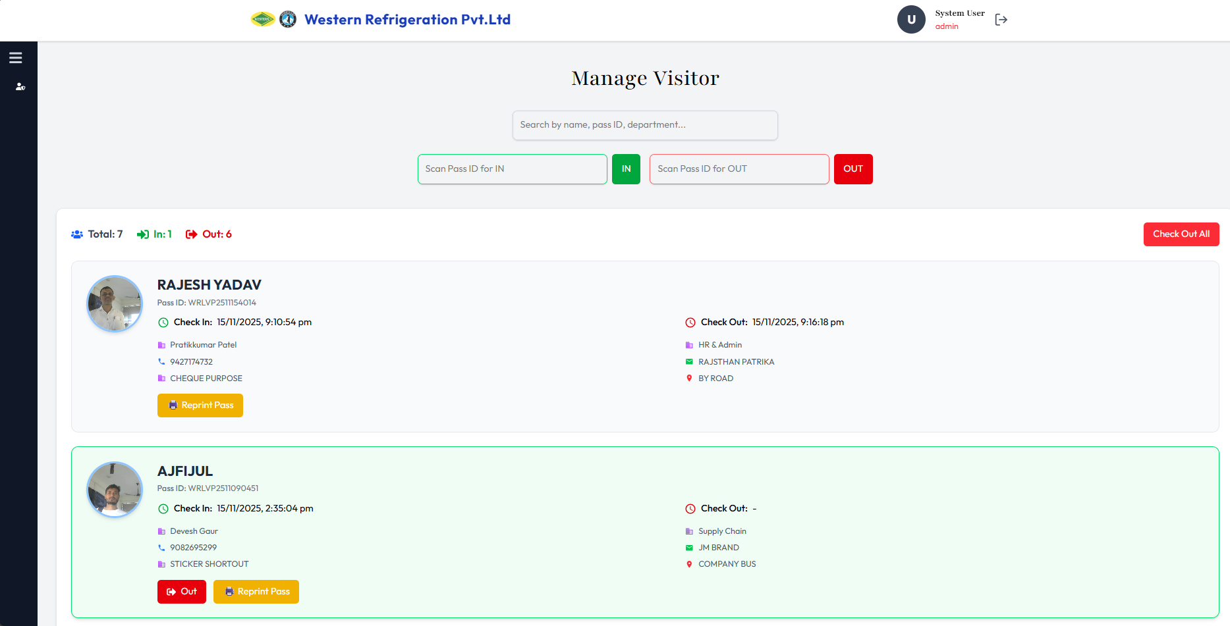
Visitor IN/OUT
Visitor IN Scanning
Visitor Searching
Visitor Out Scanning
Visitor Count Status
Total Visitor
Visitor Currently In
Visitor Currently Out
Visitor Card
Shows the visitor’s check-in and check-out time.
Includes the employee visited and department visited.
Displays the visitor’s mobile number.
Mentions the purpose of the visit.
Quick Action Button
Visitor Pass Reprint
To Quickly Check Out Visitor

Slide 4
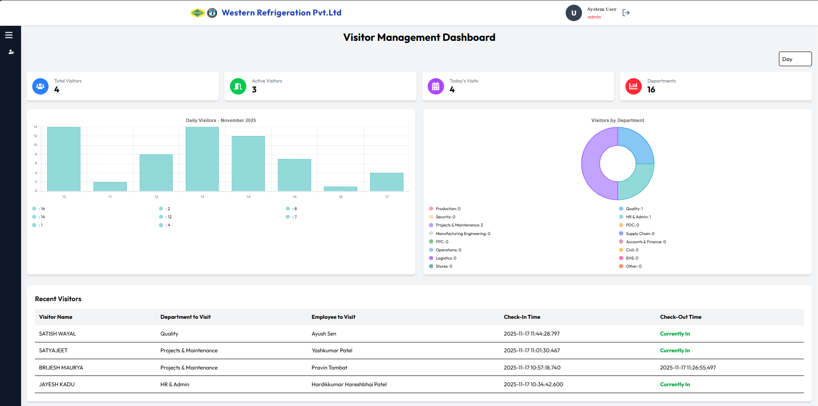
Visitor Dashboard
Total Visitors
Visitor Inside
Visitor Outside
The pie chart shows the number of visitors in each department
Column Chart
Recent Visitors

Slide 5
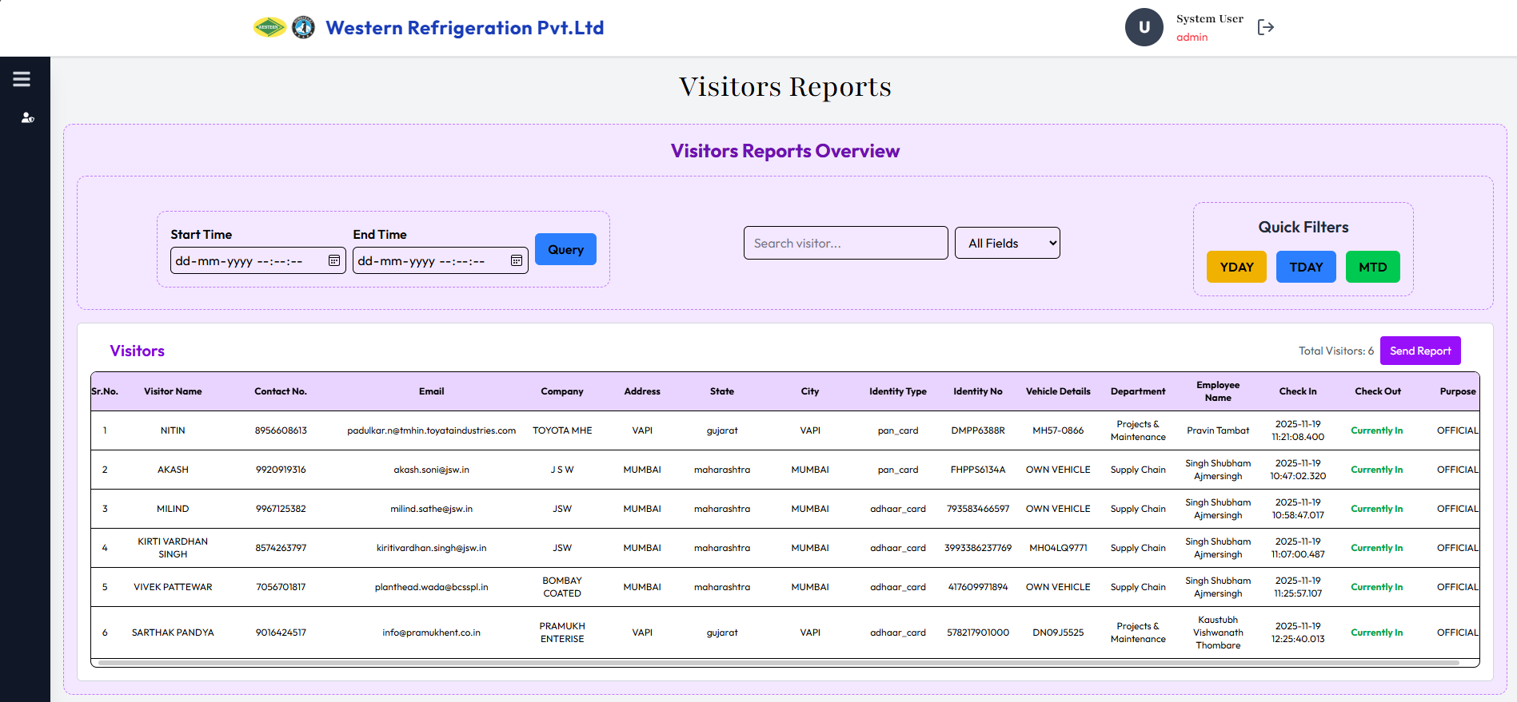
Visitor Report
Search Functionality
Quick Filter:
YDAY – for Yesterday report
TDAY – for Today’s report
MDAY – for Monthly report
Date Filter
On clicking, it will automatically send the Excel report to HR via email.
Visitor Report:
  Data: Provides the list of peoples who visited the company
  Entry/Exit Time: Tracks the visitor timing of visit inside the premises.

Slide 6
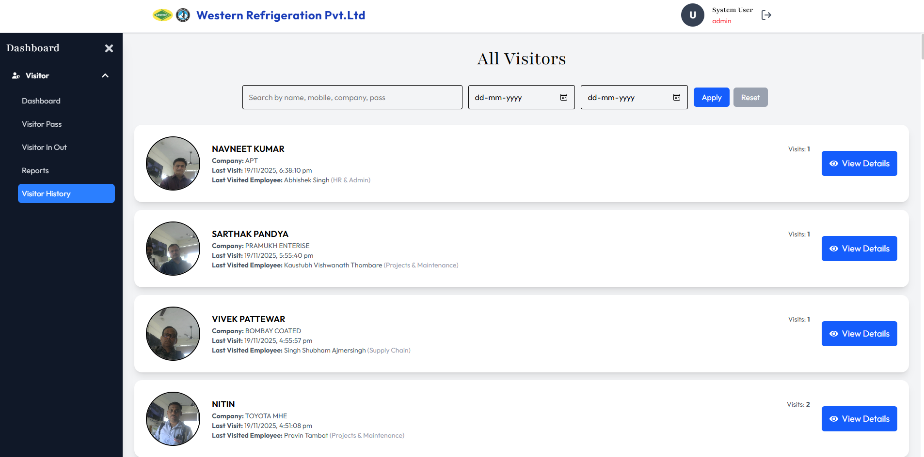
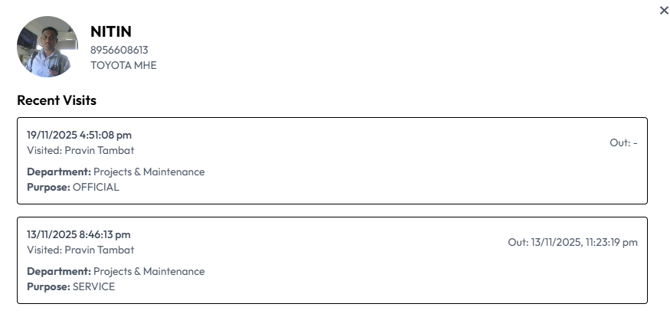
Visitor Report
Search Functionality
Date Filter
Visitor Recent Logs:
Logs of all Visits
Employee Visited
Visitor Report:
  Data: Provides the list of peoples who visited the company
  Entry/Exit Time: Tracks the visitor timing of visit inside the premises.
Visitor Details:
Last Visit Date
Last Visited Employee
Total Visits
Company Name

Slide 7
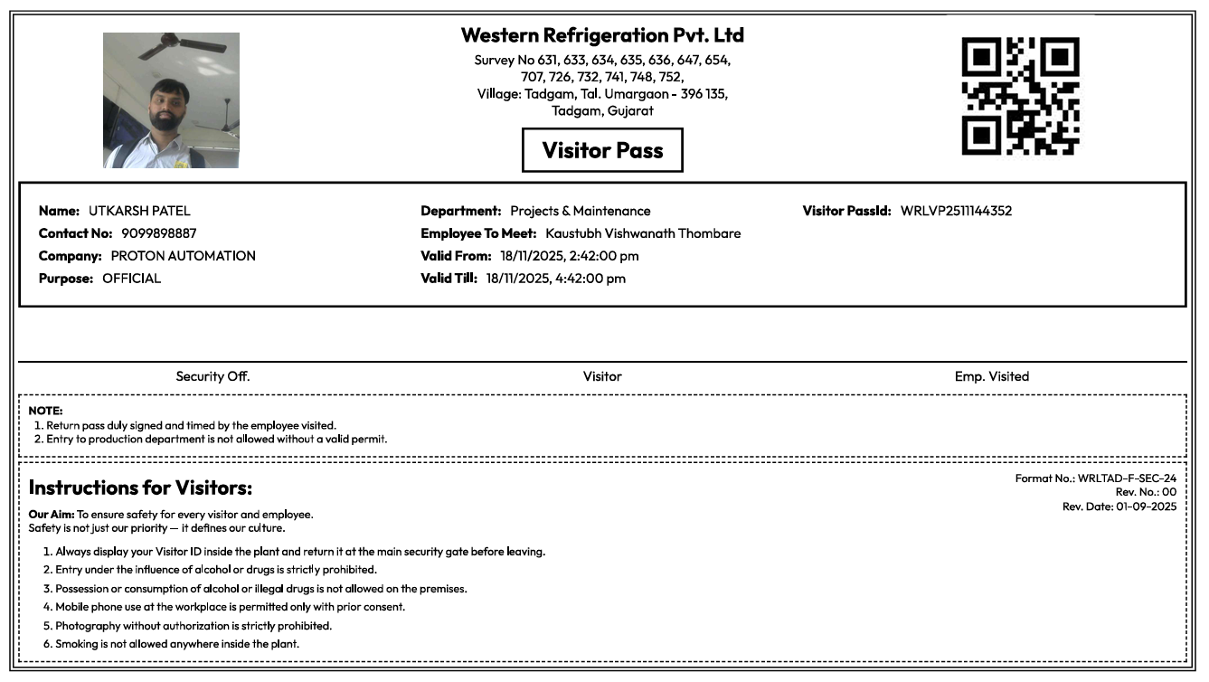
Visitor Pass Print Preview
Visitor Pic
Visitor Pic
Visitor Appointment Details
Visitor Details
Signature Space for emp, visitor & security
Instruction for visitor
ISO Document No.
Preview:
Visitor Pass Print Preview

Slide 8
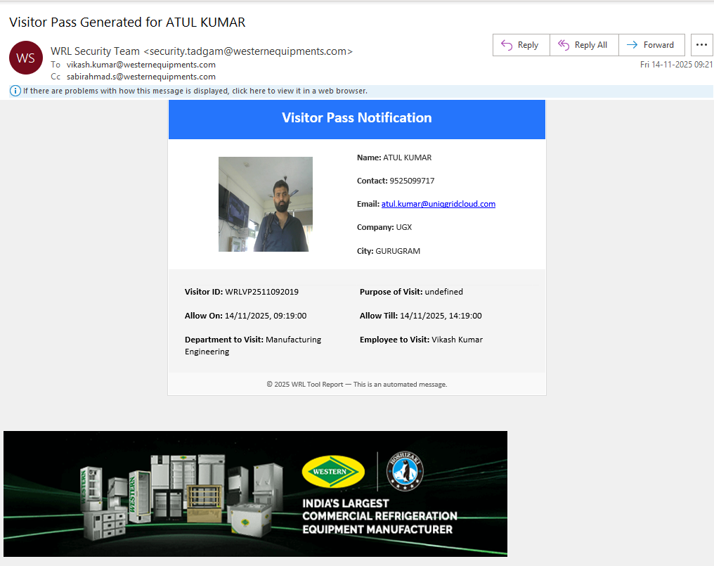
Visitor Mail Notification
Notification Mail:
To: Employee
CC: Manager
Visitor Details
Visitor Pic
Appointment Details

